Slide 1
Some questions from Lecture 3 (Berg):
1) How does COSY calculated the fringe field?
2) How important are accurate fringe field measurements for SECAR and St. GEORGE?
3) What is the meaning of the rectangles in COSY graphics output?
4) In an achromatic fragment separator, do you need a slit and/or a wedge in the dispersive intermediate plane.
5) In a gas filled separator are all charge states collected in one location?
6) How does a wedge restore the achromaticity in a fragment separator?
7) What is the purpose of the DSR (Spin dipole) in front of GRAND RAIDEN focal plan?

Slide 2
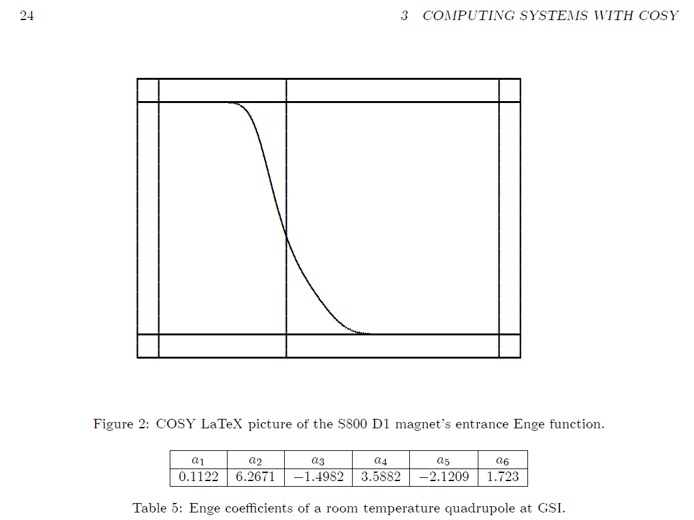
Question 1)
How does COSY calculated the fringe field?
Answer: For COSY the fringe field is an input parameter. By default COSY has a sharp cutoff field the
entrance and exit of magnetic elements. To make more realistic calculations COSY offers via the
FR command several options of typical fringe fields. See Beam Manual chapter 3.3.2.
The fringe field is defined by the Enge function. The data have to come from either field calculations
Or field measurements of a existing magnet.

Slide 3
Question 2)
How important are accurate fringe field measurements for SECAR and St. GEORGE?
Answer: Enge functions based on field measurements should be included in SECAR and ST. GEORGE
to have an as realistic as possible model of the recoil separator.

Slide 4
Question 3)
What is the meaning of the rectangles in COSY graphics output?
Answer: Standard COSY plots show the length of the magnets and drifts in z directions. Quadrupole are rectangles
that show the radius in x or y direction. Dipoles show the gap, even in x directions which is not useful to see of the
envelop of all rays fits into the system. In drawings that we show in publications we usually show the horizontal GFR
Dipoles and the radius, the GFR and the inner walls of the vacuum vessel.

Slide 5
Question 4)
In an achromatic fragment separator, do you need a slit and/or a wedge in the dispersive intermediate plane.
Answer: Yes, you need both the slit stops the unwanted fragments with different rigidity and charge, while the
wedge provides the further mass separation.

Slide 6
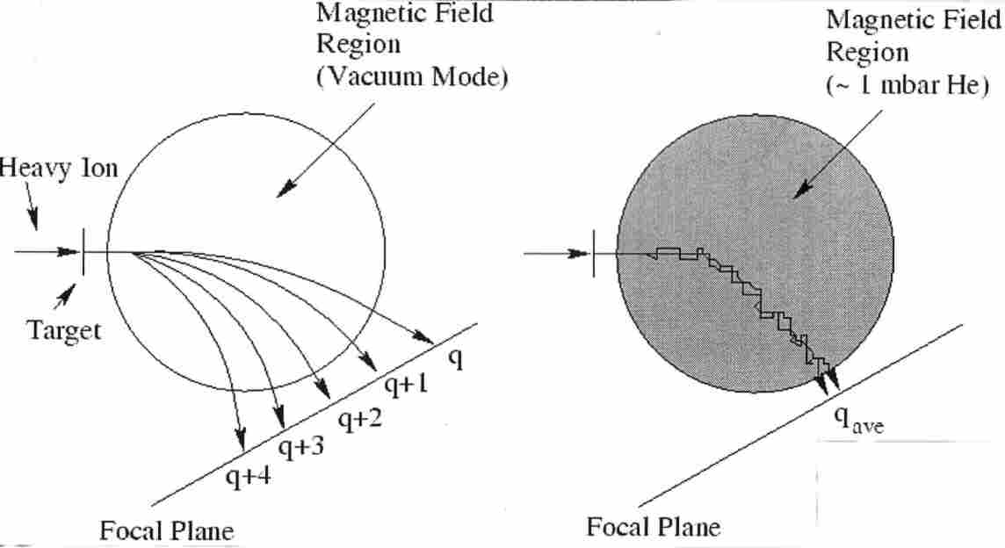
Question 5)
In a gas filled separator are all charge states collected in one location?
Answer: Yes, if pressure is high enough, the gas inside the dipole field changes the charge state along the pass
so the path of all initial state states follow the path of an average charge state with the effect that they are collected
at roughly the same location in the focal plane of the spectrometer.

Slide 7
Question 6)
How does a wedge restore the achromaticity in a fragment separator?
.
Answer: Without wedge the dispersed beam with a momentum spread +/- dp at the intermediate focal plane
continues to the final focal plane to an achromatic focus. With a degrader of constant thickness, the energy
Loss of +dp and – dp is slightly different, so that the achromaticity is slightly disturbed. By properly changing
the thickness of the degrader ( Wedge) this can make the energy loss for all rays in the wedge so that
achromaticity is restored.

Slide 8
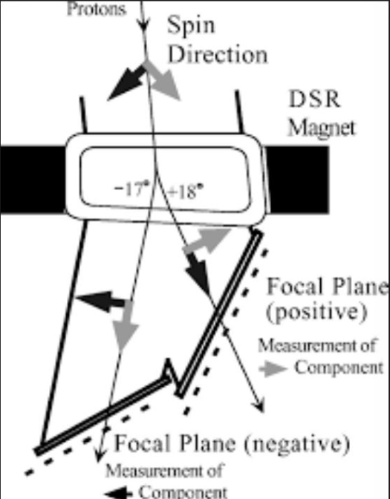
Question 7)
What is the purpose of the DSR (Spin dipole) in front of GRAND RAIDEN focal plan?
Answer: A Spin Analyzer (not shown in the figure) downstream of the
GRAND RAIDEN focal plane and measure one component of the spin direction
In the horizontal plane. The DSR = Dipole Spin Rotator allows to measure
both components of the spin direction.

