Slide 1
JINA-CEE Ion optics summer school Project
By Jason Surbrook, Takashi YOSHIMOTO, Jake flowerdew

Slide 2
Motivation
Half life of O15 is 122s
F16 is unbound
Bottle neck at O15 because of relatively long half life – can’t beta decay and can’t proton capture.
This leads to interesting reactions like an alpha capture

Slide 3
Optimizing the mass resolution in 1st order
OBJ := 1/ABS(MRESOL_P1)
Non- optimum dispersion at FP2
OBJ := 1/ABS(MRESOL_P1) + ABS(ME(1,2))
Mass resolution: 85,000+
Mass resolution: 725

Slide 4
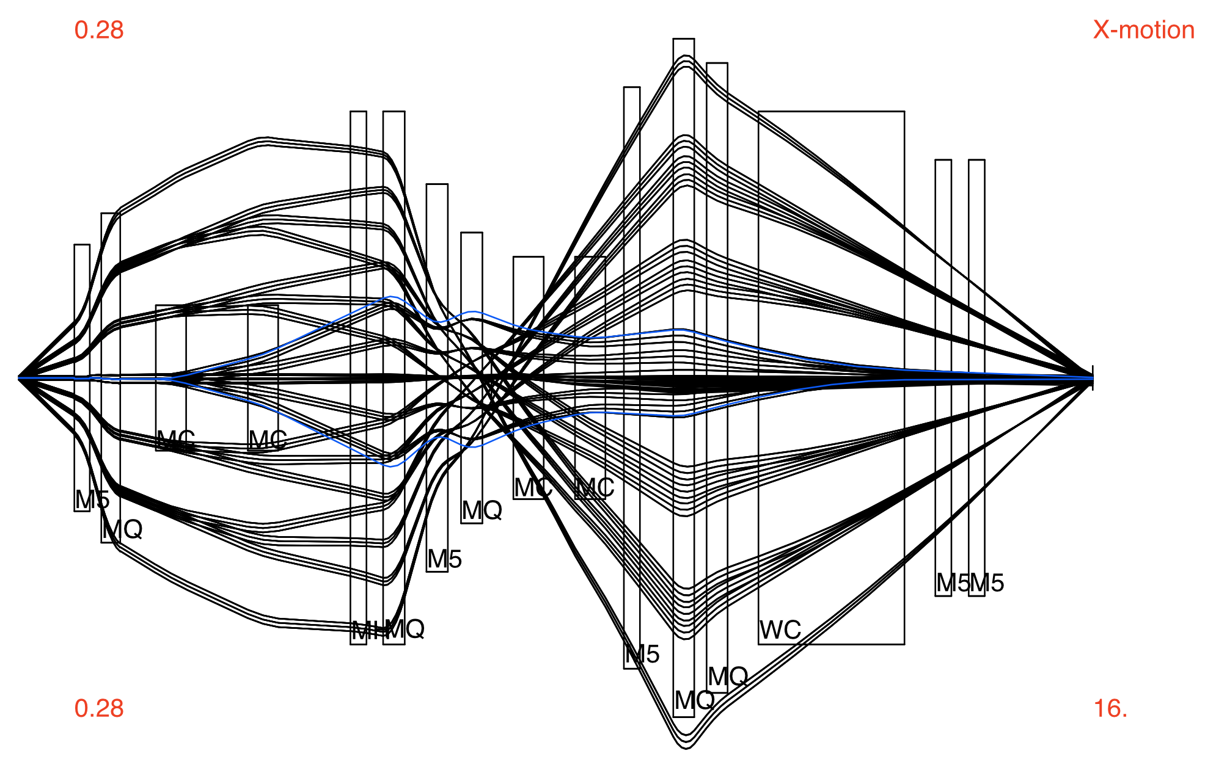
Optimizing the mass resolution in 1st order
OBJ := 1/ABS(MRESOL_P1) + ABS(ME(1,2)) + ABS(ME(1,6))
Mass resolution: 750
(Varying Q2 and Q3)
Mass resolution: 820 (Varying Q2, Q3 and Q4)
Dispersion is minimum at FP2

Slide 5
Further work
Testing the affects of the residual matrix elements after minimizing object function OBJ := 1/ABS(MRESOL_P1) + ABS(ME(1,2)) + ABS(ME(1,6))
0.13%
Exploring the sensitivity of the magnet alignment and also longitudinal, transversal and pitch changes.

