Slide 1
The Geiger-Müller Counter

Slide 2
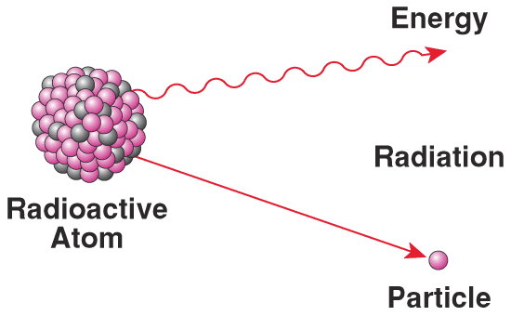
What is radioactivity?
Radioactive decay is a spontaneous process in which nucleons are emitted from or transformed within the nucleus, resulting in a change in the identity of the nucleus, and usually accompanied by the emission of one or more types of radiation from the nucleus and/or atom.
Radioactivity is measured in SI in Becquerels
1 Bq= 1 decay per second
It can be measured also in Curies (Ci)
1 Ci = 3.7 10¹⁰ Bq (Activity of 1 g of Ra)

Slide 3
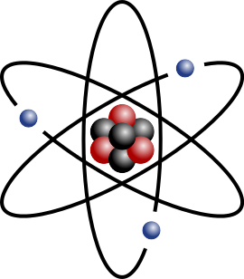
Why Are Elements Radioactive?
Unstable nucleus:
Has excess energy.
Wants to go to “ground state.”
Becomes stable by emitting radiation.
Notes:
Describe what makes certain atoms radioactive.
Chemical behavior identical to nonradioactive siblings.
Ionizing means that when the radiation deposits its energy into another atom, the energy is sufficient to cause ionization of the atom—the ejection of one of the orbital electrons.

Slide 4
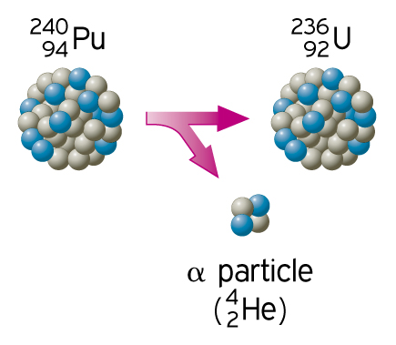
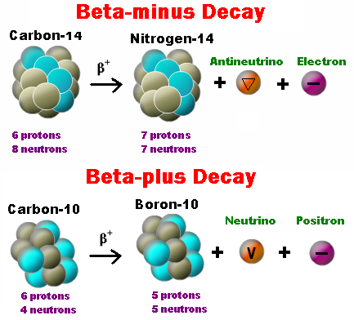
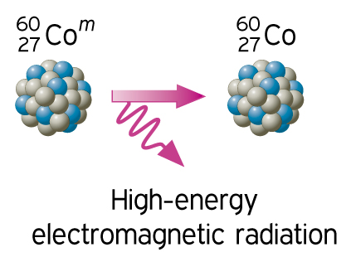
Types of Radiation (I)
β⁻
Alpha
Beta
Gamma

Slide 5
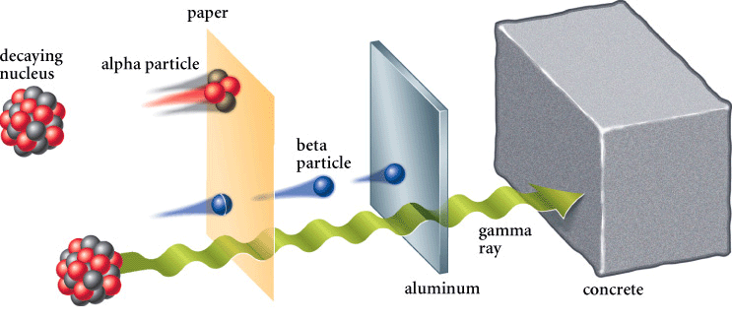
Types of Radiation (II)

Slide 6
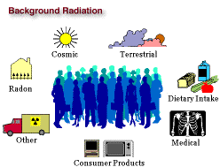
Background Radiation
It is low level ionizing radiation that is produced all the time.
It comes from different sources – natural or artificial.
Why does it happen all the time ?
When the Earth was formed , it contained many radioactive isotopes which are still existing and decaying.
When a radioactive element decays, it changes into another element along with giving out radiation.
This newly formed element may also be radioactive and decay to form another element.
This continues on and on until a element that is not radioactive is formed. (Radioactive Decay Chain)

Slide 7
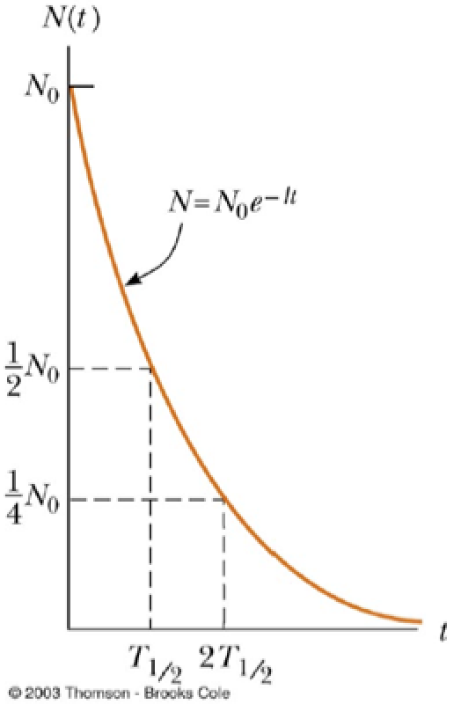
Radioactive decay
If a radioactive sample contains N radioactive nuclei, the amount of nuclei that decay varies with time. The longer we wait, the less nuclei will be decaying. It follows an exponential decay that depends on the nuclear species.
$N\left(t\right)=N_{0}e^{−λt}$
λ decay constant, τ=1/λ mean lifetime
Half-life: The radioactive half-life for a given radioisotope is the time for half the radioactive nuclei in any sample to undergo radioactive decay. After two half-lives, there will be one fourth the original sample, after three half-lives one eight the original sample, and so forth..
$$T_{1/2}=\ln\left(2\right.)τ=\frac{\left.\ln\left(2\right.\right)}{λ}$$

Slide 8
How a Radiation Detector Works
The radiation we are interested in detecting all interact with materials by ionizing atoms
While it is difficult (sometime impossible) to directly detect radiation, it is relatively easy to detect (measure) the ionization of atoms in the detector material.
Measure the amount of charge created in a detector
electron-ion pairs, electron-hole pairs
Use ionization products to cause a secondary reaction
use free, energized electrons to produce light photons
Scintillators
We can measure or detect these interactions in many different ways to get a multitude of information

Slide 9
Types of Radiation Detectors
Gas Detectors
Ionization Chambers
Proportional Counters
Geiger-Mueller Tubes (Geiger Counters)
Scintillation Detectors
Inorganic Scintillators
Organic Scintillators
Semiconductor Detectors
Silicon
High Purity Germanium

Slide 10
The Geiger Counter
Apply a very large voltage across the detector
Generates a significantly higher electric field than proportional counters
Multiplication near the anode wire occurs
Geiger Discharge
Quench Gas
Generated Signal is independent of the energy deposited in the detector
"Geiger-Muller-counter-en" by Svjo-2 - Own work.
Licensed under CC BY-SA 3.0 via Wikimedia Commons.

Slide 11
The Geiger Counter
No energy information! Only
used to count / measure the
amount of radiation. Signal is
independent of type of
radiation as well!

Slide 12
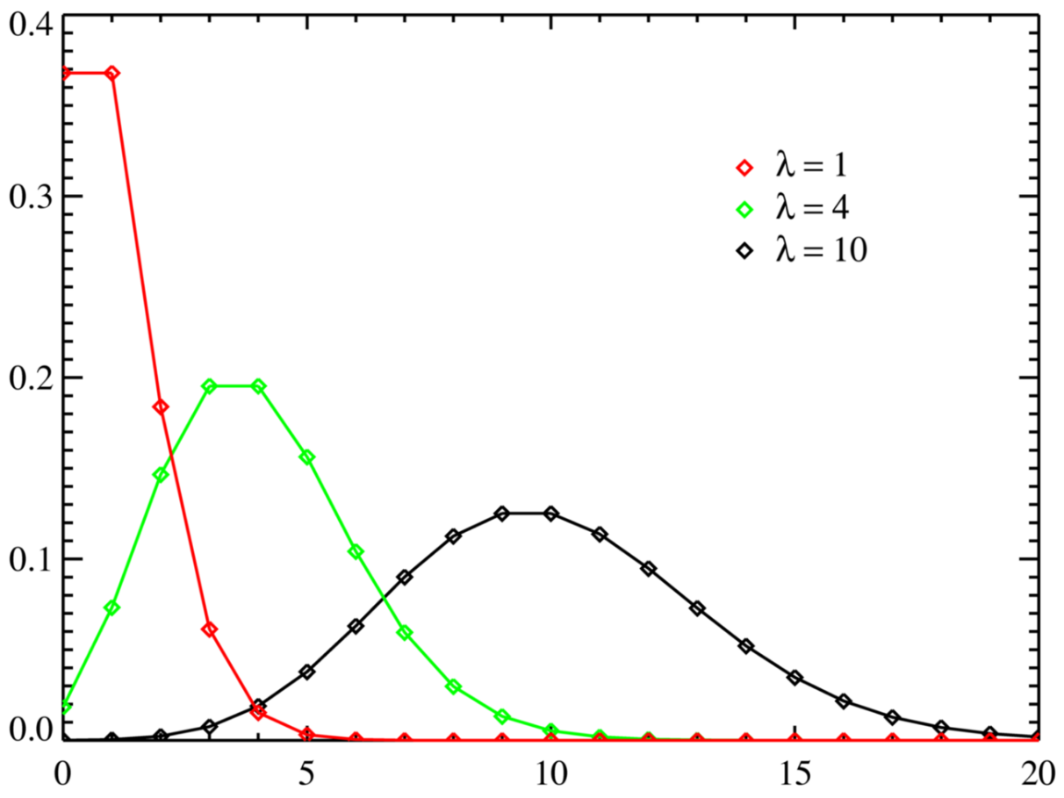
Poisson distribution
Is a probability distribution which predicts outcome of “counting experiments” where the expected number of counts is small.
$$P\left(X=k\right)=\frac{λ^{k}}{k!}e^{−λ}$$
mean $λ$, variance $λ$→ standard deviation $σ=\sqrt{λ}$
Examples of Poisson processes:
The number of traffic accidents in a city.
The number of calls you received in a day.
Type errors on a page.
Number of alpha particles emitted by a radioactive
substance in a given time.

Slide 13
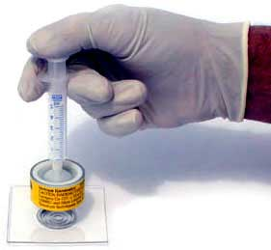
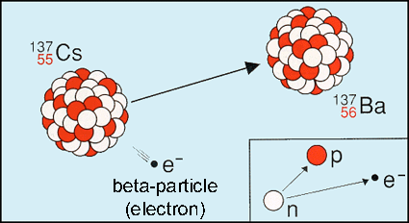
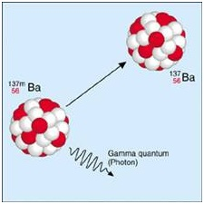
Measuring the half life of ^{137m}Ba
¹³⁷Cs (30.1 y)
β⁻ 1.174 MeV
(5.4%)
β⁻ 0.512 MeV (94.6%)
^{137m}Ba(? min)
The isotope generator
Energy (MeV)
γ 0.662 MeV(85%)
¹³⁷Ba (stable)

Slide 14
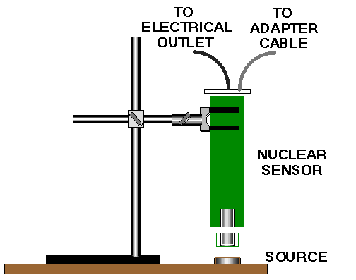
Measuring the half life of ^{137m}Ba

Slide 15
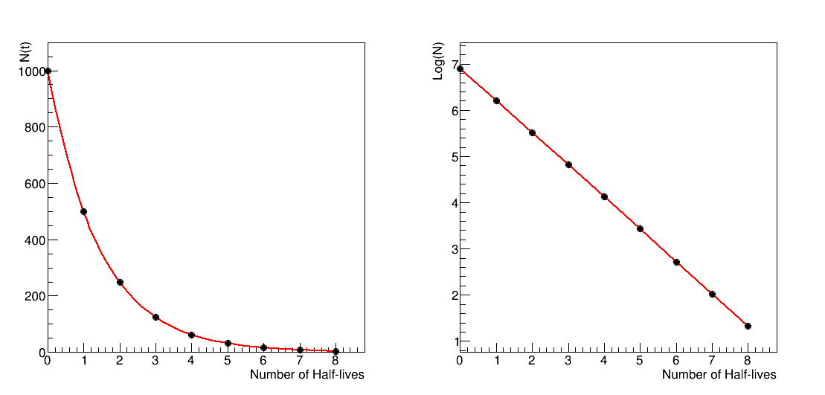
Measuring the half life of ^{137m}Ba
$$−\left(slope\right)=λ=\frac{\left.\ln\left(2\right.\right)}{t_{1/2}}$$
$$N\left(t\right)=N_{0}e^{−λt}$$

Slide 16
Safety Guidelines
Special care should always be taken to avoid unnecessary handling of the sources, contact with the skin, and close proximity of sources to the eyes.
Eating, drinking, smoking, using cosmetics, and chewing gum are strictly forbidden.
Protective gloves should be worn whenever an instructor or student is handling or transferring a radioactive liquid.
When radioactive sources are not in use, they should be stored in an appropriately labeled container and kept in a place of limited access.
Should an accident occur, it should be reported immediately to the lab instructor.
Upon completion of the experiments, sources are to be returned to their designated storage containers. No sources are to be removed from the laboratory.
Everyone who any contact with the samples should thoroughly wash their hands before leaving the laboratory.
Dispose of all waste in the designated radioactive container.
Enjoy the experiments!

