Slide 1
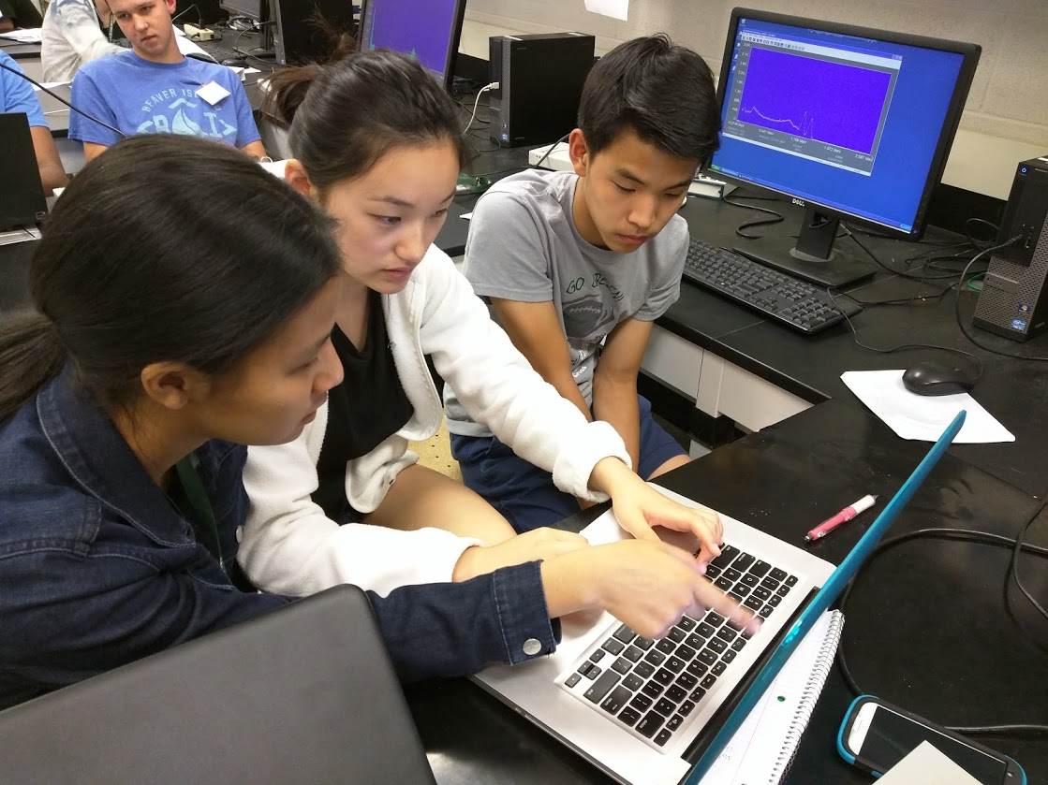
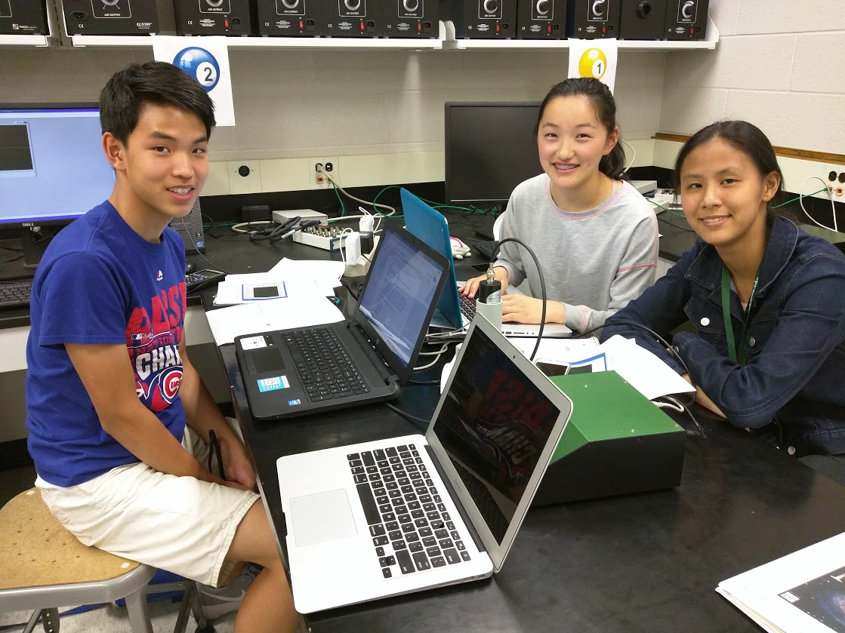
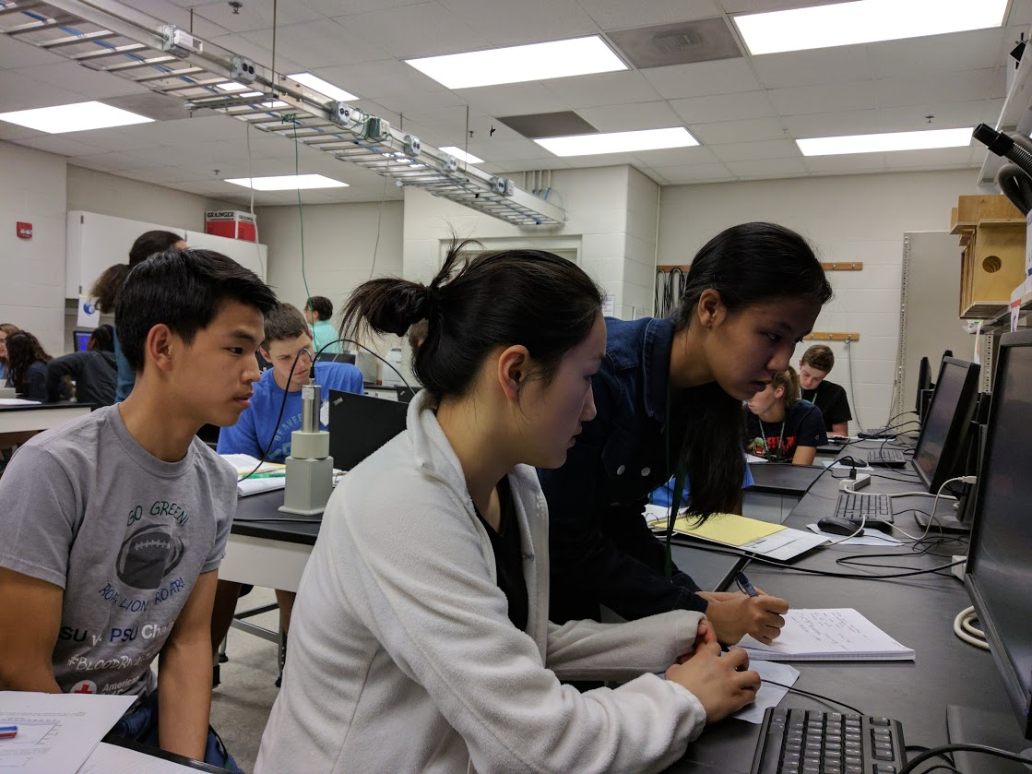
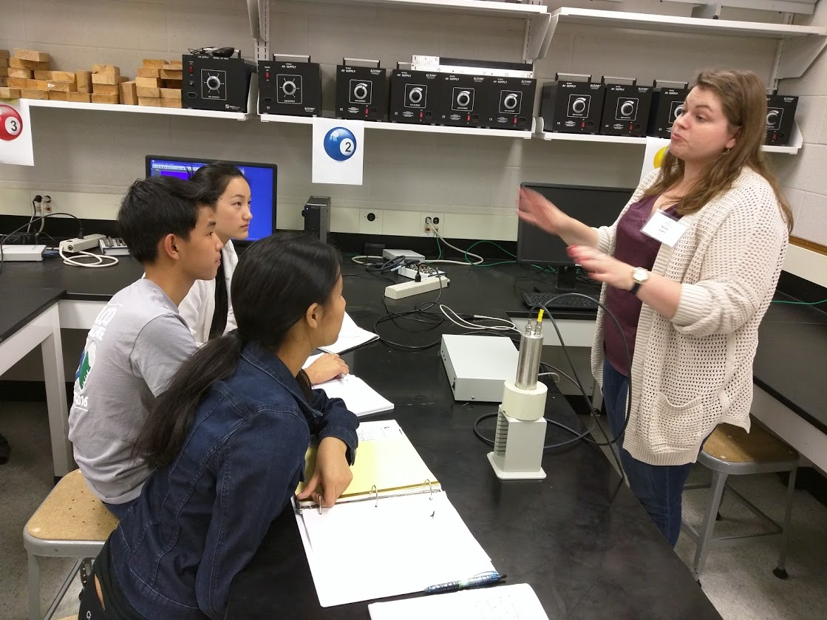
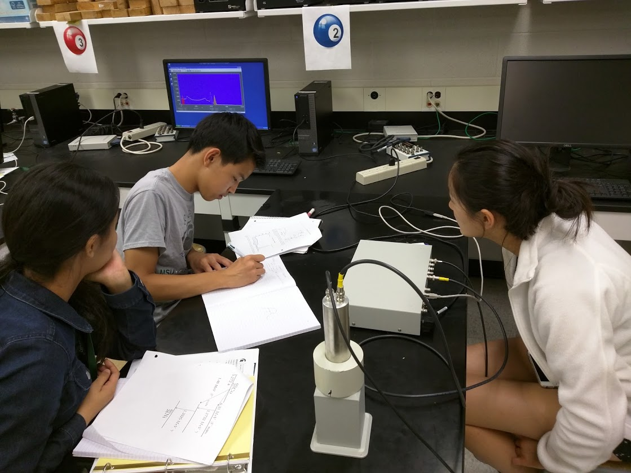
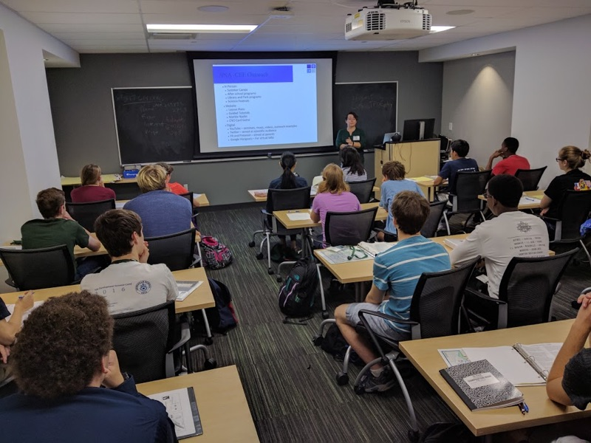
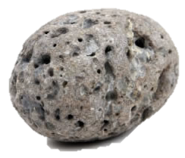
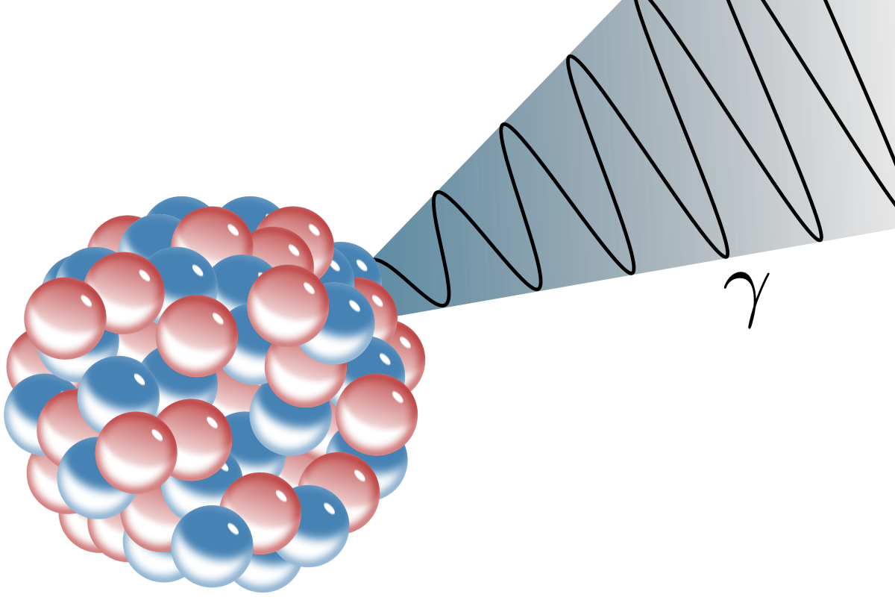
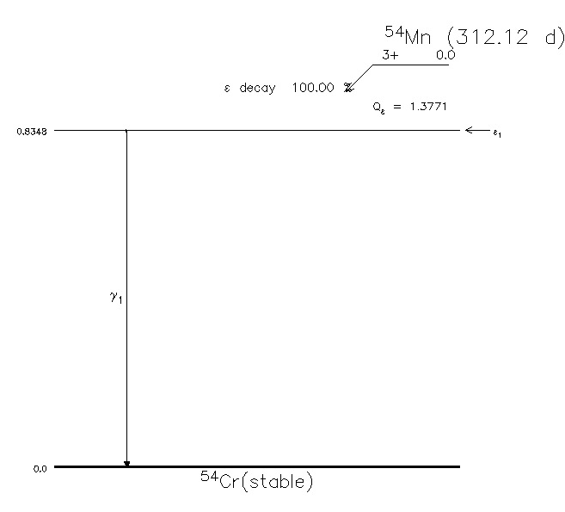
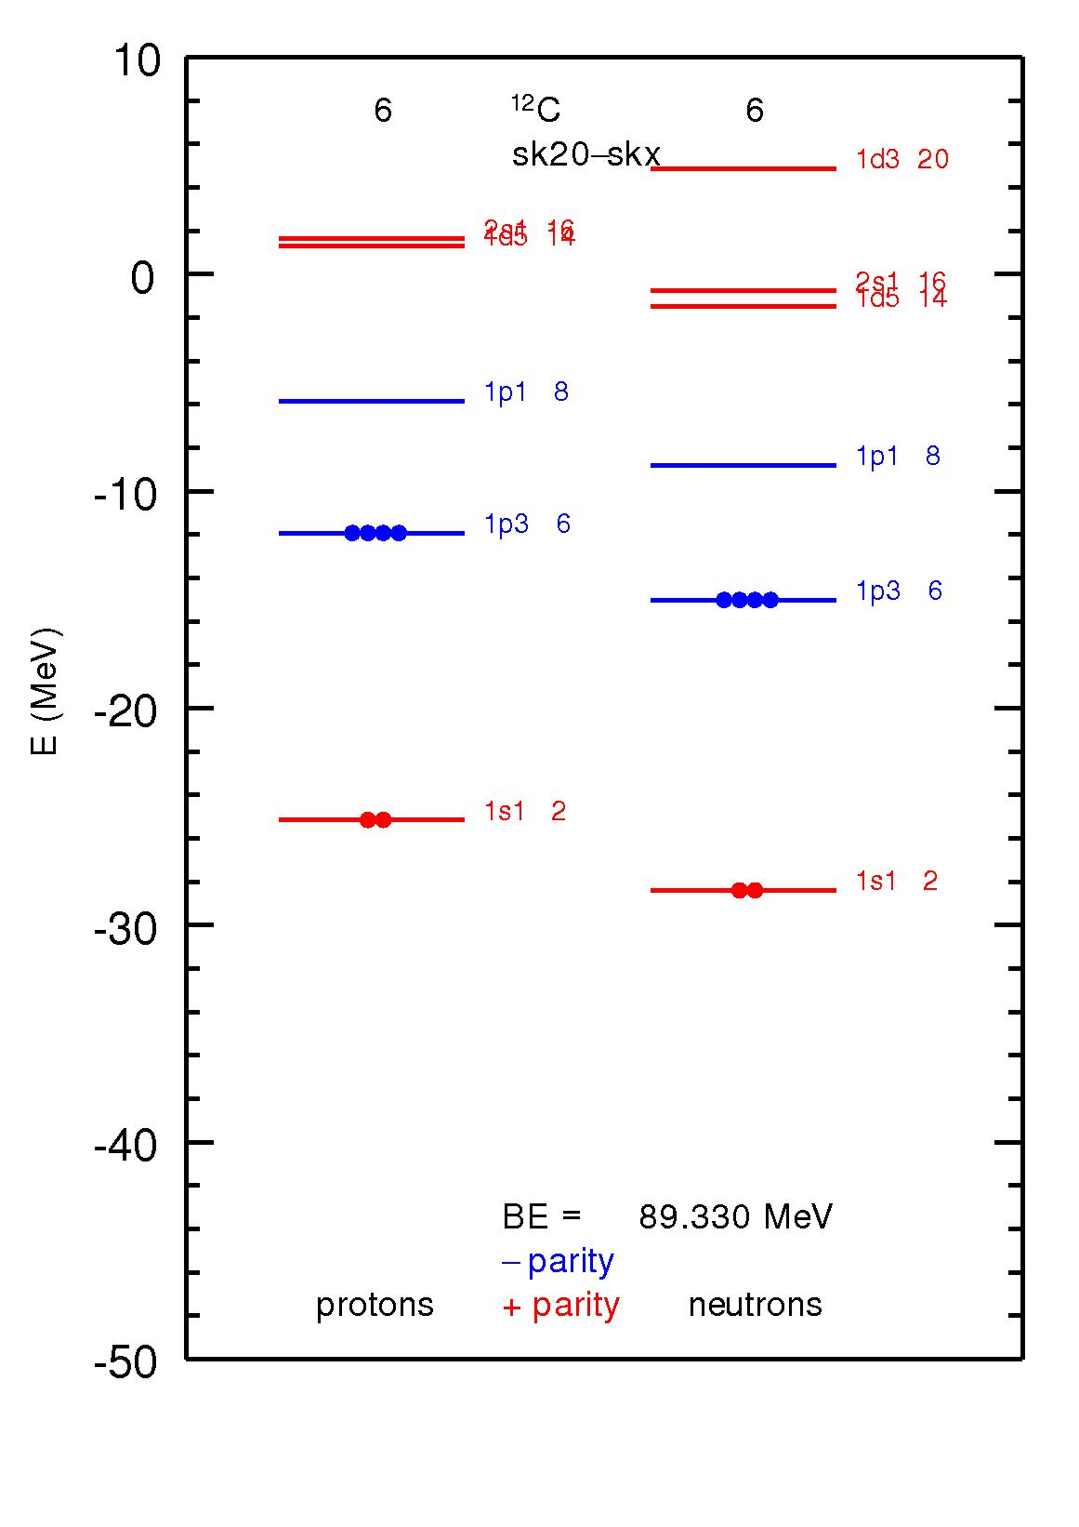
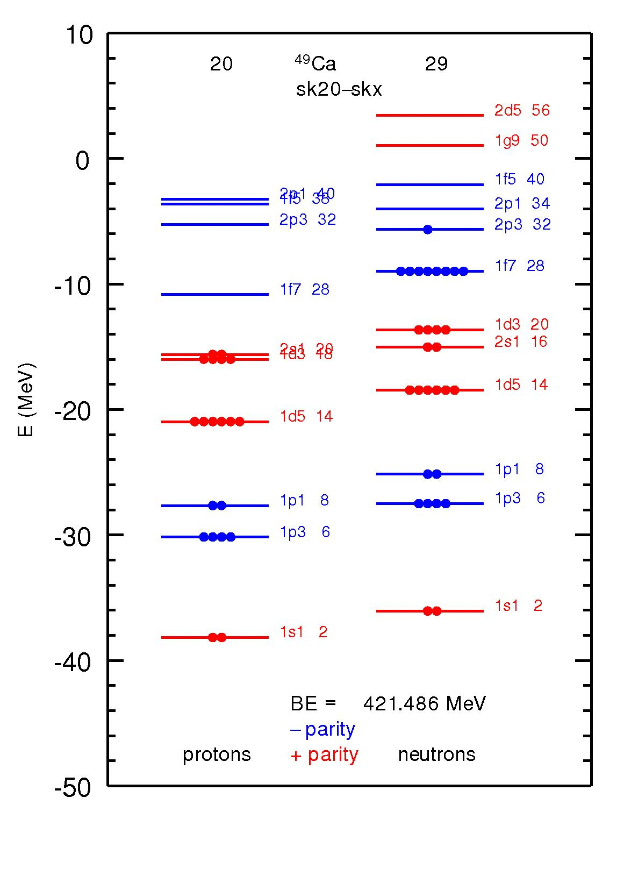
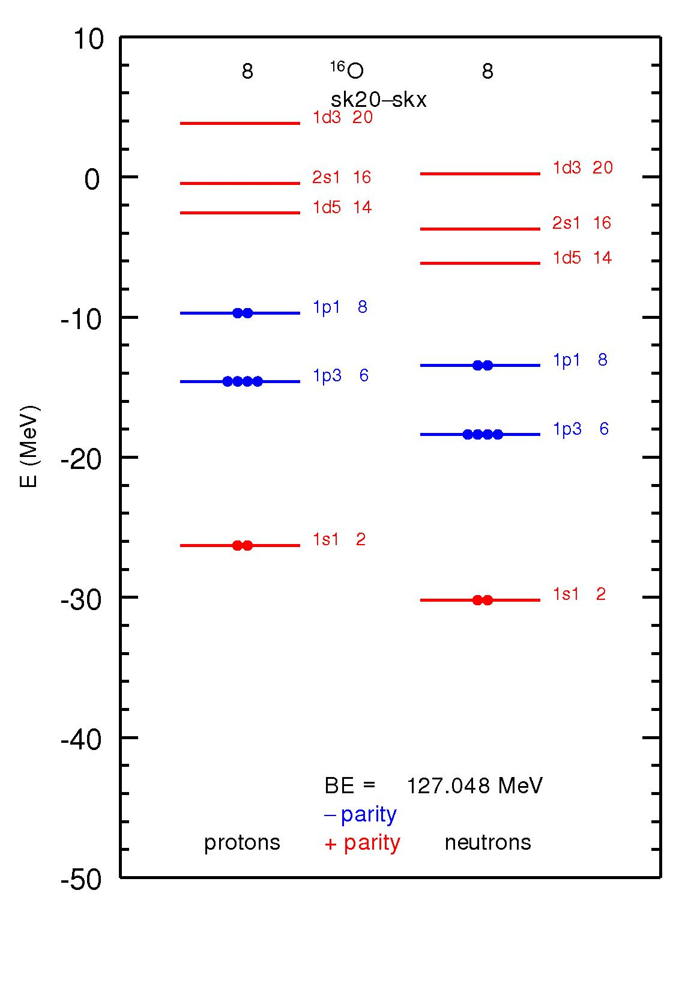
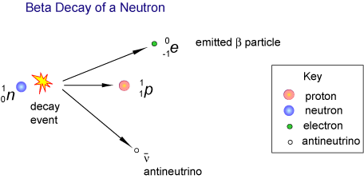
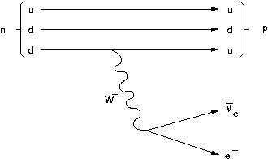
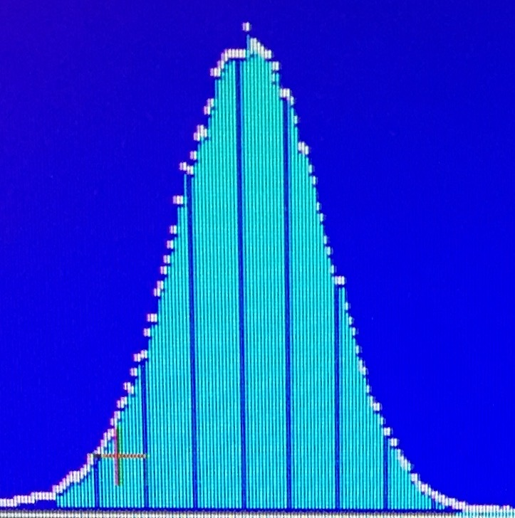
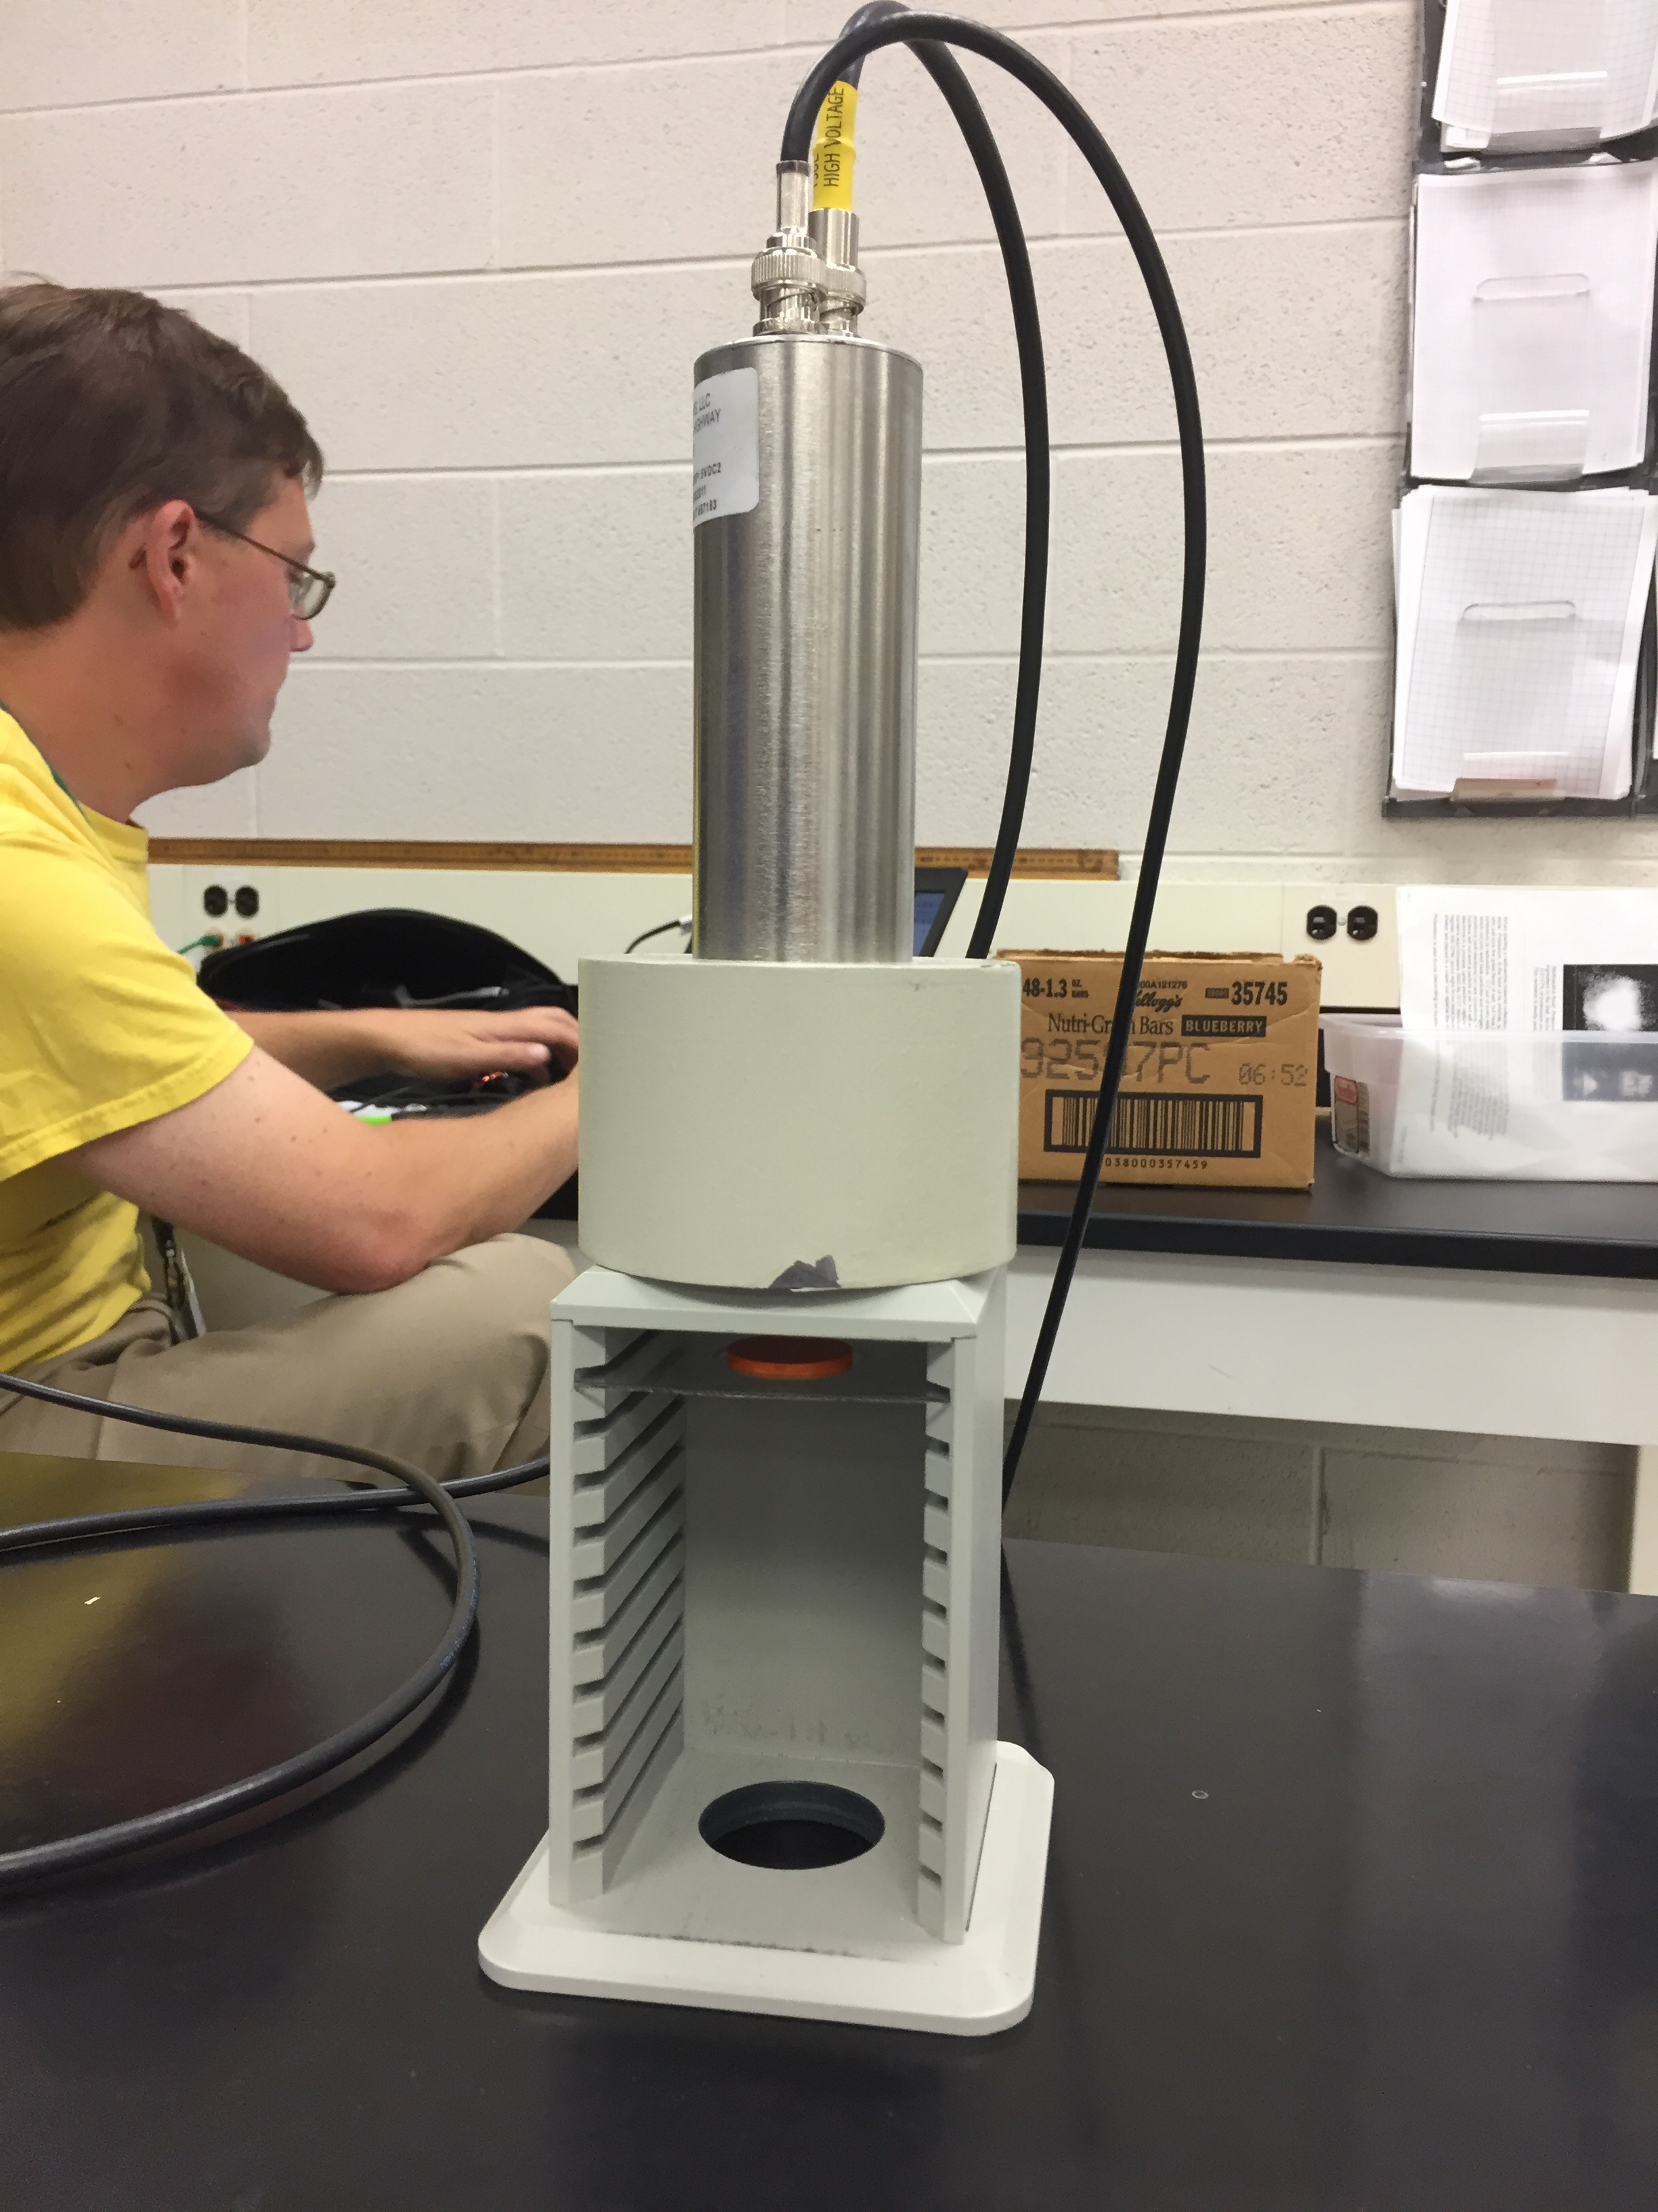
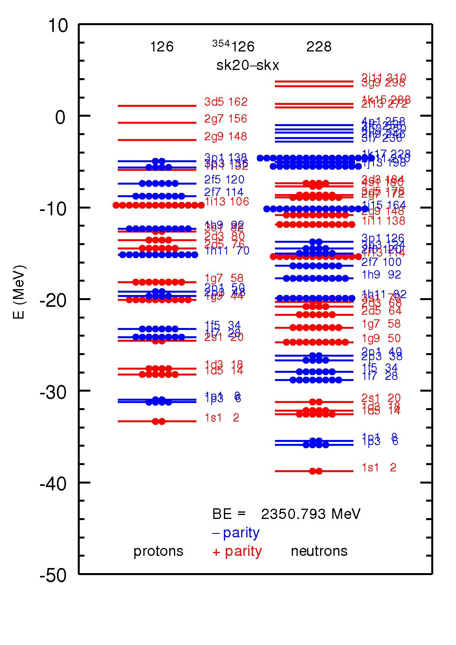
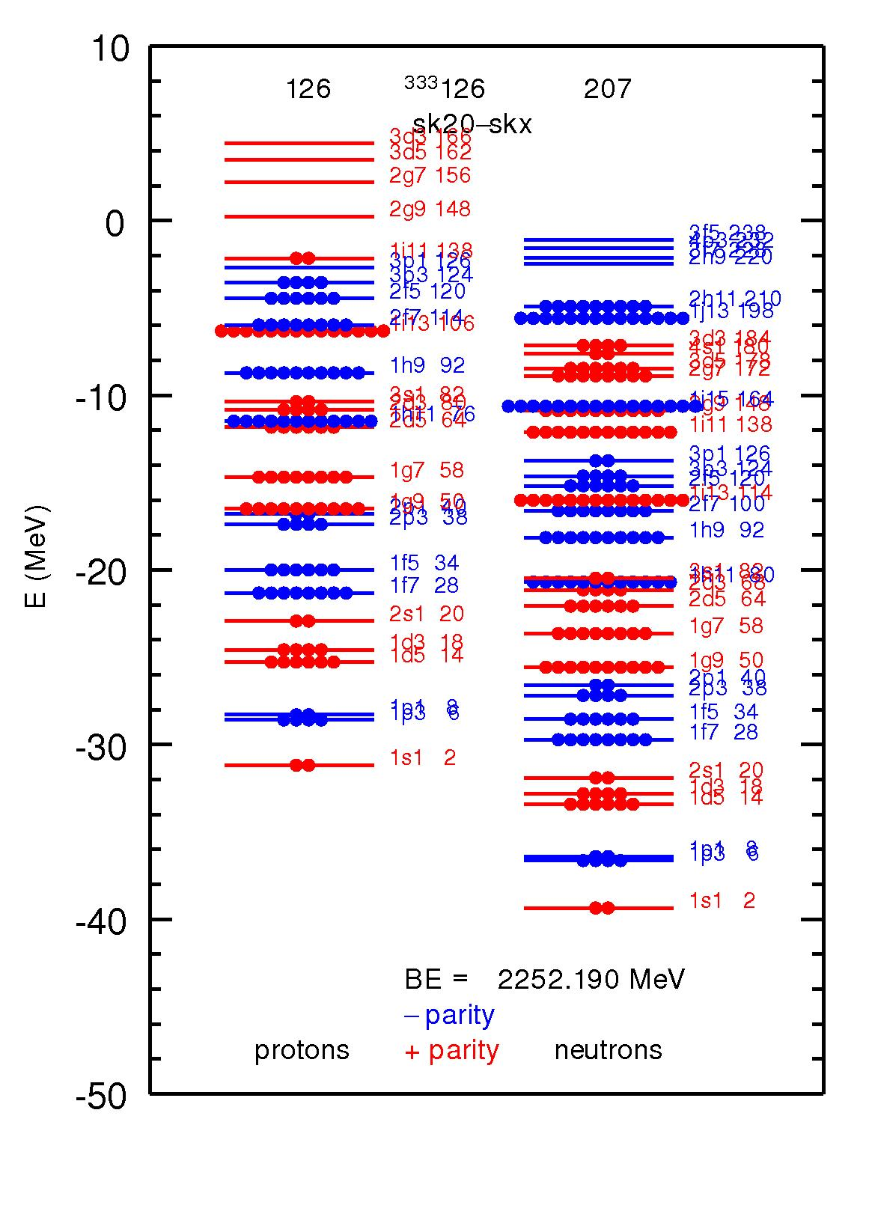
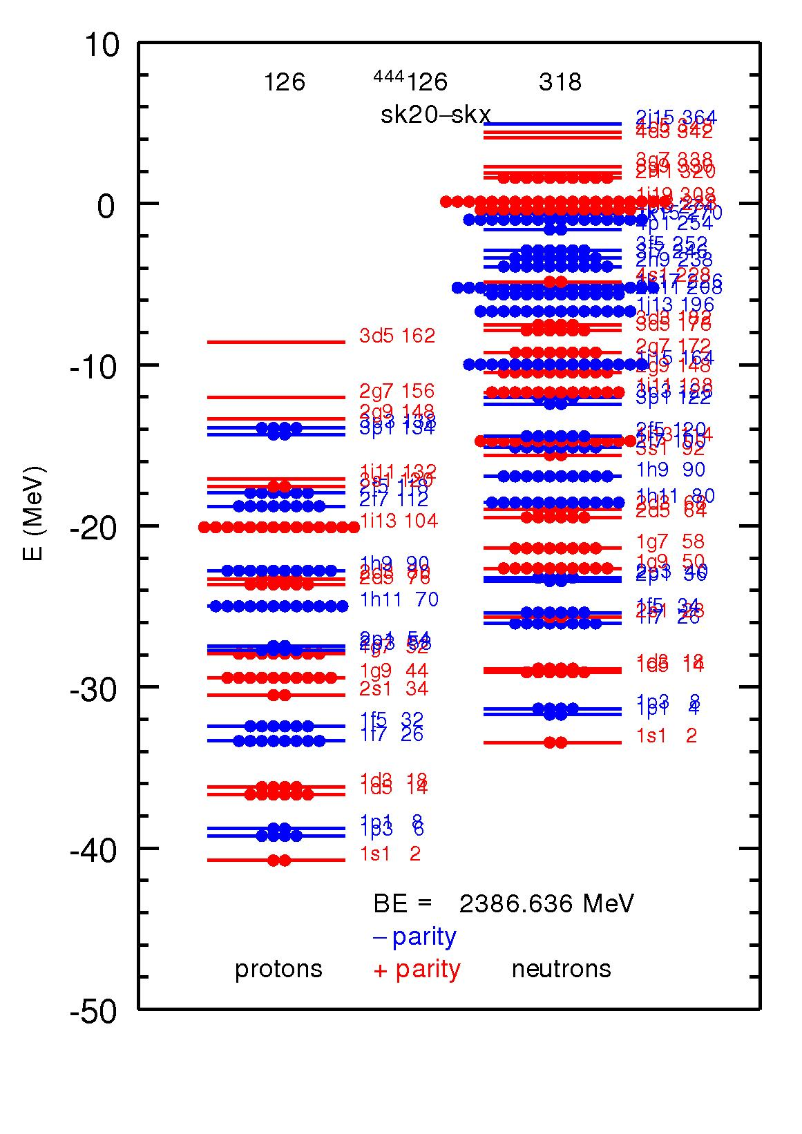
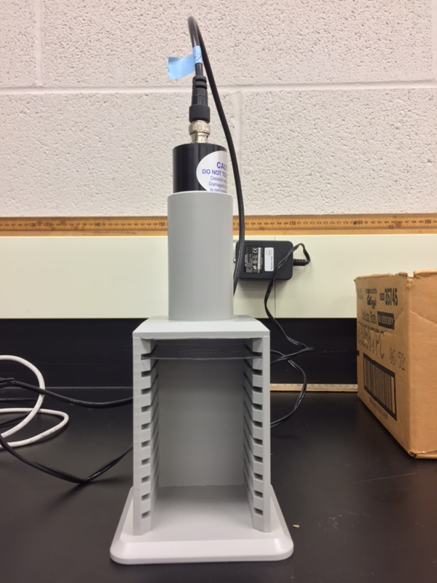
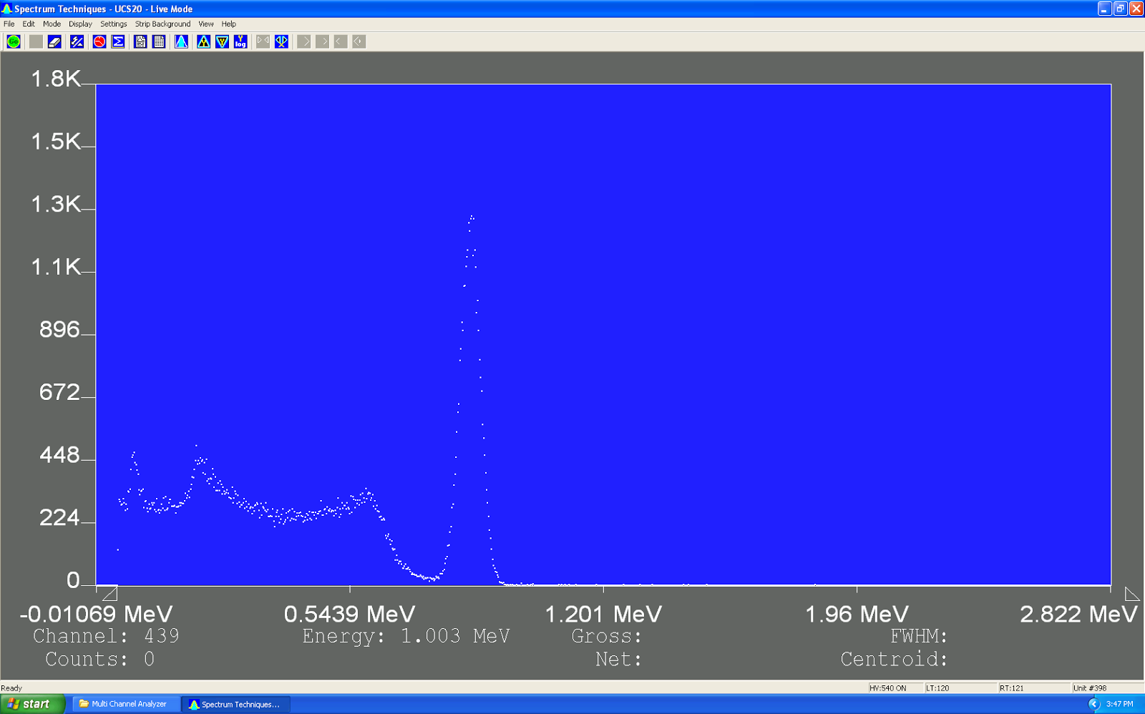
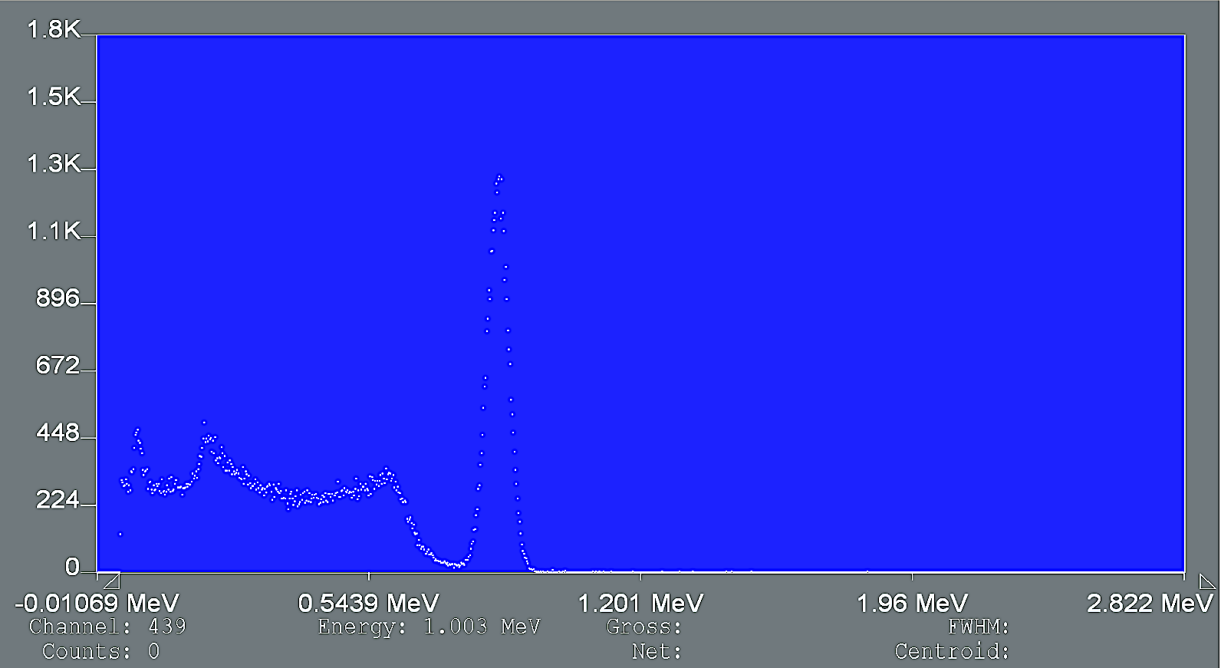
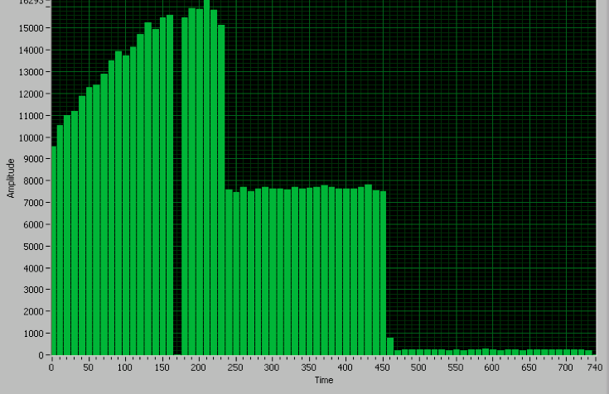
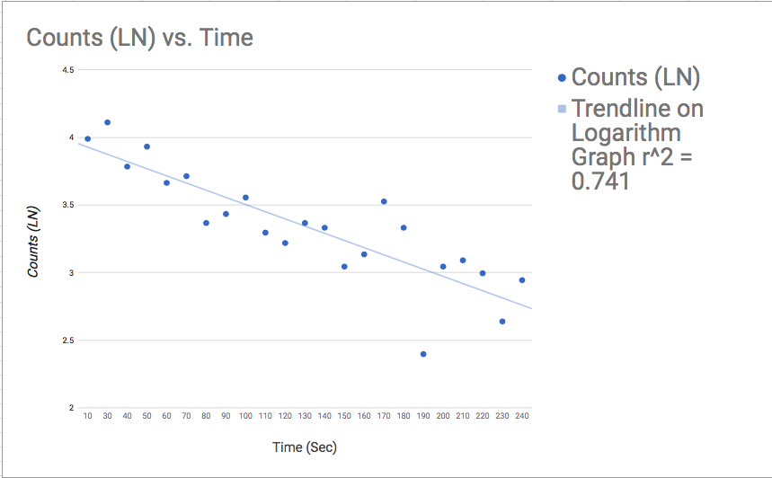
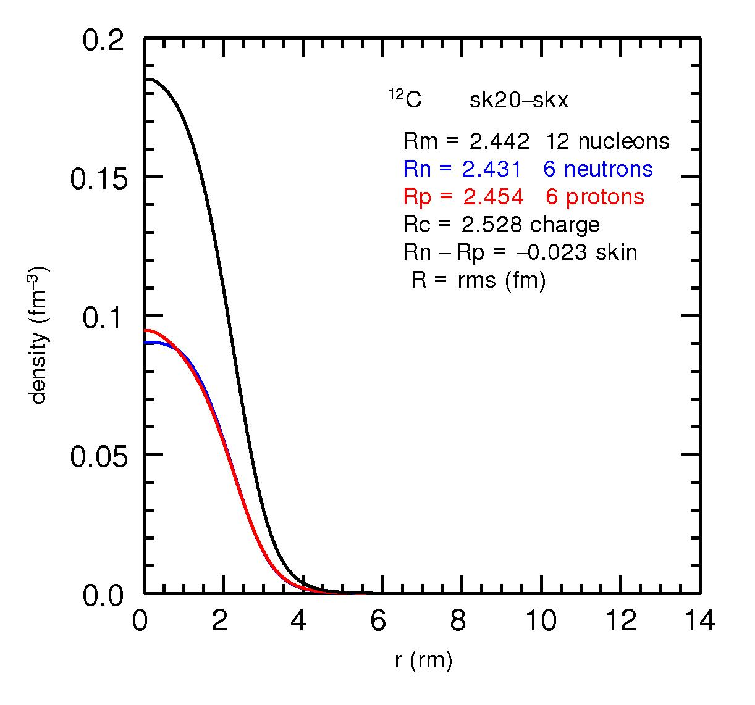
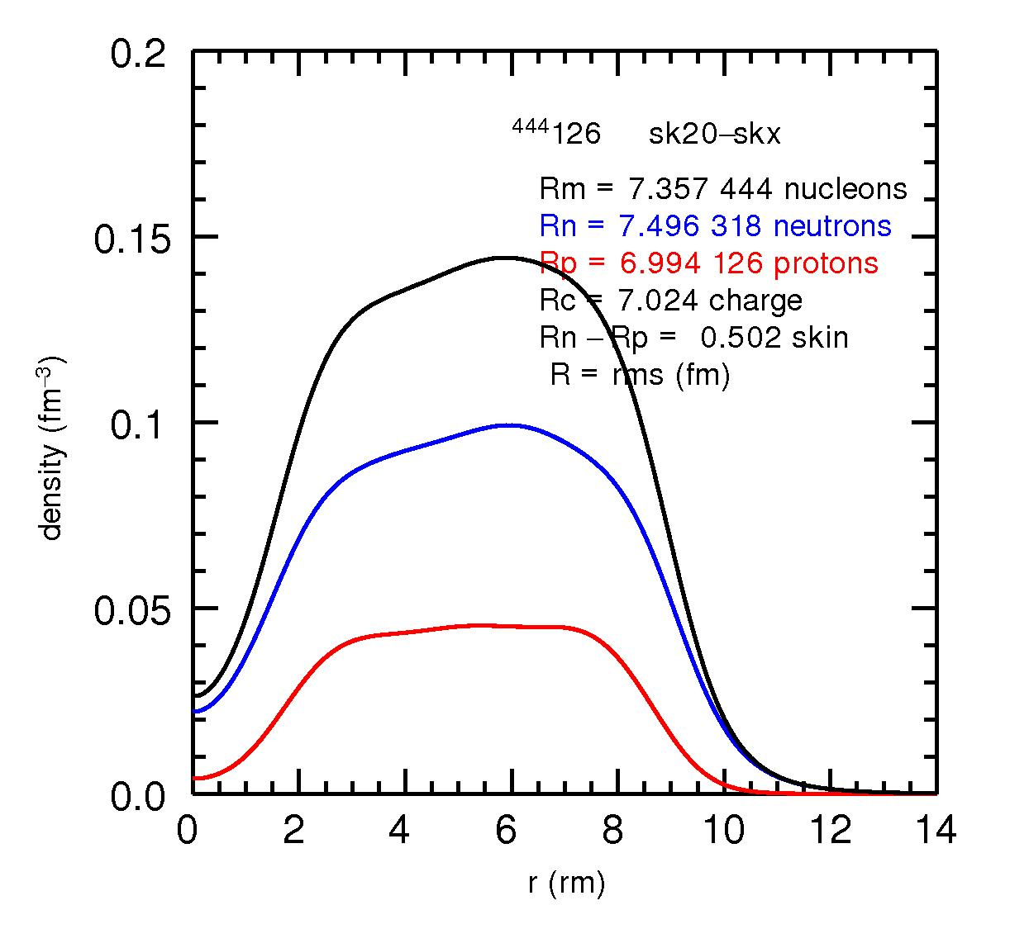
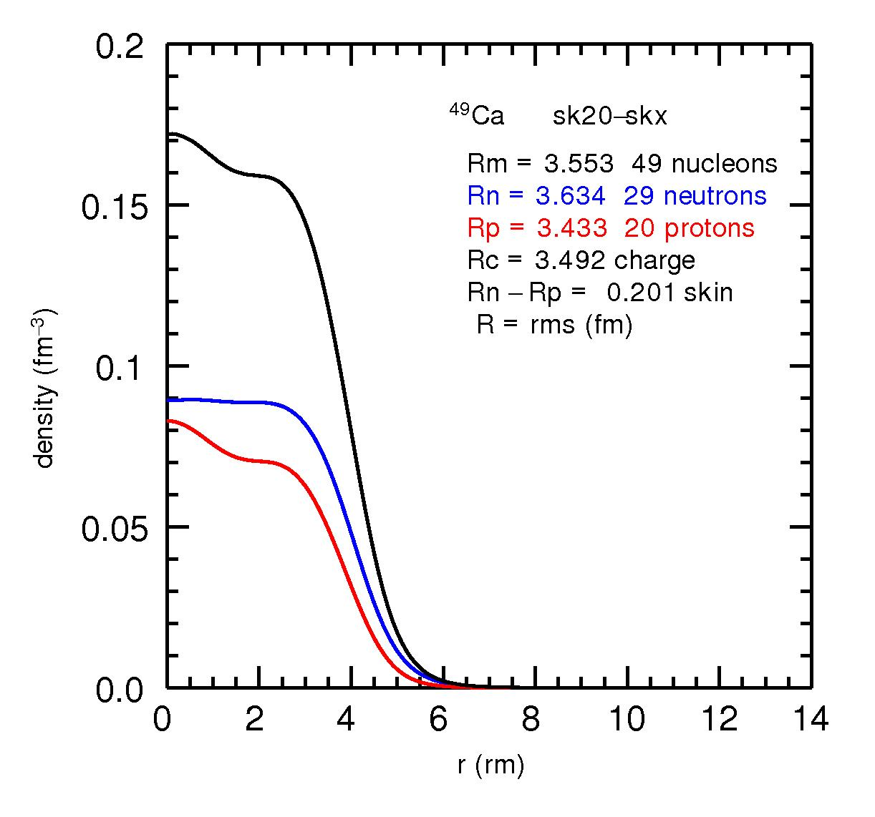
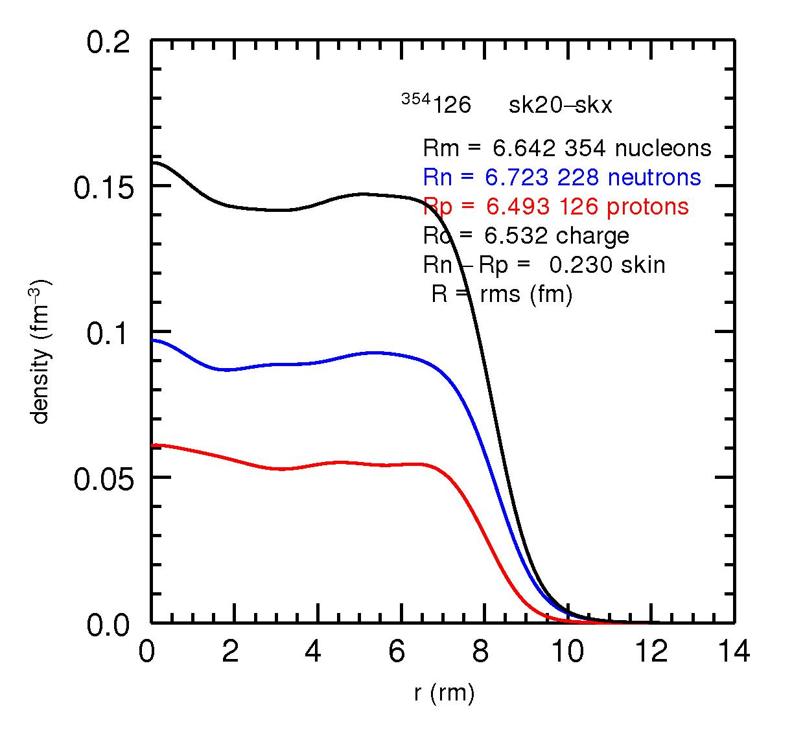
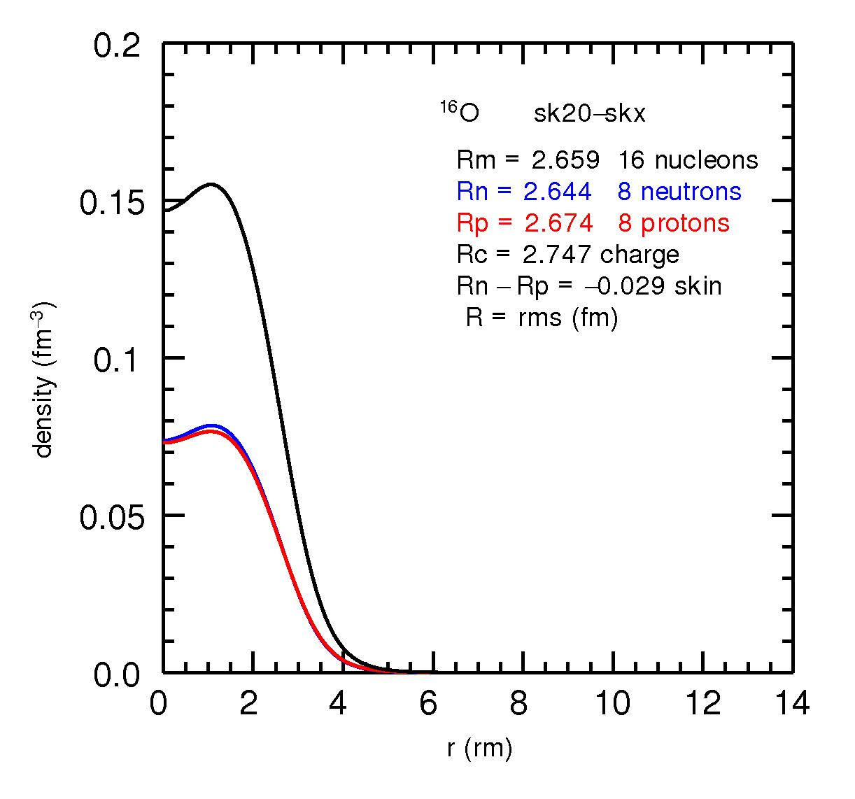
J³INA Joseph Chung¹, Joanne Yuan², Jiyun Zhu³
1 Okemos High School, Okemos, MI.
2 Los Altos High School, Los Altos, CA.
3 Illinois Mathematics and Science Academy, Aurora, IL.
Identifying *Mysterious* Source of Gamma Radiation
The Origins of Odd Siberian Rocks
Fishing for Stability Using Drip Lines
What are we detecting?
Key Point: atoms are very lazy.
The observed rock consists of Ag 107, Ag 109, Cd 108, and Cd 110- all naturally occurring forms of Ag, but no Cd 106, Cd 111, Cd 112, Cd 114.
Using a program developed by Dr. Alex Brown, we graphed the orientation of nucleons and nuclear density of various isotopes. The program uses EDF Theory to create graphs that estimate drip lines. We calculated the drip lines for isotopes. Two graphs (right) are stable and the other two are unstable and beta decay to become stable.
We believe that the rock was once entirely composed of Ag 109 which then beta decayed to Cd 106, Cd 111, Cd 112, and Cd 114. The Cd isotopes then beta decayed into Ag 107. To confirm this, we used various techniques to find the half life of Ag107.
Gamma radiation is emitted from a variety of isotopes to decay into a more stable, less energetic form.
0.8343 MeV
Procedure: Detected radiation energy of Cesium 137 and Cobalt 60 with gamma radiation detector (shown on right along with our stellar leader Zach!) and Spectrum Techniques UCS20 software.
https://en.wikipedia.org/wiki/Gamma_ray
https://www.orau.org/ptp/PTP%20Library/library/DOE/bnl/nuclidedata/MIRMn54.htm
Software
Spectrum Techniques UCS20 program allowed us to find maxima of peaks in graphs of isotope decay.
http://www.atnf.csiro.au/outreach/education/senior/cosmicengine/sun_nuclear.html
These graphs are especially helpful in in studying isotopes of undetected isotopes, such as element 126. These graphs can offer insight for what to expect when trying to create element 126.
We used a Geiger- Müller counter to detect radioactive (beta) decay from silver coins partially composed of Ag 107 and neutrons. Geiger- Müller counters are composed of a gas chamber with a thin mica window that allows all forms of radiation to pass. We then analyzed data with Half_Life software.
Results
Cobalt 60
Cesium 137
Counts
0.6671 MeV
1.1732 MeV
Counts
1.3325 MeV
Energy MeV
Energy MeV
Results
We used the known Cobalt and Cesium decay energy levels to calibrate channel – energy values. We then detected decay energy of unknown based on calibrated scale.
Density graphs can predict structure of nuclei. This can be used to predict the structure of the nucleus size.
Manganese 54 (unknown)
0.8391 ± 0.0214 MeV
Counts
Our results yielded a lot of background radiation, which we negated through subtracting baseline from our detected radiation levels. Based on the graph, we got the following equation:
Y = -0.005x + 4.024
We then calculate half life based on the following equation
half life = ln(2)/λ
Where λ = slope = .005
Therefore half life =138.63
Energy MeV
Both graphs provide good estimations for how isotopes will react in real life. However, experiments must still be done to confirm theoretical predictions.
We searched for relatively stable isotopes with similar decay energy values as unknown sample (shown above) using the Lund Nuclear Data Search with following restrictions:
We chose the following entry, determining the unknown as Manganese 54
After calculations, we noticed that silver-108 had a half-life of 139 ± 5 seconds using our data. This was 4 seconds off from the standard, 143 ± 0.02 seconds.
We can use similar techniques in future for identifying unknown sources of radiation.
We can apply similar methods when predicting behavior of isotopes or origins of elements.

