Slide 1
NUCLEAR SCIENCE
FOR EVERYONE
Public Education and Outreach for nuclear research at MSU
Dr. Zach Constan
Outreach Coordinator
National Superconducting Cyclotron Laboratory (NSCL)

Slide 2
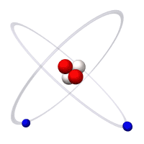
We study the atomic nucleus
Example: A Helium Atom
Electron
Proton
Neutron
NSCL scientists study the atomic nucleus
Notes:
(Have audience identify parts of the atom) At NSCL, we study the nucleus of the atom. Specifically, we study nuclei that are rare, unstable.

Slide 3
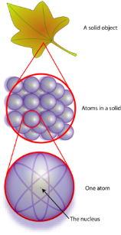
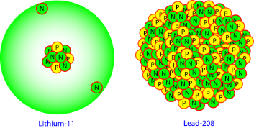
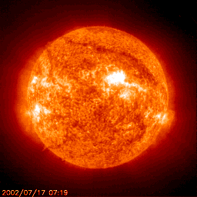
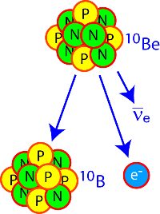
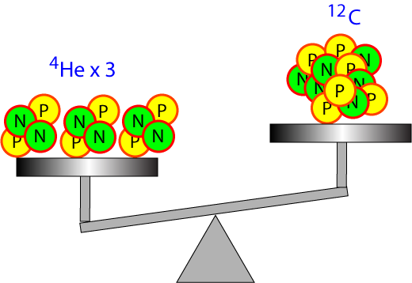
Why are nuclei interesting?
What are things made of?
How many kinds can exist?
Where did the elements come from?
How big are they?
Why are some radioactive and how long do they last?
How much do they weigh?
Questions posed by
nuclear theorists, mathematicians, computer programmers

Slide 4
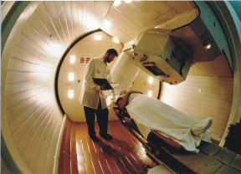
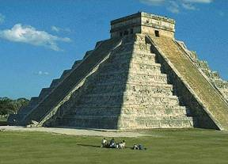
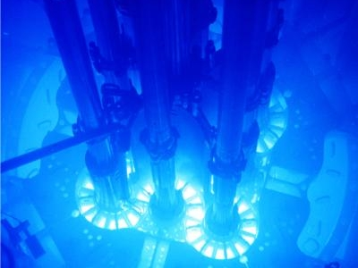
What is the value? (“Who cares?”)
Keeping us healthy
Explaining our world
Making electricity
…plus: smoke detectors, smartphones, safer food, etc.
What we learn about the nucleus can
save lives and change the world!
Jobs like medical physicist, radiation safety officer, geophysicist

Slide 5
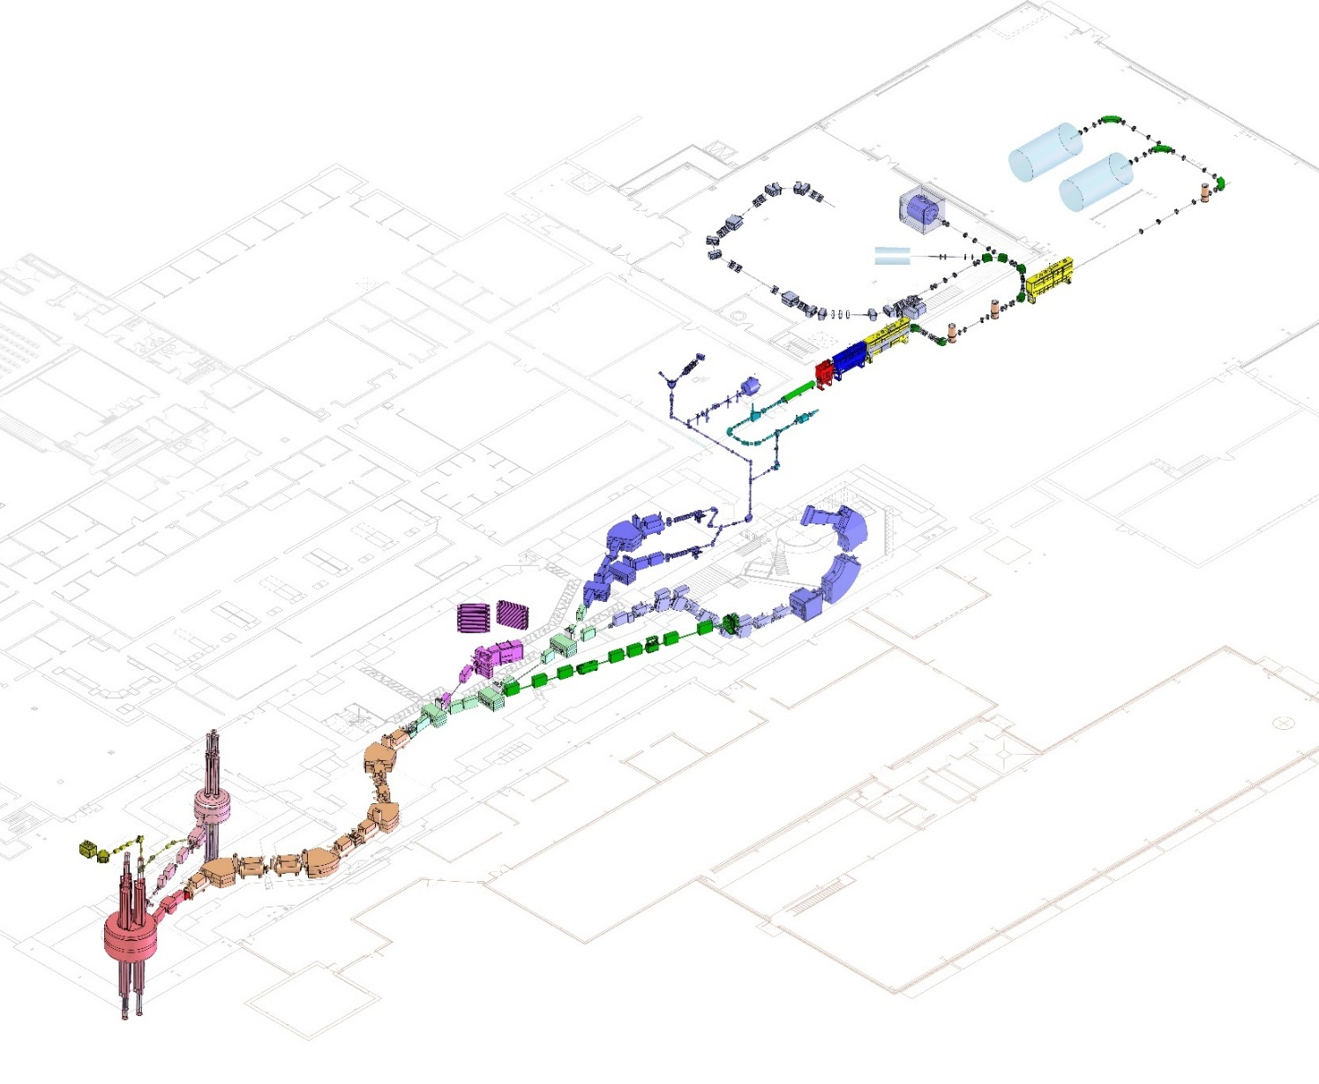
World-class research
Coupled cyclotron facility and experimental beam lines
SPEED UP NUCLEI using accelerators
and BREAK A TON OF THEM
A person
Made possible by
accelerator physicists, operations physicists,
and engineers (vacuum, electrical, cryogenic…)
~140 meters (450 feet) long
Five stories tall

Slide 6
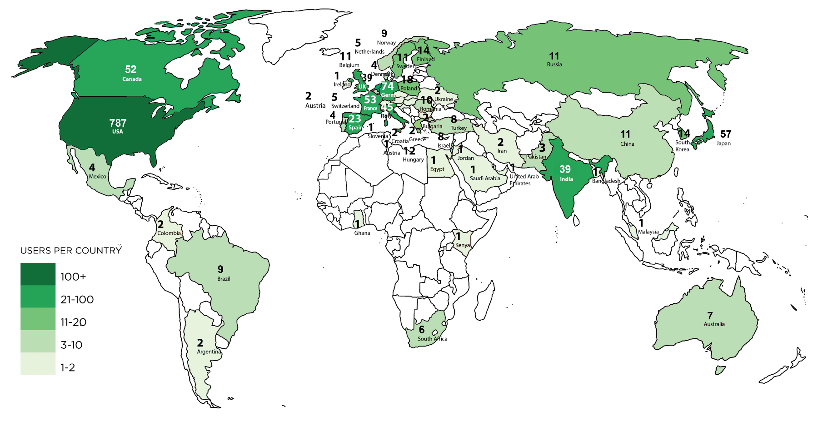
Serving Users worldwide
The best nuclear scientists on the planet come to NSCL because our lab is a world class research facility
FRIB/NSCL User Community August 2018
~1400 scientists, 50+ countries

Slide 7
Our staff makes it possible
800+ employees
Research and Development
Theorists and Experimenters
Facility operators
Designers & engineers
Undergraduate and Graduate
students
Technicians & machinists
Our people learned useful skills in:
nuclear science ▪ physics ▪ chemistry ▪ all types of engineering ▪ mathematics ▪ computer science ▪ welding ▪ machining ▪ pipefitting ▪ and so on…
And had jobs in quality control, building cars, construction, farming, etc…

Slide 8
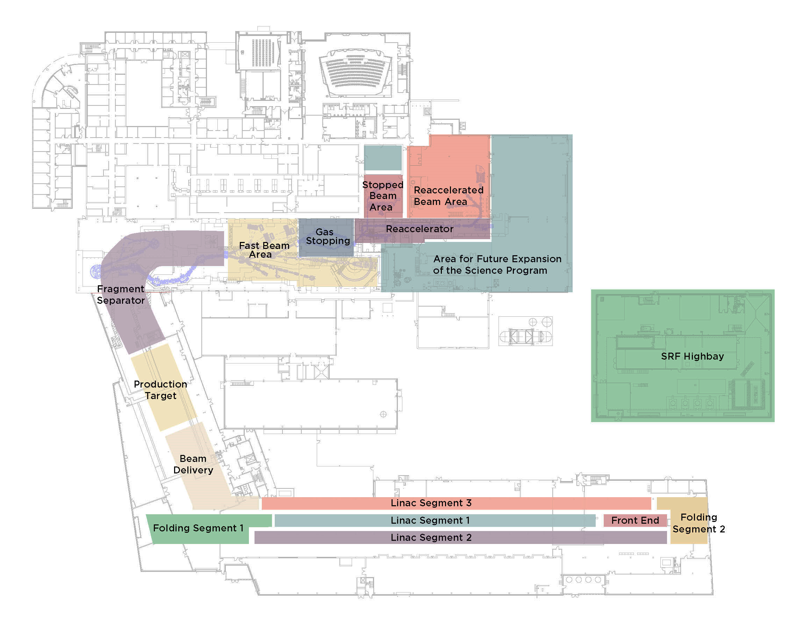
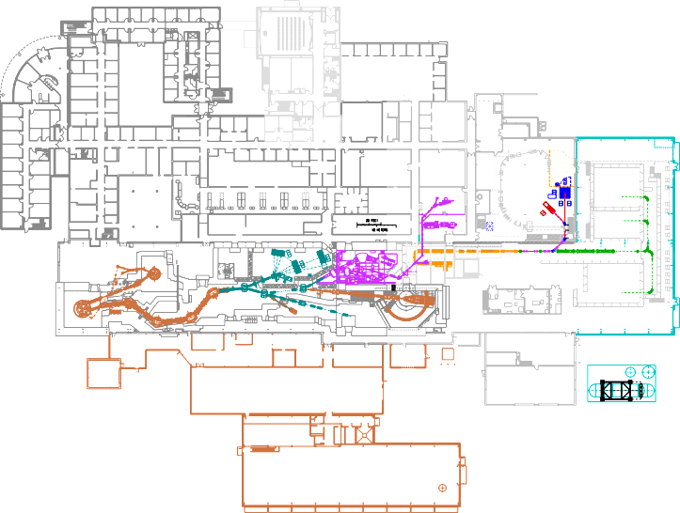
Problem: study EXTREMELY rare nuclei!
FRIB design
NSCL today
Solution:
BREAK MORE NUCLEI with our next-generation
Facility for Rare Isotope Beams (FRIB)
the $730 million discovery machine that we imagined, designed, and will build by 2022

Slide 9
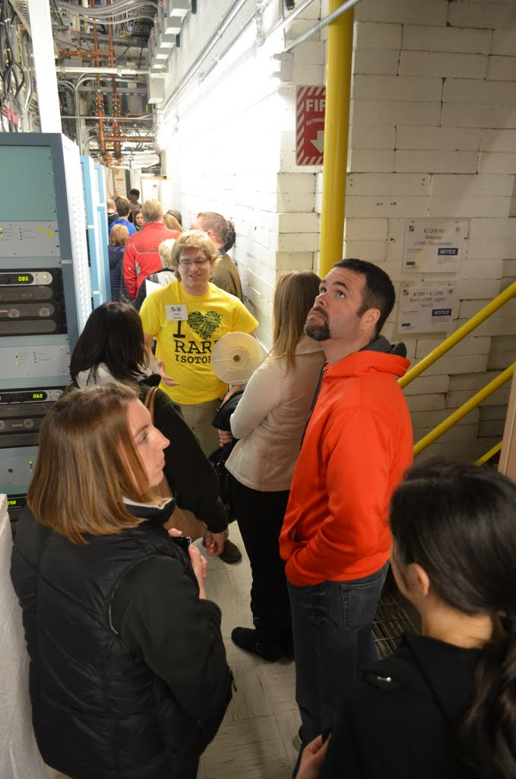
Our Outreach mission
Fulfill NSF Broader Impact Criteria
Create public awareness and understanding of nuclear physics (and roles of NSCL & JINA)
Raise public appreciation of the benefits of nuclear science
Recruit the next generation of nuclear scientists
Notes:
You can’t do everything, so at least do what your boss or organization wants.

Slide 10
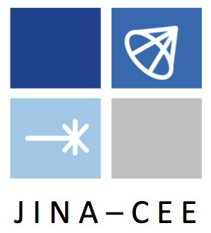
A research network for nuclear astrophysics
Joint Institute for
Nuclear Astrophysics
Center for the Evolution of Elements
JINA-CEE is supported by the National Science Foundation through the Physics Frontier Center program.

Slide 11
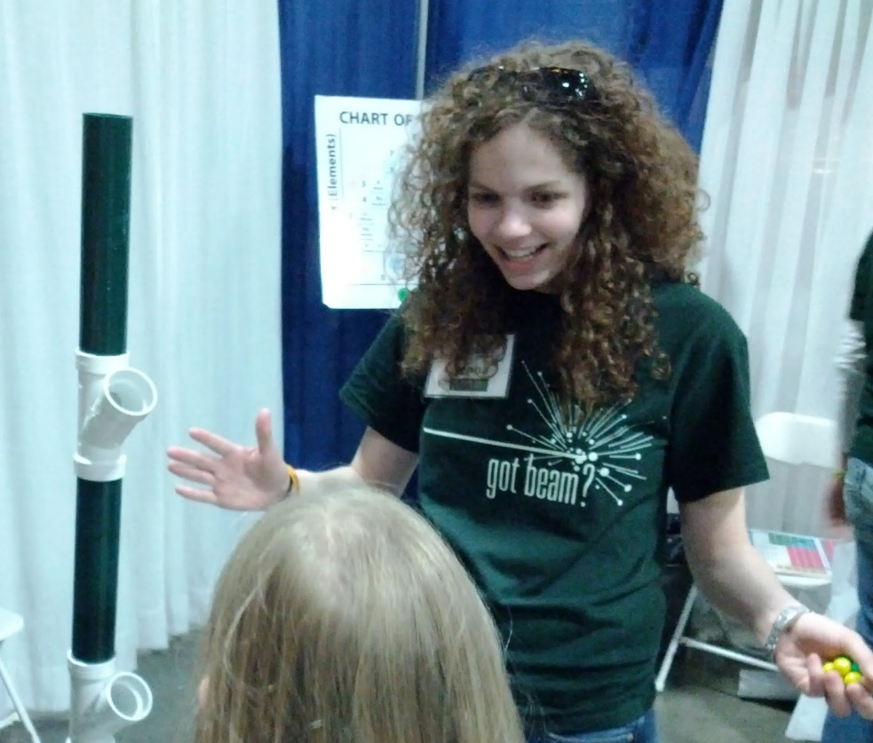
Opportunities for Everyone
Social Media/Website
Digital Games
Science Festivals
Open Houses
Talks/Webinars
Tours
Lessons/Activities
Camps/Workshops
Larger audience/Less interaction
@nscl
@NSCLMSU
Smaller audience/More interaction

Slide 12
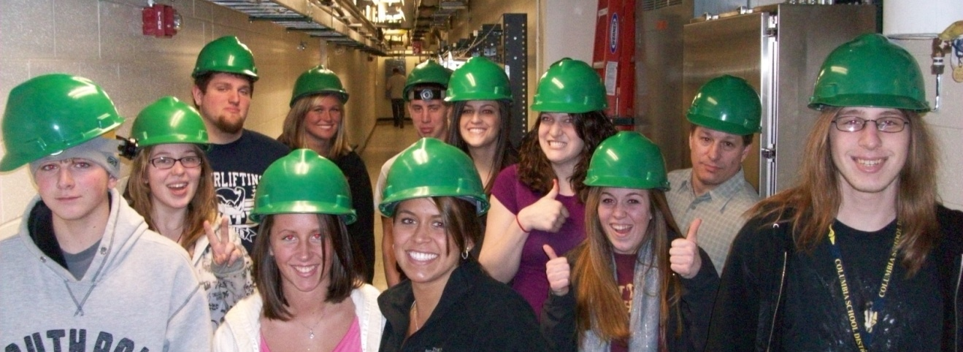
Laboratory Tours
FREE
Audience: General Public (school age and older)
Contact time: ~90 minutes
Outcome: An appreciation of nuclear science/NSCL, student interest in science careers

Slide 13
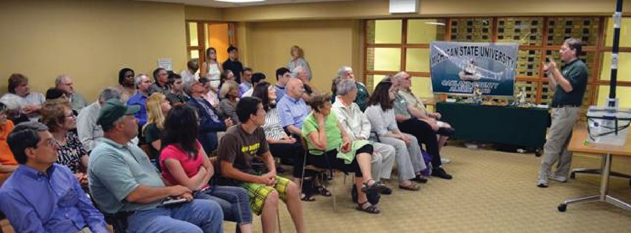
Public Talks
FREE
Seminar about research @ NSCL
A career-focused presentation for students
OR a virtual tour on the planetarium dome!
On-campus or at your location (within reason)
Can serve (almost) any size group
Also: a series of free public talks & concerts at FRIB! See “Advanced Studies Gateway” at frib.msu.edu/gateway

Slide 14
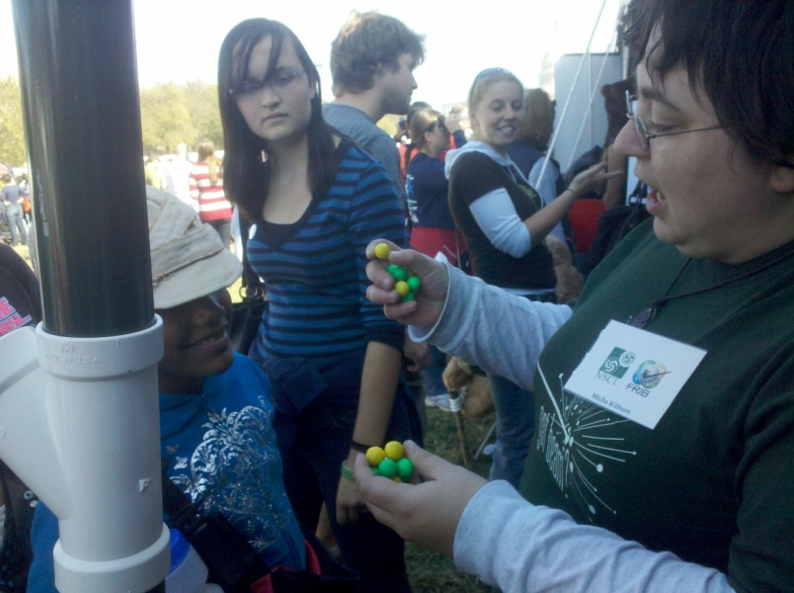
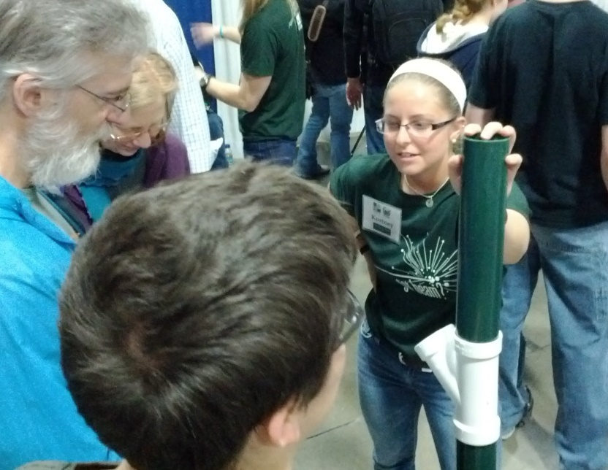
Marble Nuclei: Lesson/Activities
Lesson ideas are available for teachers who want to use the marbles for a nuclear science unit
Several hands-on activities use the marble nuclei to model nuclear processes
To date, over 350 teachers have been taught to use the marble nuclei lesson, while another 350+ have downloaded the documents
JINA Outreach personnel provide support in finding, acquiring, and utilizing the necessary equipment
www.jinaweb.org/outreach/marble/
FREE

Slide 15
The future: smashing virtual nuclei
FREE
On iOS, Android, web browsers
Learn more at http://gamedev.msu.edu/isotopolis/

Slide 16
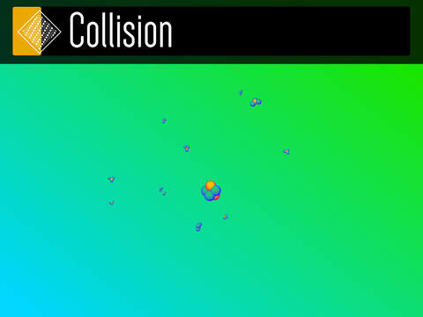
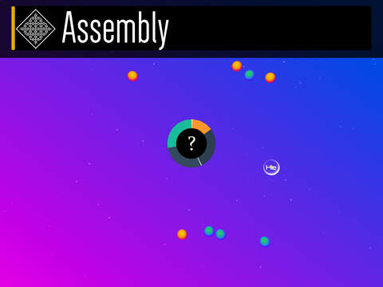
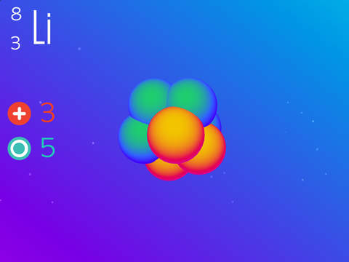
Isotopolis puts students in the driver’s seat

Slide 17
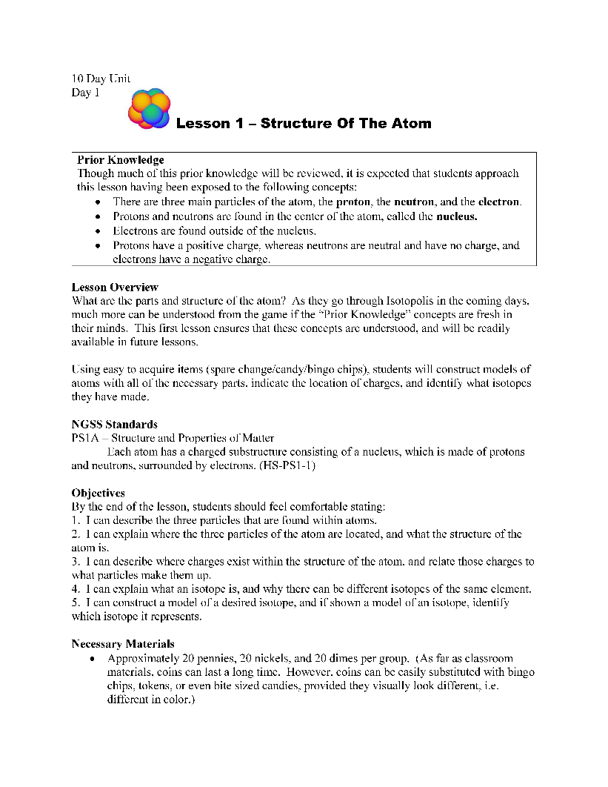
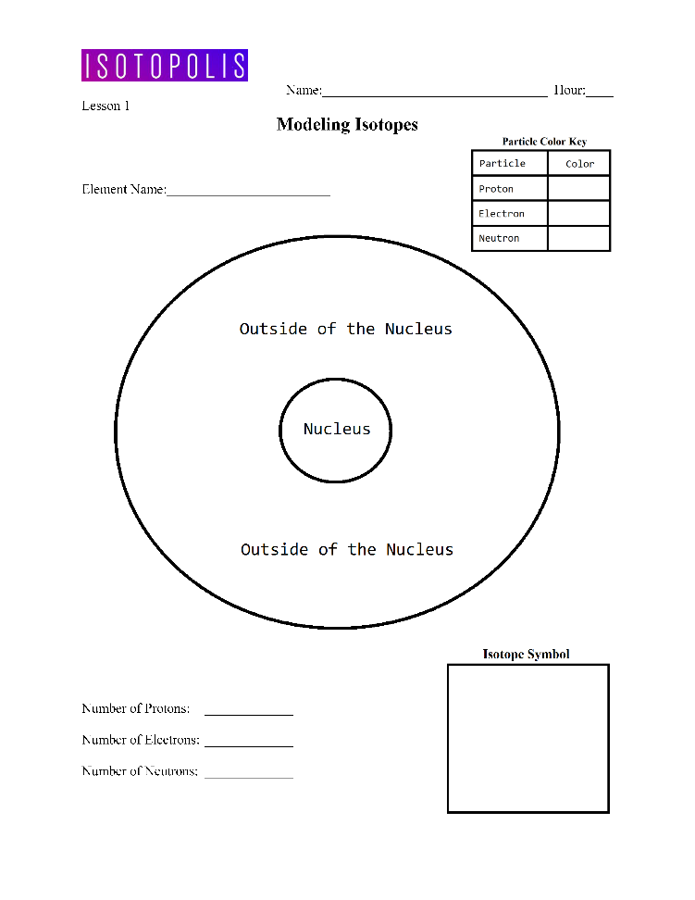
Isotopolis lesson plans
FREE
Coming Soon
10-day, 5-day, 3-day
Mix and match, modify as needed
NGSS standards listed
Final version should be appropriate for HS and MS

Slide 18
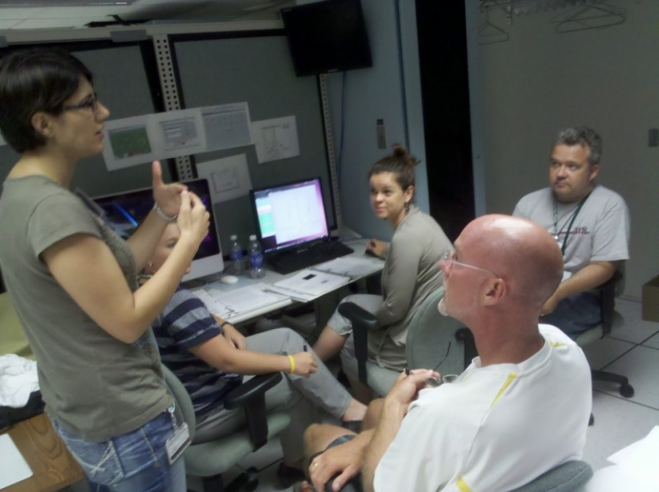
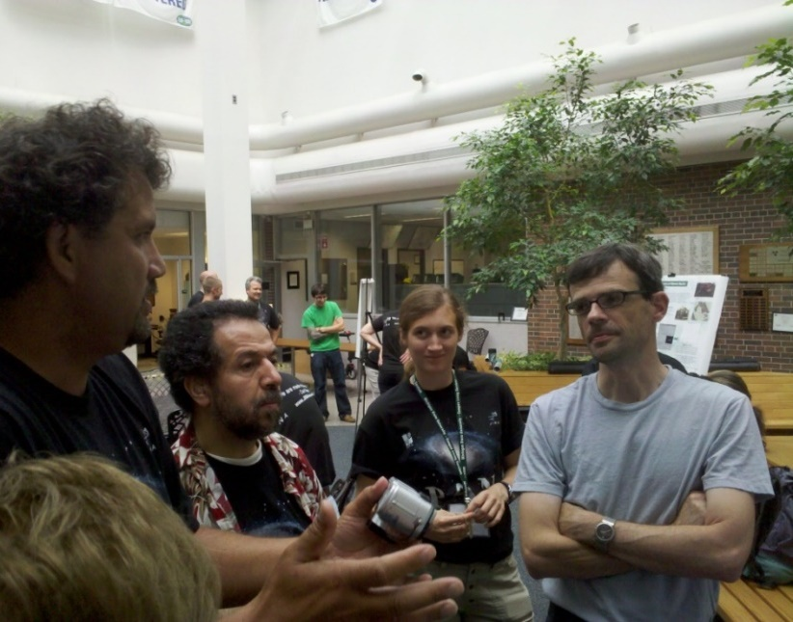
Physics of Atomic Nuclei (PAN)
For science teachers and current high school students
Separate one-week residential summer camps
Teachers gain knowledge, experience, and demo tools to teach nuclear science
Students discover career opportunities in science and envision themselves as researchers at the college level and beyond
FREE

Slide 19
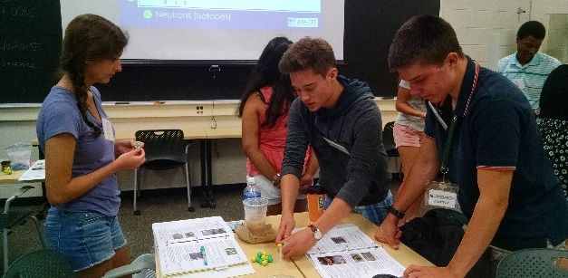
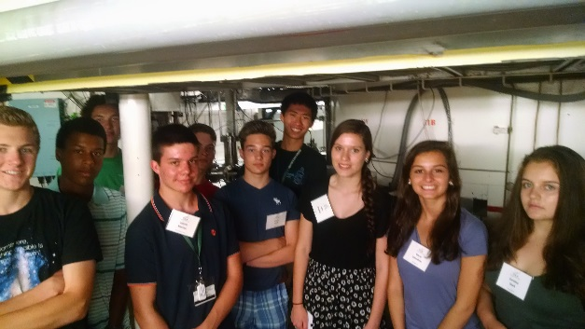
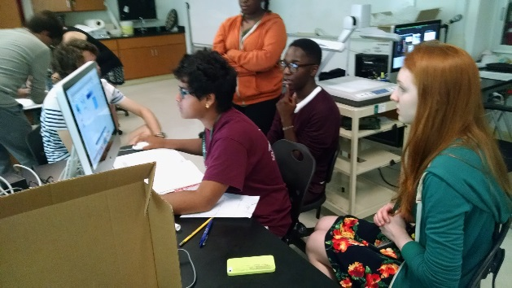
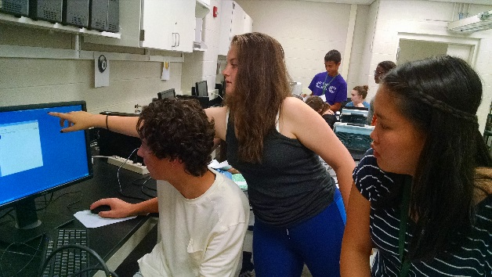
PAN Activities
Learn about research in one of the top rare-isotope laboratories in the world – talks by research faculty
Get introduced to the fascinating fields of astrophysics, cosmology, and nuclear science – trained by experimentalists
Perform your own nuclear physics experiments – has included cosmic ray detection, gamma spectroscopy, half-life estimation, theoretical modeling
Experience one of the biggest universities in the country – eat, sleep, and live on campus

Slide 20
What do students need to apply?
Pre-application
Personal & Contact Information
Contacts of two teacher recommenders
Recommend doing this early so teachers have more time
Application
NO grades, NO test scores
How much math/science are they taking?
What organized activities make them a good candidate? (camps, clubs, science teams, etc.)
What informal activities make them a good candidate? (hobbies, what they read, things they do on their own)
Statement of Interest – WHY do they want to attend PAN?
Looking for MOTIVATION to learn/pursue science
Teacher Recommendations
Form is automatically emailed
Email may get filtered/put in spam – students should make sure teacher got it!
Multiple-choice rate the student on several attributes
Comments (can copy/paste letter)

Slide 21
PAN Important Dates
Applications open December – March
Applicants informed late April
PAN@ND scheduled for late June
PAN@MSU
Science Teachers scheduled for mid-July
HS Students scheduled for late July (following week)

Slide 22
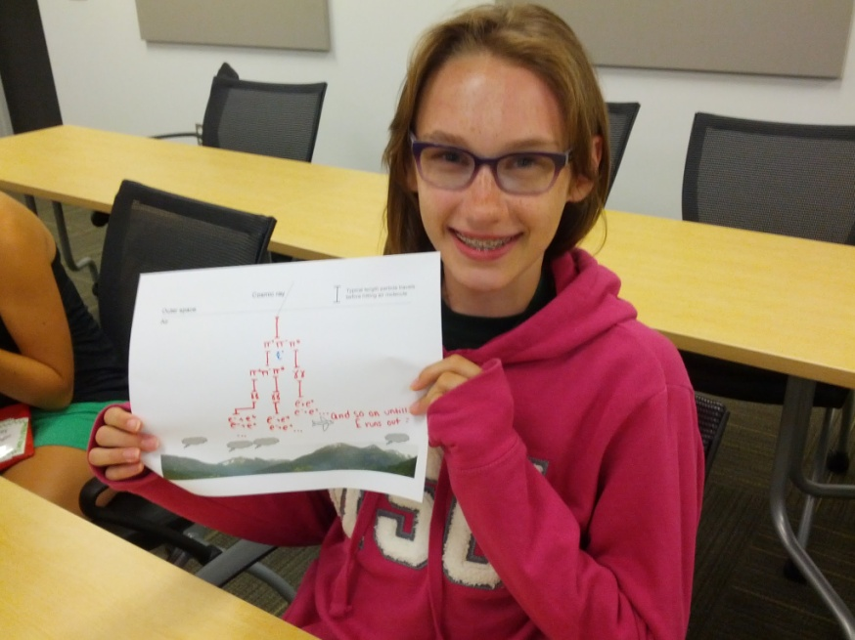
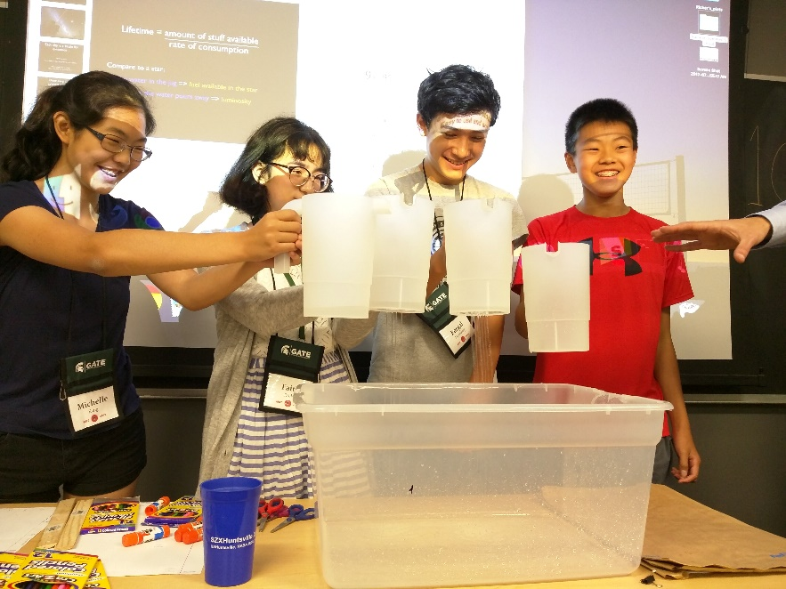
MST @ MSU: a younger crowd
MST@MSU is a summer camp for high-achieving middle-school students run by MSU Gifted and Talented Education (GATE)
One week for grades 7-8
Two weeks for grades 9-10
JINA/NSCL faculty & staff provide a Nuclear Astrophysics course
This course is very similar to PAN in scope, though the content is slightly lower-level.
https://gifted.msu.edu/programs/summer-programs/mstatmsu
NOT free - there IS a fee, but also scholarships!

Slide 23
MST@MSU details
Students choose two academic classes and one workshop
Academics: nuclear astrophysics, genetics and biotechnology, neuroscience, chemistry, physics…
Workshops: soccer, archery, anime, cooking…
All content is rigorous, beyond normal middle school level, and includes active learning in interdisciplinary fields
Students gain new perspective on career opportunities and real-world problem solving
Evening and weekend activities (field games, dance…)
Resident advisors escort students, ensure their safety, and contribute to team building
Students can stay on-campus or commute (at a savings)

Slide 24
Requirements for MST@MSU
Students must submit the following with their MST application (deadline early May):
ACT or SAT scores of at least:
ACT: Math 19 or Composite 20
SAT: Math 550 or Reading & Writing 560 or SAT Total 1090
Recommendation Form from their current math or science teacher
Most recent grade report
Essay (why they want to participate & why they should be selected)
Costs
Application fee: $100
MST@MSU Tuition
2-week program: $2k for residential, $1k for commuter
1-week program:
Need-based aid is awarded based on family income using the Federal Eligibility Guidelines for Reduced Lunch.

Slide 25
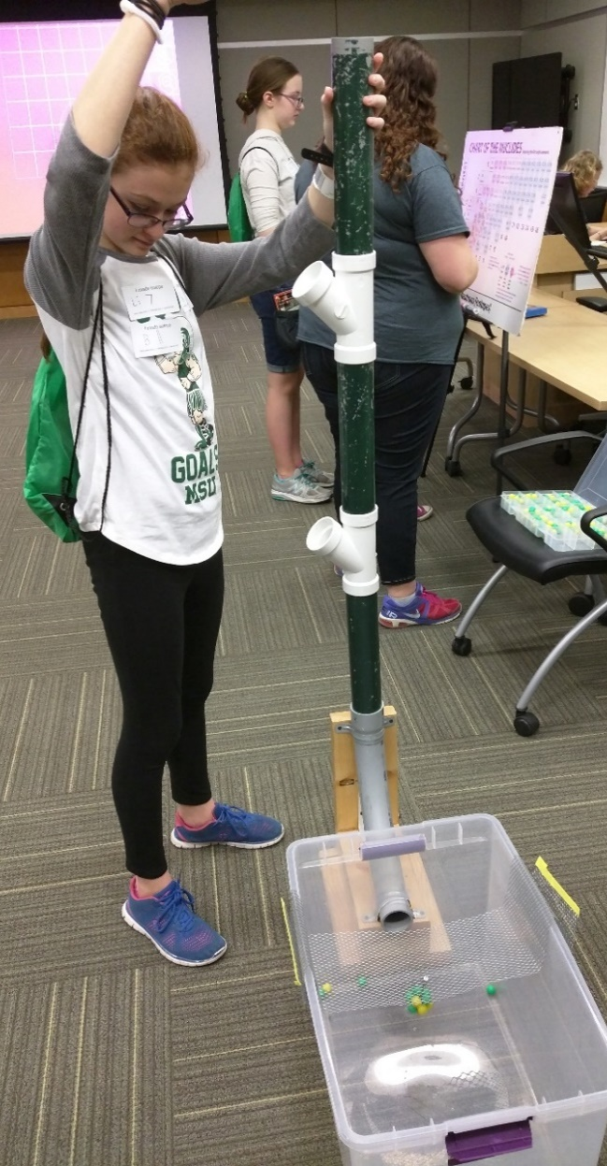
GUPPY – for elementary students!
Grades 3-4 and 5-6
One weekend of accelerated exploration
Parents can accompany them at meals
Students who choose the Astronomy track will attend:
Nuclear Astrophysics lesson with marble nuclei
Laboratory tour
And other classes by MSU experts!
$250 tuition (includes breakfast and lunch for student and parent on both days)

Slide 26
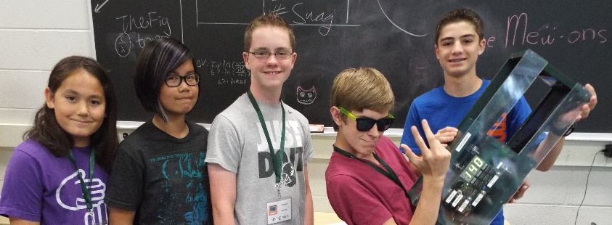
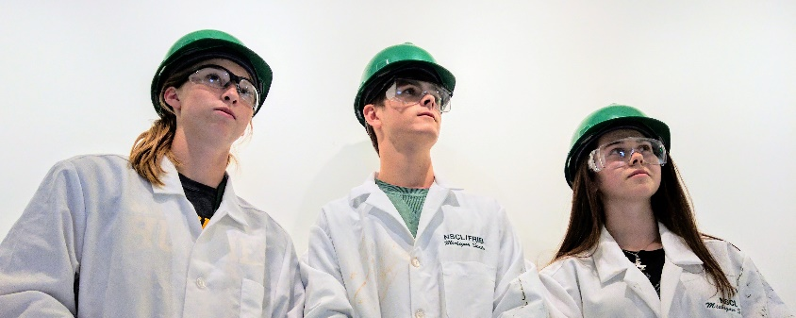
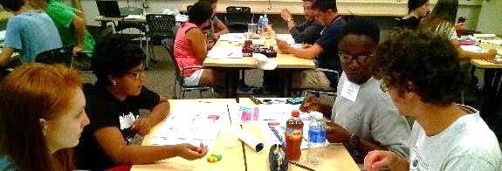
Advantages of summer programs
Students in the pipeline, discovering entirely new paths!
MST alumni are developing a new interest in physics and astronomy, many go on to attend PAN
PAN alumni are 9x more likely than their peers to major in STEM, and 8x more likely to pursue a STEM career (Journal of Higher Education Outreach and Engagement v19 (2) p.117)
Many PAN alumni choose to attend MSU
Mostly majoring in physics/astronomy, some engineering
Nearly all are involved in research, about half employed at NSCL

Slide 27
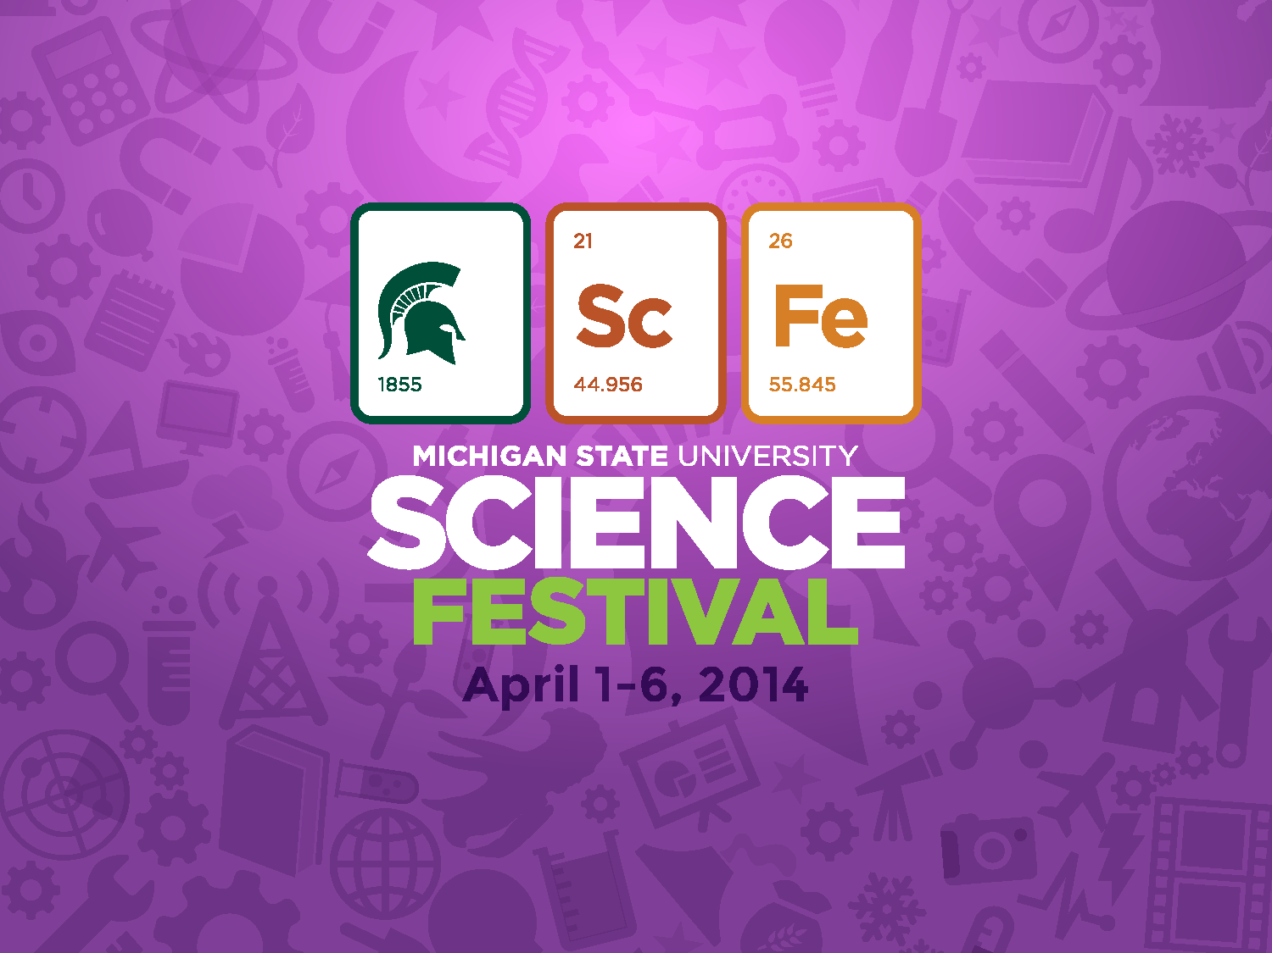
FREE
Annually in April
sciencefestival.msu.edu

Slide 28
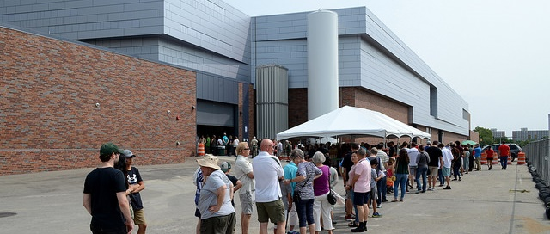
Behind the scenes with Rare Isotope Beams
FRIB OPEN HOUSE
SHAW LANE
FREE
Every 2-3 years
TOURS of the tunnel and experimental areas
Hands-on DEMONSTRATIONS
TALKS by nuclear scientists
More information to be announced at frib.msu.edu

Slide 29
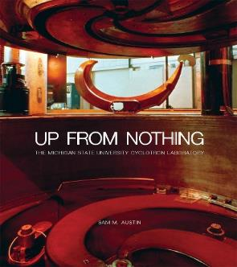
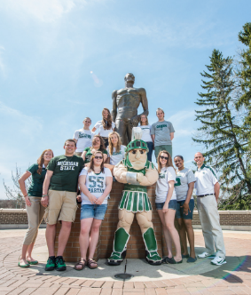
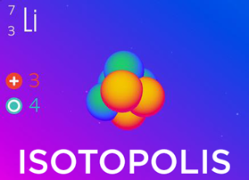
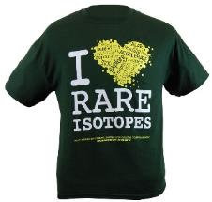
National Superconducting Cyclotron Laboratory at MSU
Learn more about our Lab and outreach programs
Get our just-published history Up From Nothing from MSU Press msupress.org or on Amazon
SPARTAN YOUTH PROGRAMS
Find camps and programs at MSU for
pre-college students: spartanyouth.msu.edu
Get the Android/ iPhone/iPad game Isotopolis for free!
Visit our “Gift Shop” on shop.msu.edu (click on “NSCL/FRIB” under “Specialty Shops”)
GIFT SHOP
contact visits@nscl.msu.edu or go to nscl.msu.edu
@nscl

