Slide 1
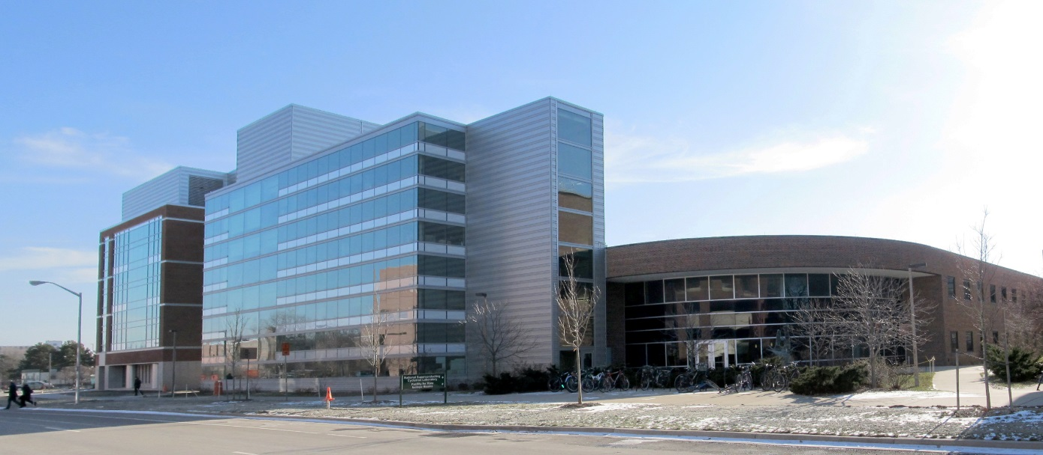
NSCL Nuclear Research at MSU
A world-class facility for nuclear experimentation and theory
NATIONAL
SUPERCONDUCTING CYCLOTRON LABORATORY
ISO 9001, ISO 14001, OHSAS 18001 registered

Slide 2
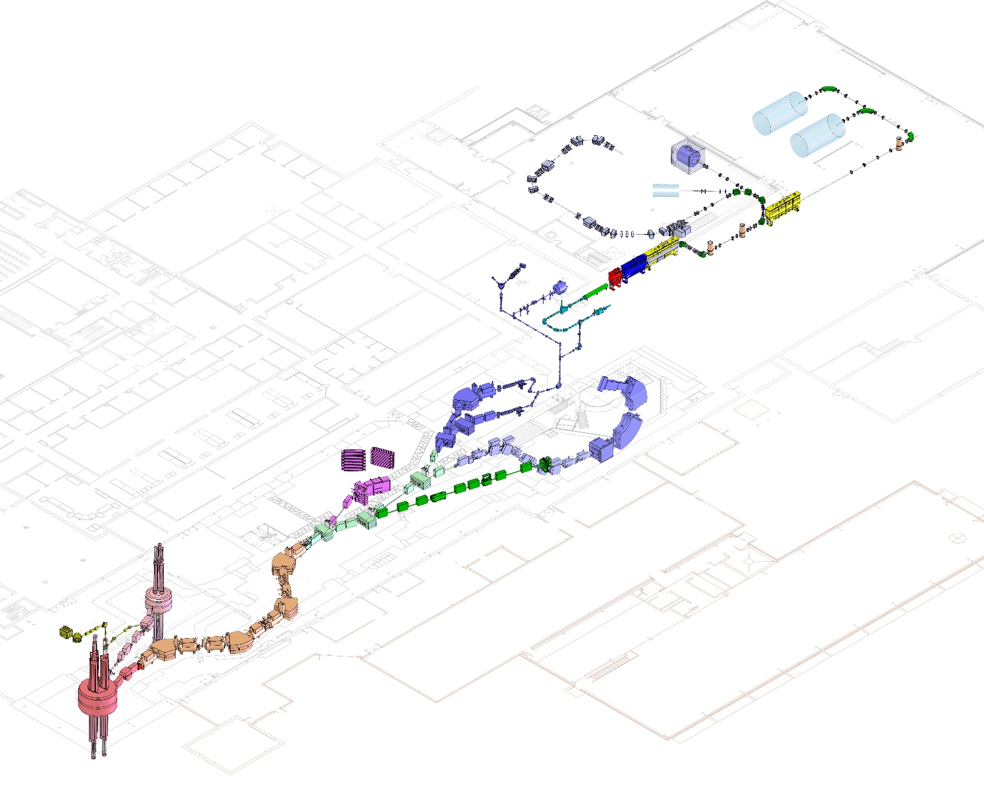
LEADING SCIENTIFIC ADVANCEMENT
Coupled cyclotron facility and experimental beam lines
A person
~140 meters (450 feet) long
Five stories tall

Slide 3
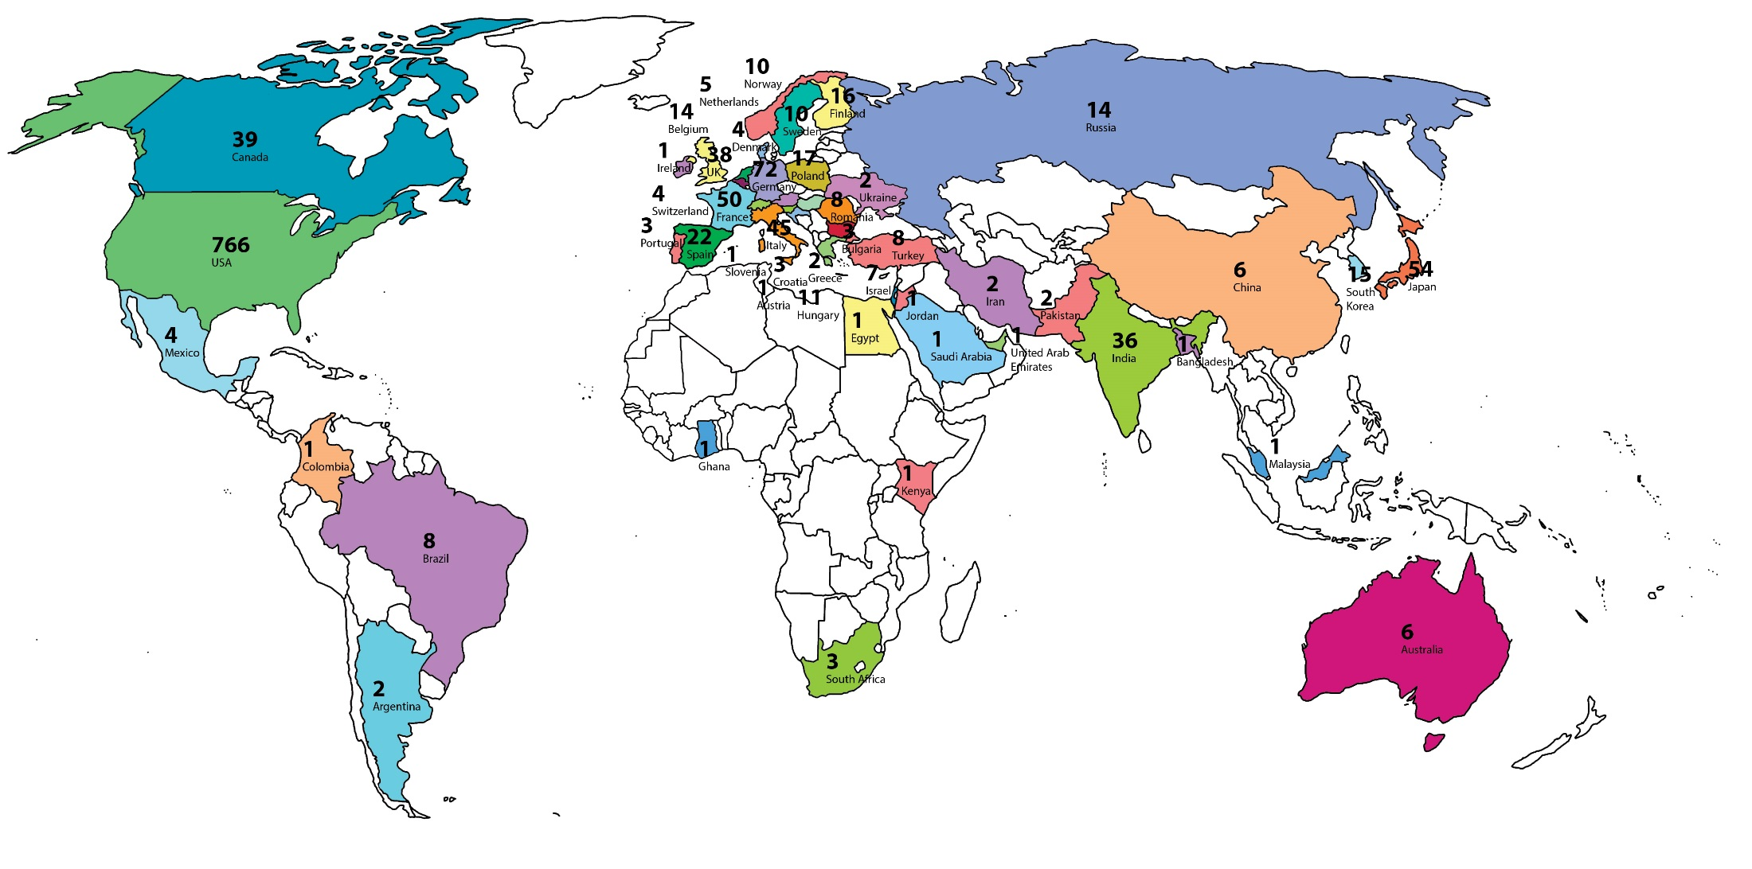
SERVING USERS
NSCL is a world class research facility, supported by the National Science Foundation (NSF), that hosts the best nuclear scientists from the US and the world.
NSCL User Community
April 2013

Slide 4
WHO IS NSCL?
500+ employees
Our employees have backgrounds in nuclear science, physics, chemistry, all types of engineering, computing, mathematics, etc. We represent most fields of Science, Technology, Engineering and Math (STEM).
Research and development scientists/engineers
Faculty researchers
Facility operators
Undergrad students
Graduate
students
Technicians, engineers & machinists

Slide 5
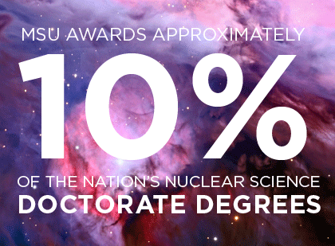
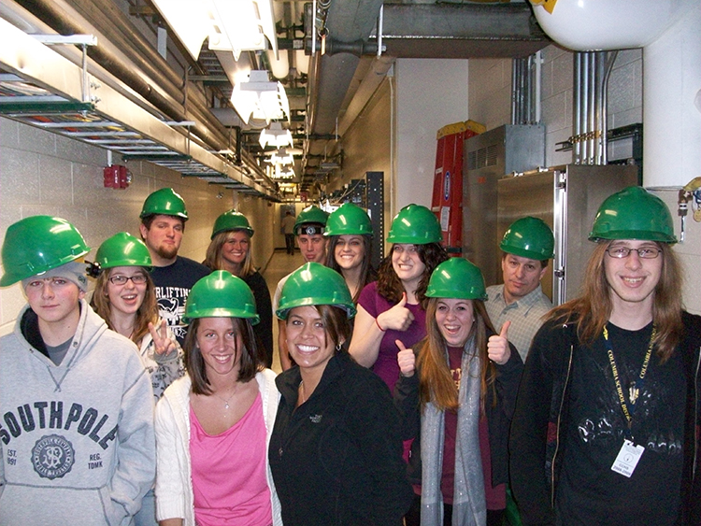
EDUCATION AND OUTREACH
NSCL has the
#1 ranked nuclear science program
among US graduate schools
(U.S. News & World Report, 2014)
NSCL Outreach offers:
Tours for the general public
Summer research programs for middle & high school students
Nuclear science experiments and lessons for teachers to use
For more information online: www.nscl.msu.edu/outreach

Slide 6
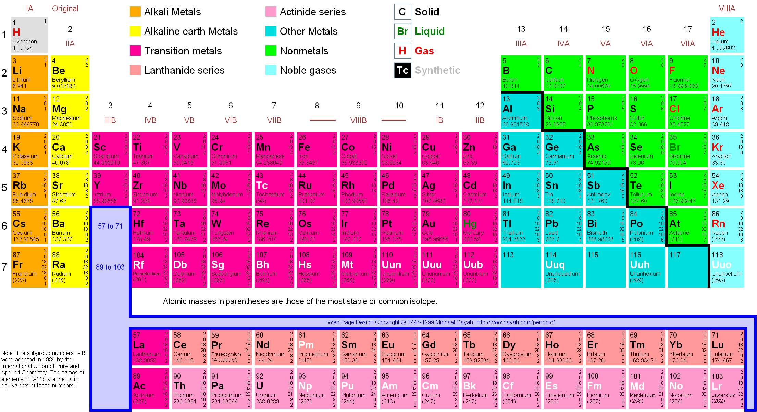
Periodic Table of the Elements
Each element (such as carbon) comes in
many varieties, some common, some rare

Slide 7
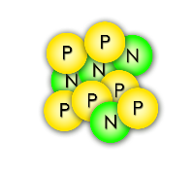
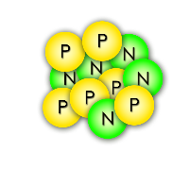
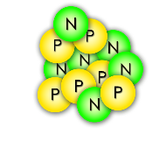
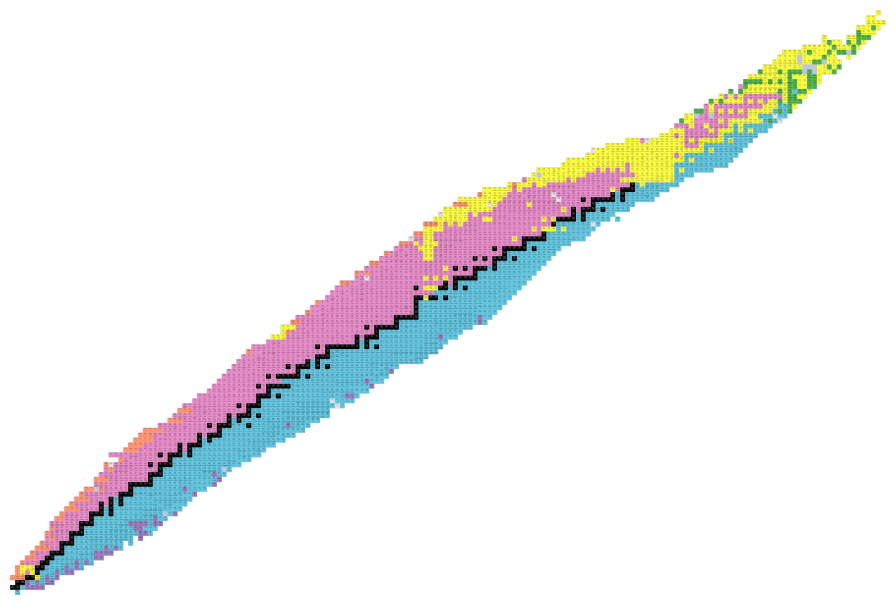
Isotopes: varieties of an element
Carbon-10
Carbon-11
Carbon-12
Protons (Elements)
All of these carbon isotopes are chemically identical, but different numbers of neutrons gives them diverse nuclear properties
Neutrons (Isotopes)

Slide 8
Our mission: study rare isotopes
Black boxes are stable isotopes of an element.
Protons (Elements)
Neutrons (Isotopes)
Colored boxes are unstable, often rare isotopes of an element. These have too many or too few neutrons to be stable.

Slide 9
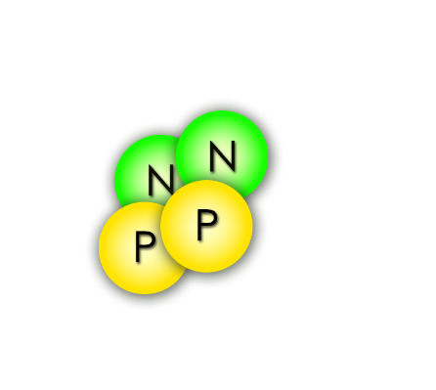
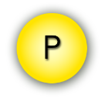
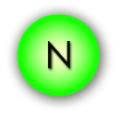
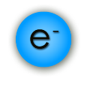
Radioactive, rare isotopes decay
Alpha particle (He nucleus)
Proton
Unstable nuclei are radioactive, meaning they will decay (come apart)…
Gamma ray
Neutron
Electron (β⁻ particle)
…and give off radiation
of some kind!
Isotopes studied at NSCL have short half-lives (< 1 s)

Slide 10
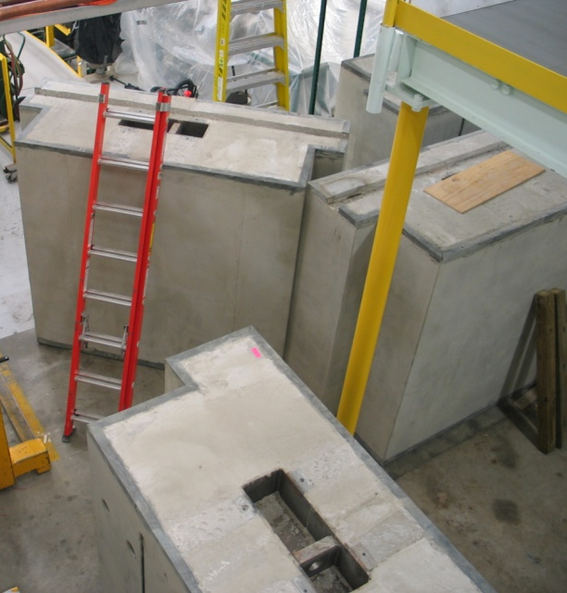
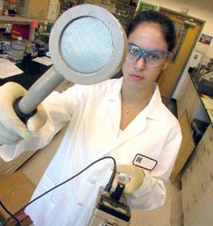
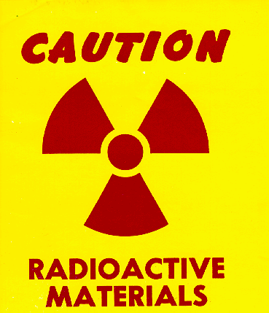
Radiation Safety
Shielding
Surveying
Labeling
and Training
NSCL takes radiation safety seriously,
and has met NRC license standards for over 50 years
Fact: NSCL has fewer radioactive sources than a major hospital
Notes:
In our lab, we use 6-foot-thick concrete to stop radiation from escaping. We’re also very careful to scan for radioactivity and train people how to handle it safely. We checked the tour route to make sure that the radiation levels were safe for you. Radiation is not dangerous when you treat it with respect and know how to manage it. In fact, I walked around the tour route before you got here with a radiation detector to make sure it was safe.

Slide 11
Radiation Exposure and You
Radiation source | Dose
Average exposure for general public (natural + medical) | > 300 mRem/yr
Government (NRC) exposure limit for lab visitors | 100 mRem/yr
NSCL/FRIB ALARA goal for visitors | 10 mRem/yr
Your visit today | < 1 mRem
Dental x-ray | 1-2 mRem
Smoking a pack of cigarettes | ~2 mRem (800 mRem/yr)

Slide 12
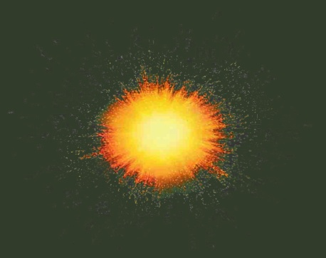
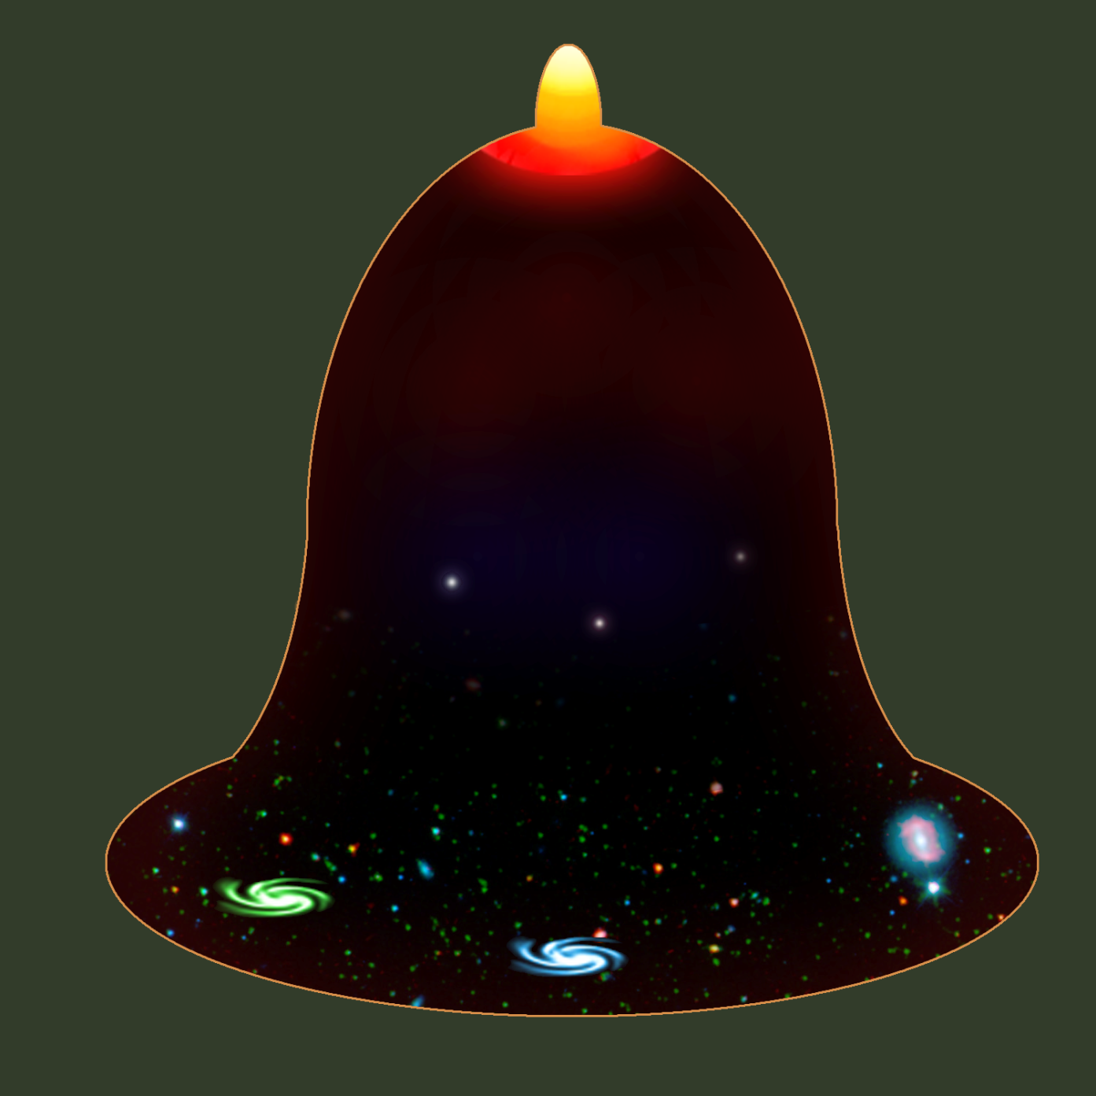
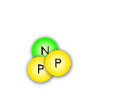
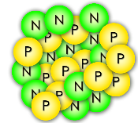
How were the elements made?
A Short History of
the Universe
A spectacular explosion of energy in an empty universe… the Big Bang !!
Inflation
The first nuclei are made: Hydrogen and Helium
1.8 Billion ºF
Slowing expansion
4 min after Big Bang
Stars fuse light elements into heavy ones, up to iron
…
Formation of the first stars
One billion years after Big Bang
helium iron
440 ºF
Supernova explosions may add lots of neutrons to iron, making unstable isotopes that will decay into heavier elements!
Accelerating expansion
-450 ºF
Now

Slide 13
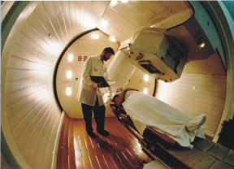
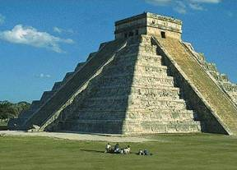
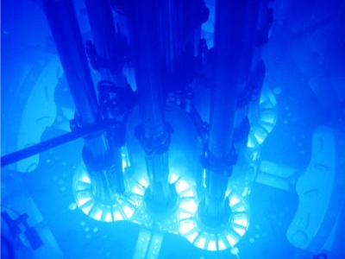
Why study rare isotopes?
Nuclear Medicine
Archeology/Geophysics
Nuclear Power
What we learn about the nucleus can generate new ideas and technologies in the fields of space science, airport security, biology/ecology, etc.

Slide 14
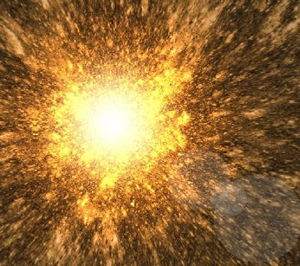
How to make unstable nuclei
NSCL’s Coupled Cyclotron Facility

Slide 15
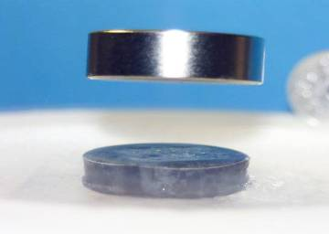
Superconductivity
NSCL cyclotrons use electromagnets made from niobium-titanium wires.
At liquid helium temperatures (-269 °C , -450 °F), these wires become superconducting, which means they have zero electrical resistance.
This allows us to make small, powerful electromagnets used to direct and control nuclei!
Superconductors also repel magnetic fields
magnet
superconductor
liquid nitrogen used to cool the superconductor

Slide 16
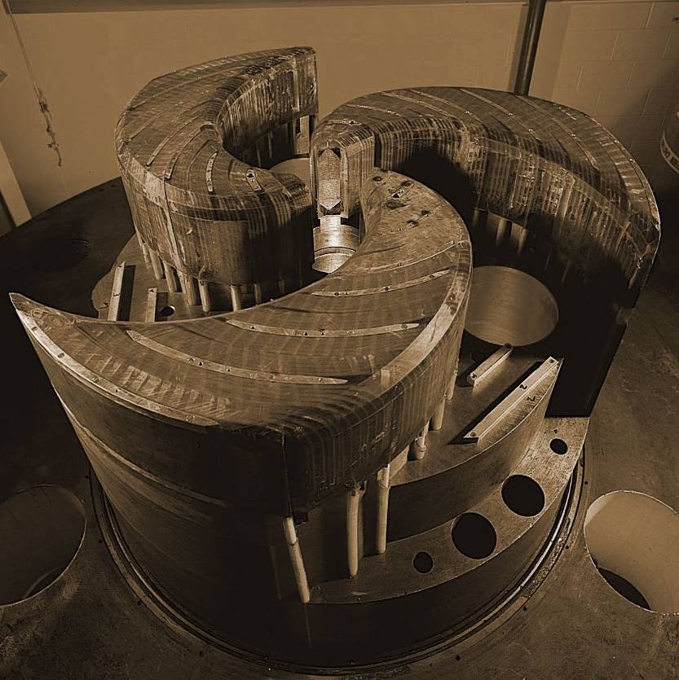
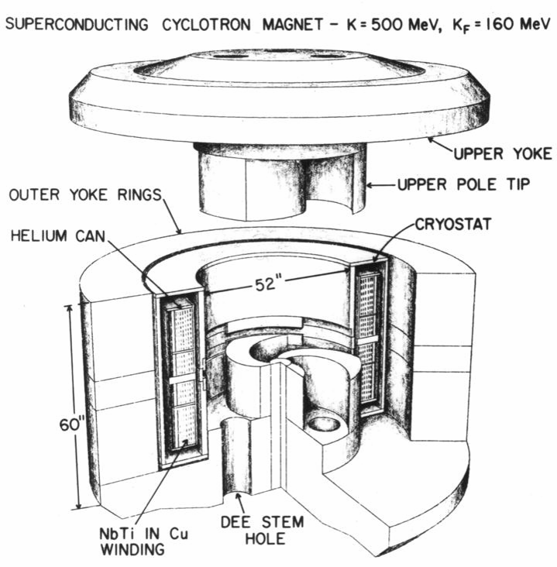
The cyclotrons
World’s first superconducting cyclotron
World’s second-highest-energy superconducting cyclotron
K500
K1200
Year completed: 1982
Diameter: 10 ft Weight: 100 tons
Magnetic field: 3-5 Tesla
Maximum energy it can impart to a proton: 500 MeV
Year completed: 1988
Length of superconducting wire: 38 mi
Time of acceleration: 0.000035 seconds
Distance a nucleus travels while inside: 1.9 miles (700 revolutions)

Slide 17
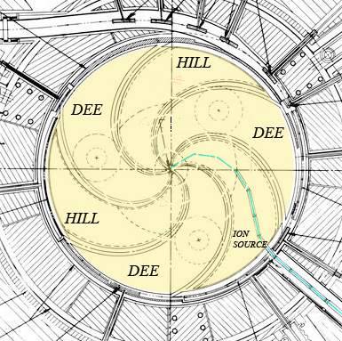
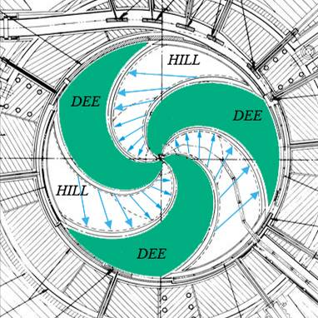
The cyclotron principle
When “normal” ions are injected into the center of the cyclotron, the magnetic field bends the path of the charged nuclei into an orbit
The “Dees” alternate a negative electric potential to create an electric field that accelerates the nuclei until they leave the cyclotron in a beam

Slide 18
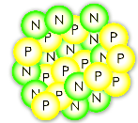
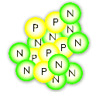
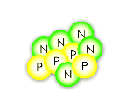
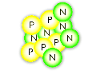
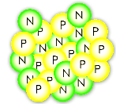
Fragmentation
BEAM at < 0.5 c
strikes foil TARGET
exits with FRAGMENTS
¹⁸O
¹⁸O
¹⁸O
¹⁸O
¹⁸O
¹⁸O
¹⁶C
⁹Be
or
¹¹B
The accelerated beam consists of the one stable isotope provided by the ion source
(>1 billion nuclei/second)
Very few beam nuclei hit a nucleus in the target and break, becoming a new element/isotope
¹⁷O
After the target, the beam contains many new isotopes (sometimes <1 desired nucleus/second)

Slide 19
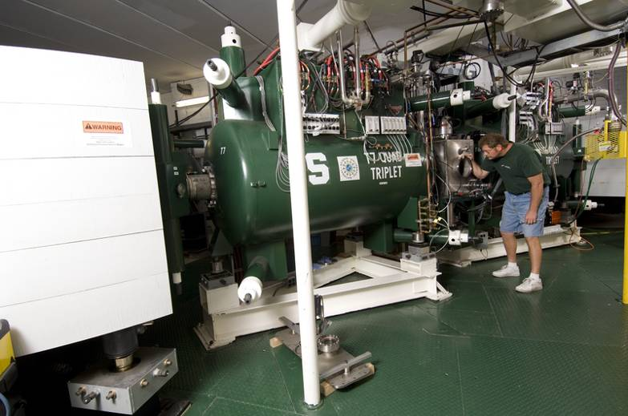
Fragment separator
Beam fragments on target
Rare isotope beam leaves A1900
Dipole magnets filter beam
Wide variety of isotopes enters A1900
The wedge-shaped dipole magnets affect different isotopes like prisms affect light, separating the unwanted nuclei (of any isotope not currently being studied) out of the beam

Slide 20
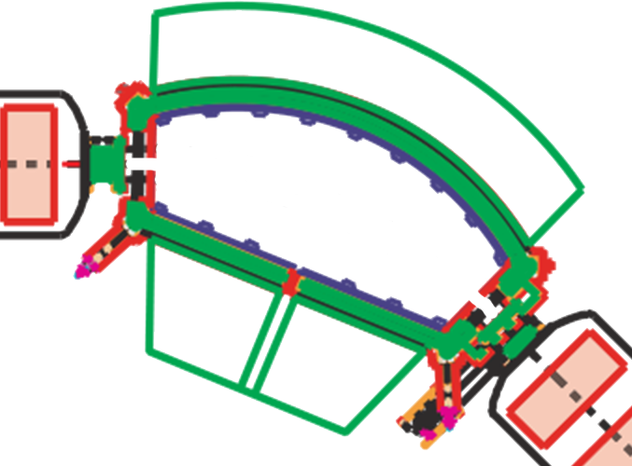
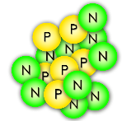
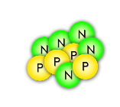
Selecting one rare isotope
Some nuclei turn too little
¹⁶C
Some nuclei turn too much
The magnetic field is just right to steer nuclei of the desired isotope through!
A dipole magnet

Slide 21
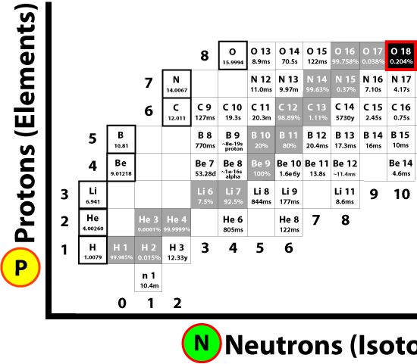
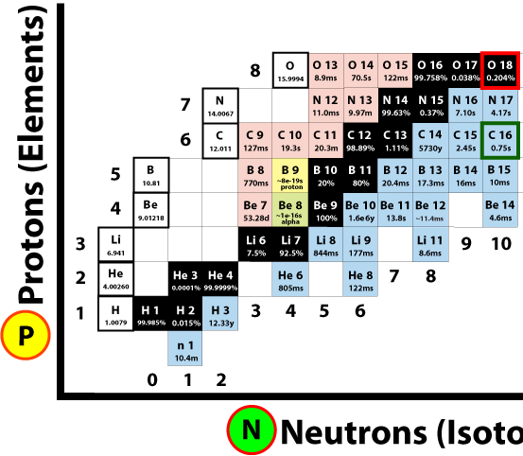
The A1900 fragment separator
Primary (stable) Beam
Fragmented Beam
Fragmentation on target
Secondary (unstable) Beam
C-16
C-16
C-16
Primary (stable) Beam >1 billion nuclei/second
Beam after fragmentation (mostly stable, some rare)
Beam after separation (fewer rare isotopes)

Slide 22
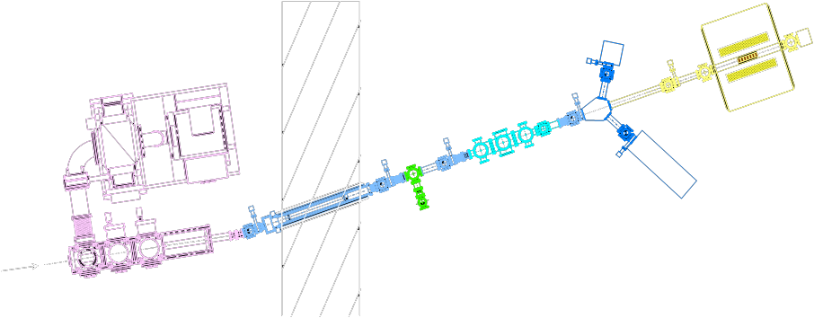
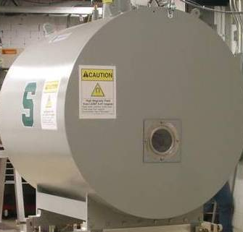
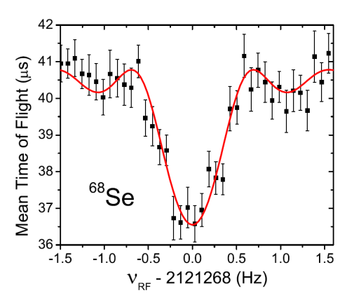
Measuring rare isotopes
Nuclei arrive in a magnetic trap and orbit in a circle.
Beam “bunching”, one or a few nuclei pass at a time
“LEBIT” 9.4 T Penning Trap
Beam
Fast beam is stopped in helium gas
Orbits per second depends on the nuclear mass; find the frequency to weigh one nucleus at a time!
The mass of selenium-68 strongly affects type I x-ray explosions on neutron stars
Notes:
Knowledge of radioactive masses helps us better understand fundamental forces, how neutrons and protons bind together, and explosions in the universe in which elements are created. One kind of stellar explosion, type I x-ray bursts, depends on certain nuclei like ⁶⁸Se.

Slide 23
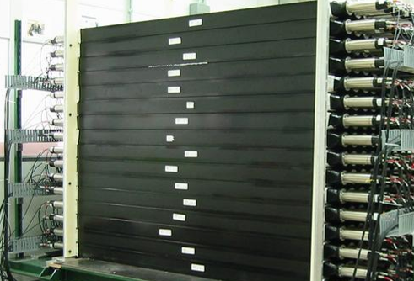
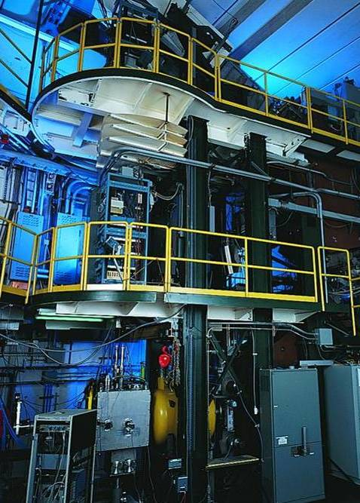
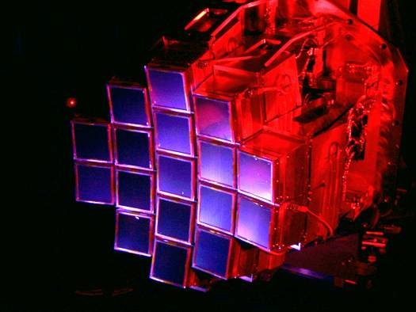
Detectors
MoNA
“Halo nuclei” and neutron-rich isotopes
S800 Spectrograph
Nuclear states from particles freed in collisions
HiRA
Nuclei found in stellar reactions
How do you measure something you can’t see?

Slide 24
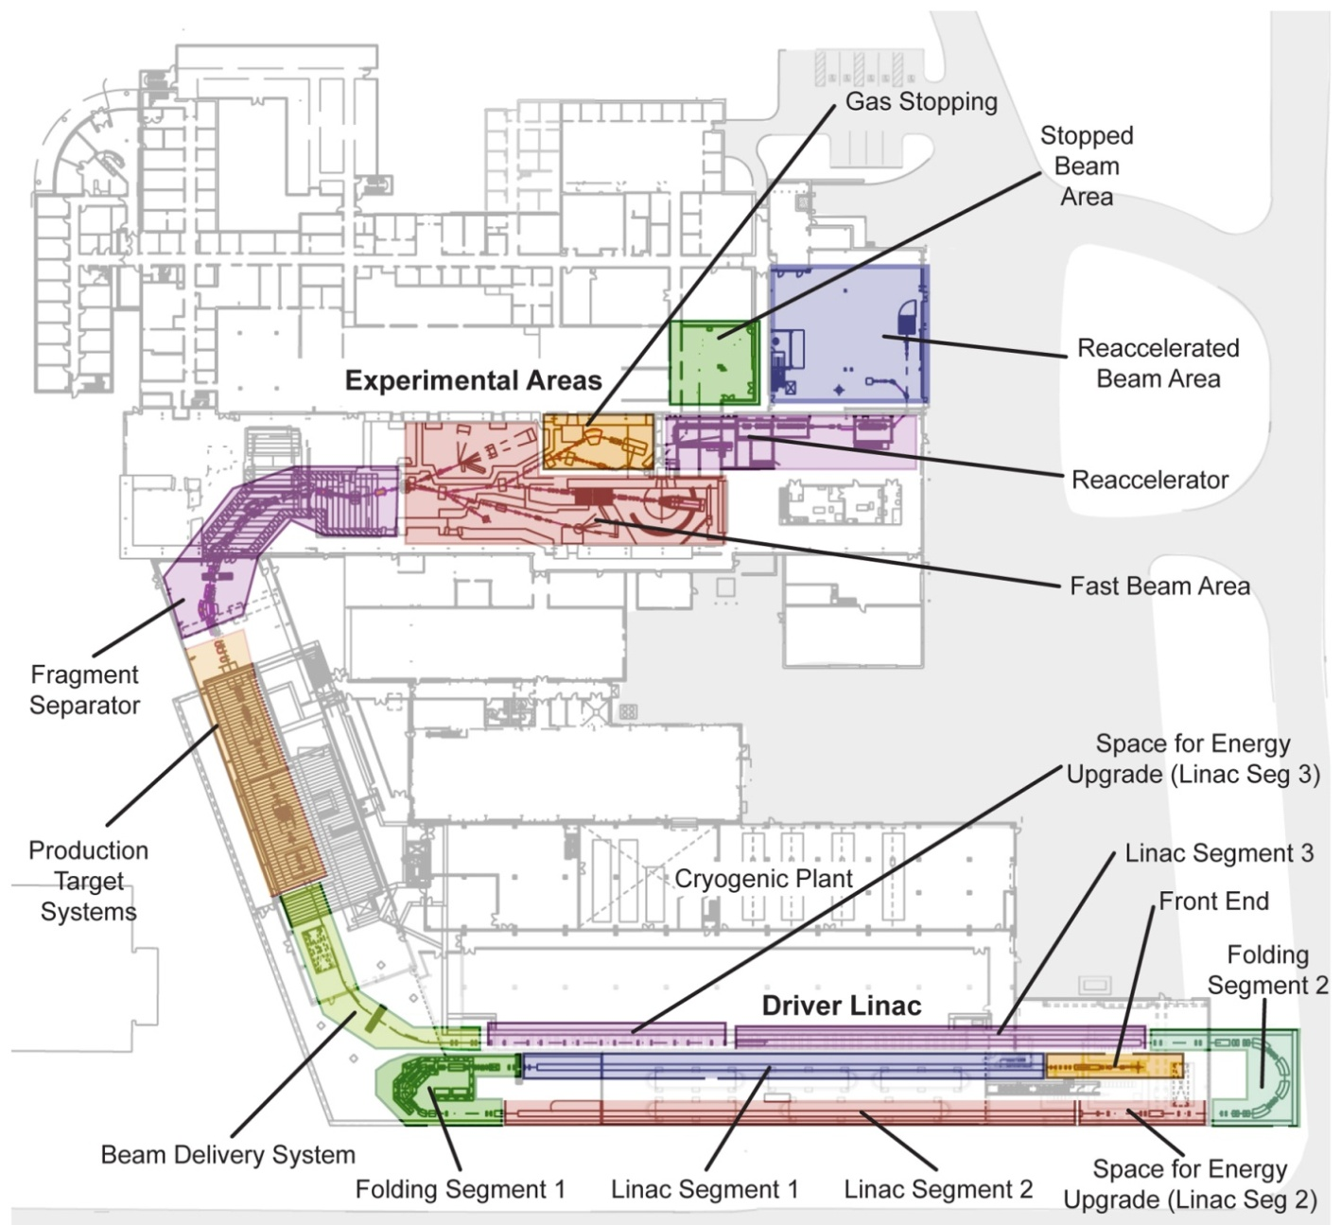
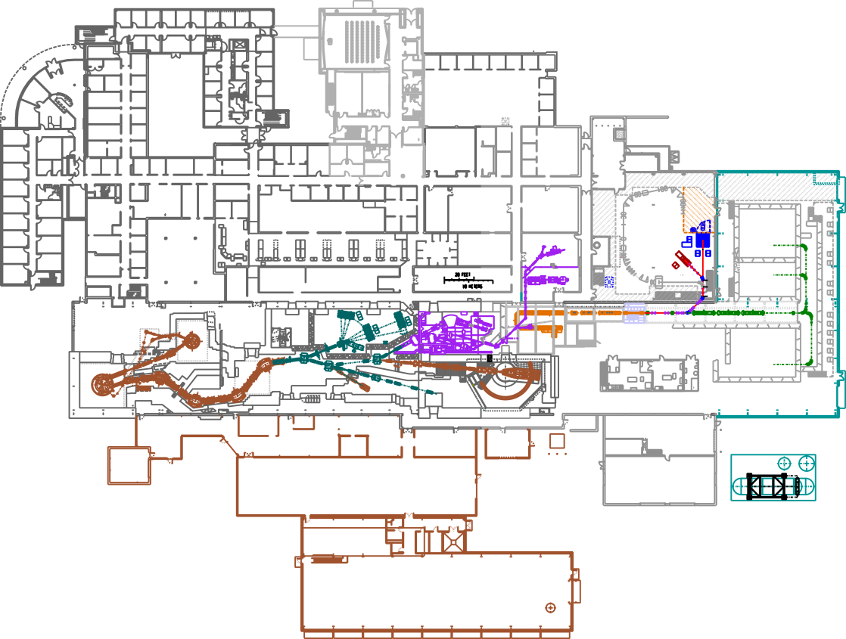
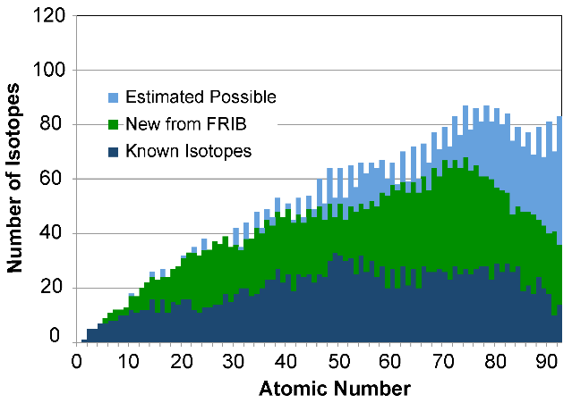
FRIB: Facility for Rare Isotope Beams
FRIB design
MSU has been chosen as the site for FRIB: a $730 million US Department of Energy project to design and establish a world-leading laboratory over the next decade. Civil construction is ongoing, completion by 2022 at the latest.
NSCL today
Notes:
400-yard linear accelerator will replace cyclotrons, producing nuclei with twice the energy and thousands of times more rare isotopes per second
Many additions to the building for personnel, cryogenics, research area, etc.

Slide 25
Safety First
No eating, drinking, smoking, chewing gum
Watch your head and step, don’t sit or lean on things
Pacemaker? Beware magnetic fields
Stay with your guide, follow instructions and don’t touch
If you become separated from the tour, dial “0” from any lab phone (“305” after hours) and the receptionist will assist you

Slide 26
National Superconducting Cyclotron Laboratory at Michigan State University
For more information about our lab and outreach programs, contact visits@nscl.msu.edu or go to www.nscl.msu.edu
Visit the “NSCL Gift Shop” online! Go to shop.msu.edu and click on “NSCL” under “Specialty Stores”
Follow us on @nscl
Friend us on
“National Superconducting Cyclotron Laboratory”

Slide 27
FRIB on the MSU campus

Slide 28
Sources of radiation

Slide 29
The Control Room
1997
1982
2003

