Slide 1
National Superconducting Cyclotron Laboratory at Michigan State University
NSCL
PEOPLE WILL PAY YOU
TO LEARN THINGS
and other careers you can do with a science degree
Zach Constan
NSCL Outreach Coordinator

Slide 2
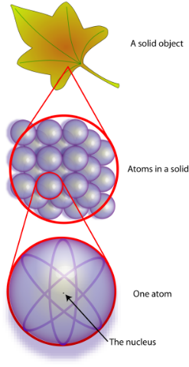
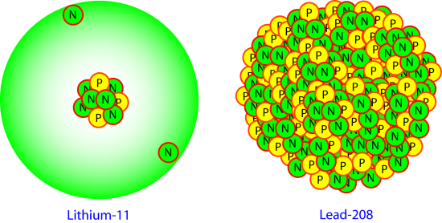
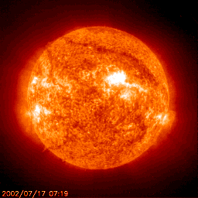
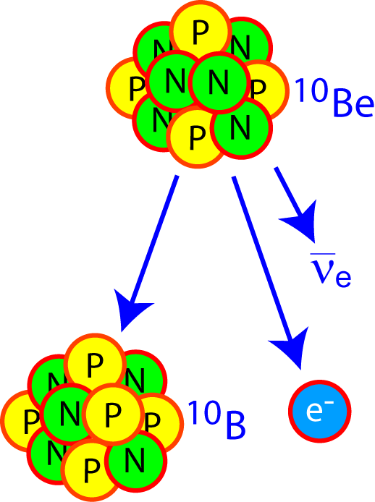
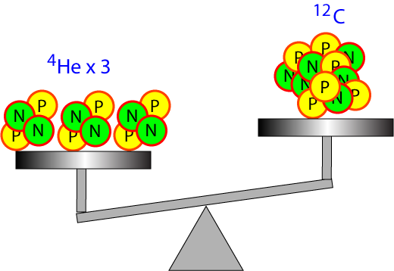
Why are nuclei interesting?
How does matter work?
How many can exist?
Where did the elements come from?
How big are they?
Why are some radioactive and how long do they last?
How much do they weigh?
Questions posed by
nuclear theorists, mathematicians, computer programmers
Notes:
Of course, we also do research because we’re curious. One big mystery we’re trying to solve is where all the different elements came from. H and He were created in the beginning of our universe, after the Big Bang, these were mostly created when stars fused hydrogen into heavier elements for fuel, these are man-made… but the vast majority of elements were made in a lot of strange and complicated ways! One of which: supernovas (exploding stars) form unstable nuclei that later become these elements, so we study the unstable nuclei to understand how.

Slide 3
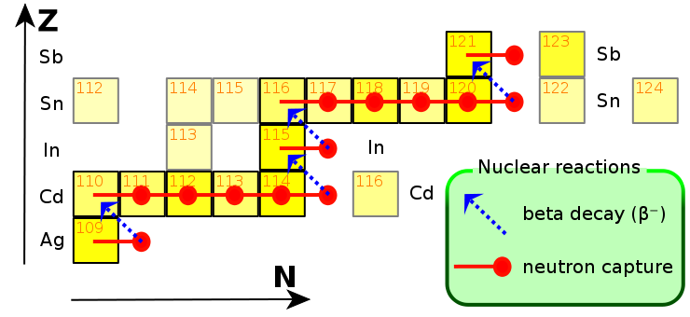
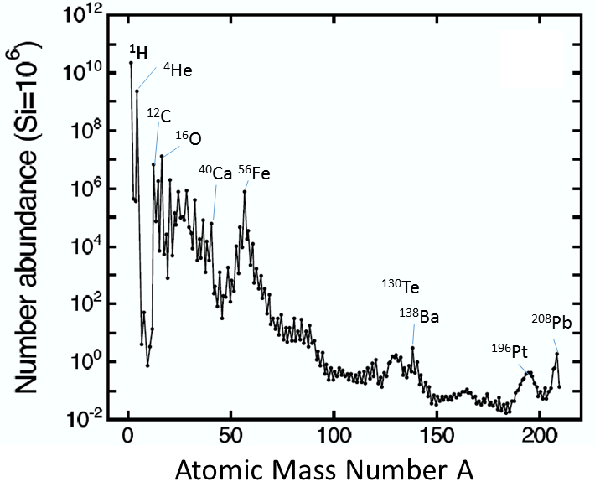
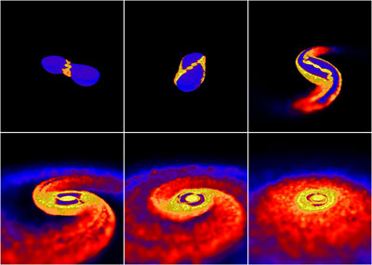
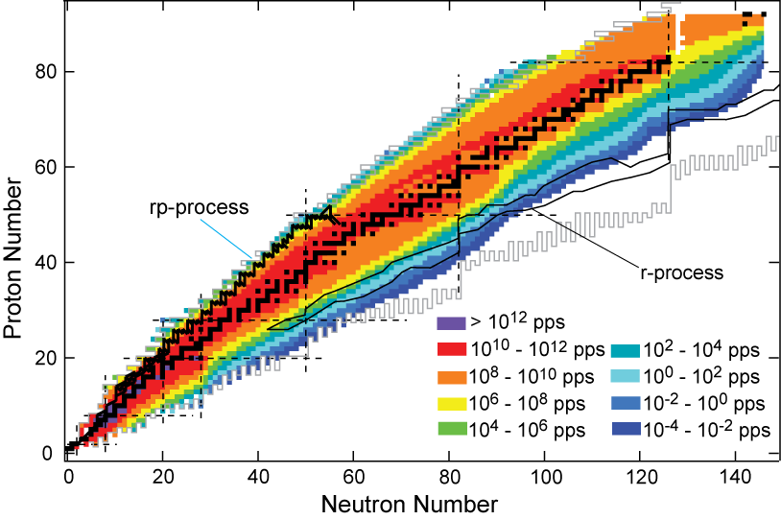
JINA-CEE & That Great Nuclear Science Laboratory in the Sky
THEORY
EXPERIMENT
OBSERVATION

Slide 4
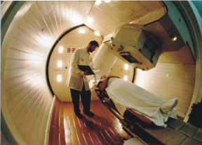
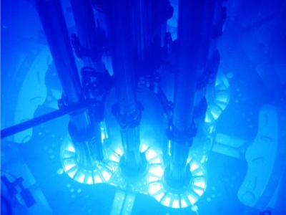
Why would somebody pay for it?
Nuclear Medicine
Archeology/Geophysics
Nuclear Power
Plus: smoke detectors, smartphones, safer food, etc.
What we learn about the nucleus can
save lives and change the world!
Jobs like medical physicist, radiation safety officer, geophysicist

Slide 5
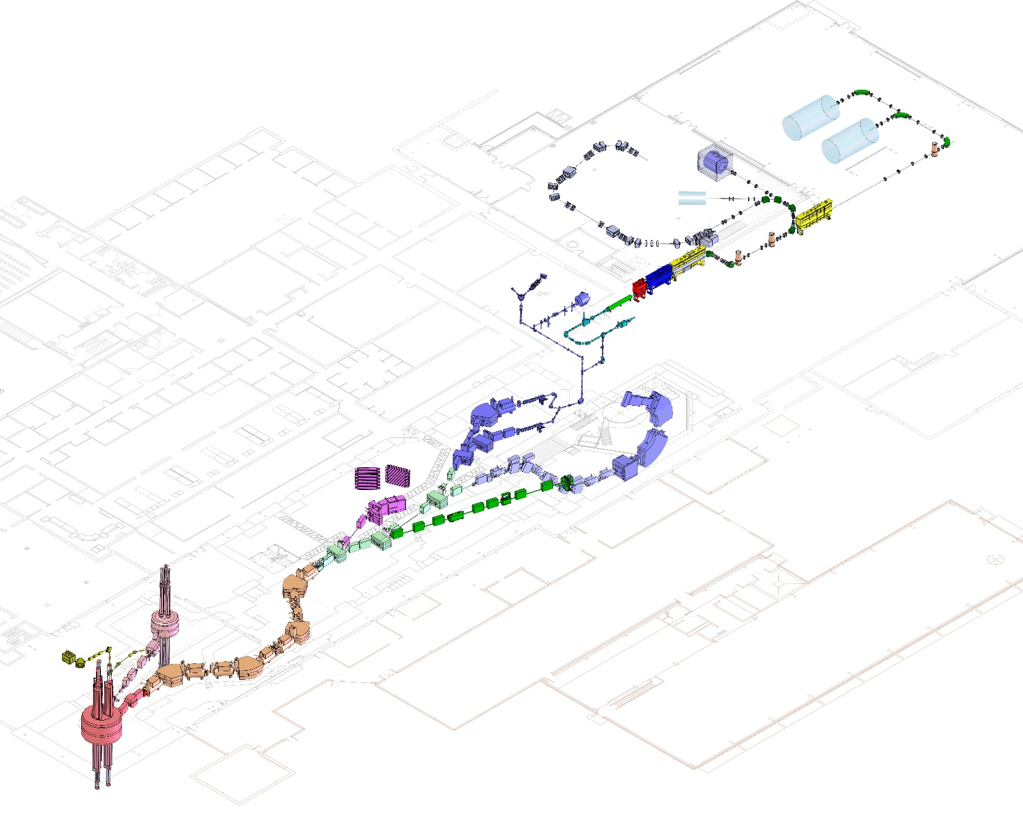
How researchers make rare nuclei
Coupled cyclotron facility and experimental beam lines
Solutions:
SMASH HARD using accelerators
SMASH OFTEN with tons of nuclei
A person
~140 meters (450 feet) long
Made possible by
operations physicists, accelerator physicists and engineers (vacuum, electrical, cryogenic…)
Five stories tall

Slide 6
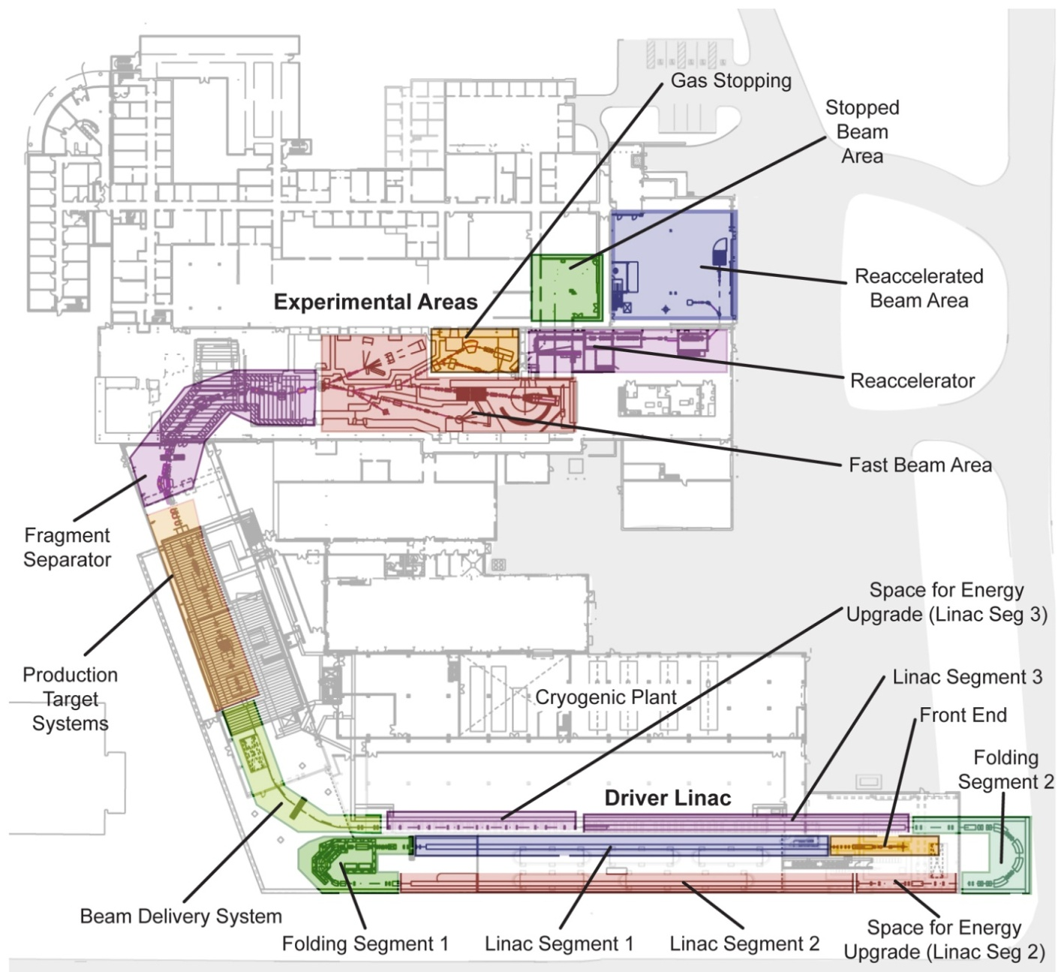
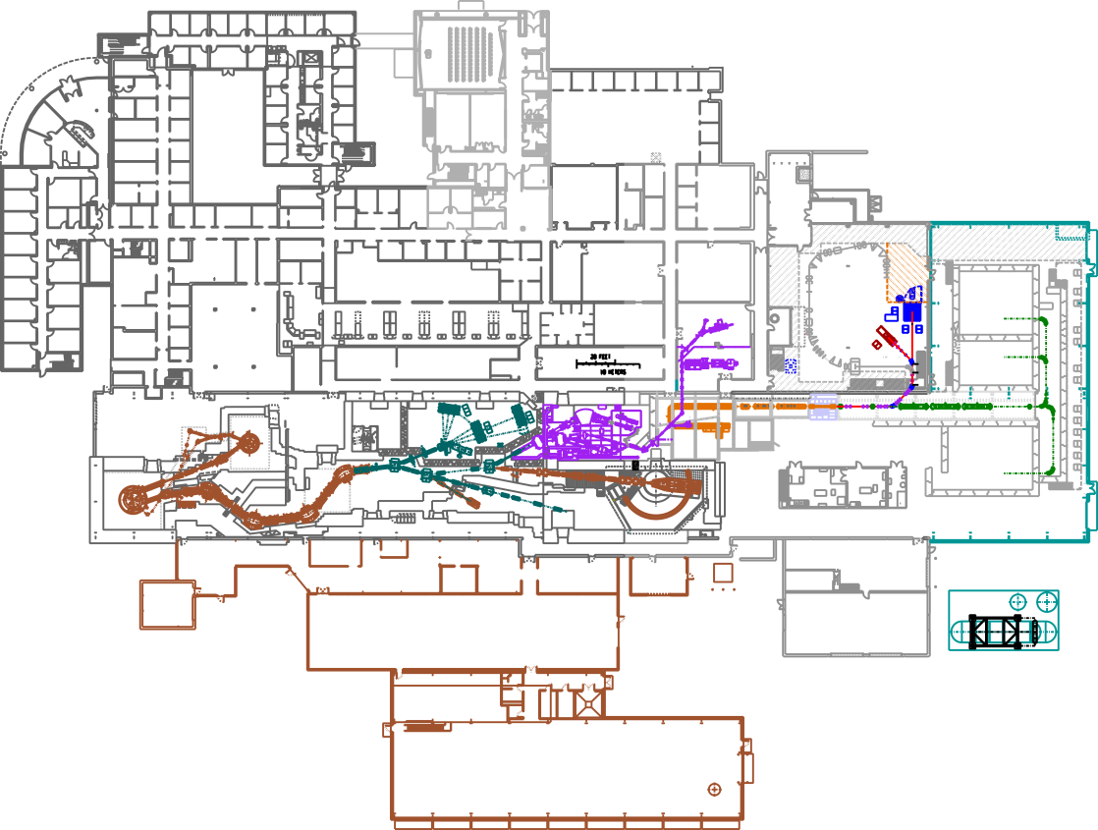
Problem: I want to study EXTREMELY rare nuclei!
FRIB design
Solution: SMASH HARDER, SMASH MORE with $730 million Facility for Rare Isotope Beams
NSCL today
Notes:
400-yard linear accelerator will replace cyclotrons, producing nuclei with twice the energy and thousands of times more rare isotopes per second
Many additions to the building for personnel, cryogenics, research area, etc.

Slide 8
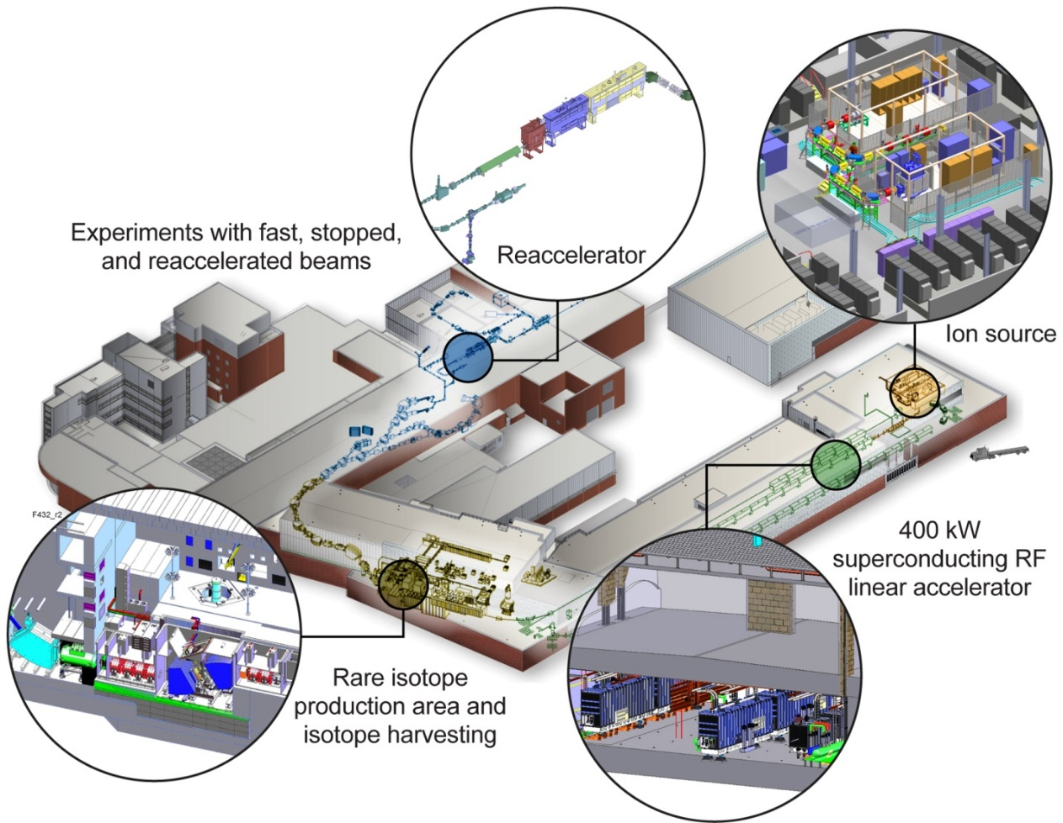
The Future of FRIB
NSCL research continues - Upcoming experiments may offer “pre-FRIB” capabilities
Project engineering and design is nearing completion
User community (1300+) is involved in planning
Civil construction began March 2014
Technical construction began this year
Early completion could be 2021
Always depends on congressional budget approval

Slide 9
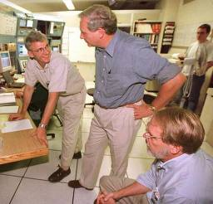
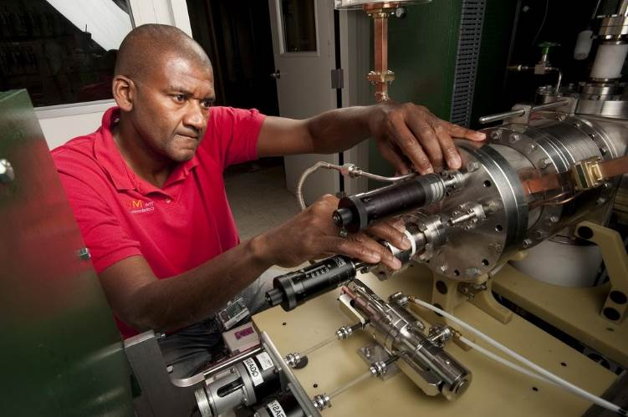
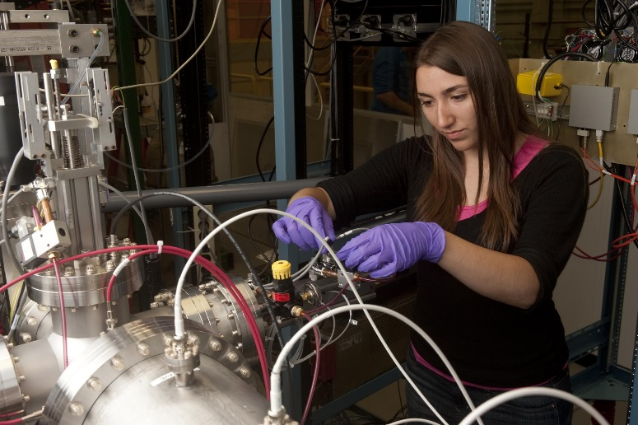
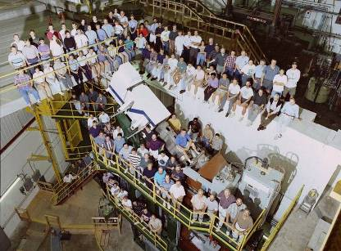
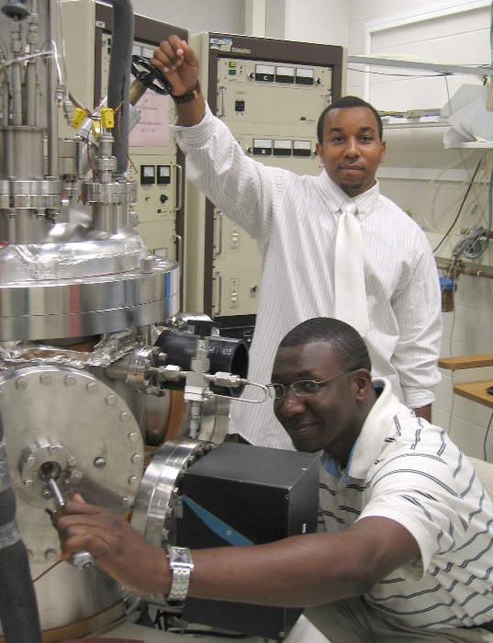
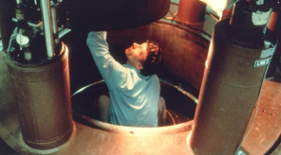
Why science? Lots of options
Faculty/ Directors
Research & Development Scientists/ Designers
Technicians
& Machinists
Which excites you?
Operators
Theorists/
Researchers
System Engineers

Slide 10
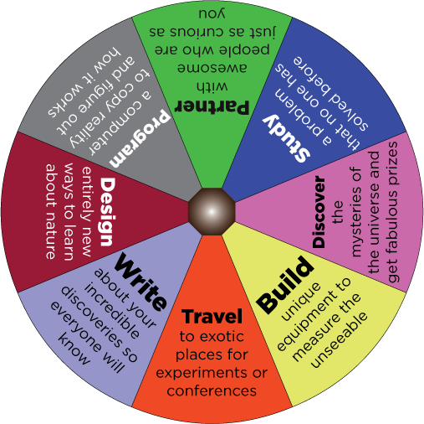
Why science? It’s always new
Spin the Wheel
Of Science!
What are you doing today?

Slide 11
Why science? It will take you places
People with degrees in science (physics!) know how to
And the skills learned in science happen to be useful in
Design/Build
Program
Think Logically
Work on a Team
Communicate
Invent New Things
Understand Information
Solve Problems
Teaching
Research
Law
Medicine
Journalism
Government
Finance
Industry…
(and that’s why the unemployment rate for scientists is so low)

Slide 12
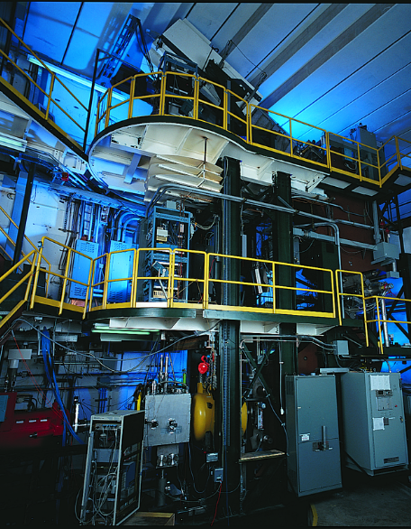
Why science? MORE money and jobs (and options, and satisfaction…)
Science, Technology, Engineering and Math (STEM) majors in college lead to:
Lower Unemployment
(17 of the top 25 majors)
Higher-paying jobs
(21 of the top 25 majors)
More career options
STEM majors are qualified for many kinds!
Your major does NOT determine your career!
Higher job satisfaction
(12 of the top 25 majors)
Playing with big toys

Slide 13
Physicist employment (aip.org/statistics)
“There are a lot of great paying jobs in the private sector looking for intelligent, highly motivated individuals with a mind that is focused on problem solving.”

Slide 14
A better path to Law/Medicine
Fun fact: you can do anything* with physics!
*Almost anything… seriously!
Society of Physics Students “Career Pathways” www.spsnational.org/cup/careerpathways

Slide 15
Why advanced degrees? (Master’s, Ph.D.)
More knowledgeable, better-qualified
Smaller candidate pools for available jobs
Higher salaries
Could be doing “real science!”
Specialized: pick your favorite sub-field of physics!
Acoustics
Astronomy
Astrophysics
Biophysics
Computational physics
Cosmology
Cryophysics
Crystallography
Fluid Dynamics
Geophysics
Nanotechnology
Nuclear Science
Optics
Particle Physics
Plasma Physics
Quantum Electrodynamics
Quantum Field Theory
Relativity
String Theory
Thermodynamics
Etc., etc.

Slide 16
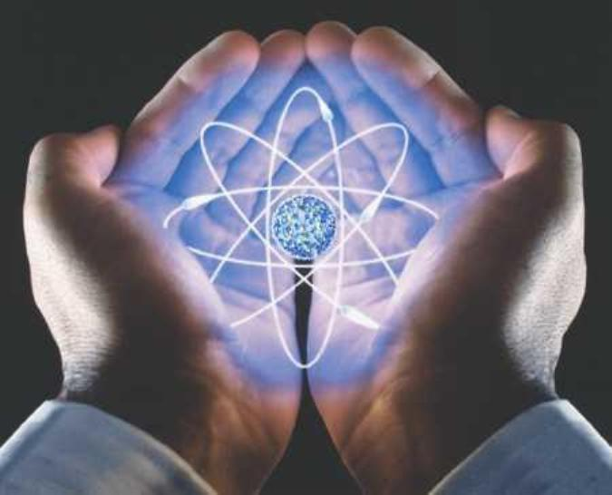
I actually want to do this stuff!
Ready to start changing the world for the better?
Problem: you are NOT READY (yet)
But…

Slide 17
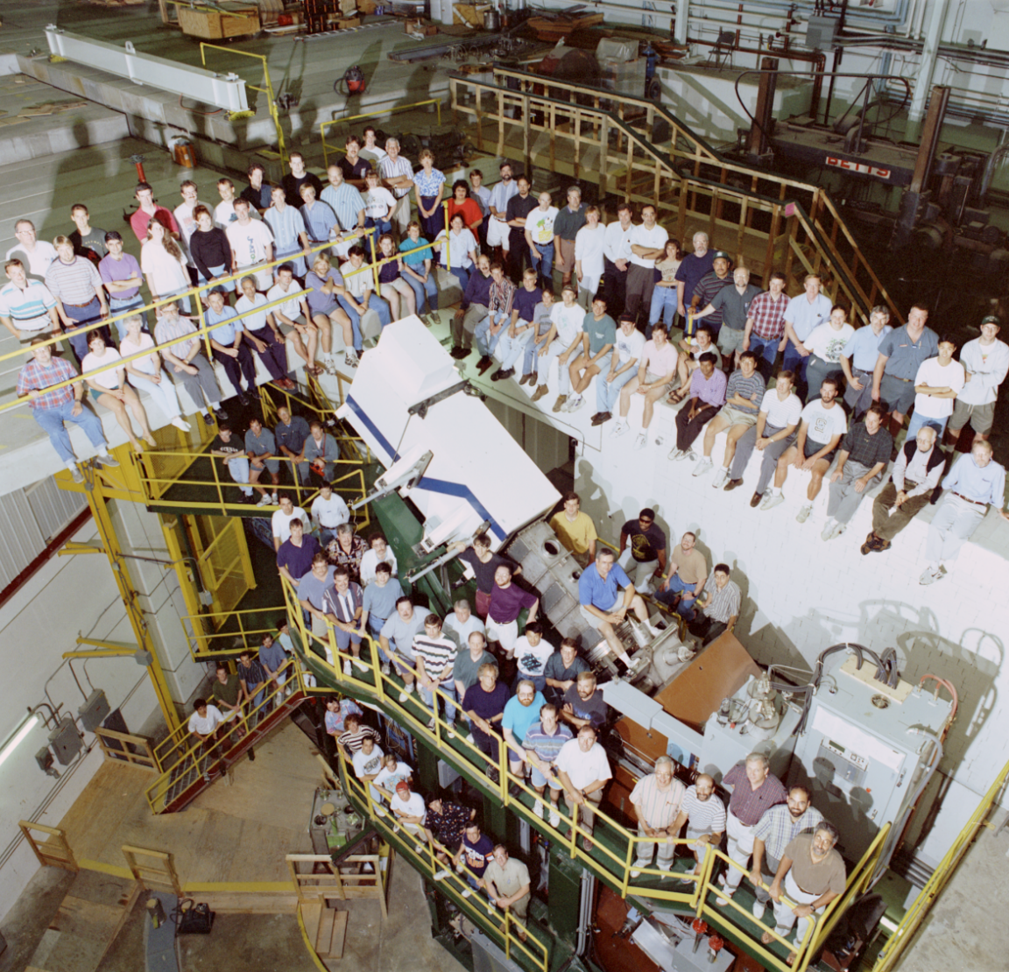
A surprising but obvious fact
…everyone at NSCL started out as a student just like you…
and
PEOPLE PAY US
TO LEARN THINGS
So how do people get into careers like ours?

Slide 18
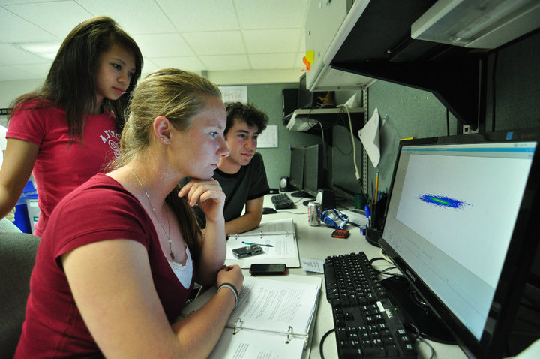
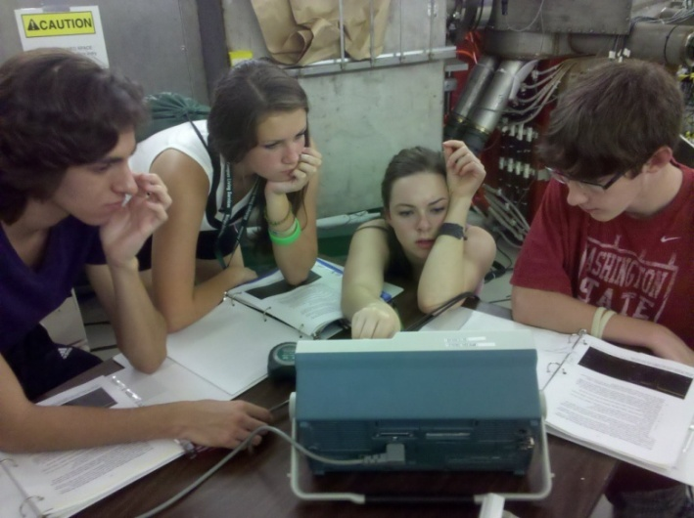
You CAN get there from here
Before college: EXPLORE!
Learn all the math & science (and computers) you can
Join science clubs/teams
Try it out (summer camps &_internships)
Ask people about their career, “shadow” them on the job
Read, research (you have the internet, use it)
Colleges care about how you use your time, and want as much information as you can give!
HSHSP
spartanyouth.msu.edu
Math, Science & Technology
PAN
Physics of Atomic Nuclei

Slide 19
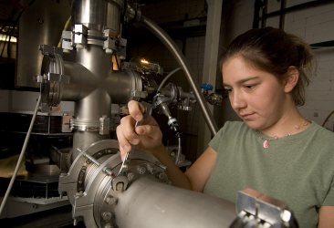
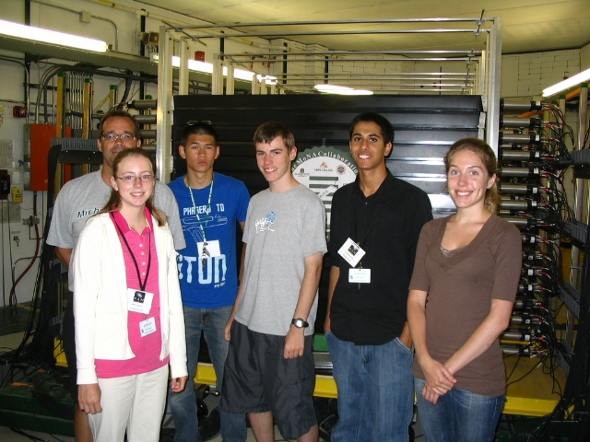
You CAN get there from here
In College (4+ years):
Pick a school that’s:
Strong in your field of interest
JINA schools are good for nuclear, but research universities are always good choices
A good fit for you
Affordable (expensive ≠ best)
Choose STEM (physics!)
Look for scholarships in STEM (especially for underrepresented groups!)
Apply to several summer Research Experiences for Undergraduates (REU)
Seek out research opportunities at your school
Try new things! Remember: your major does not lead to a specific career!

Slide 20
You CAN get there from here
Want to learn more?
Go to Grad school!
(2-6 more years after college)
Masters/Ph.D. degrees often required for science jobs
Not really school; it’s like a research job, with a few classes
In most STEM fields, you don’t pay for grad school… THEY PAY YOU TO LEARN THINGS
Note: you’ll have the skills, but it’s up to you to help employers understand that!

Slide 21
What it REALLY takes
Prepare for the unexpected
Surprising (and strange) opportunities will come to you
Get as much knowledge and as many skills as you can
NEVER assume you don’t need to know something
Find your path
Apply to schools that fit you best
Try new things (change is OK!)
Do what interests you
Stick with it
Things don’t always go your way
Stay positive, keep trying
Dr. Z says:
Want to change the world for the better?
Find a science you love and go after it

Slide 22
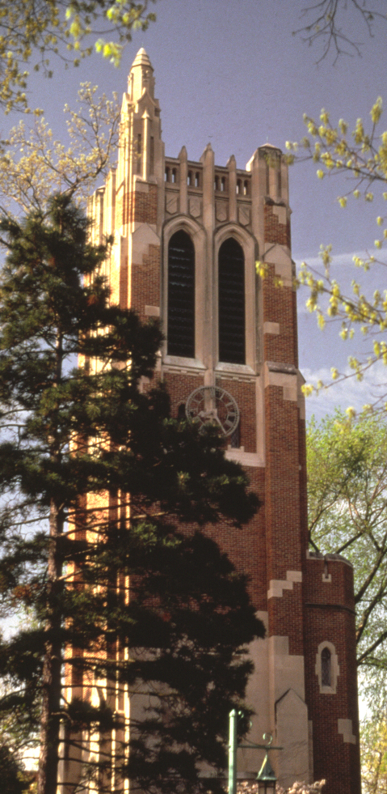
What’s next?
Society of Physics Students “Career Pathways” www.spsnational.org/cup/careerpathways
Email visits@nscl.msu.edu to ask questions
Check out nscl.msu.edu to learn about nuclear science
Visit jinaweb.org for more about nuclear astrophysics
Find camps and summer programs for you on spartanyouth.msu.edu
Keep reading and learning stuff! (great science news on phys.org)
@nscl

Slide 23
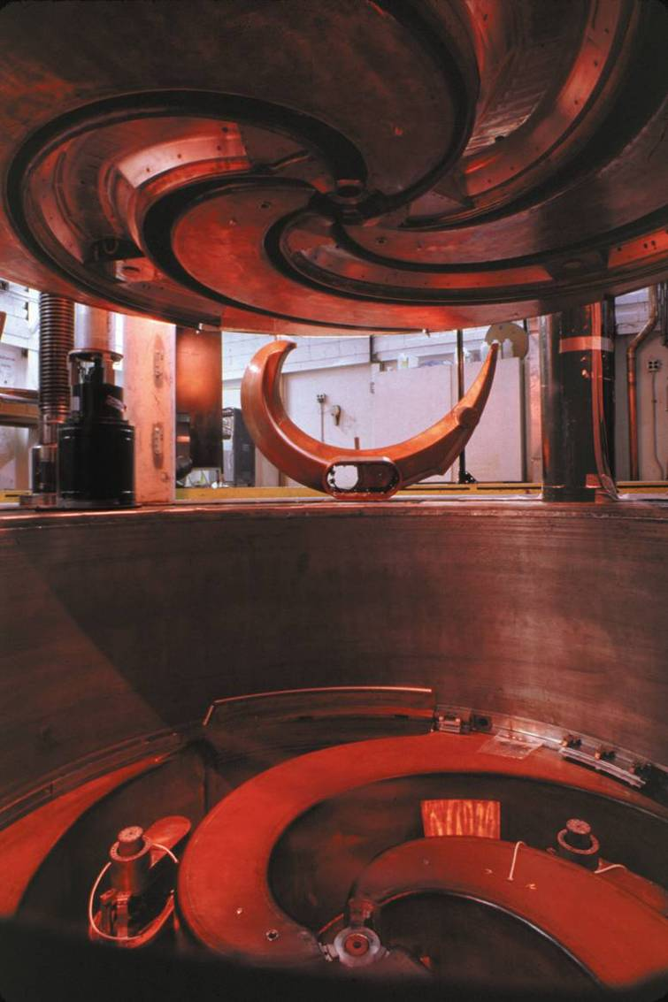
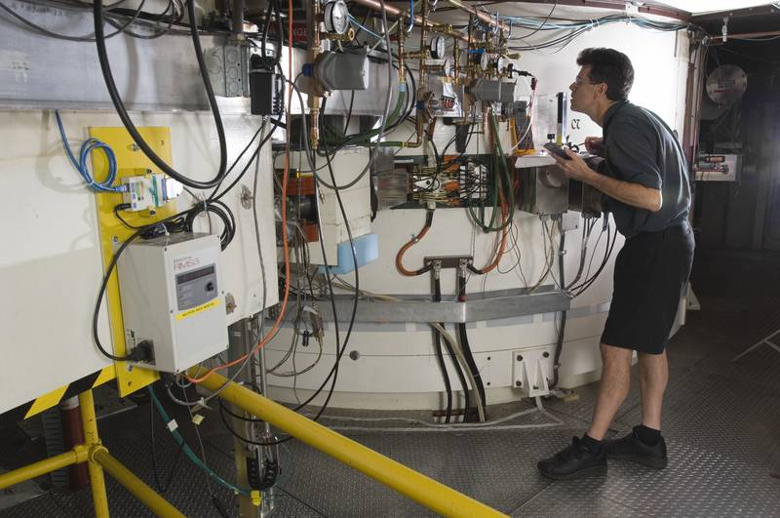
Problem: Making star-like nuclei
Fast-beam fragmentation of nuclei is performed at 0.4c – 0.5c
This is much higher energy than found in a star!
Yes, it IS possible to smash too hard

Slide 24
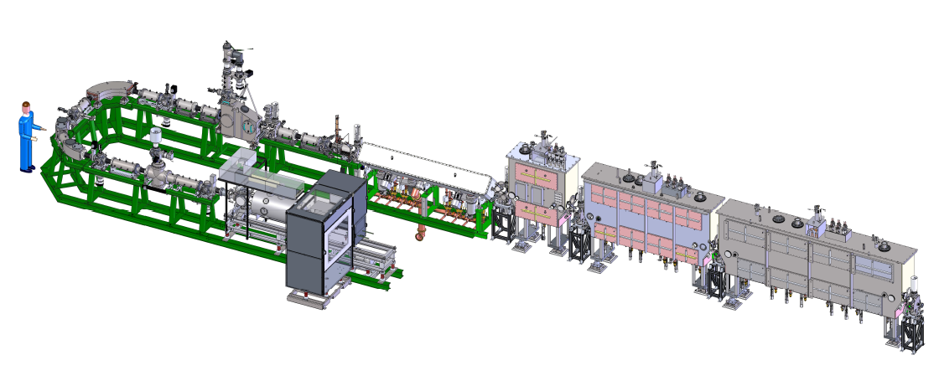
Solution: a star-like (re)accelerator
Q/A
MHB
0.041 modules
RT RFQ
0.085 module
EBIT
Charge Breeder
Just 8 simple steps!
Ionize stable isotope
Accelerate to 0.5c
Fragment on target
Separate isotope of interest
Thermalize nuclei in gas cell
Re-ionize nuclei
Purify beam
Accelerate to stellar energies

Slide 25
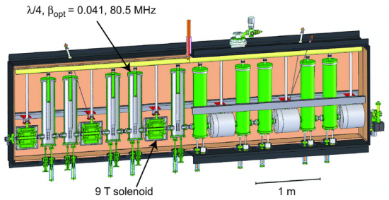
Cavities and Cryomodules
Superconducting Radio-Frequency (SRF) Cavity
(a high-voltage resonator for accelerating charged particles)
Beam
path
Accelerating
gaps
Beam
path
A cryomodule of ten SRF cavities

Slide 26
The SRF cavities in action

