Slide 1
A SUPERNOVA
IN THE LAB
World-class nuclear experimentation and theory at MSU
Dr. Zach Constan
Outreach Coordinator
National Superconducting Cyclotron Laboratory (NSCL)

Slide 2
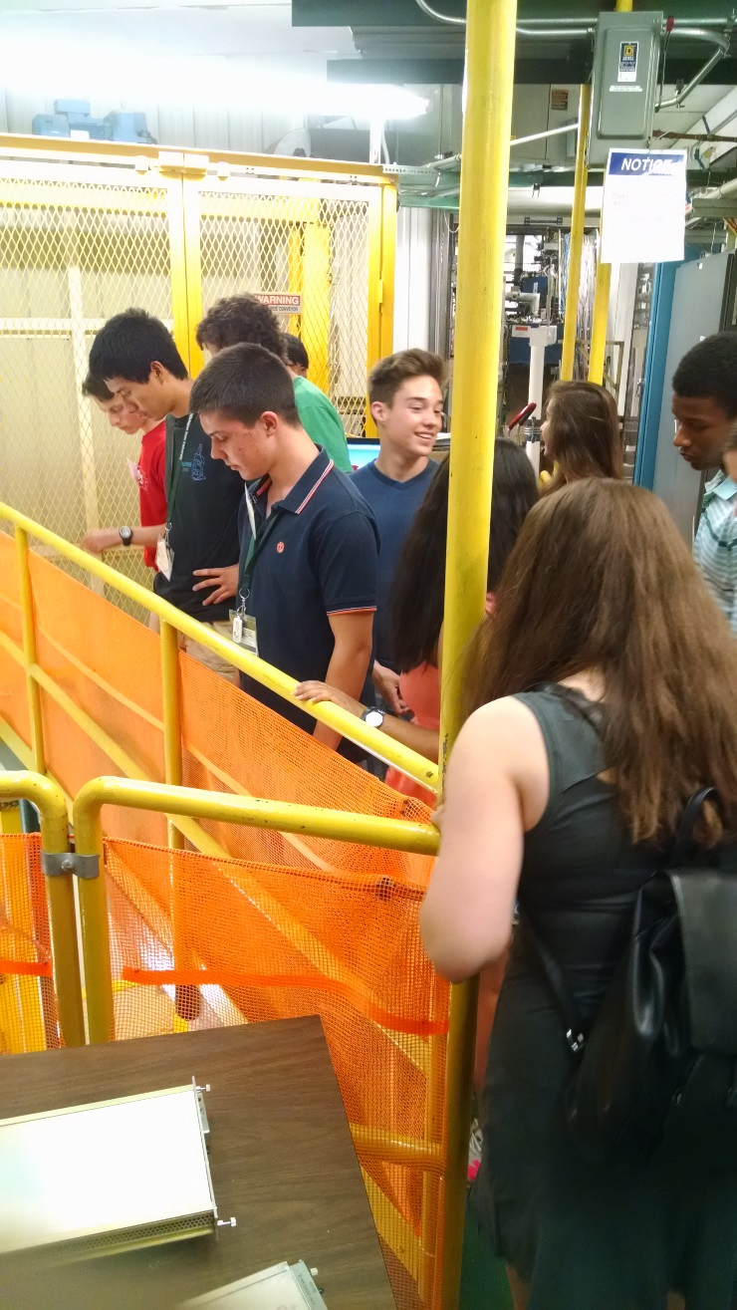
Useful Information
Location of bathrooms!
If you have minors in your group, your leader must complete a permission form.
Photography is not allowed on the tour, but we have a designated location for a group photo if you want.
You are not expected to know or understand everything! It’s OK.
Stopping us to ask questions is encouraged!

Slide 3
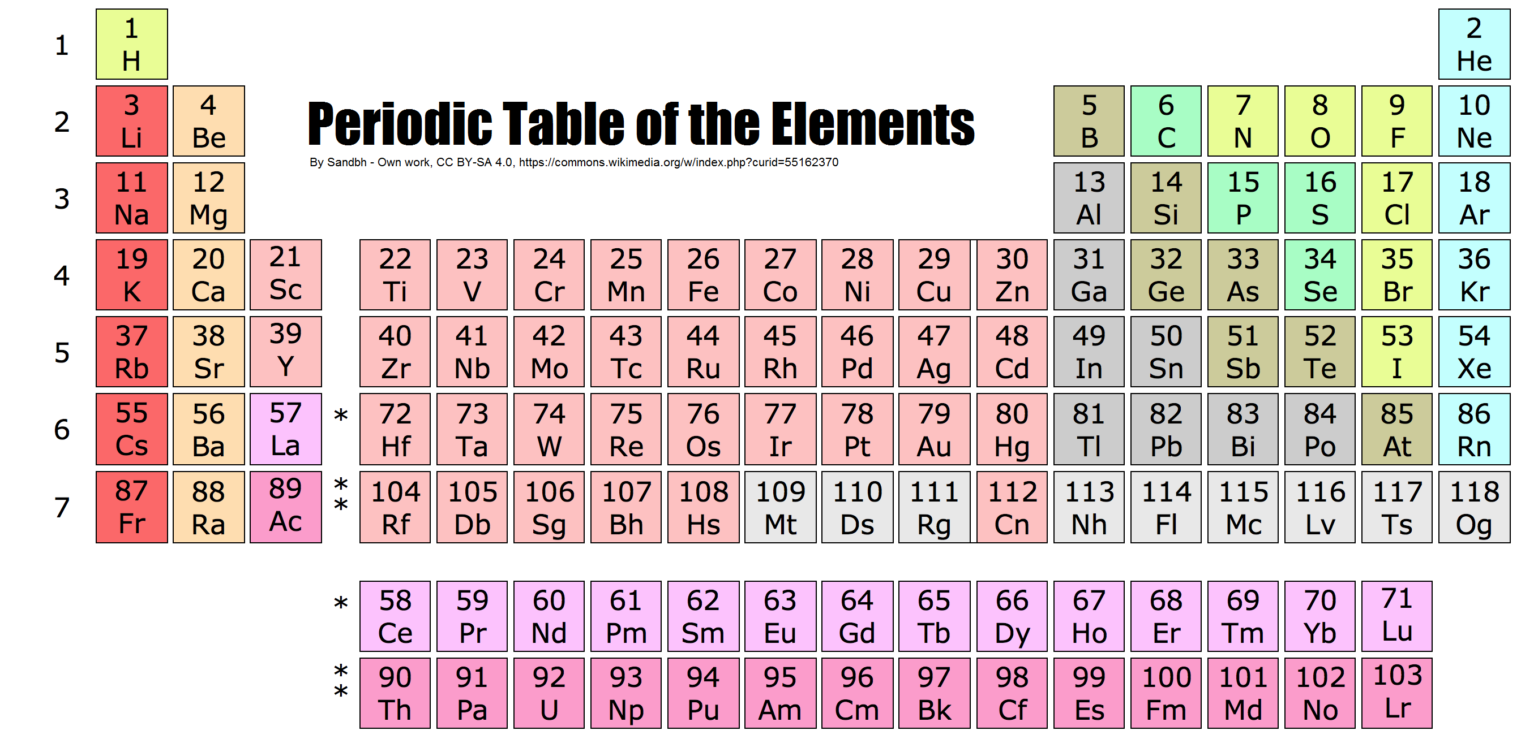
Periodic Table of the Elements
Each element (such as carbon) comes in
many varieties, some common, some rare

Slide 4
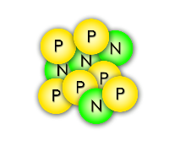
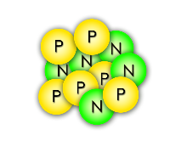
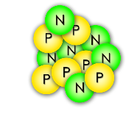
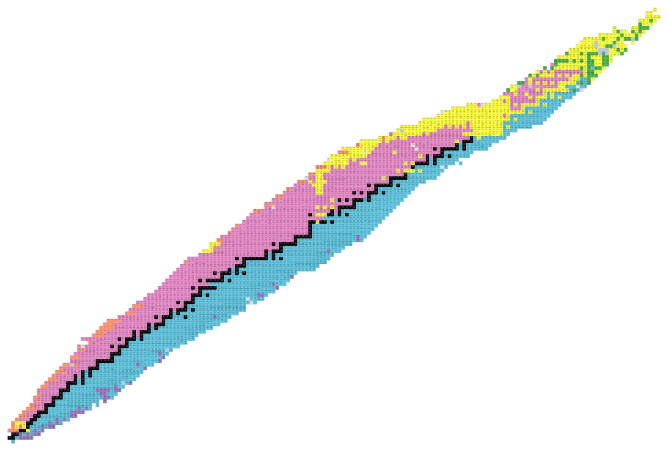
The Known Isotopes
Carbon-10
Carbon-11
Carbon-12
All of these carbon isotopes are chemically identical, but different numbers of neutrons gives them diverse nuclear properties
Protons (Elements)
Neutrons (Isotopes)

Slide 5
Our mission: study RARE isotopes
Black boxes are stable isotopes of an element.
Protons (Elements)
Neutrons (Isotopes)
Colored boxes are unstable, often rare isotopes of an element. These have too many or too few neutrons to be stable.

Slide 6
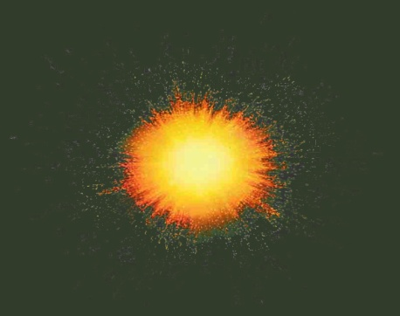
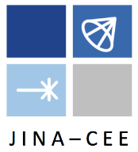
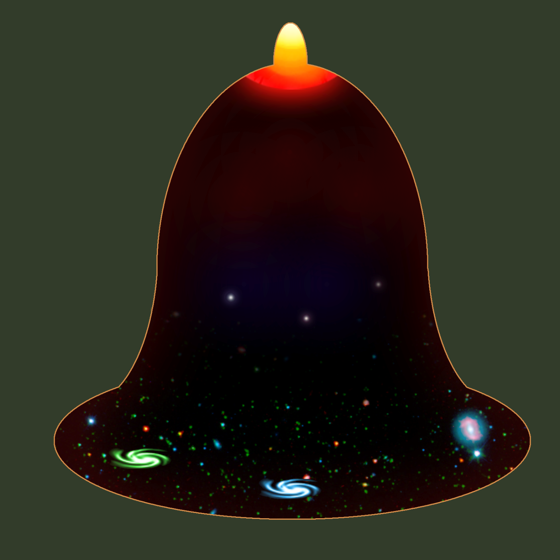
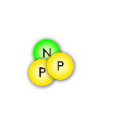
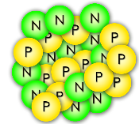
Origins of the elements
The Joint Institute for Nuclear Astrophysics (JINA) presents
A Short History of the Universe
A spectacular explosion of energy in a growing universe… the Big Bang !!
Inflation
Slowing expansion
4 min after Big Bang
1.8 Billion ºF
The first nuclei are made: Hydrogen and Helium
…
Formation of the first stars
One billion years after Big Bang
440 ºF
helium iron
Stars fuse light elements into heavy ones, up to iron
Accelerating expansion
Neutron-star mergers & supernovae may create unstable isotopes that will decay into heavier elements!
-450 ºF
Now

Slide 7
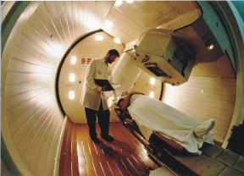
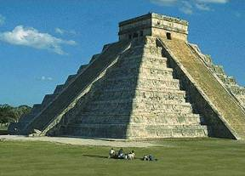
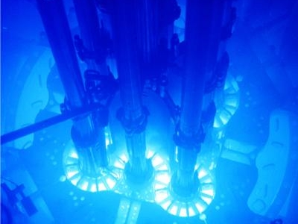
Uses of rare isotope science
Nuclear Medicine
Archeology/Geophysics
Nuclear Power
Radioisotopes are used in biomedical research as tracers, diagnostic tools, and treatments (neutron therapy, pictured)
Isotopic ratios of organic materials (C-14 dating);
Carbon/oxygen isotopic makeup of carbonates (tectonic activity, erosion)
Development of radiation detectors and engineering “radiation-hardened” electronics for orbital or extreme environments
Nuclear discoveries can generate new ideas and technologies in the fields of nuclear power, airport security, biology/ecology, etc.

Slide 8
Our staff makes it possible
800+ employees
Research and Development
Theorists and Experimenters
Facility operators
Designers & engineers
Undergraduate and Graduate
students
Technicians & machinists
Our people learned useful skills in:
nuclear science ▪ physics ▪ chemistry ▪ all types of engineering ▪ mathematics ▪ computer science ▪ welding ▪ machining ▪ pipefitting ▪ and so on…
If you like Science, Technology, Engineering, and Math (STEM), that’s what we do!
(and skilled trades!)

Slide 9
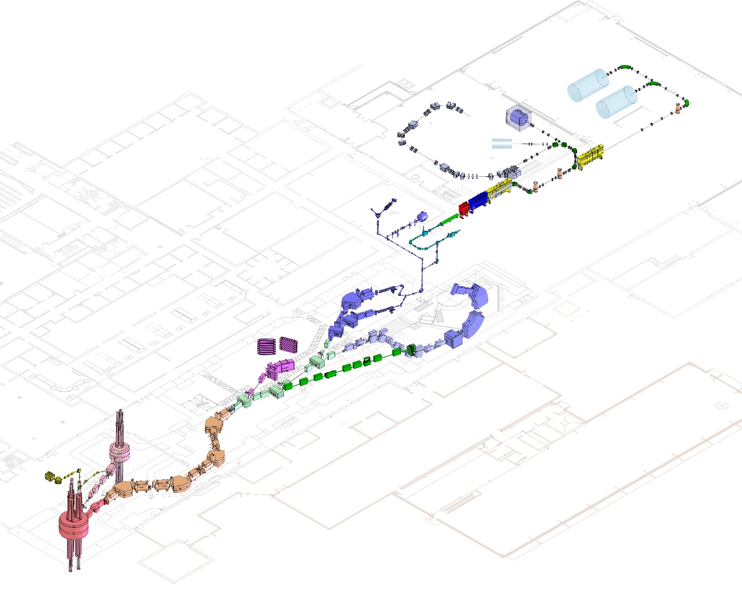
The tools we use
Coupled cyclotron facility and experimental beam lines
A person
Made possible by
accelerator physicists, operations physicists,
and engineers (vacuum, electrical, cryogenic…)
~140 meters (450 feet) long
Five stories tall

Slide 10
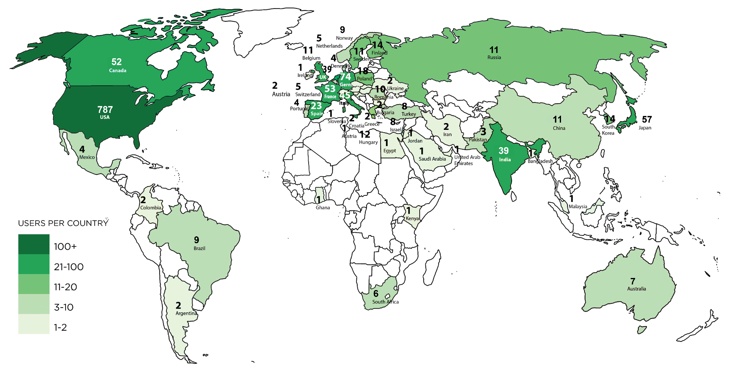
Serving Users worldwide
The best nuclear scientists on the planet come to NSCL because our lab is a world class research facility
FRIB/NSCL User Community August 2018
~1400 scientists, 50+ countries

Slide 11
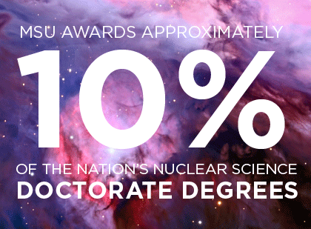
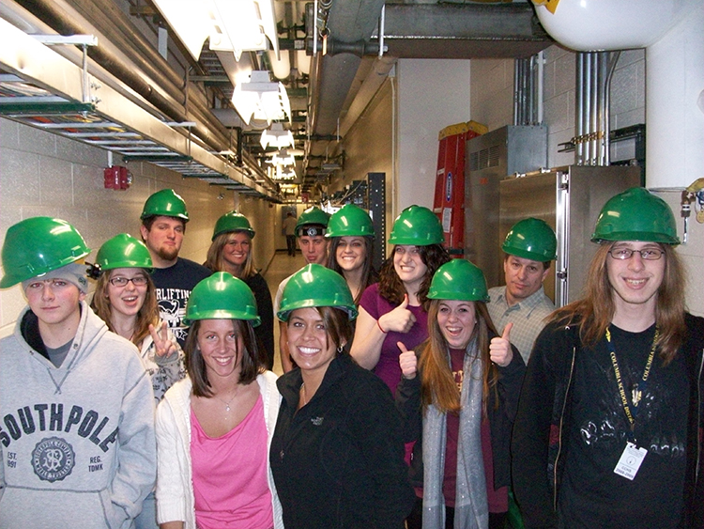
Training the next generation
NSCL has the
#1 ranked nuclear science program
among US graduate schools
(U.S. News & World Report, 2018)
NSCL Outreach offers:
Tours for the general public
Summer research programs for middle & high school students
Nuclear science experiments and lessons for teachers to use
For more information online: www.nscl.msu.edu/public/education

Slide 12
How to make “designer nuclei”
NSCL’s Coupled Cyclotron Facility

Slide 13
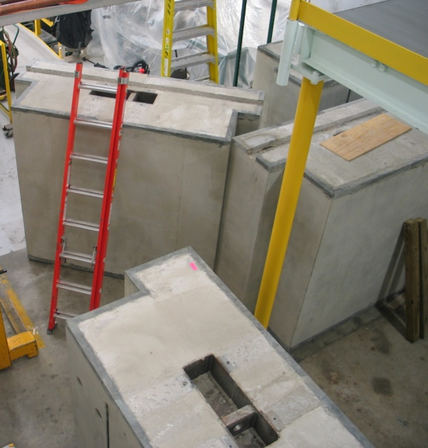
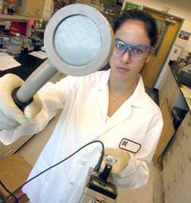
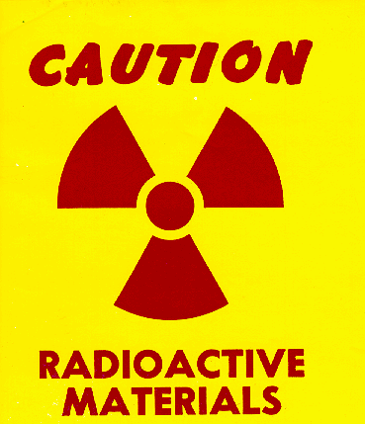
Safety with radioactive nuclei
Solutions:
keep radiation away from people & keep people away from radiation
Shielding
Surveying
Training
Managed by health physicists, safety officers

Slide 14
Radiation exposure and you
Radiation source | Dose
Average exposure for general public (natural + medical) | > 300 mRem/yr
Government (NRC) exposure limit for lab visitors | 100 mRem/yr
NSCL/FRIB ALARA goal for visitors | 10 mRem/yr
Your visit today | << 1 mRem
Dental x-ray | 0.5-1 mRem
Smoking a pack of cigarettes | ~2 mRem (800 mRem/yr)

Slide 15
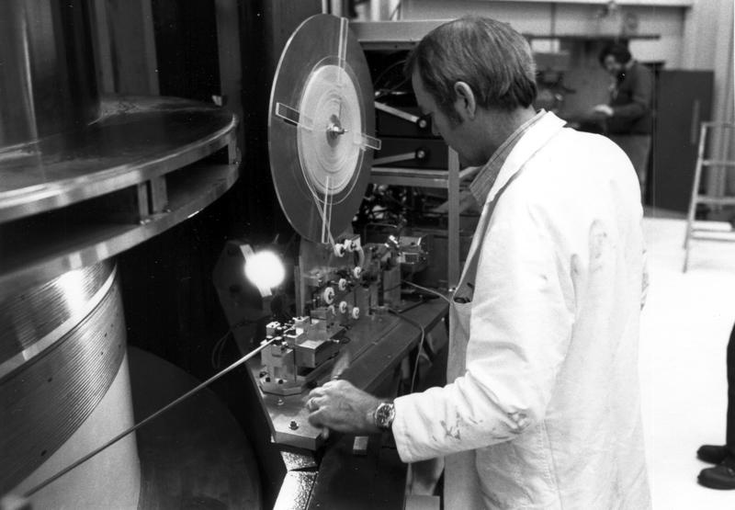
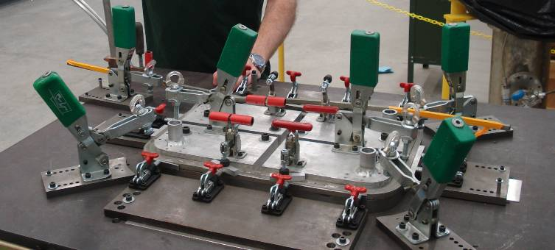
Superconductivity
NSCL cyclotrons use electromagnets made from niobium-titanium wires
At liquid helium temperatures
(-269 ºC , 4 K), these wires become superconducting, which means they have zero electrical resistance
This allows us to coil small, powerful, and energy-efficient electromagnets used to direct and control nuclei

Slide 16
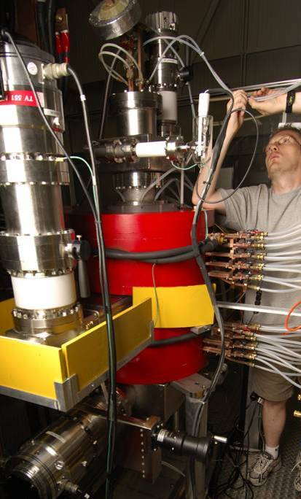
Ion Sources
NSCL uses Electron Cyclotron Resonance (ECR) sources, which trap stable atoms and ionize them by bombardment with electrons. The ions are then injected into the K500 cyclotron.
magnet
Researchers choose a stable isotope to source, using elements from oxygen to uranium (calcium is most commonly used).
A typical extracted beam power for ¹⁶O is ~1.3 kW/175 pnA (particle nanoAmps)

Slide 17
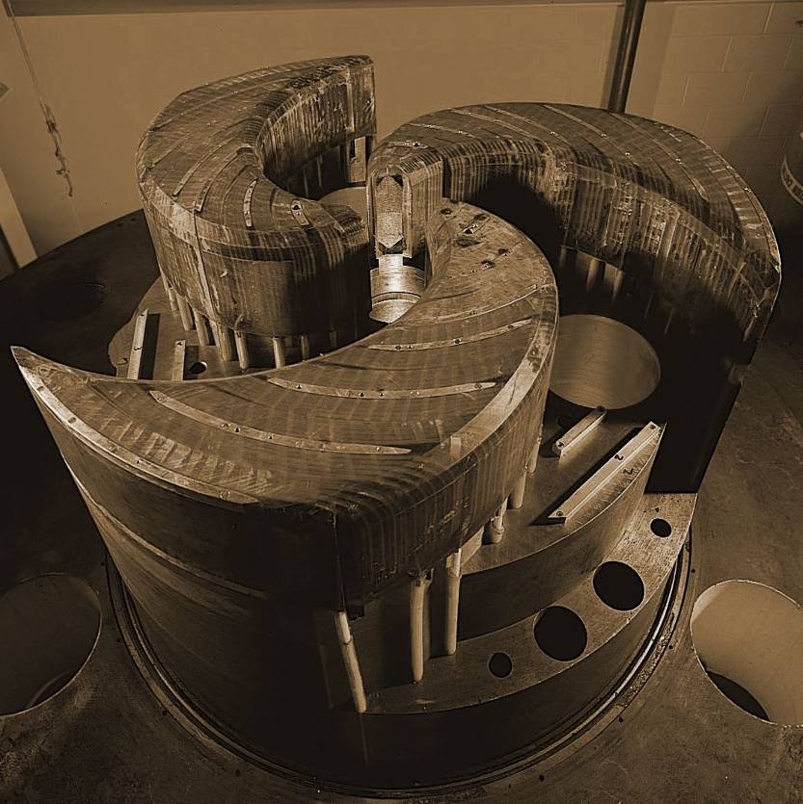
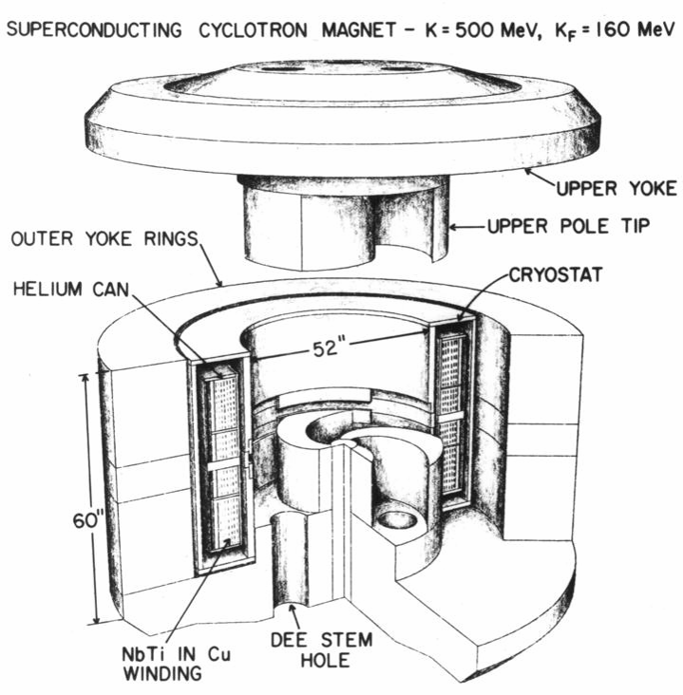
The NSCL Cyclotrons
World’s first superconducting cyclotron
World’s second-highest-energy superconducting cyclotron
K500
K1200
Year completed: 1982
Diameter: 10 ft Weight: 100 tons
Magnetic field: 3-5 Tesla
Maximum energy it can impart to a proton: 500 MeV
Year completed: 1988
Length of superconducting wire: 38 mi
Time of acceleration: 0.000035 seconds
Distance a nucleus travels while inside: 1.9 miles (700 revolutions)

Slide 18
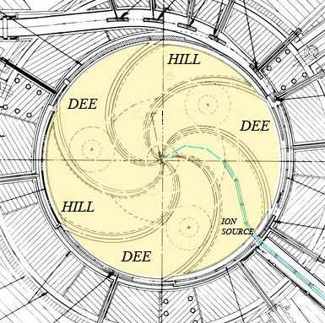
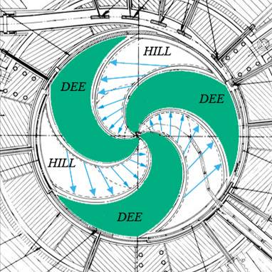
The cyclotron principle
Coil of superconducting niobium wire
Stable, “normal” ions are injected into the center of the cyclotron
Magnetic field steers nuclei in a circle
Ions orbit inside the vacuum
“Dees” alternate high voltage, creating electric field to accelerate the nuclei
Nuclei spiral to higher speeds until they leave the cyclotron in a fast beam

Slide 19
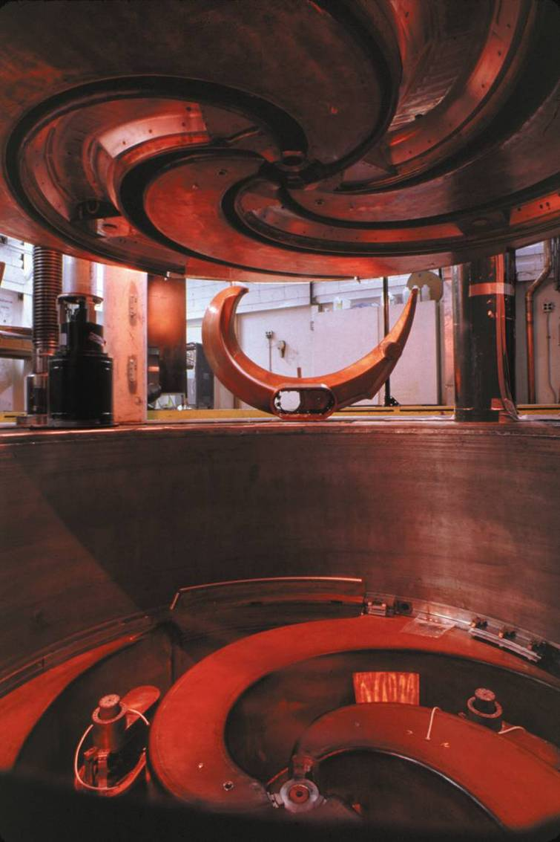
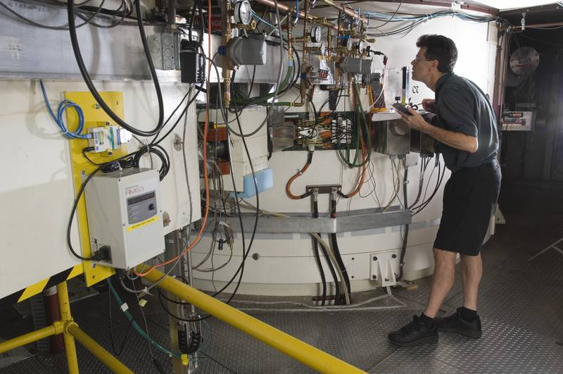
K1200 Cyclotron
Completed 1988: the world’s second-highest-energy cyclotron
Pre-accelerated ions from K500 pass through a stripper foil in the K1200, increasing ionization and improving accelerating efficiency.
Nuclei leaving the K1200 can reach 0.5 c (typically 150 MeV/nucleon).
Dees charged to 140 kV, alternated at radio frequencies (e.g. 23 MHz).

Slide 20
Nuclear Fragmentation
BEAM at < 0.5 c
strikes foil TARGET
exits with FRAGMENTS
¹⁸O
¹⁸O
¹⁸O
¹⁸O
¹⁸O
¹⁸O
¹⁶C
or
⁹Be
¹¹B
or
The accelerated beam consists of the one stable isotope provided by the ion source
(>1 billion nuclei/second)
Very few beam nuclei hit a nucleus in the target and break, becoming a new element/isotope
¹⁷O
or…
After the target, the beam contains many new isotopes (sometimes <1 desired nucleus/second)

Slide 21
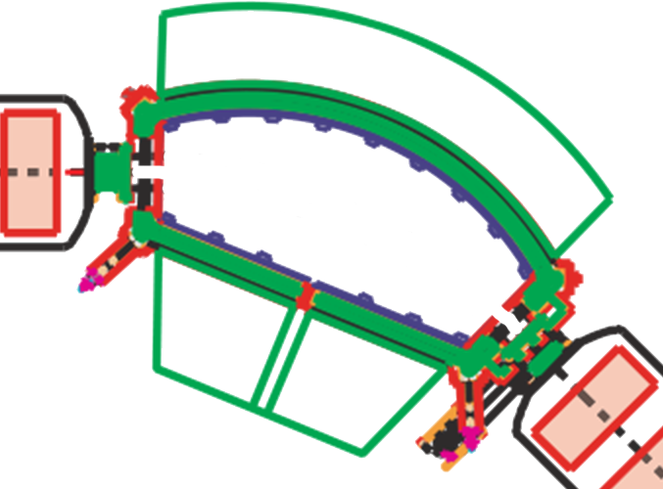
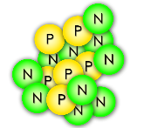
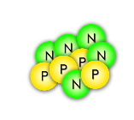
Selecting one rare isotope
The A1900 magnetic fragment separator
(mass spectrometer)
Some nuclei turn too little
¹⁶C
Some nuclei turn too much
The magnetic field is just right to steer nuclei of the desired isotope through!
A dipole magnet

Slide 22
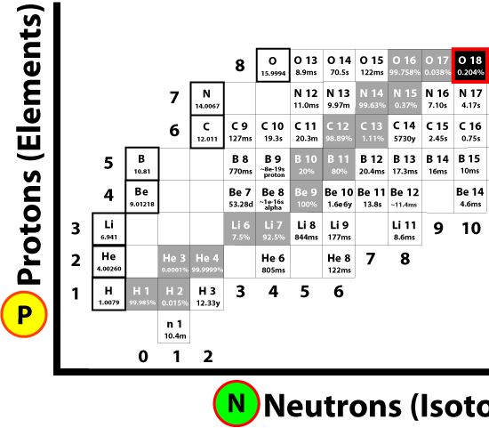
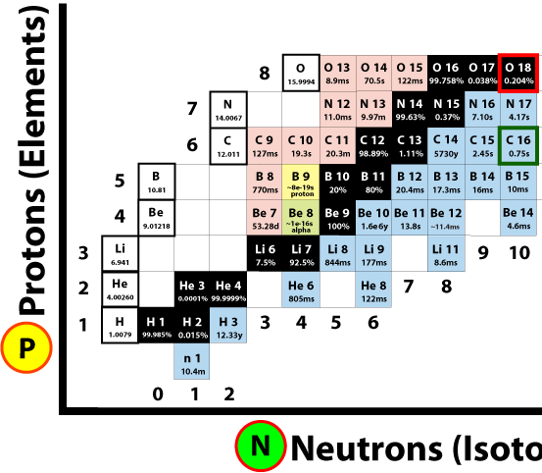
Fragment selection
Primary (stable) Beam
Fragmented Beam
Fragmentation on target
Secondary (unstable) Beam
Primary (stable) Beam
>1 billion nuclei/second
Beam after fragmentation (mostly stable, some rare)
Beam after separation (fewer rare isotopes)

Slide 23
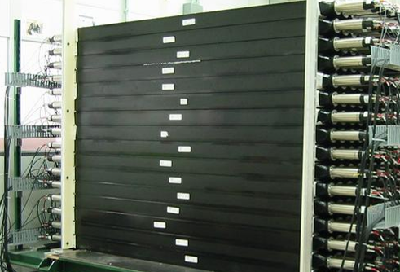
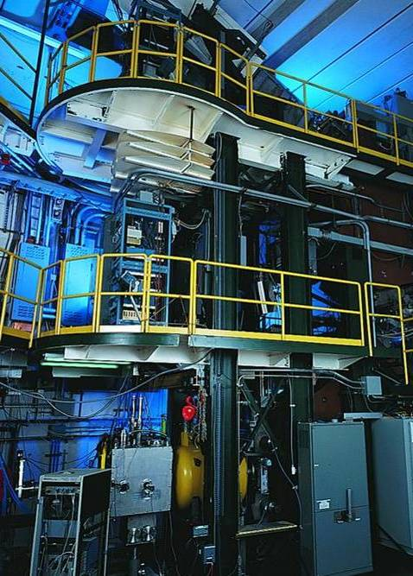
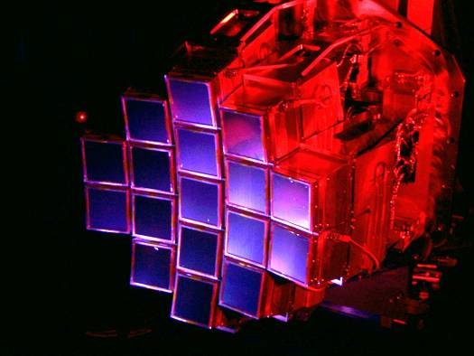
Detectors
MoNA
“Halo nuclei” and neutron-rich isotopes
Mostly created in-house by
detector physicists, mechanical designers, chemists, machinists, technicians…
… useful for measuring astrophysical reaction rates, nuclear structure, symmetry breaking, etc.
S800 Spectrograph
Nuclear states from particles freed in collisions
Nuclei found in stellar reactions
HiRA

Slide 24
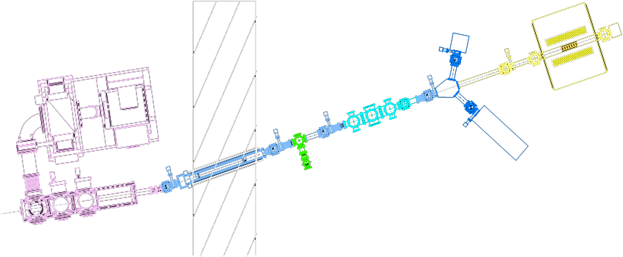
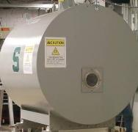
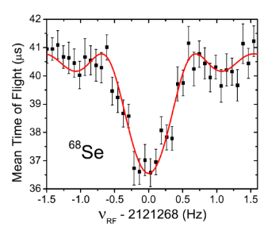
A sample experiment
Mass measurement of the nucleus with a Penning trap
Nuclei arrive in a magnetic trap and take on a circular orbit.
$$ω_{c}=\frac{qB}{m}$$
Beam “bunching”, one or a few nuclei pass at a time
“LEBIT” 9.4 T Penning Trap
Fast beam is stopped in helium gas
Beam
The cyclotron frequency of trapped nuclei depends on their mass; find the resonant frequency to obtain mass to a precision of 1 part in 10⁸
The mass of selenium-68 strongly affects type I x-ray explosions on neutron stars
Notes:
Knowledge of radioactive masses helps us better understand fundamental forces, how neutrons and protons bind together, and explosions in the universe in which elements are created. One kind of stellar explosion, type I x-ray bursts, depends on certain nuclei like ⁶⁸Se.

Slide 25
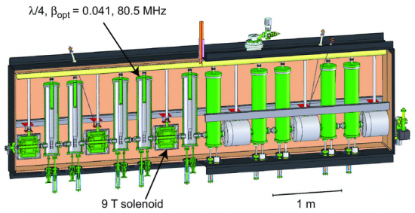
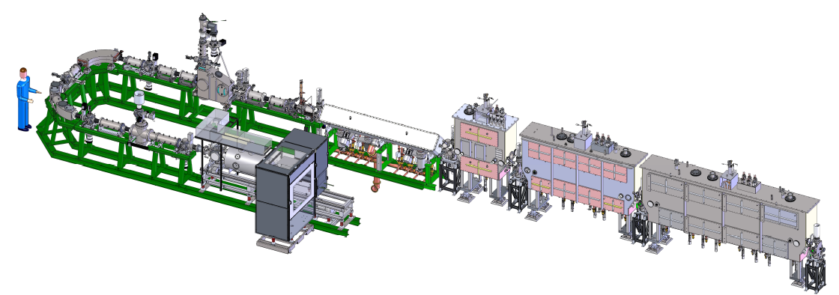
ReA3 (ReAccelerator)
ReA3 accelerates thermalized nuclei to 3 MeV/u or more, creating a beam suitable for nuclear astrophysics experiments.
The linear accelerator is made of cryomodules containing superconducting radio frequency (SRF) cavities (99% niobium)
Q/A
MHB
RT RFQ
β=0.041 modules
β=0.085 module
EBIT Charge Breeder

Slide 26
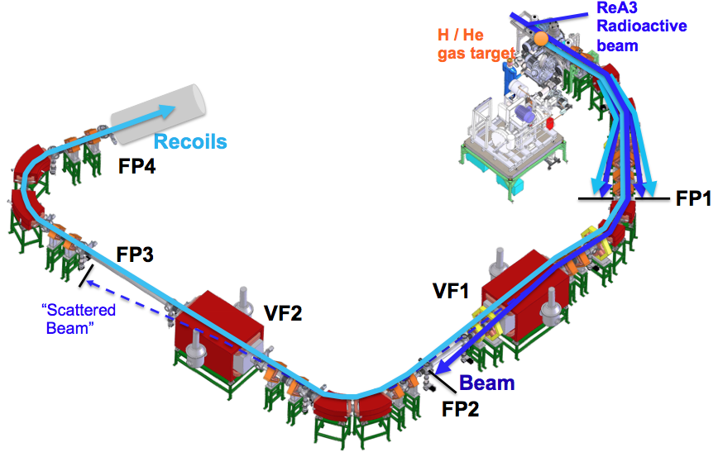
SEparator for CApture Reactions (SECAR)
SECAR will measure low-energy capture reactions that occur in nuclear astrophysics (such as novae, x-ray bursts, supernovae, etc.)
Accepts stellar-energy nuclei from ReA3
Detects projectiles that capture H or He nuclei from the gas target (as little as one in 10¹⁷)
Will significantly outperform all previous measurement instruments

Slide 27
FRIB: the future of rare isotope research
NSCL today
MSU has been chosen as the site of the next-generation
Facility for Rare Isotope Beams (FRIB)
the $730 million US Department of Energy project to design and establish a world-leading laboratory over the next decade. Civil and technical construction are being managed to early completion in 2021.

Slide 28
FRIB: a Next-Generation facility
FRIB will provide the highest-intensity beams of rare isotopes available anywhere ⁽¹⁾
Beam energies: up to 200 MeV/nucleon for uranium (approximately twice the energy of NSCL) with the option of upgrading to 400 MeV ⁽¹⁾
Beam Power: 400 kW (nearly 10x that of similar facilities) ⁽¹⁾
Beam Driver: heavy-ion linear accelerator, made of superconducting RF resonators ^{(1, 2)}
Incorporating many newly-developed technologies
Notes:
Particle velocity: up to 57% of the speed of light
R&D activities for the past decade at several national laboratories and universities (Argonne, Berkeley, Brookhaven, Colorado School of Mines, Los Alamos, MSU, Oak Ridge, and Texas A&M) (2) have led to significant advances that have optimized machine performance and made possible a more cost-effective design for FRIB. (3)

Slide 29
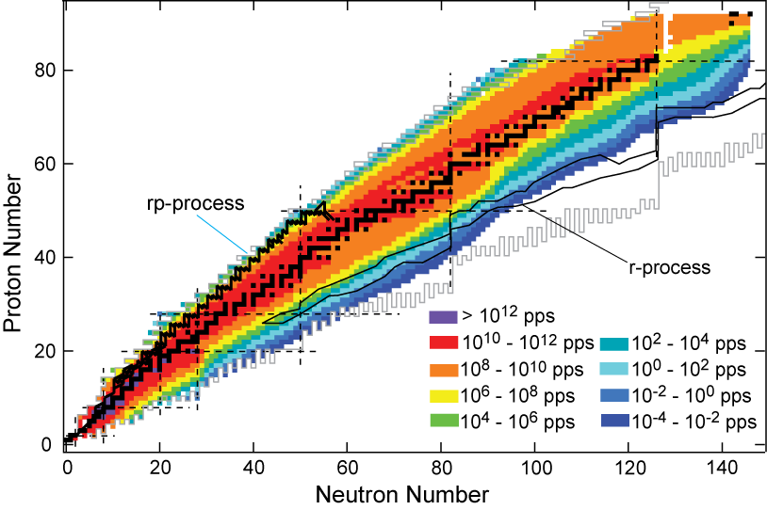
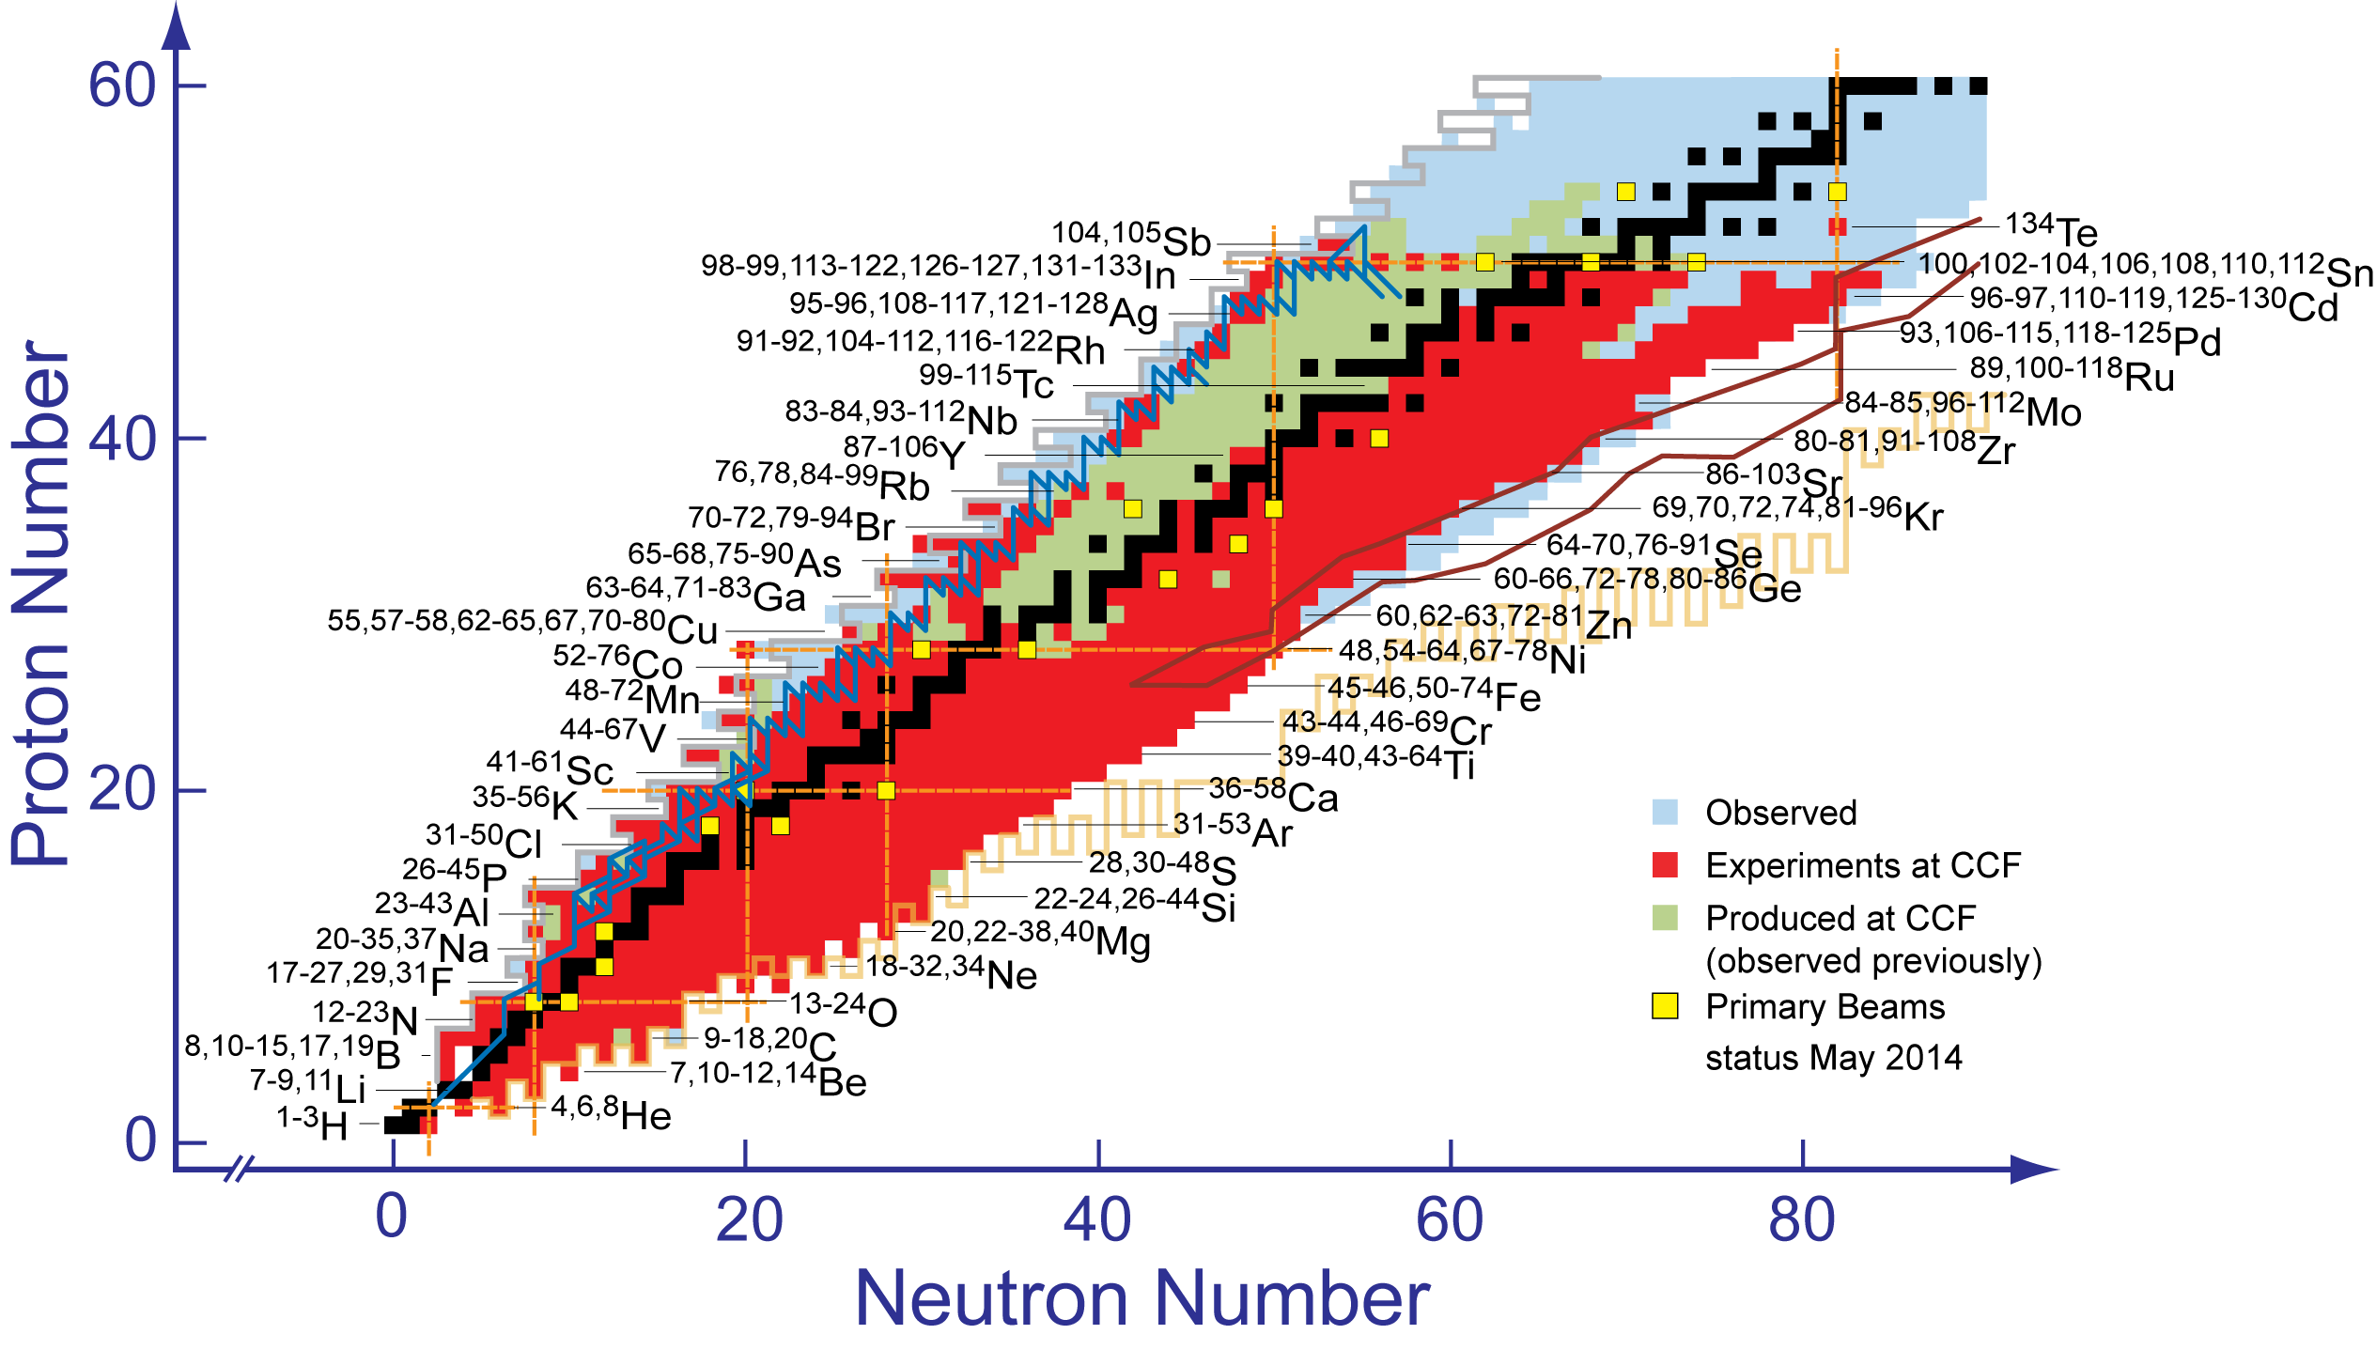
FRIB and stellar nucleosynthesis
FRIB will access many new isotopes that are expected to be critical to stellar nucleosynthesis through neutron capture.
Isotopes created and studied at current NSCL

Slide 30
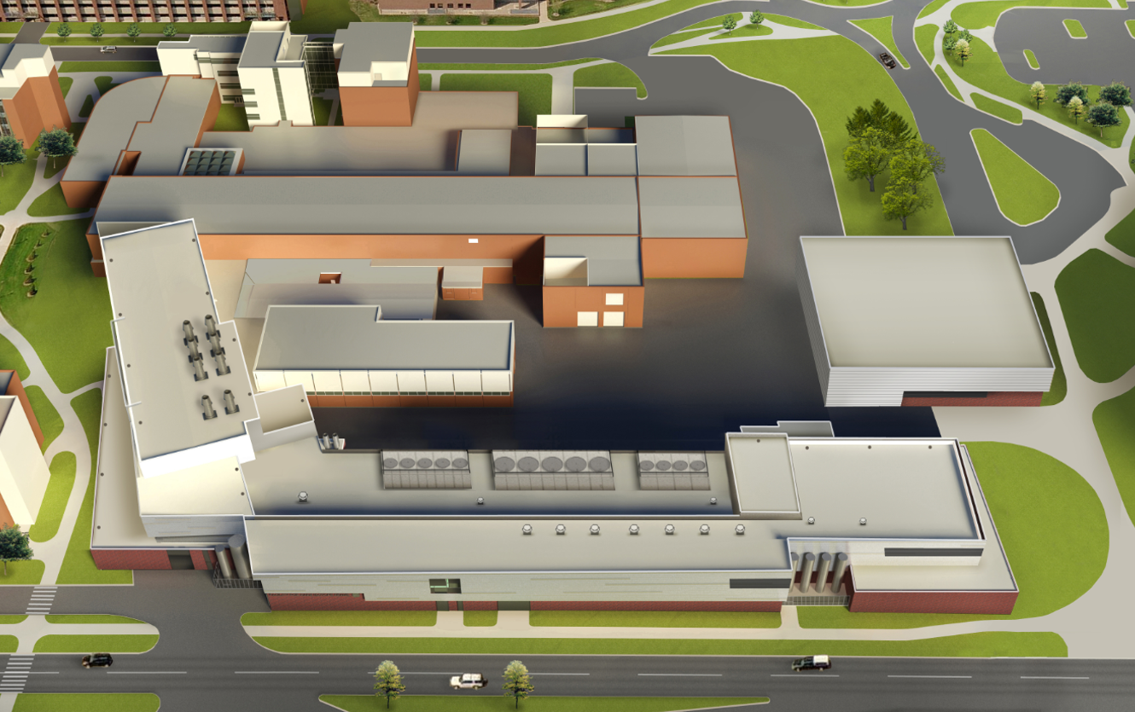
FRIB on the MSU campus

DAIRY STORE
(one
block)
WHARTON
CENTER

SHAW LANE
Lobby
BOGUE STREET
Existing NSCL
Target
Highbay
SRF Assembly
Ion Sources
Linac Support Building
WILSON ROAD

Slide 31
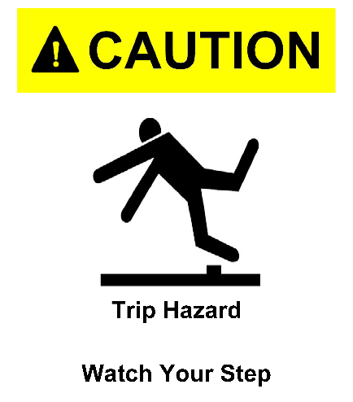
Safety First
DON’T put anything in your mouth (eat, drink, chew gum)
DO watch your head and step
DON’T sit or lean on things
DO obey posted signs
DON’T take photos
DO stay with your guide
DON’T touch equipment
If you lose your tour, dial “0” on a lab phone (“77305” after hours)
DO leave items (especially open food/drink) you don’t want to carry

Slide 32
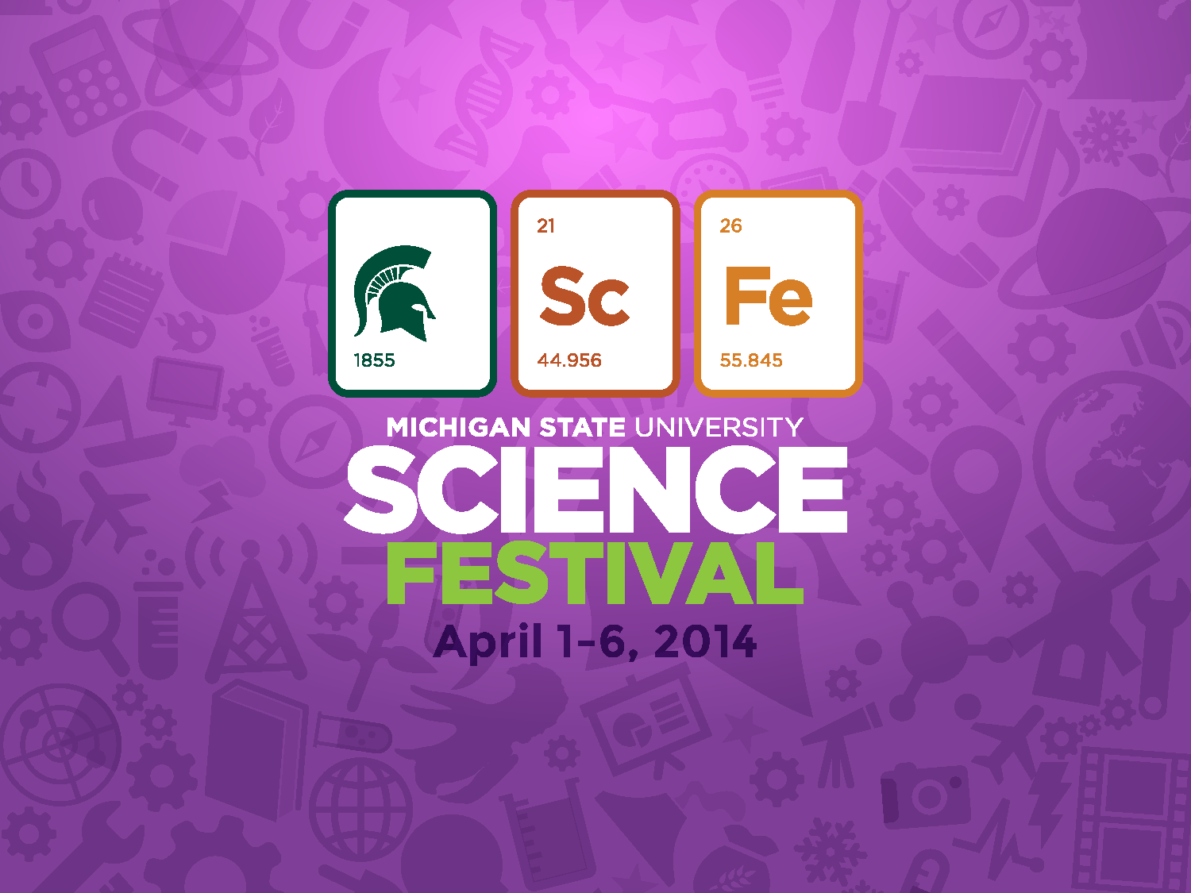
Annually in April
sciencefestival.msu.edu

Slide 33
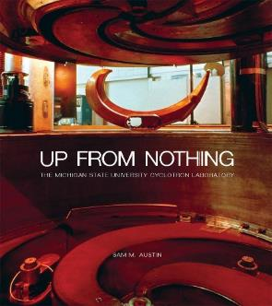
National Superconducting Cyclotron Laboratory at MSU
Learn more about our Lab and outreach programs
Get our just-published history Up From Nothing from MSU Press msupress.org or on Amazon
SPARTAN YOUTH PROGRAMS
Find camps and programs at MSU for
pre-college students: spartanyouth.msu.edu
Get the Android/ iPhone/iPad game Isotopolis for free!
Visit our Gift Shop on shop.msu.edu (click on “NSCL/FRIB” under “Specialty Shops”)
GIFT SHOP
contact visits@nscl.msu.edu or go to nscl.msu.edu
@nscl

