Slide 1
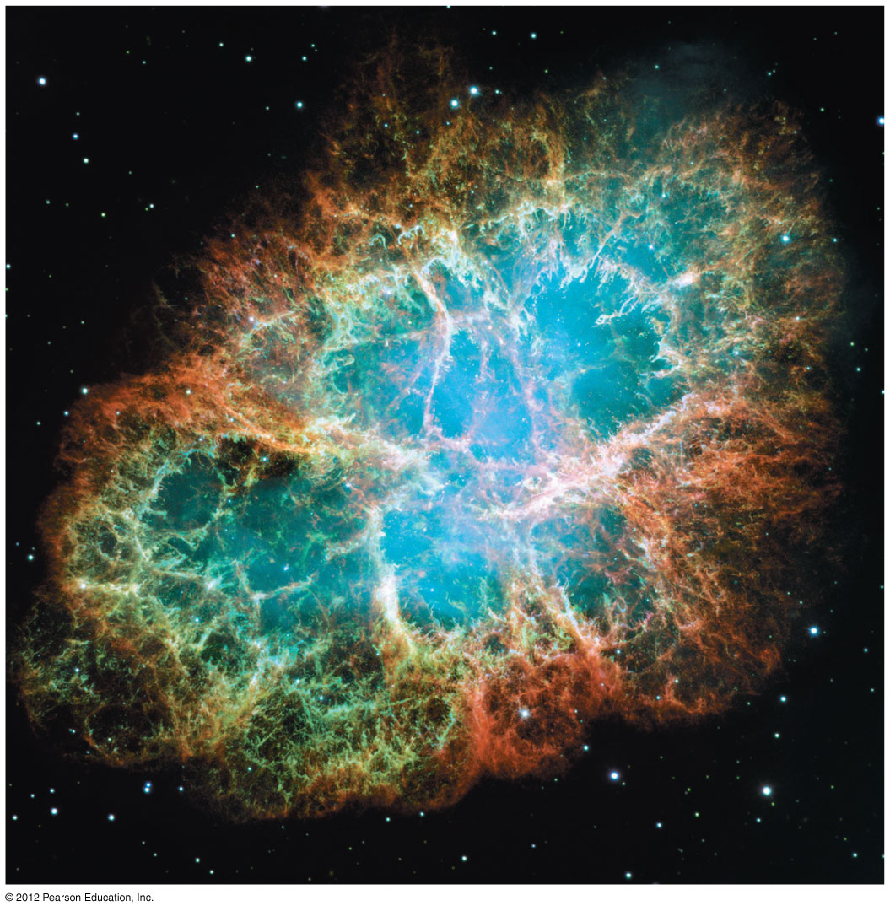
Nuclear Astrophysics
Chris Wrede
Michigan State University &
National Superconducting Cyclotron Laboratory
Physics of Atomic Nuclei
July 27th and August 3rd, 2016

Slide 3
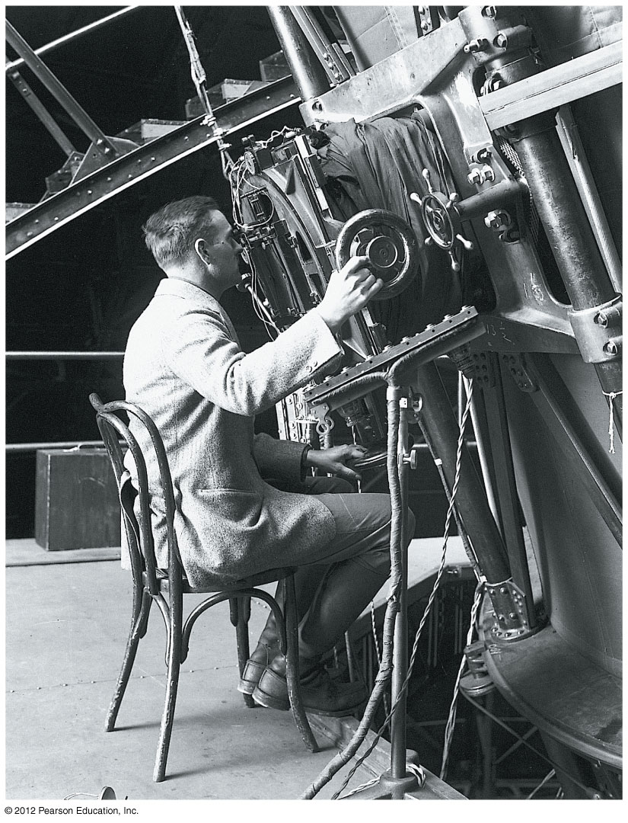
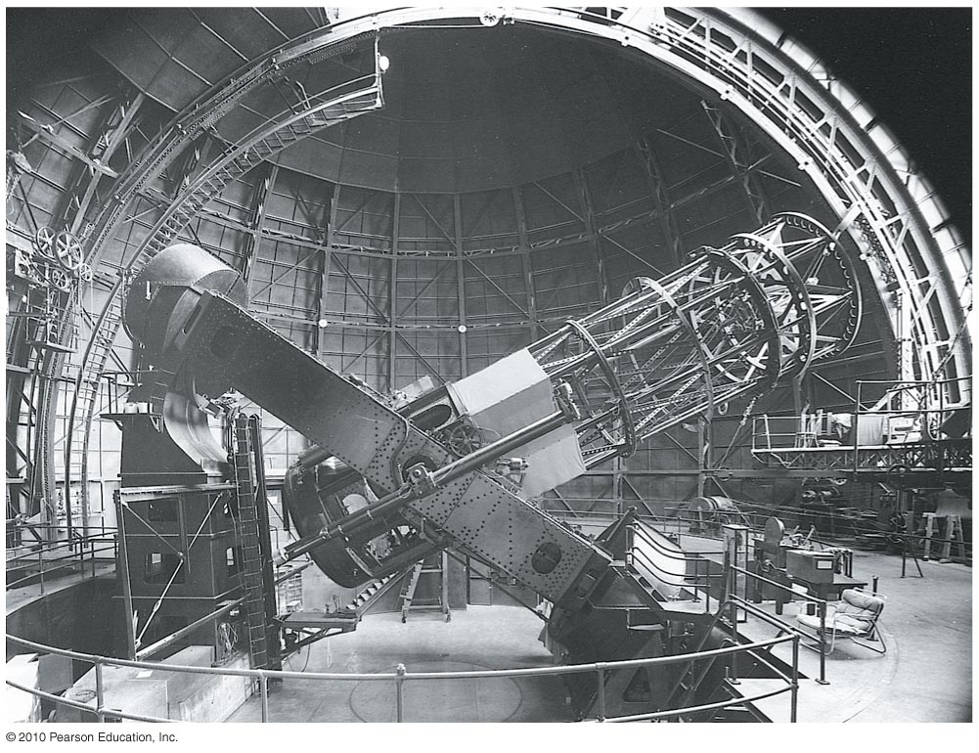
Hubble measuring the distance to the Andromeda Galaxy using Cepheid variable stars as standard candles.

Slide 4
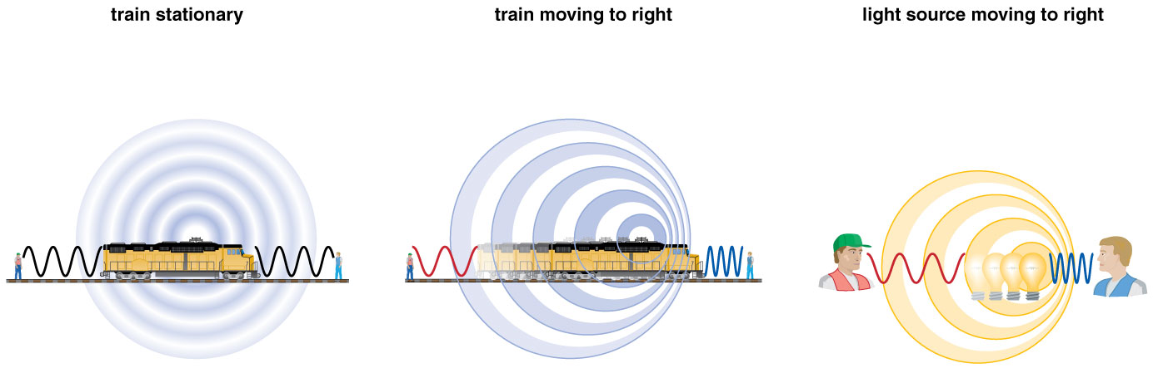
How does light tell us the speed of a distant object?
The Doppler Effect
Notes:
This figure from the book can give an introduction to the Doppler effect.

Slide 5
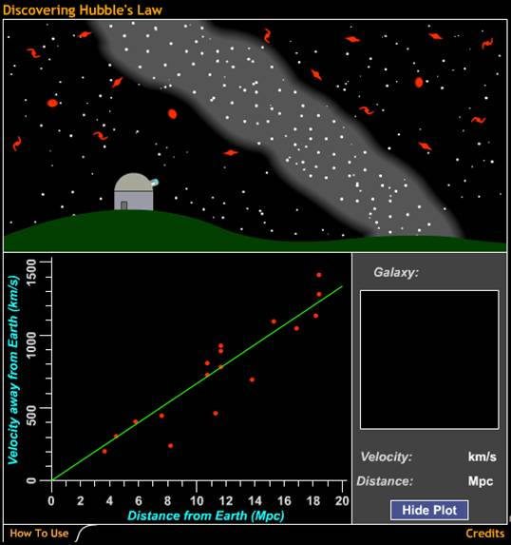
Hubble found that velocity and distance are related in a special way:
The further away a galaxy is, the faster it is moving away from us.
The universe is expanding!
Discovering Hubble's Law

Slide 6
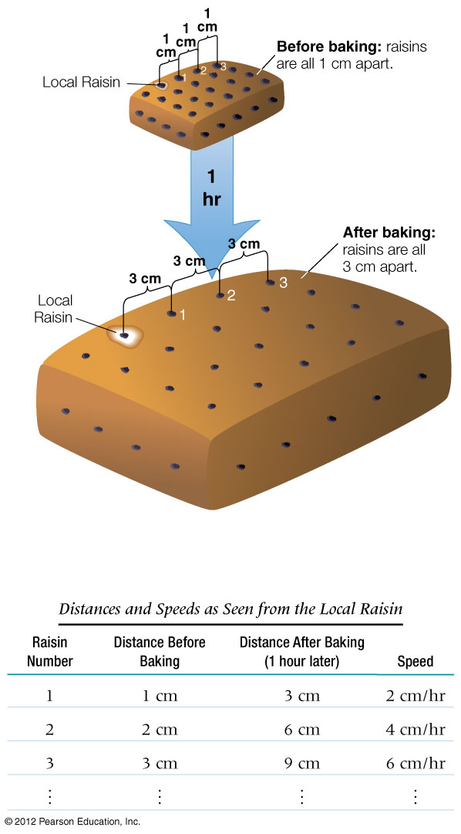
How do galaxies move within the universe?
Galaxies are carried along with the expansion of space:
Evidence for the Big Bang!
High energy densities and temperatures in early universe

Slide 7
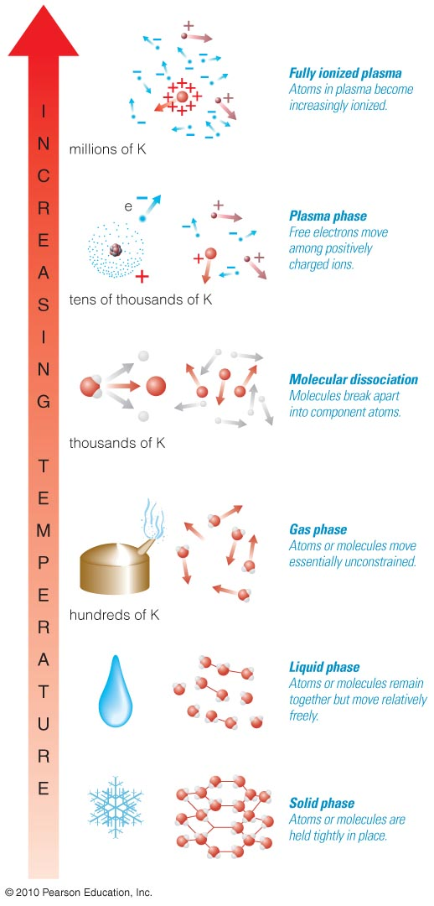
As temperature increases, particles move faster and break apart into smaller particles.
10⁶ K
Ionized
Gas
(Plasma)
10⁵ K
10⁴ K
Neutral gas of atoms
10³ K
Neutral gas of atoms and molecules
10² K
Liquid
10 K
Solid

Slide 8
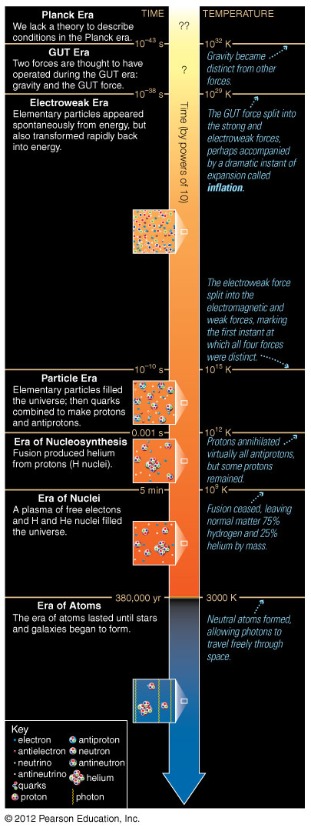
Era of Nucleosynthesis
Time: 0.001 s–5 min
Temp: 10¹²–10⁹ K
Began when matter annihilated remaining antimatter at
~ 0.001 s, leaving small excess of matter
Helium fused from protons and neutrons by 5-min mark

Slide 9
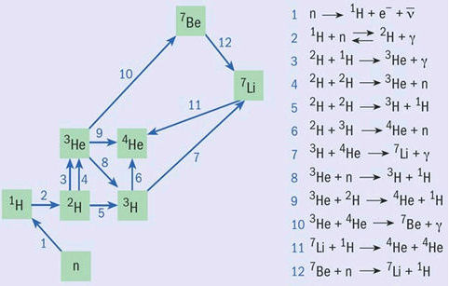

Slide 10
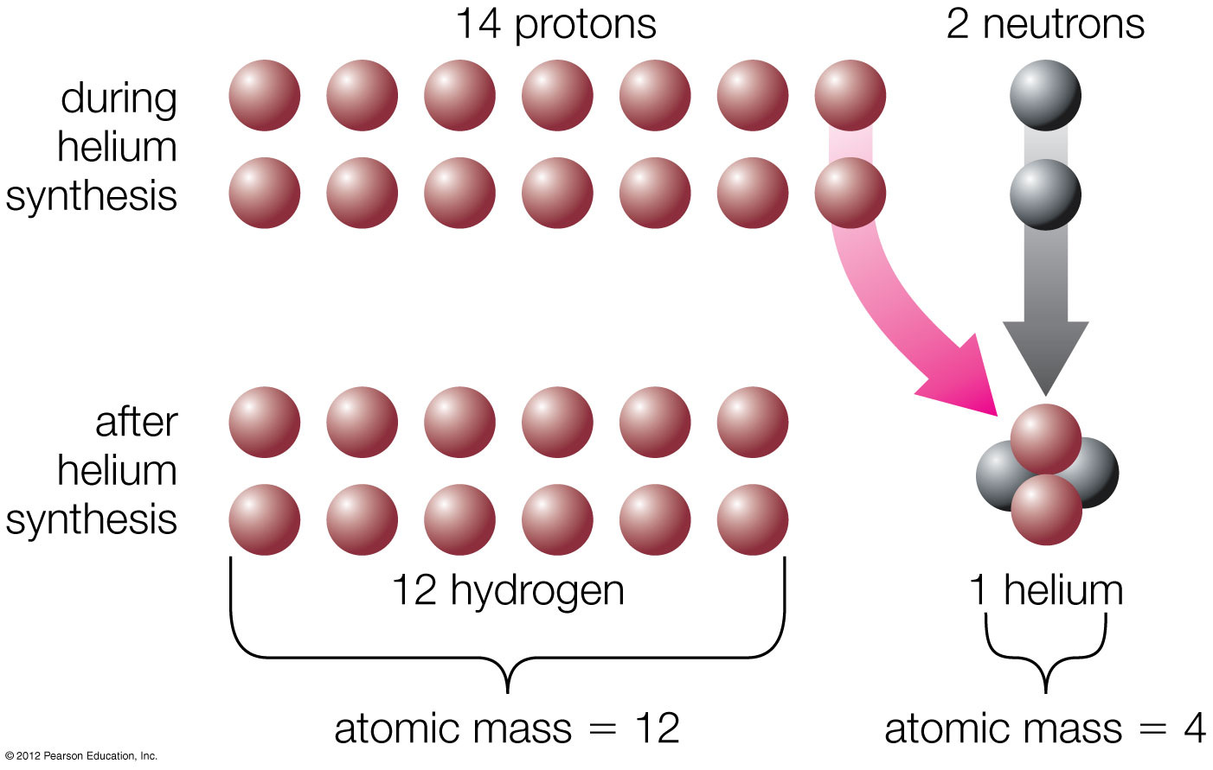
Big Bang theory prediction: 75% H, 25% He (by mass)
Matches observations of nearly primordial gases

Slide 11
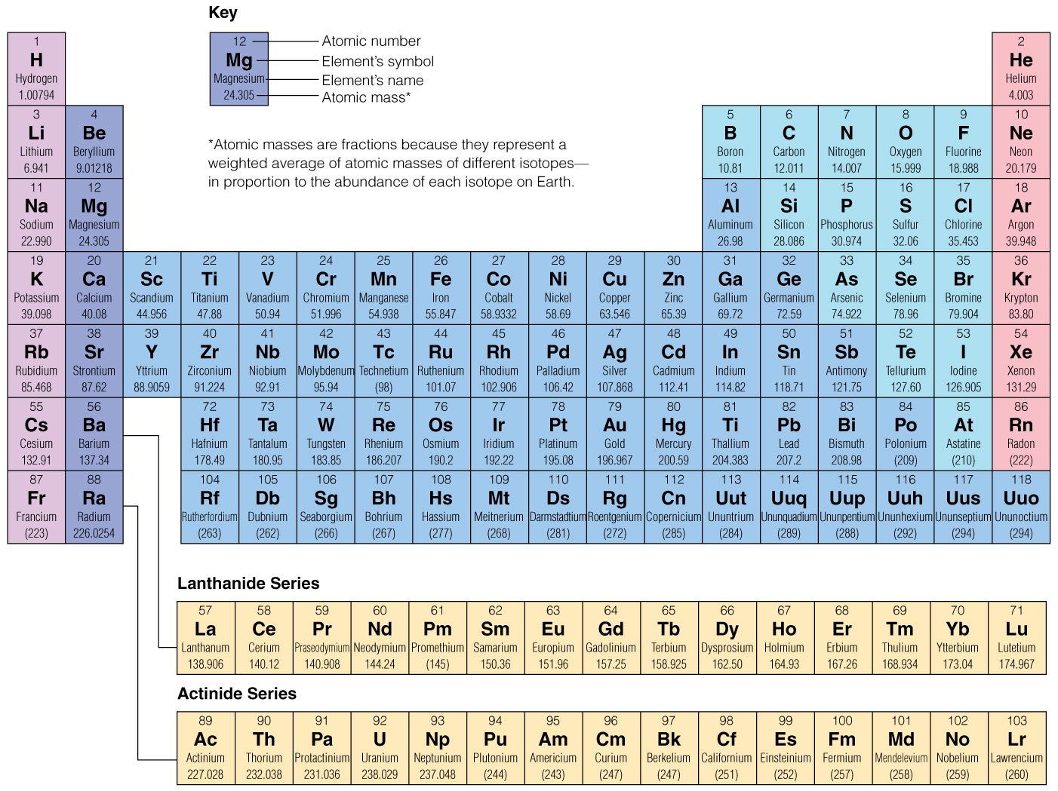
Big Bang made 75% H, 25% He—stars make everything else.

Slide 12
Era of Nuclei
Time: 5 min–380,000 yrs
Temp: 10⁹–3000 K
Plasma of nuclei, electrons, and photons for next 380,000 years.
Ended when electrons combined with nuclei

Slide 13
Era of Atoms
Time: 380,000 years– 1 billion years
Temp: 3000–20 K
Atoms formed at age ~380,000 years (electrons became bound to nuclei).
Background radiation is released at 3000 K or 380,000 years.

Slide 14
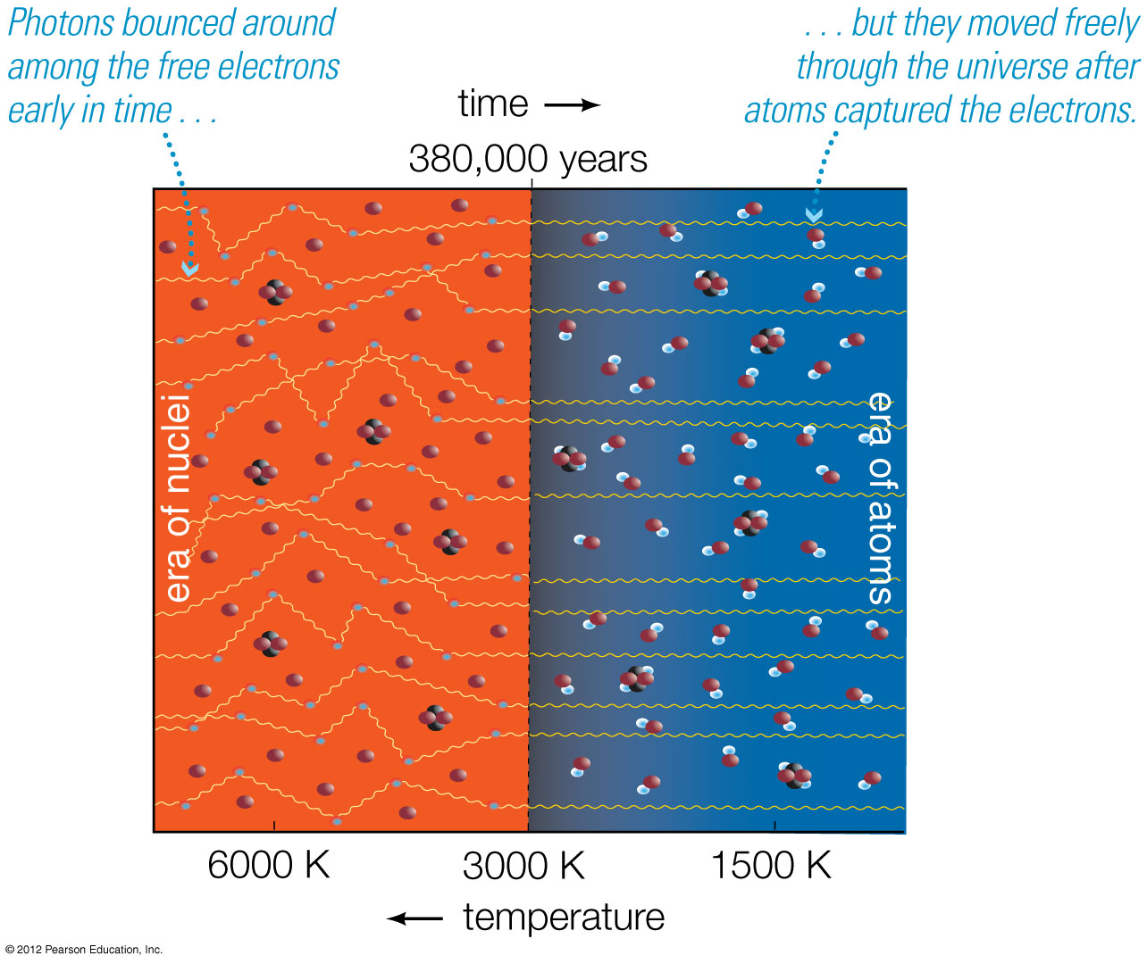
Background radiation from the Big Bang has been freely streaming across the universe since atoms formed at temperature ~3000 K: visible/infrared.

Slide 15
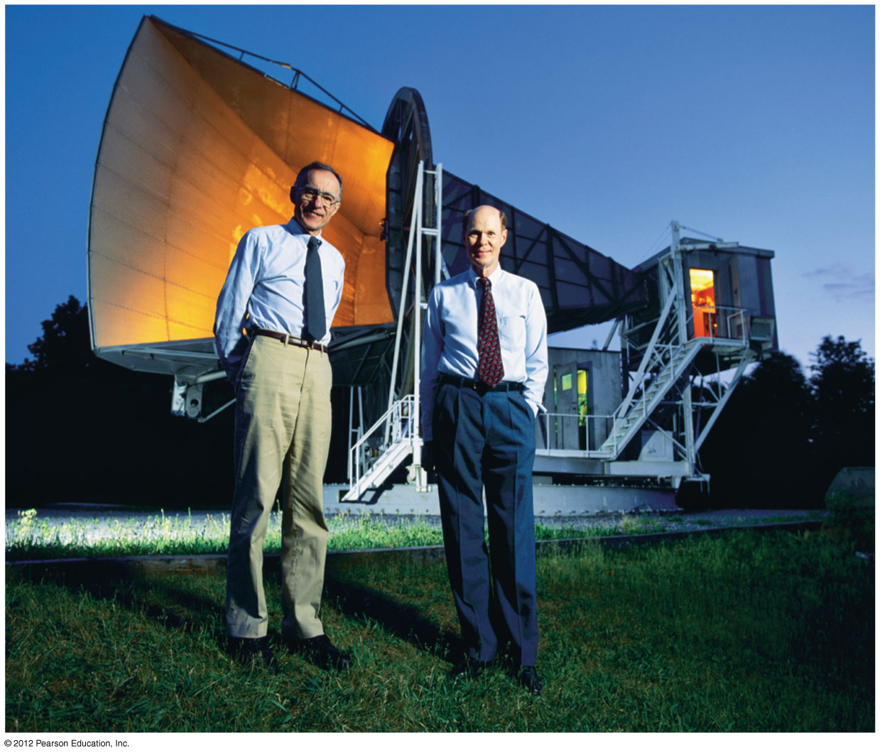
The cosmic microwave background— the radiation left over from the Big Bang— was detected by Penzias and Wilson in 1965.

Slide 16
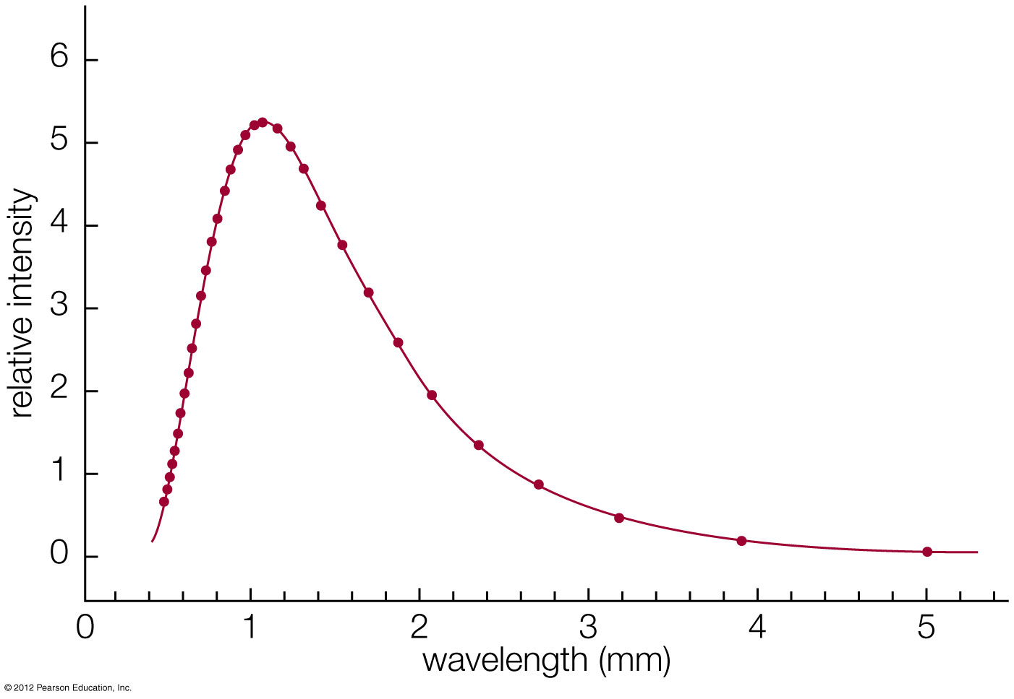
Background has perfect thermal radiation spectrum at temperature 2.73 K.
Expansion of the universe has redshifted thermal radiation from that time to ~1000 times longer wavelength: microwaves.

Slide 17
Era of Galaxies
Time: ~1 billion years–present
Temp: 20–3 K
The first stars and galaxies formed by ~1 billion years after the Big Bang.

Slide 18
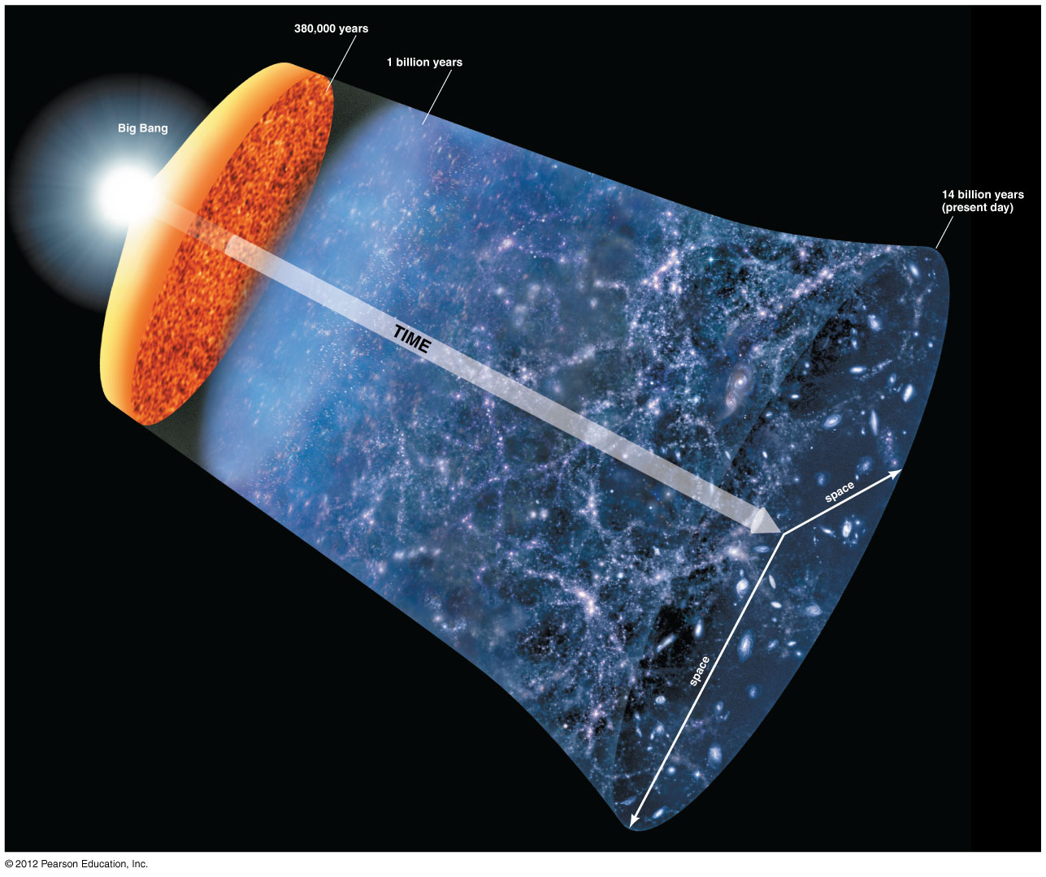
History of the universe according to the Big Bang theory

Slide 19
The Milky Way (which hosts the Sun) is one of about 100 billion galaxies.
10¹¹ stars/galaxy × 10¹¹ galaxies = 10²² stars
It has as many stars as grains of (dry) sand on all of Earth’s beaches.

Slide 20
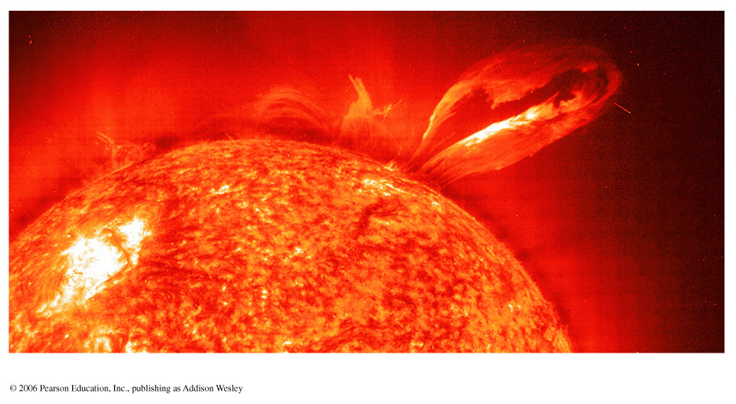
The Sun: how does it shine?

Slide 21
Is it on FIRE? … NO!
Chemical Energy Content
~ 10,000 years
Luminosity

Slide 22
Is it CONTRACTING? … NO!
Gravitational Potential Energy
~ 25 million years
Luminosity

Slide 23
E = mc²
—Einstein, 1905
It is powered by NUCLEAR ENERGY!
Nuclear Potential Energy (core)
~ 10 billion years
Luminosity

Slide 24
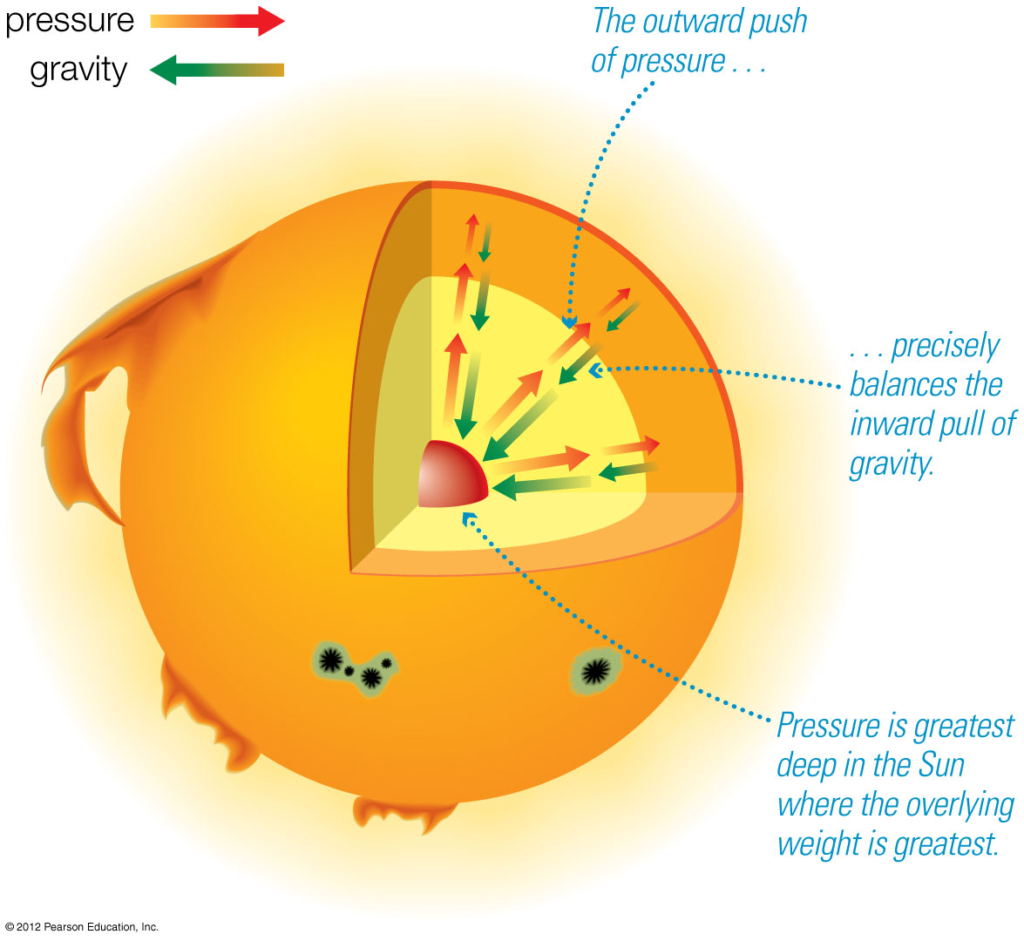
Gravitational equilibrium:
Gravity pulling in balances pressure pushing out.
Energy balance:
Thermal energy released by fusion in core balances radiative energy lost from surface.

Slide 25
The Sun releases energy by fusing four hydrogen nuclei into one helium nucleus.
Neutrinos created during fusion fly directly through the Sun.
Observations of these solar neutrinos can tell us what’s happening in the core.

Slide 26
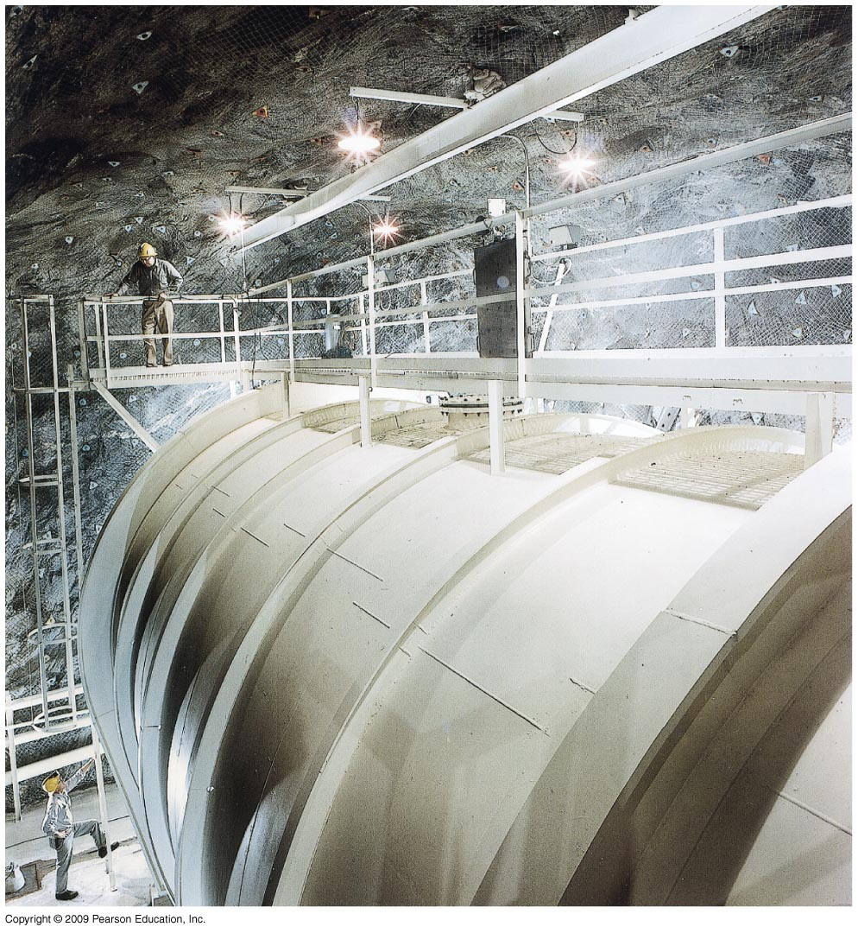
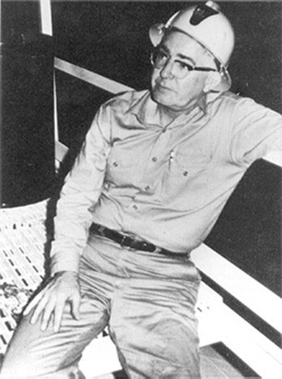
Solar neutrino problem:
Early searches (1960’s) for solar neutrinos by Ray Davis, Jr. failed to find the predicted number.

Slide 27
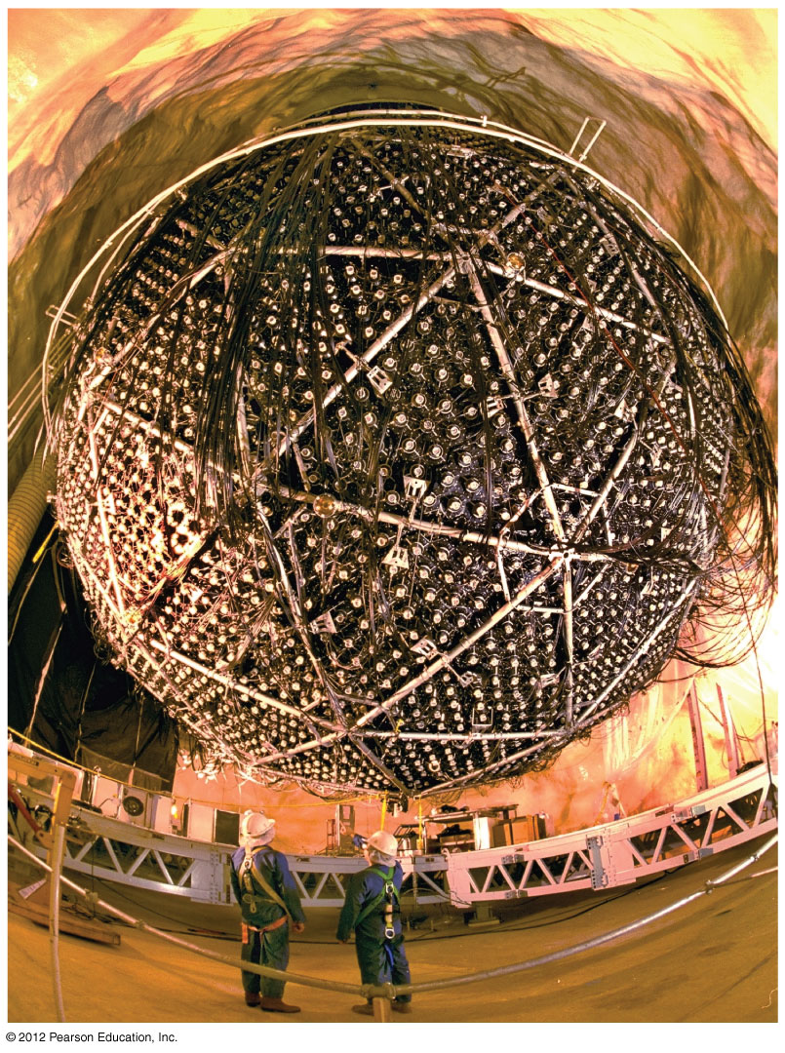
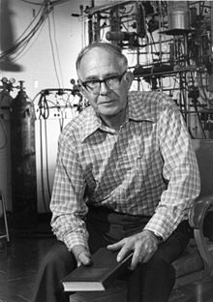
Solar neutrino problem:
More recent (2000’s) observations find the right number of neutrinos, but some have changed form!
Ray Davis
finally
won
Nobel
Prize
in 2002

Slide 28
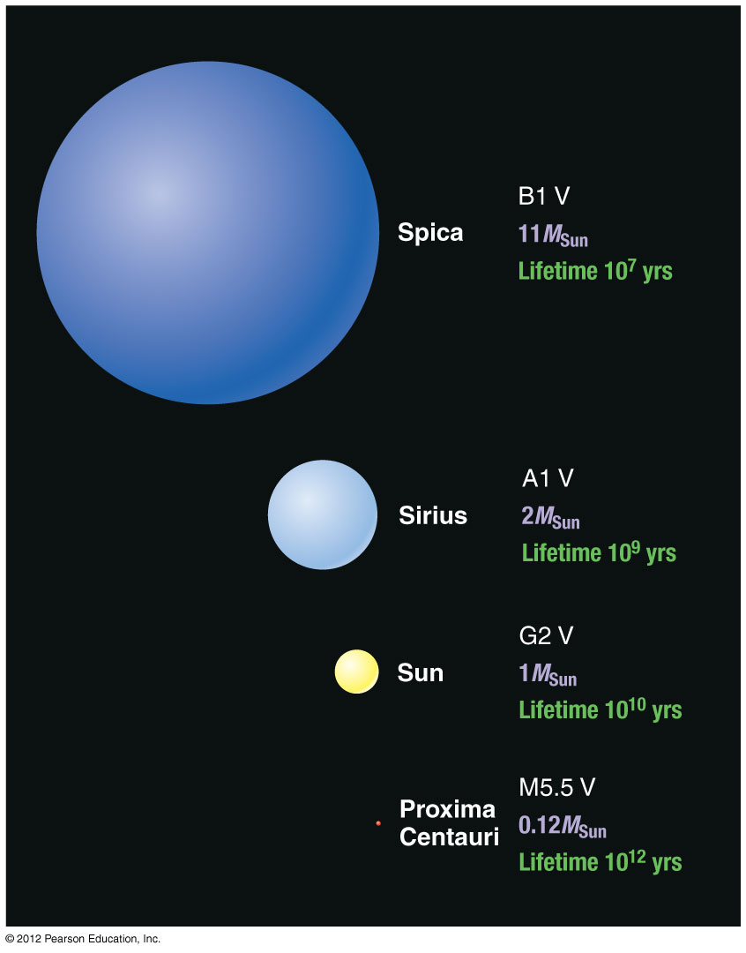
Hydrogen-burning stars in general
High-mass:
High luminosity
Short-lived
Large radius
Blue
Low-mass:
Low luminosity
Long-lived
Small radius
Red

Slide 29
Life Stages of Low-Mass Star
Protostar: cloud of gas collapses under gravity
Main Sequence: H fuses to He in core
Red Giant: H fuses to He in shell around He core until He flash
Helium Core Fusion: He fuses to C in core while H fuses to He in shell
5. Double Shell Fusion: H and He both fuse in shells
Planetary Nebula: outer layers expelled
White dwarf star left behind
Not to scale!

Slide 30
Helium fusion does not begin right away because it requires higher temperatures than hydrogen fusion—larger charge leads to greater repulsion.
The fusion of two helium nuclei doesn’t work, so helium fusion must combine three He nuclei to make carbon.

Slide 31
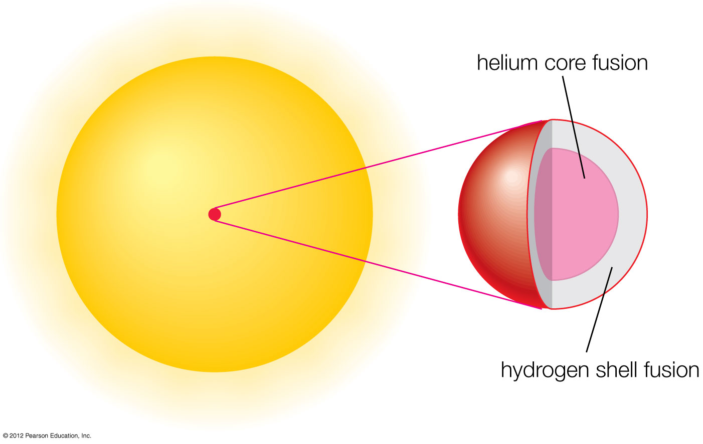

Slide 32
Helium fusion can make carbon in low-mass stars.

Slide 33
Life Stages of High-Mass Star
1. Protostar: cloud of gas collapses under gravity
Main Sequence: H fuses to He in core
Red Supergiant: H fuses to He in shell around He core
Helium Core Fusion: He fuses to C in core while H fuses to He in shell
Multiple Shell Fusion: many elements fuse in shells
Supernova explosion after iron core collapses
Neutron star or black hole left behind
Not to scale!

Slide 34
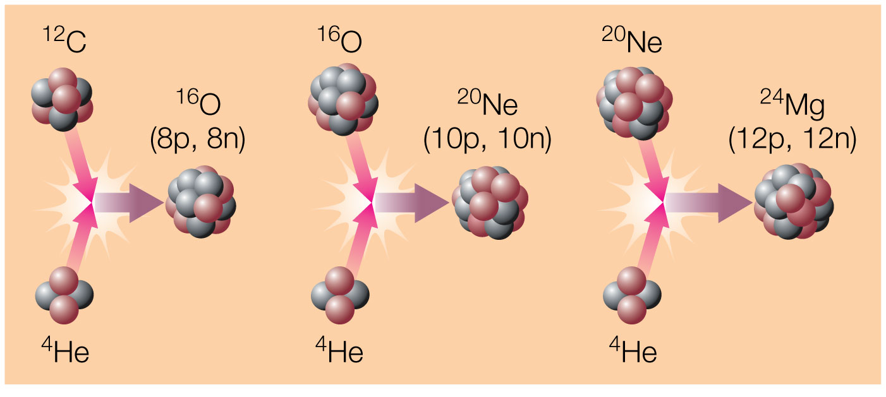
How do high-mass stars make the elements necessary for life?
High core temperatures allow helium to fuse with heavier elements.

Slide 35
Helium capture builds C into O, Ne, Mg …

Slide 36
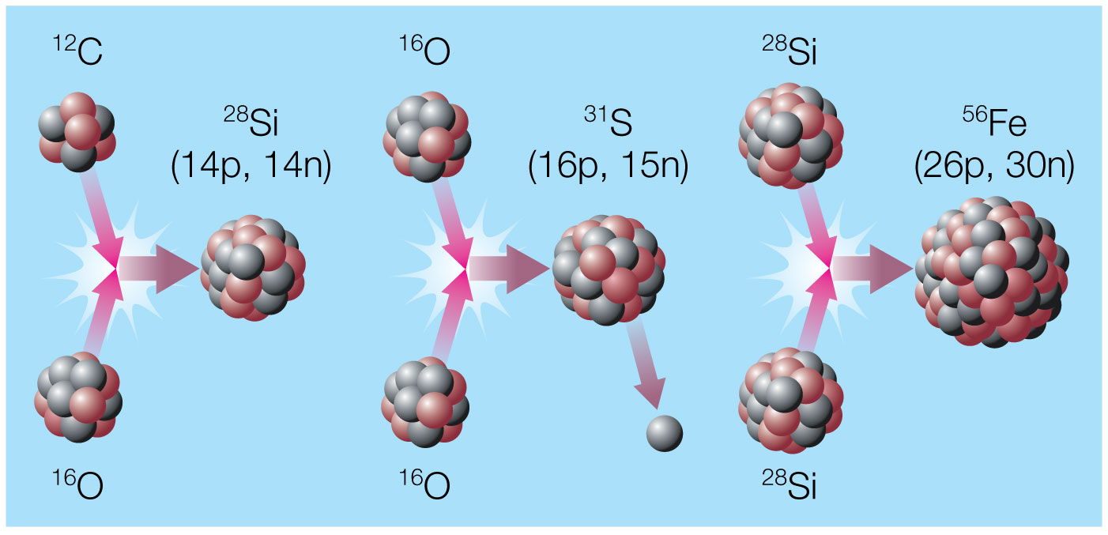
Advanced Nuclear Burning
Core temperatures in stars with >8M_{Sun} allow fusion of elements as heavy as iron.

Slide 37
Advanced reactions in stars make elements such as Si, S, Ca, and Fe.

Slide 38
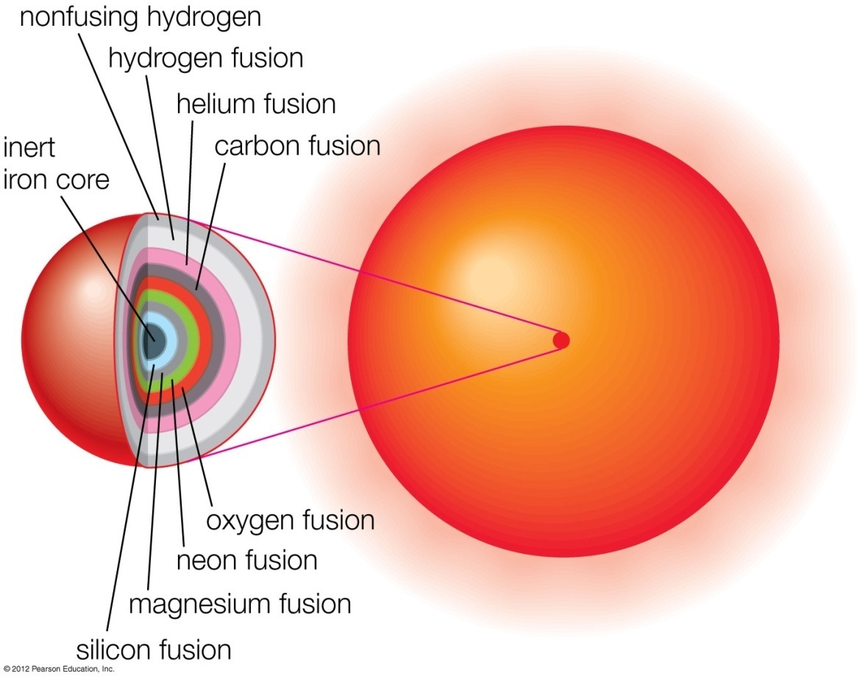
Multiple Shell Burning
Advanced nuclear burning proceeds in a series of nested “onion-like” shells.

Slide 39
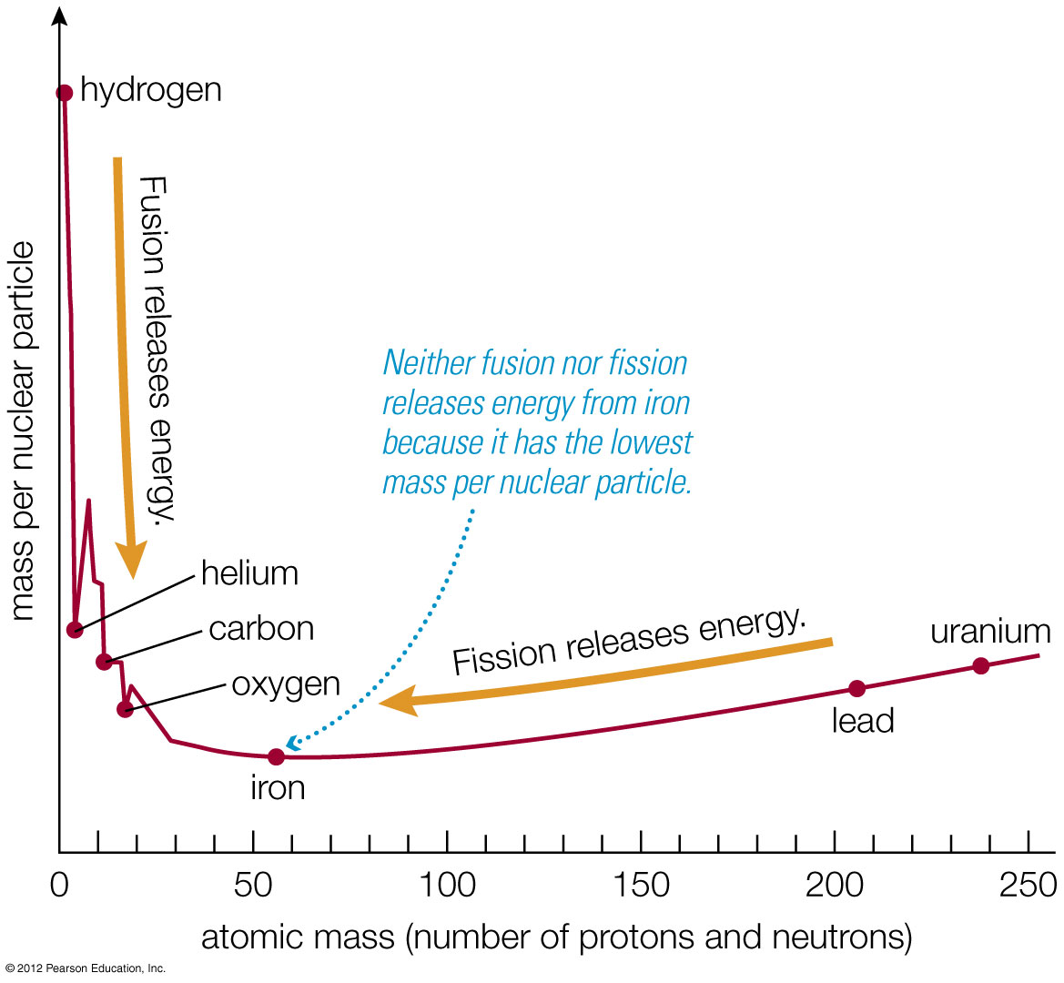
Iron is a dead end for fusion because nuclear reactions involving iron do not release energy.
(Iron has lowest mass per nuclear particle.)

Slide 40
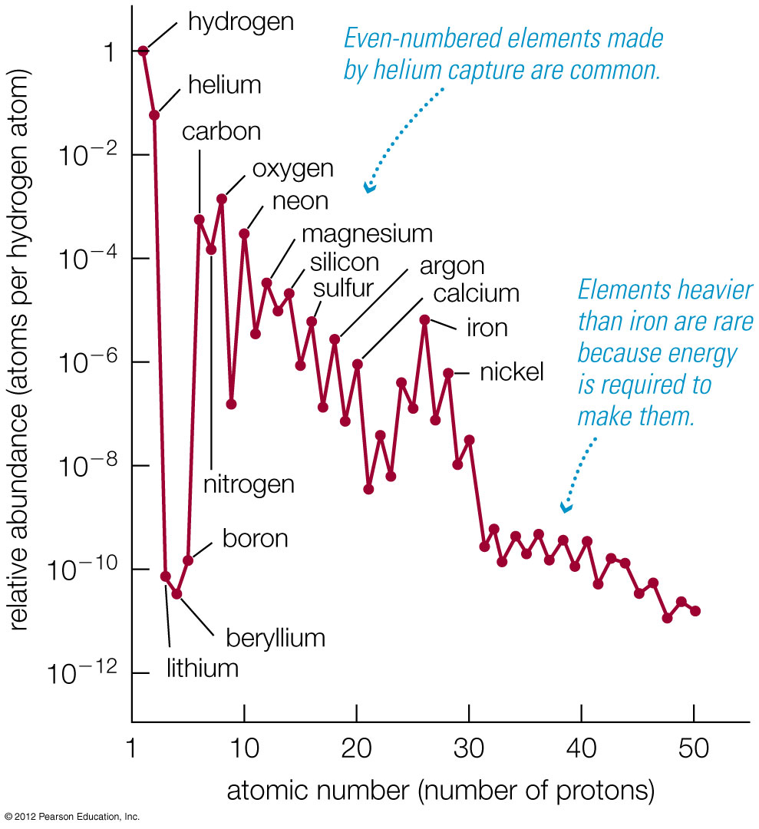
Some evidence for origin of the elements

Slide 41
How are elements heavier than iron created?
Iron from a previous generation of stars is exposed to a flux of neutrons
How does this create heavy elements ?
Neutron Capture Processes
There are 2:
- s-process (slow neutron capture)
- r-process (rapid neutron capture)

Slide 42
Chart of nuclides
Number of protons (Z) -->
Number of neutrons (N) -->

Slide 43
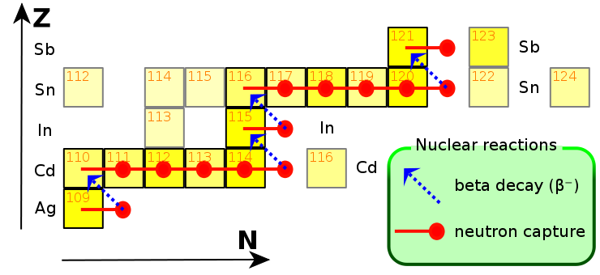
The s-process

Slide 44
Where do neutrons for s-process come from?
¹³C + ⁴He --> ¹⁶O + n
²²Ne + ⁴He --> ²⁵Mg + n

Slide 45
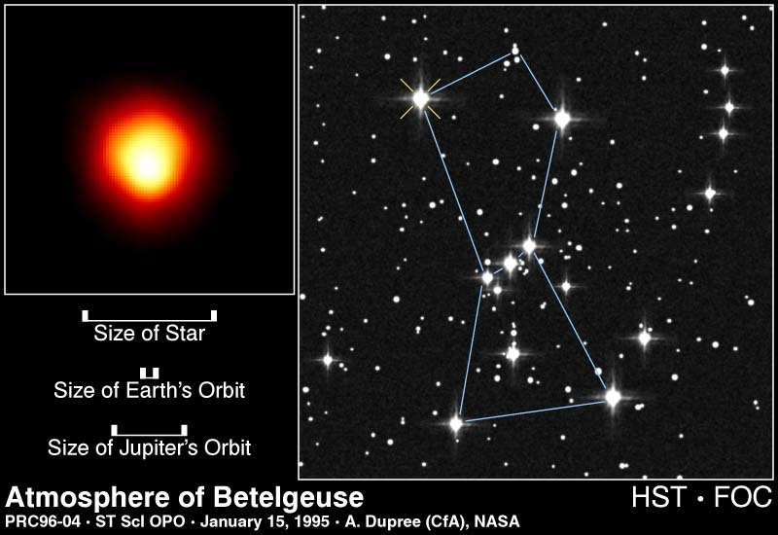
Where does the s-process happen ?
there !
in red giants – and it takes several million years !
(or, more correctly, low mass TP-AGB stars)

Slide 46
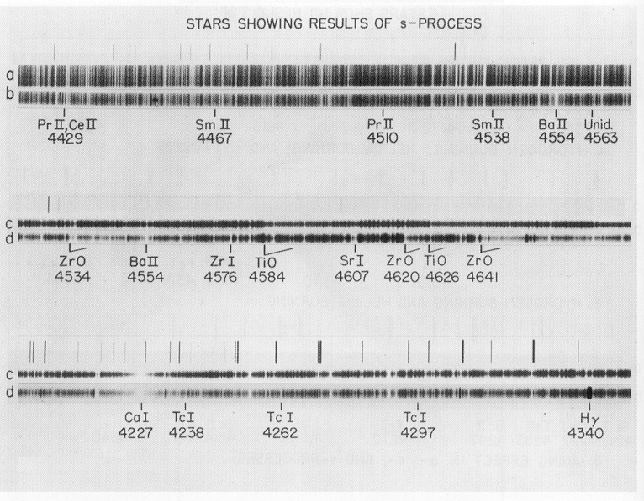
How can we tell ?
Analyze light from a red giant:
Star contains Technetium (Tc) !!! (heavy element Z=43, T_{1/2} = 4 million years, Merrill 1952)

Slide 47
The s-process makes only half of all heavy elements.
So, where do the rest come from ?

Slide 48
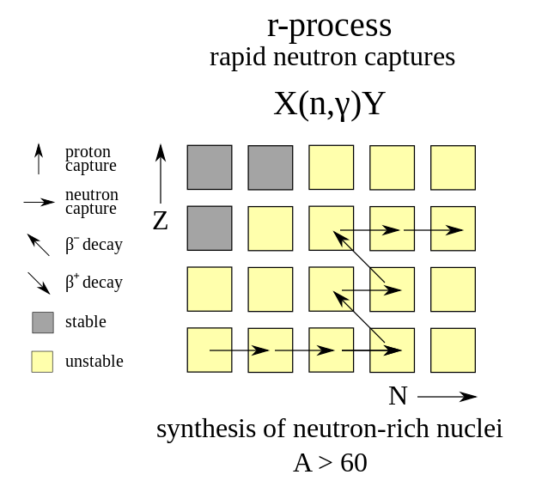

Slide 49
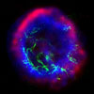
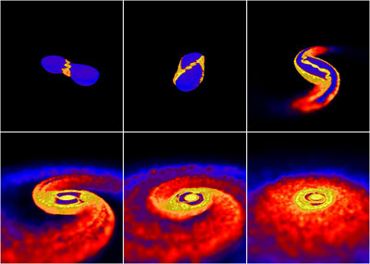
Where does the r-process happen ?
The r-process creates most of the remaining
elements, but we don’t know the site
– here are some ideas:
Supernovae? ?
Neutron-star mergers? ?

Slide 50
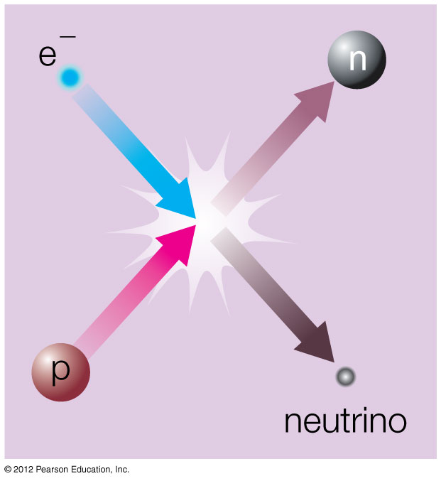
Supernova Explosion
Electrons combine with protons, making neutrons and neutrinos.
Neutrons collapse to the center, forming a neutron star or a black hole

Slide 51
Supernova Remnant
Energy released by the collapse of the core drives outer layers into space.
The Crab Nebula is the remnant of the supernova seen in A.D. 1054.
Neutron star left behind

Slide 52
Energy and neutrons released in a massive-star supernova explosion or a merger of two neutron stars may enable elements heavier than iron to form, including Gold (Au) and Uranium (U)

Slide 53
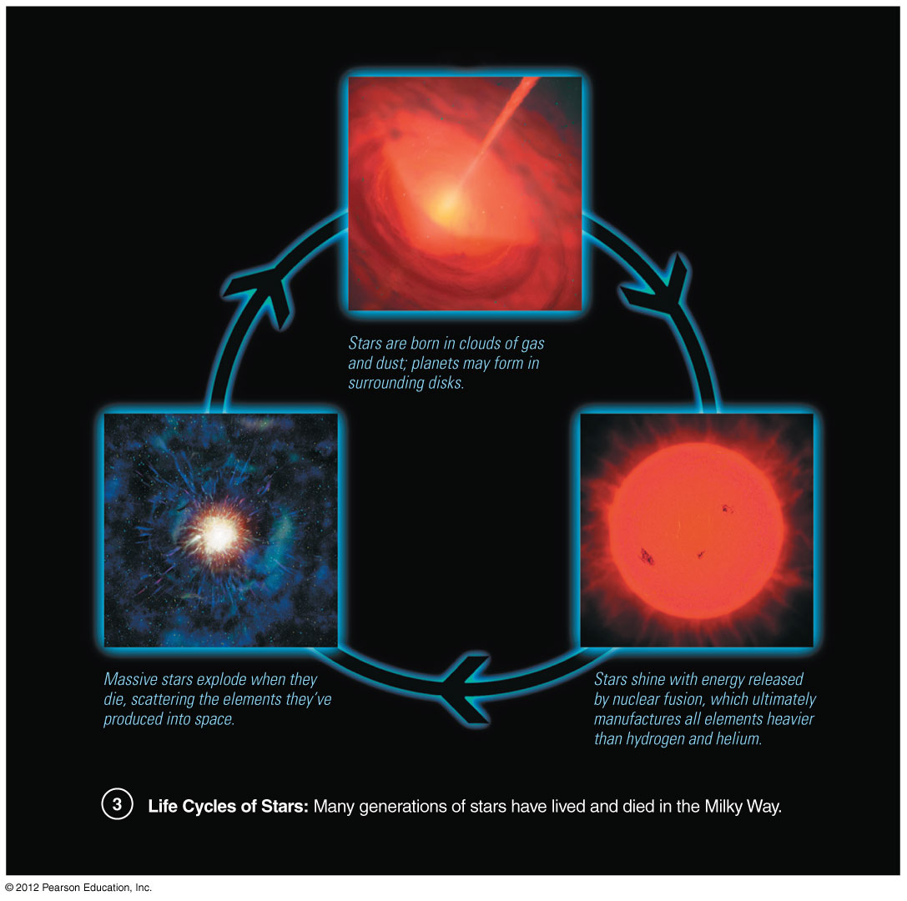
How did we come to be?

Slide 54
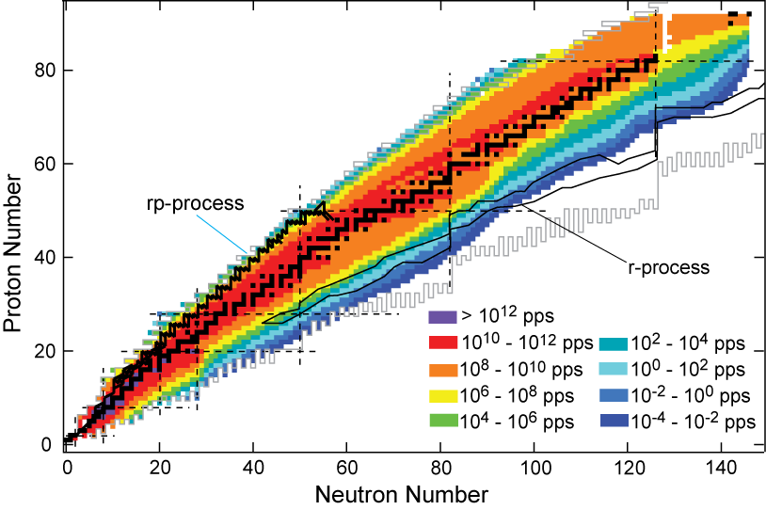
FRIB will help us to understand stellar nucleosynthesis in detail!

Slide 55
Thank you for your attention!
Now, for an exercise…

