Slide 1
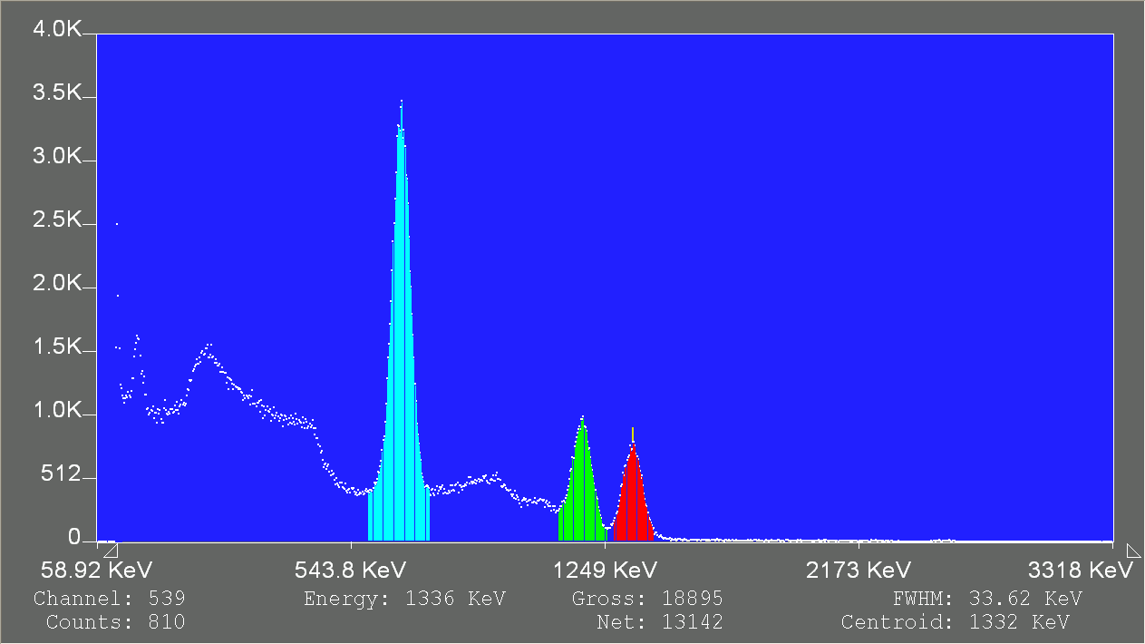
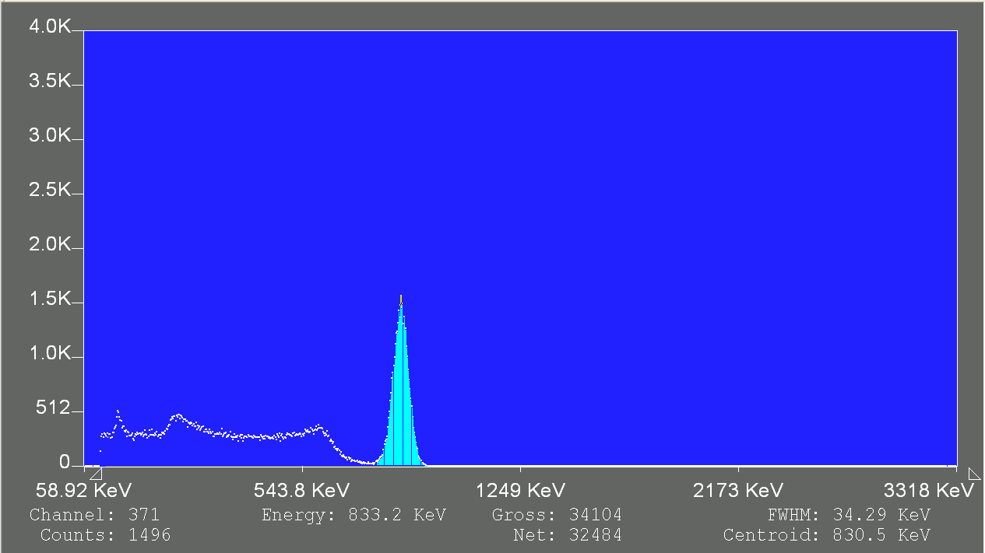
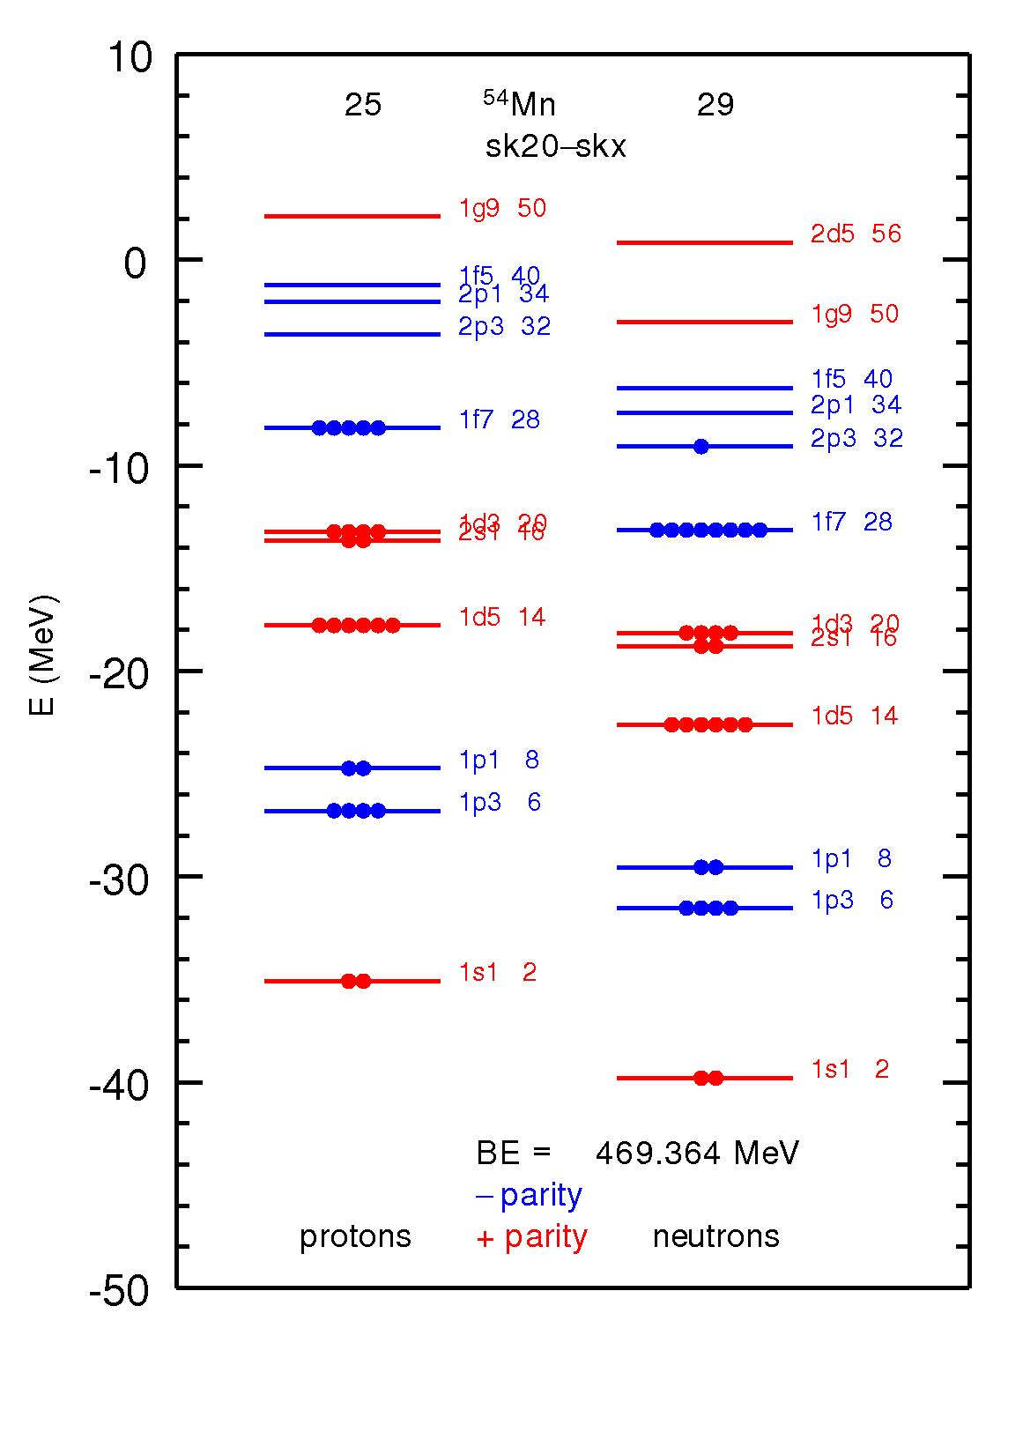
Radiation Detectives: PAN 2017 Experiments Isabel Reynolds¹, Francesca Sica¹, Ebony Matthews¹
1 Physics of Atomic Nuclei II an outreach of JINA-CEE, Michigan State University, East Lansing, MI, 48823, USA.
Using Gamma Spectroscopy to Identify an Unknown Decaying Nucleus
Using Alpha Spectroscopy to Identify Half-Life of Ag-108
Procedure: We are using radiation detection equipment to produce a decay scheme to identify an unknown nucleus that produces gamma rays as result of beta decay. The decay scheme will be calibrated using cesium-137 and cobalt-60.
Procedure: We are using radiation detection equipment to produce a decay scheme to identify the half-life of Ag-108.
Hypothesis: The half life of Ag-108 will be approximately 4 minutes.
Results: The energy emitted by the cesium and cobalt helped us to figure out the identity of the unknown substance. We searched the energy and half life of the unknown. The unknown was Mn-54.
Results: The half-life of Ag-108 was calculated to 119.5 +/- 16.43 seconds.

