Slide 1
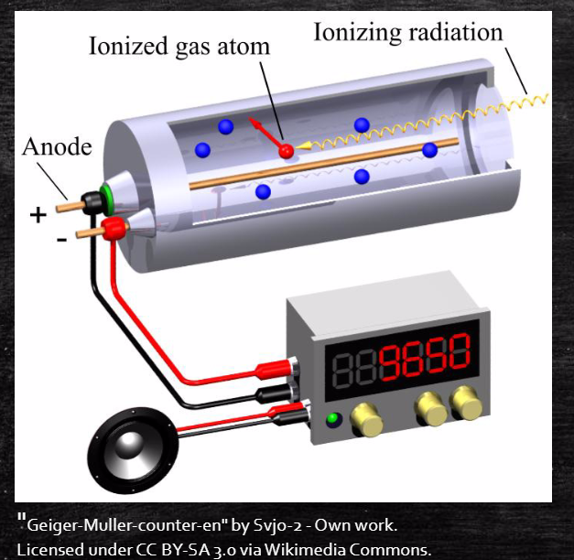
Radiation and The Geiger-Müller Counter
Joe Belarge

Slide 2
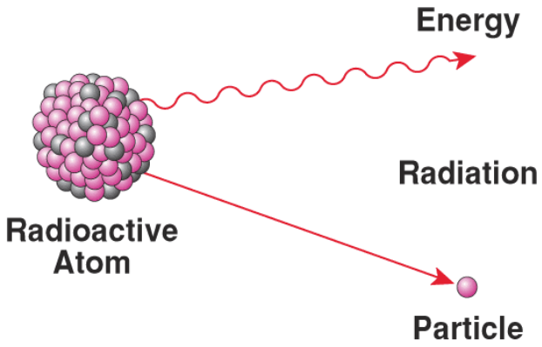
What is Radioactive Decay
Radioactive Decay is a spontaneous process in which a nucleus will decrease its energy by emitting electromagnetic radiation, or subatomic particle(s). In many cases the identity of the nucleus is changed through radioactive decay.

Slide 3
Why Are Some Nuclei Radioactive?
Nature is lazy → It wants to be in the lowest energy state.
Neon lights are analogous to nuclear radiation (and emit electro-magnetic (EM) radiation).
Ne

Slide 4
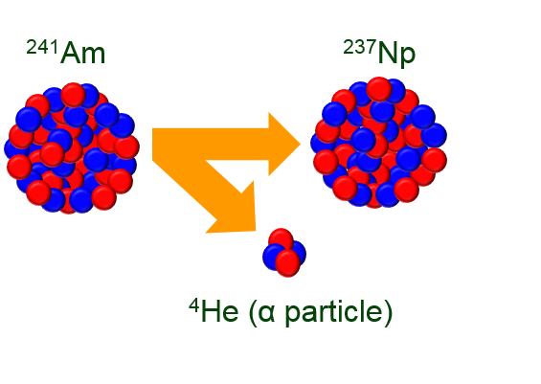
Types of Radiation
Alpha

Slide 5
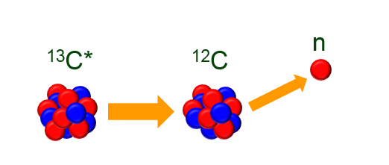
Types of Radiation
Alpha
Neutron

Slide 6
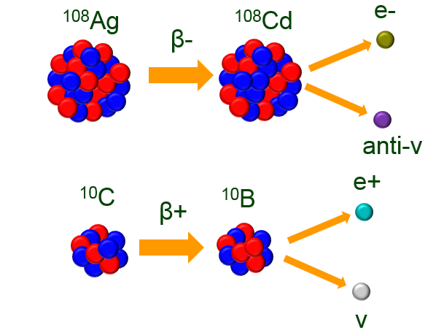
Types of Radiation
Alpha
Beta
Neutron

Slide 7
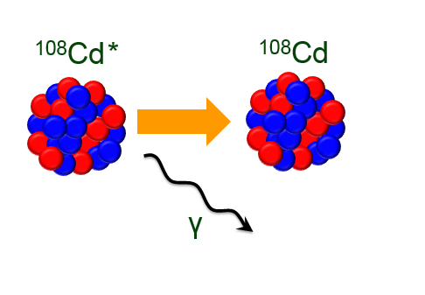
Types of Radiation
Alpha
Gamma
Neutron
Beta

Slide 8
Types of Radiation
Alpha
Gamma
Neutron
Beta

Slide 9
Types of Radiation
Alpha
Gamma
The ²⁴¹Am will α-decay, and these α particles will be captured by the ⁹Be in the AmBe source.
Neutron
Beta

Slide 10
Types of Radiation
Alpha
Gamma
The ²⁴¹Am will α-decay, and these α particles will be captured by the ⁹Be in the AmBe source.
¹³C* will de-excite through neutron emission.
Neutron
Beta

Slide 11
Types of Radiation
Alpha
Gamma
The ²⁴¹Am will α-decay, and these α particles will be captured by the ⁹Be in the AmBe source.
¹³C* will de-excite through neutron emission.
Neutron capture will happen on ^{107,109}Ag, creating radioactive ^{108,110}Ag.
Neutron
Beta

Slide 12
Types of Radiation
Alpha
Gamma
The ²⁴¹Am will α-decay, and these α particles will be captured by the ⁹Be in the AmBe source.
¹³C* will de-excite through neutron emission
Neutron capture will happen on ^{107,109}Ag, creating radioactive ^{108,110}Ag.
^{108,110}Ag will β- decay to ^{108,110}Cd*. Electrons are detected in the Geiger Müller counter.
Neutron
Beta

Slide 13
Types of Radiation
Alpha
Gamma
The ²⁴¹Am will α-decay, and these α particles will be captured by the ⁹Be in the AmBe source.
¹³C* will de-excite through neutron emission.
Neutron capture will happen on ^{107,109}Ag, creating radioactive ^{108,110}Ag.
^{108,110}Ag will β- decay to ^{108,110}Cd*. Electrons are detected in the Geiger Müller counter.
^{108,110}Cd* will de-excite through γ-ray emission, and the γ-rays will be detected in the Geiger Müller counter.
Neutron
Beta

Slide 14
Radioactive Decay
If a radioactive sample contains $N_{0}$ radioactive nuclei, the amount of nuclei at time t is given below, with λ defined as the decay constant.
$$N\left(t\right)=N_{0}e^{−λt}$$
The Half-life of a radioisotope is determined by solving the above equation.
$$N\left(t_{1/2}\right)=\frac{N_{0}}{2}=N_{0}e^{−λt_{1/2}}$$
$$ln\left(\frac{1}{2}\right)=−λt_{1/2} →t_{1/2}=\frac{ln⁡(2)}{λ}$$

Slide 15
Detecting Radiation
Often it is very difficult to directly detect radiation. It is much easier to detect the ionization of atoms in a detector material that is caused by the radiation we are interested in.
There are many ways to do this, but the goal is always to collect charge carriers.
+
-

Slide 16
Detecting Radiation
Often it is very difficult to directly detect radiation. It is much easier to detect the ionization of atoms in a detector material that is caused by the radiation we are interested in.
There are many ways to do this, but the goal is always to collect charge carriers.
+
+
-
-
+
-
+
-

Slide 17
Detecting Radiation
Often it is very difficult to directly detect radiation. It is much easier to detect the ionization of atoms in a detector material that is caused by the radiation we are interested in.
There are many ways to do this, but the goal is always to collect charge carriers.
+
+
-
-
+
-
+
-

Slide 18
Detecting Radiation
Often it is very difficult to directly detect radiation. It is much easier to detect the ionization of atoms in a detector material that is caused by the radiation we are interested in.
There are many ways to do this, but the goal is always to collect charge carriers.
+
+
-
-
+
-
+
-

Slide 19
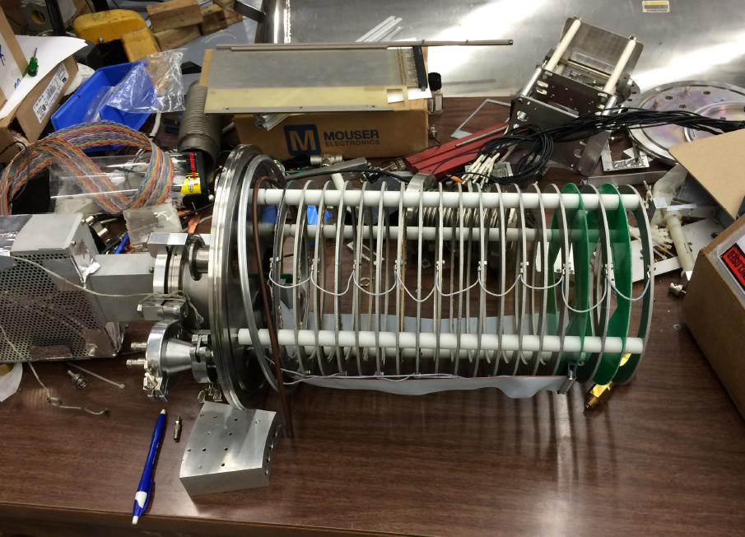
Detecting Radiation – Gas Detectors
Ion Chambers – Radiation passing through gas creates electron-ion pairs that are collected to create the signal.

Slide 20
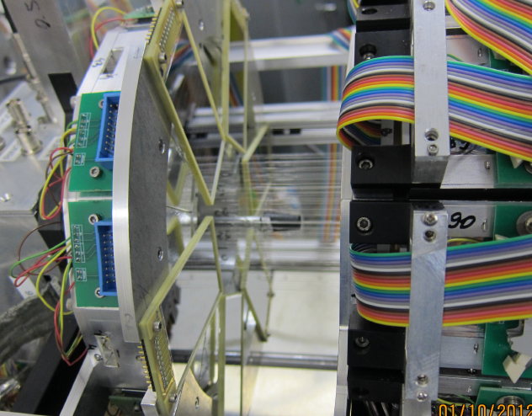
Detecting Radiation – Gas Detectors
Proportional Counters – Radiation creates electron-ion pairs, and the accelerated electrons create an avalanche of ionizations that are proportional to the original charge.

Slide 21
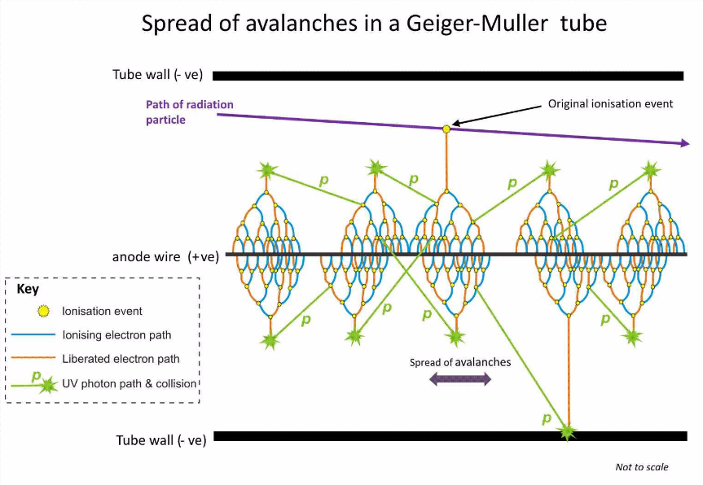
Detecting Radiation – Gas Detectors
Geiger Müller Counter – A higher electric field is applied than for proportional counter or ion chambers, resulting in many more avalanches.
The end signal is independent of the original number of electron-ion pairs produced in the gas.
No energy information! Only works for counting!

Slide 22
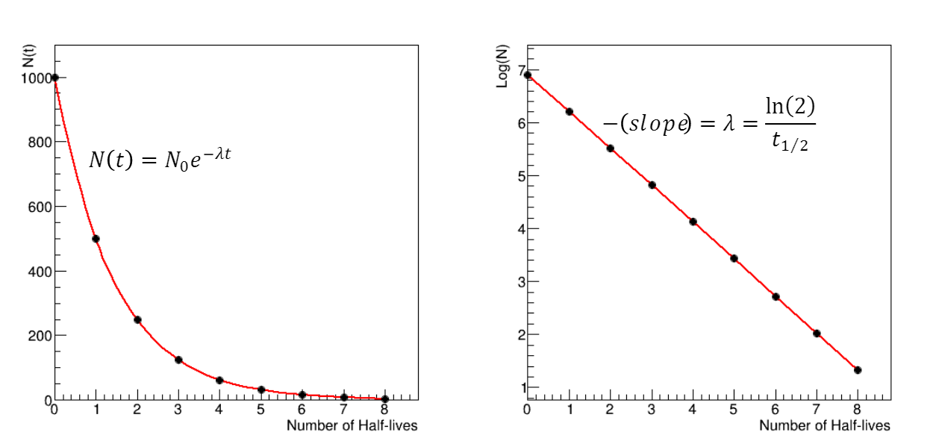
Todays Experiment – Measuring the Half-life of ^{108,110}Ag
Measure counts in the GM tube as a function of time.
From the histogram calculate the lifetime of the Ag isotopes.

Slide 23
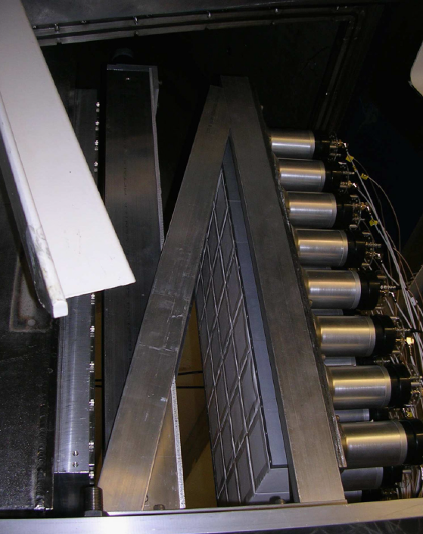
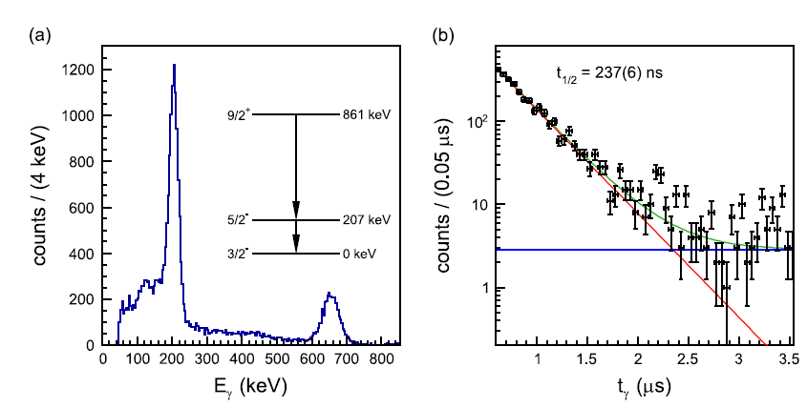
Todays Experiment – In the Real World
Physicists at NSCL use the same technique to measure the lifetime of unknown nuclear states using the Hodoscope.
K. Wimmer et al., NIMA 769, 65-71 (2015)

Slide 24
Questions
Thanks to everyone at PAN, NSCL, and BPS for making this possible, including:
P. C. Bender, S. Ayoub, C. Fry, K. Childers, Z. Constan, M. Olsen, S. Tessmer

