Slide 1
Zach Kohley

Slide 3
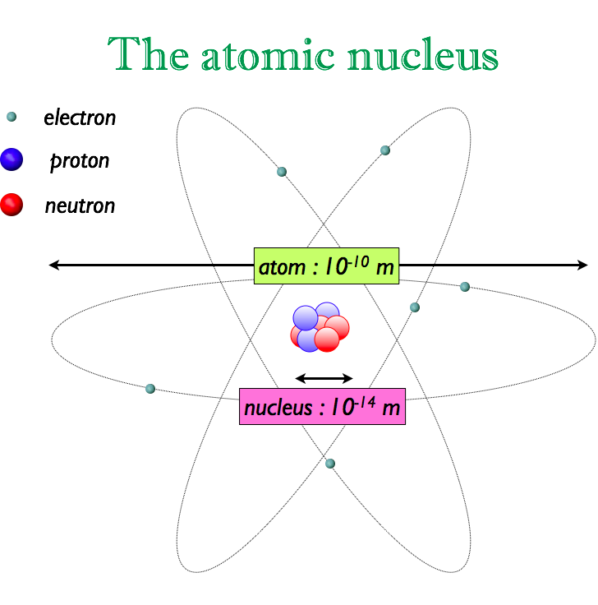
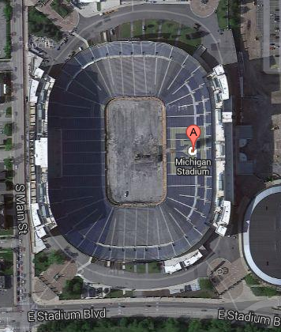

Slide 5
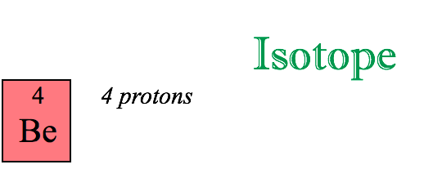
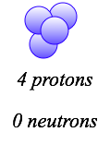
0.000000000000000000001 seconds

Slide 7
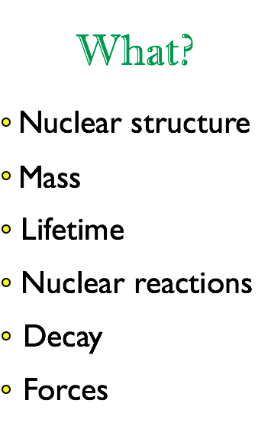
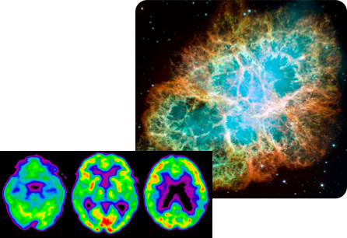

Slide 8
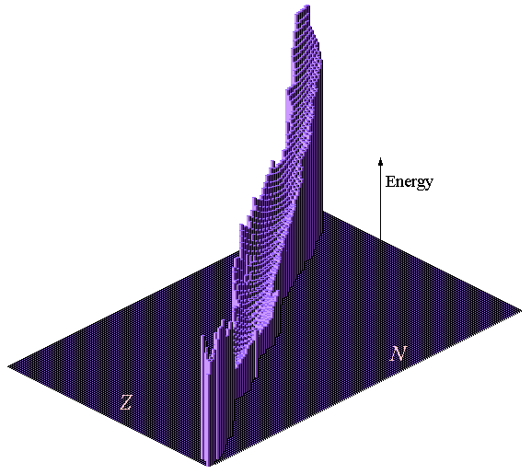
Chart of nuclides
Height represents the “instability”

Slide 9
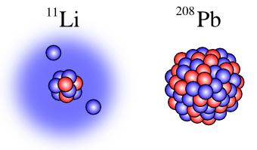
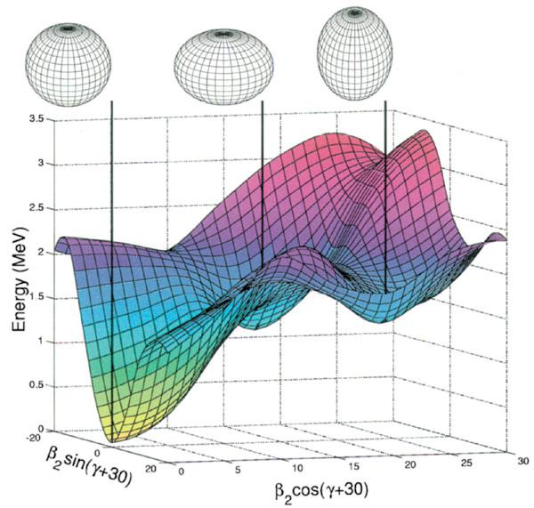
Shape Coexistence

Slide 10
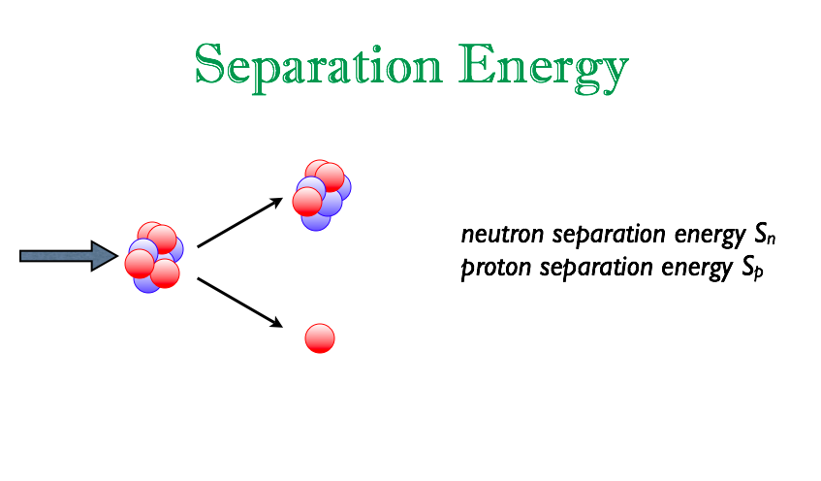
¹²Be
¹³Be
n
S_{n} = M_{12Be} + M_{n} – M_{13Be}
Amount of energy we need to give to the nucleus to remove one of its neutrons(protons).
Bound: S_{n} > 0 MeV
Unbound: S_{n} < 0 MeV
¹²Be
n
¹⁴Be
n
¹⁴Be
2n

Slide 11
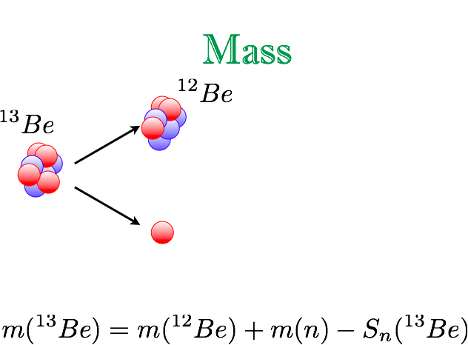
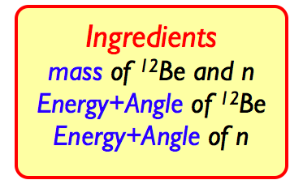
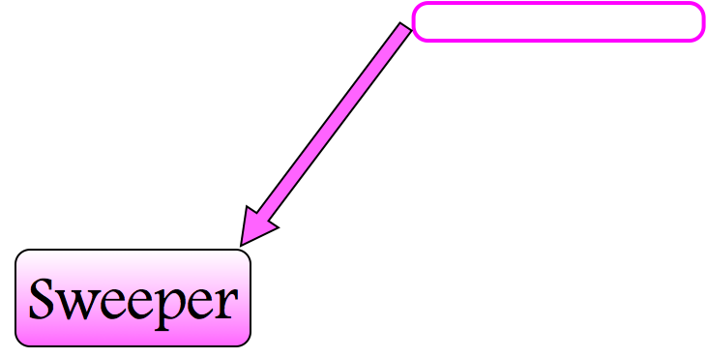
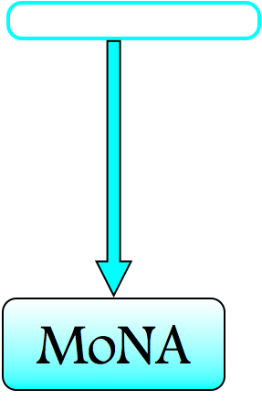
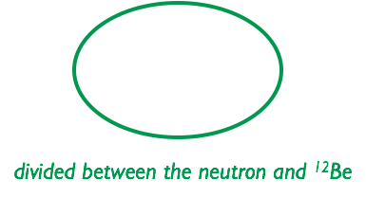
Unbound
S_{n} < 0 MeV

Slide 14
Me

Slide 19
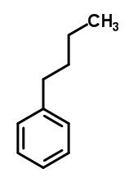

Slide 20
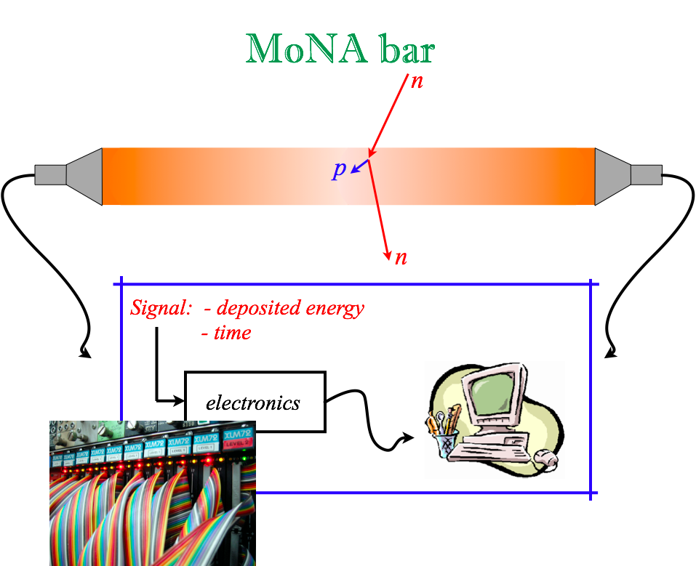
Cosmic Rays for calibration

Slide 21
1 GeV = 10,000 per m² per second
1 TeV = 1 per m² per second

Slide 22
1TeV proton hitting the atmosphere

Slide 23
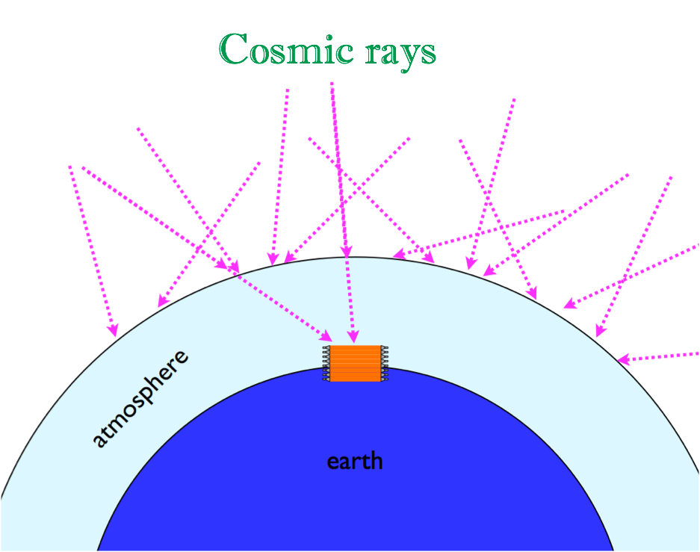

Slide 25
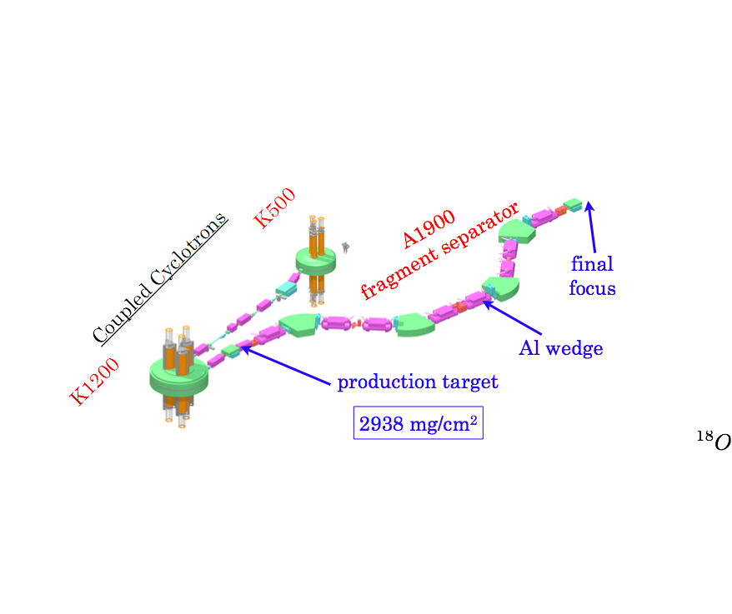

Slide 26
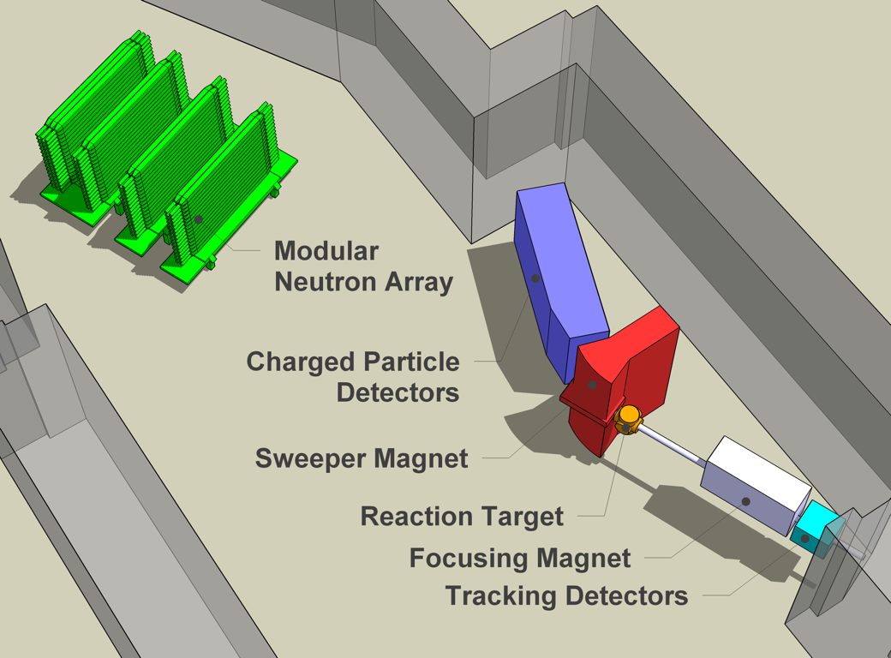
Variations
Charged fragment
n
n
beam

Slide 27
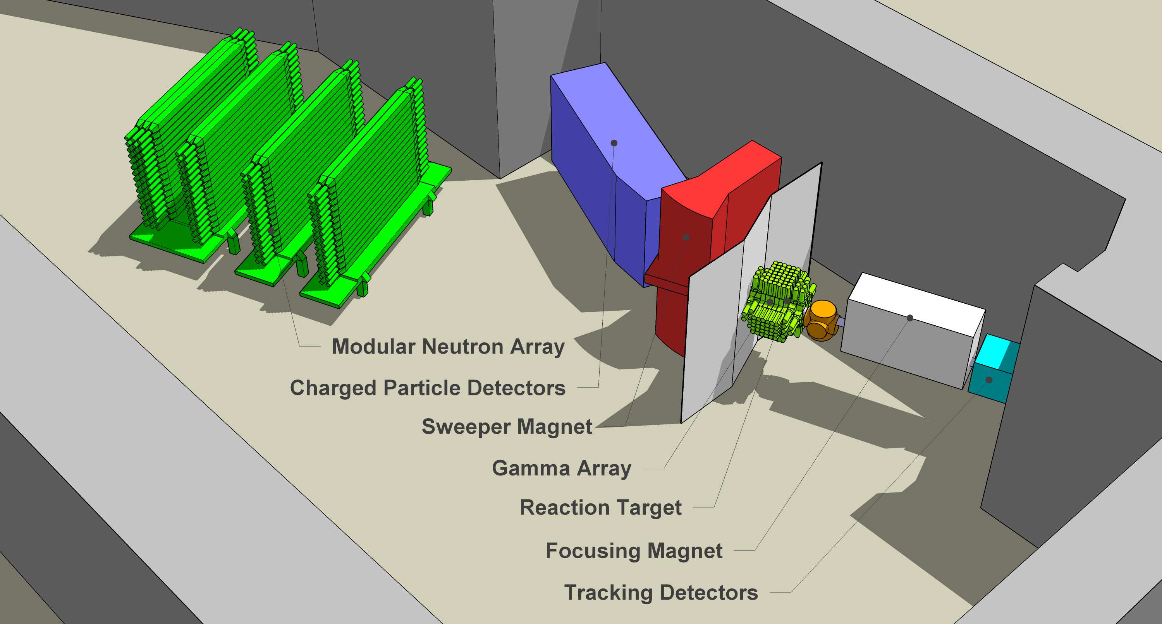
Variations
Include gamma ray detection
Charged
fragment
n
γ
γ
⁴⁸Ca
²⁹N beam
γ
²⁹Ne
γ
n
²⁸F
n
²⁸F
γ
n
²⁷F(+γ)
²⁷F+n

Slide 28
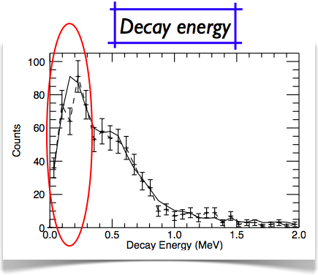
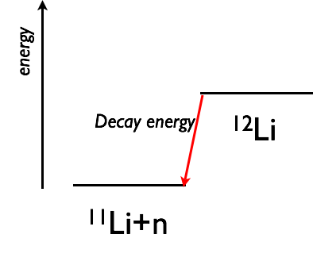

Slide 29
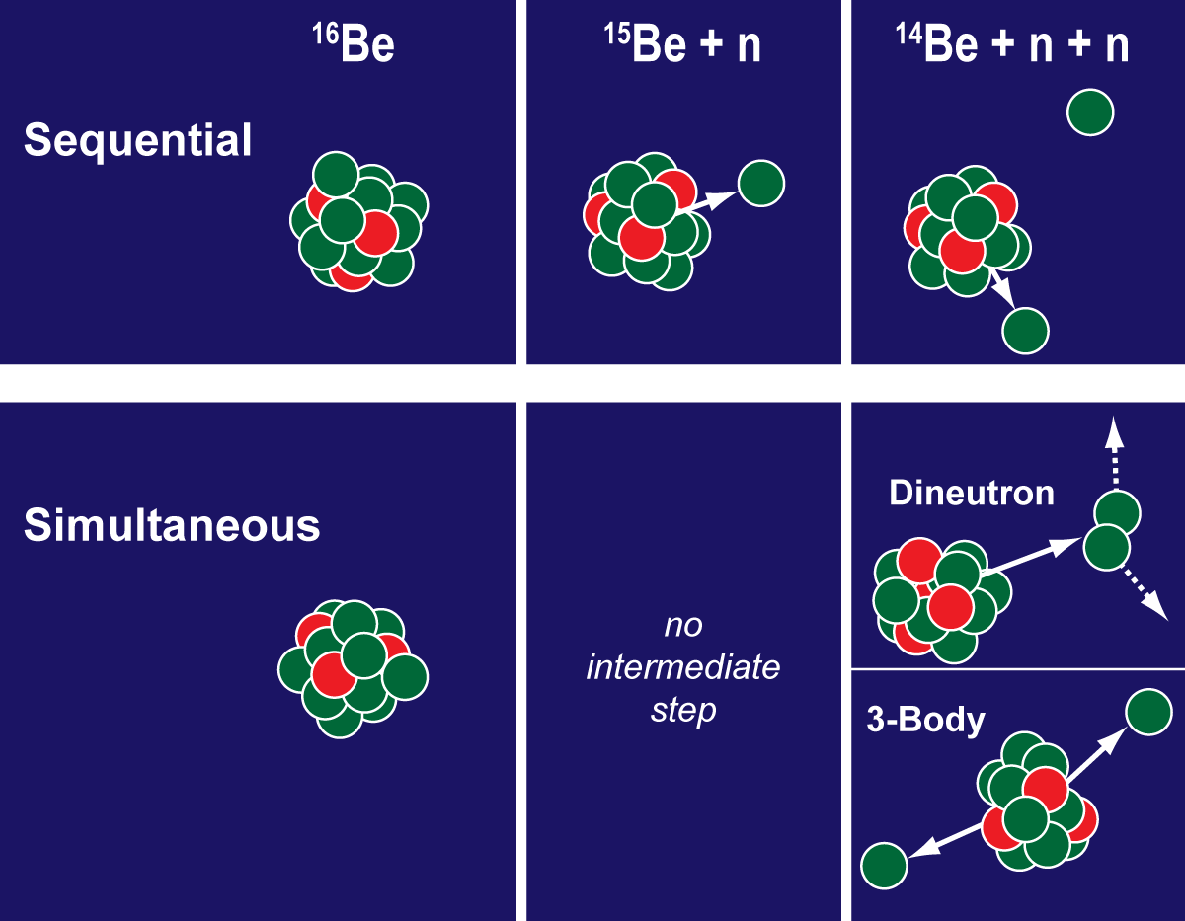
Dineutron
n₁
¹⁶Be
¹⁵Be+n
n₂
¹⁴Be+2n
n₂
n₁
¹⁶Be
¹⁴Be+2n

Slide 30
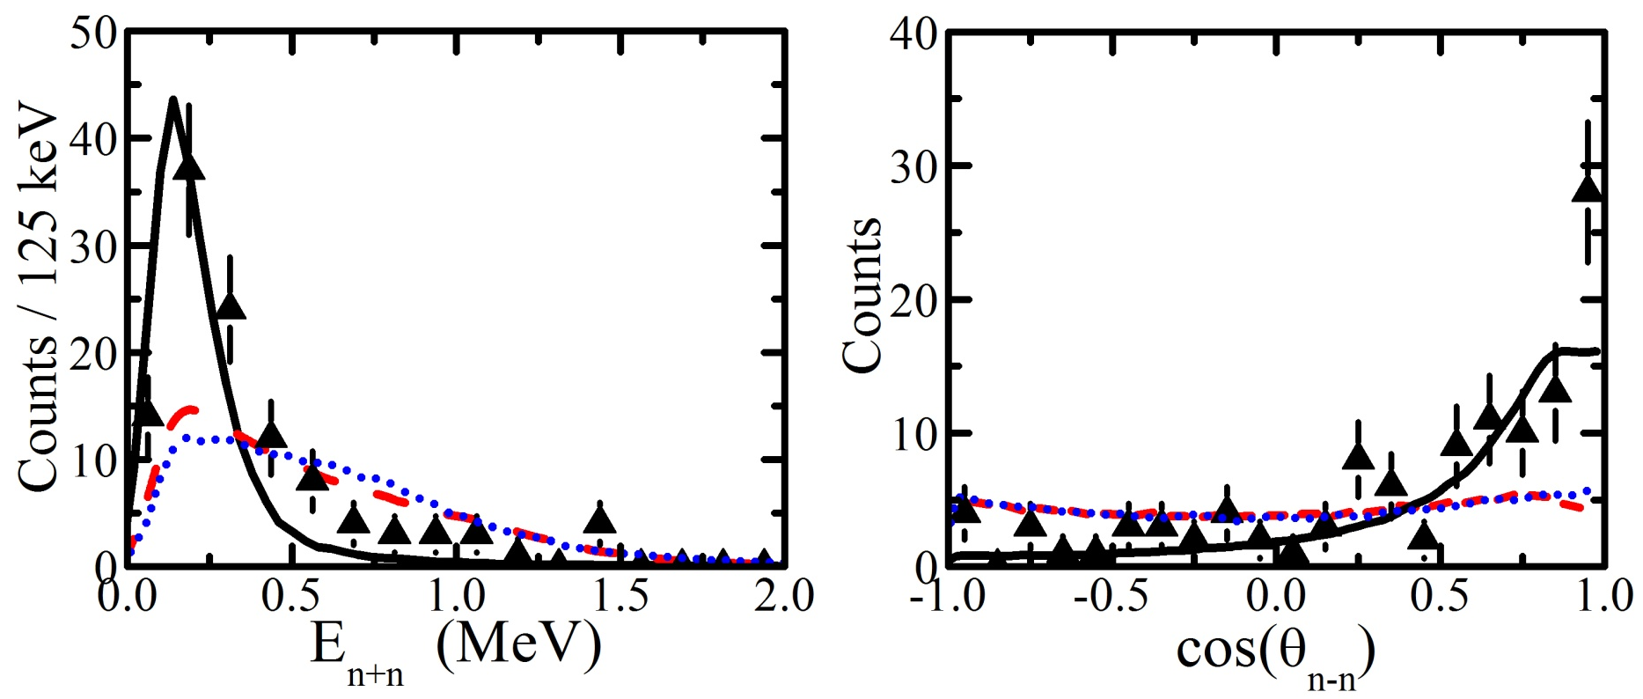
Dineutron
Sequential
3-body
Dineutron
E(n₁+n₂)
θ(n₁+n₂)
First observation of dineutron decay
Further experimental and theoretical work to understand the strong n-n interactions

Slide 31
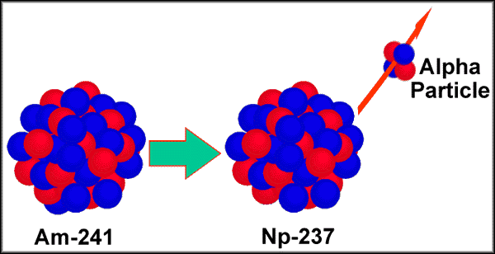
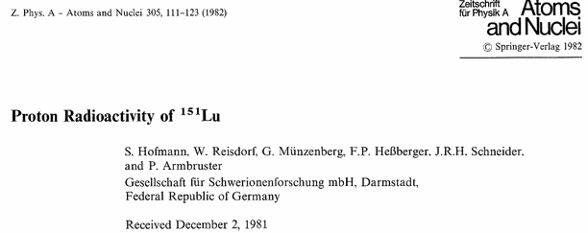
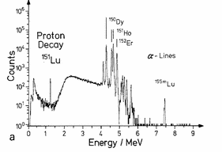
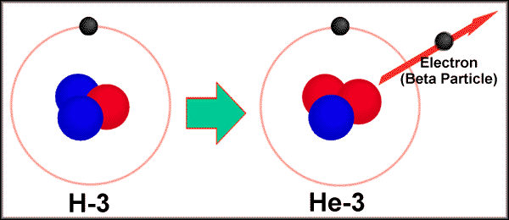
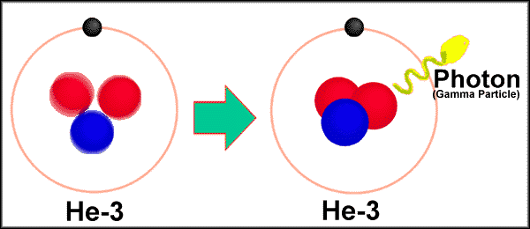
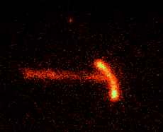
New Type of Radioactivity
Different kinds of radioactivity:

Slide 32
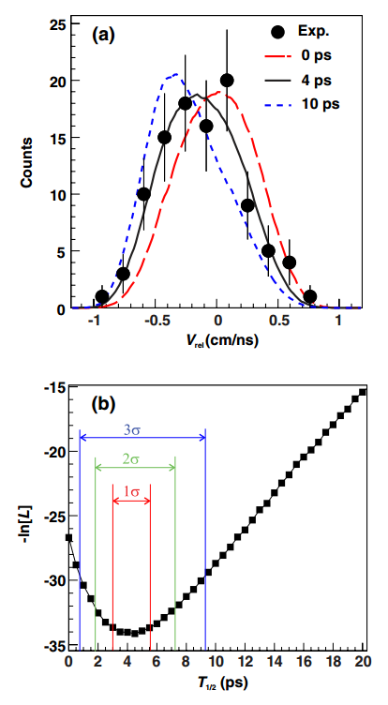
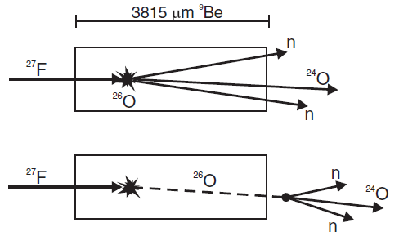
New Type of Radioactivity
Gated on ²⁶O G.S.
Kohley et al., Phys. Rev. Lett. 110 (2012) 152501
increased lifetime = reduced velocity neutrons
V_{rel} = V_{n} - V_{frag}
Lifetime: T_{1/2} = 4.5^{+1.1} ps (1σ)
Unbinned maximum likelihood technique

Slide 34
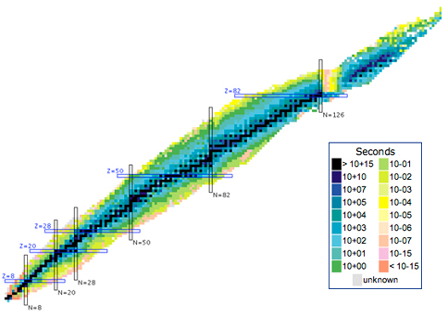
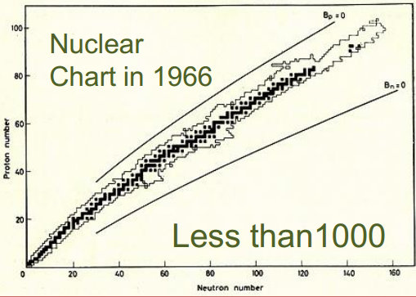
Radioactive beam facilites (such as the NSCL) greatly improved our understanding of nuclear matter.
Present Day
~3000
Z
N

Slide 35
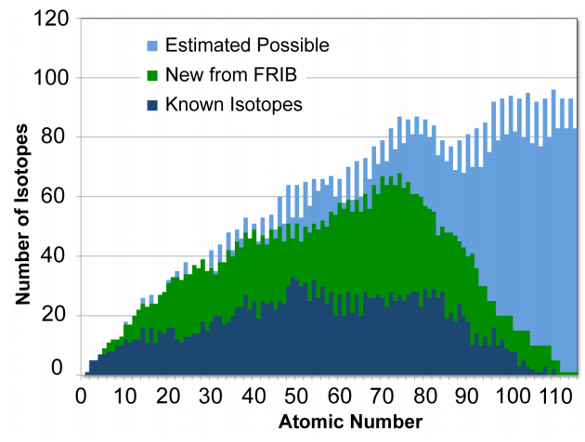
Radioactive beam facilites (such as the NSCL) greatly improved our understanding of nuclear matter.
Erler et al. Nature 486, 509 (2012)

Slide 36
