Slide 1
Prototype AT-TPC
March 18, 2010
Weekly Meeting
Daisuke Suzuki, NSCL

Slide 2
Field cage: Basic concepts
Specifications
Gas tight
50 kV at maximum
1 kV/cm
E
-50 kV
Risk
Sparking between neighboring electrodes
Permanent damages

Slide 3
Field cage: Ideas
G10 + Ring
G10 + Foil electrodes
G10-Ring electrode stack
Resistive glass
50 cm
Circuit sheet
w/electrode
+
or
~90 cm
28cm

Slide 4
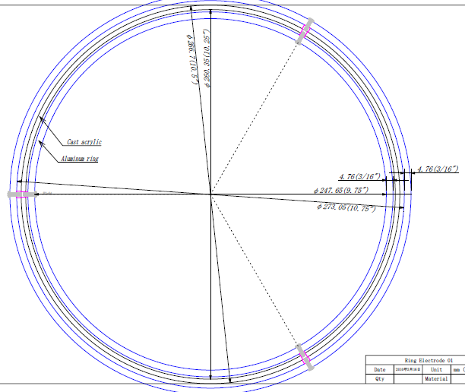
Test
How to fabricate a ring?
How to fix a ring?
Acrylic tube
(10.5” O.D.)

Slide 5
Fixing jig
Screw
Clip
Which one is for the first attempt?
Parallel plates

Slide 6
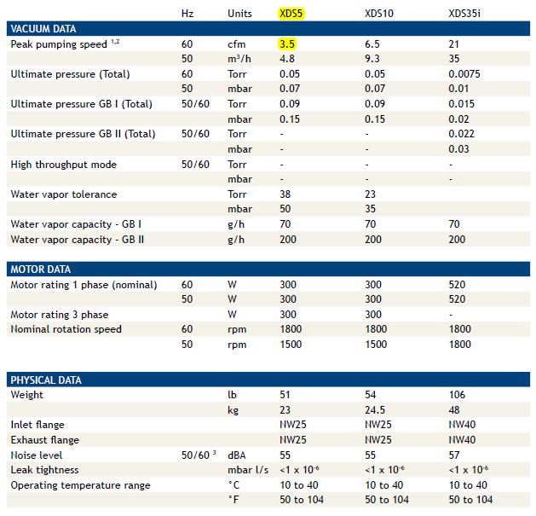
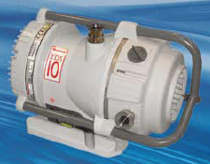
Purchasing of a scroll pump
A part of the new gas handling system
It is nice to have one as soon as possible.
Edward XDS10
Pump speed: 6.5 cfm = 184 L/min
Ultimate pressure: 0.05 Torr
No lubricated bearings inside the vacuum
3,950 USD
Chose by Ana & Fernando

