Slide 1
The NSCL
Training Workshop
for New Tour Guides
Dr. Zach Constan
Outreach Coordinator
National Superconducting Cyclotron Laboratory (NSCL)

Slide 2
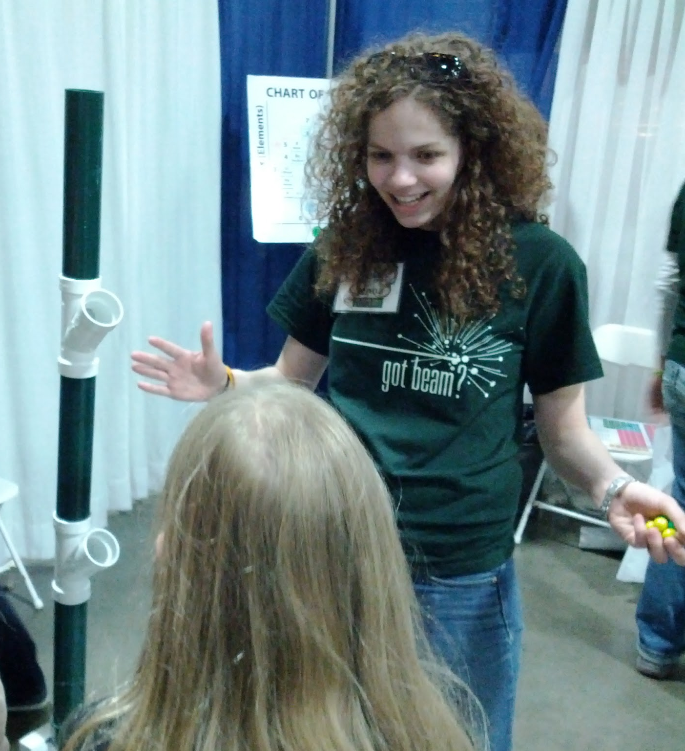
Why do Science Outreach?
What is the value?
An opportunity to share why your work is important
Spreading the excitement for science (and maybe rekindling your own)
Satisfaction of knowing you have made a difference
A brighter future for humanity
Outreach benefits volunteers as much as the community!

Slide 3
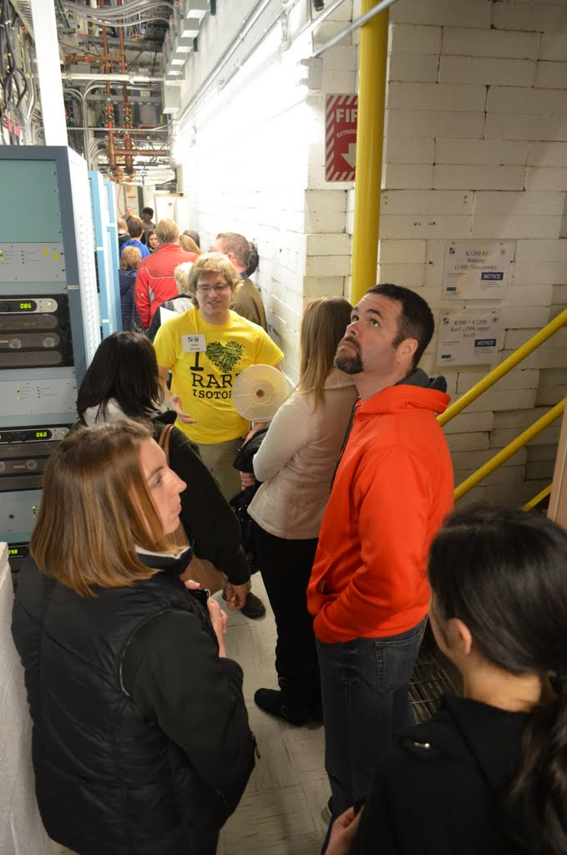
NSCL/JINA Goals
Fulfill National Science Foundation Broader Impact Criteria for our grant
Create public awareness and understanding of nuclear physics (and roles of FRIB, NSCL & JINA)
Increase appreciation of the benefits of nuclear science
Recruit the next generation of nuclear scientists
Notes:
You can’t do everything, so at least do what your boss or organization wants.

Slide 4
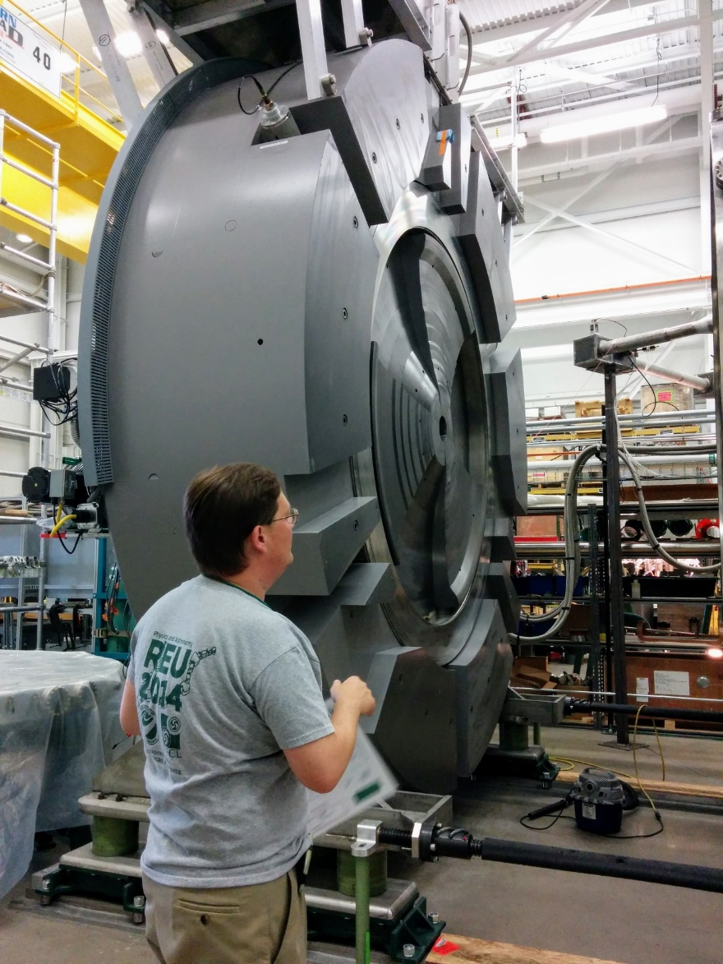
Why do we have high-quality tours?
High-quality graduate students
Regular training for tour guides ensures the safety, quality, and consistency of tours
Plenty of resources for guides
Understanding our limitations (space, personnel, etc.)
Exciting research on the frontier of nuclear science
One amazing laboratory

Slide 5
Why should you want to give tours?
Improve your public speaking skills: “… on a base level I hate public speaking, but outreach and giving tours really helps with handling some of that anxiety”
Learn much more about FRIB/NSCL: “… it makes me feel more connected and involved with the lab”
Meet great people of all backgrounds
Inspire & amaze visitors because public support for science is always vital
Give back to the community that supports us
A fresh perspective: “When work is frustrating, explaining my research to the public helps me remember how exciting it is”
Earn cash money: “[Earnings from giving tours] paid for my trip”

Slide 6
I could guide tours, but…
… what if I don’t know what to say?
We’ve spent a lot of time creating resources for guides!
ANY grad can learn more about the lab and how to guide!
Check out the “Tour wiki”: IntraEnterprise > Employee Information > Resources for Tour Guides
… I don’t like talking in front of people.
That’s the best reason to give tours!
It’s an opportunity to practice with an easy audience.
Explaining NSCL and your work improves your understanding too!
… I don’t know if my advisor will approve.
Do what you and your advisor are comfortable with.
Most faculty recognize the importance of outreach!
… what if they ask a question I can’t answer?
It’s always OK to say “I don’t know”!
Focus on how science makes new discoveries, and the need for a team with many different skills to make it work.

Slide 7
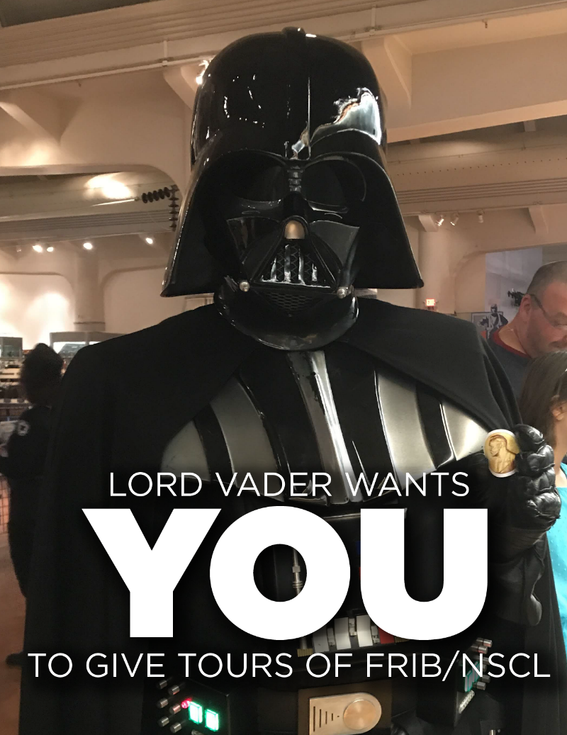
It takes a village… of tour guides
Total visitors
Active tour guides
Year

Slide 8
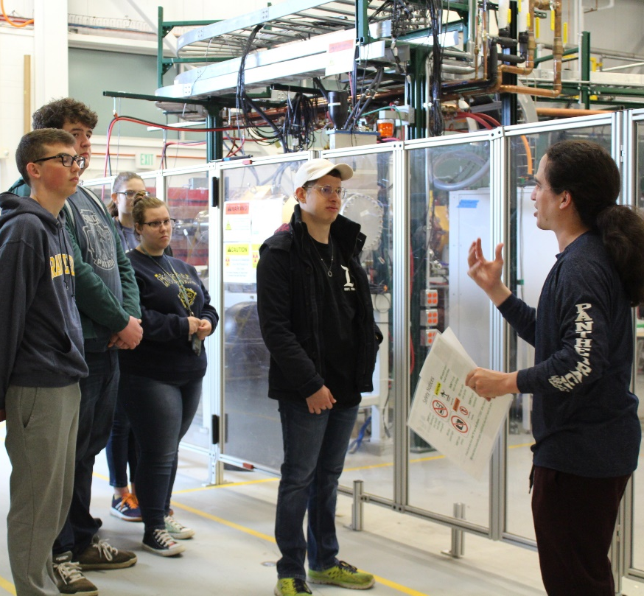
Comments from tour groups
“Several members of our groups commented that it was the best tour that they have had at MSU.”
“Zach and the graduate students were awesome. This is the 4th time I've brought a class group. It has been better every time and this was easily the most organized and presented tour we have taken to date. We look forward to coming back again!”
“The chaperones were beyond thrilled with our visit and stated they would gladly come again. The students were in awe and felt like they were respected for their intelligence. A few students even said they wanted to be nuclear scientists AND go to MSU.”
~ 90% of tour groups rated the tour a 5 out of 5

Slide 9
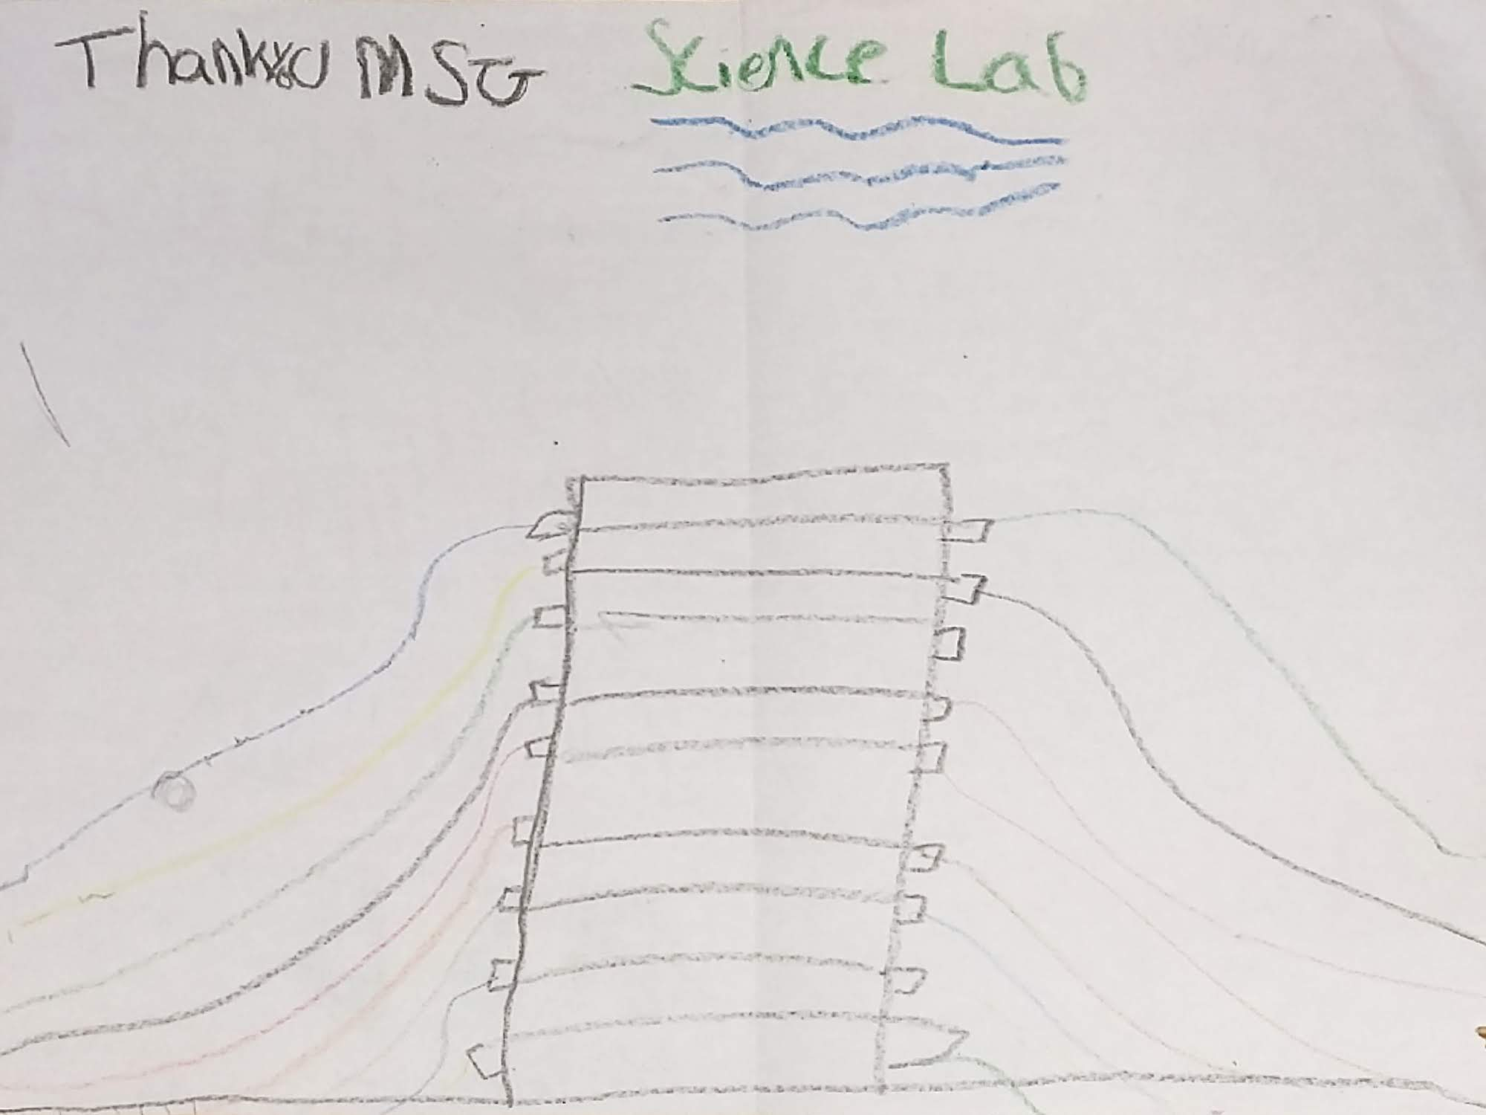
Proof that we have an impact

Slide 10
Room for improvement
7/2/18 “It's difficult to hear the tour guides when out in the large 'factory' style areas… the students seemed to lose interest when they can't stay engaged.”
11/8/18 “[The tour guides] started at too high a level of understanding in their remarks”
2/9/19 “The cyclotron tour was sub-par… most people didn’t care much about, it was also hard to hear so the long-winded talking by the tour guide was tough.”
11/7/08 “From the group members that went on the tour, I received feedback that they were very impressed with the quality of the [introductory] presentation… and found that to be very enjoyable, but then thought that the tour guides were…”
unprepared (use wiki, shadow tours, ask for help)
hard to hear (ask people to move closer, speak loudly, use speaker system)
hard to understand (speak clearly, watch terminology)
unable to answer questions (read wiki FAQ, forward questions to Zach, but it’s OK to say “I don’t know”!)
For every potential problem, guides have a solution (see resources, previous slide)!

Slide 11
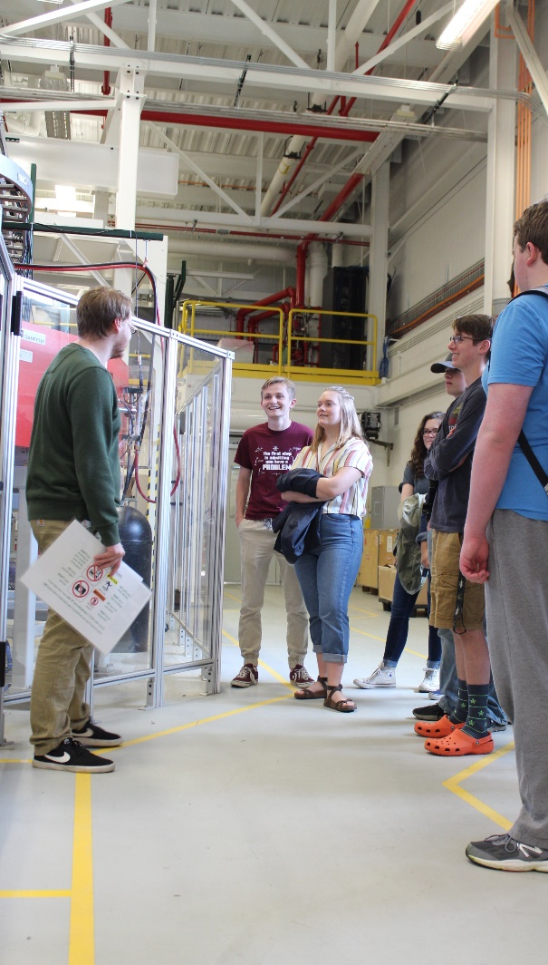
The Challenges
Undefined terminology
nucleus, particle accelerator, nuclides, unstable, isotope, radioactive decay, electric repulsion
Disconnected audience
Overwhelming information/fast pace
The NSCL is LOUD and disorienting
Limited in what we can see
Experiments close vaults
Equipment isn’t interesting from the outside
People visiting “the cyclotron” expect to see one
Our own incomplete understanding!
And many more…

Slide 12
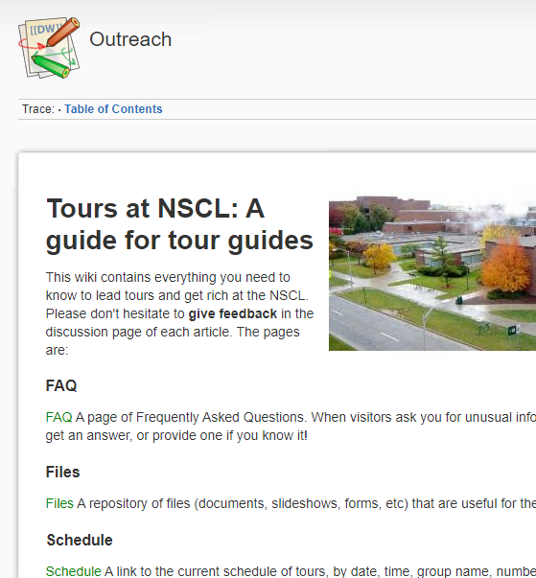
Your Resources
The “Tour wiki”: bookmark it, explore it, use it, love it.
IntraEnterprise > Employee Information > Resources for Tour Guides
Tour Introduction slideshow & script
The Tour location script
Frequently Asked Questions: learn more about NSCL than you ever wanted to know. Several updates include interesting questions from visitors and guides!
NSCL Outreach website: www.nscl.msu.edu/public/education
Links to downloads, our YouTube channel, the NSCL Gift Shop, etc.
Demonstration materials
Laminated maps and speaker systems
Shadow fellow tour guides & Zach
Posters in hallways
Small Matter of Big Science (YouTube)

Slide 13
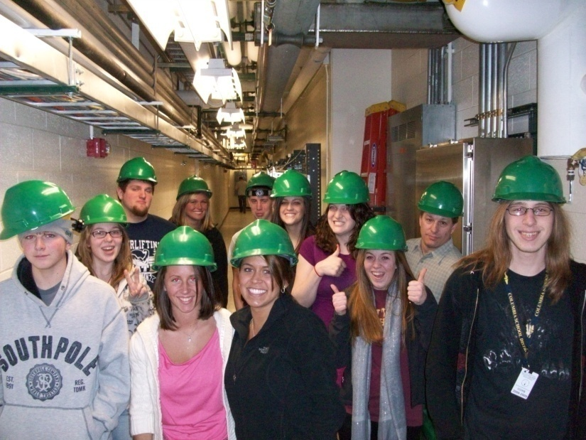
Tour location script
Approved by each vault coordinator
Contains correct information and prudent language regarding equipment
Be very careful with any deviations from the script – our message must be accurate and consistent. NSCL (and DOE) is particular about public communication.
Use your judgment. We want to give a positive impression of the lab, so don’t share anything that detracts from that.
You can say anything you know is factual and is not a sensitive subject
Explain things from a positive stance
As always, when in doubt, don’t be afraid to say “I don’t know”
Note: all approved information on FRIB is given in the intro!
DOE, $730 mil, ~10-year project
new SRF linear accelerator will be underground
ReA3 technology is related to the final accelerator

Slide 14
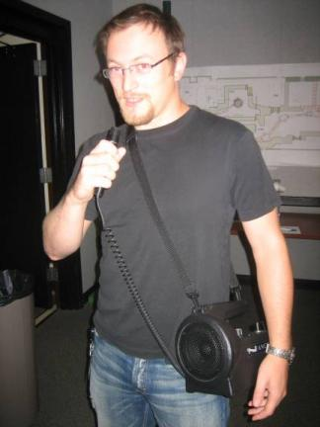
In the vaults: tour language and info
Know your audience! See the tour script for breakdown by group type.
General Public
High school science class/undergrads
Younger students
Lower-level audiences: focus on interesting and impressive facts about our facility. Help them relate to our work through analogies
Higher-level audiences: deal more with the physics and techniques, to the level you are comfortable
Be understandable and audible – use the speaker system if necessary
Ask visitors to ask about terms they don’t know
Carry a tour map to show location
Carry the “Tour location script” if you like!

Slide 15
The right message for the right audience
Get groups involved, don’t just lecture
Ask THEM questions, get their predictions
Offer result A or B, take a vote
Get instant feedback by asking about things you said
Poll about their past experience: who’s had dry ice?
Talk about how you relate to the equipment/place
Have you worked on an experiment there?
Did you have a particular challenge?
Tell your story!
Relate abstract/difficult concepts to common knowledge or shared experiences!
dipole magnet : different isotopes :: prism : different colors
Remember that you will generally know FAR more about the lab than your audience – be confident!

Slide 16
Do’s and Don’ts
DON’T go over their heads with complex science or terminology
DON’T fail to engage your audience – ask questions, keep them moving, mix it up!
DON’T give answers you’re unsure of… be comfortable saying “I don’t know”
DO keep the groups small, continually encourage them to move closer, and talk loudly and clearly in the vaults
DO encourage questions
DO make it clear how the current vault relates to the things they’ve seen so far
DO be enthusiastic: NSCL is amazing!

Slide 17
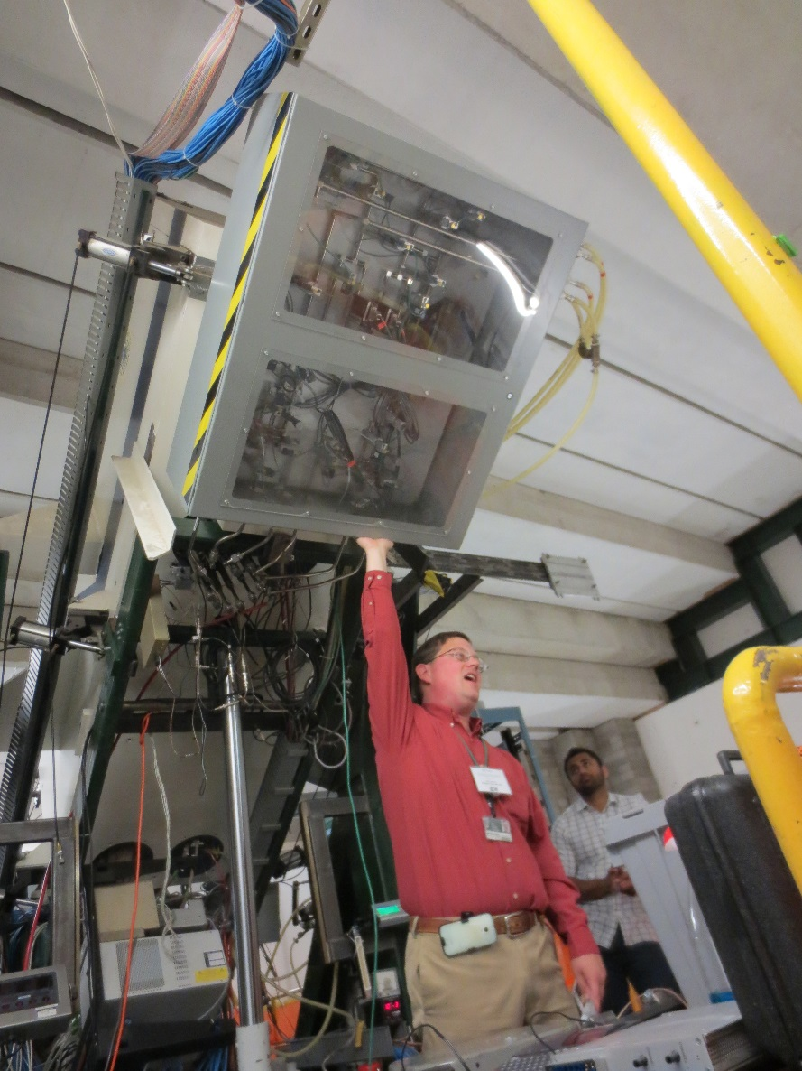
An important “Don’t”
Tour guides should never change the state of a vault.
This includes:
Opening or closing a vault door
Moving equipment
Leaving something inside or taking something away from a vault
Tours should leave no trace of their passing!

Slide 18
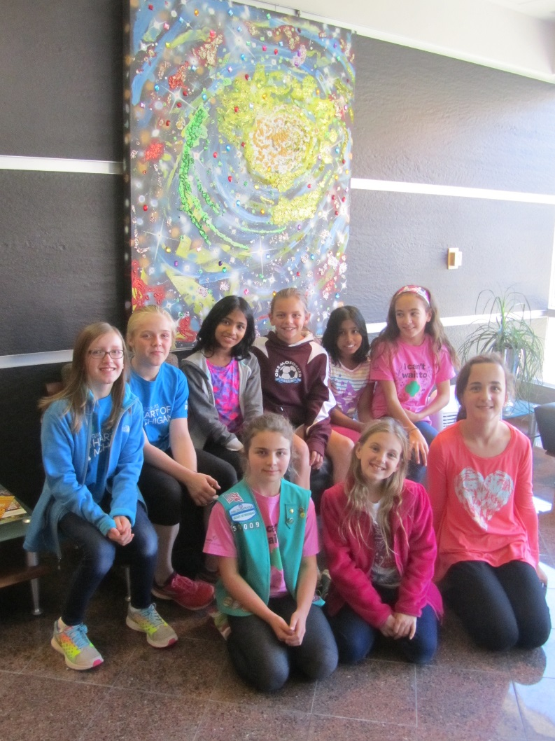
After the tour
Watch the clock, get them back on time (usually ~45 minutes after starting)
skip locations if necessary, make sure you visit high-priority sites (CCF, Cycstopper, S800, ReA3)
Take the group back to the room where you got them (unless time is an issue, then return them to the lobby), stay with them until tour leader takes over
Make sure the room where the intro was done is clean
Fill out a payslip (found under “files” on wiki, or in Zach’s mailbox) and give it to Zach
Submit any questions you couldn’t answer or ones you thought were interesting for the wiki FAQ

Slide 19
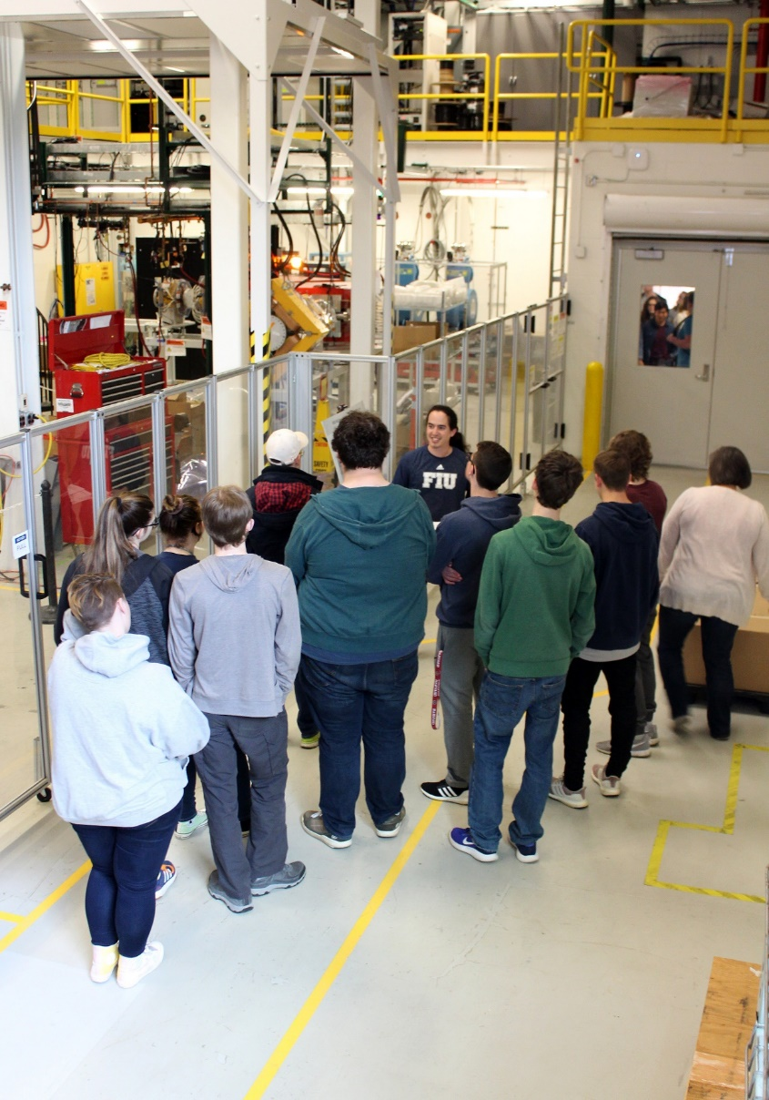
Part II: Safety
SAFETY IS YOUR FIRST RESPONSIBILITY
Safety is more vital than entertaining or educating
Our excellent safety record is no accident – literally, it takes planning and effort
YOU are responsible for the safety of people in your tour group
At NSCL, we don’t take chances… just ONE accident is too many

Slide 20
The (current) Tour Route
Public Areas
Public tours (for outreach, not business) are restricted to the shaded public areas above.
All other areas are for visitors with a specific interest who complete export control forms

Slide 21
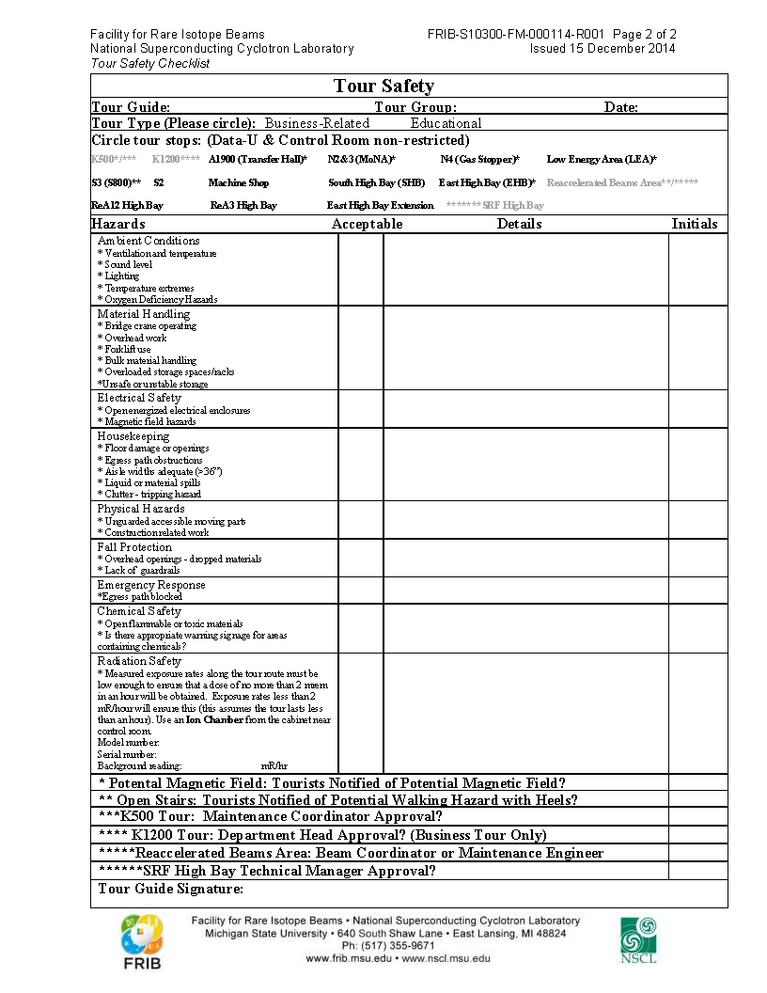
Before the tour: Safety Survey
Tour “leader” will walk the route beforehand (dependent on current vault restrictions) with an ion chamber and safety survey (on), looking for:
Ambient conditions – temp, light, ventilation
Material Handling – operating crane/forklift, storage
Electrical Safety – open cabinets, extension cords
Housekeeping – trip hazards, unobstructed path
Physical Hazards – construction, exposed machines
Fall protection – guardrails, dropped items
Chemical Safety – open containers, warning signs
Radiation Safety – ion chamber reads < 2 mR/hr
(Survey copies are on clipboard in Zach’s office or room 1305 by tower III elevators, ion chamber is in cabinet in level II area near control room)
Tour “leader” will inform other guides of route and its conditions, making SURE everyone knows where they can go (look for circled tour stops) by providing copies of the safety survey! NEVER guide a tour if you haven’t seen the safety survey.
If you ever find safety issues that make you concerned about taking a tour through, inform safety office or control room right away!
Exception: while some non-public areas may be circled because they were surveyed, limit your tour to the public areas!

Slide 22
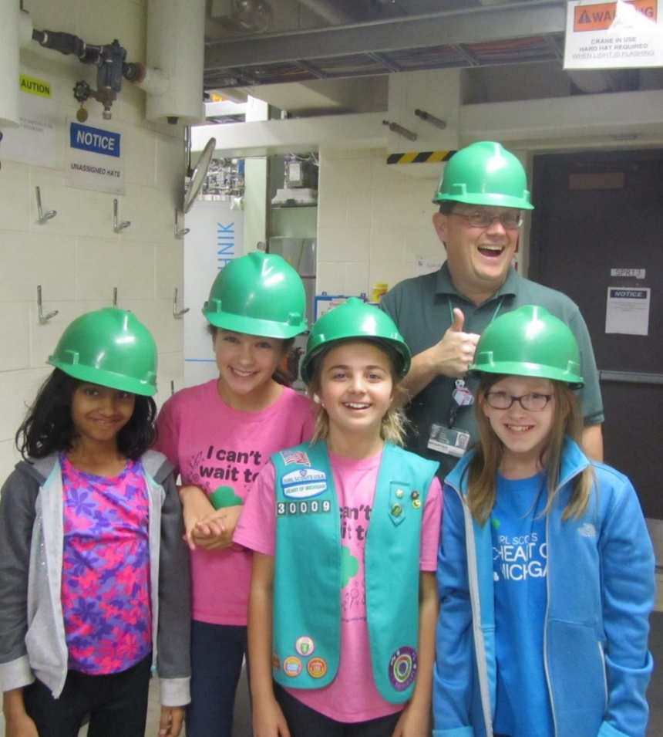
Communicating safety to visitors
Before starting the tour (usually in the intro), the visitors should be told:
NO food, drink, gum, or smoking.
High magnetic fields may be present.
Stay together and follow all instructions.
Follow signage; sorry, no photography.
Keep children close, prevent horseplay.
Do not touch equipment or controls.
No sitting, leaning, climbing, or going beyond safety barriers.
Stay aware of your surroundings (e.g., stairs, trip hazards).
Dial “0” on any NSCL telephone if separated from the tour group, or x305 after hours (or, after hours during a shutdown, x143 for the paging system).
For groups younger than high school, each guide should be accompanied by one of their chaperones as the “trailer” bringing up the rear to ensure that no one is left behind.
Notes:
Adapt – different groups have different backgrounds AND interests!
Flexible – Have a lot of options in case things don’t go as planned, and adjust your activity based on the looks in the audience
Differentiate – They’re used to classrooms
Complement – latch onto any connection with their recent learning (or the news!)
Partner – don’t reinvent the wheel. Someone else may be able to do it better and faster. MSU has lots of resources and audiences for you!
Leverage – make sure to incorporate what makes your program special
Say Yes – this is a service industry
Word – the reward for a job well done is more jobs

Slide 23
General safety issues on the tour
Groups ≤ 12, adult chaperone “trailer” with each group of young students
NSCL Medical Emergency Policy
Overview the scene to ascertain risks.
Dial 911 (or have a staff member do so) and summon professional rescuers.
Dial 143 (or have a staff member do so) and announce “Medical emergency, (location).” Do not broadcast the victim’s name.
Provide care commensurate with your level of training and comfort level.
Never take visitors past safety barriers (Oxygen Deficiency Hazard, exclusion zones, etc.)
Point out steps and obstructions to visitors
Don’t leave anyone behind
When in doubt, don’t go there
It’s OK to demonstrate the interlock button in some locations, but inform workers there first that it is a demonstration
If guests are doing too much horseplay or other unsafe activities, warn them that you will escort the group out if it does not stop.
If the problem persists, guide them back to the lobby and explain that you can’t continue the tour for their own safety.

Slide 24
Specific safety issues on the tour

Slide 25
Export Compliance Considerations
Export Control regulations restrict access to controlled items by citizens of specifically-identified countries
Public tours (open without selection of participants beyond capacity and safety) are restricted to Public Tour Areas on the map
Non-public tours or tours not following the standard route will require the outside group organizer to complete the FRIB/NSCL Tour Certification form before the tour will proceed. The Outreach Coordinator will retain the completed form.
Citizens of Cuba, Iran, N. Korea, Sudan or Syria may not participate in non-public tours.
Questions related to export compliance can be directed to export@frib.msu.edu

Slide 26
Part III: How to be a Guide
Prior to giving their first tour, new tour guides must:
Have worked at NSCL for (nearly) a full school year as a graduate assistant or regular employee.
Maintain training for access to Radiation Restricted Areas.
NOTE: if you are on a visa, the lab cannot pay you the hourly rate we offer for tours during fall/spring semesters - sorry. If you are still interested in giving tours unpaid, you are most welcome!
Shadow at least one safety survey, introduction, and tour.
See “Upcoming tours” on IntraEnterprise to find a tour you might join, and inform Zach in advance.
Shadow Zach or any other current guides, as much as you like!
MSU Youth Programs Policy requires a background check authorization form. I have pre-filled section 1; complete section 2 and sign (you can type in the PDF!), then email me a copy. I will send them to HR.
Review the necessary files (scripts, powerpoints, FAQ) and other resources to prepare to speak with a tour group – keep up with changes! You can print and carry a copy of the script if it helps.
If it would make you more comfortable, consider having Zach or other guides tag along on your first tour (or more, if desired)!
Attend a tour guide refresher workshop each fall.

Slide 27
Getting on a Tour
Qualified tour guides are added to the tour announcement email list
Zach will email all tour guides when a new tour is available, noting number and type of visitors, date, time, number of guides/leaders needed
For tours after hours (Minimum 20 visitors): there will be TWO tour leaders; one will conduct the safety survey and stand by the lobby door to let in guests for 15 minutes before and after their planned arrival time, while the other will prepare and give the introduction.
For RARE tours > 50 visitors Zach will generally not accept the tour until enough guides have been confirmed, no matter how far in advance.
Email Zach (constan@nscl.msu.edu) to volunteer
If selected to guide that tour, you will receive an automated email and Outlook calendar event specifying the time and place to arrive
If there are more volunteers than necessary, you may not be assigned and won’t get an email
Show up at the right place/time to lead up to 12 guests through vaults
Make sure you get a safety survey and know where to go/if there are any issues! Do not lead a tour without seeing the safety survey!
If necessary, double-check where to leave your guests at the end of the tour, and don’t leave them until the tour leader takes over (unless they exit the lab)
Complete a payslip (on wiki and in Zach’s mailbox)

Slide 28
Being a professional tour guide
Tour guides are well-paid because you are highly trained in nuclear science and safety.
You are expected to be professional, which means the following:
Being present on time
Considering the needs of visitors first
Keeping visitors safe
Taking the time to anticipate problems before they occur
If you are scheduled to guide a tour and learn in advance that you can’t, you will recruit your own replacement and email Zach.
If you are scheduled to guide a tour and miss it entirely, you will get a warning. If it happens a second time, your tour guide status will be revoked for the current year.
Practice makes perfect – the best way to learn is to JUST DO IT. Give tours (and shadow as necessary) to maintain your skills and keep yourself updated!
If you aspire to be a tour leader and/or use the demonstrations, you must be trained to use the demo equipment (by appointment), study Appendix A, and shadow 1+ extra tour introductions.
Tour leaders earn 5 hours of pay for ~2.5 hours of work.

Slide 29
Recent questions from guides
What if one visitor asks to leave before the tour ends?
Visitors shouldn’t be unaccompanied in the lab, and especially not in level II areas! Take the whole group with you to escort them to an outside door.
What if a visitor says “this is all over my head”
Touring NSCL can be overwhelming, confusing, etc. This doesn’t mean you’re not communicating well.
Possible responses:
“It’s a lot to process at once! But remember, it has taken decades to get to this point.”
“No one here can understand it all either, that’s why we have 800+ people working together,”
“The excitement of not knowing is what drives us.”
“Research is full of big problems that sometimes seem incomprehensible. They’re solved by teams who work for years and don’t give up.”

Slide 30
Advice for New Guides
Safety
Study the tour route and the safety map!
Always have a safety survey with you, go only where it says
CPR: training is optional, but recommended!
Guiding tours
Recommend at least one tour per semester to maintain tour guide status
Getting over “the hump”: your first tour and beyond
Tour volume: only do as many as you and your advisor are comfortable with
Try to stay on time, getting them back to where you started within 45 minutes, limit stops if necessary
Surveys, maps, and lots of other equipment in room 1305 by tower III elevators (UB-5 key will get you in; Reception desk should have one.)
Comments, problems, suggestions?

Slide 31
2020 New Tour Guide Graduation Ceremony

Slide 32
Appendix A: leading a tour
In most cases, Zach will perform the duties of “tour leader”, which includes:
Setup
meeting the visitors
giving the intro
leading a group through the vaults
questions and further demos
showing visitors out
Cleanup
Grad students fill the role of “tour guide”, which only involves leading a group through the vaults, takes about 40 minutes, and pays two hours at your hourly rate
However, sometimes you may have the opportunity to serve as “tour leader”, which pays five hours at your hourly rate for about 2 hours of effort - instructions are on the following slides!

Slide 33
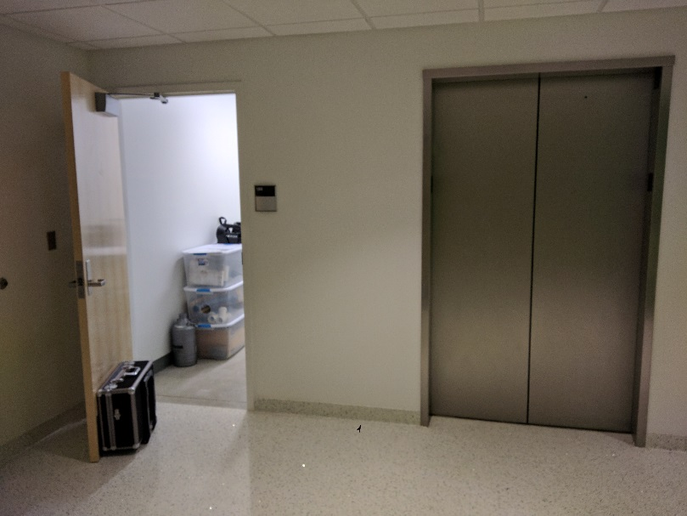
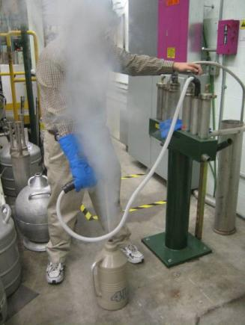
Tour procedures - preparation
30 minutes before: collect cart of equipment from room 1305 by tower III elevators (Reception has UB-5 key)
Perform safety survey (forms on a clipboard on that cart, in my office, and on tour wiki)
If performing Meissner effect demo, fill Dewar halfway with Liquid Nitrogen (LN)
Load up tour introduction powerpoint (on wiki, choose one appropriate for audience)
Make sure venue (e.g. Lecture Hall, Seminar Room) is clean and neat for visitors

Slide 34
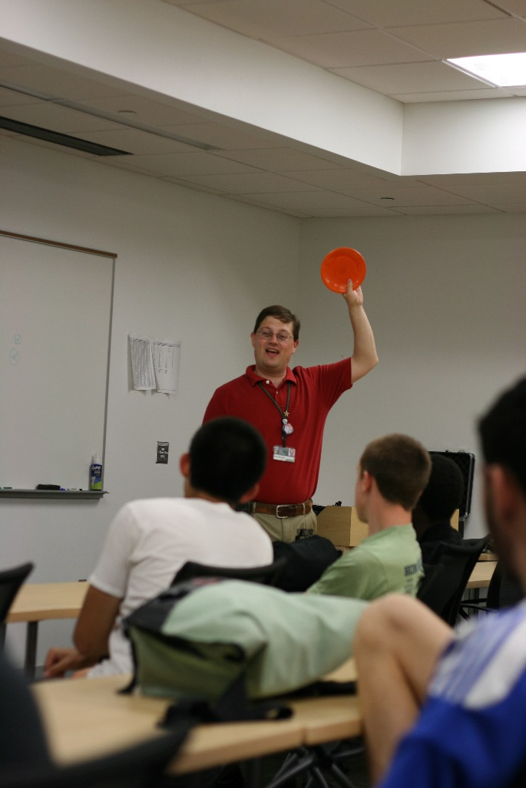
Tour procedures - during
You will meet group in the lobby (on weekends/evenings, one tour leader will let them in the door while the other hosts them in the seminar room)
Ask about time limitations, education level(?), collect minor permission form
Introduction/demos: encourage questions and ask their opinions
Provide copies of the safety survey to all guides assisting you, answer any questions
Tour: split into groups ≤12, stagger starting location (control room, EHB…)
Return to seminar room, invite remaining questions, more demos?
Provide Zach’s card if guests want further info, escort group out

Slide 35
The right introduction for the audience
Know your audience! There are tour introductions for each on the wiki
Young Students
General Public
Science students: High school / Undergrads
Simpler explanations must still use the correct science!
Consider what terms need to be defined, or can be dropped (e.g. General Public and Young Students talks don’t introduce isotopes)
Consider what should each audience hear about the NSCL: the “take-home message”

Slide 36
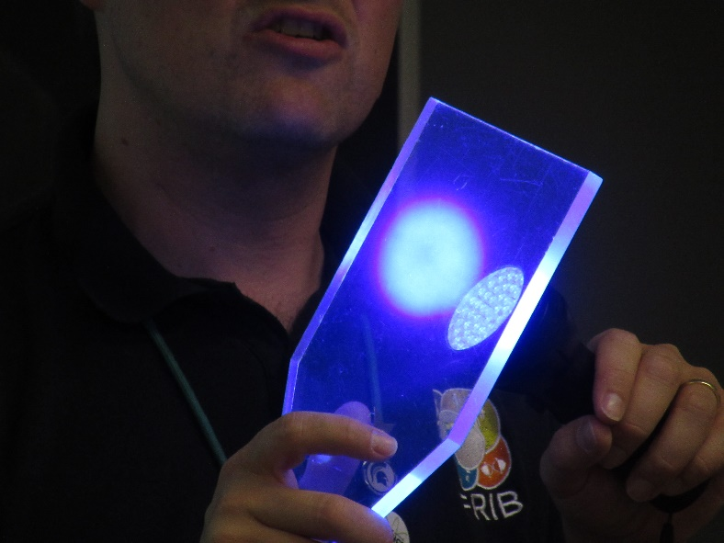
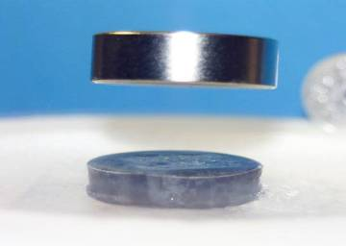
Demonstrations
In order of priority:
Fragmentation/rare isotope production with Marble Nuclei
Conducting copper wire vs. Superconducting niobium-titanium wire
Scintillator Plastic (an example of a particle detector)
Geiger counter: cosmic rays, Fiestaware, shielding
Superconductivity, Meissner Effect (levitation)
Balloon, leaves, post-1983 penny in LN
Other suggestions?
magnet
superconductor
liquid nitrogen used to cool the superconductor

Slide 37
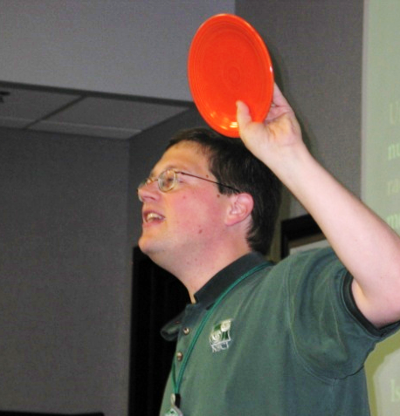
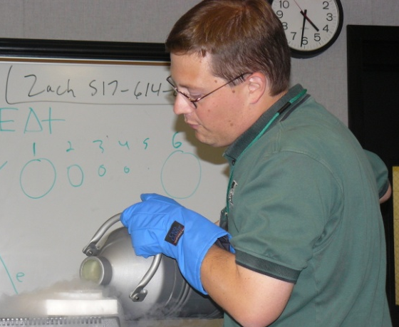
Demo Safety
The Fiestaware plate is not dangerous; however, to adhere strictly to internal ORCBS regulations, visitors should not handle it.
Liquid Nitrogen (LN) is very dangerous and should only be handled by tour guides. Do not handle/use LN unless all guests are seated. No guests should sit in row nearest LN.
Use Cryogloves and safety glasses every time you are pouring or moving LN.
Place Meissner effect demo (Pyrex dish) on the foam block some distance from audience to prevent spill accidents
When not in use, place Dewar under or behind a table to avoid accidental contact
Pour out all remaining LN after the tour
Don’t let guests climb up to drop marble nuclei down the tube

Slide 38
Tour procedures - Cleanup
Replace things in outreach closet, empty LN
Make sure venue (e.g. Seminar Room or Lecture Hall) is clean
Payslip (form on wiki) in Zach’s mailbox
Survey form and permission slips in Becky DeZess’s mailbox
Submit questions for FAQ on wiki

Slide 39
The State of NSCL Tours
The number of tours is relatively steady, with lots of visitors every year! Progress on FRIB has generated many new requests…

