Slide 1
Laboratory Event Volunteer Training

Slide 2
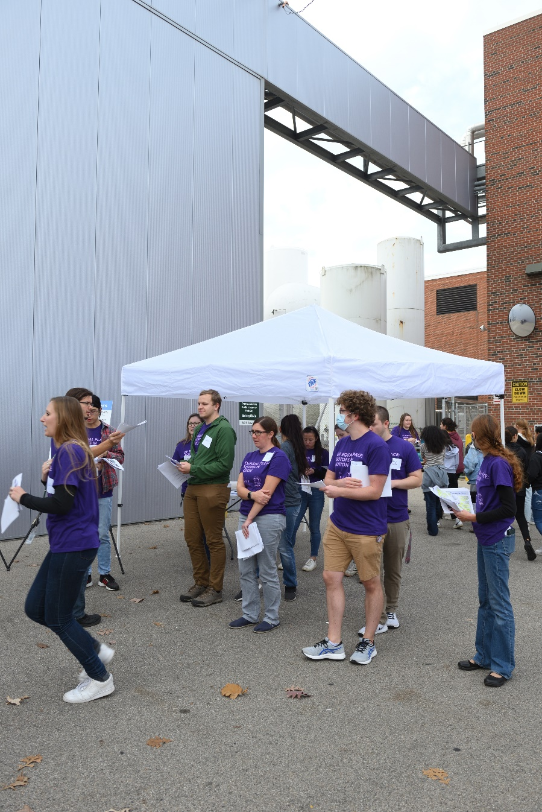
What is an Event?
Public events either on-site or off-site provide an opportunity to showcase the laboratory and the work that is performed here
Events can be classified in two ways
Open-access, allowing anyone to join
Registration required, containing a pre-selected audience
This training will focus on public education events that invite guests to interact with our laboratory and/or staff
Open House
Public talk
Art exhibition
Summer camps
Expositions e.g. MSU Science Festival
Events provide guests with information about FRIB and help them appreciate its importance

Slide 3
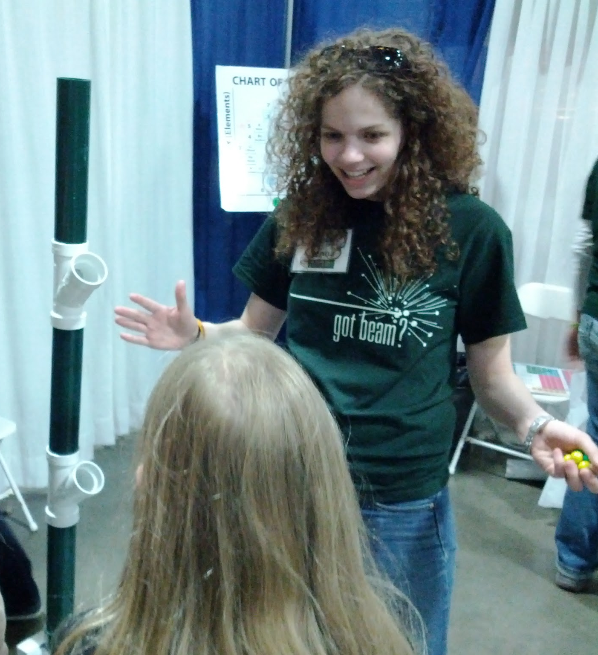
Why do Science Outreach?
Connect with humans! The value of outreach is:
An opportunity to share why your work is important
Spreading the excitement for science (and maybe rekindling your own)
The satisfaction of knowing that you have made a difference
A brighter future for humanity
Outreach benefits BOTH volunteers AND the community!

Slide 4
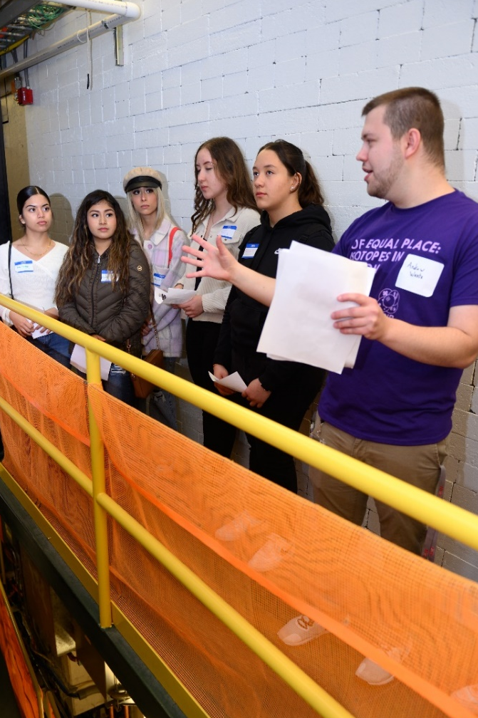
Know your goals
WHO is your audience?
WHO is your audience?
What will you do for your audience?
Tour/Talk/Activity/Program/Resource/???
Length of interaction?
What will they tell friends/family?
Develop an elevator speech
“FRIB is a world leader at smashing nuclei and studying the pieces”
What science can you actually teach?
w/ informal education: keep expectations reasonable
Keep focused on the message
HOW does this science affect THEM?
How can you make a long-term impact?
Introduce them to something new
Give them ideas and tools for the future
Change attitudes
!!

Slide 5
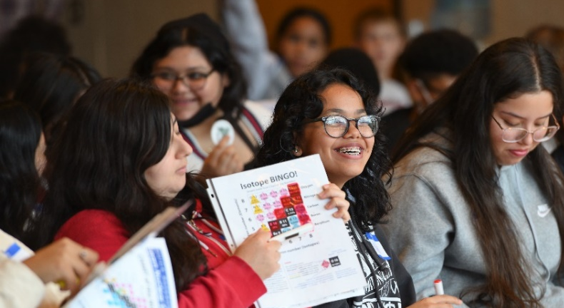
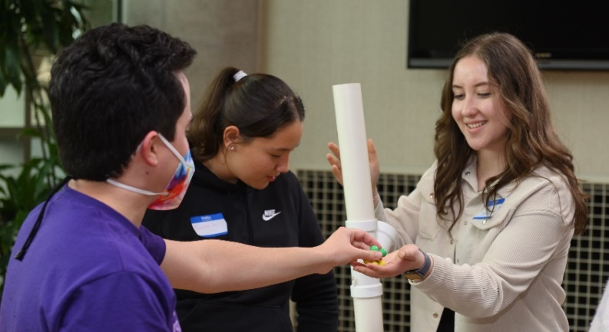
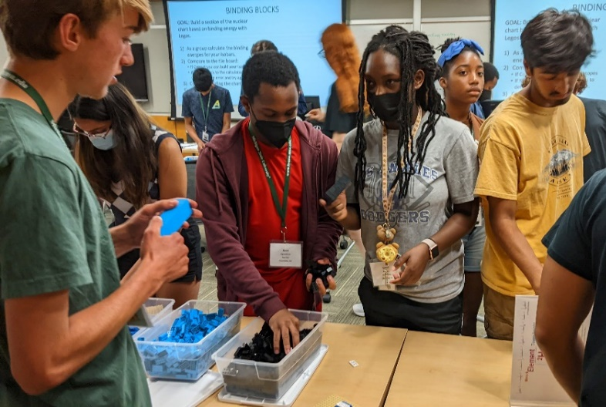
FRIB/JINA Outreach Goals
Fulfill National Science Foundation Broader Impact Criteria for our grant
Create public awareness and understanding of nuclear physics (and roles of FRIB & JINA)
Increase appreciation for the benefits/applications of nuclear science
Recruit the next generation of nuclear scientists
Notes:
You can’t do everything, so at least do what your boss or organization wants.

Slide 6
Challenges/Strategies for a General Audience
Includes a range of ages
Wildly varying levels of content knowledge
Struggle with unfamiliar terms & too much info
Common misconceptions
Keeping them engaged
???
Traditional and familiar methods (e.g. lecture) don’t usually apply

Slide 7
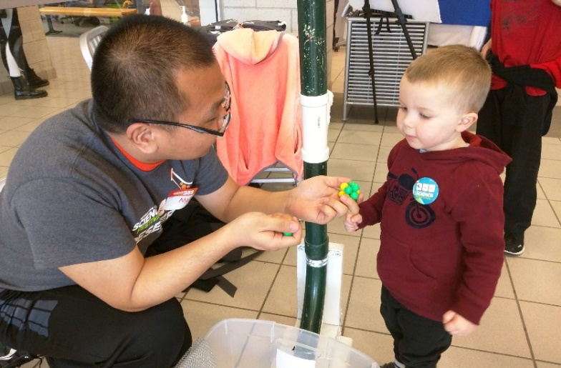
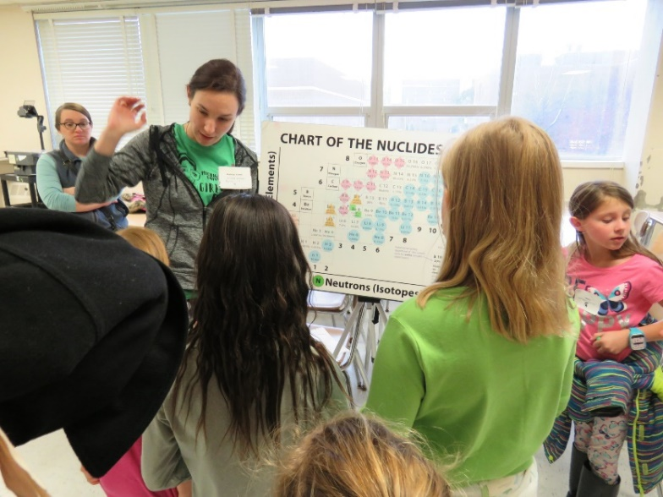
Challenges/Strategies for a General Audience
Varying age/maturity and learning strategies
Communicate in multiple ways!
Visual – images, animations, models
Auditory – reiterate with words
Kinesthetic – active and hands-on
Use all the tools at your disposal – include something for everyone (like children’s movies?)
Speak as you would to a non-scientist friend, be natural. It’s NOT a conference or a class.

Slide 8
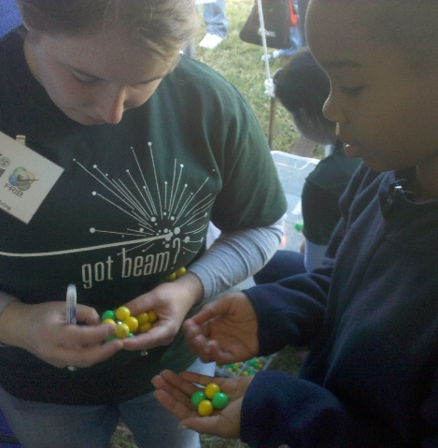
Challenges/Strategies for a General Audience
Varying knowledge and understanding
Is there a key concept? Why is it exciting? Explain it simply!
You might have to target the audience who has learned the key concept already (5th grade?) – you can’t always reach everyone!
Those with more knowledge will likely ask more questions, maybe challenge you. This is a good sign!
It’s OK to say “I don’t know,” emphasize the challenges and explain how scientists might move forward
What is your
“elevator speech”?

Slide 9
Challenges/Strategies for a General Audience
Terminology and overwhelming information
Focus on how this affects THEM
Offer some impressive facts
Build on current news
What complements the audience’s formal learning?
Use analogies, connect to common experiences: have you seen dry ice? Who has had an MRI?
When it comes to demonstrations: flashy is fun, but simple is substantial (especially if they could reproduce on their own)

Slide 10
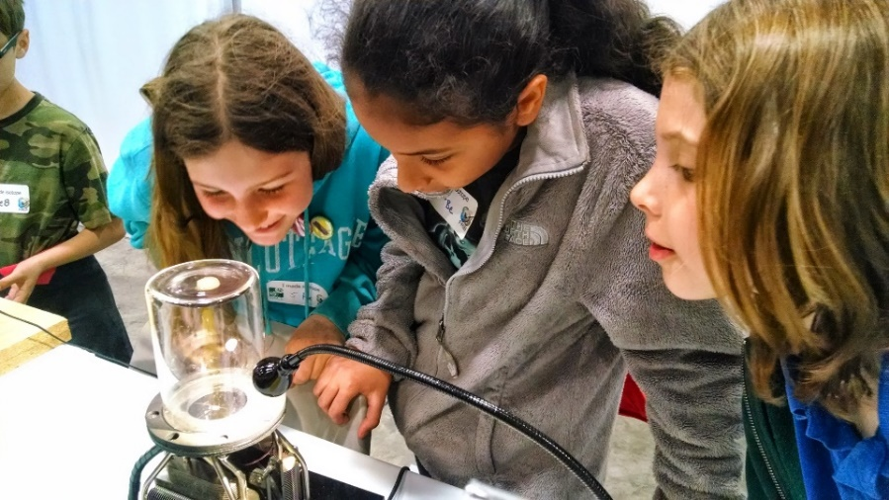
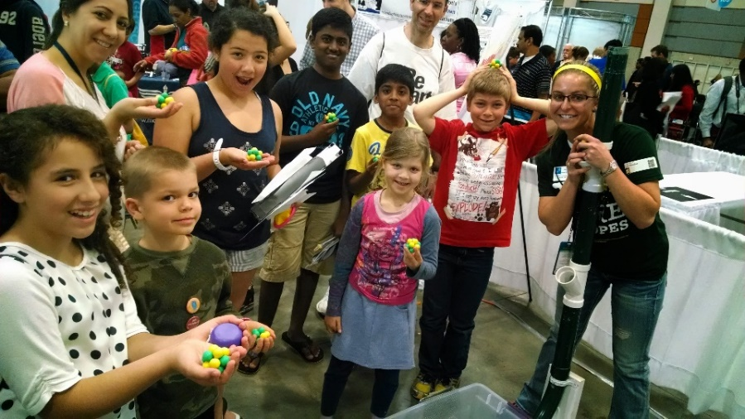
Challenges/Strategies for a General Audience
Terminology and overwhelming information (continued)
Be clear on how we use models – “theory” is popularly perceived as a “guess”
Tell the story about people – help them relate to scientists and your work (and students see themselves in that role)
Send them home with something (gives more time to process, engage later)

Slide 11
Challenges/Strategies for a General Audience
X
Misconceptions/Stereotypes
What does a scientist look like?
Show our diversity
How do scientists behave?
Debunk fictional characters
Examples of hobbies/interests?
Safety Hazards
“Do you guys glow in the dark?”
I’m not good at science
There are many different sciences
Jobs in STEM they’ve never heard of!
People think they can only do science if it comes easily, but what truly makes a great scientist is persevering
What do you wish your audience would “unlearn”?

Slide 12
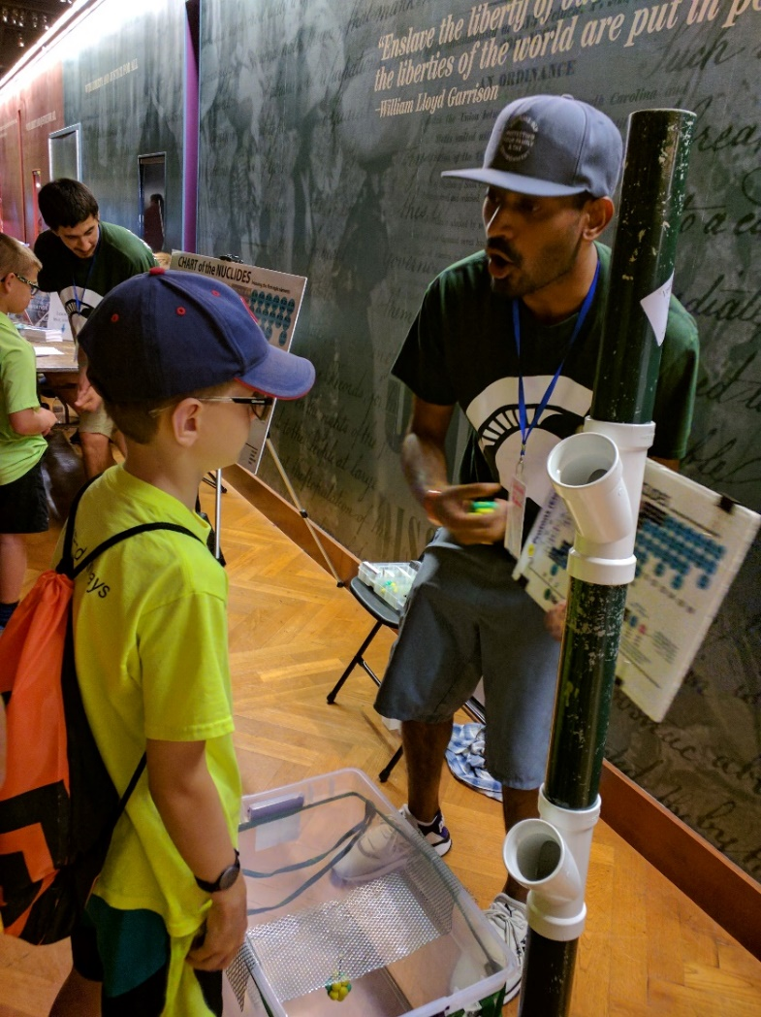
Challenges/Strategies for a General Audience
Keeping them engaged
Invite questions (once they get started, it could snowball)
Ask them questions
Mix it up, offer opportunities for the audience to be interactive
Invite volunteers from the audience!
Watch their eyes, read their expressions/body language and adapt as needed
If you’re losing them, bring out your best demo!
With a general audience, there is no substitute for enthusiasm

Slide 13
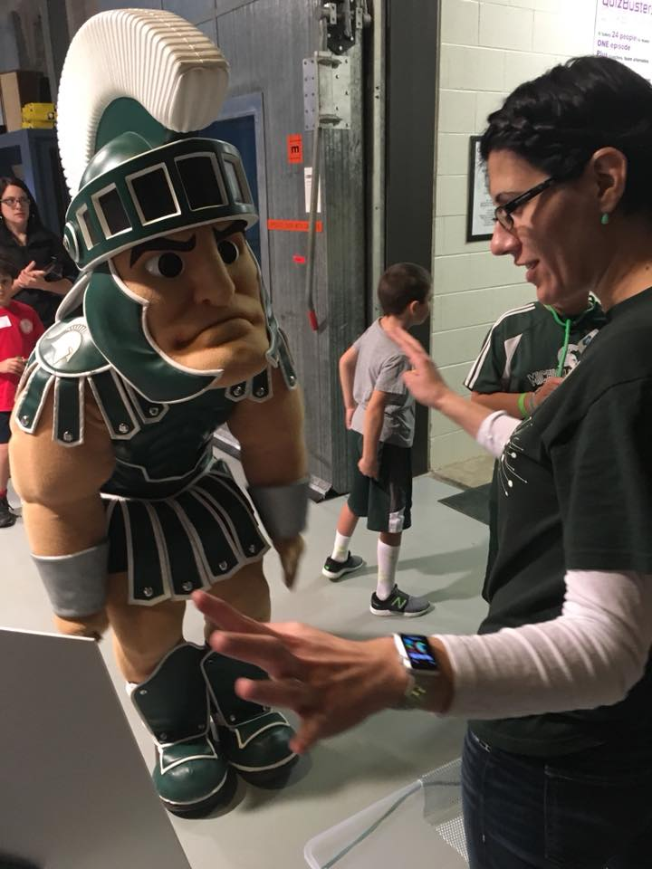
Sharing positive impressions with visitors
Ensure the interaction you have is positive, relevant to FRIB, and audience-appropriate.
To protect and build FRIB’s reputation and image, assume that your visitors plan to share their experience to social media channels.
Do not say or do anything that you would not want released on the internet as a representation of FRIB, FRIB science, FRIB use of taxpayer resources, Michigan State University, U.S. Department of Energy, or other funding agencies and stakeholders.

Slide 14
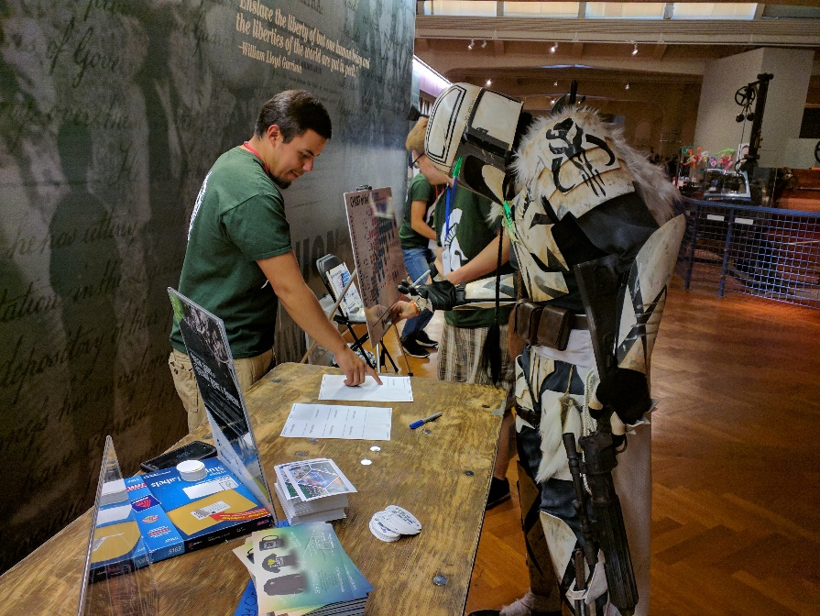
Being a good volunteer
You are expected to represent FRIB in a positive manner by:
Being present on time
Considering the needs of visitors first
Keeping visitors safe
Taking the time to anticipate problems before they occur
Practice makes perfect – the best way to learn science communication for the public is to just do it!
THANK YOU FOR BEING A VOLUNTEER

