Slide 1
WHO WILL DISCOVER
OUR FUTURE?
World-class nuclear experimentation and theory at MSU
Dr. Zach Constan
Outreach Coordinator
Facility for Rare Isotope Beams (FRIB)

Slide 2
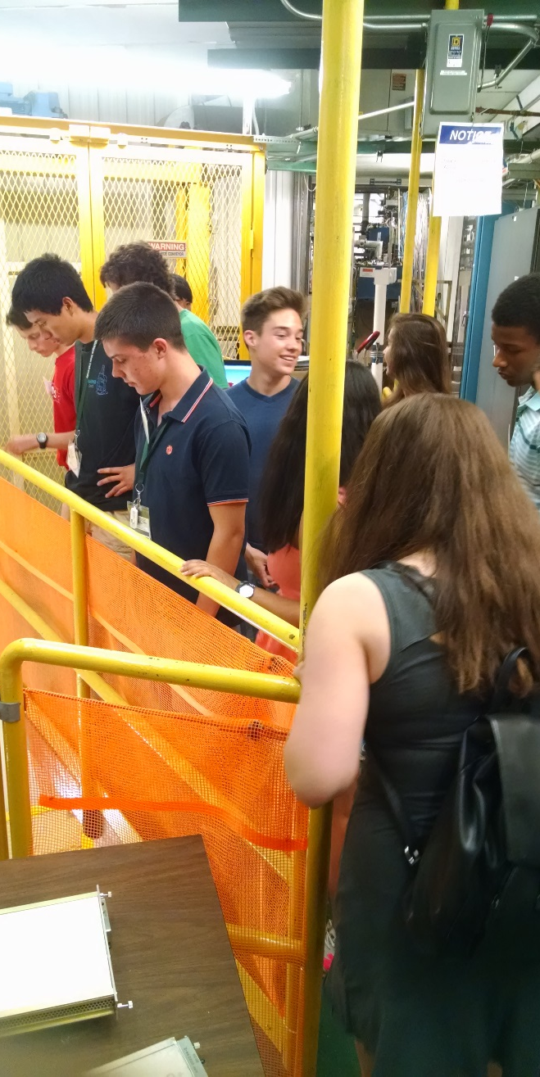
Useful Information
Location of bathrooms!
If you have minors in your group, your leader must submit a permission form.
Photography is not allowed on the tour, but we have a designated location for a group photo if you want.
You are not expected to know or understand everything! It’s OK.
Stopping us to ask questions is encouraged!
LAND ACKNOWLEDGEMENT
We collectively acknowledge that Michigan State University occupies the ancestral, traditional, and contemporary Lands of the Anishinaabeg – Three Fires Confederacy of Ojibwe, Odawa, and Potawatomi peoples. In particular, the University resides on Land ceded in the 1819 Treaty of Saginaw. We recognize, support, and advocate for the sovereignty of Michigan’s twelve federally-recognized Indian nations, for historic Indigenous communities in Michigan, for Indigenous individuals and communities who live here now, and for those who were forcibly removed from their Homelands. By offering this Land Acknowledgement, we affirm Indigenous sovereignty and will work to hold Michigan State University more accountable to the needs of American Indian and Indigenous peoples.

Slide 3
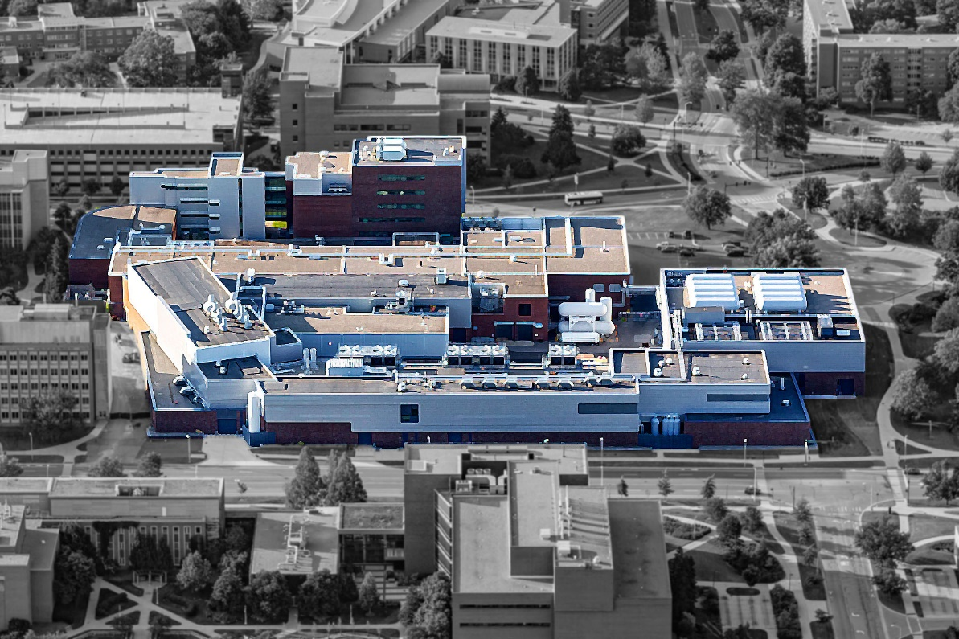
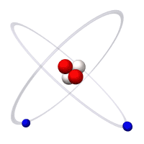
At FRIB, it’s all about the nuclei
A Helium Atom
Electron
LOBBY
ENTRANCE
Detectors/Experiments
Linear Accelerator
Proton
Neutron
The Facility for Rare Isotope Beams (FRIB)
at Michigan State University
FRIB scientists study
the atomic nucleus
Notes:
Other Points to Mention:
FRIB enables scientist to make discoveries in properties of atomic nuclei, nuclear astrophysics, tests of fundamental symmetries, and isotope research for society
Approximately 1,400 world-class scientists are engaged and belong to the FRIB Users Organization (FRIBUO)
Made possible by partnerships with the best in the nation and world; 13 active Work-for-Others agreements and 14 active MOUs

Slide 4
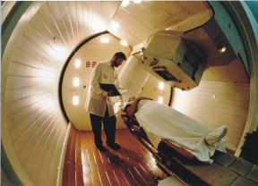
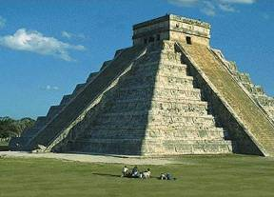
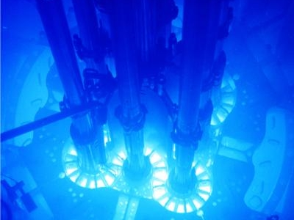
What is the value? (“Who cares?”)
Keeping us healthy
Explaining our world
Making electricity
…plus: smoke detectors, smartphones, safer food, etc.
What we learn about the nucleus can
save lives and change the world!
Jobs like medical physicist, radiation safety officer, geophysicist

Slide 5
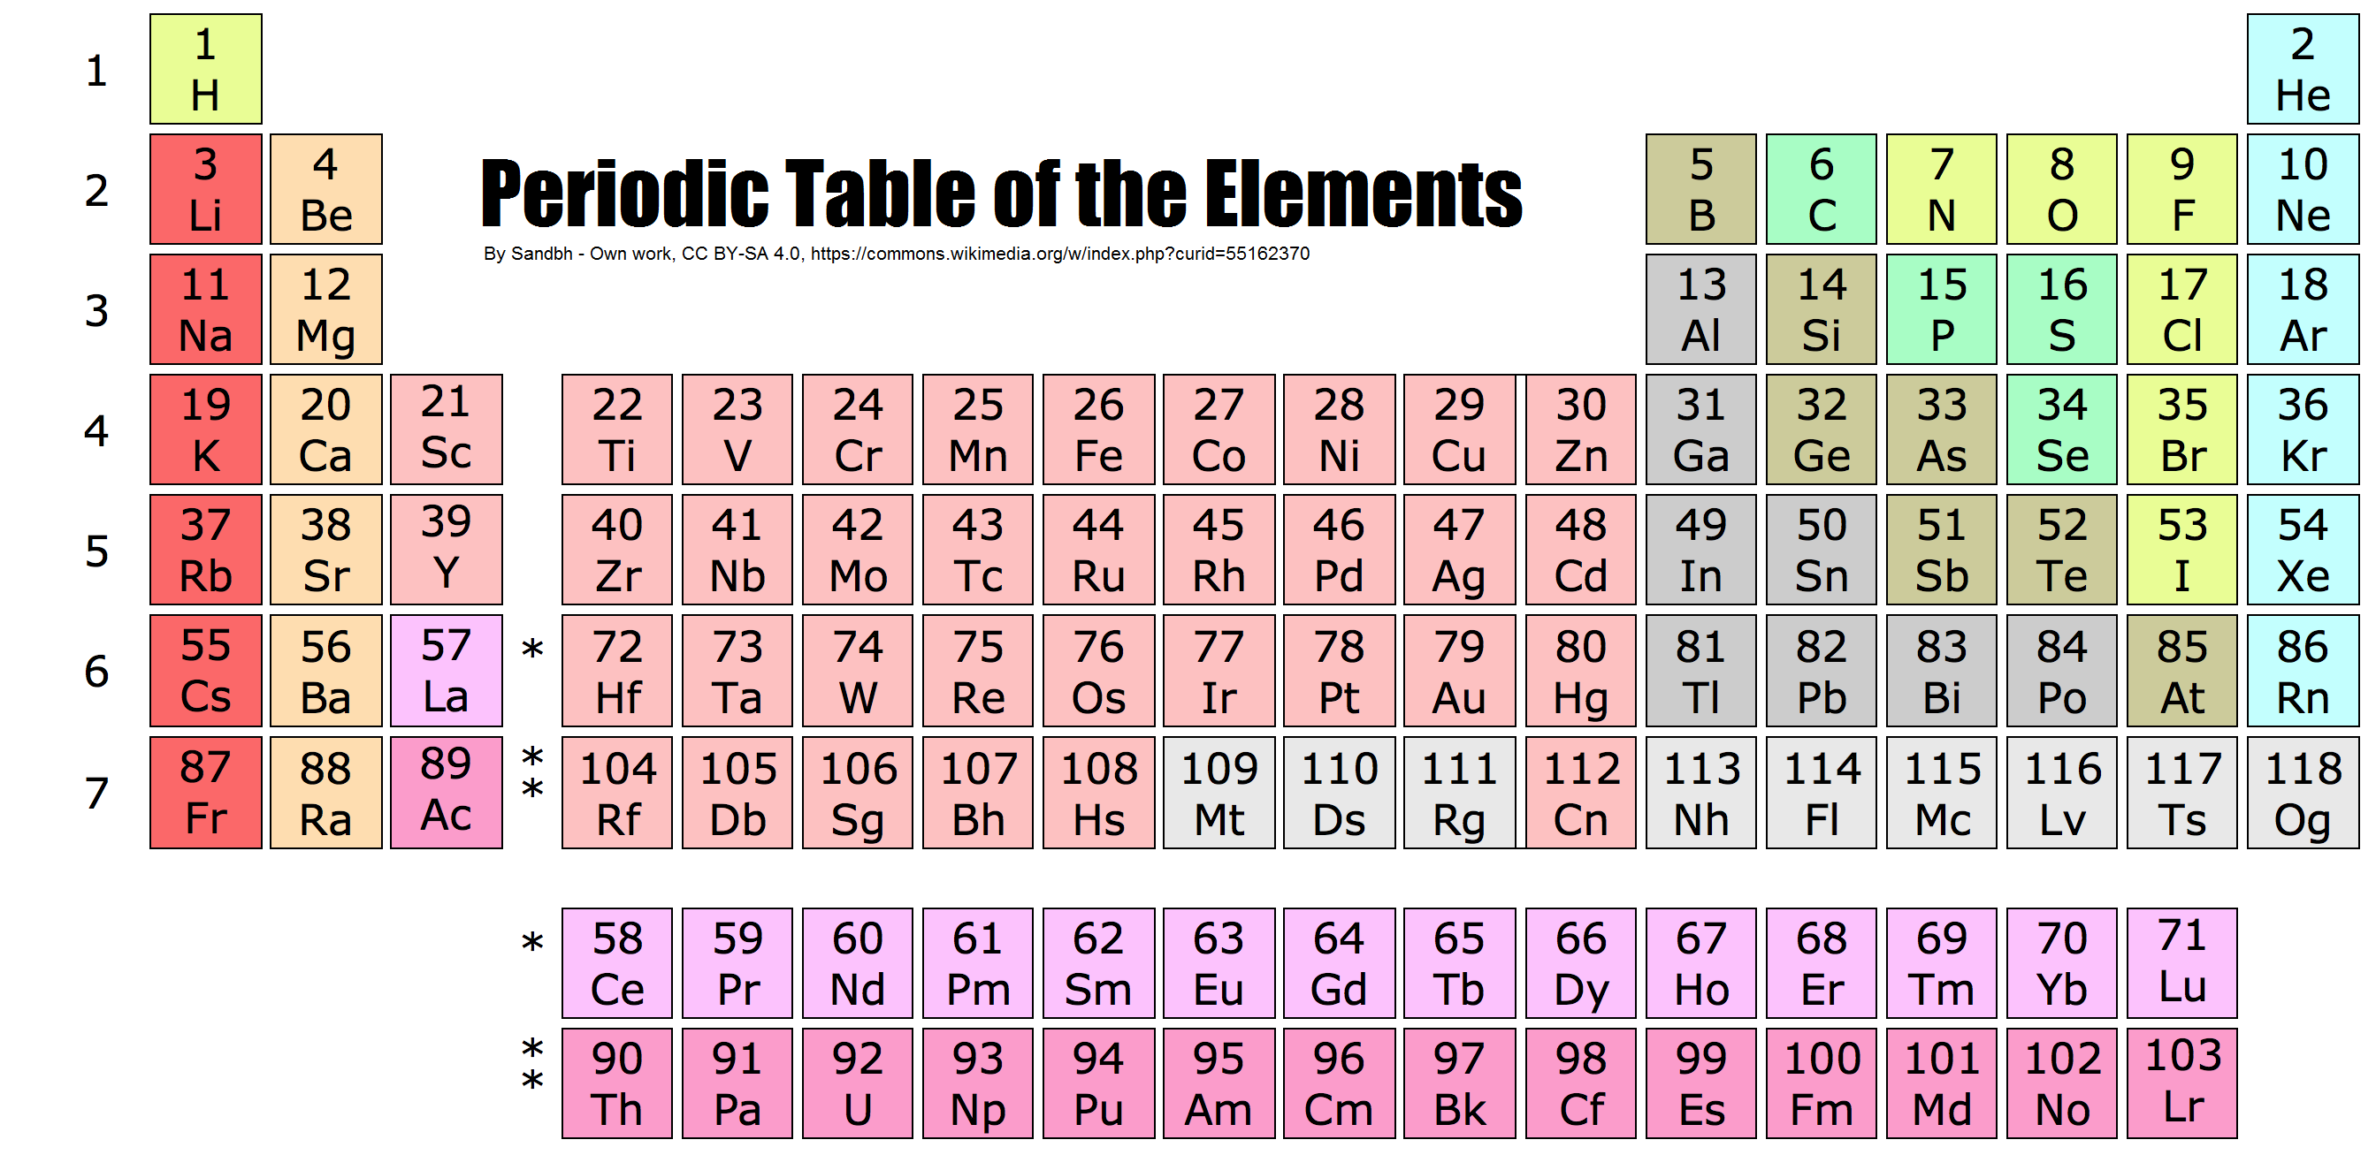
Periodic Table of the Elements
Each element (such as carbon) comes in
many varieties known as isotopes, some common, some rare

Slide 6
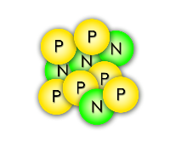
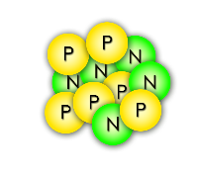
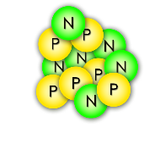
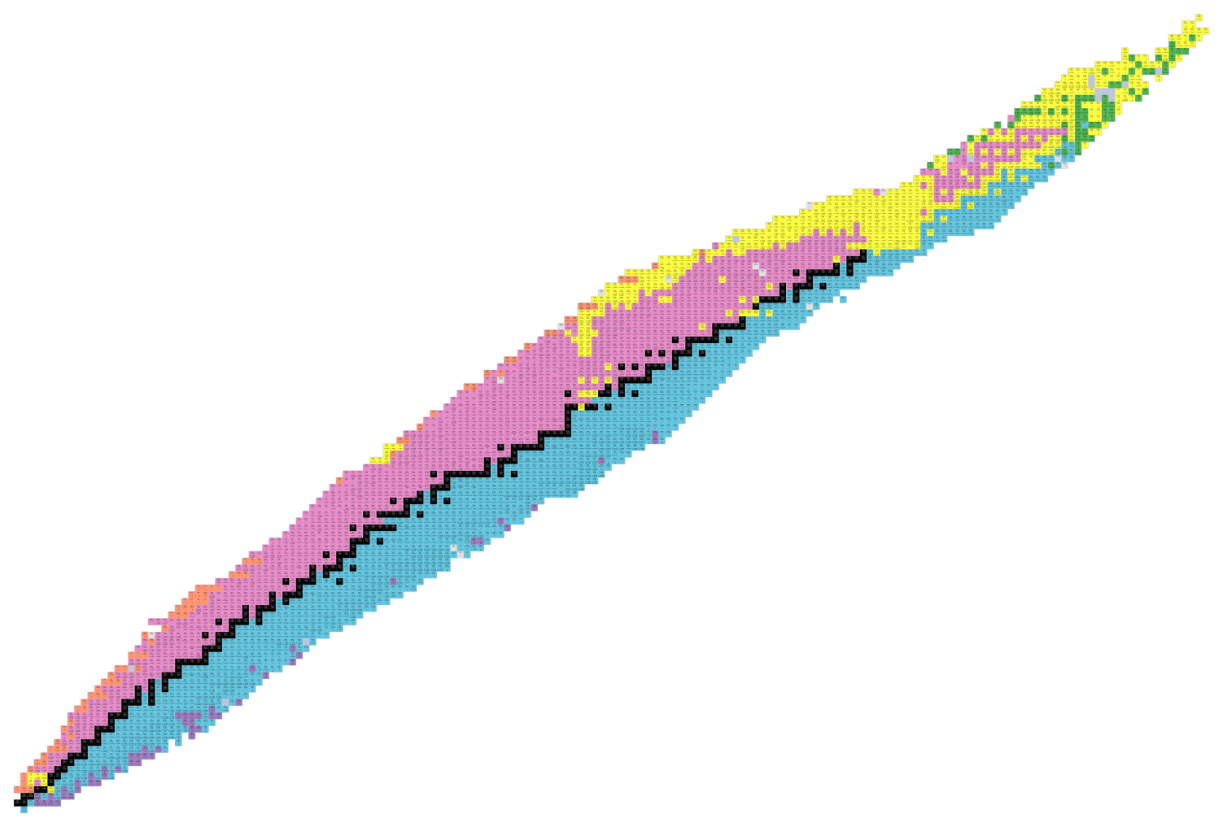
Isotopes: varieties of an element
The Chart of Nuclides
Carbon-10
Carbon-11
Carbon-12
All of these carbon isotopes are chemically identical, but different numbers of neutrons gives them diverse nuclear properties
Protons (Elements)
Neutrons (Isotopes)

Slide 7
FRIB mission: study RARE isotopes
Black squares
Stable, common isotopes
<300 known
Undiscovered Territory
Protons (Elements)
Undiscovered Territory
Colored squares
Unstable, radioactive, rare isotopes
>3000 known and growing
Neutrons (Isotopes)

Slide 8
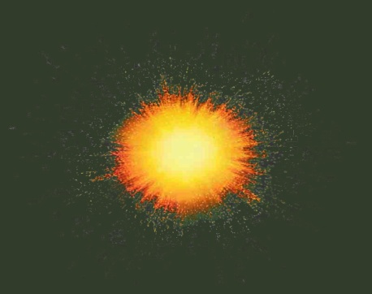
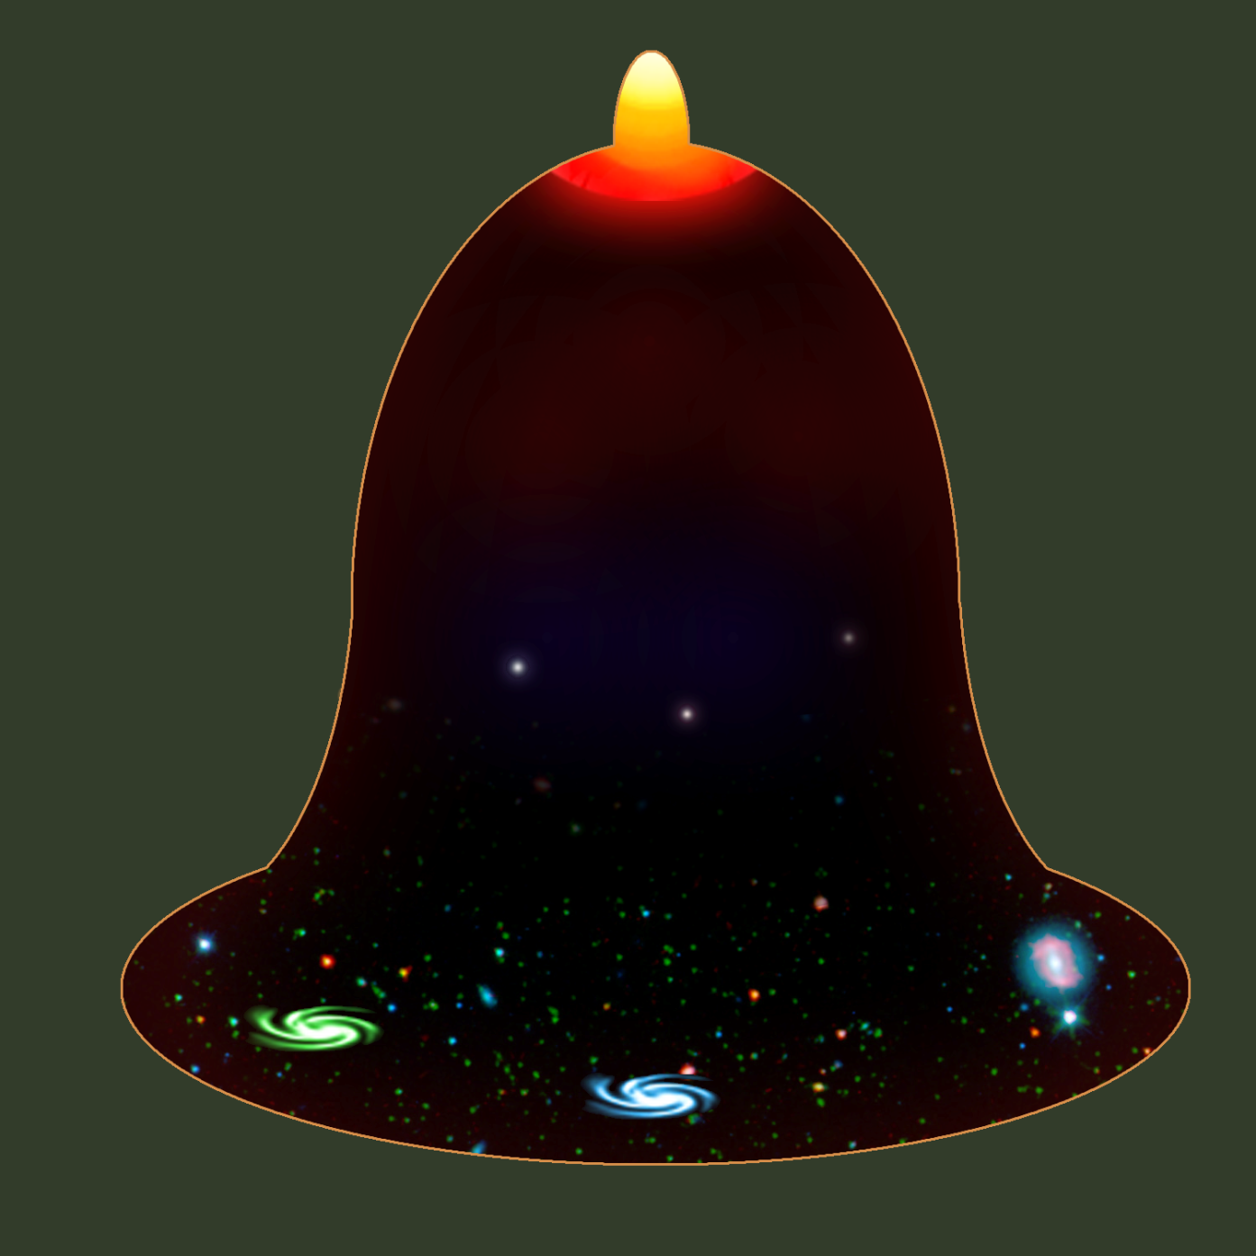
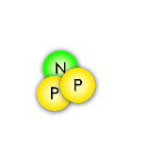
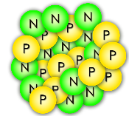
How were the elements made?
The Joint Institute for Nuclear Astrophysics (JINA) presents
A Short History of the Universe
A spectacular explosion of energy in a growing universe… the Big Bang !!
Inflation
Slowing expansion
4 min after Big Bang
1.8 Billion ºF
The first nuclei are made: Hydrogen and Helium
…
Formation of the first stars
One billion years after Big Bang
440 ºF
helium iron
Stars fuse light elements into heavy ones, up to iron
Accelerating expansion
Neutron-star mergers & supernovae may create rare isotopes that will decay into heavier elements!
-450 ºF
Now

Slide 9
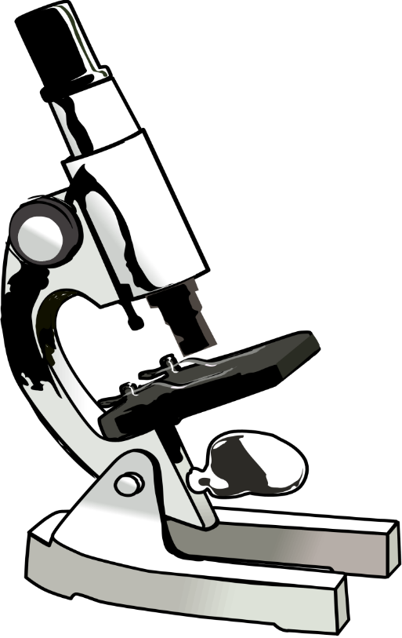
The Problem(s)
Nuclei are too small
to see
(even with
the best microscopes!)
To make it even more interesting: FRIB studies
nuclei that are
radioactive,
short-lived, and
not found on Earth

Slide 10
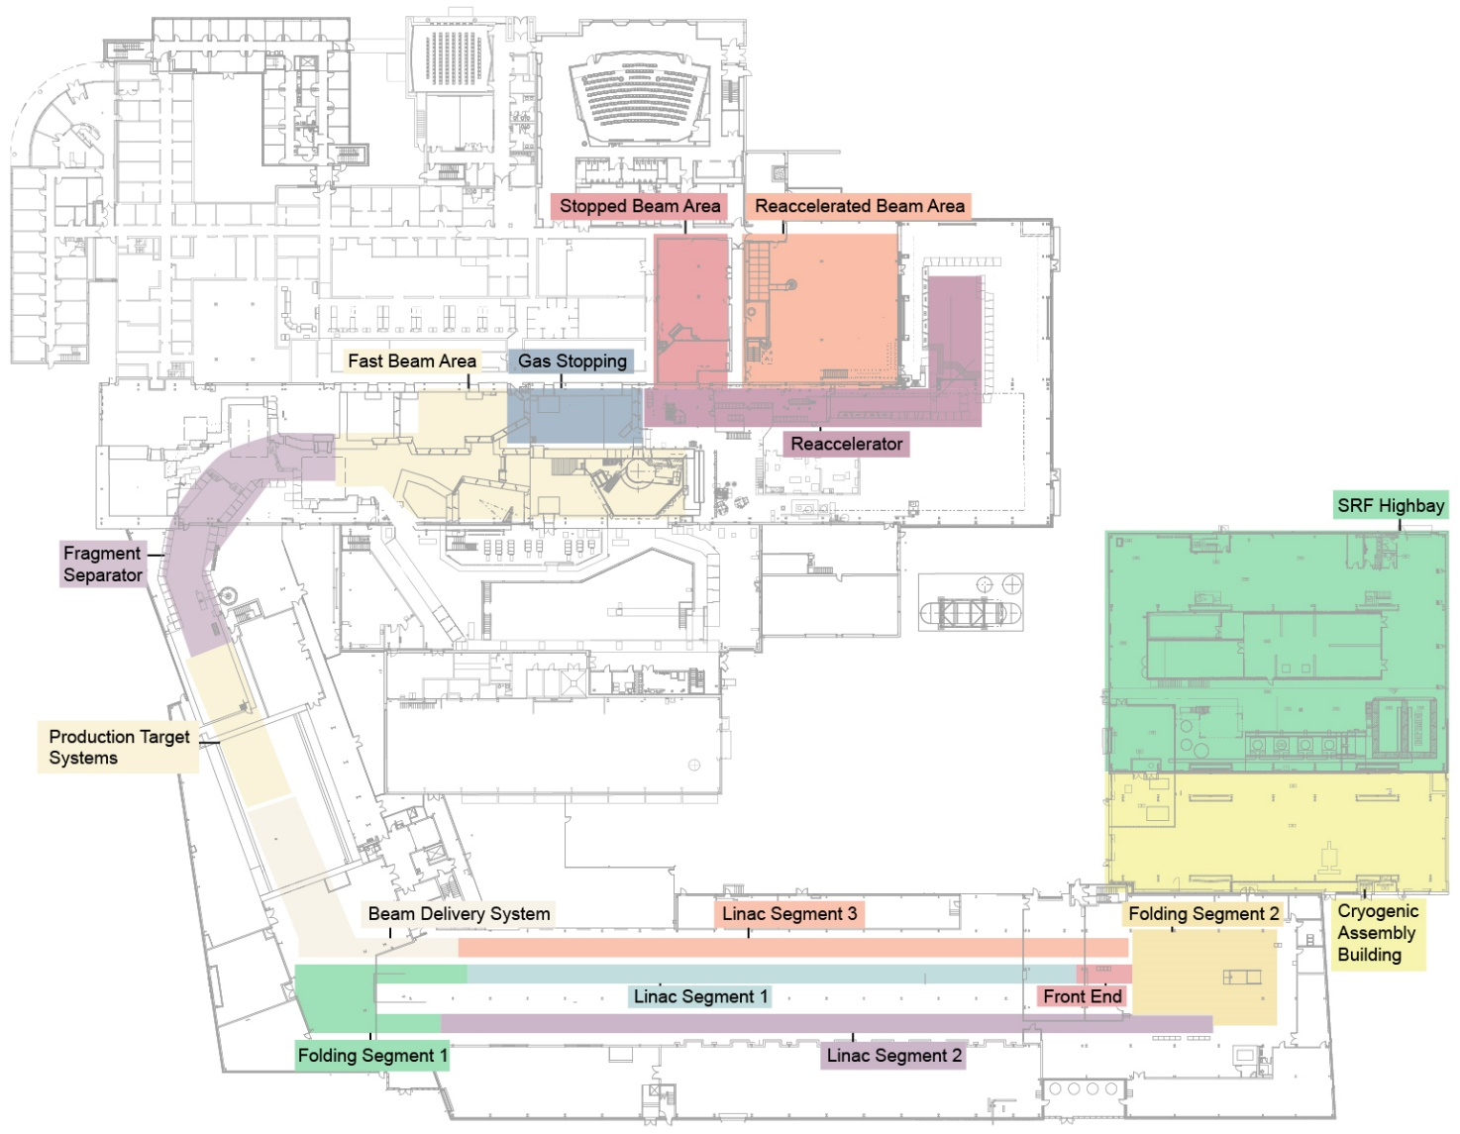
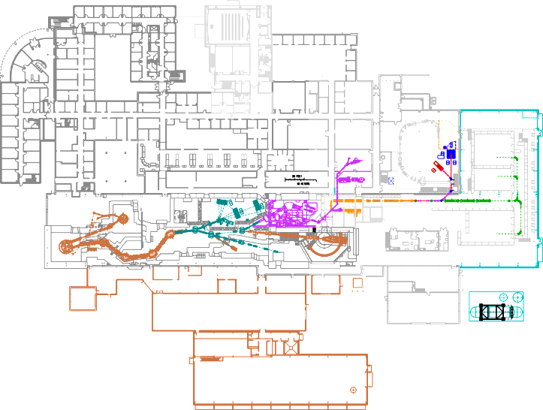
Rare isotopes from a particle accelerator
FRIB today
What NSCL was
To discover something new: speed up and BREAK MORE NUCLEI with our next-generation
Facility for Rare Isotope Beams (FRIB)
the $730 million discovery machine that we imagined, designed, built, and is now operational
Connects with experimental systems in place
Research Space (450 feet)
Collides w/ target at half the speed of light
400-yard-long folded linear accelerator
Double energy, up to 400x more nuclei/sec
TIME FOR A DEMO!

Slide 11
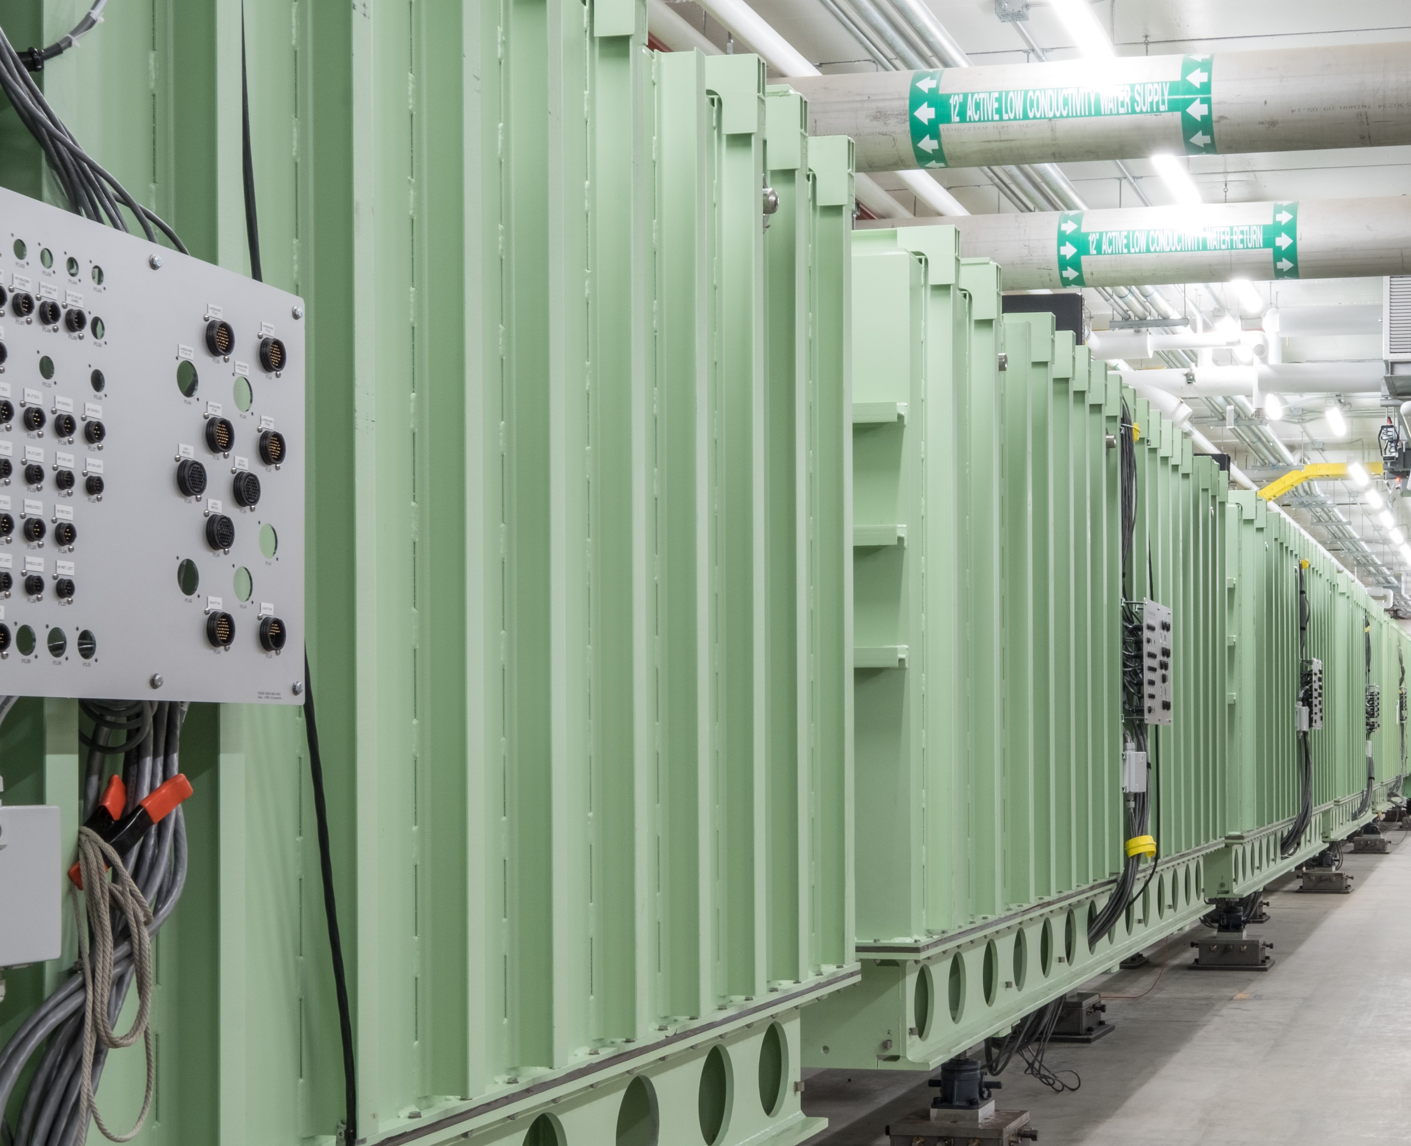
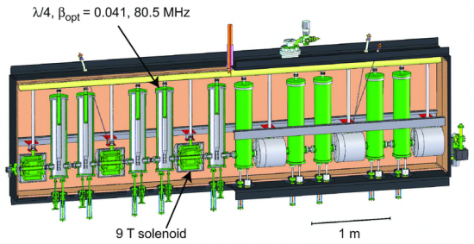
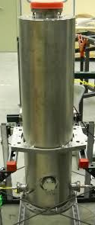
Linear Accelerator: one cryomodule at a time
A cryomodule (cold box) of ten cavities that charge to ~1 MV
CRYOMODULES
(below -450ºF / 4K)
Beam
path
One of 330 high-voltage accelerating cavities to produce beam @ ~0.5c

Slide 12
Problem: Making designer nuclei
BEAM at ~0.5 c
strikes a TARGET
exits with FRAGMENTS
¹⁸O
¹⁸O
¹⁸O
¹⁸O
¹⁸O
¹⁸O
¹⁶C
or
¹²C
¹¹B
or
The accelerated beam contains the one or two stable isotopes provided by the ion source
(~400 billion nuclei/second)
Very few beam nuclei (<1%) actually hit a nucleus in the target and break (fragment), becoming a different element and/or isotope
¹⁷O
or…
After the target, the beam is:
mostly original stable isotope
many new isotopes
a few of the desired isotope (maybe <1 nucleus/second)

Slide 13
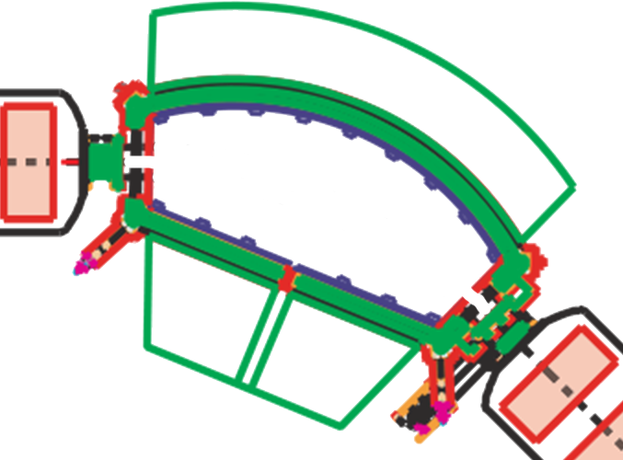
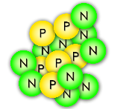
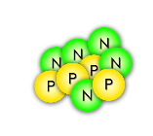
Problem: Selecting one rare isotope
Some nuclei turn too little
Solution:
A fragment separator (mass spectrometer) made of superconducting electromagnets
¹⁶C
Some nuclei turn too much
The magnetic field is set just right to steer nuclei of the chosen isotope through!
A dipole magnet

Slide 14
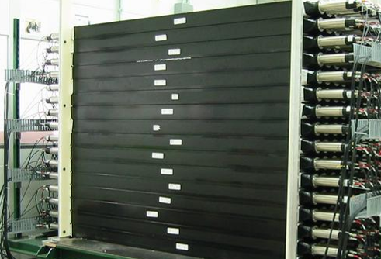
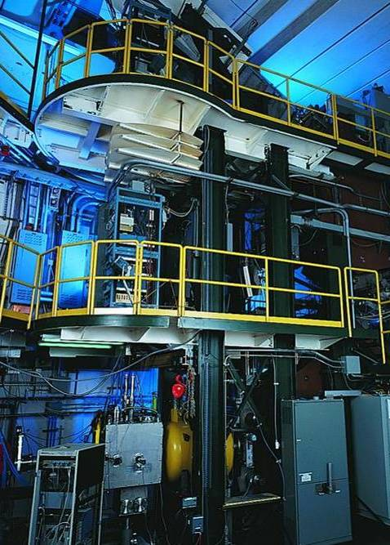
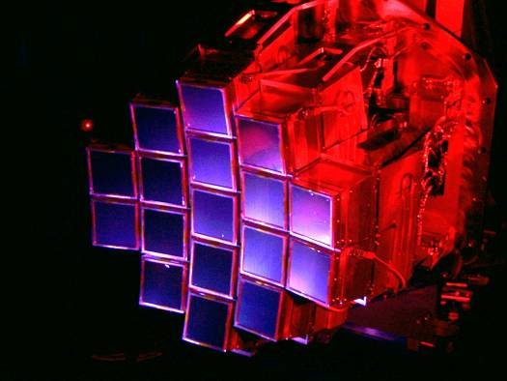
Detectors measure the invisible
Rare isotopes are delivered to various detectors which can measure mass, size, shape, half-life, etc.
These tools must be created by a team of
detector physicists, mechanical designers, chemists, machinists, technicians…
… and who knows how else we might use those tools someday!
MoNA
“Halo nuclei” and neutron-rich isotopes
S800 Spectrograph
Nuclear energy states from particles freed in collisions
Nuclei found in
stellar reactions
HiRA
TIME FOR A DEMO!

Slide 15
Who works at FRIB? Users
The best nuclear scientists
on the planet come to FRIB because our laboratory is a world class research facility
~1500
researchers

Slide 16
Who works at FRIB? Staff
Research and Development
Theorists and Experimenters
Facility operators
Designers & engineers
Undergraduate and Graduate
students
Technicians & machinists
Our 800+ faculty, staff, and students learned useful skills in:
nuclear science ▪ physics ▪ chemistry ▪ all types of engineering ▪ mathematics ▪ computer science ▪ welding ▪ machining ▪ pipefitting ▪ and so on…
And had jobs in quality control, building cars, construction, farming, etc…
If you like Science, Technology, Engineering, and Math (STEM), that’s what we do!
(and skilled trades!)

Slide 17
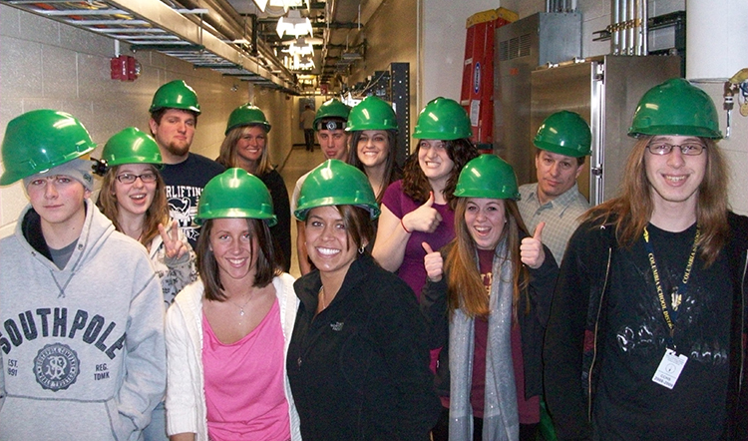
Who works at FRIB? Students
For 30+ years, NSCL & FRIB has been the home of a
top-ranked nuclear science school
among U.S. universities
(U.S. News & World Report, 2018)

Slide 18
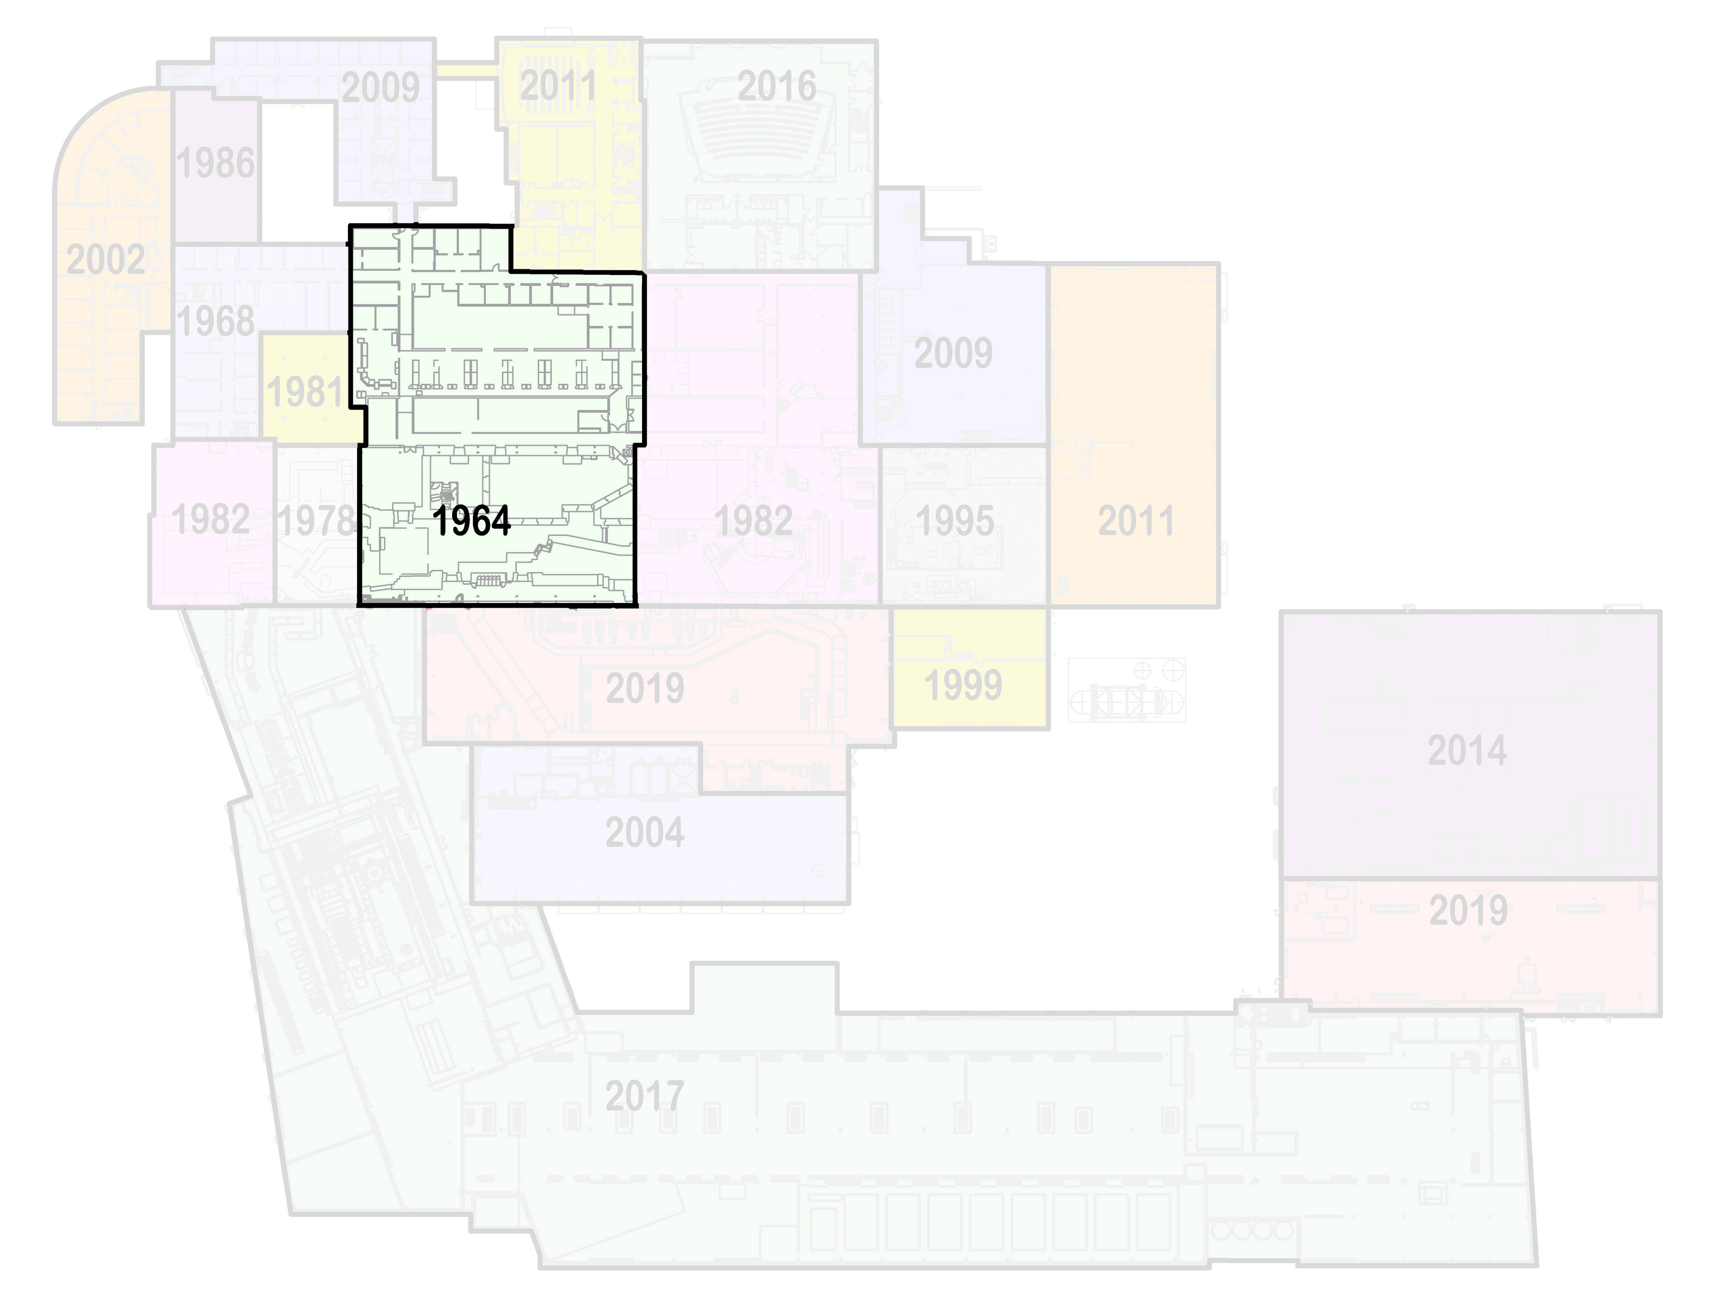
Want to keep discovering? Upgrade!
Decades of pushing discovery with NSCL, and the future is FRIB

Slide 19
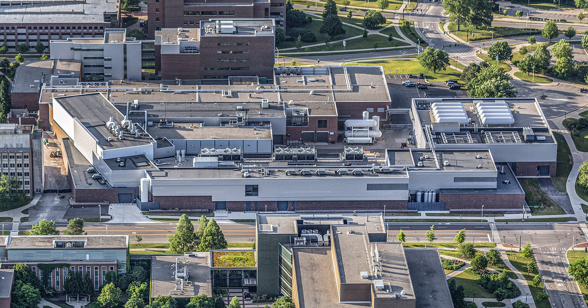
FRIB on the MSU campus
SHAW LANE
Lobby
Offices & Labs
WHARTON
CENTER

Detectors & Experiments

DAIRY STORE
(one
block)
Target
Highbay
Machine Shop & Assembly
Accelerator Testing
Ion Sources
Accelerator Support (power, cooling)
WILSON ROAD

Slide 20
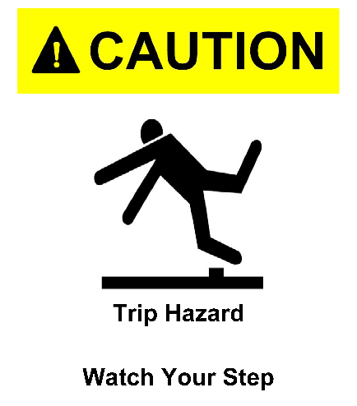
Safety First
DON’T put anything in your mouth (eat, drink, chew gum)
DO watch your head and step
DON’T sit or lean on things
DO obey posted signs
DON’T take photos
DO stay with your guide
DON’T touch equipment
If you lose your tour, dial “0” on a lab phone (“77305” after hours)
DO leave items (especially open food/drink) you don’t want to carry

Slide 21
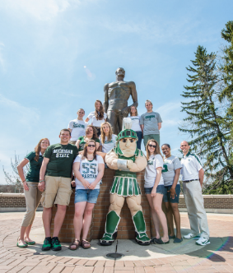
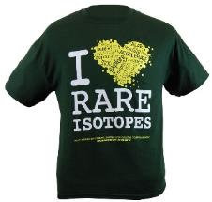
Explore FRIB at MSU
Learn more about our Lab and outreach programs
Visit the FRIB exhibit at Impression 5 Science Center in downtown Lansing!
impression5.org
SPARTAN YOUTH PROGRAMS
Find camps and programs at MSU for
pre-college students: spartanyouth.msu.edu
Each April, explore the MSU Science Festival!
sciencefestival.msu.edu
Visit our Gift Shop on shop.msu.edu (click “FRIB” under “Specialty Shops”)
Get the Android/ iPhone/iPad game Isotopolis for free!
GIFT SHOP
contact visits@frib.msu.edu or go to frib.msu.edu/public
@friblab

Slide 22
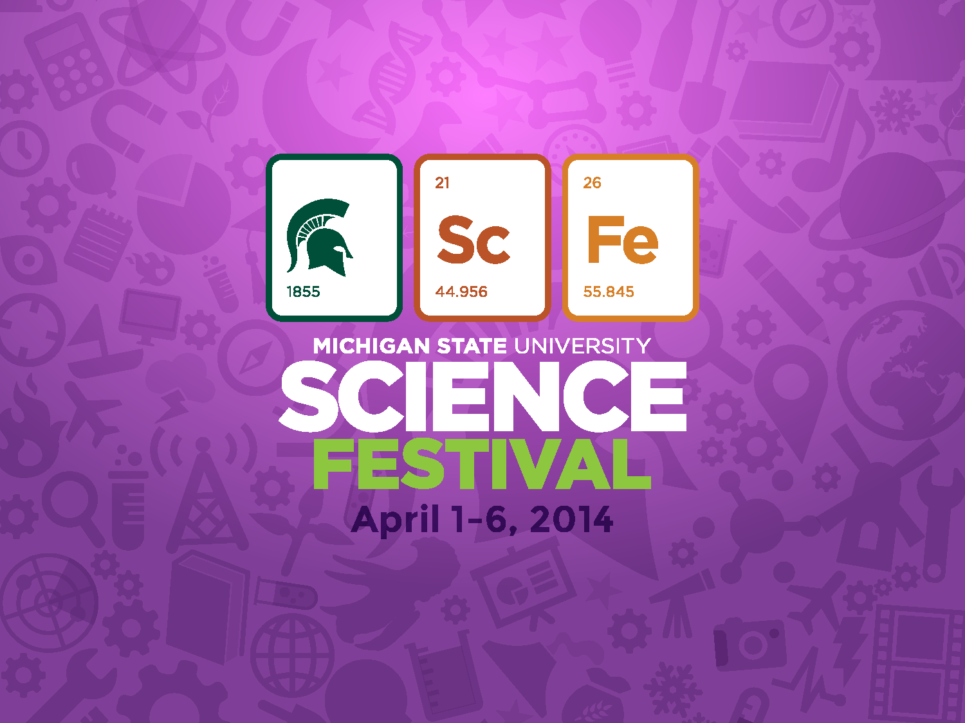
Annually in April
sciencefestival.msu.edu

Slide 23
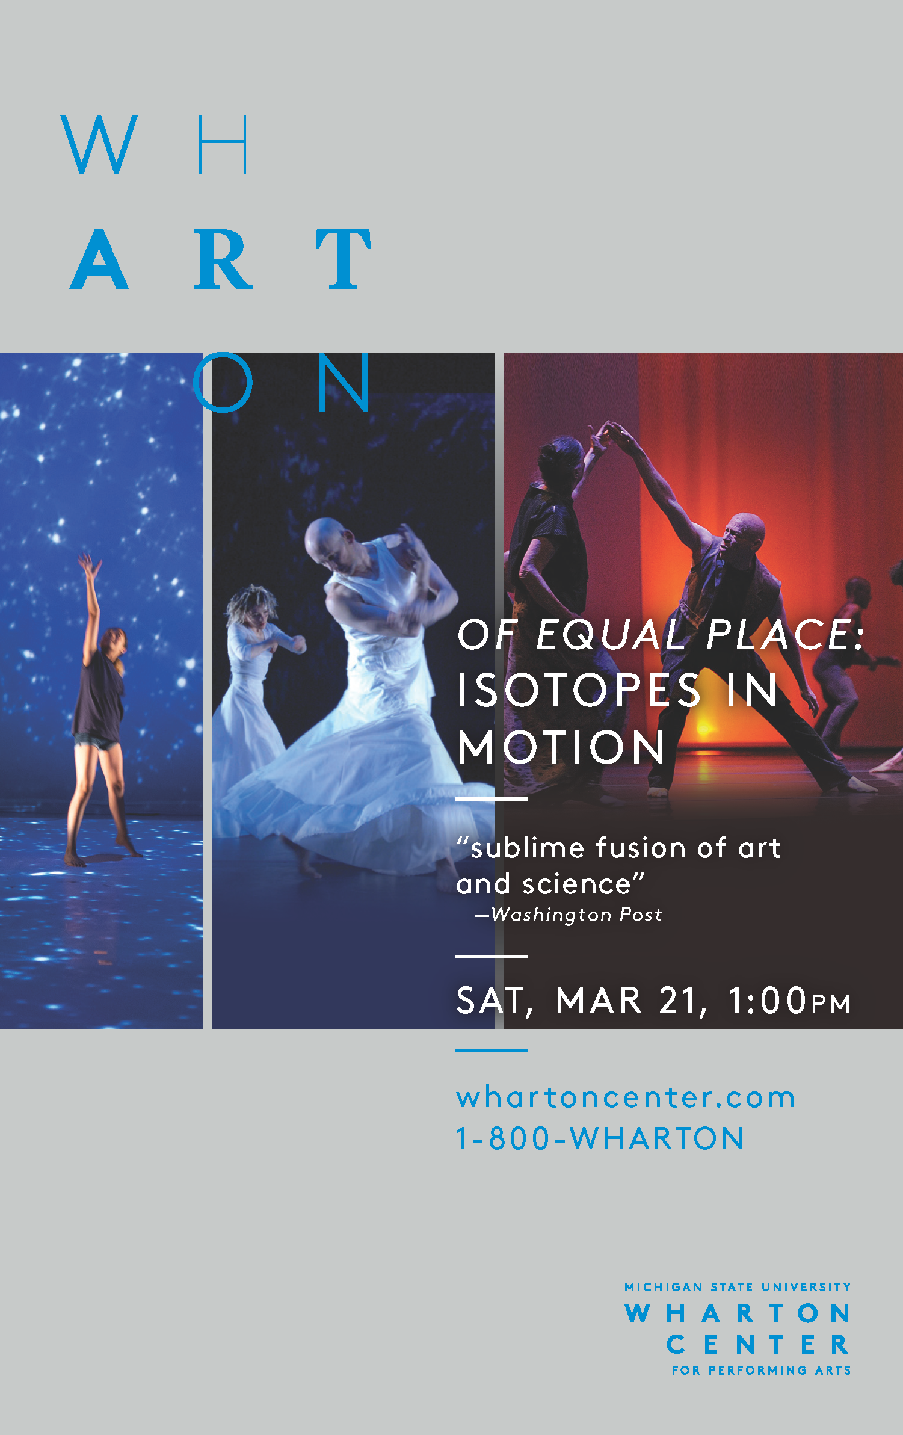
NOV 6TH
Annually in April
sciencefestival.msu.edu
Followed by workshops, tours, and demonstrations!

Slide 24
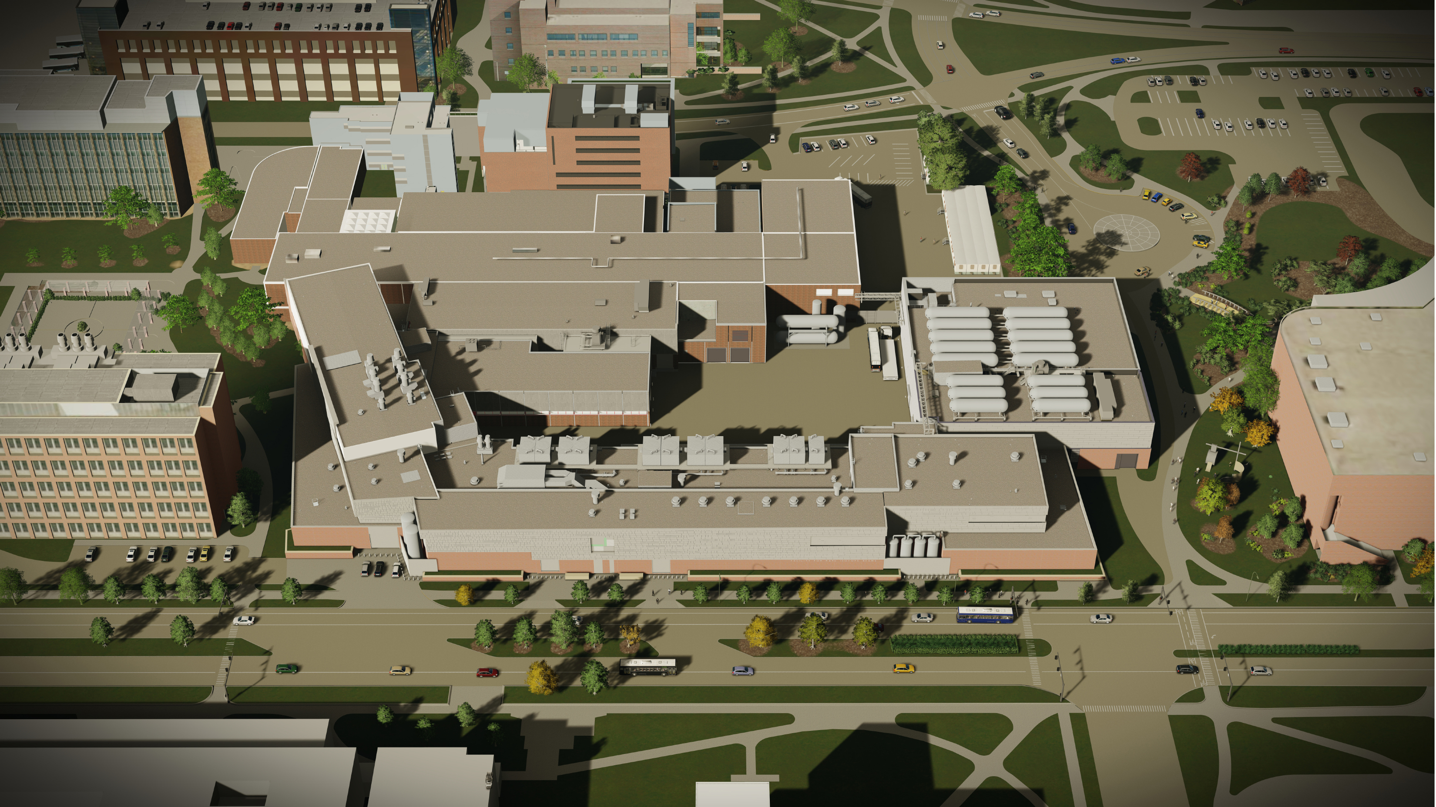
FRIB on the MSU campus

DAIRY STORE
(one
block)
SHAW LANE
BOGUE STREET
Offices/Labs
WHARTON
CENTER

Lobby
Detectors/Experiments
SRF Assembly
Target
Highbay
Ion Sources
Linac Support Building
WILSON ROAD

Slide 25
Special COVID-19 Considerations
Thanks for helping us alleviate COVID risk by:
Not attending the tour if you feel sick
Wearing a mask over nose and mouth
Maintaining 6-foot separation when possible

