Slide 1
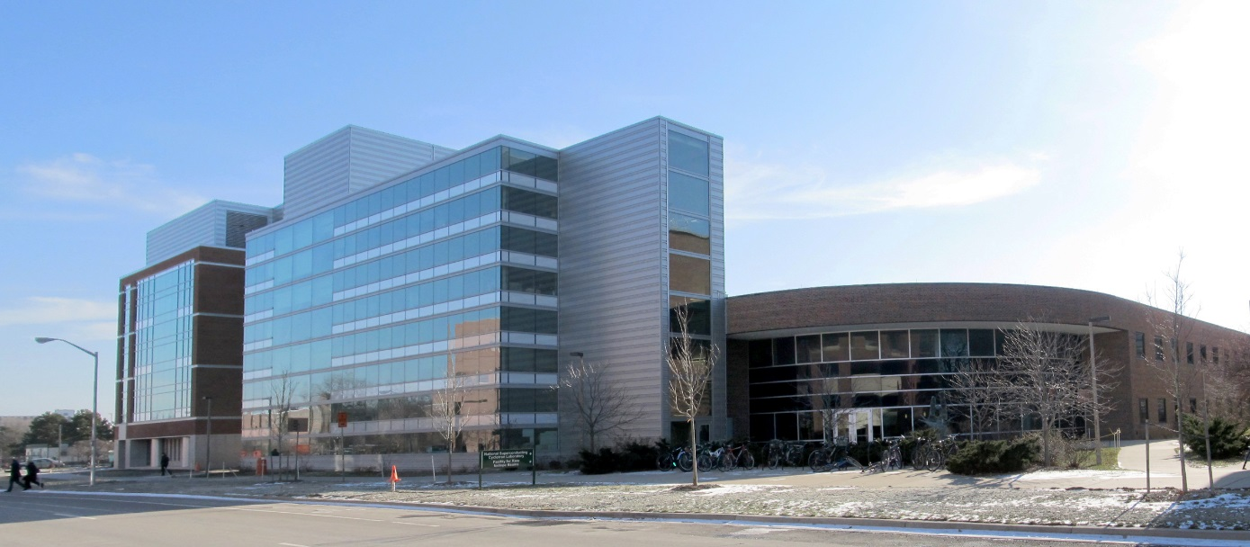
NSCL Nuclear Research at MSU
A world-class facility for nuclear experimentation and theory
NATIONAL
SUPERCONDUCTING CYCLOTRON LABORATORY
ISO 9001, ISO 14001, OHSAS 18001 registered

Slide 2
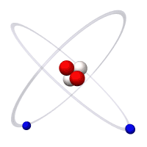
We study the atomic nucleus
Example: A Helium Atom
Electron
Proton
Neutron
NSCL scientists study the atomic nucleus
Notes:
(Have audience identify parts of the atom) At NSCL, we study the nucleus of the atom. Specifically, we study nuclei that are rare, unstable.

Slide 3
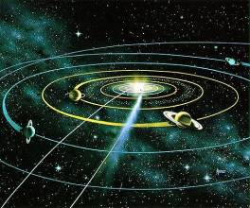
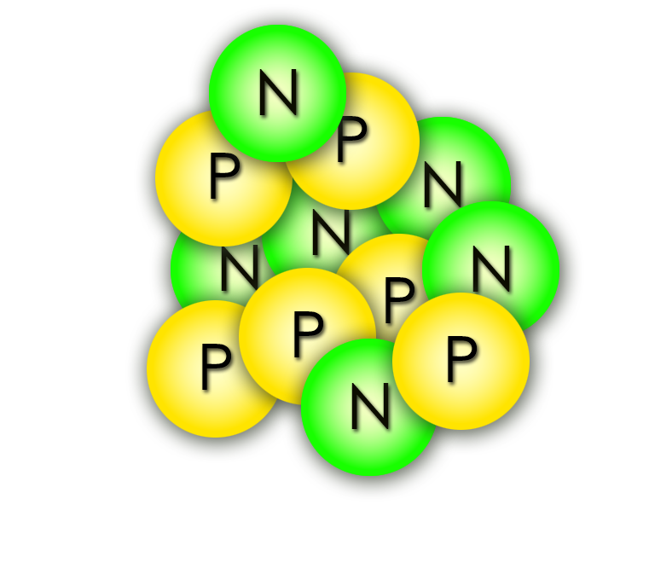
The nucleus is SMALL
An atomic nucleus is as small compared to you…
…as you are compared to our ENTIRE solar system
We can’t see the nucleus, so it’s hard to work with.
But we’ve still found clever ways to control and study it!
Notes:
The nucleus is really small, can’t see even with the most powerful microscopes. It’s as small compared to you as you are compared to the ENTIRE SOLAR SYSTEM.

Slide 4
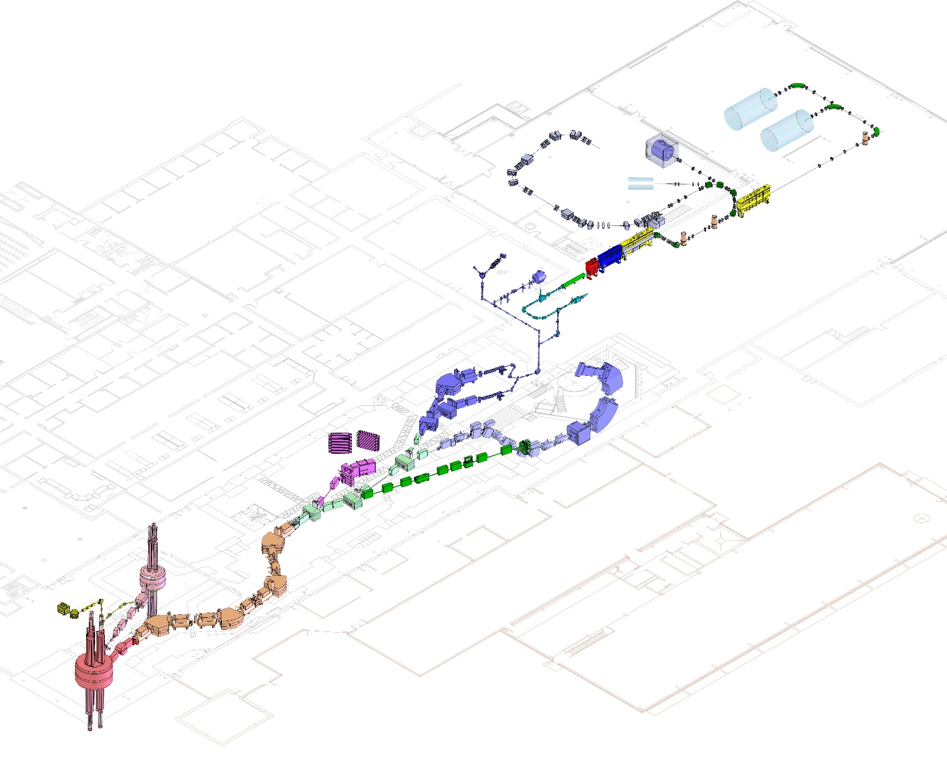
LEADING SCIENTIFIC ADVANCEMENT
Coupled cyclotron facility and experimental beam lines
A person
~140 meters (450 feet) long
Five stories tall

Slide 5
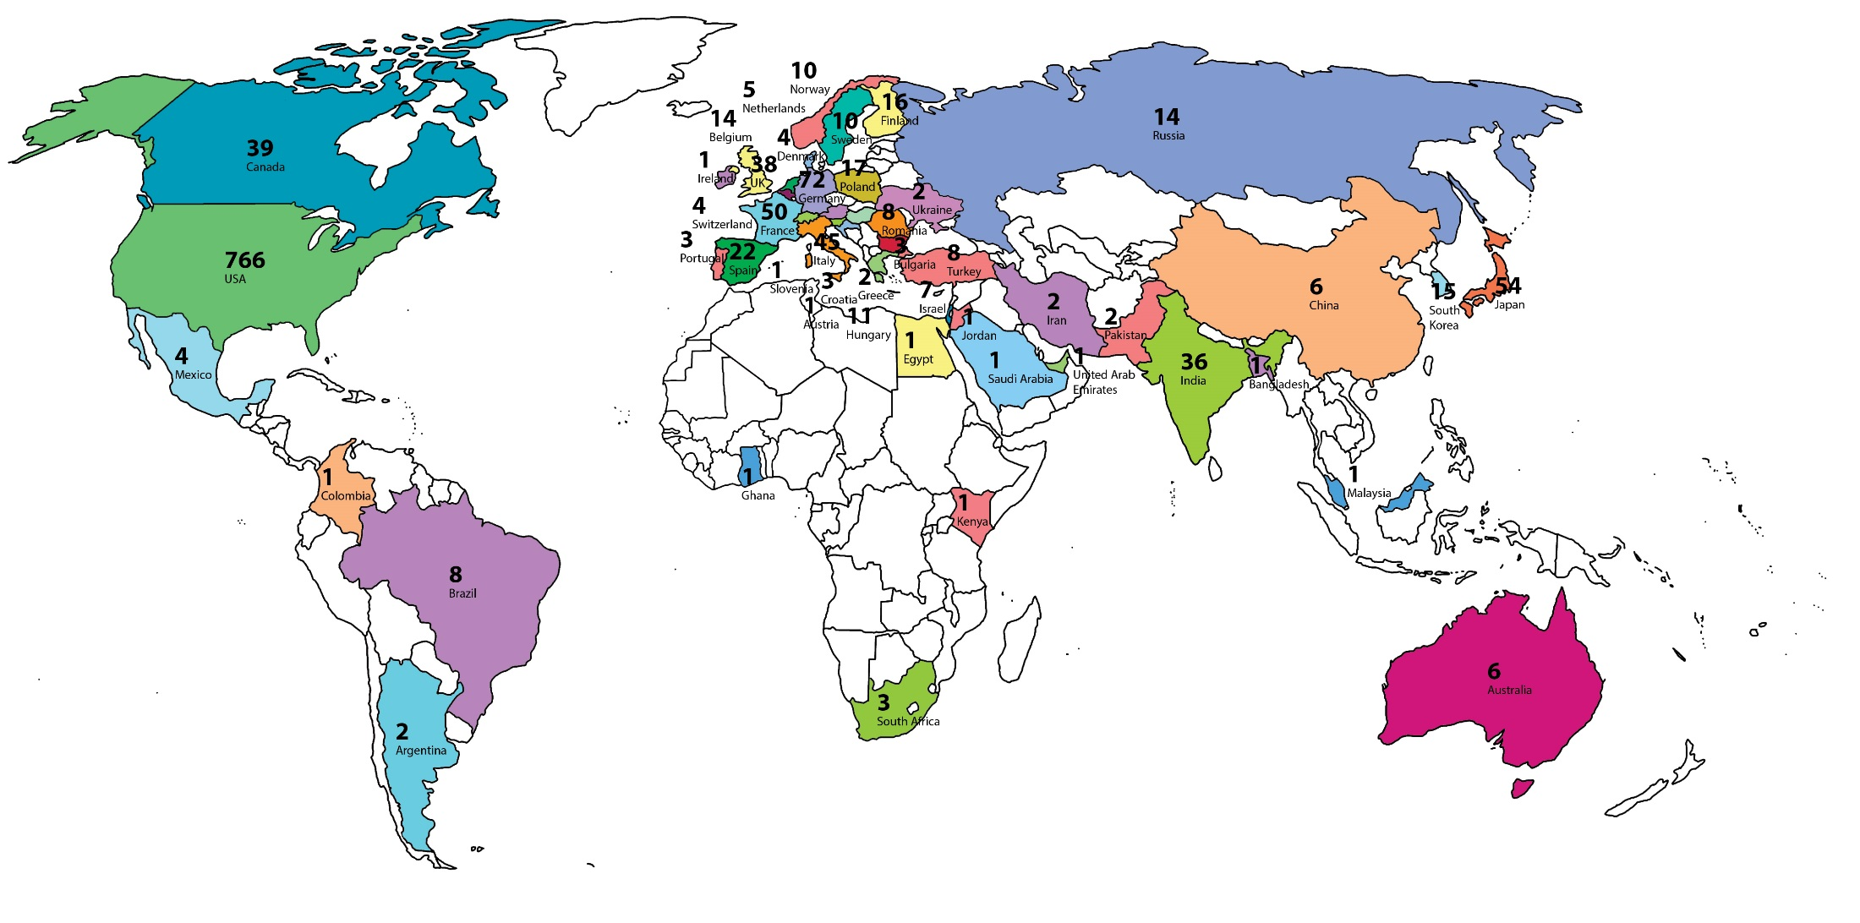
SERVING USERS
NSCL is a world class research facility, supported by the National Science Foundation (NSF), that hosts the best nuclear scientists from the US and the world.
NSCL User Community
April 2013 (>1300 scientists)

Slide 6
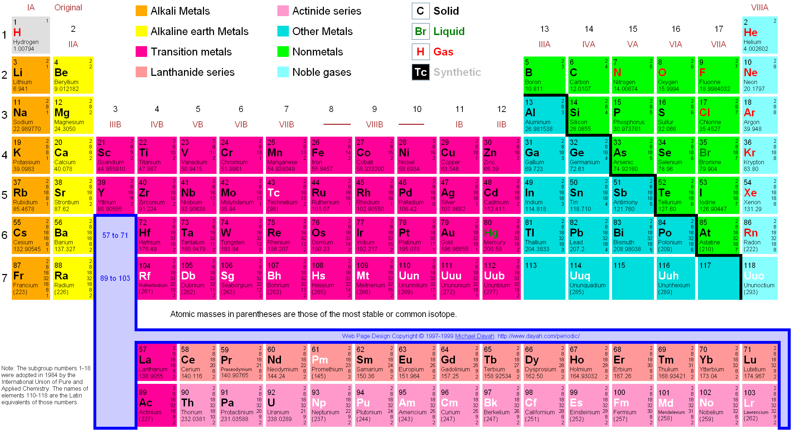
How were the elements made?
The Periodic Table
BIG
BANG
STARS
BURNING
STARS BURNING
MANY CREATED BY EXPLODING STARS
MAKING UNSTABLE NUCLEI
HUMAN-MADE
(OUR BEST THEORY SO FAR)
HUMAN-MADE
Notes:
Of course, we also do research because we’re curious. One big mystery we’re trying to solve is where all the different elements came from. H and He were created in the beginning of our universe, after the Big Bang, these were mostly created when stars fused hydrogen into heavier elements for fuel, these are man-made… but the vast majority of elements were made in a lot of strange and complicated ways! One of which: supernovas (exploding stars) form unstable nuclei that later become these elements, so we study the unstable nuclei to understand how.

Slide 7
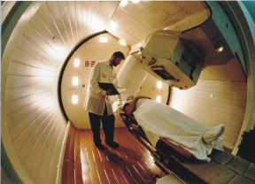
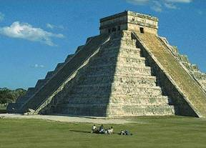
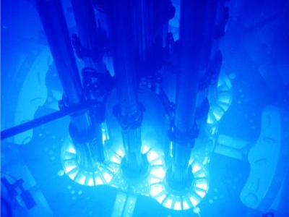
Why study rare isotopes?
Nuclear Medicine
Archeology/Geophysics
Nuclear Power
What we learn about the nucleus can generate new ideas and technologies in the fields of space science, airport security, biology/ecology, etc.

Slide 8
WHO IS NSCL?
700+ employees
Our employees have backgrounds in nuclear science, physics, chemistry, all types of engineering, computing, mathematics, etc. We represent most fields of Science, Technology, Engineering and Math (STEM).
Research and development scientists/engineers
Faculty researchers
Facility operators
Undergrad students
Graduate
students
Technicians, engineers & machinists

Slide 9
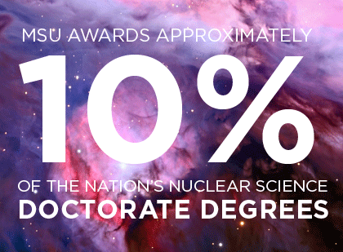
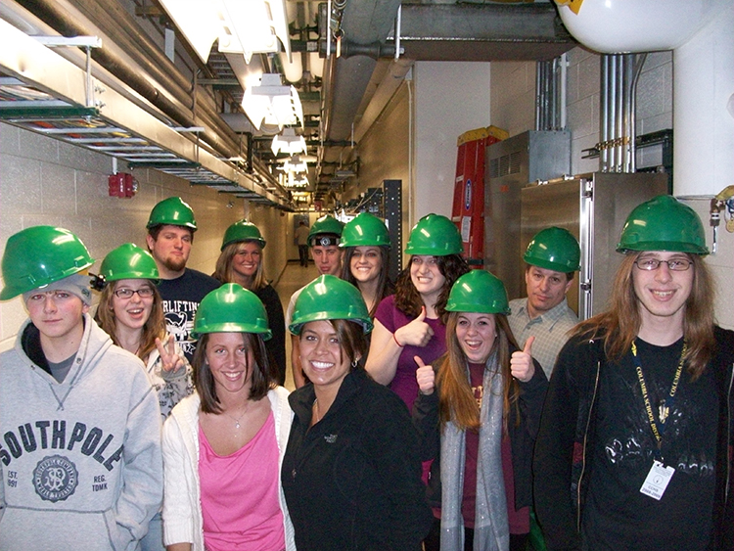
EDUCATION AND OUTREACH
NSCL has the
#1 ranked nuclear science program
among US graduate schools
(U.S. News & World Report, 2014)
NSCL Outreach offers:
Tours for the general public
Summer research programs for middle & high school students
Nuclear science experiments and lessons for teachers to use
For more information online: www.nscl.msu.edu/public/education

Slide 10
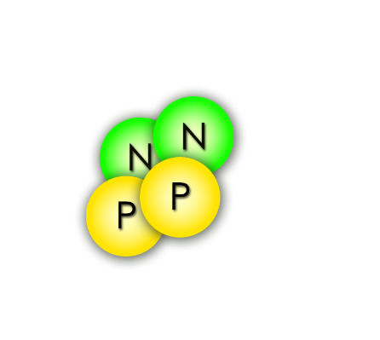
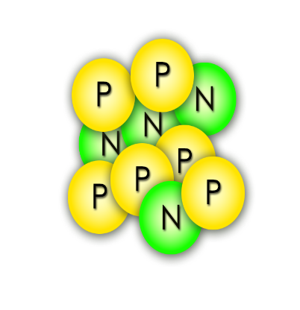
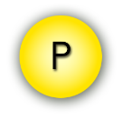
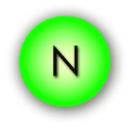
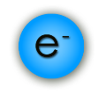
Radioactive, rare isotopes decay
Alpha particle (He nucleus)
Proton
Unstable nuclei are radioactive, meaning they will decay (come apart)…
Gamma ray
Neutron
Electron (β⁻ particle)
…and give off radiation
of some kind!
Isotopes studied at NSCL have short half-lives (< 1 s)

Slide 11
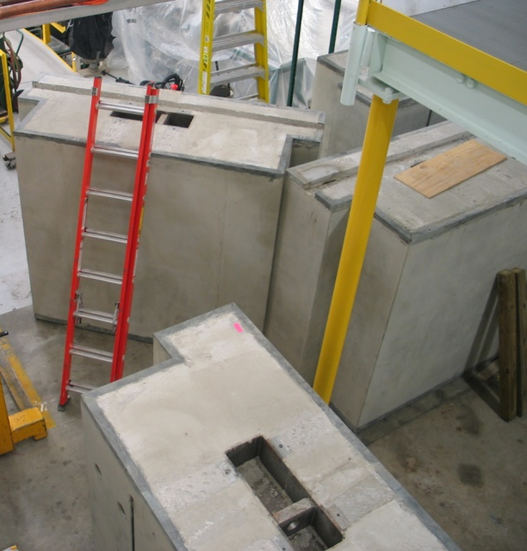
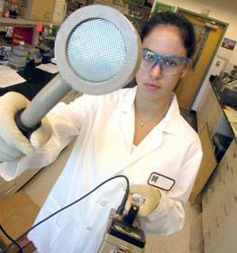
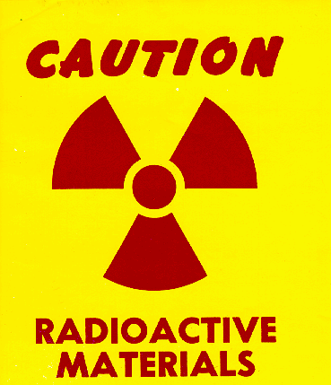
Radiation Safety
Shielding
Surveying
Labeling
and Training
NSCL takes radiation safety seriously,
and has met NRC license standards for over 50 years
Fact: NSCL has fewer radioactive sources than a major hospital
Notes:
In our lab, we use 6-foot-thick concrete to stop radiation from escaping. We’re also very careful to scan for radioactivity and train people how to handle it safely. We checked the tour route to make sure that the radiation levels were safe for you. Radiation is not dangerous when you treat it with respect and know how to manage it. In fact, I walked around the tour route before you got here with a radiation detector to make sure it was safe.

Slide 12
Radiation Exposure and You
Radiation source | Dose
Average exposure for general public (natural + medical) | > 300 mRem/yr
Government (NRC) exposure limit for lab visitors | 100 mRem/yr
NSCL/FRIB ALARA goal for visitors | 10 mRem/yr
Your visit today | < 1 mRem
Dental x-ray | 1-2 mRem
Smoking a pack of cigarettes | ~2 mRem (800 mRem/yr)

Slide 13
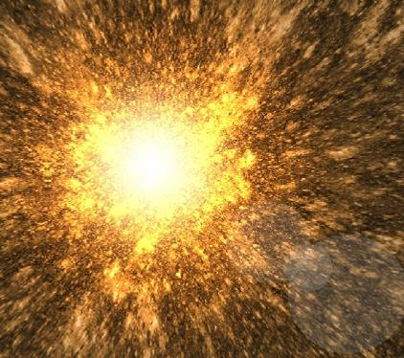
How to make unstable nuclei
NSCL’s Coupled Cyclotron Facility

Slide 14
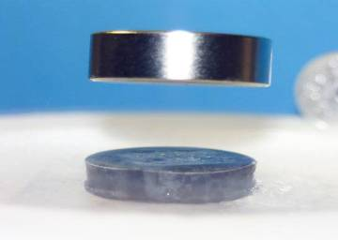
Superconductivity
NSCL cyclotrons use electromagnets made from niobium-titanium wires.
At liquid helium temperatures (-269 °C , -450 °F), these wires become superconducting, which means they have zero electrical resistance.
This allows us to make small, powerful electromagnets used to direct and control nuclei!
Superconductors also repel magnetic fields
magnet
superconductor
liquid nitrogen used to cool the superconductor

Slide 15
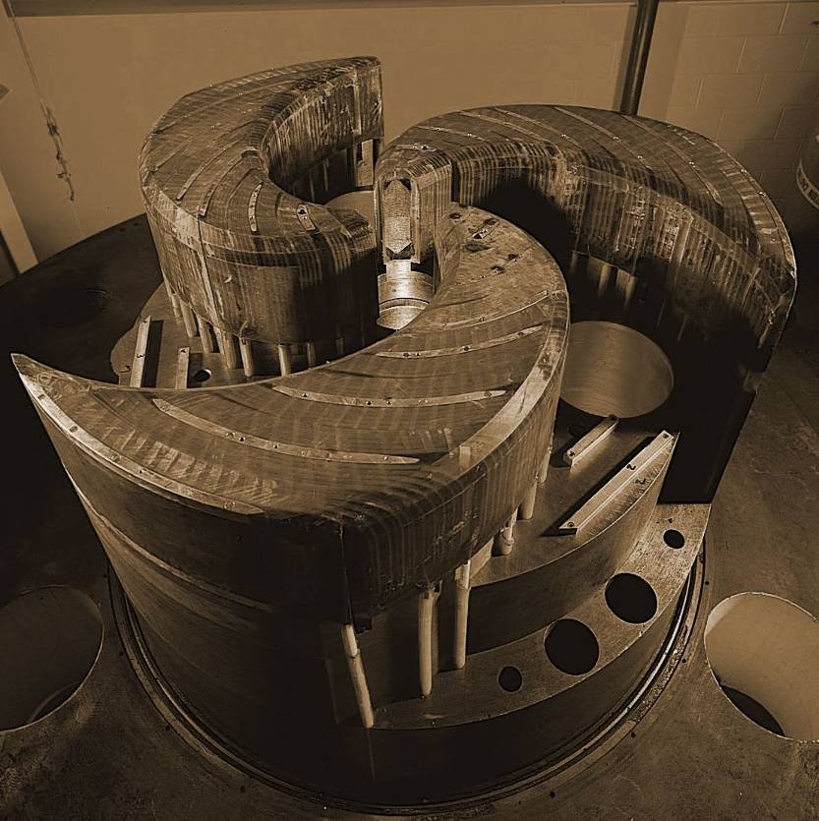
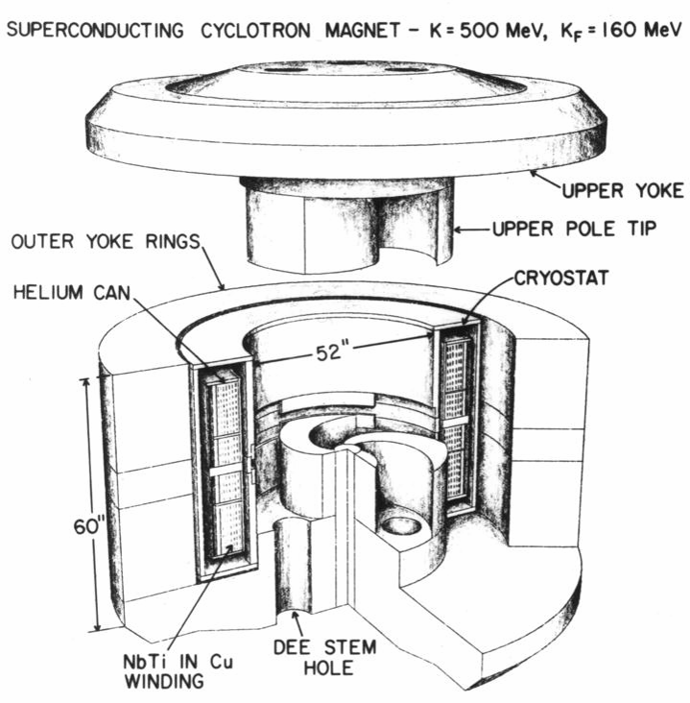
The cyclotrons
World’s first superconducting cyclotron
World’s second-highest-energy superconducting cyclotron
K500
K1200
Year completed: 1982
Diameter: 10 ft Weight: 100 tons
Magnetic field: 3-5 Tesla
Maximum energy it can impart to a proton: 500 MeV
Year completed: 1988
Length of superconducting wire: 38 mi
Time of acceleration: 0.000035 seconds
Distance a nucleus travels while inside: 1.9 miles (700 revolutions)

Slide 16
How a cyclotron works
When stable nuclei from the ion source enter a cyclotron,
a magnetic field bends their path into a circular “orbit” while electric fields speed them up, so they spiral outward
Notes:
A cyclotron uses a Magnetic field to steer the nuclei in a circle, and an Electric field to speed it up (that’s why it’s spiraling outward). The K500 speeds nuclei up to 20% of the speed of light and sends them to the K1200, which accelerates them up to HALF the speed of light. How far is that every second?

Slide 17
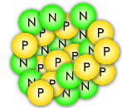
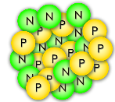
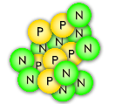
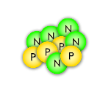
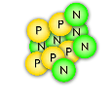
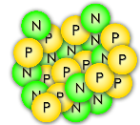
Fragmentation
BEAM at < 0.5 c
strikes foil TARGET
exits with FRAGMENTS
or
The accelerated beam consists of the one stable isotope provided by the ion source
(>1 billion nuclei/second)
Very few beam nuclei hit a nucleus in the target and break, becoming a new element/isotope
After the target, the beam contains many new isotopes (sometimes <1 desired nucleus/second)

Slide 18
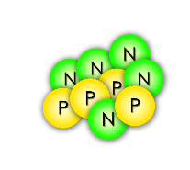
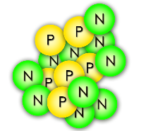
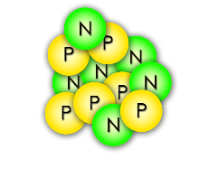
Fragment separator
Wide variety of nuclei from collisions with the target enter…
The A1900 filters out all but the one (or more) unstable nucleus for study
Wedge-shaped dipole magnets act like prisms that separate nuclei

Slide 19
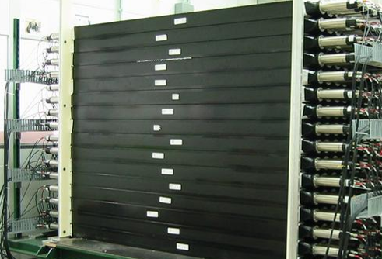
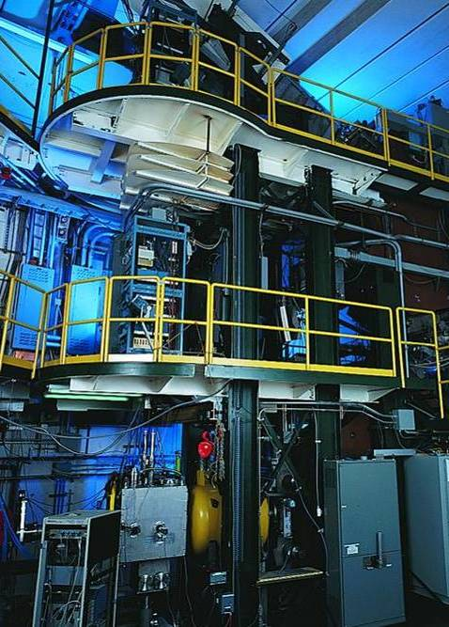
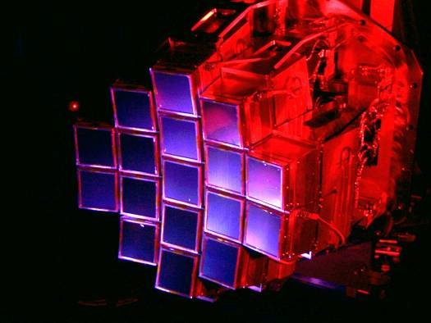
Detectors
MoNA
“Halo nuclei” and neutron-rich isotopes
S800 Spectrograph
Nuclear states from particles freed in collisions
HiRA
Nuclei found in stellar reactions
How do you measure something you can’t see?

Slide 20
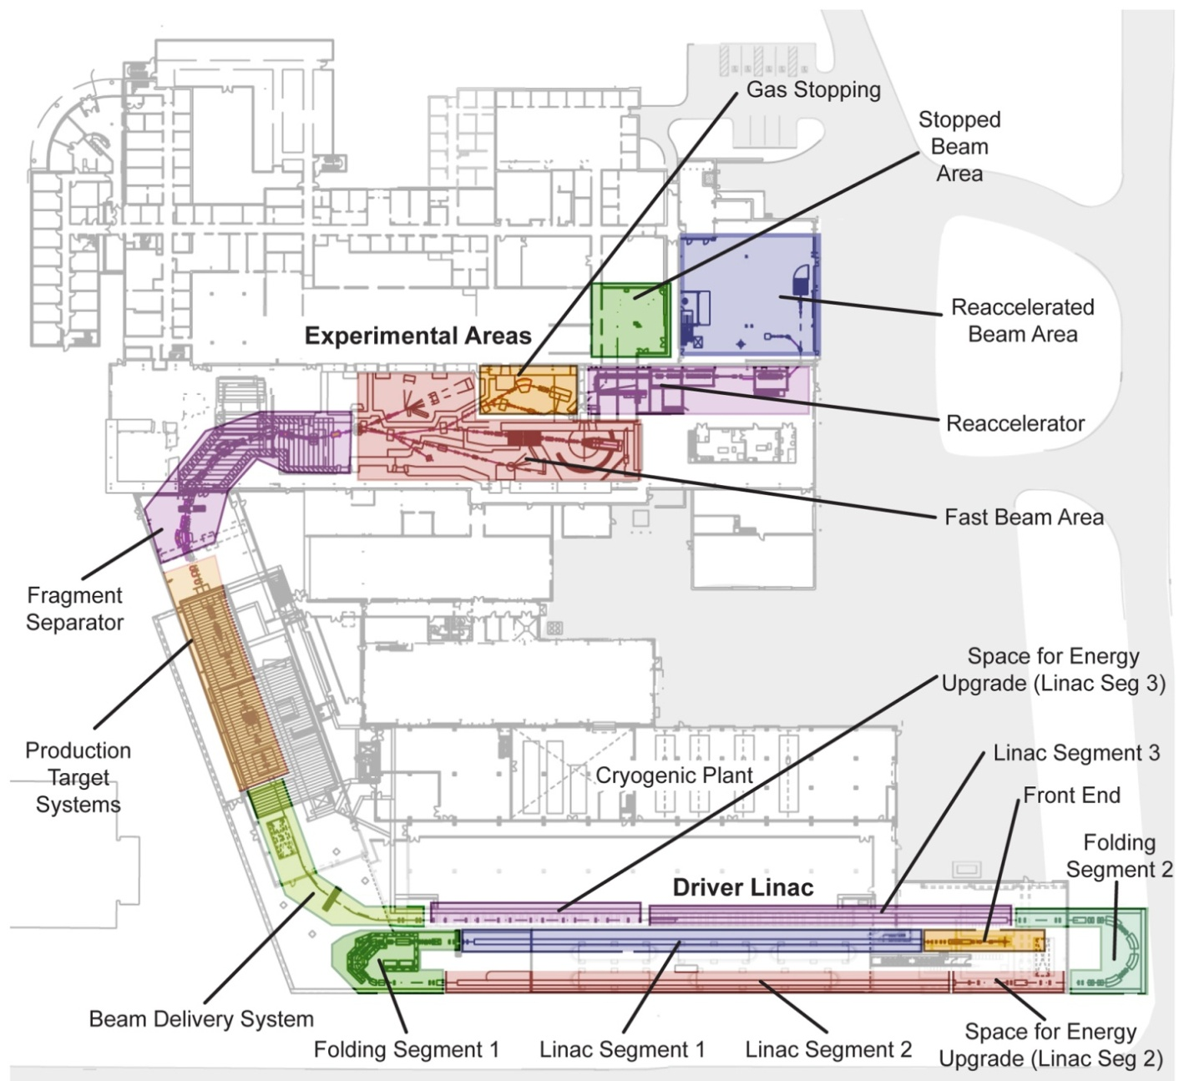
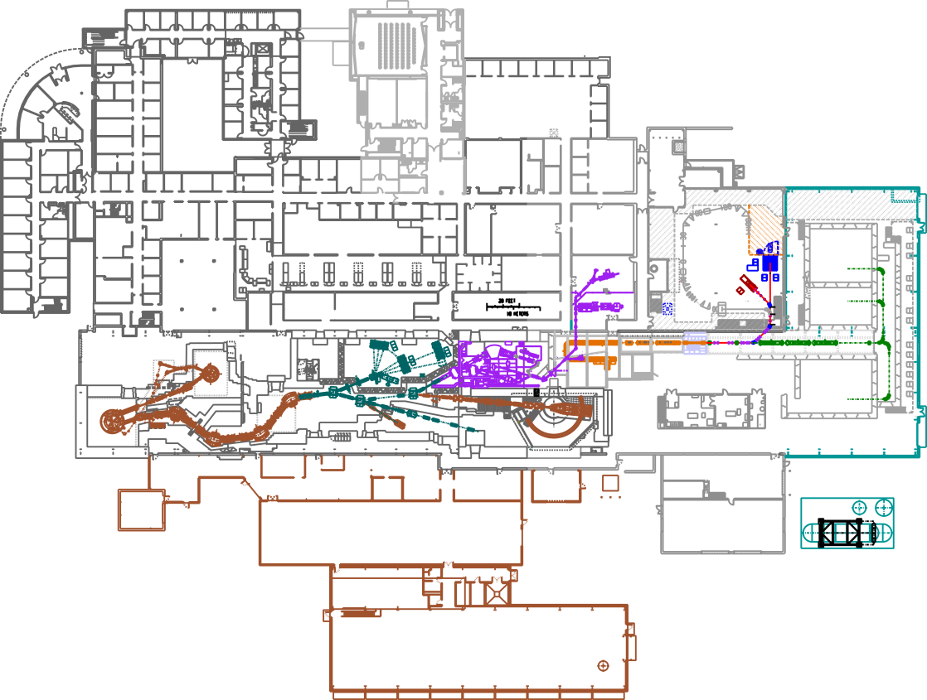
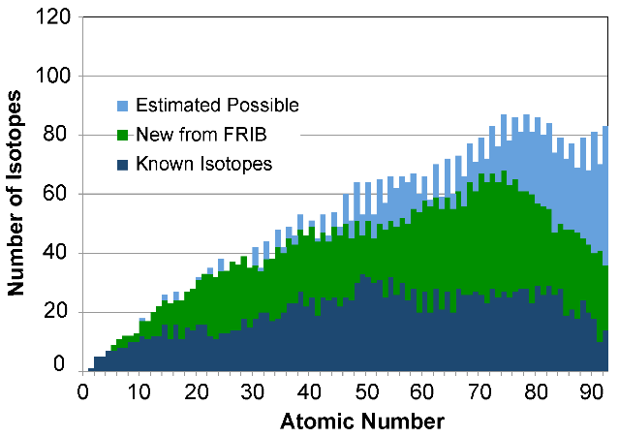
FRIB: Facility for Rare Isotope Beams
FRIB design
MSU has been chosen as the site for FRIB: a $730 million US Department of Energy project to design and establish a world-leading laboratory over the next decade. Civil construction is ongoing, completion by 2022 at the latest.
NSCL today
Notes:
400-yard linear accelerator will replace cyclotrons, producing nuclei with twice the energy and thousands of times more rare isotopes per second
Many additions to the building for personnel, cryogenics, research area, etc.

Slide 21
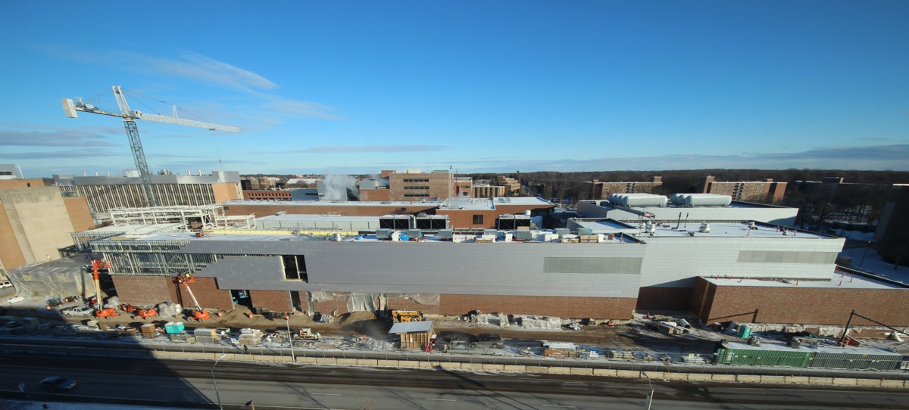
Behind the scenes at Facility for Rare Isotope Beams
FRIB OPEN HOUSE
SHAW LANE
BOGUE STREET
Saturday, August 20, 1-4pm
TOURS of the tunnel and experimental areas
Hands-on DEMONSTRATIONS
TALKS by nuclear scientists
Continuous VIDEO documentaries about the laboratory
More information to be announced at frib.msu.edu

Slide 22
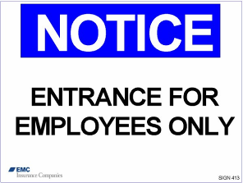
Safety First
No eating, drinking, smoking, chewing gum
Watch your head and step, don’t sit or lean on things
Pacemaker? Beware magnetic fields
Stay with your guide, follow instructions and don’t touch
If you become separated from the tour, dial “0” from any lab phone (“305” after hours) and the receptionist will assist you

Slide 23
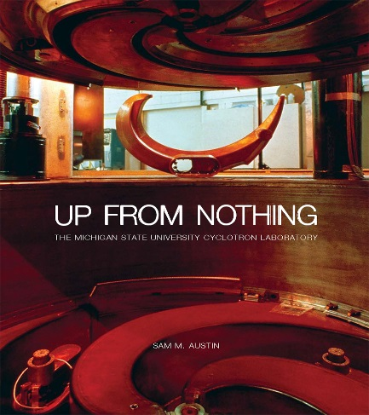
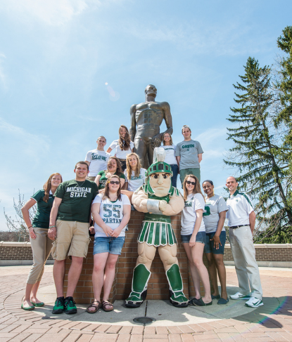
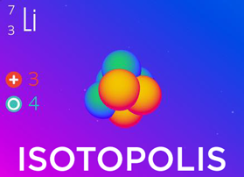
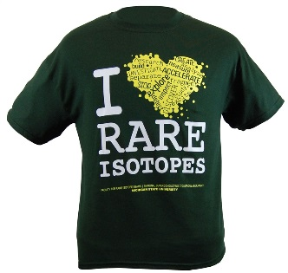
National Superconducting Cyclotron Laboratory at MSU
Learn more about our Lab and outreach programs
Get our just-published history Up From Nothing from MSU Press msupress.org or on Amazon
SPARTAN YOUTH PROGRAMS
Find camps and programs at MSU for
pre-college students: spartanyouth.msu.edu
Get the iPad game Isotopolis for free! (More platforms coming soon)
Visit our “Gift Shop” on shop.msu.edu (click on “NSCL/FRIB” under “Specialty Shops”)
GIFT SHOP
contact visits@nscl.msu.edu or go to nscl.msu.edu

Slide 24
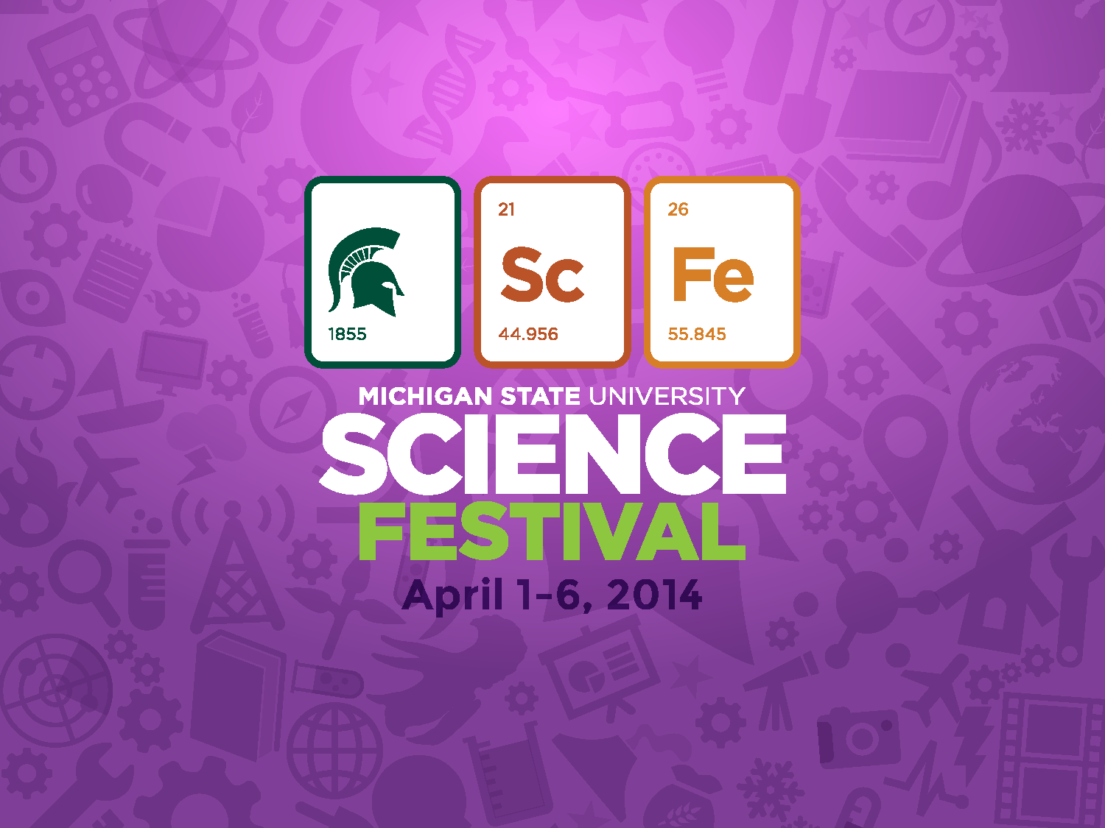
April 12-17, 2016
sciencefestival.msu.edu
sciencefestival.msu.edu

Slide 25
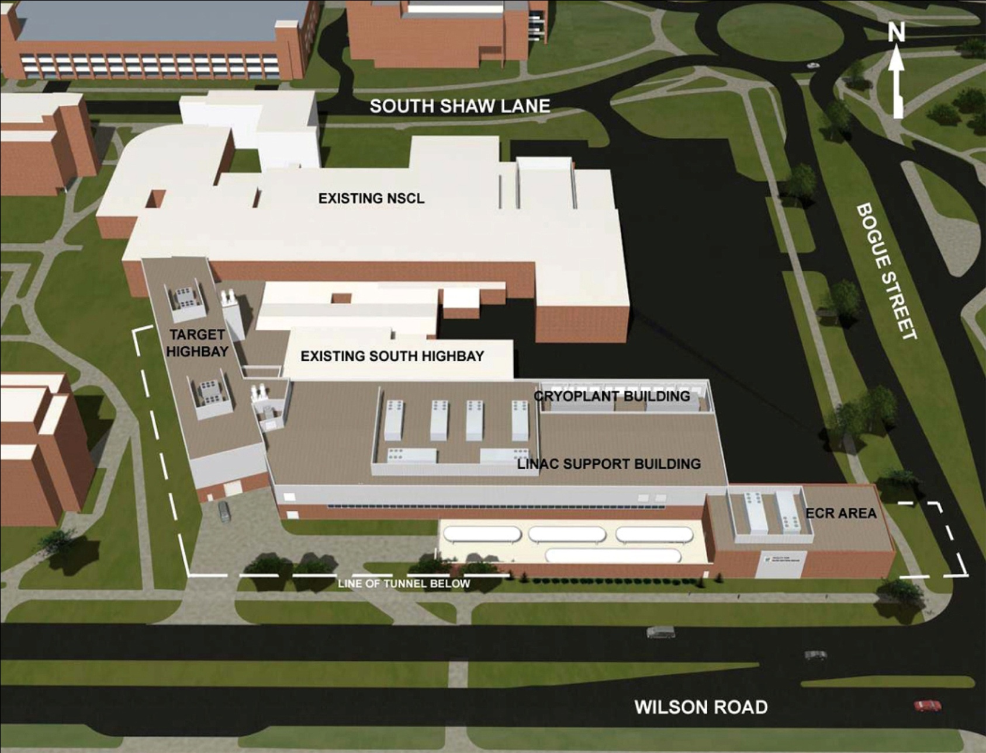
FRIB on the MSU campus

Slide 26
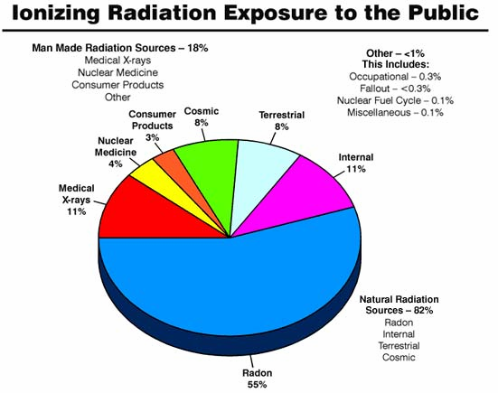
Sources of radiation

Slide 27
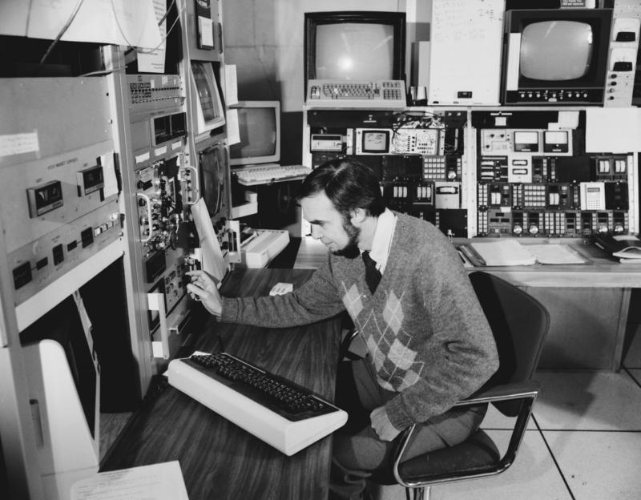
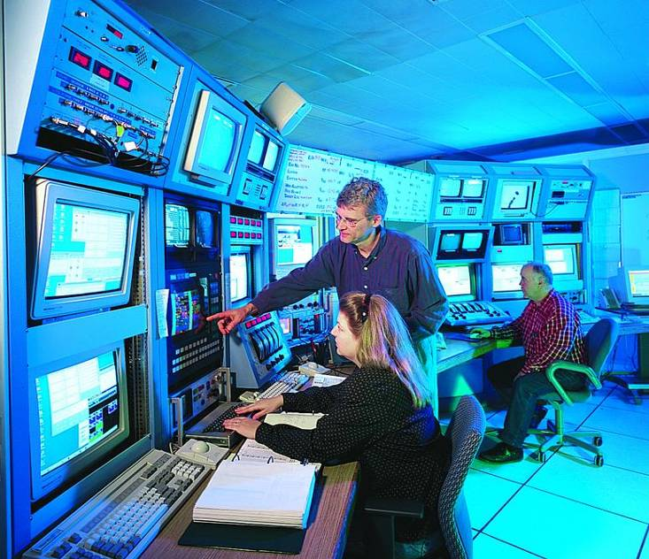
The Control Room
1997
1982
2003

