Slide 1
Laboratory Tour Guide Training

Slide 2
What is a Tour?
Tours provide an opportunity to showcase the laboratory and the work that is performed here
Tours can be separated into two classes:
Business related tours
The tour will be conducted to accomplish a business-related goal (inspections, vendor orientation, etc.)
Educational tours
Not business related, for example members from a school group or family and friends
All persons without Radiation Worker or Radiation Contamination Worker training are considered members of the general public
A radiation survey of the tour route must be performed before any person from the general public is taken into radiation restricted areas
During the survey, the guide must also check for and record industrial hazards (slip/trip/fall, construction work, etc.)
The guide must also assess the appearance of areas along the route
Tours shall not go to places where there is an unmitigated industrial hazard or those that appear unkempt or reflect poorly on FRIB

Slide 3
Who May Give Tours
Only appropriately-trained employees may give tours
Tour Guides can be Laboratory graduate students, staff or faculty that have:
Completed this training
Have up-to-date Radiation Worker or Radiation Contamination Worker training
Undergraduate students and visitors cannot be tour guides

Slide 4
Safety is Your FIRST Priority
As a tour guide, safety is your first priority and is much more important than being entertaining or even educational
YOU are responsible for the safety of your entire tour group
Under MSU’s Radiation Safety Program, employees with Radiation Worker training are responsible for compliance with the NRC license and the MSU ALARA program
Watch for industrial hazards and keep your guests away
MIOSHA standards (Ashley, please advise)

Slide 5
Tour Guides must inform Area Coordinators
To ensure visitor safety in restricted laboratory spaces, area coordinators must be informed prior to touring
Determine the tour route and areas that will be visited
Submit a Work Control Plan (WCP) on Portal to alert area coordinators of the upcoming tour
See a sample by searching for “public tours planned”
State the day and time of the planned tour
Use the Floor Plans link to identify which room numbers should be included
All public tours given by outreach personnel are already included in a monthly WCP to inform area coordinators of the upcoming schedule along a standard public tour route
When the tour is on short notice (24 hours or less), email the area coordinators AND submit a WCP

Slide 6
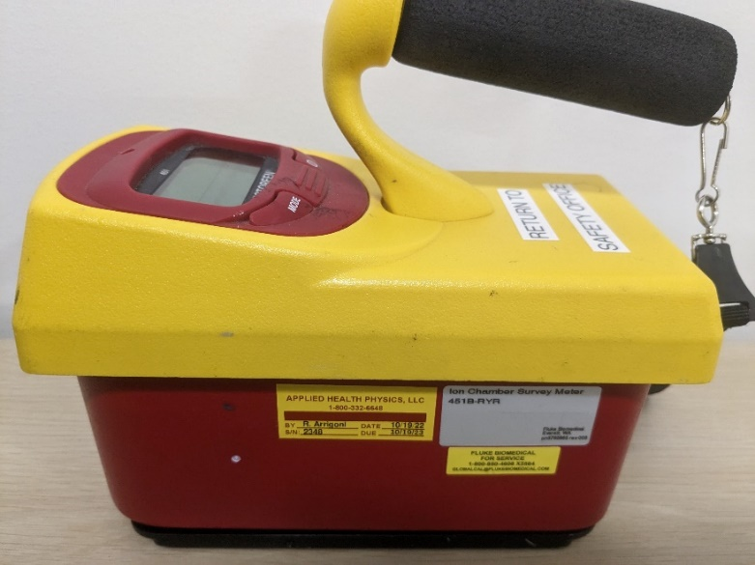
Tour Route must be surveyed before the tour
Walk through surveys using an ion chamber (see photo) are required prior to giving a tour
All public tours given by outreach personnel are surveyed by the tour leader
The Laboratory is a dynamic workplace
The dynamic nature of work in the Laboratory necessitates up to date tour surveys performed earlier on the day of the tour
Tour surveys used the day before may not be extended into the next day
MSU’s Broad Scope Radiation License is based on compliance with NRC regulations and includes specific requirements for members of the general public (10 CFR 20.1301)
For example, the general public cannot receive more than 2 mR in any hour

Slide 7
Safety Survey (To Be Completed Prior to Tour)
FOR REFERENCE ONLY
Located on Portal > ESH > Forms > Tour Safety Checklist
Walk the planned tour route (dependent on current vault restrictions) with a survey form and an ion chamber (available from the safety office) and perform a safety survey focusing on everyday problems:
Ambient conditions – temp, light, ventilation
Material Handling – operating crane/forklift, storage
Electrical Safety – open cabinets, extension cords
Housekeeping – trip hazards, unobstructed path
Physical Hazards – construction, operating machines
Fall protection – guardrails, dropped items
Chemical Safety – open containers, warning signs
Radiation Safety – all ion chamber readings must be below 2 mR/hr
Certain areas (e.g. SRF High Bay) require special access and permissions
Report all safety hazards or issues to the Safety Office when you return the survey form before the tour
Safety issues must be mitigated before the tour, or the tour route must be altered to avoid any hazard
For public tours given by outreach personnel, the tour leader is responsible for conducting the survey and providing copies of the completed checklist to all guides

Slide 8
Tours Are Not Allowed In…[1]
Cyclotron vaults and N1
These are sensitive areas with potential for removable radioactive contamination
Exceptions for business-related tours can be approved by the Laboratory Area Coordinator for the area and the Operations Department Head
Note that the area between the Atrium and the ECR control room may routinely have a radiation level about 2 mR/hr
Radiation Restricted Areas adjacent to the Transfer Hall (including the 1HW8 North Hallway & 1500J pathway between S3 and clean room)
Access to these areas carries the following requirements
Laboratory director approval
Request to Operations Manager to install locked out beam inhibit device for the duration of the tour
Written communication to Operations Manager on the day of the tour before it begins, and another just after the tour ends
See this document in DCC: “Record of Decision on Areas to Secure and Location of Credited Neutron Monitors during 1 kW Beam Operation”

Slide 9
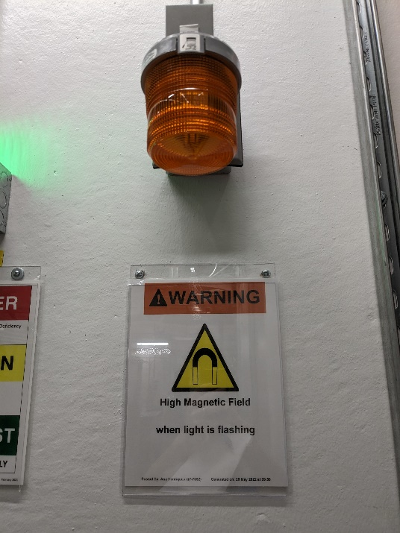
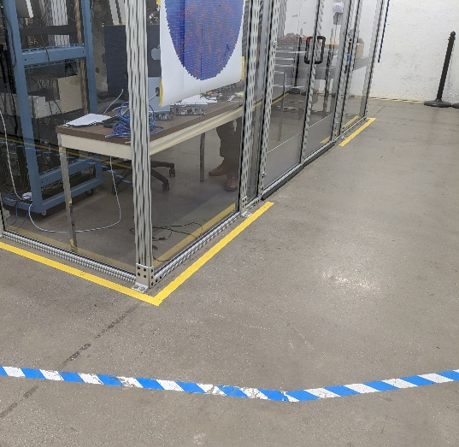
Tours Are Not Allowed In…[2]
Any area which requires special access
Linac tunnel, clean room, chemical etching room, etc.
Exceptions for business-related tours can be approved in special cases by the Laboratory Area Coordinator
Areas with a high magnetic field
Fields above 5 gauss are indicated by a orange light – look for Warning signs and blue/white tape on ground that indicates a high field area.
Educational tours may not proceed past these indicators
Business-related tourists may proceed, but guests must be notified of the magnetic field hazard and agree to proceed
Areas with radiation or high radiation
These areas will expose the visitors to radiation levels over the public dose limit

Slide 10
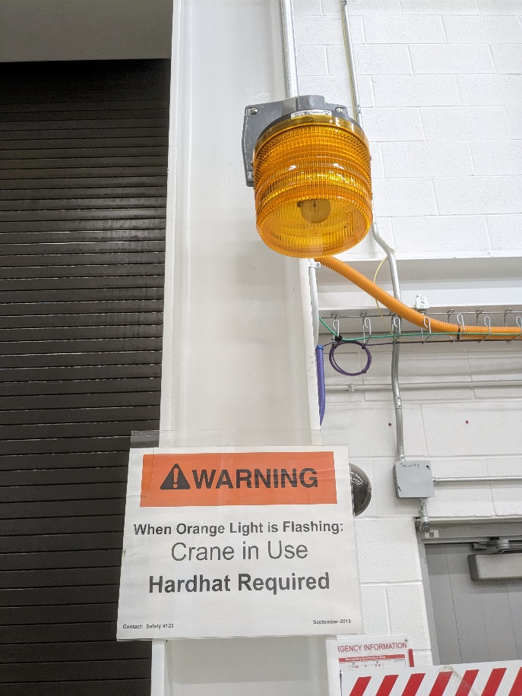
Safely Conducting a Tour [1]
If a medical emergency occurs, dial 911
Tour Guides shall:
Inform guests of these rules before the tour
No eating/drinking/chewing gum.
No photography or video recording.
Watch for trip hazards.
Do not touch equipment.
Stay with the tour guide.
Point out steps and obstructions to visitors.
Be sure the visitors are properly attired.
Warn visitors about the open stairs and potential problems with small-heeled shoes.
Closed-toed shoes are required in the machine and welding shops.
Be aware of overhead crane activity (watch for flashing orange lights).
Tour groups must wear hardhats to enter areas where a crane is in operation.
If possible, avoid areas that have active crane usage.

Slide 11
Safely Conducting a Tour [2]
Tour Guides shall:
Watch for magnetic field warning lights.
Keep close account of their tour group. Do not leave anyone behind at any stage.
Lead no more than 15 visitors. Larger groups must be split among multiple guides or have a second guide follow at the rear.
Assess whether the actions of any guests would make it unsafe to continue. If guest behavior ever becomes a safety concern, terminate the tour and lead them out.
Never take visitors past safety barriers (oxygen deficiency hazard, exclusion zones, etc.).
Never take tours into areas not included in the initial safety survey
Watch for current status of areas your tour is visiting. When in doubt about the status of an area or vault during a tour, do not enter that area/vault.

Slide 12
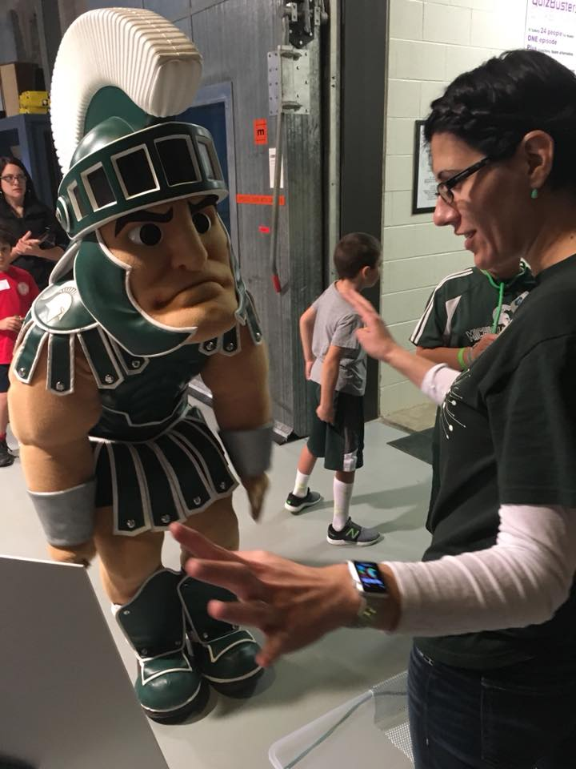
Sharing positive impressions with visitors
Ensure the interaction you have is positive, relevant to FRIB, and audience-appropriate.
To protect and build FRIB’s reputation and image, assume that your visitors plan to share their experience to social media channels.
Do not say or do anything that you would not want released on the internet as a representation of FRIB, FRIB science, FRIB use of taxpayer resources, Michigan State University, U.S. Department of Energy, or other funding agencies and stakeholders.

Slide 13
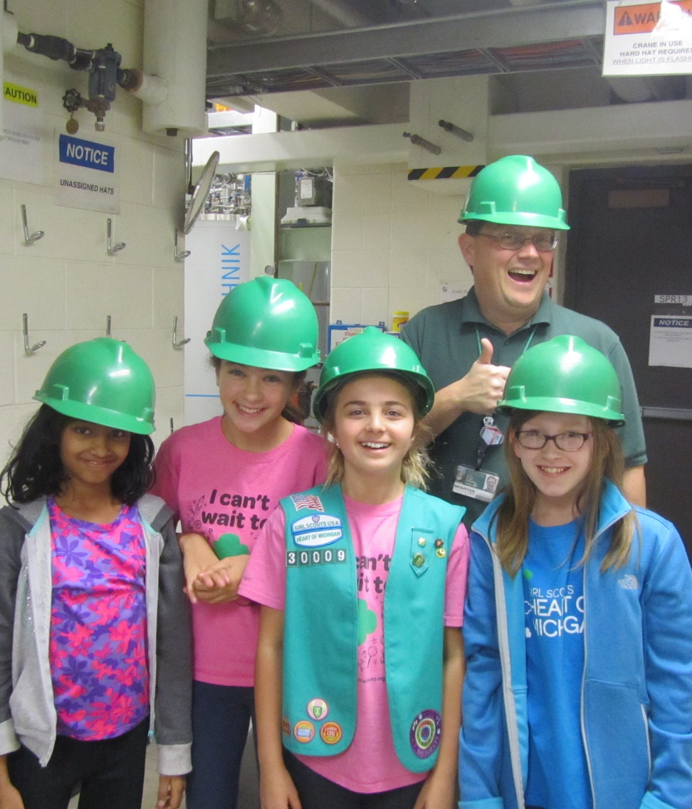
Accessibility
Public tours stay on handicap-accessible routes
Speak loudly and clearly in the noisy laboratory environments
The outreach coordinator has wearable loudspeaker devices that can help project your voice
For general audiences, avoid jargon or specialized terminology.
Encourage your audience to ask questions!

