Slide 1
A Brief History of Nuclear Science at MSU
World-class nuclear experimentation and theory at NSCL/FRIB
Dr. Zach Constan
Outreach Coordinator
Facility for Rare Isotope Beams

Slide 2
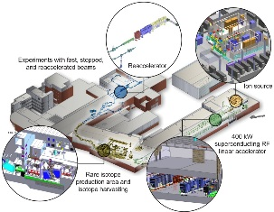
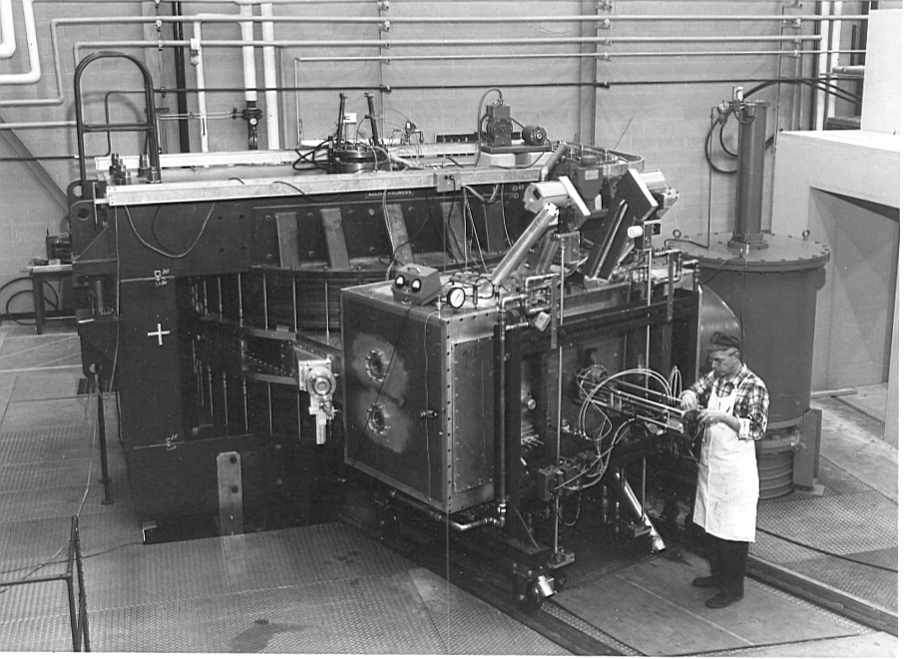
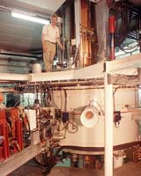
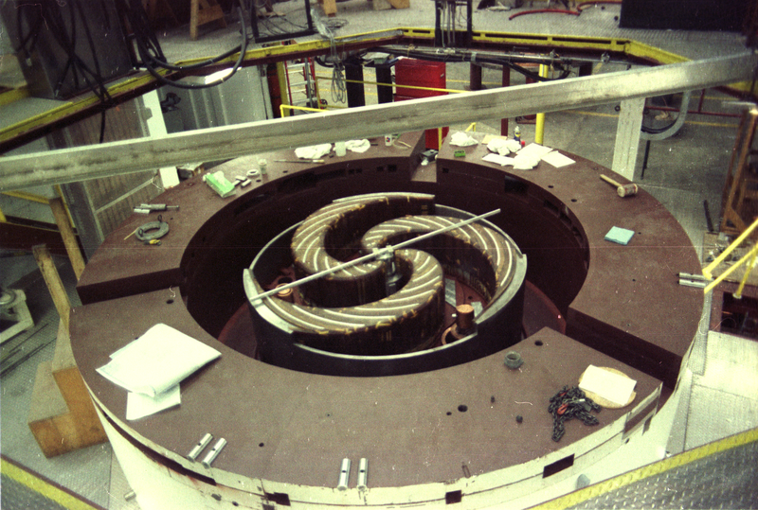
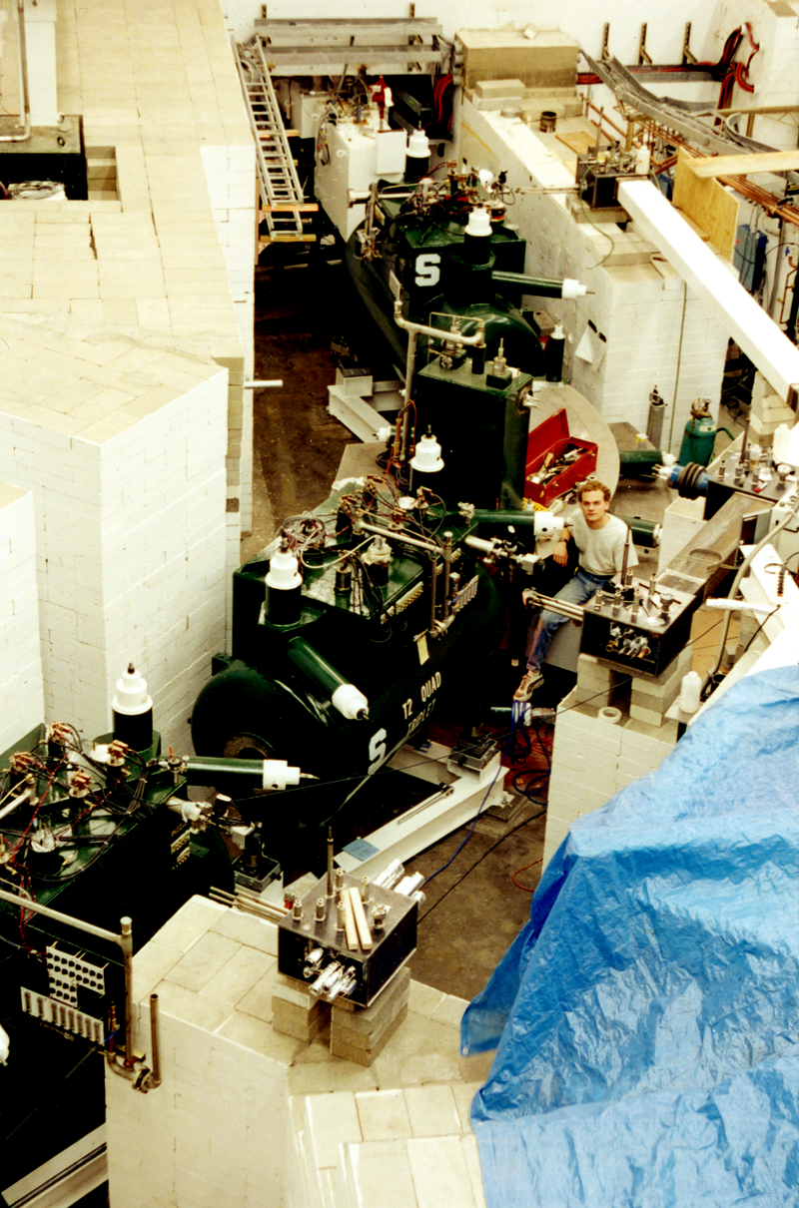
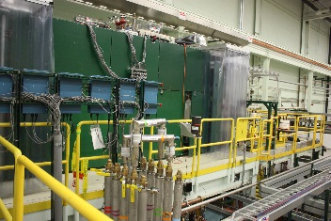
50+ years of nuclear science at MSU
Accelerator innovations drive discovery science at Michigan State University
K50 | K500 | K1200 | CCF | ReA | FRIB
1965 | 1982 | 1989 | 2001 | 2015 | 2022
Light ions | Heavy ions |  | Rare isotopes
Reactions | Reactions |  | +Structure, +Astro |  | +Applied, +Fundamental
Nucleon-nucleus interaction | Nuclear temperature, transport theory |  | Drip lines, new isotopes, shell evolution |  | Predictive nuclear model, origin of elements, application of isotopes

Slide 3
1965: Research with the K50 Cyclotron
Single-turn extraction cyclotron offers more precise energies
World-leading resolution in studies of various reactions

Slide 4
1982: Research with the K500 Cyclotron
World’s first superconducting cyclotron: 500 MeV for a proton
Creation of the National Superconducting Cyclotron Laboratory (NSCL) at MSU
Director Henry Blosser’s
excited note to staff

Slide 5
1989: Research with the K1200 Cyclotron
World’s highest-energy cyclotron for 20 years
Imparting 1200 MeV for a proton
Independent operation of K500 and K1200
Many new detectors come online during this period
1/4th the diameter of TRIUMF’s cyclotron

Slide 6
1992: Medical Cyclotron begins operation
Henry Blosser
Funded by and installed at Harper Hospital in Detroit
Provided targeted neutron therapy for 20 years
Licensed NSCL cyclotron technologies are used in many medical facilities

Slide 7
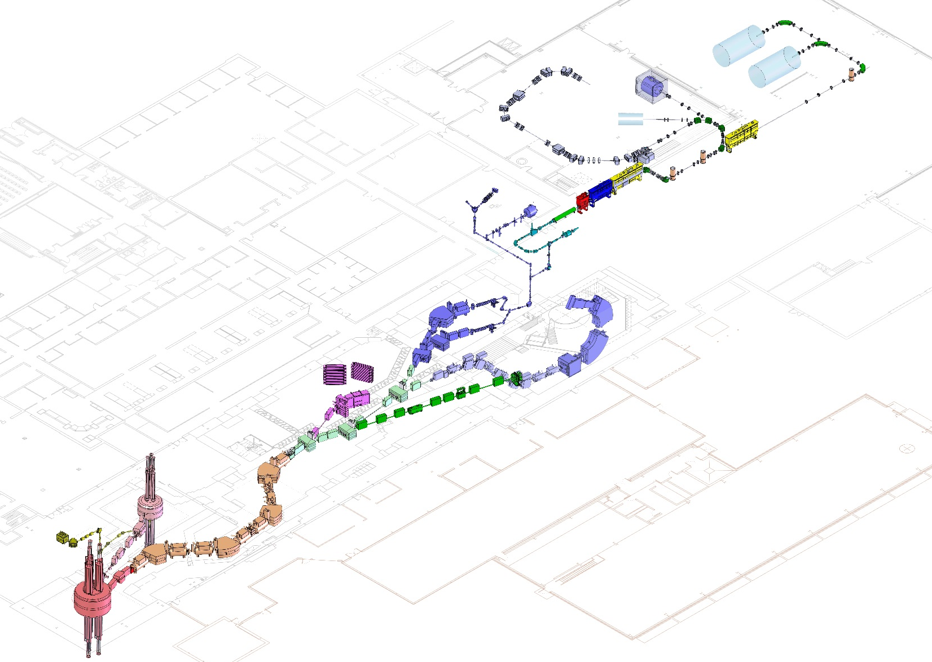
2001-2020: the Coupled Cyclotron Facility
Coupled Cyclotron Facility and experimental beam lines
Higher ionization → efficient acceleration → higher energy (150 MeV/u)
Fast-beam fragmentation for rare isotope production
Focus on world-leading rare-isotope research
>1000 isotope beams are produced for study
60+ known isotopes were discovered at the CCF
A person

Slide 8
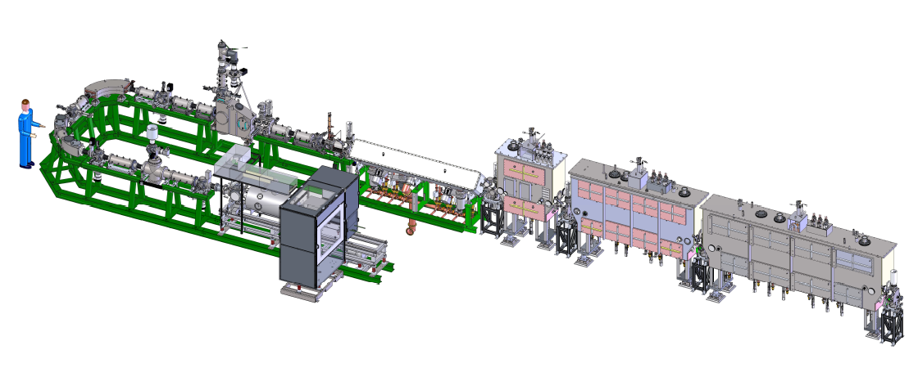
2015: Research with ReA3 ReAccelerator
Q/A
MHB
β=0.041 modules
RT RFQ
β=0.085 module
EBIT
Charge Breeder
Linear heavy-ion accelerator of fifteen novel superconducting radio-frequency cavities
Accepts stopped nuclei, re-ionizes and filters to produce rare isotope beams at ≥3 MeV/u that are useful for nuclear astrophysics studies

Slide 9
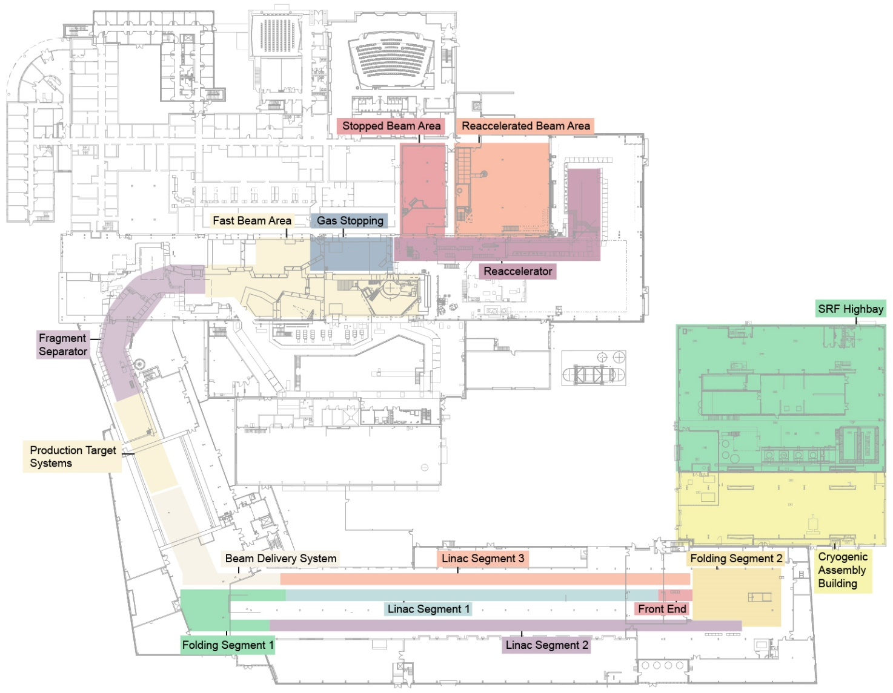
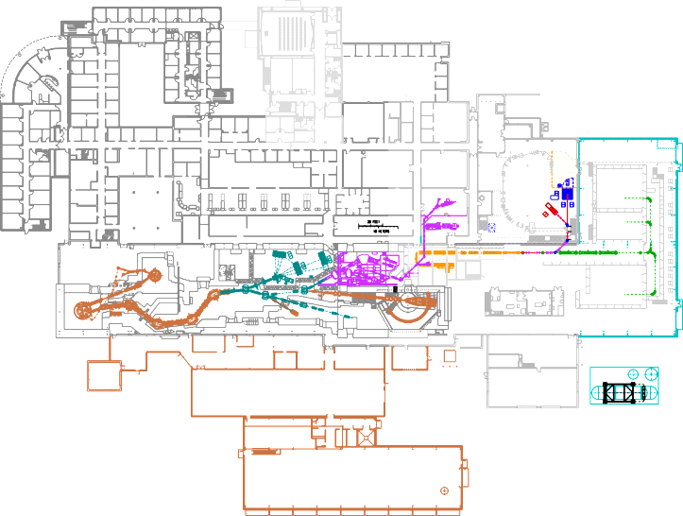
2022: Facility for Rare Isotope Beams
The FRIB future
MSU will host the next-generation
Facility for Rare Isotope Beams (FRIB)
the $730 million discovery machine that we imagined, designed, and are preparing for operation in 2022 – FRIB will discover >1000 new isotopes!
What NSCL was
Connects with experimental systems in place
Research Space (450 feet)
Collides w/ target at half the speed of light
350-meter-long folded linear accelerator
>200 MeV/u, up to 400 kW of beam power

Slide 10
FRIB: A DOE-SC Scientific User Facility
Funded by U.S. Department of Energy Office of Science (DOE-SC) supporting the mission of the Office of Nuclear Physics
2008 – FRIB Awarded to MSU
2014 – Construction started
2017 – Civil construction completed
2022 – Completed early & on-budget
>1,800 users from 50+ countries
Key feature is 400 kW beam power for all ions (5x10¹³ ²³⁸U/s)
Separation of isotopes in-flight
Fast development time for any isotope
Suited for all elements and short half-lives
Fast, stopped, and reaccelerated beams

Slide 11
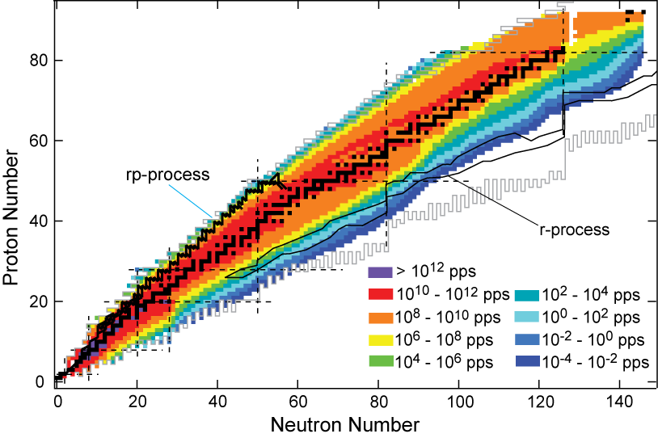
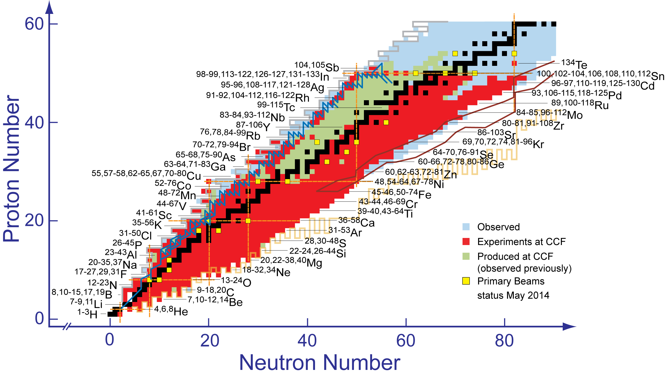
NSCL Reach vs. FRIB Reach
FRIB will help us to understand stellar nucleosynthesis in detail!
Isotopes created and studied at current NSCL
r-process

Slide 12
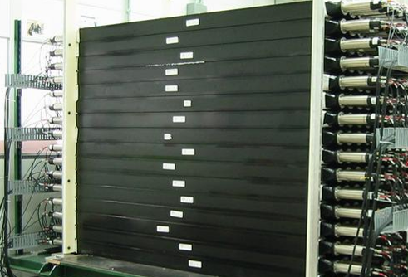
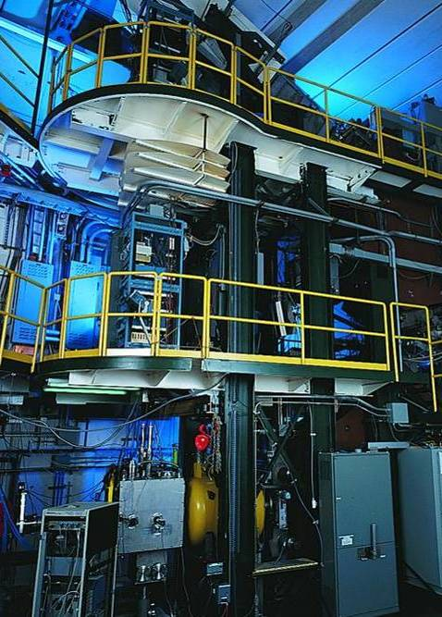
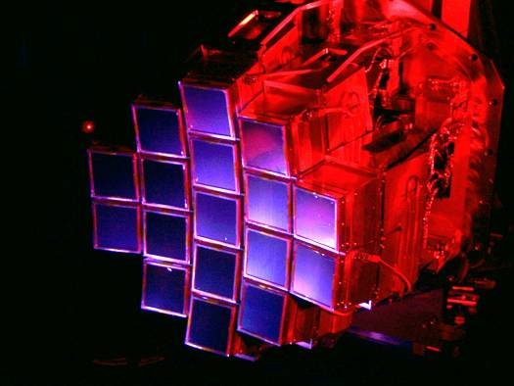
Detectors push the envelope
LEBIT:
high-precision mass measurements
GRETINA:
world-class gamma ray spectrometer
JENSA & SECAR: capture reactions with helium
BECOLA:
stopped-beam laser spectroscopy
SOLARIS:
nucleon transfer and inelastic scattering
MoNA
“Halo nuclei” and neutron-rich isotopes
S800 Spectrograph
Nuclear energy states from particles freed in collisions
Nuclear structure
and discovery
HiRA

Slide 13
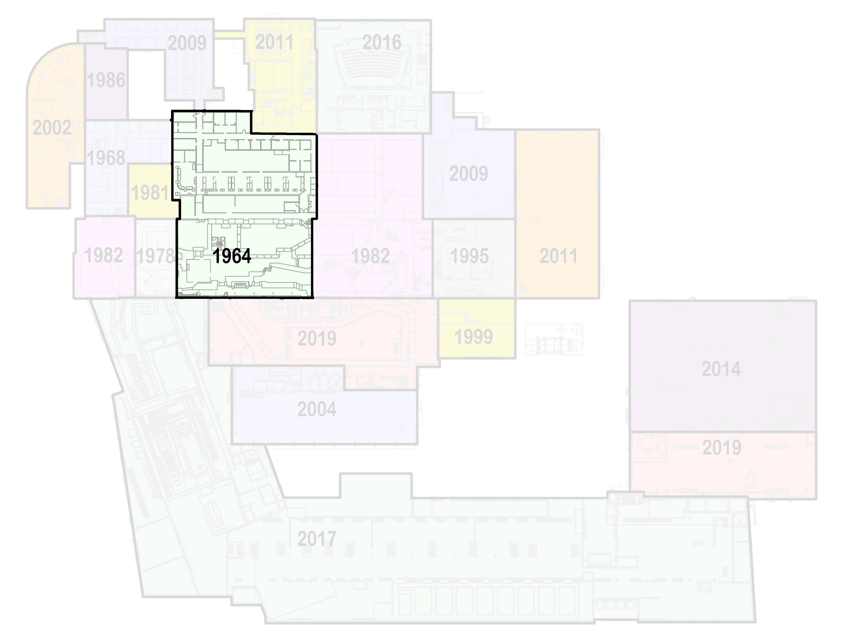
Our laboratory so far
Science Questions from the Long Range Plan for Nuclear Physics
How did visible matter come into being and how does it evolve?
Are the fundamental interactions that are basic to the structure of matter fully understood?
How does subatomic matter organize itself and what phenomena emerge?
How can the progress provided by nuclear physics best be used to benefit society?
The future of rare isotope beams is FRIB
fast • stopped • reaccelerated

Slide 14
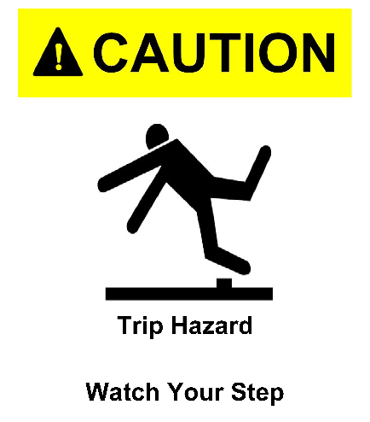
Safety First
DON’T put anything in your mouth (eat, drink, chew gum)
DO watch your head and step
DON’T sit or lean on things
DO obey posted signs
DON’T take photos
DO stay with your guide
DON’T touch equipment
If you lose your tour, dial “0” on a lab phone (“77305” after hours)
DO leave items (especially open food/drink) you don’t want to carry

Slide 15
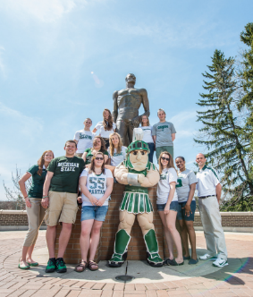
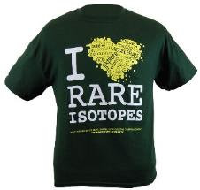
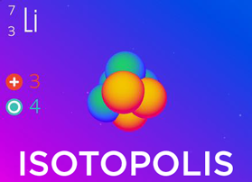
Explore FRIB at MSU
Learn more about our Lab and outreach programs
Visit the FRIB exhibit at Impression 5 Science Center in downtown Lansing!
impression5.org
SPARTAN YOUTH PROGRAMS
Find camps and programs at MSU for
pre-college students: spartanyouth.msu.edu
Each April, explore the MSU Science Festival!
sciencefestival.msu.edu
Visit our Gift Shop on shop.msu.edu (click “FRIB” under “Specialty Shops”)
Get the Android/ iPhone/iPad game Isotopolis for free!
GIFT SHOP
contact visits@frib.msu.edu or go to frib.msu.edu/public
@friblab

Slide 16
More Safety Information
The tour route is a long walk, including climbing down and then back up 56 stairs
You must wear Personal Protective Equipment provided
Vest
Hard Hat
Safety Glasses
Closed-toe shoes are required
Be aware that magnetic field and oxygen deficiency hazards may be present
A safety survey has been conducted to check that the tour route is safe for visitors
In case of alarm, there will be lights and an announcement – evacuate to the nearest safe exit
Follow the directions of your tour guide

