Slide 1
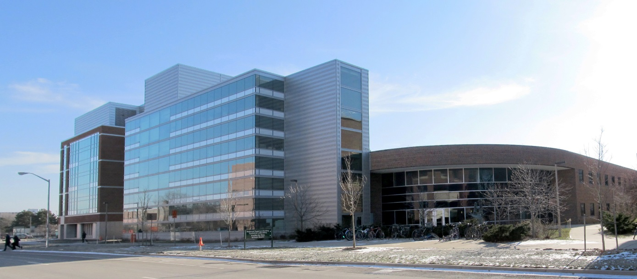
NSCL Nuclear Research at MSU
A world-class facility for nuclear experimentation and theory
NATIONAL
SUPERCONDUCTING CYCLOTRON LABORATORY
ISO 9001, ISO 14001, OHSAS 18001 registered

Slide 2
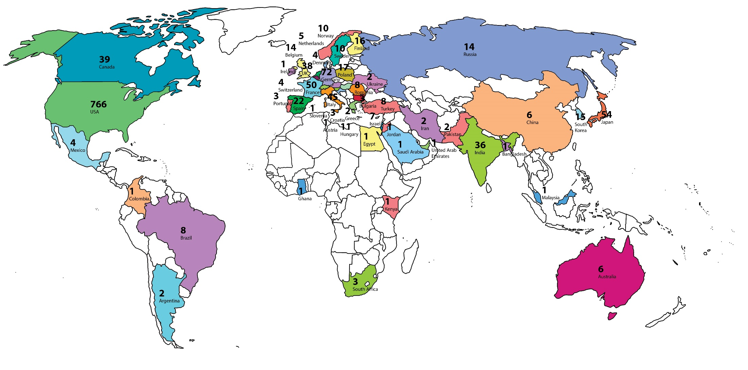
SERVING USERS
NSCL is a world class research facility, supported by the National Science Foundation (NSF), that hosts the best nuclear scientists from the US and the world.
NSCL User Community
April 2013 (>1300 scientists)

Slide 3
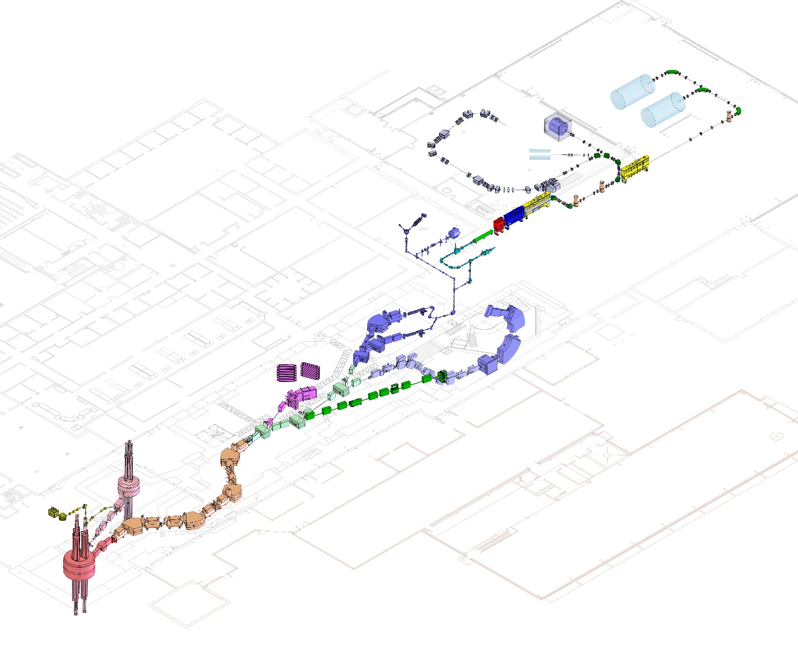
LEADING SCIENTIFIC ADVANCEMENT
Coupled cyclotron facility and experimental beam lines
A person
~140 meters (450 feet) long
Five stories tall

Slide 4
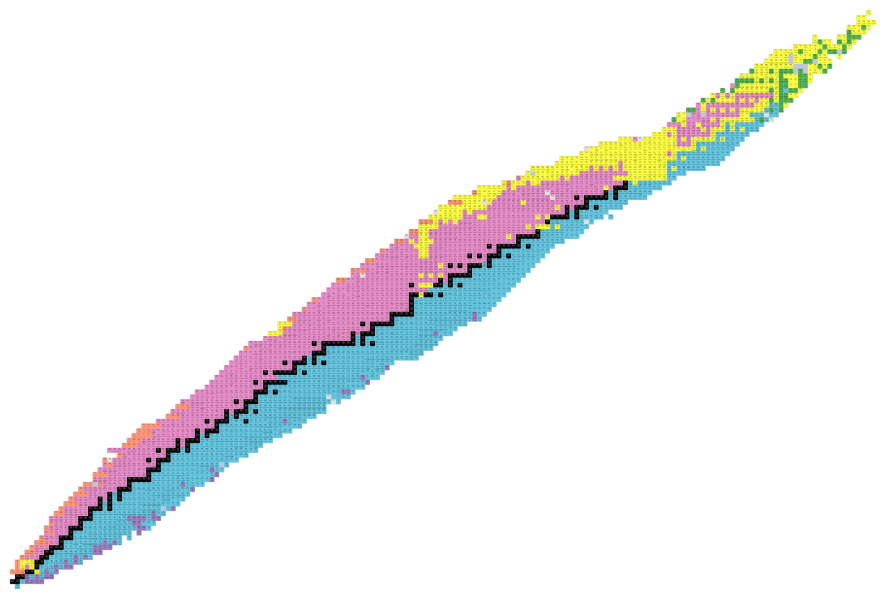
The Known Isotopes
Only ~300 isotopes are stable, over 3000 have been discovered
Protons (Elements)
Neutrons (Isotopes)

Slide 5
Our mission: study rare isotopes
Black boxes are stable isotopes of an element.
Protons (Elements)
Neutrons (Isotopes)
Colored boxes are unstable, often rare isotopes of an element.
By studying the limits of nuclear stability (driplines) and other aspects of nuclear behavior, NSCL researchers seek to understand the nuclear equation of state.

Slide 6
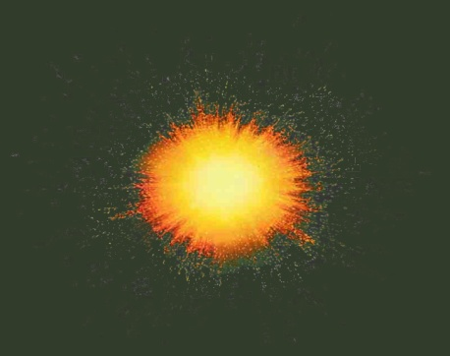
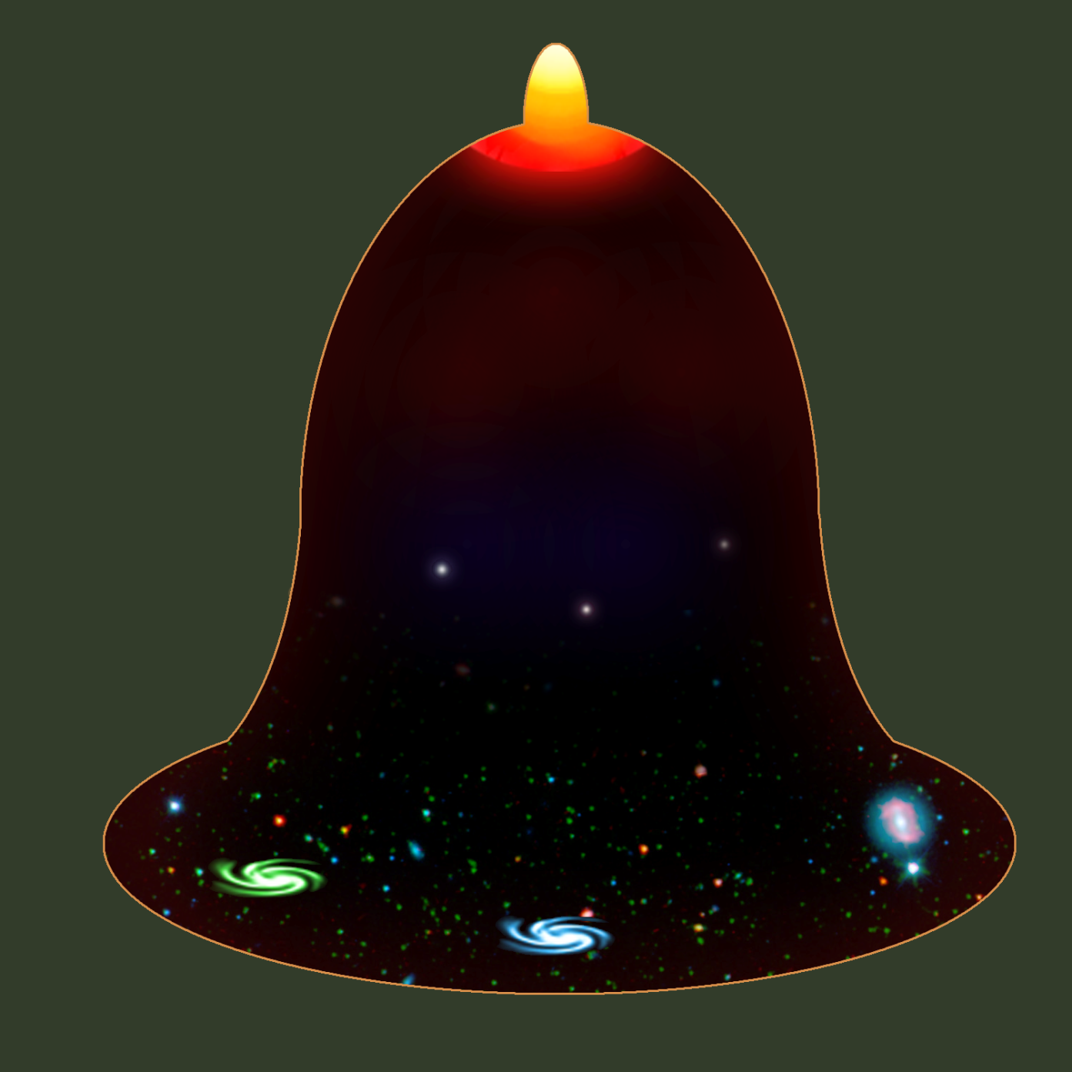
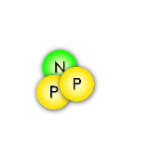
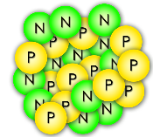
Origins of the elements
A Short History of
the Universe
A spectacular explosion of energy in a growing universe… the Big Bang !!
Inflation
The first nuclei are made: Hydrogen and Helium
1.8 Billion ºF
Slowing expansion
4 min after Big Bang
Stars fuse light elements into heavy ones, up to iron
…
Formation of the first stars
One billion years after Big Bang
helium iron
440 ºF
Activity in stars (the r-process, s-process, p-process, etc.) may build unstable isotopes that will create heavier elements
Accelerating expansion
-450 ºF
Now

Slide 7
The r-process
Black boxes are stable isotopes
Protons (Elements)
Iron
Neutrons (Isotopes)
Nuclei in a supernova are bombarded with neutrons, forming rare isotopes that will decay into stable heavy elements

Slide 8
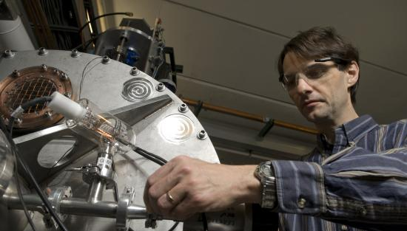
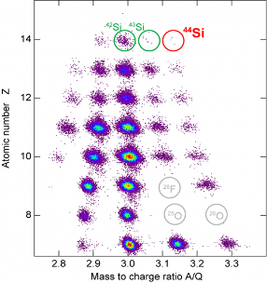
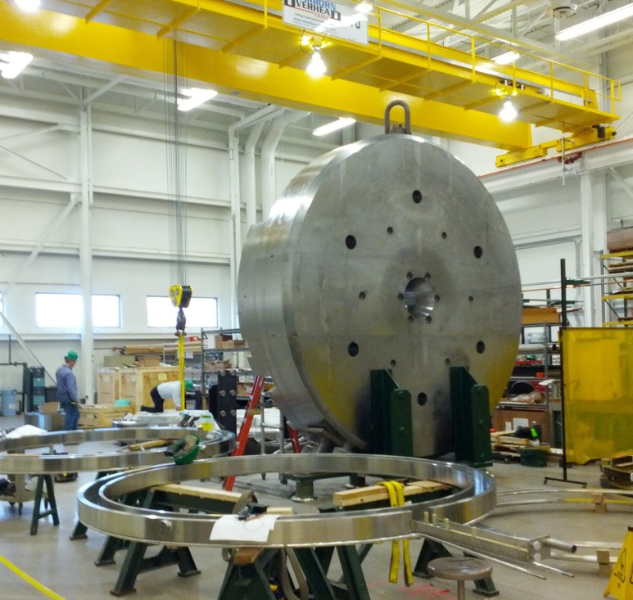
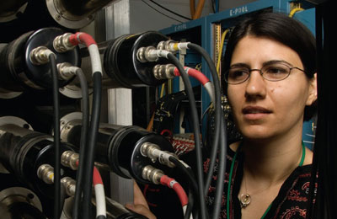
Notable research at NSCL
Production of doubly-magic tin-100
Heaviest silicon, magnesium and aluminum isotopes ever detected
The world’s first cyclotron gas stopper
Discovery of di-neutron decay

Slide 9
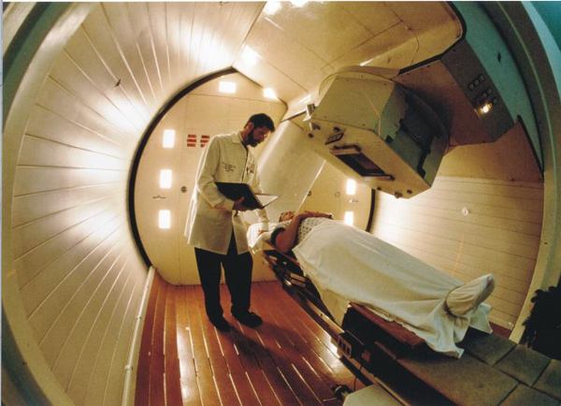
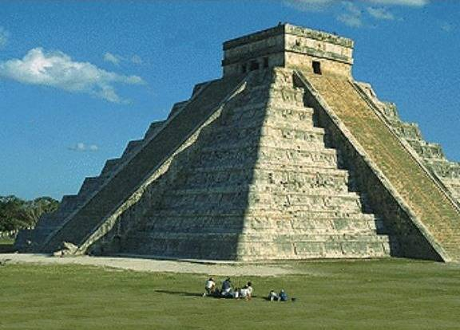
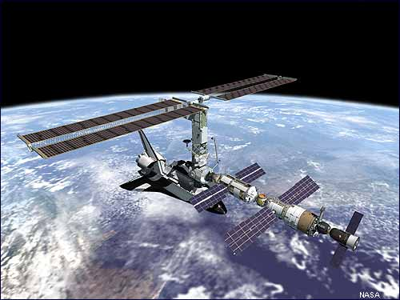
Uses of isotope science
Archeology/
Geophysics
Space Science
Nuclear Medicine
Radioisotopes are used in biomedical research as tracers, diagnostic tools, and treatments (neutron therapy, pictured)
Isotopic ratios of organic materials (C-14 dating);
Carbon/oxygen isotopic makeup of carbonates (tectonic activity, erosion)
Development of radiation detectors and engineering “radiation-hardened” electronics for orbital or extreme environments
Nuclear discoveries can generate new ideas and technologies in the fields of nuclear power, airport security, biology/ecology, etc.

Slide 10
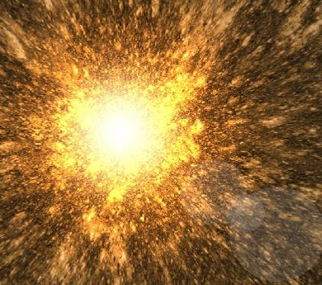
How to make unstable nuclei
NSCL’s Coupled Cyclotron Facility

Slide 11
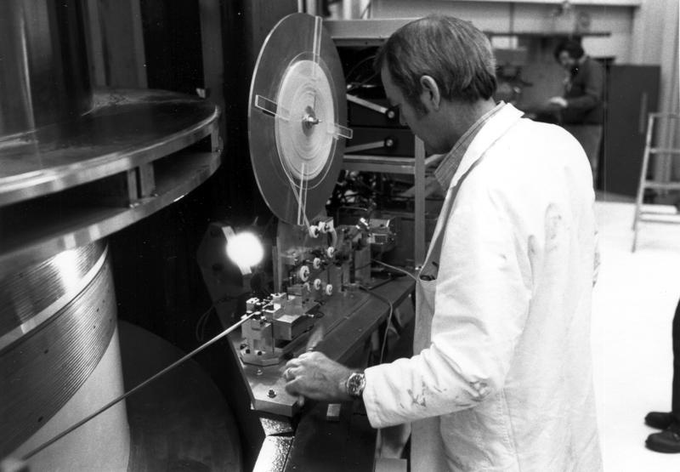
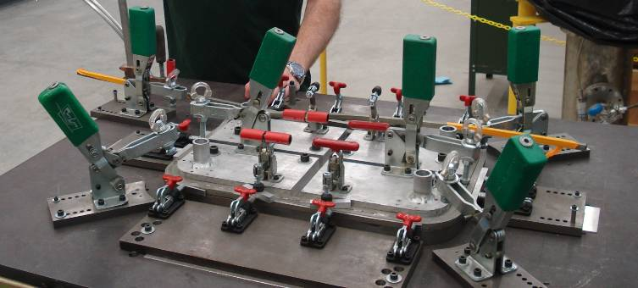
Superconductivity
NSCL cyclotrons use electromagnets made from niobium-titanium wires
At liquid helium temperatures (-269 °C , 4 K), these wires become superconducting, which means they have zero electrical resistance
This allows us to make small, powerful electromagnets used to direct and control nuclei!

Slide 12
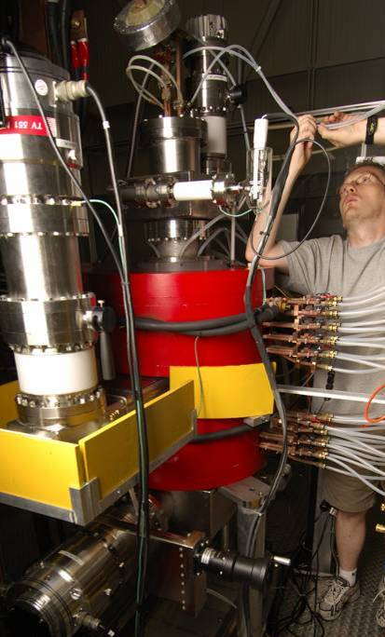
Ion Sources
NSCL uses Electron Cyclotron Resonance (ECR) sources, which trap stable atoms and ionize them by bombardment with electrons. The ions are then injected into the K500 cyclotron.
magnet
Researchers choose a stable isotope to source, using elements from oxygen to uranium
A typical extracted beam power for ¹⁶O is ~1.3 kW/175 pnA (particle nanoAmps)

Slide 13
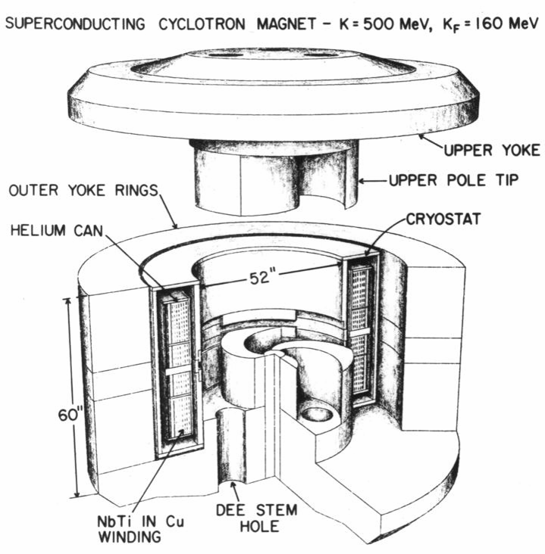
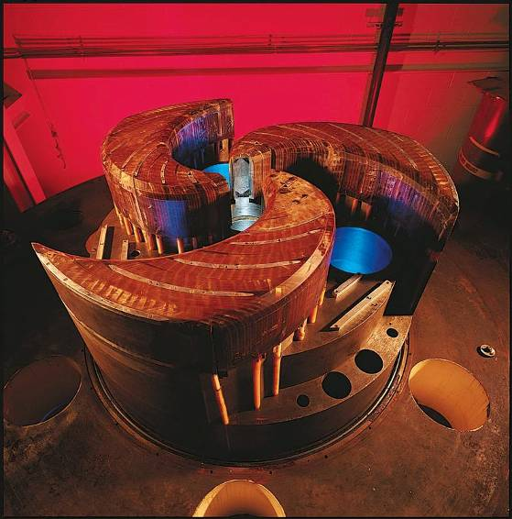
K500 Cyclotron
Year completed: 1982 (the world’s first superconducting cyclotron)
Diameter: 10 ft
Weight: 100 tons
Magnetic field: 3-5 Tesla
Superconducting wire coil: 20 miles long, carrying 800 amps
Maximum energy it can impart to a proton: 500 MeV

Slide 14
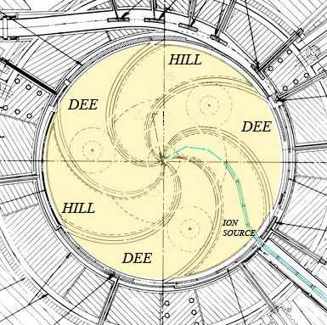
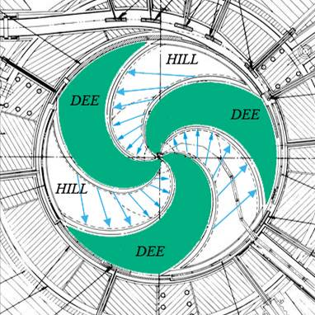
The cyclotron principle
Superconducting niobium coil
Stable, “normal” ions are injected into the center of the cyclotron,
Magnetic field bends their path
Ions travel in a circle
“Dees” alternate high voltage, creating electric field that accelerates the nuclei
Nuclei spiral to higher speeds until they leave the cyclotron in a beam
Dees are shaped to provide vertical focusing; magnetic field increases with radius to account for the relativistic mass of nuclei

Slide 15
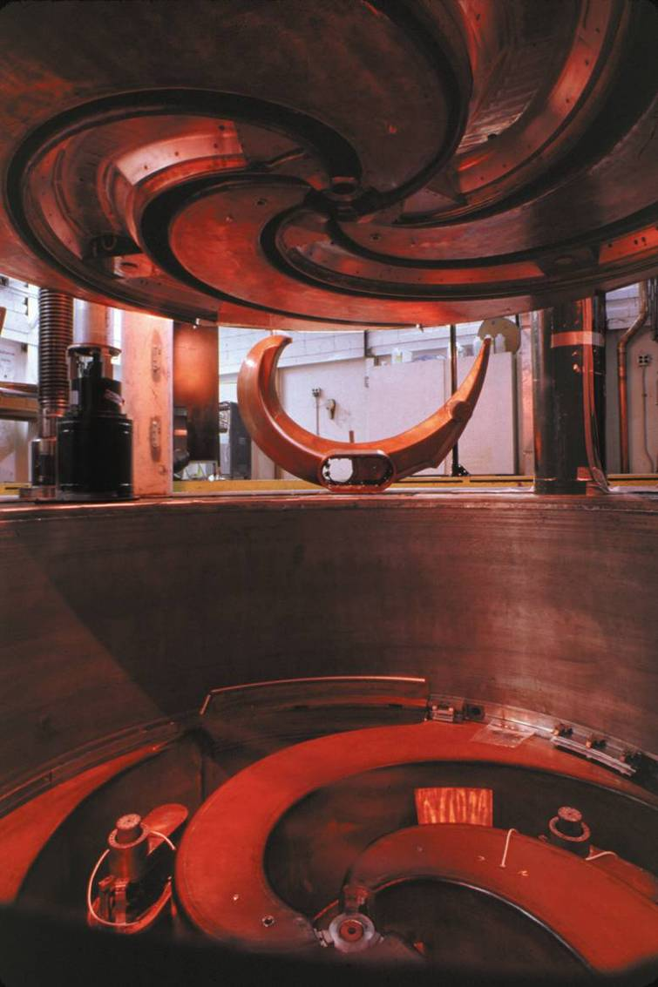
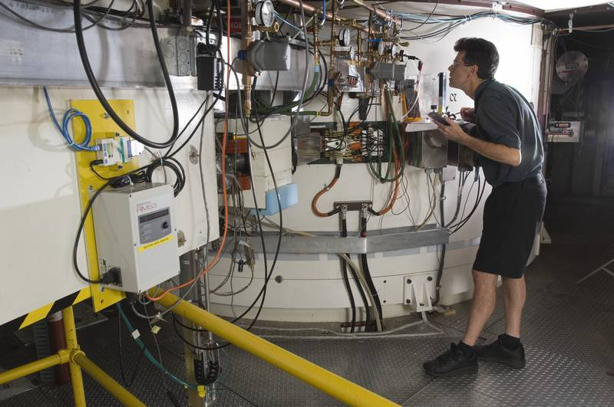
K1200 Cyclotron
Completed 1988: the world’s second-highest-energy cyclotron
Pre-accelerated ions from K500 pass through a stripper foil in the K1200, increasing ionization and improving accelerating efficiency.
Nuclei leaving the K1200 can reach 0.5 c (typically 150 MeV/nucleon).
Dees charged to 140 kV, alternated at 23 MHz.

Slide 16
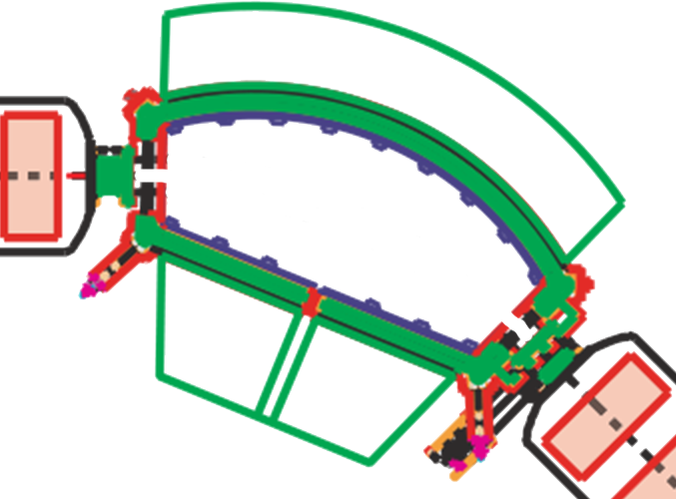
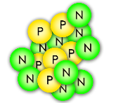
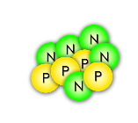
Selecting one rare isotope
Some nuclei turn too little
¹⁶C
Some nuclei turn too much
The magnetic field is just right to steer nuclei of the desired isotope through!
A dipole magnet

Slide 17
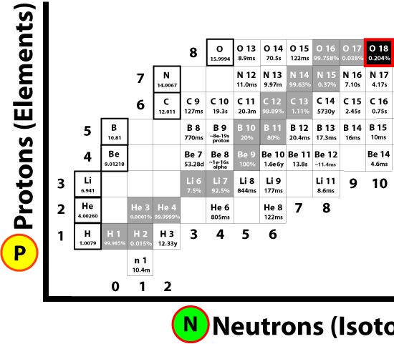
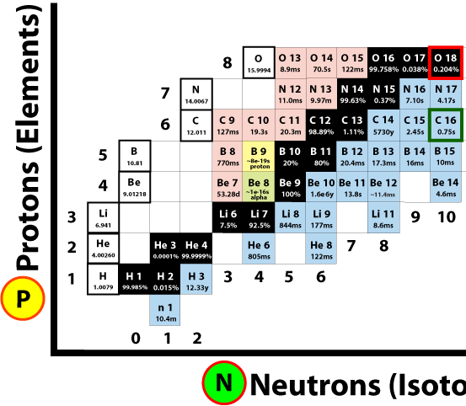
Fragmentation and Separation
Primary (stable) Beam
Fragmented Beam
Fragmentation on target
Secondary
(unstable) Beam
C-16
C-16
C-16
Primary (stable) Beam >1 billion nuclei/second
Beam after fragmentation (mostly stable, some rare)
Beam after separation (fewer rare isotopes)

Slide 18
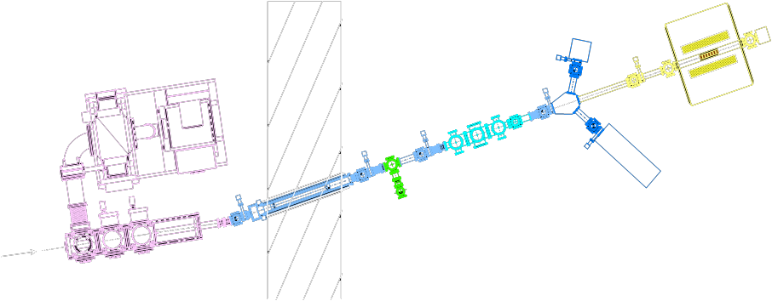
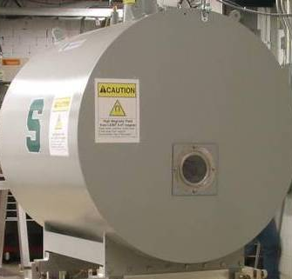
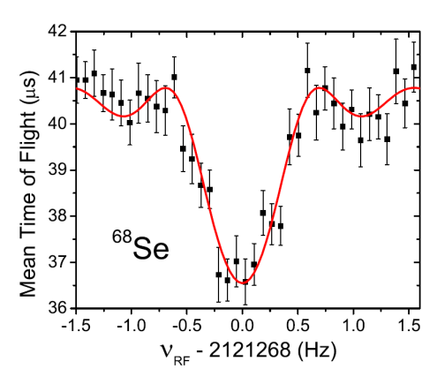
Experiments
Nuclei arrive in a magnetic trap and orbit in a circle.
Beam “bunching”, one or a few nuclei pass at a time
“LEBIT” 9.4 T Penning Trap
Beam
Fast beam is stopped in helium gas
Cyclotron frequency depends on the nuclear mass; find the frequency to obtain mass to 1 part in 10⁸
The mass of selenium-68 strongly affects type I x-ray explosions on neutron stars
Notes:
Knowledge of radioactive masses helps us better understand fundamental forces, how neutrons and protons bind together, and explosions in the universe in which elements are created. One kind of stellar explosion, type I x-ray bursts, depends on certain nuclei like ⁶⁸Se.

Slide 19
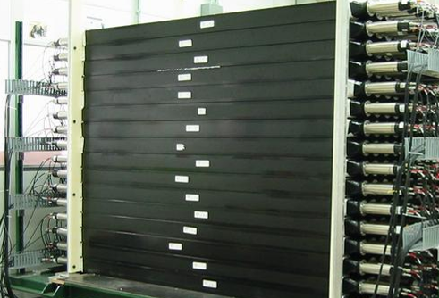
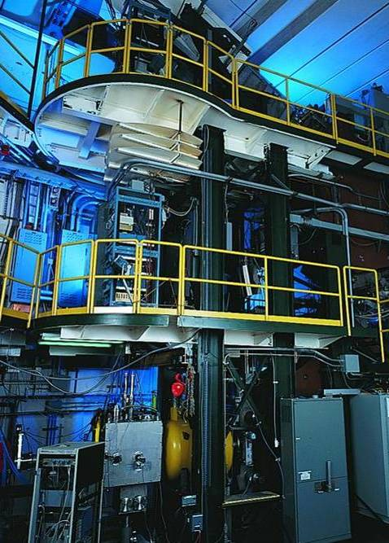
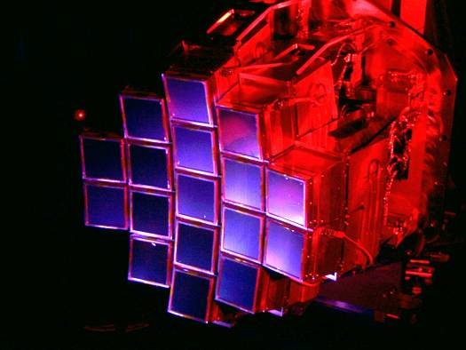
Detectors
MoNA
“Halo nuclei” and neutron-rich isotopes
S800 Spectrograph
Nuclear states from particles freed in collisions
HiRA
Nuclei found in stellar reactions
Nuclear structure, astrophysical reaction rates, symmetry breaking, etc.

Slide 20
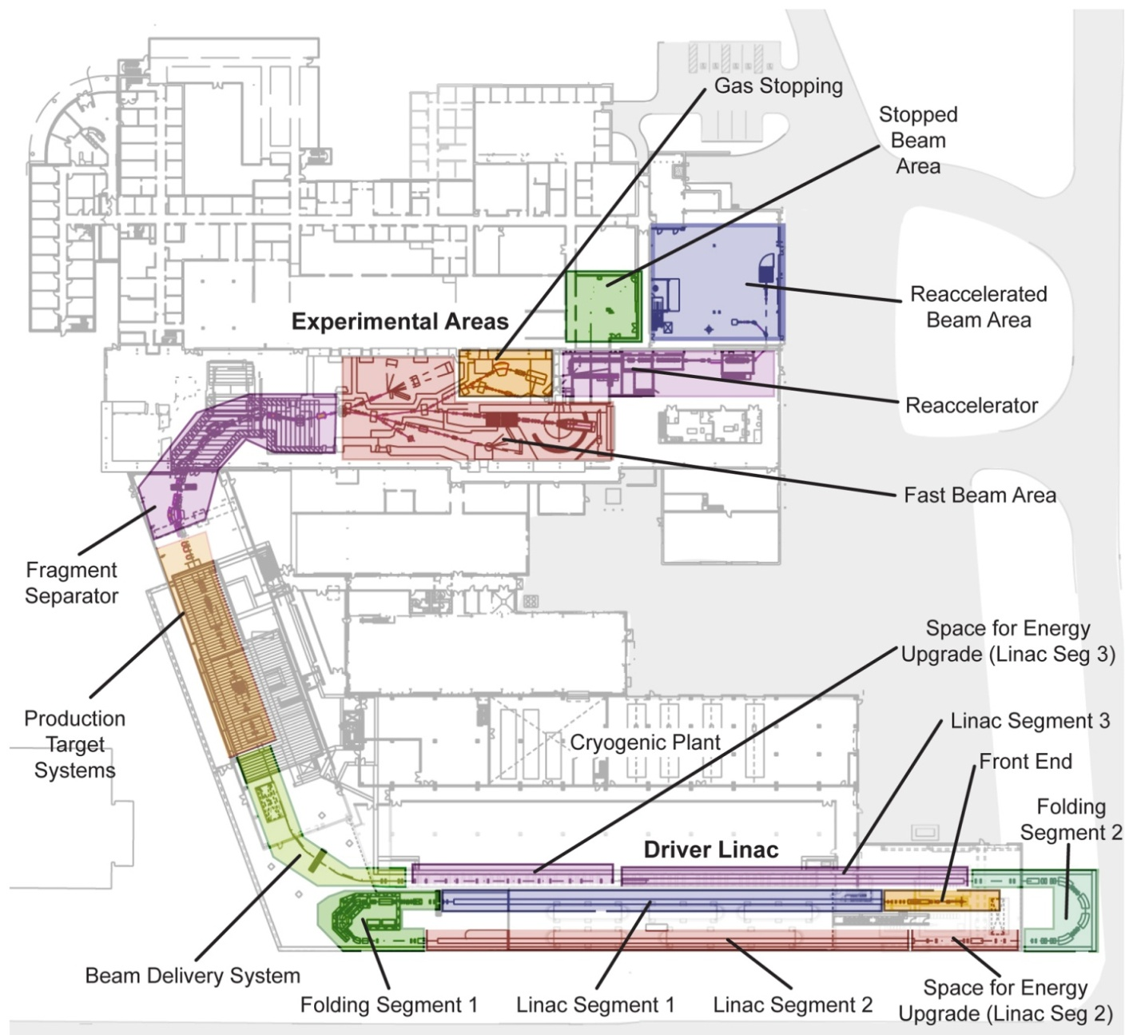
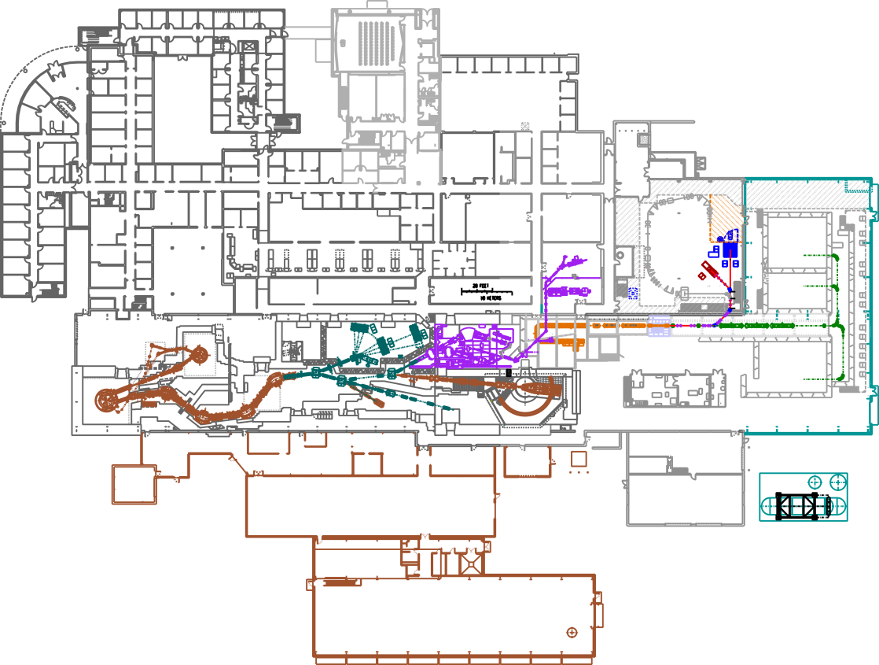
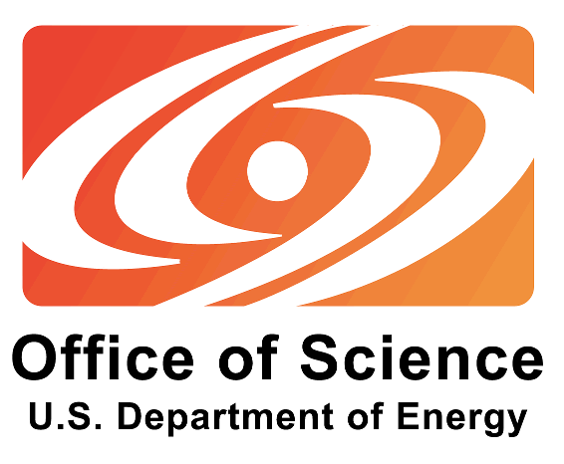
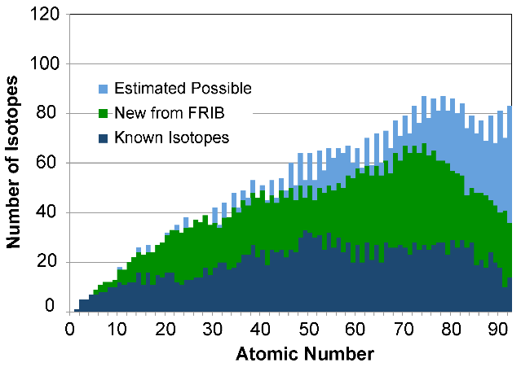
FRIB: Facility for Rare Isotope Beams
FRIB design
MSU has been chosen as the site for FRIB: a $730 million US Department of Energy project to design and establish a world-leading laboratory over the next decade. Civil construction is ongoing, completion by 2022 at the latest.
NSCL today
Notes:
400-yard linear accelerator will replace cyclotrons, producing nuclei with twice the energy and thousands of times more rare isotopes per second
Many additions to the building for personnel, cryogenics, research area, etc.

Slide 21
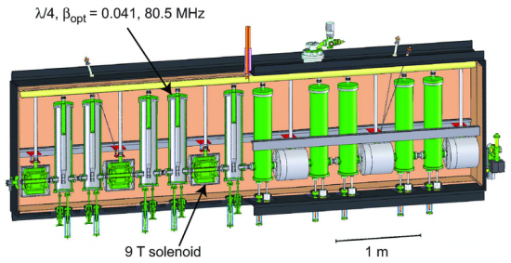
FRIB: a Next-Generation facility
FRIB will provide the highest-intensity beams of rare isotopes available anywhere ⁽¹⁾
Beam energies: up to 200 MeV/nucleon for uranium (approximately twice the energy of NSCL) with the option of upgrading to 400 MeV ⁽¹⁾
Beam Power: 400 kW (nearly 10x that of similar facilities) ⁽¹⁾
Beam Driver: heavy-ion linear accelerator, made of superconducting RF resonators ^{(1, 2)}
Incorporating many newly-developed technologies
Notes:
Particle velocity: up to 57% of the speed of light
R&D activities for the past decade at several national laboratories and universities (Argonne, Berkeley, Brookhaven, Colorado School of Mines, Los Alamos, MSU, Oak Ridge, and Texas A&M) (2) have led to significant advances that have optimized machine performance and made possible a more cost-effective design for FRIB. (3)

Slide 22
FRIB Experiments
The FRIB design also includes three beam stopping stations and a reaccelerator, currently under construction at NSCL.
FRIB’s 47,000-square-foot experimental area will feature areas for fast, stopped, and reaccelerated beams. ⁽¹⁾
Low-energy nuclei behave as they would in a star or supernova, so experimenters can use reaccelerated beams to measure what processes occur under those conditions!

Slide 23
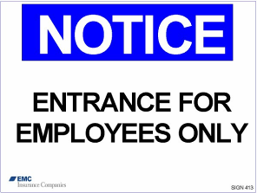
Safety First
No eating, drinking, smoking, chewing gum
Watch your head and step, don’t sit or lean on things
Pacemaker? Beware magnetic fields
Stay with your guide, follow instructions and don’t touch
If you become separated from the tour, dial “0” from any lab phone (“305” after hours) and the receptionist will assist you

Slide 24
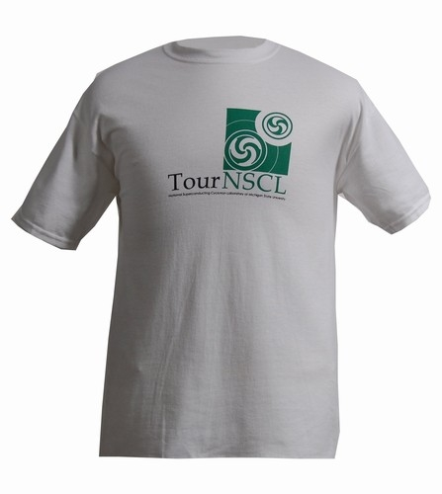
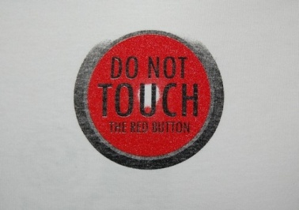
National Superconducting Cyclotron Laboratory at Michigan State University
For more information about our lab and outreach programs, contact visits@nscl.msu.edu or go to www.nscl.msu.edu
Visit the “NSCL Gift Shop” online! Go to shop.msu.edu and click on “NSCL” under “Specialty Stores”
Follow us on @nscl
Friend us on
“National Superconducting Cyclotron Laboratory”

Slide 25
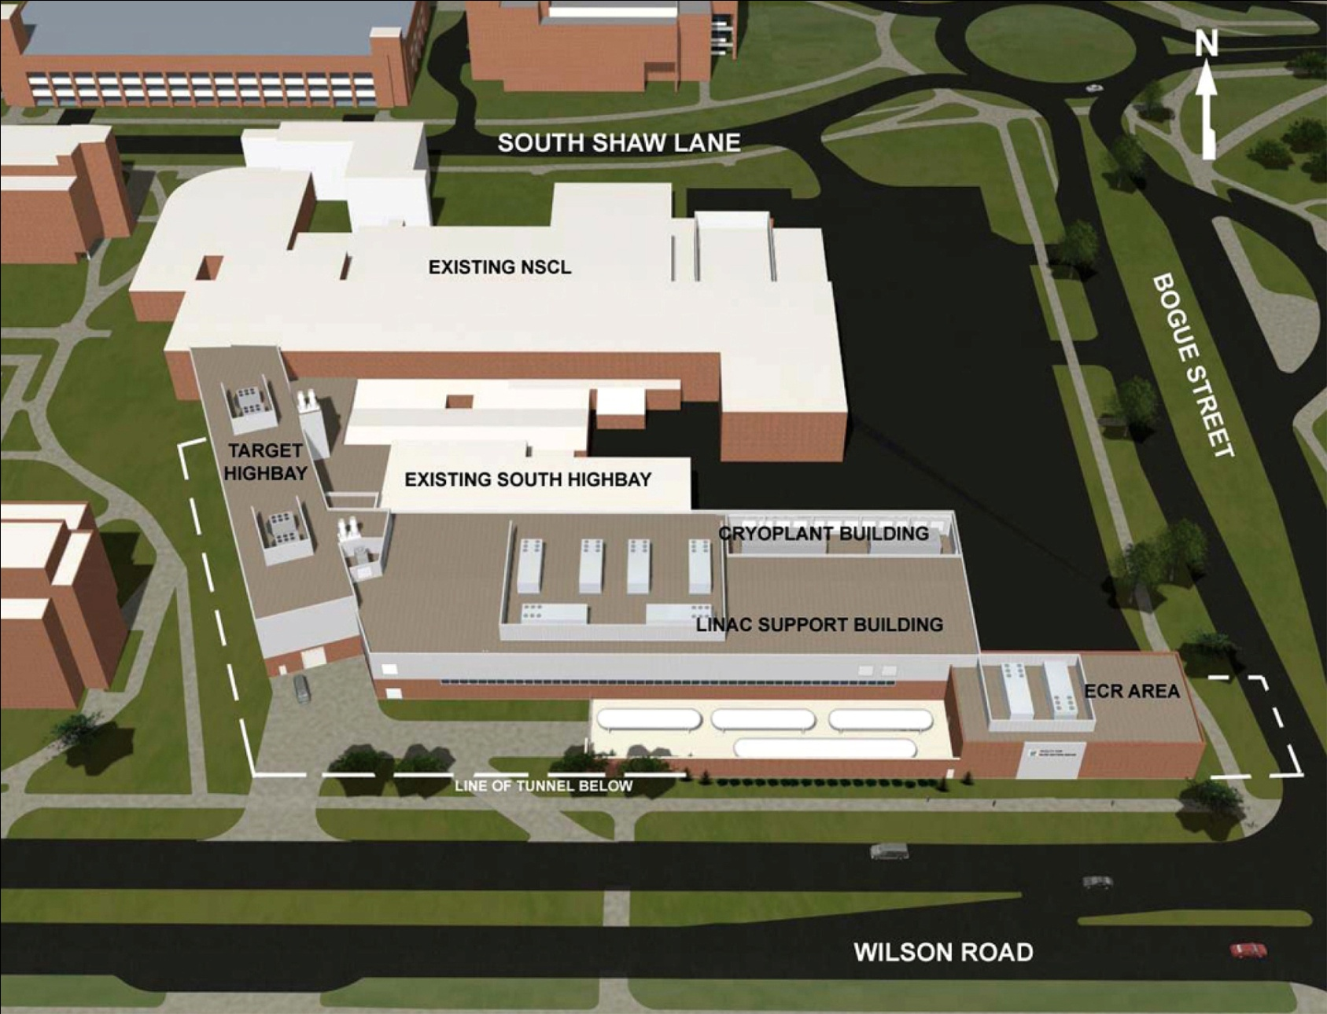
FRIB on the MSU campus

Slide 26
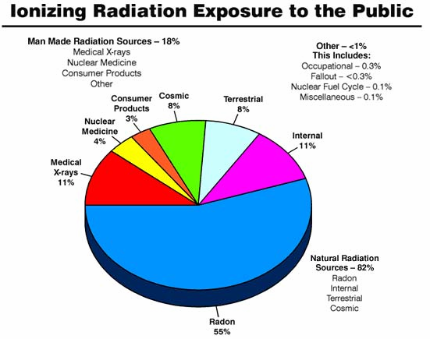
Sources of radiation

Slide 27
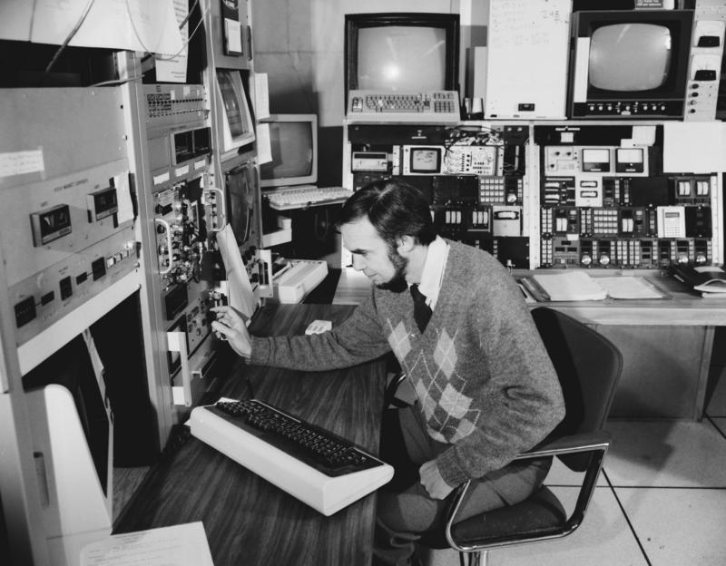
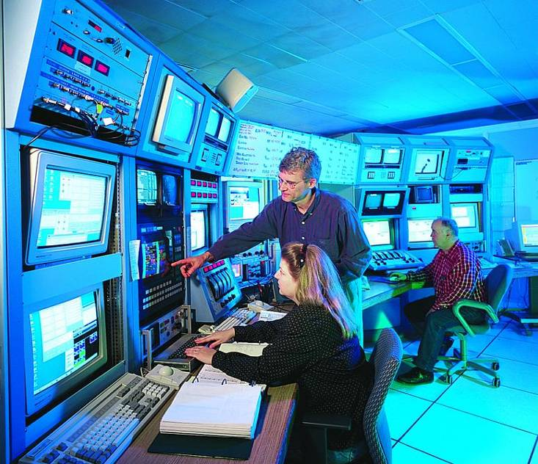
The Control Room
1997
1982
2003

