Slide 1
WHO WILL DISCOVER
OUR FUTURE?
World-class nuclear experimentation and theory at MSU
Dr. Zach Constan
Outreach Coordinator
National Superconducting Cyclotron Laboratory (NSCL)

Slide 2
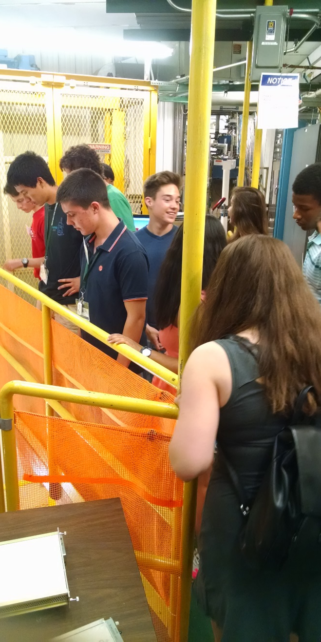
Useful Information
Location of bathrooms!
If you have minors in your group, your leader must submit a permission form.
Photography is not allowed on the tour, but we have a designated location for a group photo if you want.
You are not expected to know or understand everything! It’s OK.
Stopping us to ask questions is encouraged!
LAND ACKNOWLEDGEMENT
We collectively acknowledge that Michigan State University occupies the ancestral, traditional, and contemporary Lands of the Anishinaabeg – Three Fires Confederacy of Ojibwe, Odawa, and Potawatomi peoples. In particular, the University resides on Land ceded in the 1819 Treaty of Saginaw. We recognize, support, and advocate for the sovereignty of Michigan’s twelve federally-recognized Indian nations, for historic Indigenous communities in Michigan, for Indigenous individuals and communities who live here now, and for those who were forcibly removed from their Homelands. By offering this Land Acknowledgement, we affirm Indigenous sovereignty and will work to hold Michigan State University more accountable to the needs of American Indian and Indigenous peoples.

Slide 3
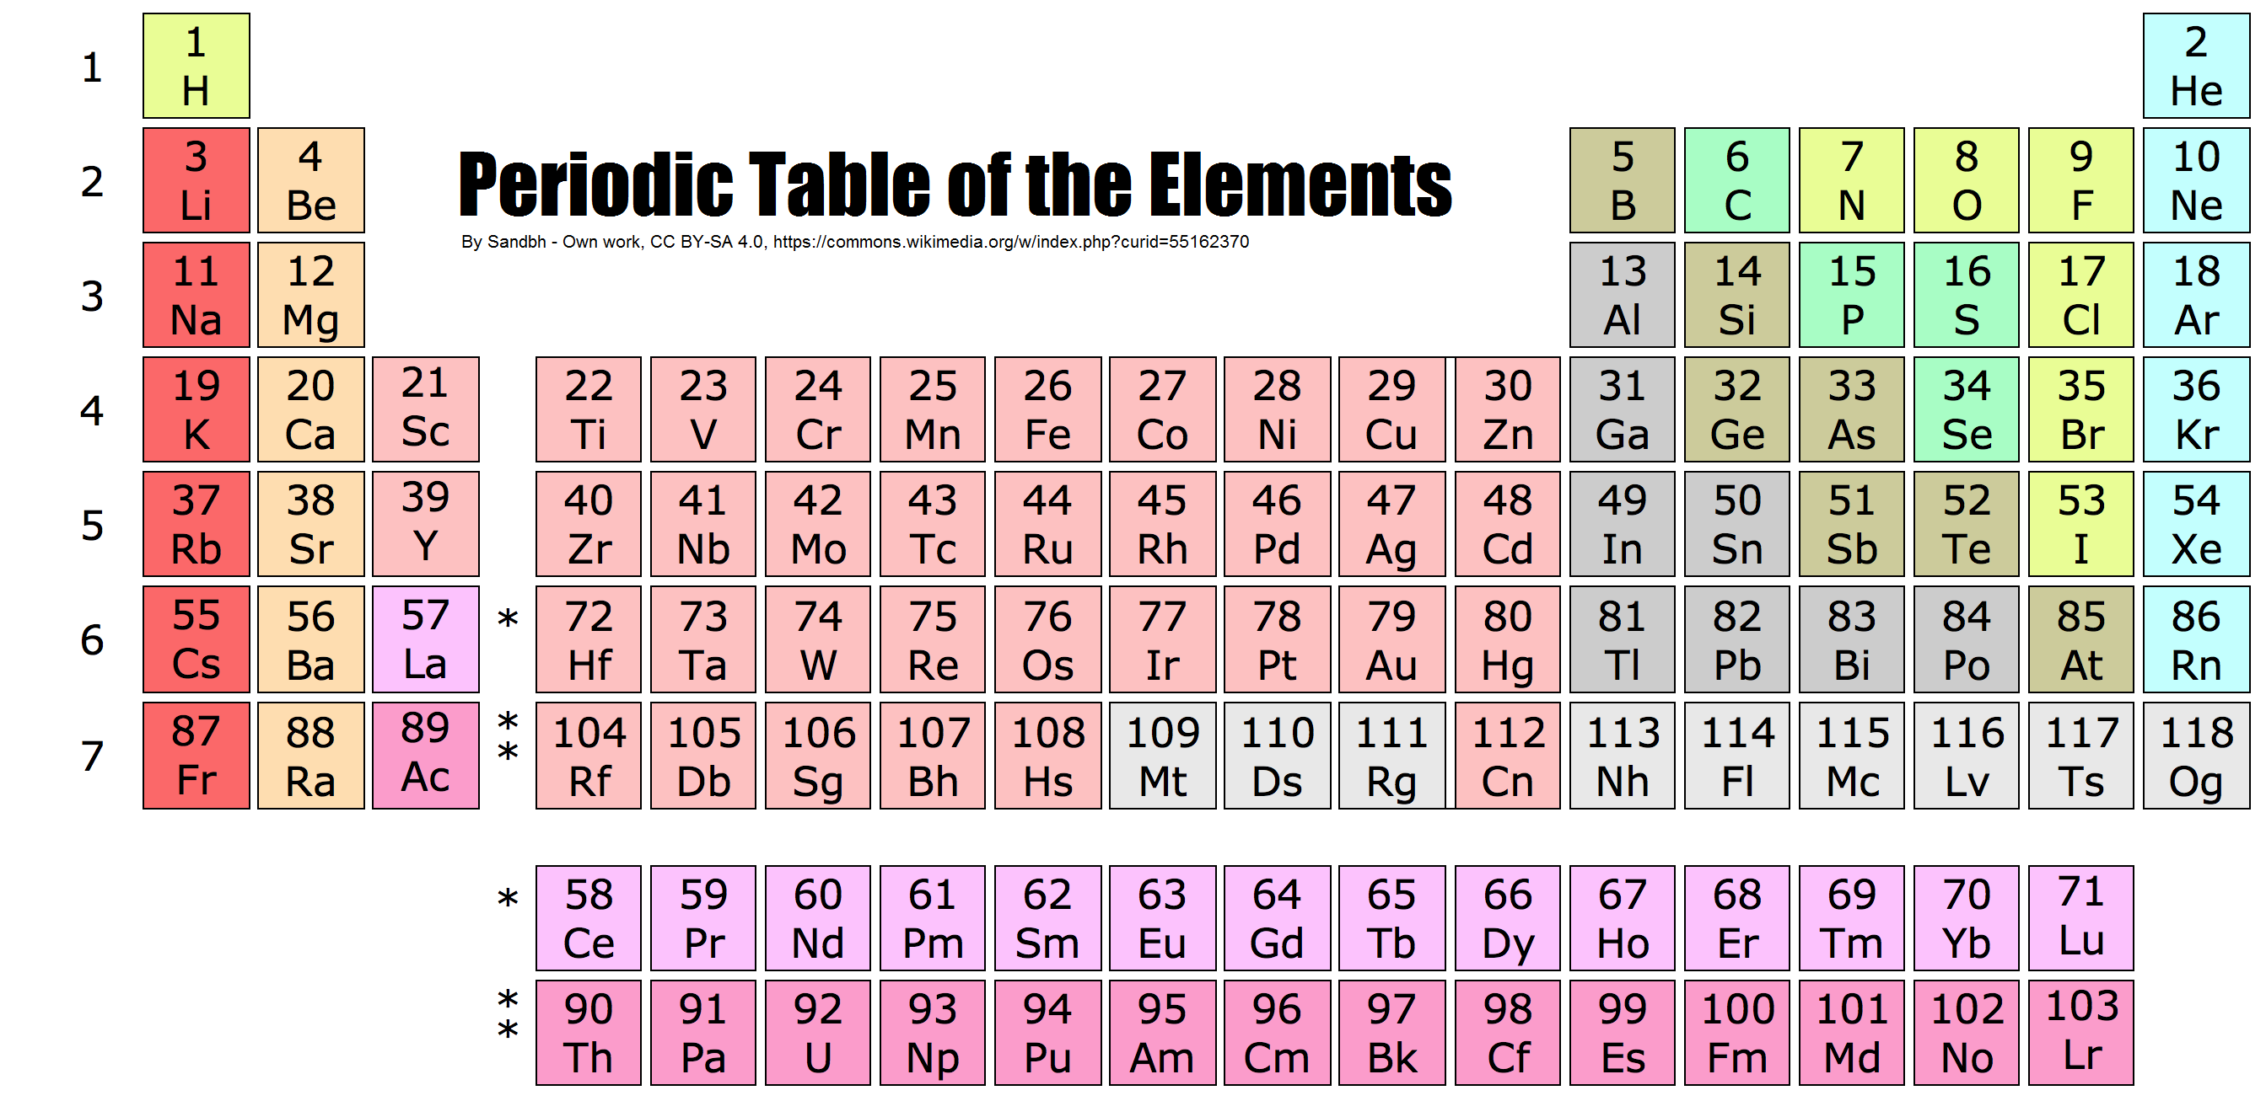
Periodic Table of the Elements
Each element (such as carbon) comes in
many varieties, some common, some rare

Slide 4
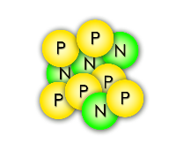
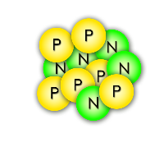
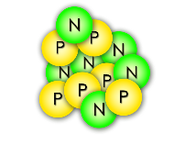
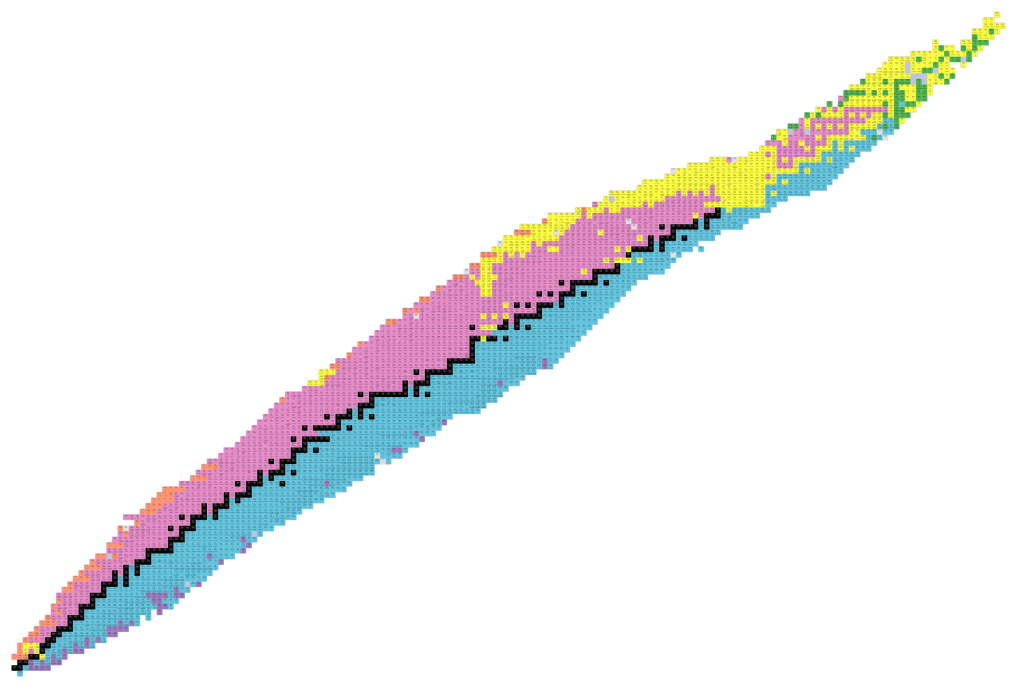
Isotopes: varieties of an element
Carbon-10
Carbon-11
Carbon-12
All of these carbon isotopes are chemically identical, but different numbers of neutrons gives them diverse nuclear properties
Protons (Elements)
Neutrons (Isotopes)

Slide 5
Our mission: study RARE isotopes
Black squares
Stable, common isotopes
~300 known
Undiscovered Territory
Protons (Elements)
Undiscovered Territory
Colored squares
Unstable, radioactive, rare isotopes
>3000 known and growing
Neutrons (Isotopes)

Slide 6
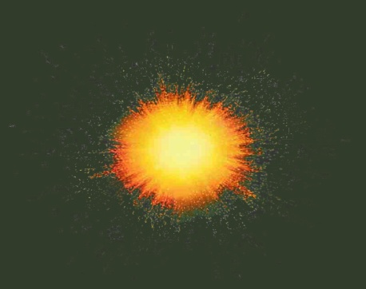
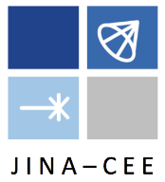
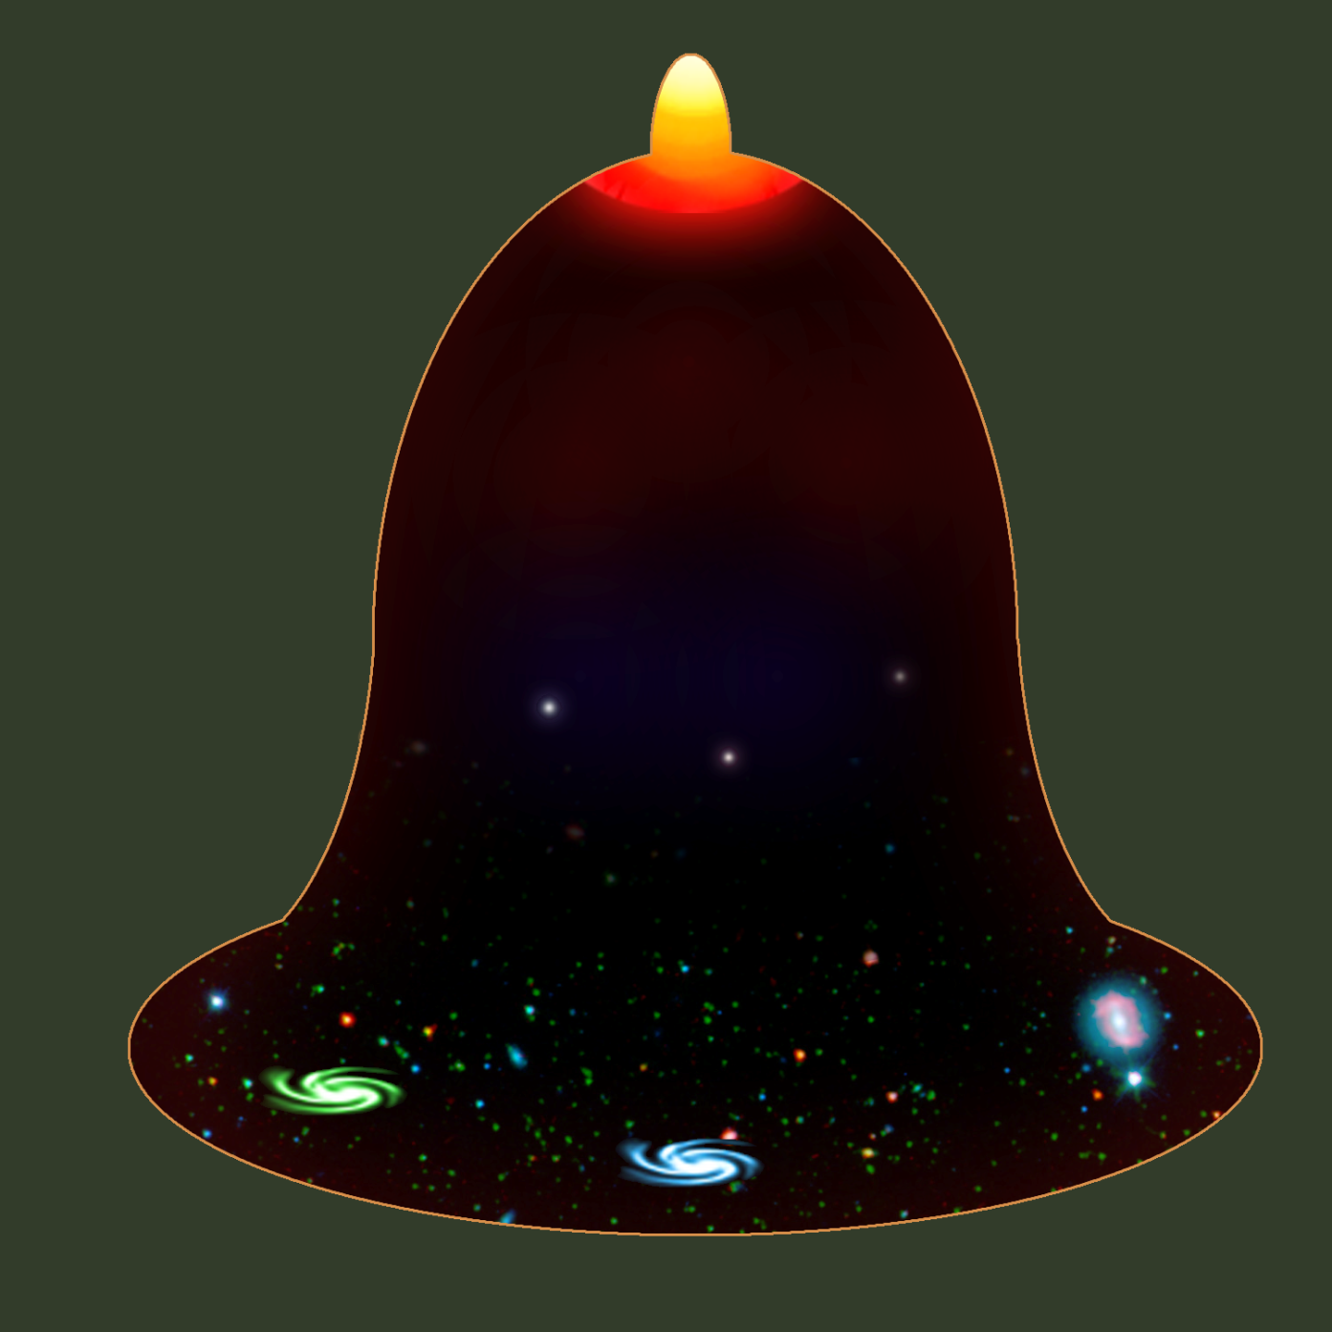
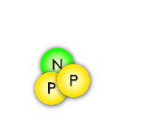
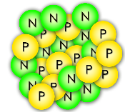
How were the elements made?
The Joint Institute for Nuclear Astrophysics (JINA) presents
A Short History of the Universe
A spectacular explosion of energy in a growing universe… the Big Bang !!
Inflation
Slowing expansion
4 min after Big Bang
1.8 Billion ºF
The first nuclei are made: Hydrogen and Helium
…
Formation of the first stars
One billion years after Big Bang
440 ºF
helium iron
Stars fuse light elements into heavy ones, up to iron
Accelerating expansion
Neutron-star mergers & supernovae may create unstable isotopes that will decay into heavier elements!
-450 ºF
Now

Slide 7
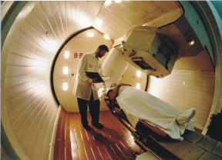
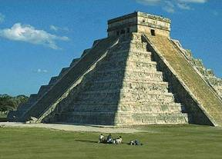
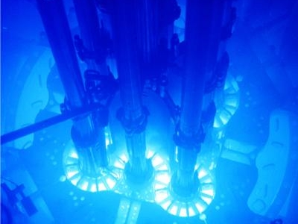
What is the value? (“Who cares?”)
Nuclear Medicine
Archaeology/Geophysics
Power Plants
…plus: smoke detectors, smartphones, safer food, etc.
What we learn about the nucleus can
save lives and change the world!
Jobs like medical physicist, radiation safety officer, geophysicist

Slide 8
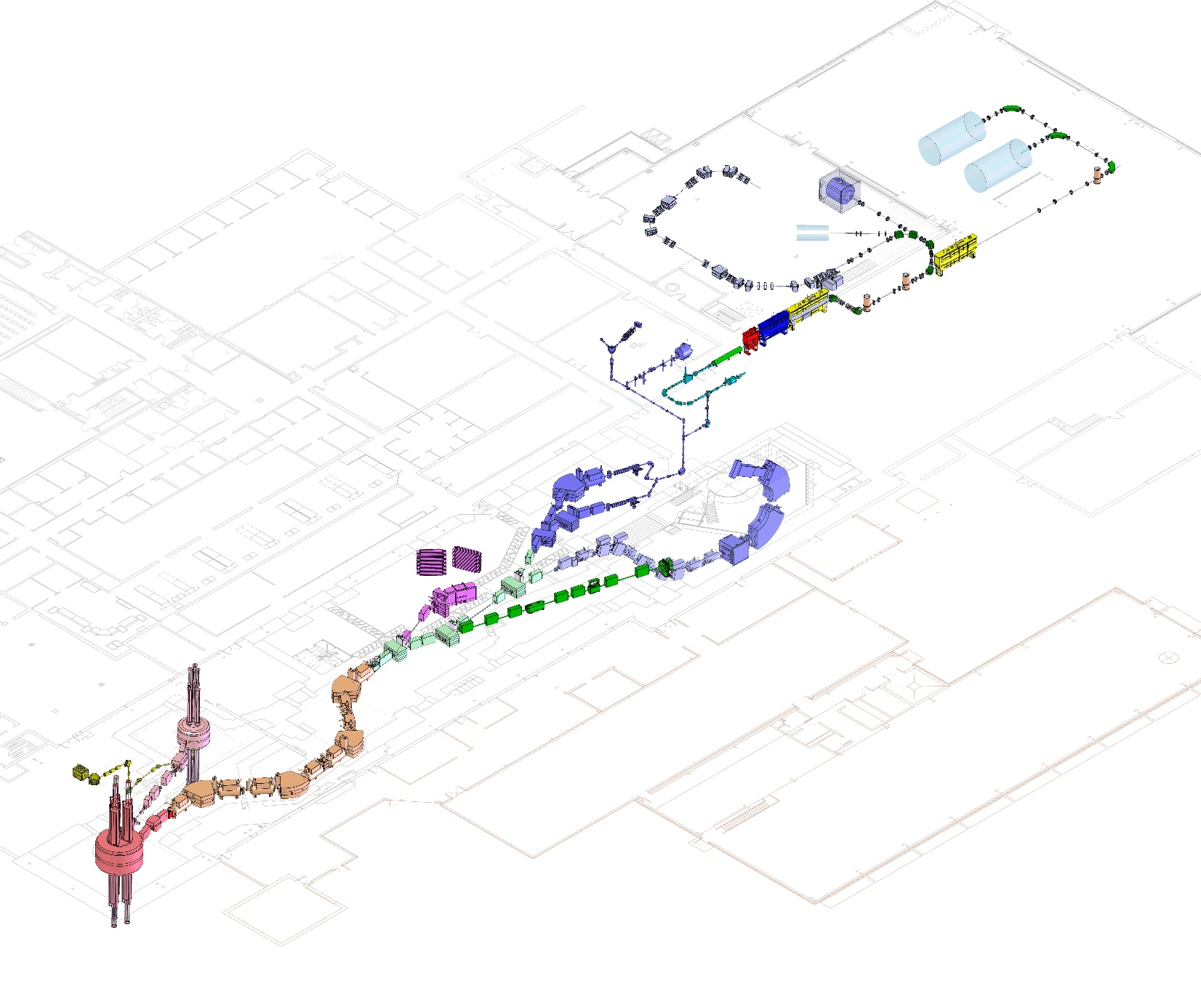
The tools we use
Coupled cyclotron facility and experimental beam lines
SPEED UP NUCLEI using accelerators
and BREAK A TON OF THEM
A person
Made possible by
accelerator physicists, operations physicists,
and engineers (vacuum, electrical, cryogenic…)
~140 meters (450 feet) long
Five stories tall

Slide 9
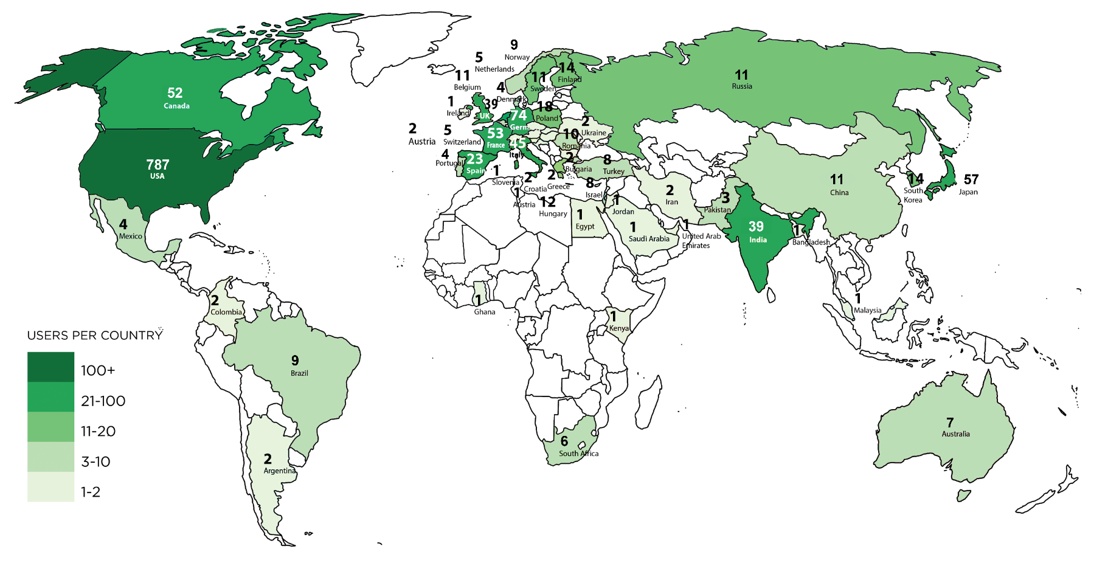
Serving Users worldwide
The best nuclear scientists on the planet come to NSCL because our lab is a world class research facility
FRIB/NSCL User Community August 2018
~1400 scientists, 50+ countries

Slide 10
Our staff makes it possible
800+ employees
Research and Development
Theorists and Experimenters
Facility operators
Designers & engineers
Undergraduate and Graduate
students
Technicians & machinists
Our people learned useful skills in:
nuclear science ▪ physics ▪ chemistry ▪ all types of engineering ▪ mathematics ▪ computer science ▪ welding ▪ machining ▪ pipefitting ▪ and so on…
If you like Science, Technology, Engineering, and Math (STEM), that’s what we do!
(and skilled trades!)

Slide 11
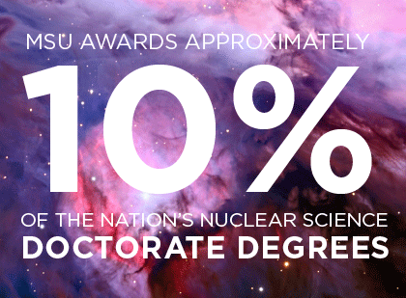
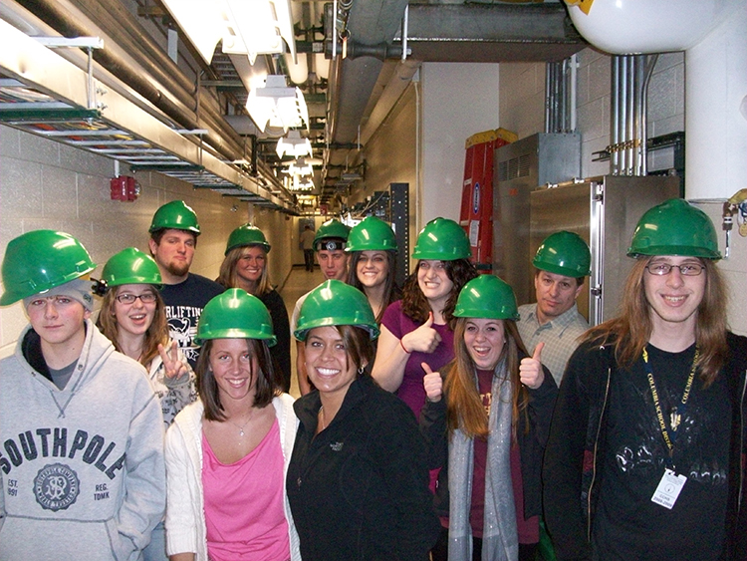
Training the next generation
NSCL has the
#1 ranked nuclear science program
among US graduate schools
(U.S. News & World Report, 2018)
NSCL Outreach offers:
Tours for the general public
Summer research programs for middle & high school students
Nuclear science experiments and lessons for teachers to use
For more information online: www.nscl.msu.edu/public/education

Slide 12
How to break your nuclei
NSCL’s Coupled Cyclotron Facility

Slide 13
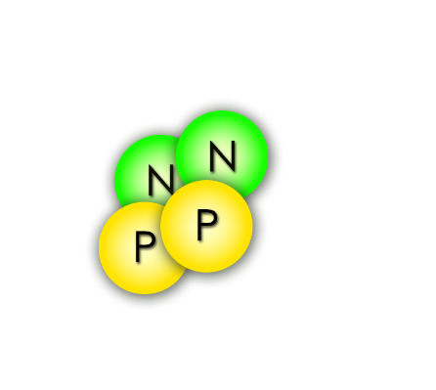
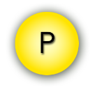
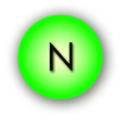
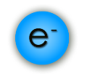
Want to study radioactive nuclei?
Problem:
You’re making rare, interesting, but unstable nuclei
They decay and emit radiation
Radiation can be bad for humans
Alpha particle (Helium nucleus)
Proton
Gamma ray
(high energy light)
Neutron
Beta-minus particle (electron)
Different types of radiation

Slide 14
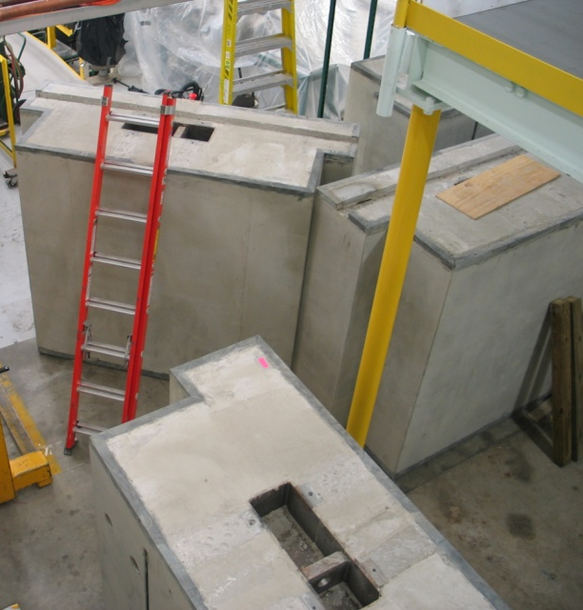
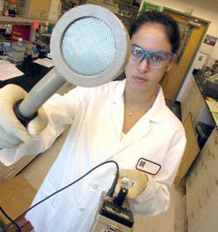
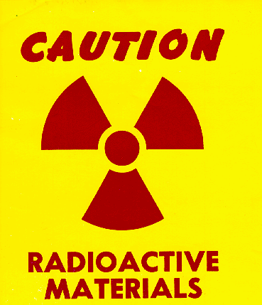
Safety with radioactive nuclei
Solutions:
keep radiation away from people & keep people away from radiation
Shielding
Surveying
Training
Managed by health physicists, safety officers

Slide 15
Radiation exposure and you
Radiation source | Dose
Average exposure for general public (natural + medical) | > 300 mRem/yr
Government (NRC) exposure limit for lab visitors | 100 mRem/yr
NSCL/FRIB ALARA goal for visitors | 10 mRem/yr
Your visit today | << 1 mRem
Dental x-ray | 0.5-1 mRem
Smoking a pack of cigarettes | ~2 mRem (800 mRem/yr)

Slide 16
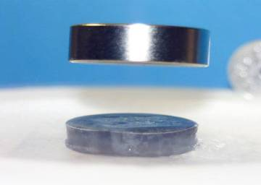
Superconductivity is cool
NSCL cyclotrons use electromagnets made from niobium-titanium wires.
At the temperature of liquid helium (-269 ºC , -450 ºF), these wires become superconducting,
which means they have
zero resistance to electricity.
This allows us to make small, powerful electromagnets used to direct and control nuclei!
Superconductors also repel magnetic fields
magnet
superconductor
liquid nitrogen used to cool the superconductor

Slide 17
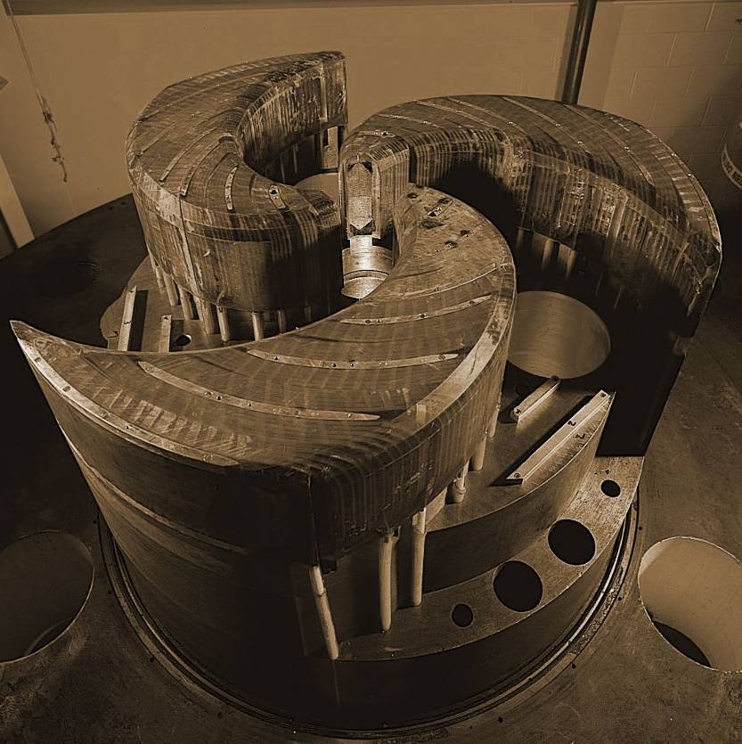
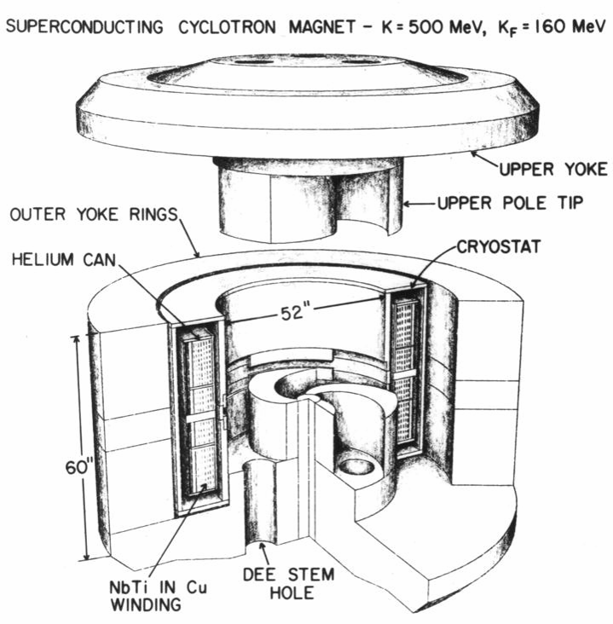
The NSCL Cyclotrons
World’s first superconducting cyclotron
World’s second-highest-energy superconducting cyclotron
K500
K1200
Year completed: 1982
Diameter: 10 ft Weight: 100 tons
Magnetic field: 3-5 Tesla
Maximum energy it can impart to a proton: 500 MeV
Year completed: 1988
Length of superconducting wire: 38 mi
Time of acceleration: 0.000035 seconds
Distance a nucleus travels while inside: 1.9 miles (700 revolutions)

Slide 18
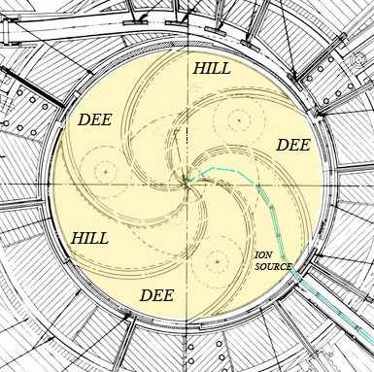
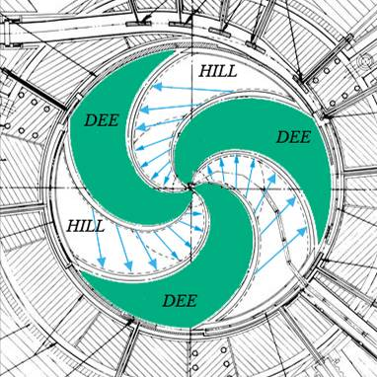
How to build your own cyclotron
Coil of superconducting niobium wire
Stable, “normal” ions are injected into the center of the cyclotron
Magnetic field steers nuclei in a circle
Ions orbit inside the vacuum
“Dees” alternate high voltage, creating electric field to accelerate the nuclei
Nuclei spiral to higher speeds until they leave the cyclotron in a fast beam

Slide 19
Problem: Making designer nuclei
BEAM at < 0.5 c
strikes foil TARGET
exits with FRAGMENTS
¹⁸O
¹⁸O
¹⁸O
¹⁸O
¹⁸O
¹⁸O
¹⁶C
or
⁹Be
¹¹B
or
The accelerated beam consists of the one stable isotope provided by the ion source
(>1 billion nuclei/second)
Very few beam nuclei hit a nucleus in the target and break, becoming a new element/isotope
¹⁷O
or…
After the target, the beam contains many new isotopes (sometimes <1 desired nucleus/second)

Slide 20
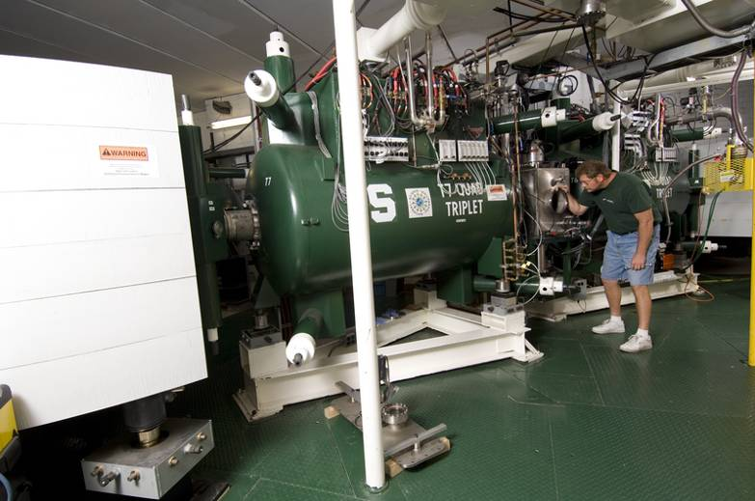
Fragment Separator: a filter for nuclei
Beam fragments on target
Rare isotope beam leaves A1900
Dipole magnets filter beam
Wide variety of isotopes enters A1900
The wedge-shaped dipole magnets affect isotopes like prisms affect light, separating the unwanted nuclei
(of any isotope not currently being studied) out of the beam

Slide 21
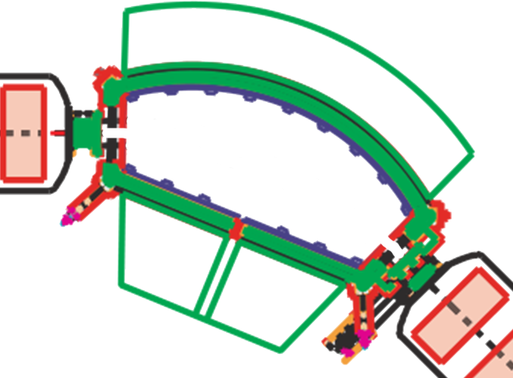
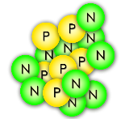
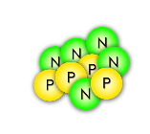
Problem: Selecting one rare isotope
Solution:
magnetic separators
(mass spectrometer)
Some nuclei turn too little
¹⁶C
Some nuclei turn too much
The magnetic field is just right to steer nuclei of the desired isotope through!
A dipole magnet

Slide 22
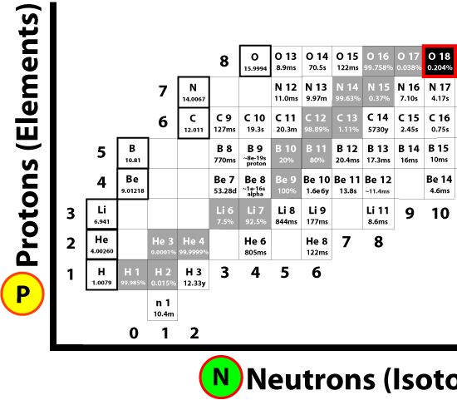
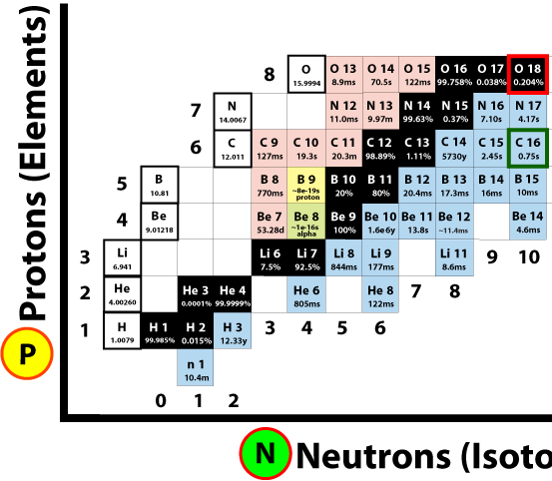
The A1900 Fragment Separator
Primary (stable) Beam
Fragmented Beam
Fragmentation on target
Secondary (unstable) Beam
Primary (stable) Beam
>1 billion nuclei/second
Beam after fragmentation (mostly stable, some rare)
Beam after separation (fewer rare isotopes)

Slide 23
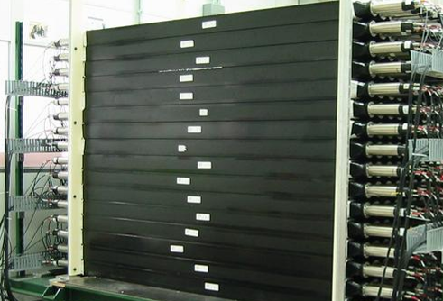
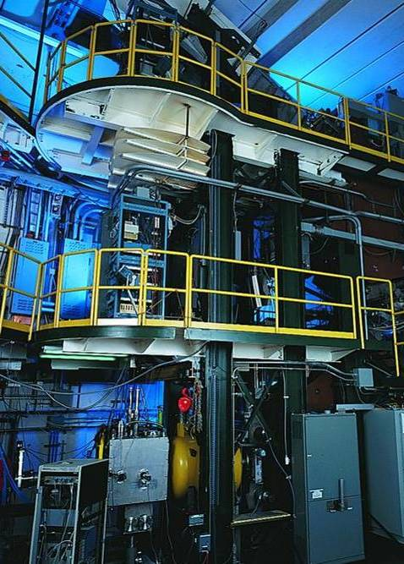
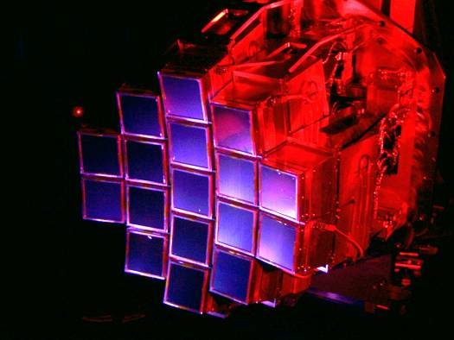
Detectors measure the invisible
MoNA
“Halo nuclei” and neutron-rich isotopes
(These tools must be created by
detector physicists, mechanical designers, chemists, machinists, technicians…
… and who knows how else we might use those tools someday!)
S800 Spectrograph
Nuclear states from particles freed in collisions
Nuclei found in stellar reactions
HiRA

Slide 24
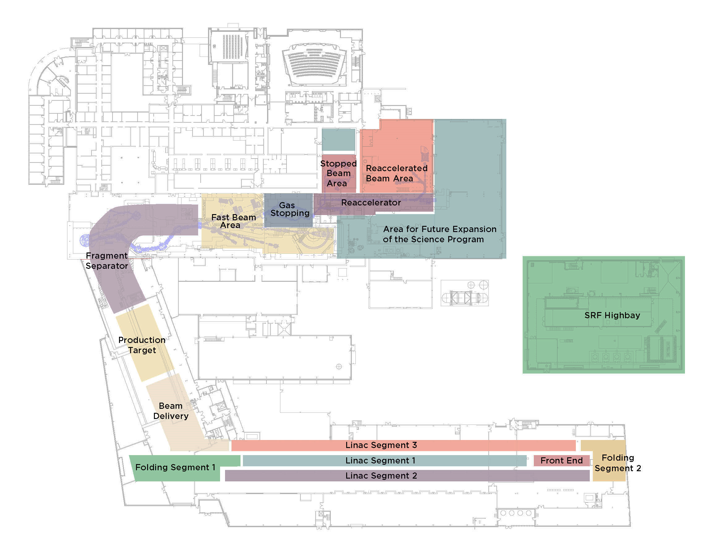
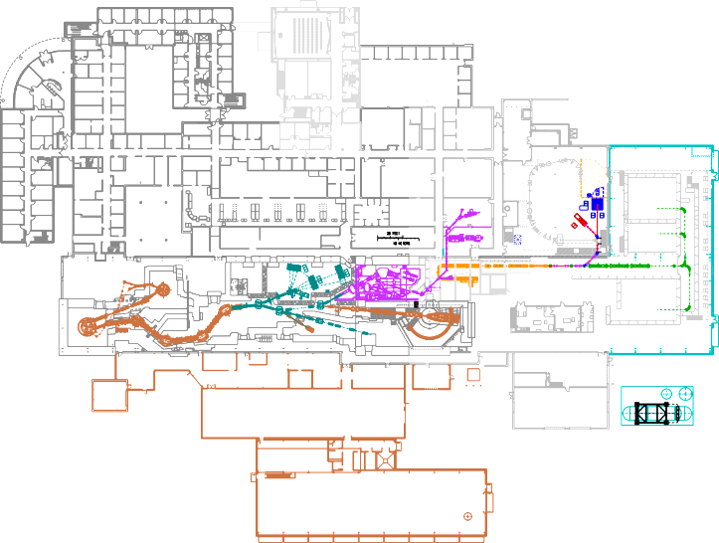
Problem: study EXTREMELY rare nuclei!
FRIB design
NSCL today
Solution:
BREAK MORE NUCLEI with our next-generation
Facility for Rare Isotope Beams (FRIB)
the $730 million discovery machine that we imagined, designed, and will build by 2022
Research Space (450 feet)
400-yard-long folded linear accelerator
Double energy, up to 400x more nuclei/sec

Slide 25
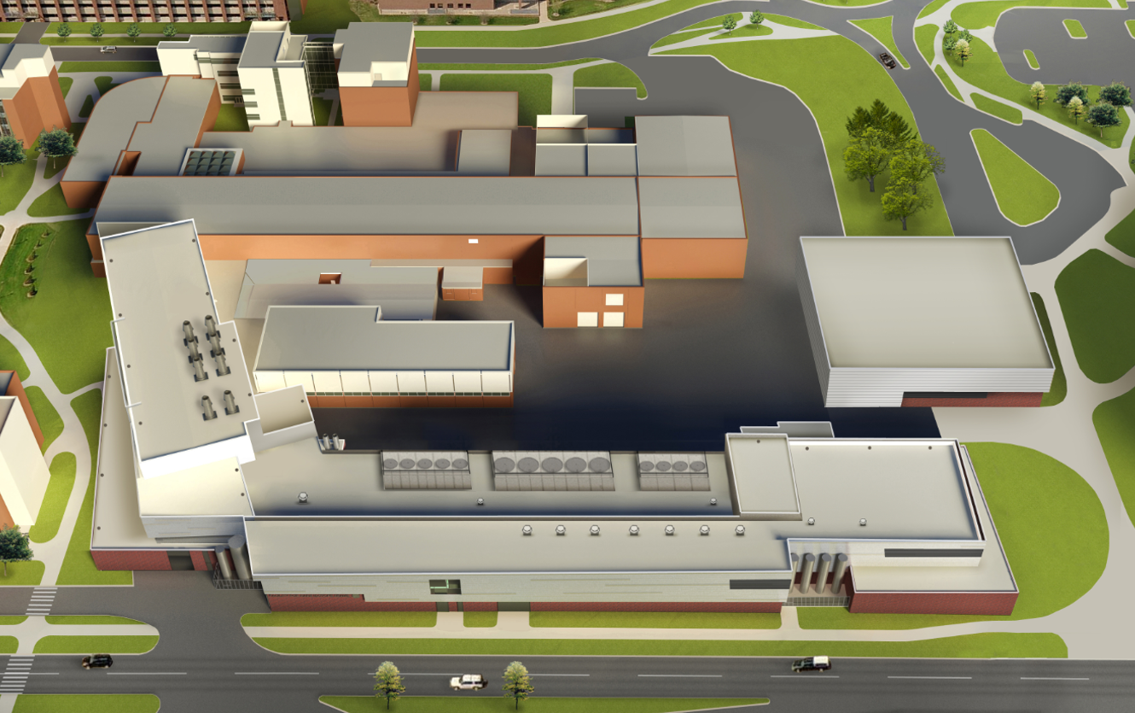
FRIB on the MSU campus

DAIRY STORE
(one
block)
WHARTON
CENTER

SHAW LANE
Lobby
BOGUE STREET
Existing NSCL
Target
Highbay
SRF Assembly
Ion Sources
Linac Support Building
WILSON ROAD

Slide 26
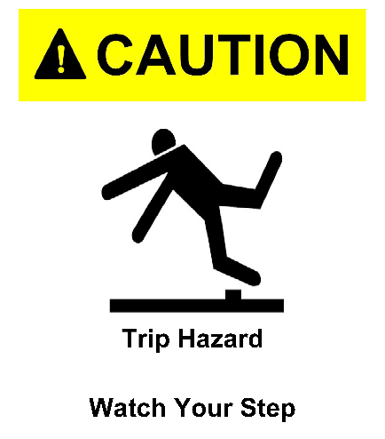
Safety First
DON’T put anything in your mouth (eat, drink, chew gum)
DO watch your head and step
DON’T sit or lean on things
DO obey posted signs
DON’T take photos
DO stay with your guide
DON’T touch equipment
If you lose your tour, dial “0” on a lab phone (“77305” after hours)
DO leave items (especially open food/drink) you don’t want to carry

Slide 27
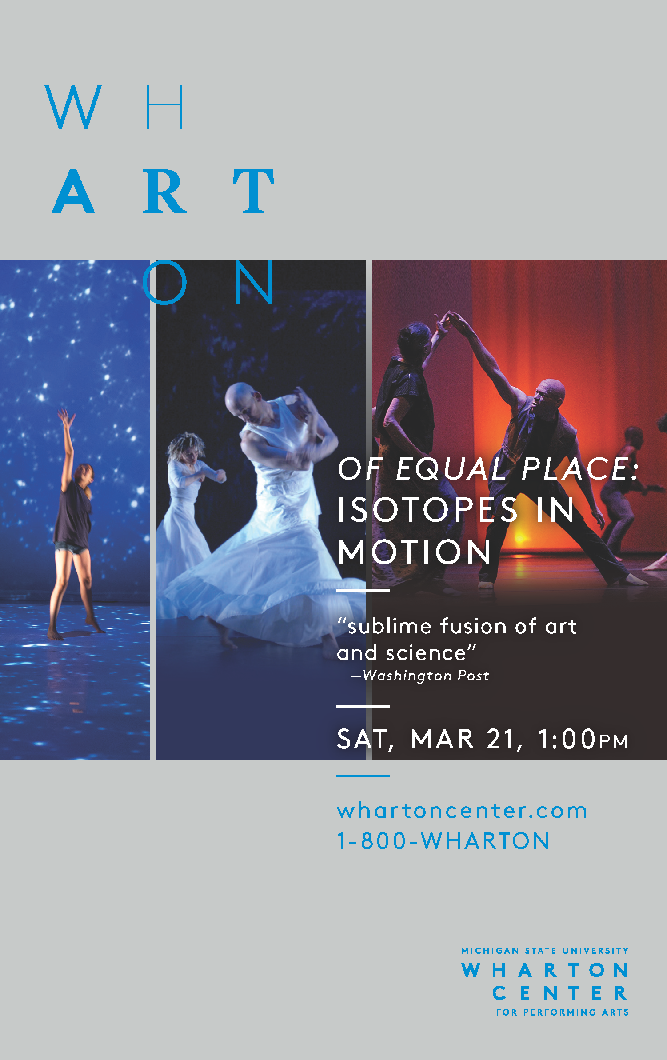
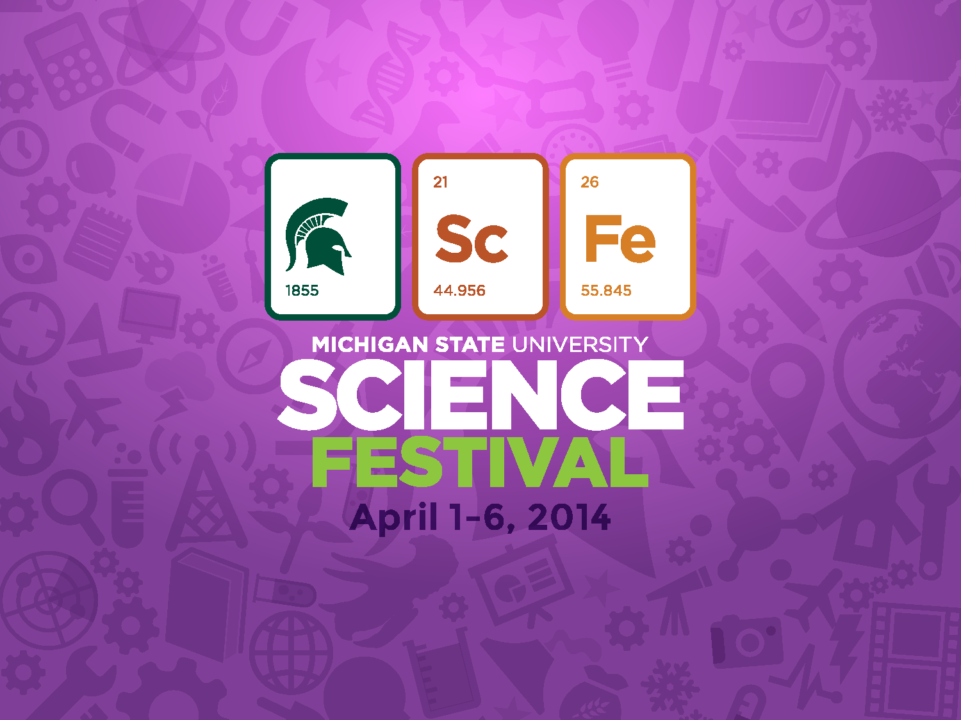
Annually in April
sciencefestival.msu.edu
Followed by workshops, tours, and demonstrations!

Slide 28
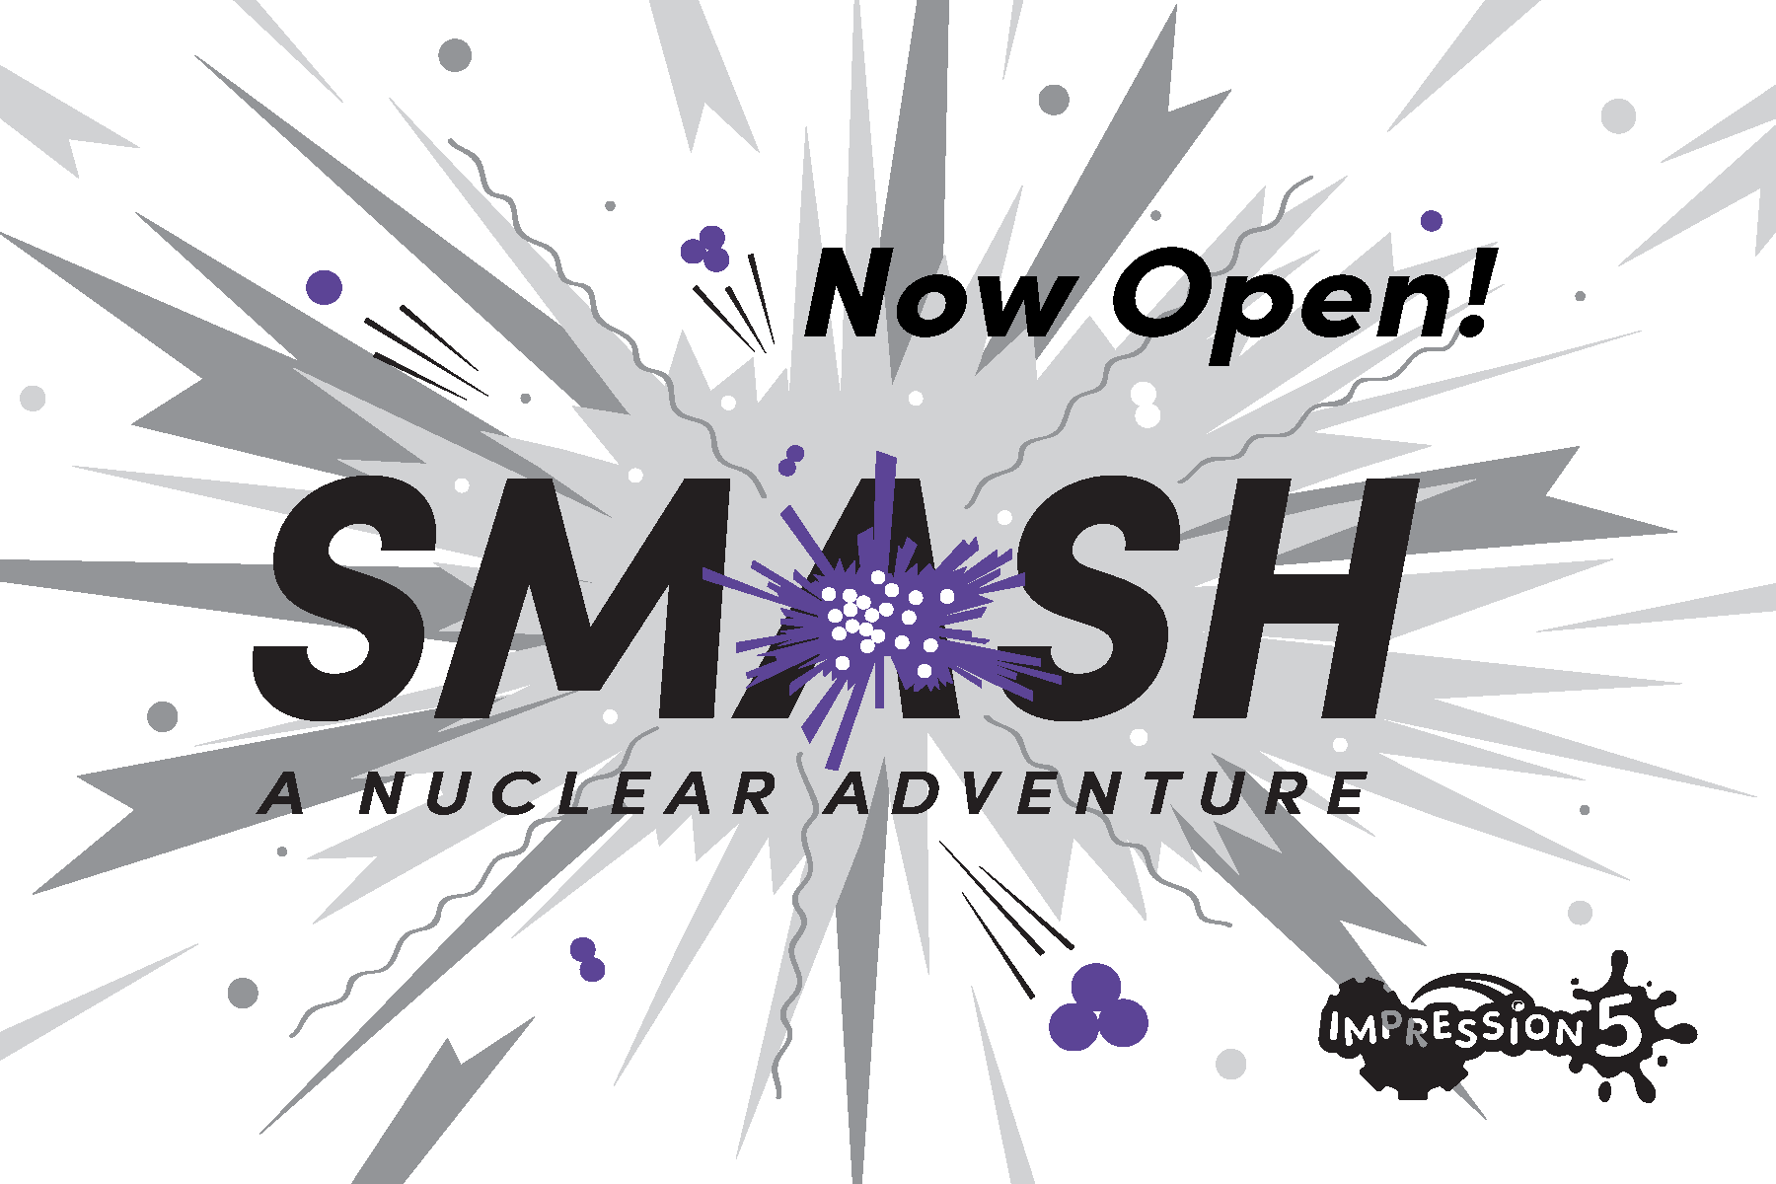
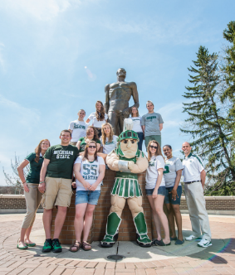
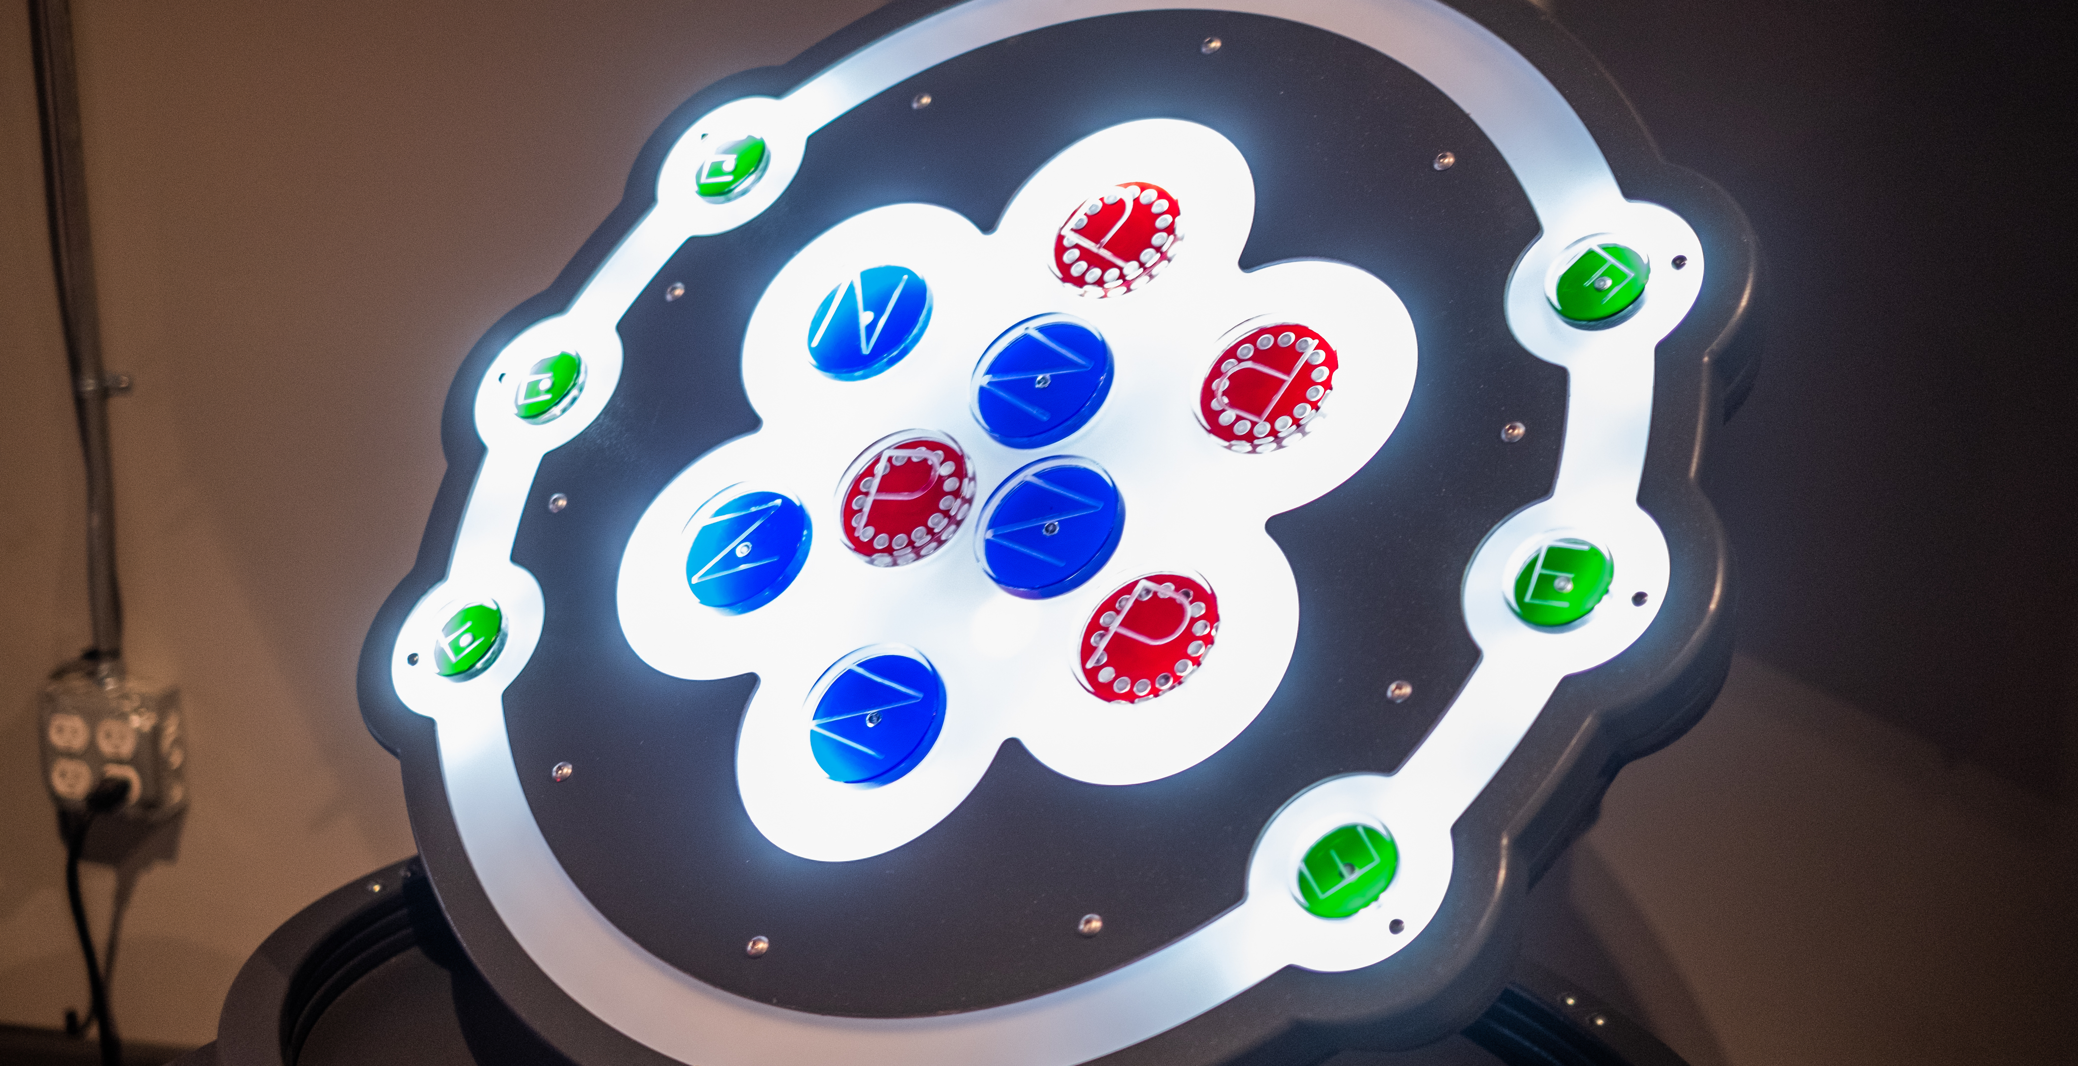
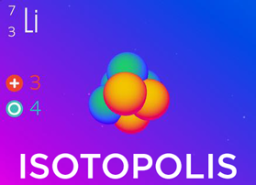
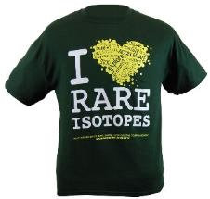
Explore FRIB & NSCL at MSU
Learn more about our Lab and outreach programs
Visit the FRIB-inspired nuclear science exhibit at Impression 5 Science Center in downtown Lansing!
impression5.org
SPARTAN YOUTH PROGRAMS
Find camps and programs at MSU for
pre-college students: spartanyouth.msu.edu
Get the Android/ iPhone/iPad game Isotopolis for free!
Visit our Gift Shop on shop.msu.edu (click on “NSCL/FRIB” under “Specialty Shops”)
GIFT SHOP
contact visits@nscl.msu.edu
or go to nscl.msu.edu/public/education
@nscl

Slide 29
Annually in April
sciencefestival.msu.edu

