Slide 1
Triggering with Mesh signal

Slide 2
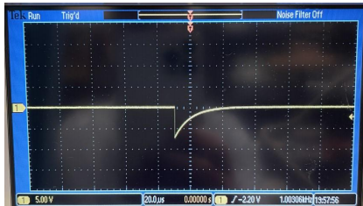
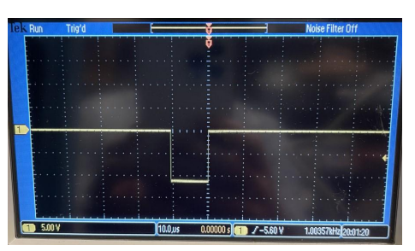
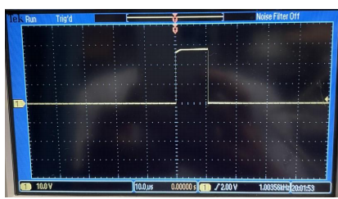
Block Diagram for Mesh Trigger
Signal from mesh
Shaping Amplifier
Start
Pre-Amplifier
Fan in Fan
out
Semi-/Gaussian
pulse
Stop
Delayed
(using a long cable)
Pulse from Random Pulse Generator
Digital signal with1 µsec width
Output from SCA adjusted using delay unit
NIM to TTL
Translator
Single
Channel
Analyzer/TAC
Delay
Unit
Trigger
To cobo
Output from delay module adjusted to 10 µsec

Slide 3
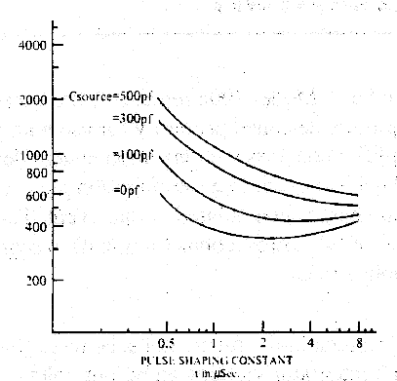
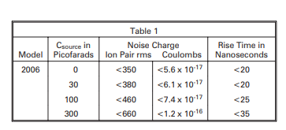
Modules Used
Random Pulse Generator : (Berkley Nucleonics Corporation Model DB -2)
A variable frequency pulse (10 Hz - 1 MHz) is taken from random pulse generator and fed to the pre-amplifier.
2. Pre- Amplifier : (Canberra 2006 pre-amplifier): It is a charge sensitive preamplifier.
Input Impedance : 93 Ω ( It is modified pre-amplifier with low impedance ~ 50 Ω)
Energy Sensitivity: 47 mV/MeV or 235 mV/MeV (Internally selected)
Noise Output performance:
Table 1: Noise output performance
Fig1: Typical Noise Behavior

Slide 4
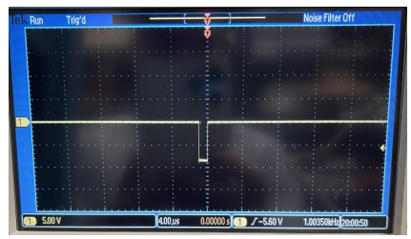
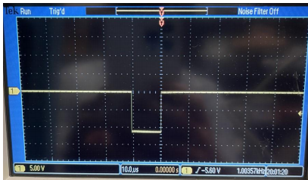
Shaping Amplifier: (Tennelec TC241): It generates very symmetrical pseudo Gaussian unipolar pulses with selectable peaking time (1, 3 or 6 μsec).
FAN in FAN out: The output from amplifier is fed to this unit and one output goes directly to SCA unit as a START signal and another output is delayed using a very long cable and the delayed output is fed as STOP signal to SCA.
5. Single Channel Analyzer /Time to Amplitude Convertor: (Ortec 467 and Canberra 2143)
It operates in window mode where Upper level (ULD) and lower level (LLD) can be adjusted (0-10 V). The output of the SCA is a logic pulse with width of 1 μ sec and that can be adjusted using a delay unit up to 40 μ sec

Slide 5
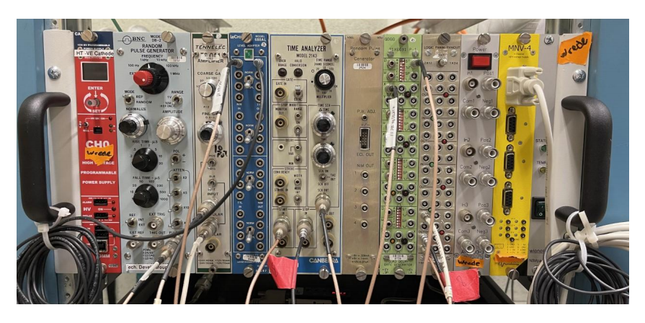
6. Delay unit: It can be used to adjust the width of the gate generated by SCA. The width can be adjusted from 1-40 μ sec.
7. NIM to TTL Translator: (LeCroy 688 AL): Cobo accepts TTL signal. Therefore, the SCA output is given to NIM to TTL translator.

Slide 6
Testing the Trigger
With different amplitude pulses: Set up the trigger with different amplitude pulse (200 mV – 110 V) from the pulse generator.
2) With different shape pulses: Set up the trigger with pulses of different shapes (Square, Tail pulse with adjustable rise and fall time etc.)
3) With different frequency pulses from the pulse generator: Set up the trigger with different frequencies from pulse generator in order to see the maximum count rate this system can handle.
GET Software Parameters that were adjusted to get higher count rate:
Full Read out Mode with threshold above a certain level.
Partial read out Mode
Enabling the Zero suppression level
Ethernet switch that we are using : 1 Gbit/sec

Slide 7
Table 2 : Count rate handling efficiency as a function of frequency
Frequency from Pulsar | Read out Mode | Threshold on the counts | No: of Channels read by software | Count rate handling efficiency (%)
100 Hz | Full | None | All 1024 | 40 %
 | Partial | None | 64 | 100%
 | Full | 500 | 160 | 100%
 | Full | 460 | 205 | 100%
1 KHz | Partial | None | 64 | 35%
 | Full | None | All 1024 | ~20 %
 | Full | 460 | 150 | 25%
 | Full | 470 | 128 | 35%

Slide 8
Expected Count rate for ²⁴¹Am source test:
:
Strength of the source =1.173 μCi
No : of decays per sec = 1.173 x 10⁻⁶ x 3.7 x 10¹⁰ = 43401
No: of decays per sec in active volume = 43401/2 = 21700.5 (only 50%)
After attenuator this will be= 21700.5/12 = 1808 counts/sec
Time between the events = 1/1808 = 0.55 ms
Drift time ~ 7.5 μs
The gate that we have set for the cobo is around 10 μs
0.55 ms
10 μs
10 μs

