Slide 1
Pressure Upgrade Clean Room and Reassembly

Slide 2
We found that one of the o-rings on an outlet line was missing

Slide 3
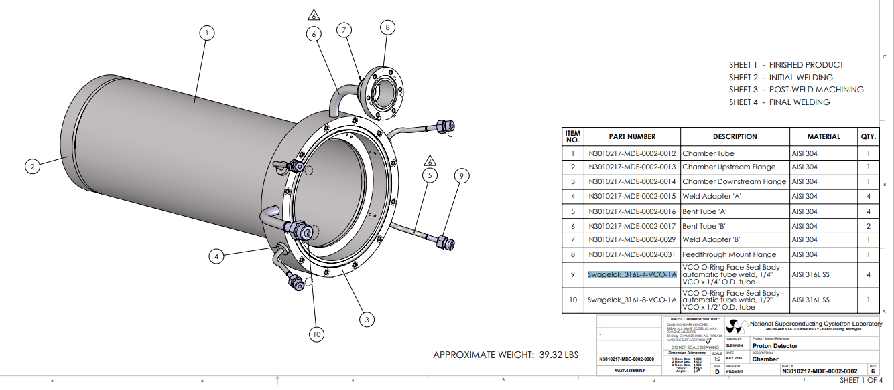
We found that one of the o-rings on an outlet line was missing
Based on drawing ‘N3010217-MDE-0002-0002’, the connector is ¼” VCO
https://www.mcmaster.com/9452K18/

Slide 4
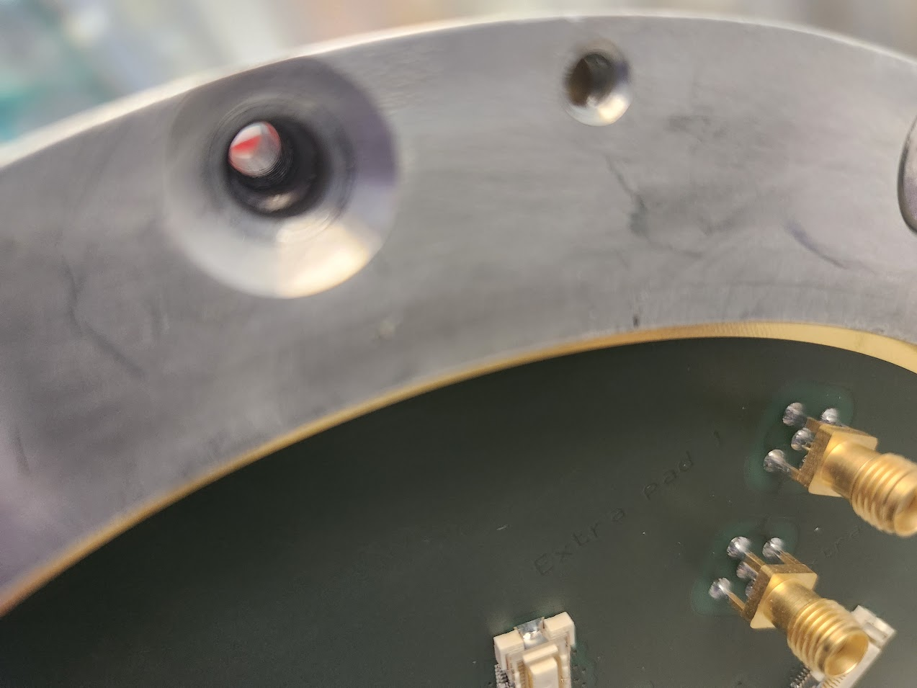
Cleaned metal shavings out of the tapped holes

Slide 5
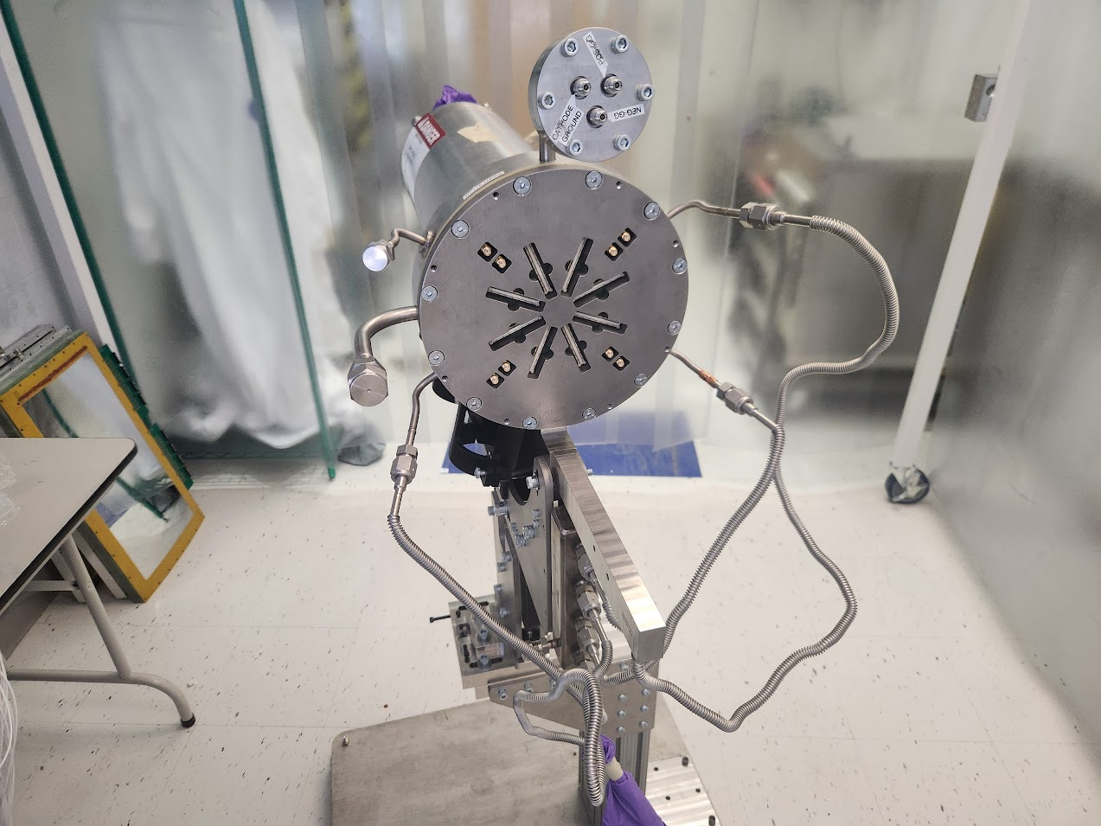
Screws went back in easier after cleaning
120 lb-in of torque to tighten Micromegas screws

Slide 6
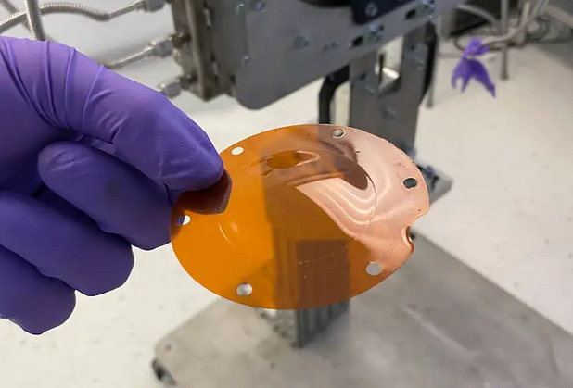
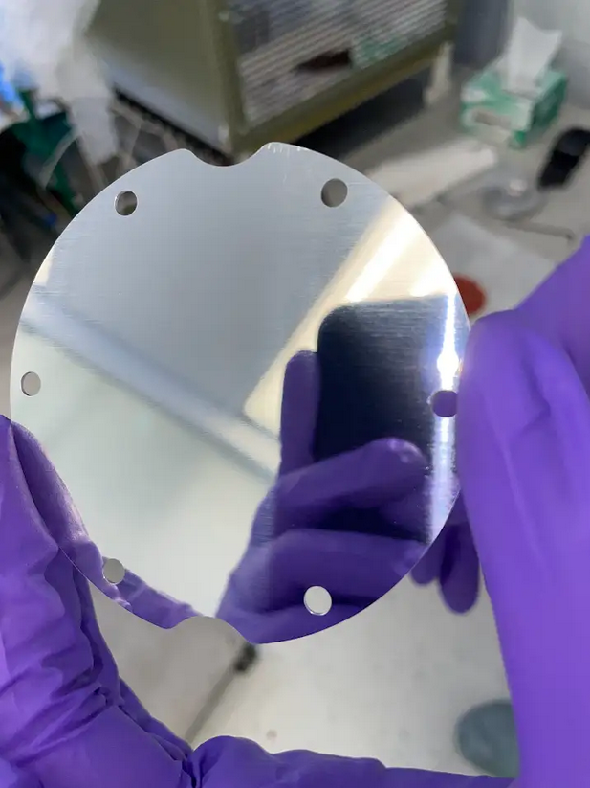
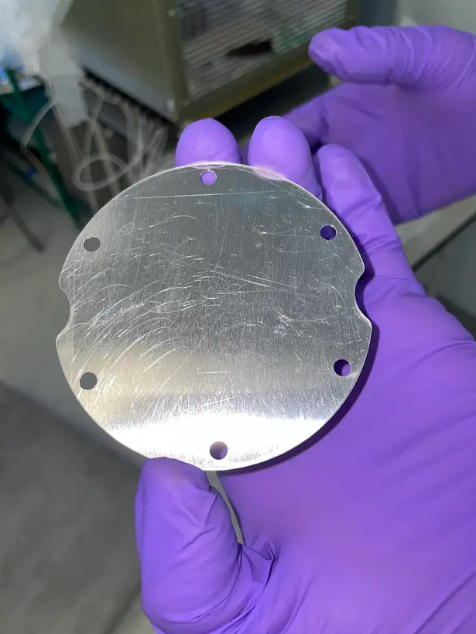
Scuffed side of metal window went to the outside of the detector

Slide 7
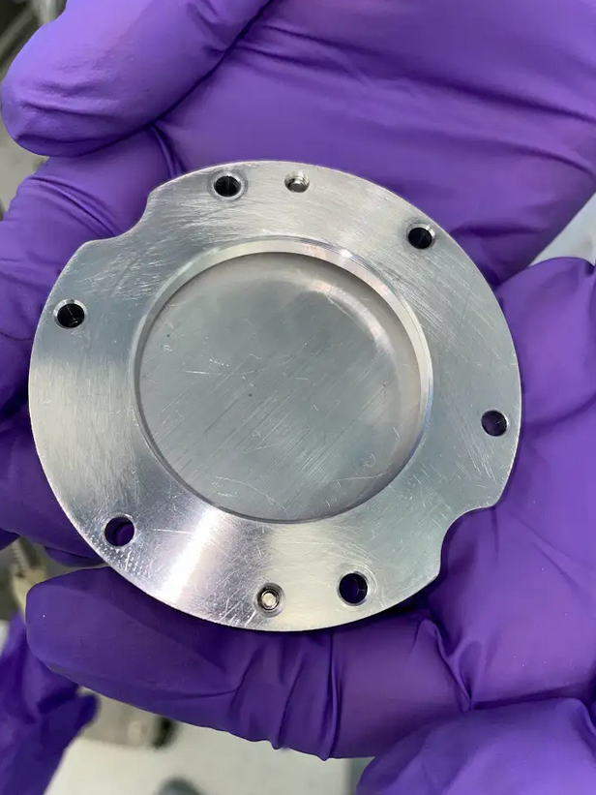
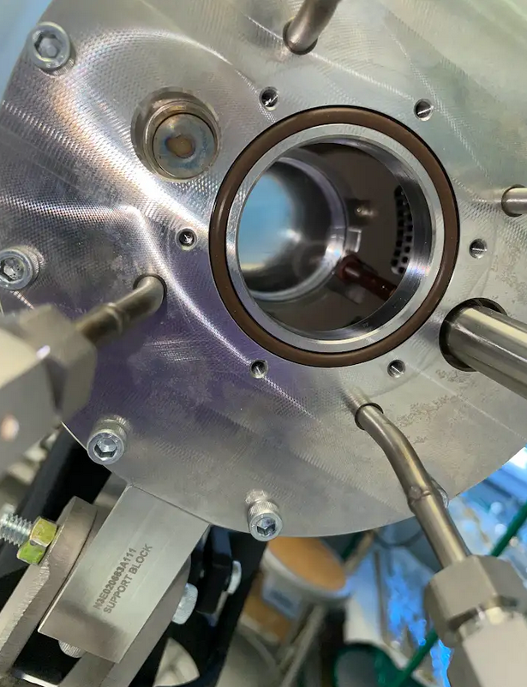
Scuffed side of metal window went to the outside of the detector

Slide 8
Hardware for new valve
https://products.swagelok.com/en/c/straights/p/SS-4-WVCR-6-DF
Pending quote from procurement
We plan on adding this new valve to the diagnostics line, and setting it at a standard flow rate. That way, we can use the already installed valve in the GHS box to turn on and off the flow, without having to carefully adjust it every time (this is reflected in the updated schematic I made last week)

Slide 9
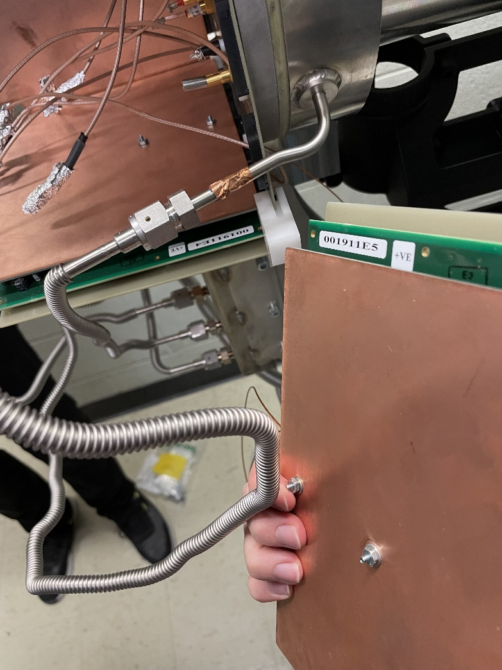
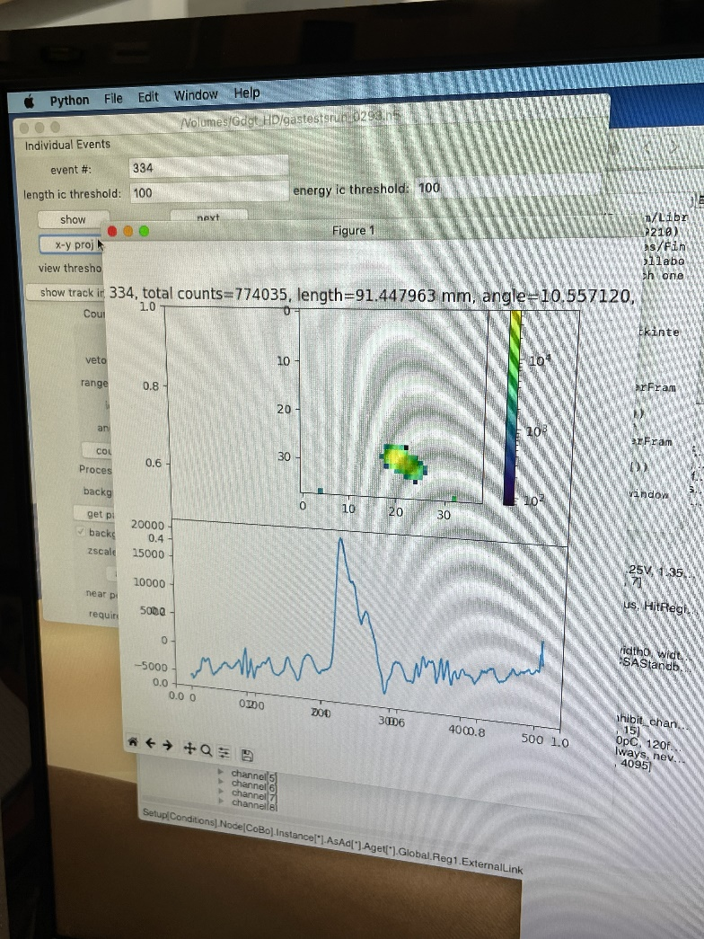
Tuesday we reattached electrical connections after pumping overnight: We see tracks!

Slide 10
Next Up:
Get HA doc fully squared away so that we can operate at higher pressure
Finish grounding and sort the clean/dirty power situation
Clean up the room, so we know what we have (spare parts, tools, etc.)
Buy extra o-ring and union for adding valve and operating at higher pressure

Slide 11
https://products.swagelok.com/en/c/low-pressure-relief-valve/p/SS-RL3M4-F4

