Slide 1
e24joe

Slide 2
06/03/2024
New Denisov Paper: https://journals.aps.org/prc/accepted/3e07ePb0E211f9046999039045ee03ba8664a9f1b
²¹²Po alpha decay: https://doi.org/10.1016/j.apradiso.2023.110953
²¹⁶Bi Gammas: https://journals.aps.org/prc/abstract/10.1103/PhysRevC.109.064321
We adjusted the threshold for the south Ge because it was triggering on noise (10 kHz event rate)
We also version controlled the XIA config files so we have a change log of the DDAS parameters
We measured the xyz of the Ge detectors, and took a few calibration runs with 152Eu in different places on the outside of the TPC
We think the ‘mystery blob’ has real events from 212Bi

Slide 3
152Eu Ge calibration runs
Once we placed the Ge in the spots they will remain, we took 5 calibration runs:
Run 801: Source on top of TPC, 2.7 cm from MM rim
Run 802: Source on top of TPC, 13 cm from MM rim
Run 803: Source on top of TPC, 40 cm from MM rim
Run 804: Source on side of TPC, across from North
Run 805: Source on side of TPC, across from South

Slide 4
Germanium Detectors’ XYZ
South:
31.33 mm from top of TPC to top of Ge
41.69 mm from MM rim on TPC to edge of Ge
07.74 mm from front of Ge to side of TPC
North:
29.88 mm from top of TPC to top of Ge
113.7 mm from MM rim on TPC to edge of Ge
04.23 mm from front of Ge to side of TPC

Slide 5
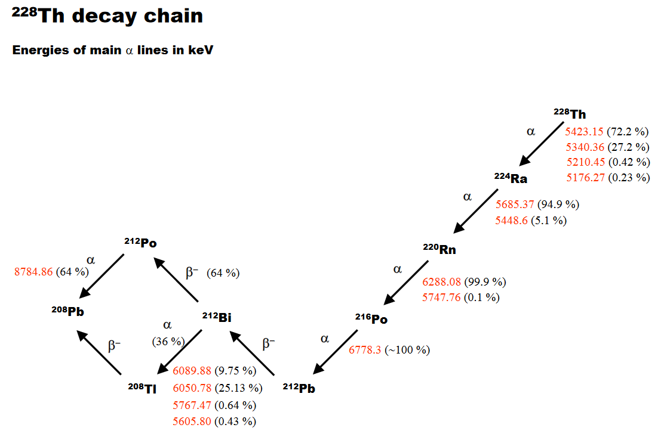
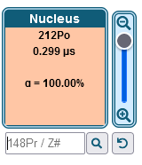
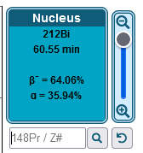
²²⁸Th Decay Chain

Slide 6
Gas Test run 0418 (run on 05/24/24, when gas had been flowing all day)

Slide 7
Gas Test run 0421 (run on 05/29/24 as one of the first runs after not flowing gas for 5 days)

Slide 8
Run 0003

Slide 9
Run 0004

Slide 10
Run 0005

Slide 11
Run 0006

Slide 12
Run 0007

Slide 13
Run 0008

Slide 14
Run 0010

Slide 15
Run 0011

Slide 16
Run 0012

Slide 17
Run 0013

Slide 18
Run 0014

Slide 19
Run 0015

Slide 20
Run 0016

Slide 21
Run 0017

Slide 22
Run 0018 (no ²²⁰Rn flow)

Slide 23
Run 0019 (no ²²⁰Rn flow)

Slide 24
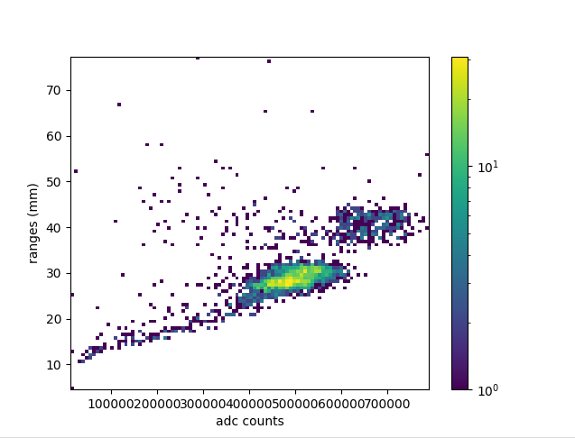
Run 0020 (no ²²⁰Rn flow)

Slide 25
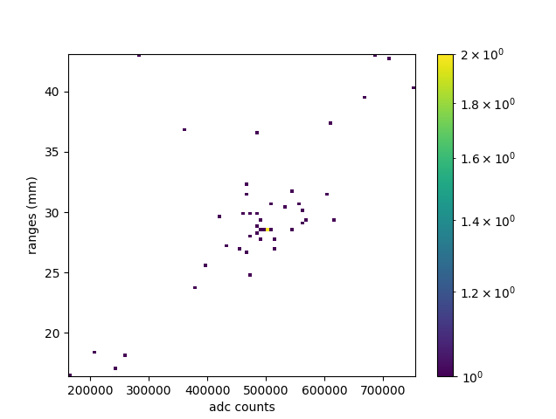
Run 0021 (no ²²⁰Rn flow)

Slide 26
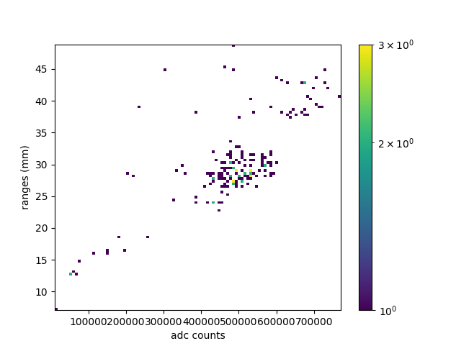
Run 0022 (no ²²⁰Rn flow)

Slide 27
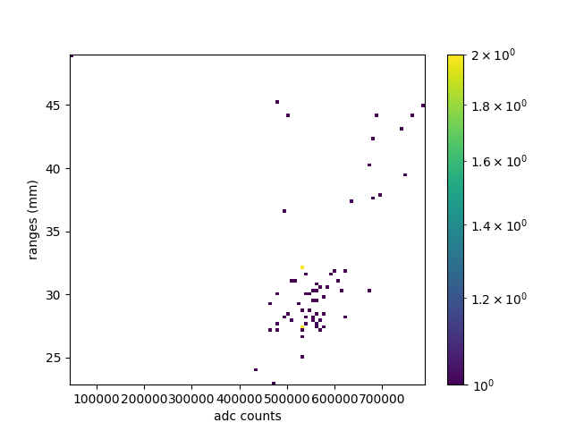
Run 0023 (evacuated upstream)

Slide 28
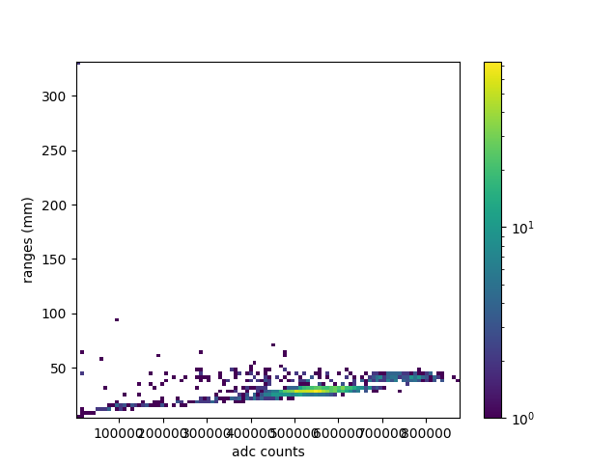
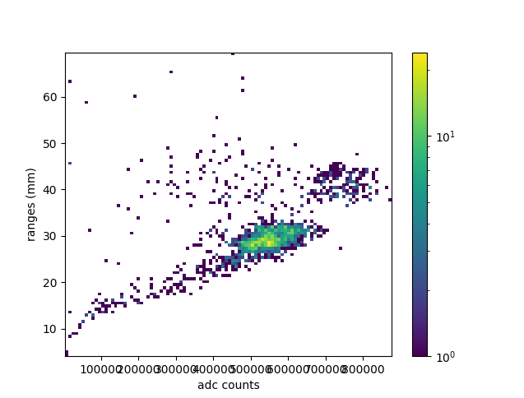
Run 0024 (evacuated upstream)
No range limits
Range limits: 0-80

Slide 29
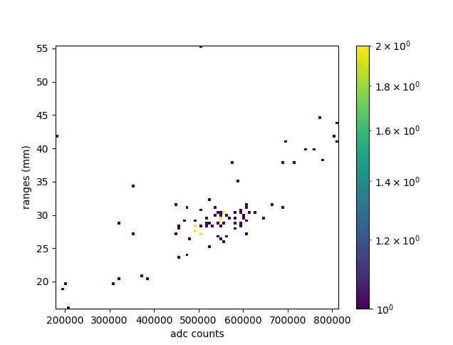
Run 0025 (evacuated upstream)

Slide 30
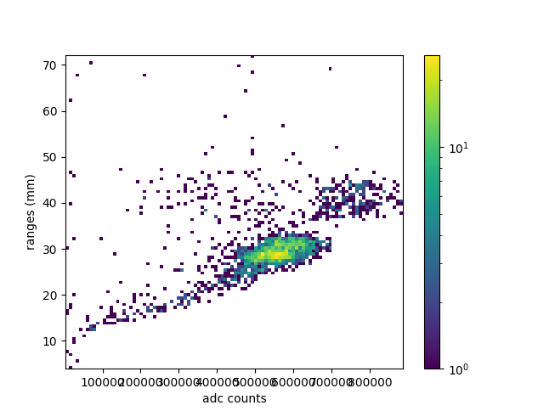
Run 0026 (evacuated upstream)

Slide 31
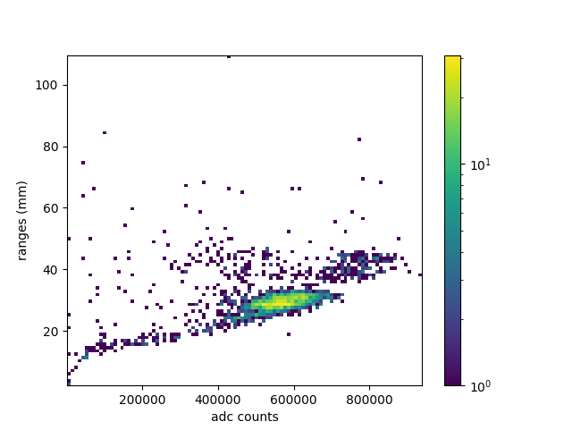
Run 0027 (evacuated upstream)
No range limits
Range limits: 0-80

Slide 32
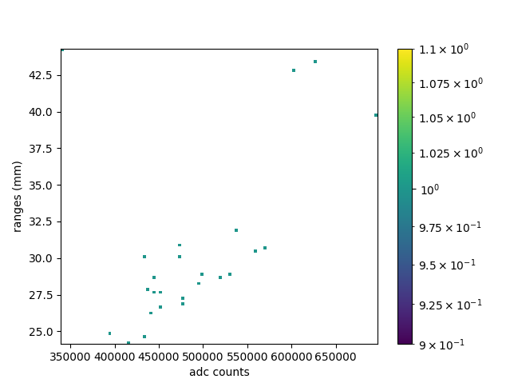
Run 0028 (Source Still Isolated, flow 24 sccm)
Flow 024 sccm: 0.3779 events/sec

Slide 33
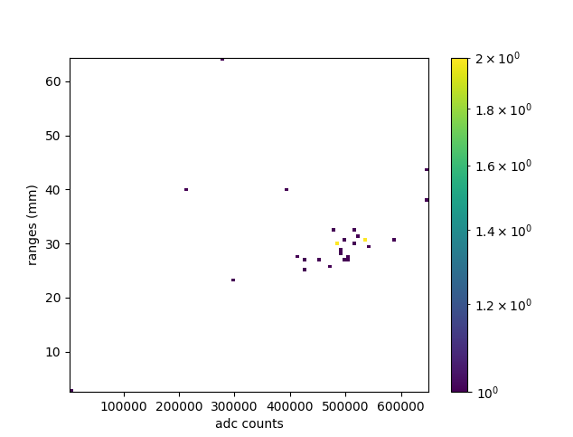
Run 0029 (Source Still Isolated, flow 175 sccm)
Flow 175 sccm: 0.3314 events/sec

Slide 34
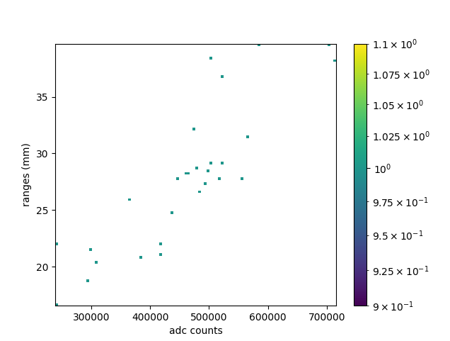
Run 0030 (Source Still Isolated, flow 521 sccm)
Flow 521 sccm: 0.3187 events/sec

Slide 35
Run 1

Slide 36
Run 2

Slide 37
Run 3

Slide 38
Run 4

Slide 39
Run 5

Slide 40
Run 6

Slide 41
Run 7

Slide 42
Run 8

Slide 43
Run 9

Slide 44
Run 10

Slide 45
Run 11

Slide 46
Run 12

Slide 47
Run 13

Slide 48
Run 14

Slide 49
Run 15

Slide 50
Run 16

Slide 51
Run 17

Slide 52
Run 31

Slide 53
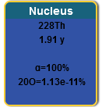
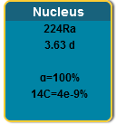
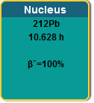
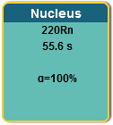
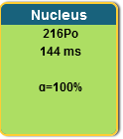
²²⁸Th Decay Chain

Slide 54
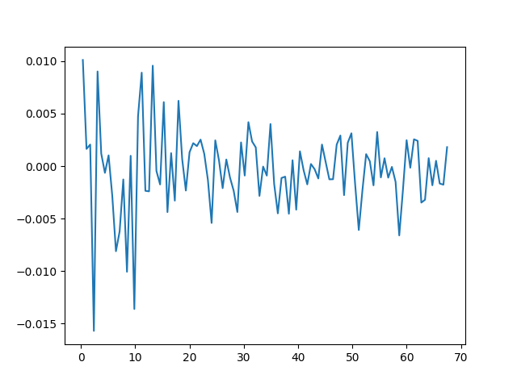
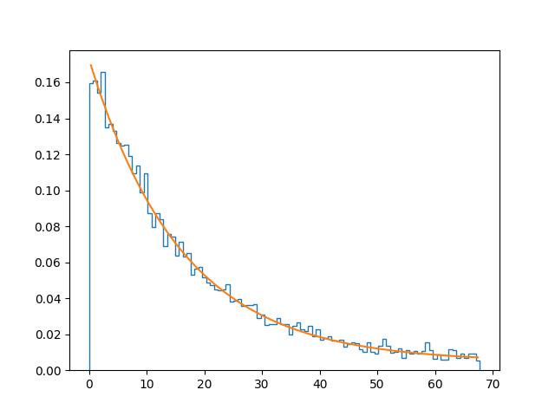
2024/06/10

Slide 55
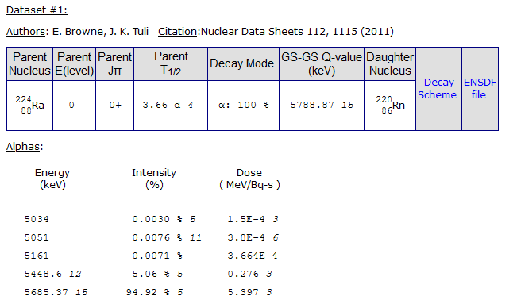
²⁴¹Am and ²²⁴Ra Decays
²⁴¹Am Decays to ²³⁷Np, which has a 2.1 million year half-life
²⁴¹Am has x-rays at 13.9 and 59.54 keV
²²⁴Ra has a 241 keV gamma with an intensity of 4% (which we do see in the Ge spectrum)
²²⁸Th has gamma 132 keV, 166 keV, 216 keV w/ intensity: 0.127%, 0.101%, and 0.25%

Slide 56
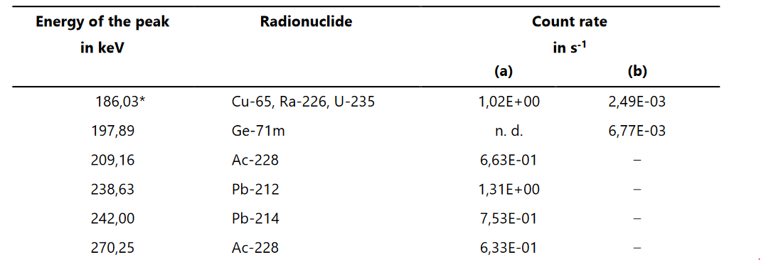
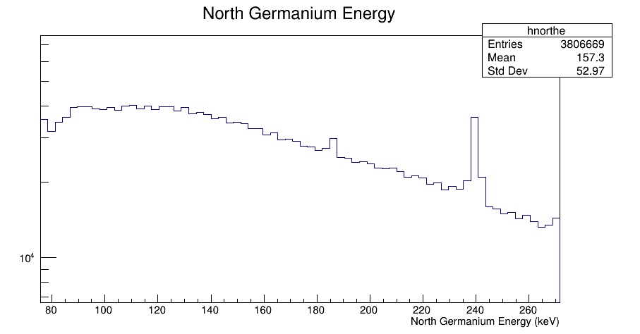
Evidence of ²²⁴Ra? (most likely Lead-212 or Lead-214)

Slide 57
Look at Mesh and Ge timing spectra (run 0017)

Slide 58
2D Hist with Mesh Spectrum and Gamma data (Run 0017)

Slide 59
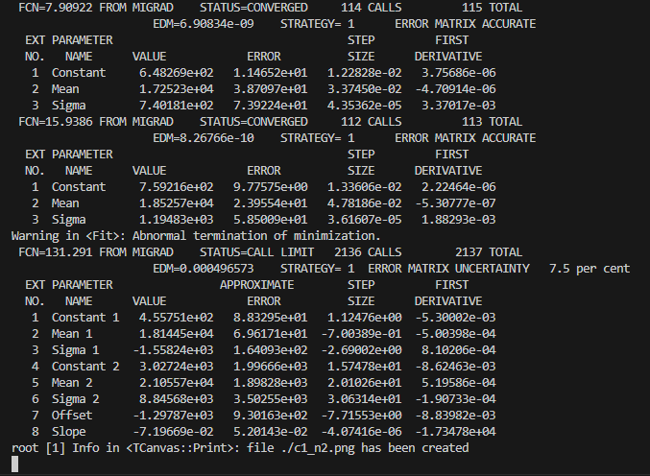
Mesh Energy Spectrum and fit (Run 0017) XIA

Slide 60
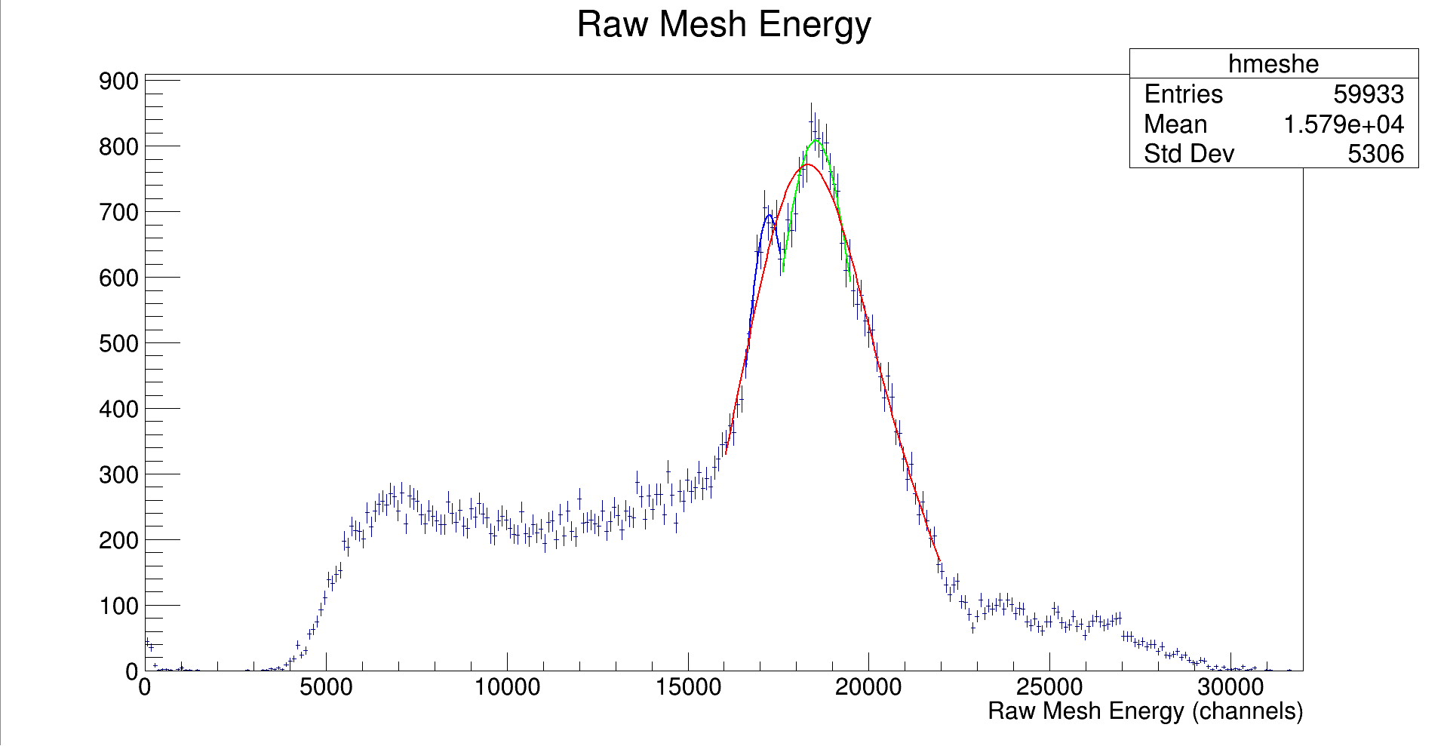
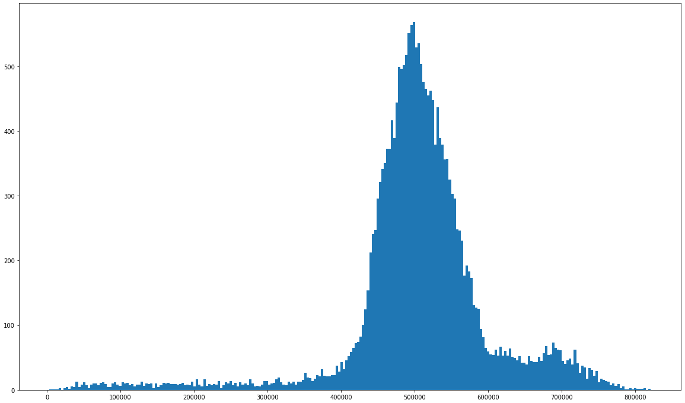
Mesh Energy Spectrum and fit (Run 0017) GET

Slide 61
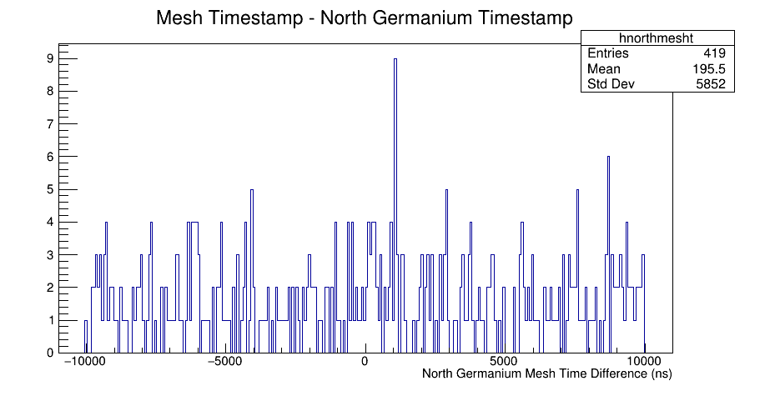
2024/06/13 THURSDAY
Sum from -10,000 ns to 15 ns: 197
Sum from 15 ns to 10,000 ns: 222

Slide 62
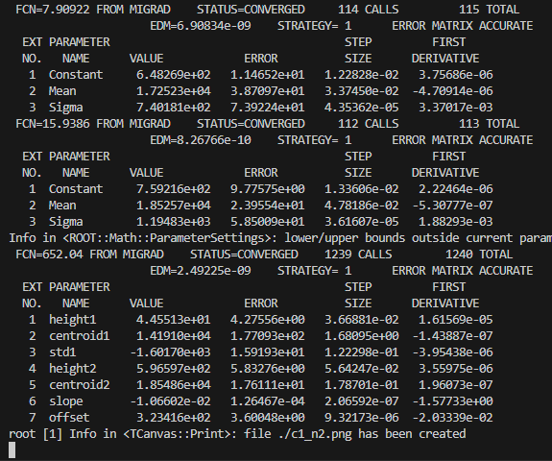
Fit Mesh with constrained FWHM

Slide 63
Increased Flow Rate Tests, source is still bypassed, we are just looking at ‘bg’ (runs 27-30)
Flow 000 sccm: 0.3794 events/sec
Flow 024 sccm: 0.3779 events/sec
Flow 175 sccm: 0.3314 events/sec
Flow 521 sccm: 0.3187 events/sec
Alex and I think that this could be explained by flowing gas in the opposite direction for a while. ²²⁸Th decays in that space after the cathode, and when the ²²⁰Rn is produced, the higher flow rate carries more of it away
Slightly inconsistent with wall effect changes from runs 16-19 on slides 20-23

Slide 64
Wall Effect Mystery
When we turn off flow, we see the top line disappear, which suggests to me that these lines are from different decays, not related to location in the chamber where the alpha was created
See runs 16-19 on slides 20-23

Slide 65
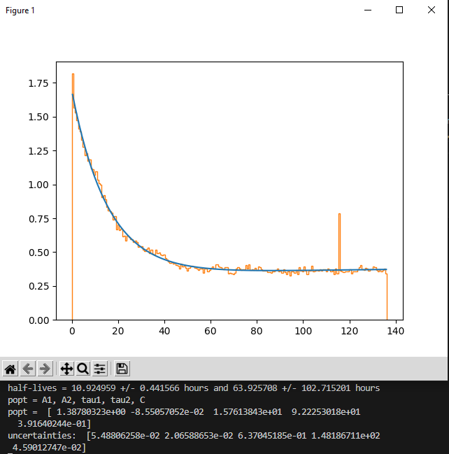
Decay Timestamp plot runs 0018-0030 (fitted with 2 decay curves 10 hours and 3.6 days)
²²⁸Th half-life: 1.8 years
²²⁴Ra half-life: 3.6 days
²²⁰Rn half-life: 55.6 seconds
²¹⁶Po half-life: 144 ms
²¹²Pb half-life: 10.6 hours
Suggests that we are possibly looking at ²²⁸Th

Slide 66
2024/06/17 MONDAY
Runs with no Ge data:

Slide 67
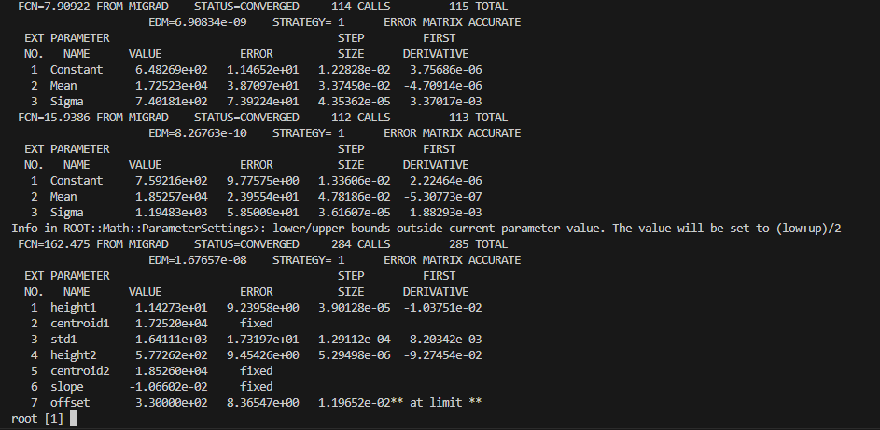
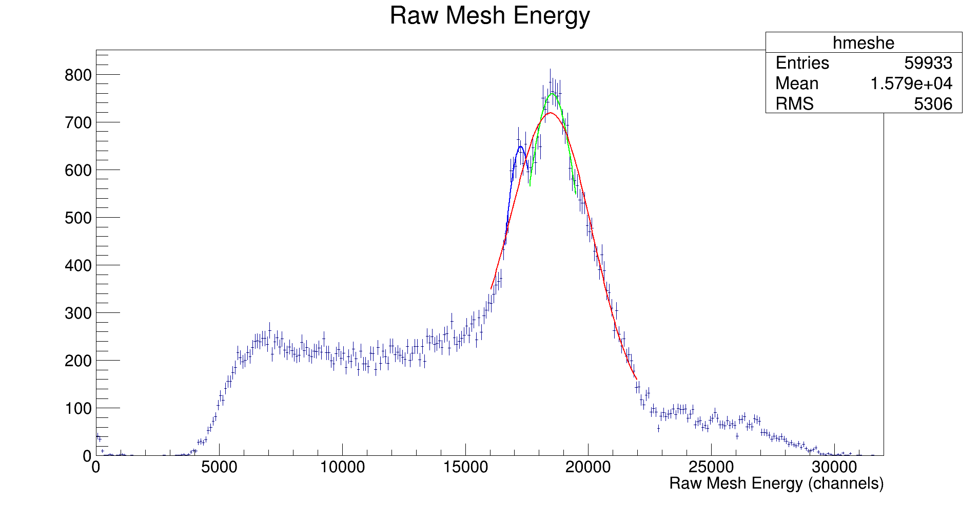
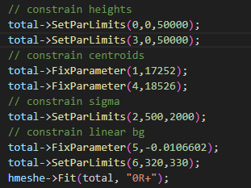
Fit Mesh Spectrum by hand

Slide 68
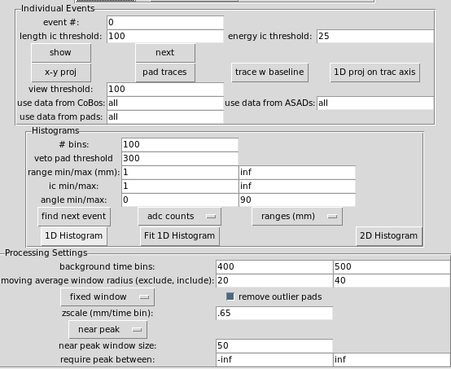
Reprocessed Earlier Runs so they are all using the following settings:
Using the config file: ‘p10_2000torr.gui_ini’
RUN 0006 IS GIVING US ERRORS, SEE SLIDE 11 (on fishtank)
Run 7 is able to be reprocessed on fishtank
Run 8

Slide 69
Some problems processing larger runs
The mac mini has what looks to be 32 GB of ram
Fishtank is a bit more complicated, maybe 12 GB available

Slide 70
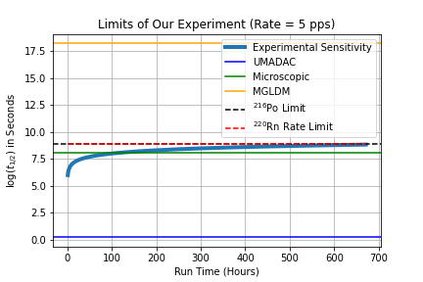
Event estimate
Total events from production runs 1-30: 3.57 million
Conservative estimate would say we have about 1 million alphas from ²²⁰Rn, assuming we get ~2.5 alphas per Radon decay

Slide 71
DNP Abstract
Incorporated Chris’ comments and sent back to him for further revision

Slide 72
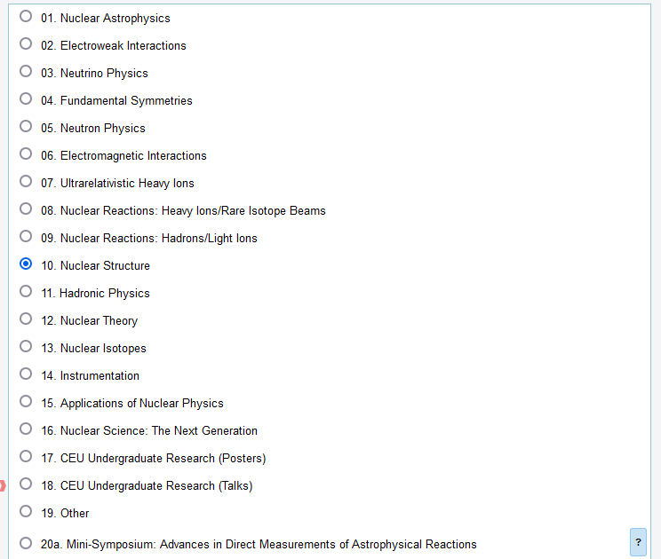
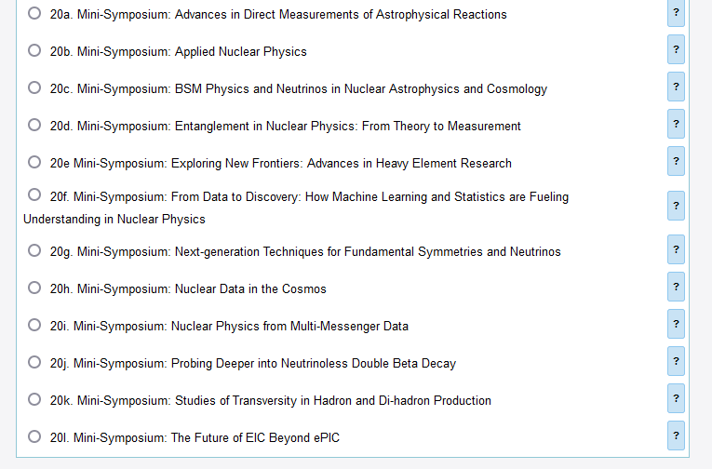
DNP Meeting Categories:

Slide 73
2024/06/24 MONDAY
Combined production runs to produce RvE Histogram

Slide 74
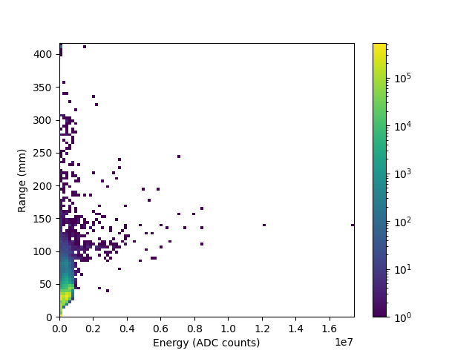
RvE for production runs 1-31 (no veto) early runs with bad gain included
Total number of events: 3,375,536

Slide 75
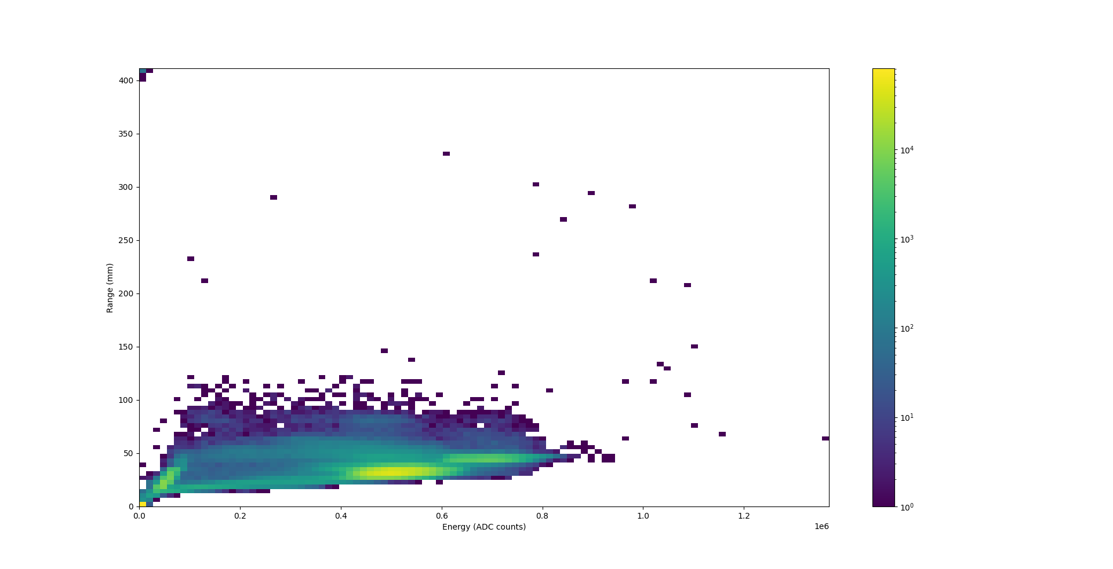
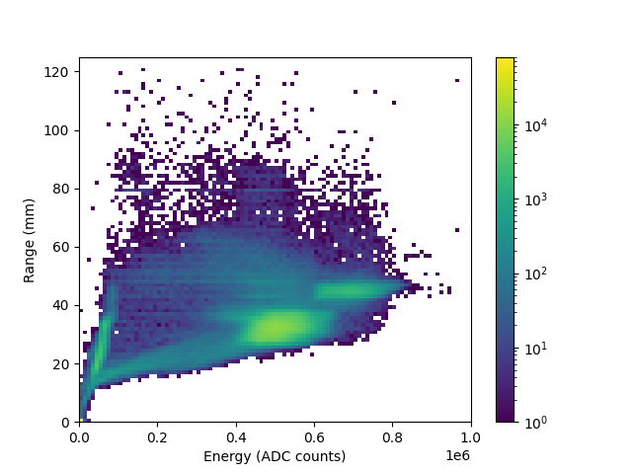
RvE for production runs 1-31 (vetoed on >150) early runs with bad gain included
Total number of events: 1,045,905

Slide 76
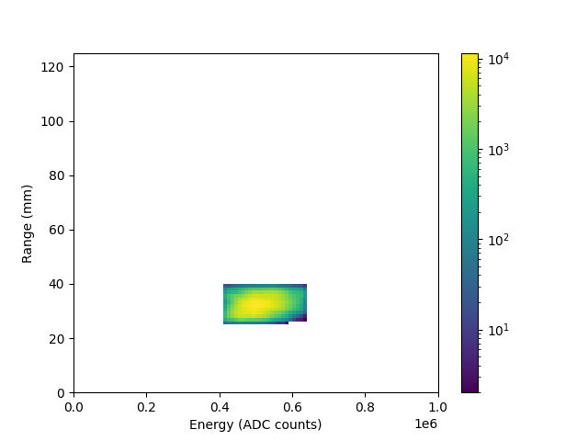
RvE with cut on 6 MeV & 150 veto condition
This is 170 hours of data (a little over a week)
We have 737495 events in the 6 MeV blob
Worst case scenario we got 312498 events in that time frame (assuming the Po and Bi alphas have the save efficiency as the Ra alphas)
This means we have a ²²⁰Rn decay rate of 1740 per hour, or ~0.48 per second (as a lower bound)
Does this mean we can increase the flow rate? We based our current flow rate on the fact that our GET DAQ is collecting 5 events per second, which of course has no veto condition

Slide 77
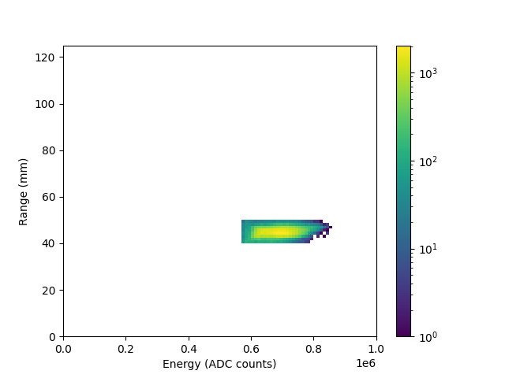
RvE with cut on 8 MeV & 150 veto condition
Total non-vetoed events in the 8 MeV blob: 75233

Slide 78
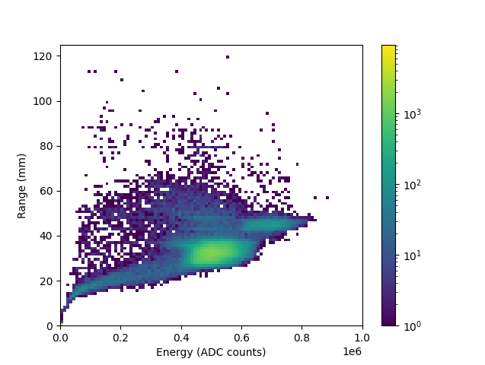
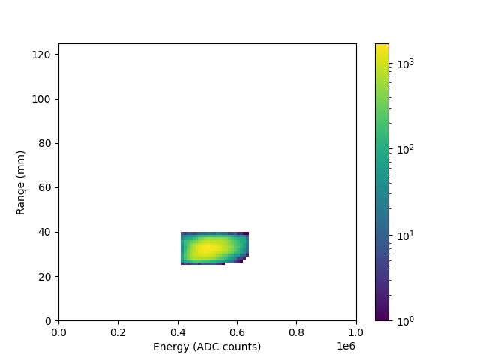
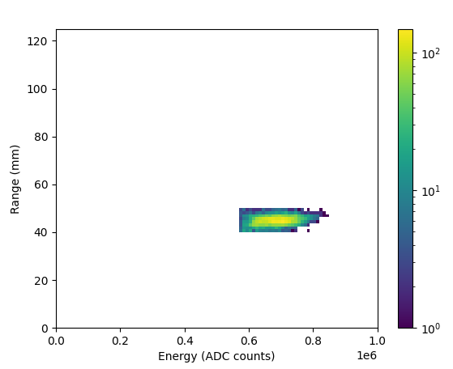
Run 31 was the first run we introduced the source after a week of isolation
Events in the 8 MeV: 5804
Events in the 6 MeV: 102833
6-8 Ratio in run 31: 17.718
6-8 Ratio in production runs 1-31: 9.8028

Slide 79
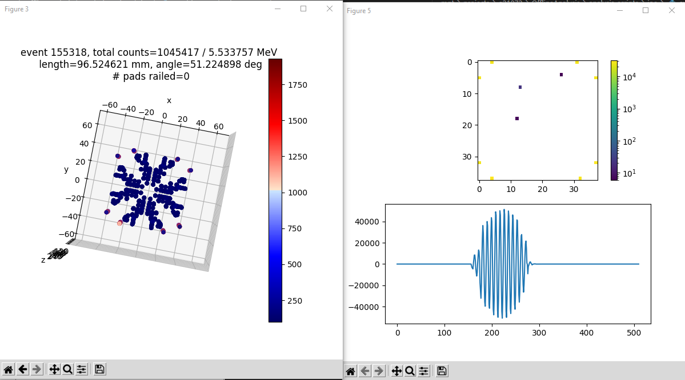
Run 1 Event 155318 (crosstalk between vetos and adjacent pads)

Slide 80
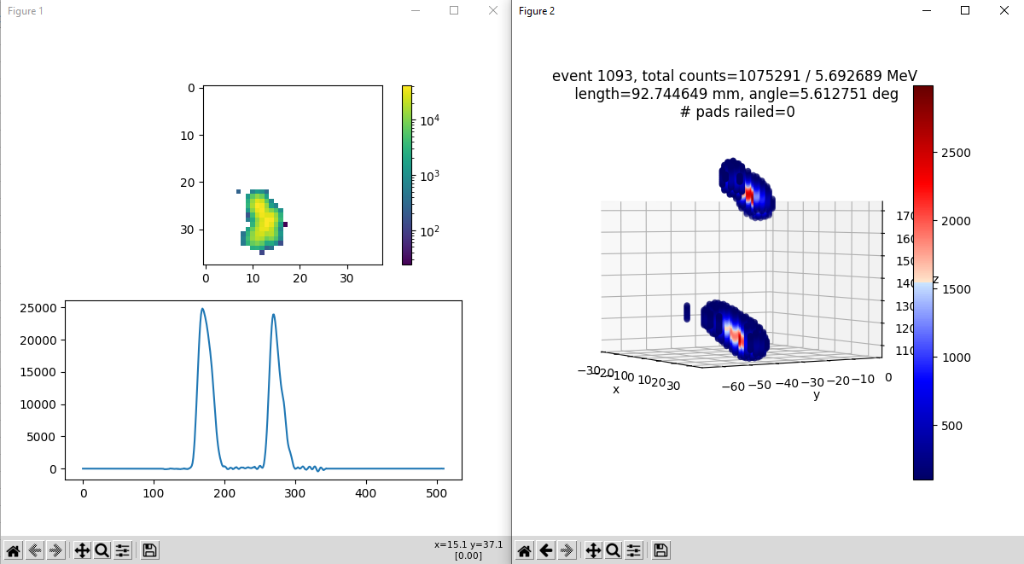
Run 3 Event 1093

Slide 81
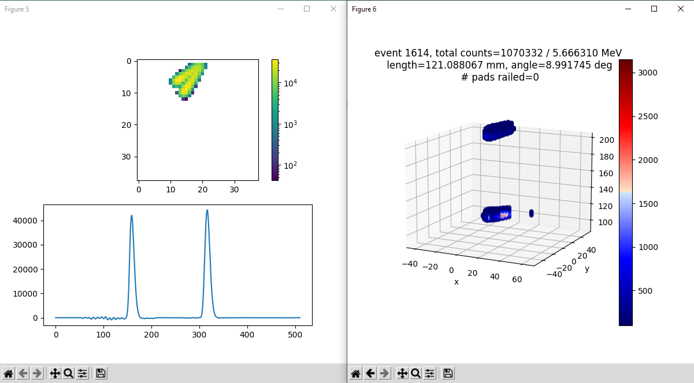
Run 3 Event 1614

Slide 82
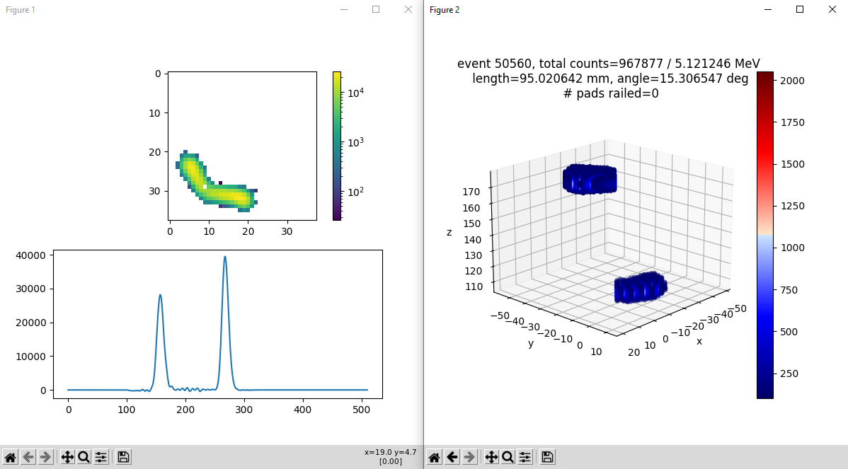
Run 5 Event 50650

Slide 83
Run 5 Event 85566

Slide 84
Run 5 Event 103991

Slide 85
Run 5 Event 110804

Slide 86
Run 5 Event 113758

Slide 87
Run 5 Event 162886

Slide 88
Run 5 Event 245601

Slide 89
Run 5 Event 295365

Slide 90
Run 5 Event 324309

Slide 91
Run 5 Event 326950

Slide 92
Run 7 Event 65771

Slide 93
Run 7 Event 90308

Slide 94
Run 8 Event 165420

Slide 95
Run 8 Event 261100

Slide 96
Run 10 Event 160001 (Double Alpha?)

Slide 97
Run 10 Event 258053

Slide 98
Run 12 Event 176748

Slide 99
Run 14 Event 23030

Slide 100
Run 14 Event 53275

Slide 101
Run 14 Event 71891 (?)

Slide 102
Run 14 Event 247782 (accidental coin?)

Slide 103
Run 15 Event 137612 (scatter?)

Slide 104
Run 16 Event 110785

Slide 105
Run 16 Event 152872

Slide 106
Run 31 Event 63736

Slide 107
Run 31 Event 193219

Slide 108
Run 31 Event 213088

Slide 109
I want to confirm the back half of the decay chain is mainly decaying on the cathode

Slide 110
Same plot as previous slide with veto condition enabled

Slide 111
Plotted Angular distribution weighted by 1/sin(theta)

Slide 112
2024/06/27 THURSDAY
Gated Range spectrum on 6 MeV blob
Efficiency Sims for ²²⁰Rn uniform dist, ²¹⁶Po & ²¹²Po on cathode, and double alpha

Slide 113
Cut on 6 MeV blob and looked at range projection to see if we can distinguish peaks

Slide 114
ATTPCROOT Efficiency Sim to determine ratio of detected events
When I set the decays to occur only on the cathode, I get an efficiency of 37% (this is for uniform dist., beam dist. gives an efficiency of 98%)
This means that we probably are not simulating alphas that run into the border
In the calculate efficiency script, I add the number of vetoed events and the number of events with 0 hits on the pads to get total ‘missed events’. For 1,000 simulated ²¹²Po events, we get:
542 0 hits (likely decayed into the cathode)
340 vetoed events
8.784 MeV ²¹²Po alpha efficiency on the cathode of: 11.8%
For 6.7783 MeV ²¹⁶Po on the cathode:
541 0 hits
300 vetoed events
6.7783 MeV ²¹⁶Po alpha efficiency on the cathode of: 15.9%
For 6.288 MeV ²²⁰Rn uniformly distributed:
87 0 hits
636 vetoed events
6.288 MeV ²²⁰Rn alpha efficiency on the cathode of: 27.7%
For double alpha uniform dist. (upper limit because we are including partial cathode events hits > 0):
22 0 hits
866 vetoed events
6.288 MeV ²²⁰Rn alpha efficiency on the cathode of: 11.2%

Slide 115
Using PCA to extract ranges (run_0017)

Slide 116
Data Estimate (up to run 46)
All events (no veto condition)
Total non-vetoed events: 2,995,764
Events in 8 MeV peak: 227,845
Events in 6 MeV peak: 2,235,169
Estimated ²²⁰Rn decays detected (using 6 MeV peak and assuming everything but ²²⁰Rn decay on the cathode in a uniform dist.): 1,255,960
Zhao predicts a BR of 10^{-6.4}, so to get 1 double alpha events, we need to decay 2.51 million ²²⁰Rn.
To get 10 non-vetoed double alpha decays to occur (taking into account their efficiency compared to a single alpha ²²⁰Rn decay) we need 60 million ²²⁰Rn alpha decays. At our current rate, that would require to run for 66 weeks
We probably want a higher event rate to complete this experiment
We do not want to go above 30 non-vetoed events per second, as that is when our rate limiting bg is on the same order of magnitude as the BR predicted by Zhao
Flow rate -> Event rate
174 sccm gives 5 events/sec (vetoed + nonvetoed)
244 sccm gives 14 events/sec (vetoed + nonvetoed)
324 sccm gives 25 events/sec (vetoed + nonvetoed)
Non-vetoed events (veto<150)

Slide 117
Processing Run 49 gave this message, but seemed to complete the processing

Slide 122
Gain matching GET energy spectra on a sub run basis

Slide 123
Tchain gamma data together to look for alpha-gamma events

Slide 124
Looking for ²³²U in the gamma data

Slide 125
Python GUI graphical cut

Slide 126
Testing attpc merger with evt and graw files

Slide 127
Convection/Diffusion Model for Radon distribution in the TPC active area

Slide 128
FYI Slides

Slide 129
CHANGING GAS PRESSURE running ATTPCROOT
For some reason, running the GADGET_II.root macro does not properly replace the two files in the geometry directory required to properly adjust the gas pressure, so I run the following commands to properly adjust the pressure
/mnt/simulations/pxct/joe/gadget/ATTPCROOTv2/macro/Simulation/GADGET$ root -q ../../../geometry/GADGET_II.C; cp GADGET_II.root ../../../geometry/; cp GADGET_II_geomanager.root ../../../geometry/; cd ../../../build/; make; cd ../macro/Simulation/GADGET/; root -q Mg20_test_sim_pag.C; root -q rundigi_sim_Ari.C;

Slide 130
Evt to root files

Slide 131
Chain loading root files
In /mnt/analysis/e21010/sun
analysis_chain_sorted_e21010.C
analysis_chain_unpacked_e21010.C
These two look very similar to me. One is for their raw root; one is for their calibrated root, I think.
I looked at the cal.root file size; simply hadd all runs should be fine.

Slide 132
Checking energy resolution at higher pressure with Michael Roosa’s code
Located in /mnt/simulations/proton_detector/michael

Slide 133
Argonne Cf source
²⁵²Cf -> α + ²⁴⁸Cm -> α + ²⁴⁴Pu -> α + ²⁴⁰U -> β + ²⁴⁰Np -> β + ²⁴⁰Pu -> α + ²³⁶U -> α + ²³²Th -> α + ²²⁸Ra -> β + ²²⁸Ac -> β + ²²⁸Th

