Slide 1
Conceptual Design and Simulation of a Proton Detector for studying low-energy resonances relevant in thermonuclear reactions
David Perez-Loureiro
NSCL, Michigan State University
Collaborators: C. Wrede, E. Pollacco and the AstroBox collaboration

Slide 2
Outline
Motivation
Conceptual Design
MicroMEGAS Detectors
Detector Simulations
Summary and Outlook

Slide 3
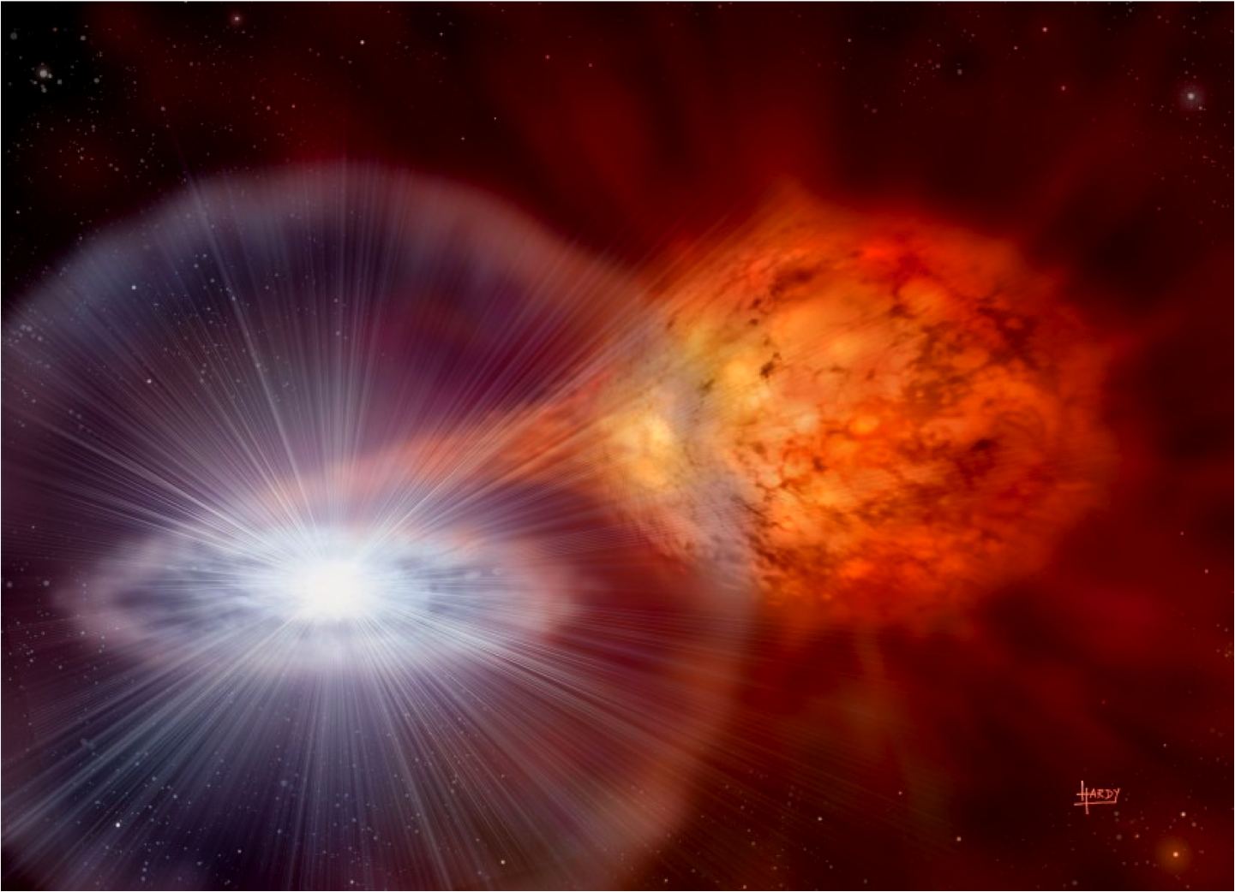
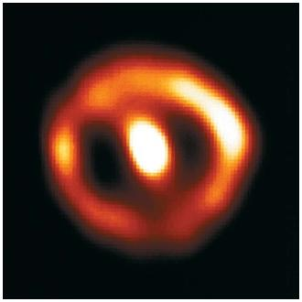
Motivation
White dwarf (Novae) or neutron star (type I X-ray burster) accreting H from binary companion
Temperature increases without expansion
Hot CNO cycle ignites thermonuclear runaway at surface
Temperatures up to 0.4 GK (Novae) and 2 GK (type I X-ray burst)
Credit: David A. Hardy/http://www.astroart.org & PPARC
Nova Cygni 1992 (in 1994) NASA, ESA, HST
Notes:
X-ray bursters are explosions on the surface of neutron stars which accrete material from a companion star in a stellar binary system. They are characterised by intense short-lived bursts of X-rays. A key question about such explosions is the trigger for the break-out from the hot-CNO cycle into the rp-process.
There are a number of reactions of interest in terms of the break-out from the hot-CNO cycle. These include ¹⁵O(α,γ), ¹⁴O(α,p) and ¹⁸Ne(α,p). Ideally, we would study these reactions directly and obtain astrophysical reaction rates for them for the complete temperature regime of interest. In practice, this is extremely challenging as each of the nuclei are short-lived radioactive species. Such nuclei can be produced as accelerated radioactive beams at facilities such as Oak Ridge National Laboratory in the US, REX-ISOLDE in CERN, ISAC in Vancouver and CRIB in Japan. It has not been possible, however, to obtain these beams with sufficient intensity to make direct measurements with a useful precision, or at energies corresponding to sufficiently low temperatures.

Slide 4
Nucleosynthesis
Proton captures and β-decays
Nucleosynthesis in novae and X-ray bursts depends on thermonuclear reaction rates
¹⁵O(α,γ)¹⁹Ne is one of the two routes to break out CNO cycles and trigger rp-process in X-ray bursts
³⁰P(p,γ)³¹S reaction is a potential bottleneck for rp-process in ONe novae (t_{1/2}=2.5 min)
Dominated by resonant capture
Can’t be measured directly because of low intensities available
Indirect methods
Mg (12)
Na (11)
13
14
Proton Number
Ne (10)
F (9)
11
12
O (8)
N (7)
9
10
HOT CNO cycle
C (6)
¹⁵O(α,γ)¹⁹Ne
3
4
5
6
7
8
3α process
Neutron Number

Slide 5
Indirect measurements
β-delayed particle and γ emission
Excited stated of the nucleus of interest populated in beta-decay of precursor
Need to measure E_{r},Γ_{γ},Γ_{p} and J_{r}
X
β
E
p
γ
Z+p
Y

Slide 6
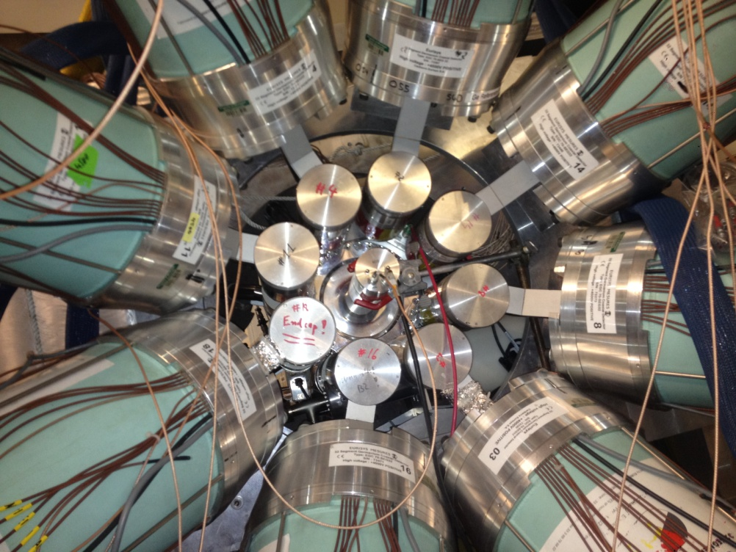
Detector requirements
Ability to detect β-delayed ps and as αs low in energy as possible with high efficiencies because Γ_{particle} << Γ_{γ} at low energies due to Coulomb and centrifugal barriers
Beta energy deposition: can cause background and summing
Need to distinguish β-p from β-p-γ
Multi-charged-particle emission
Want detector chamber to fit inside cylindrically-symmetric SeGA array, which has an inner diameter of 18cm
Want sensitivity to protons and alphas below 200 keV (ideally beta background stops at 150 keV)
SeGA
³¹Cl β-delayed gamma emission measured at NSCL (analysis ongoing)
²⁰Mg β decay experiment accepted by PAC to investigate ¹⁵O(α,γ)¹⁹Ne

Slide 7
MicroMEGAS Detectors
ν_{e}
Drift Region
Particles ionize the gas along their trajectories
Electrons drift to anode pads under an applied field (~100 V/cm)
Amplification Region
Avalanche multiplication
Signal induced in readout pads
Fast timing, robust, cost effective, good energy resolution
Cathode
HV₁
β
Drift Region
p
10 cm
E₁
100 V/cm
e⁻
e⁻
e⁻
e⁻
e⁻
MicroMesh
HV₂
Amplification Region
100 μm
E₂
50 kV/cm
Readout Pad
Y. Giomataris et al. Nucl. Instr. and Meth. A, 376 (1996), p. 29

Slide 8
AstroBox detector
Similar detector already used at Texas A&M University Cyclotron
Successful operation with ²³Al beam
Same technology based on MGPDs
E. Pollacco et al. Nucl. Instr. and Meth. A, 723 (2013), p. 102

Slide 9
NSCL ProtonDetector Simulation
Based on Geant 4.9.6 and ROOT 5.34
Realistic input distributions based on LISE++ calculations
Different geometries available
Information of the track of all particles inside the gas stored in a ROOT file
http://geant4.web.cern.ch/geant4/
http://root.cern.ch
http://lise.nscl.msu.edu/lise.html

Slide 10
Event generation
Gas Volume
Two step simulations: Implantation+Decay
Initial beam properties calculated with LISE++ and inserted in GEANT
Decay: Initial position distribution from Implantation stage
Radioactive Beam
Implant
Gas Volume
β
p
ν_{e}
Decay

Slide 11
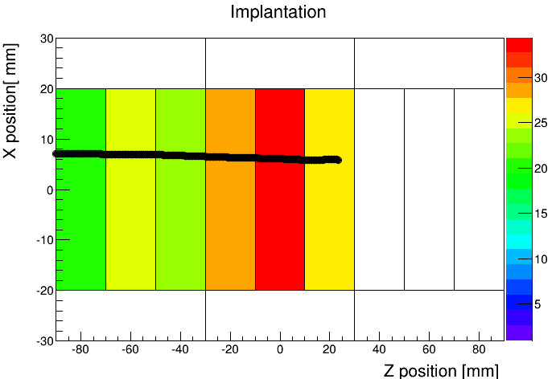
Simulation of drift, amplification and digitization of MPGDs
Calculation of primary electrons from energy deposited at each interaction step with Poisson fluctuation.
Randomization of the final position at the anode according to transversal diffusion coefficients for each of the electrons produced (Charge spread)
Gain fluctuations calculated for each electron using the Polya distribution.
Charge collected on pads is the sum of all the electrons produced.
Charge threshold applied.
(x₁,y₁,z₁,t₁,ΔE₁)

Slide 12
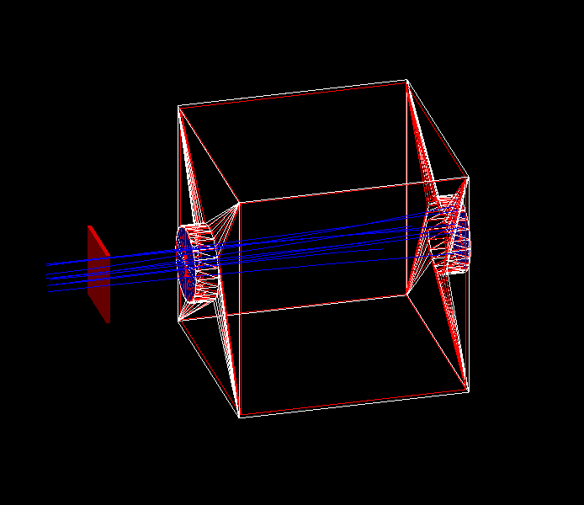
Considered Geometries
Box-shaped detector
120x120x180 mm
X and Y lengths defined to fit inside SeGA ring
Segmented rectangular pad plane (20x40 mm) parallel to the beam axis
Cylindrical detector
∅ 180 mm x 200 mm length
Keeps the symmetry of SeGA array rings
Central pad (∅ 60 mm) + 4 sectors (∅120 mm), perpendicular to the beam axis

Slide 13
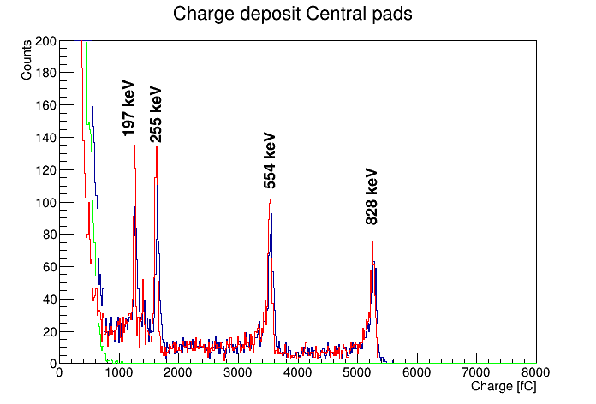
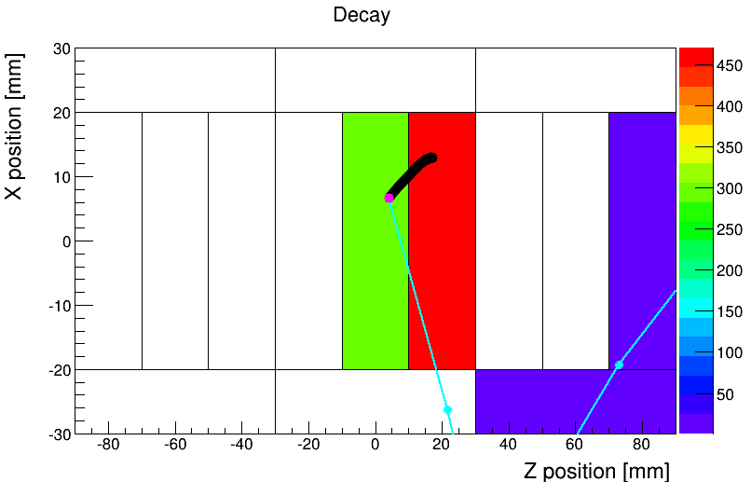
Box Geometry
All
Protons
Betas
p
β
²³Al β-delayed proton emission
Beta contribution lower than 150 keV
Resolution ∼7% FWHM at 200 keV

Slide 14
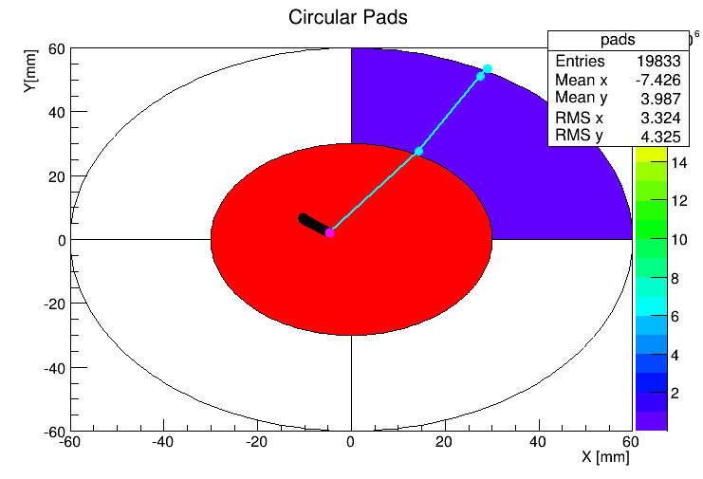
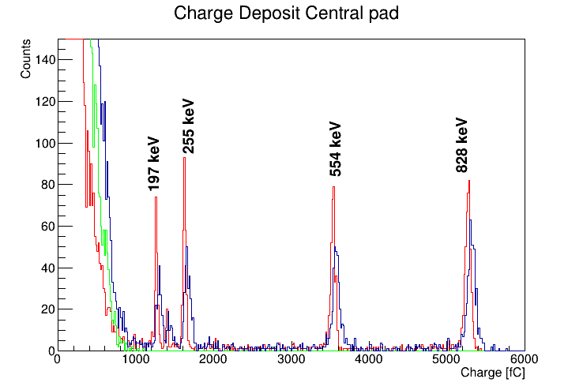
Cylindrical Geometry
β
All
Protons
Betas
p
²³Al β-delayed proton emission
Beta contribution lower than 150 keV
Resolution ∼6.5% FWHM at 200 keV

Slide 15
Summary and Outlook
Simulation operative and running
Beta background as low as 150 keV for both geometries
Next Steps:
Define final geometry by end of summer to order the MicroMEGAS to CERN
Investigate position sensitive pad planes for multi particle emission
Add gamma detectors to simulation
Test with MicroMEGAS prototypes
Commissioning experiment with ²³Al beam

Slide 16
Thank you for your attention!

