Slide 1
Astro-Gamma Electrostatic & Other Calculations
David Perez Loureiro
NSCL/MSU
9th September 2015

Slide 2
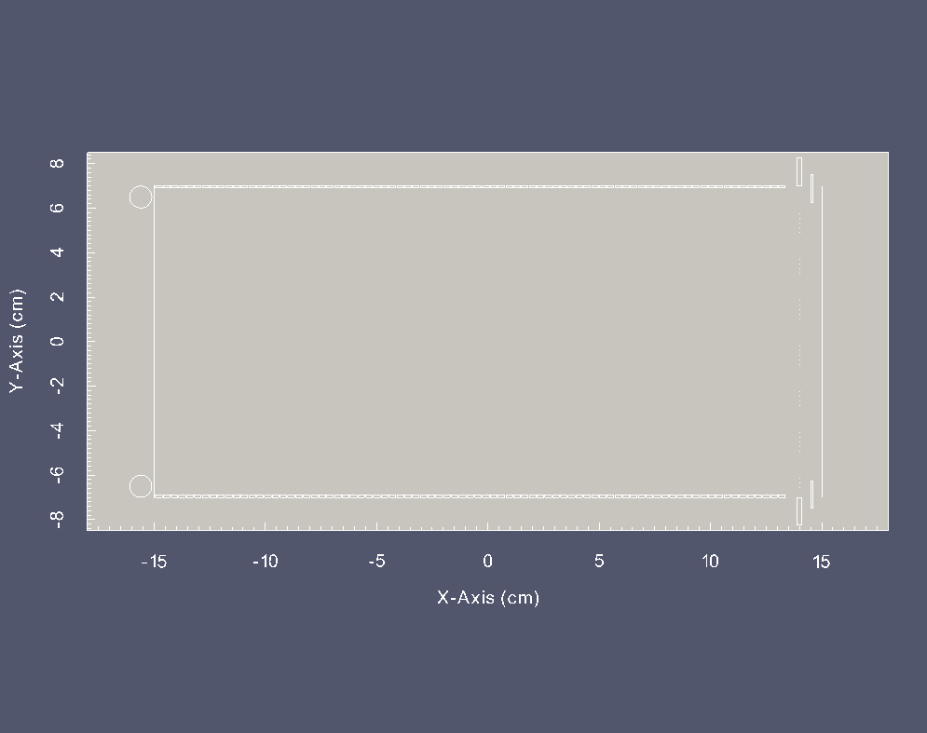
83 equipotential strips
(3mm wide)
0.5 mm gap
Kapton layer (0.3 mm)
1.5cm
Variable Ring
14cm
Gating Grid
Corona Ring 5mm radius
3cm
1cm
Variable ring allows to change the field lines in the region near the mesh placed at 5mm from micromesh

Slide 3
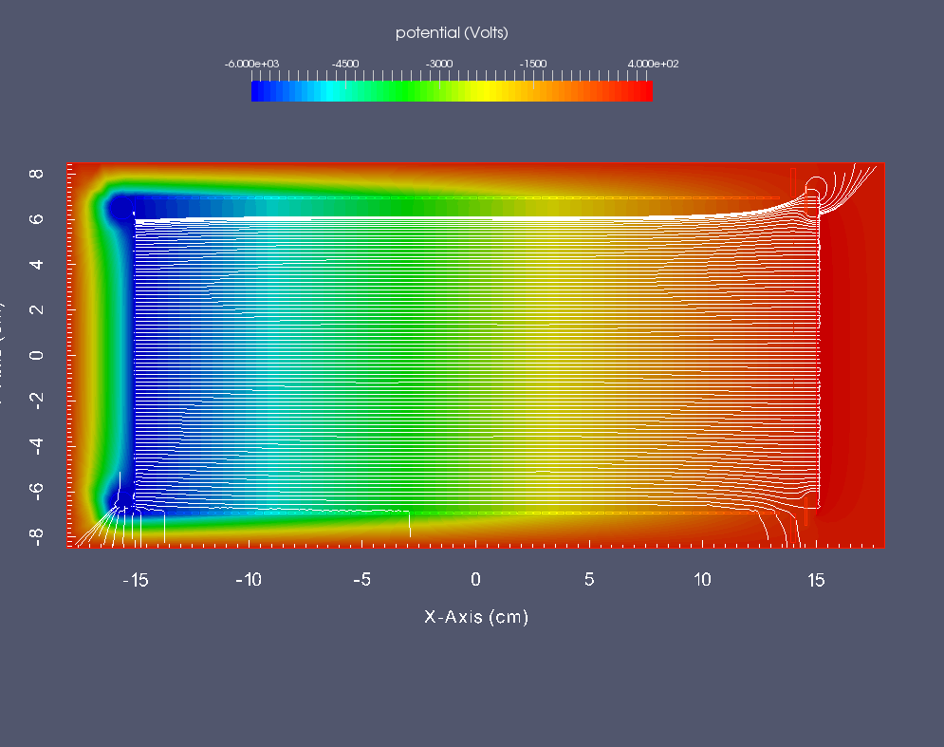
Variable Ring
Set to -160V
Gating Grid off
Field lines

Slide 4
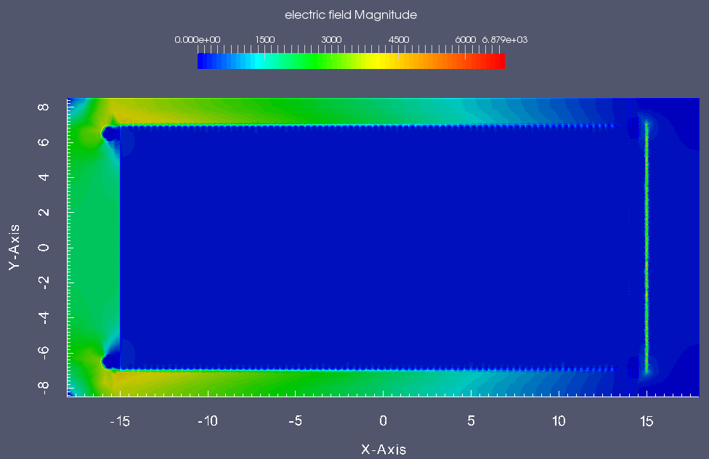
Ar-iso 2.5% 1 atm 1cm
V_{B}= 5981 V
Ar-iso 5% 1 atm 1cm
V_{B}= 7323 V
Ar-iso 10% 1 atm 1cm
V_{B}= 9611 V
Electric field below 5kV/cm. Safe for sparking

Slide 5
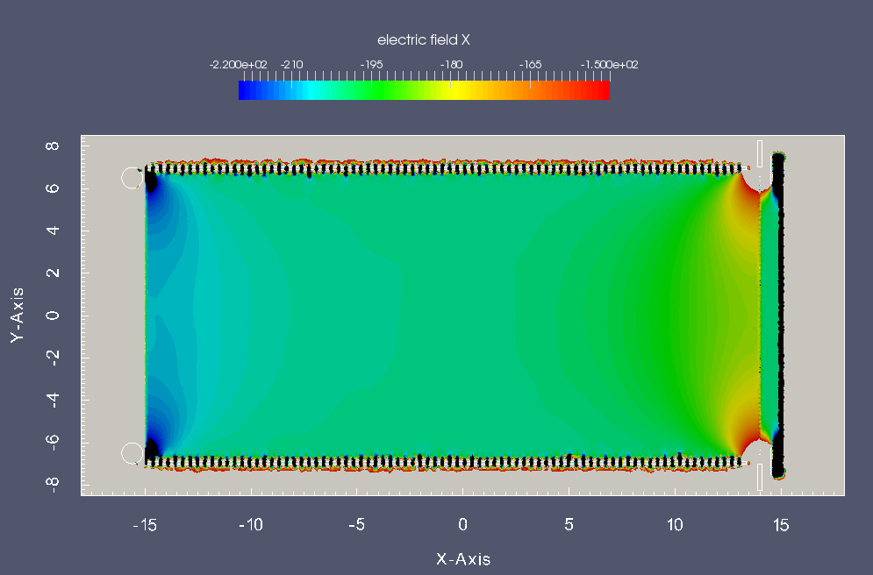
Drift field uniformity

Slide 6
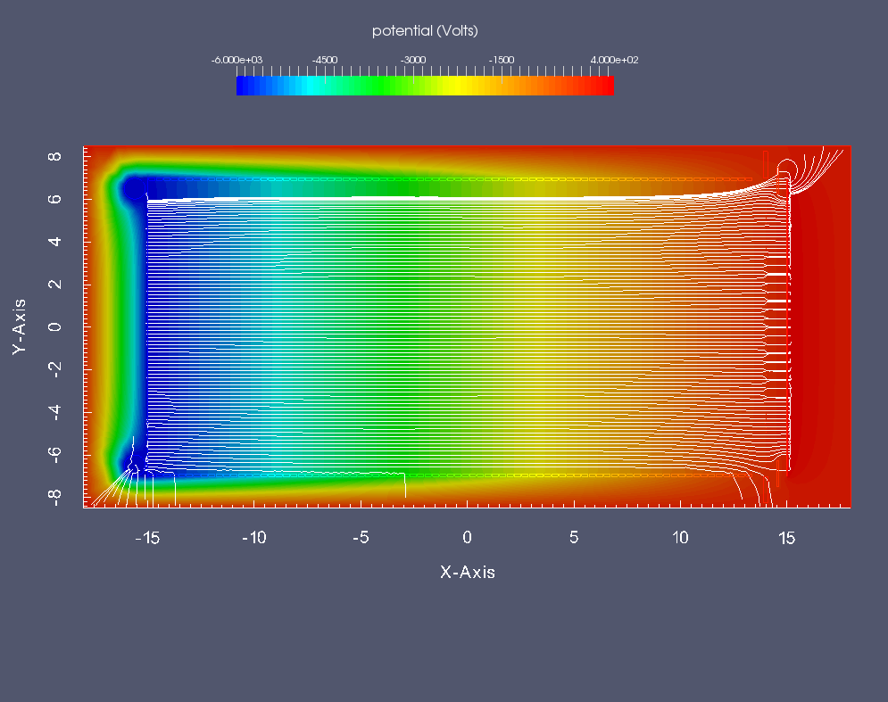
Gating Grid On

Slide 7
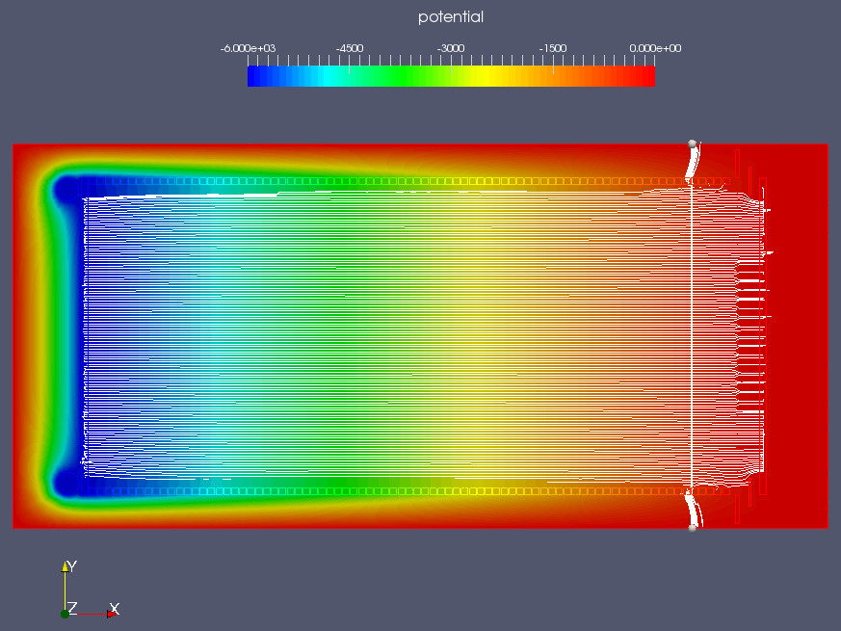

Slide 8
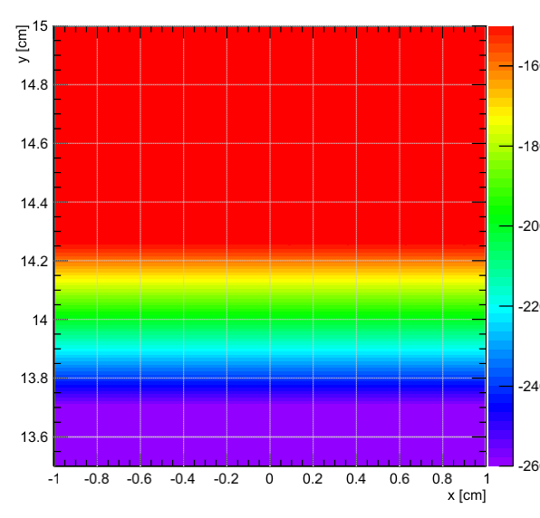
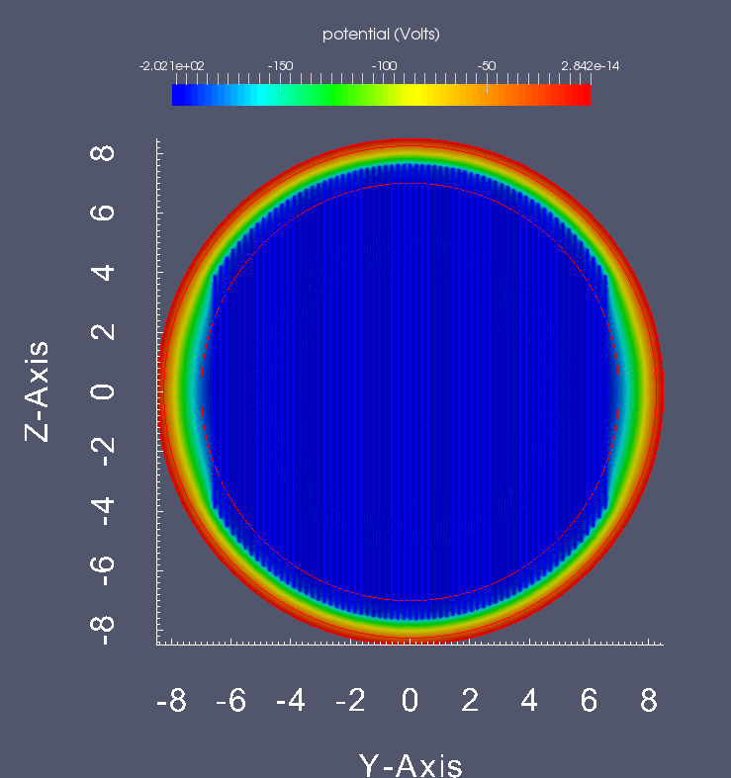
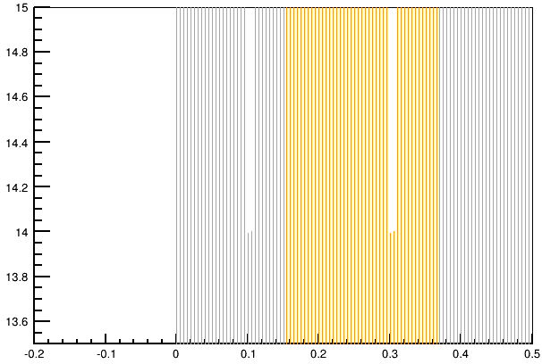
Z [cm]
Potential (V)
Y [cm]
Electron drift lines
0 V
E
200 V

Slide 9
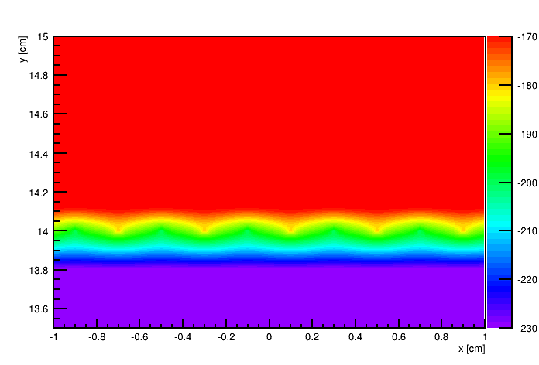
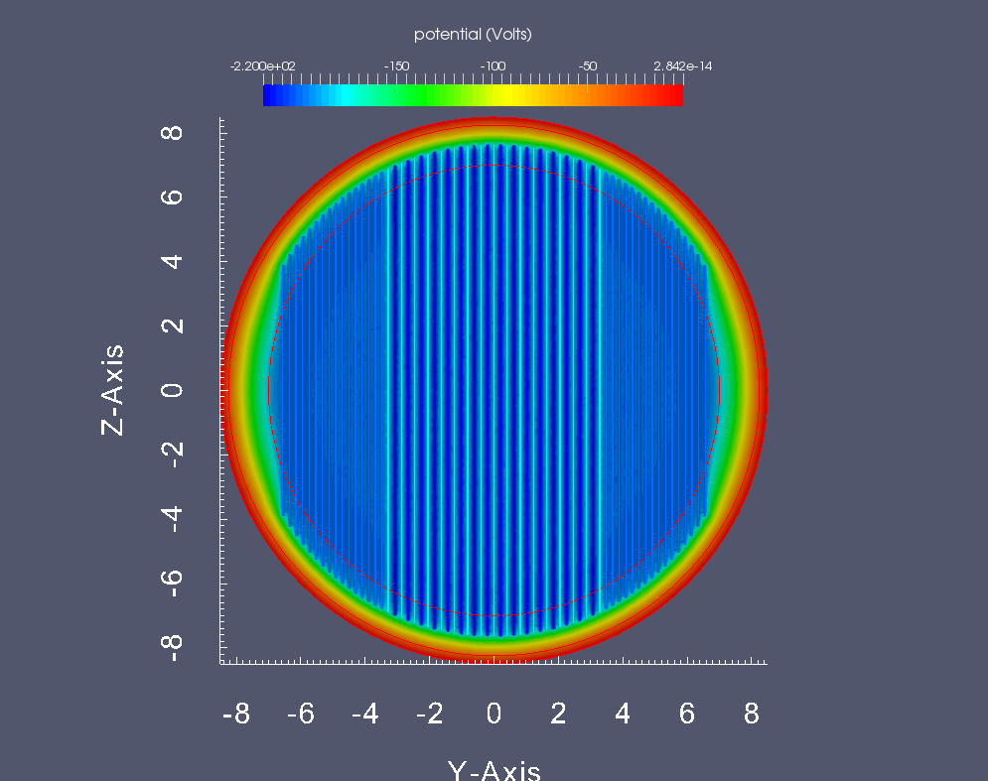
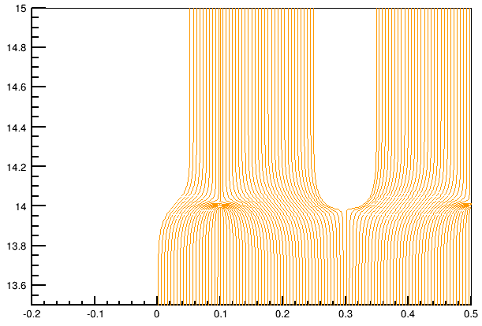
0 V
E
200 V ± ΔV
+ΔV
-ΔV
+ΔV

Slide 10
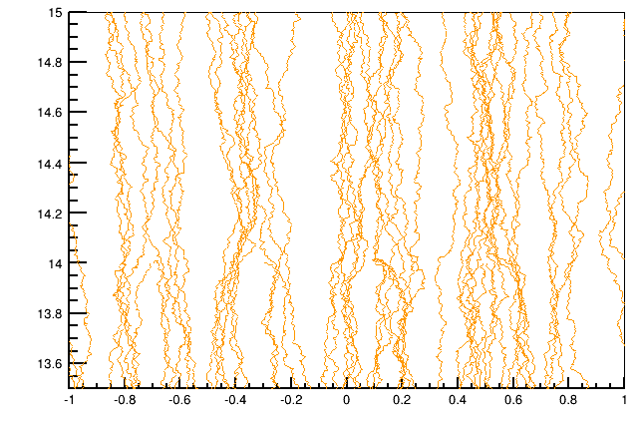
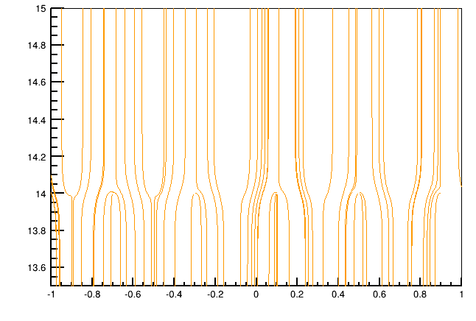
Gating Grid Transparency
Diffusion enabled
Diffusion disabled

Slide 11
Ne
Ar

Slide 12
Ne

Slide 13
