Slide 1
e24joe

Slide 2
06/03/2024
New Denisov Paper: https://journals.aps.org/prc/accepted/3e07ePb0E211f9046999039045ee03ba8664a9f1b
²¹²Po alpha decay: https://doi.org/10.1016/j.apradiso.2023.110953
We adjusted the threshold for the south Ge because it was triggering on noise (10 kHz event rate)
We also version controlled the XIA config files so we have a change log of the DDAS parameters
We measured the xyz of the Ge detectors, and took a few calibration runs with 152Eu in different places on the outside of the TPC
We think the ‘mystery blob’ has real events from 212Bi

Slide 3
152Eu Ge calibration runs
Once we placed the Ge in the spots they will remain, we took 5 calibration runs:
Run 801: Source on top of TPC, 2.7 cm from MM rim
Run 802: Source on top of TPC, 13 cm from MM rim
Run 803: Source on top of TPC, 40 cm from MM rim
Run 804: Source on side of TPC, across from North
Run 805: Source on side of TPC, across from South

Slide 4
Germanium Detectors’ XYZ
South:
31.33 mm from top of TPC to top of Ge
41.69 mm from MM rim on TPC to edge of Ge
07.74 mm from front of Ge to side of TPC
North:
29.88 mm from top of TPC to top of Ge
113.7 mm from MM rim on TPC to edge of Ge
04.23 mm from front of Ge to side of TPC

Slide 5
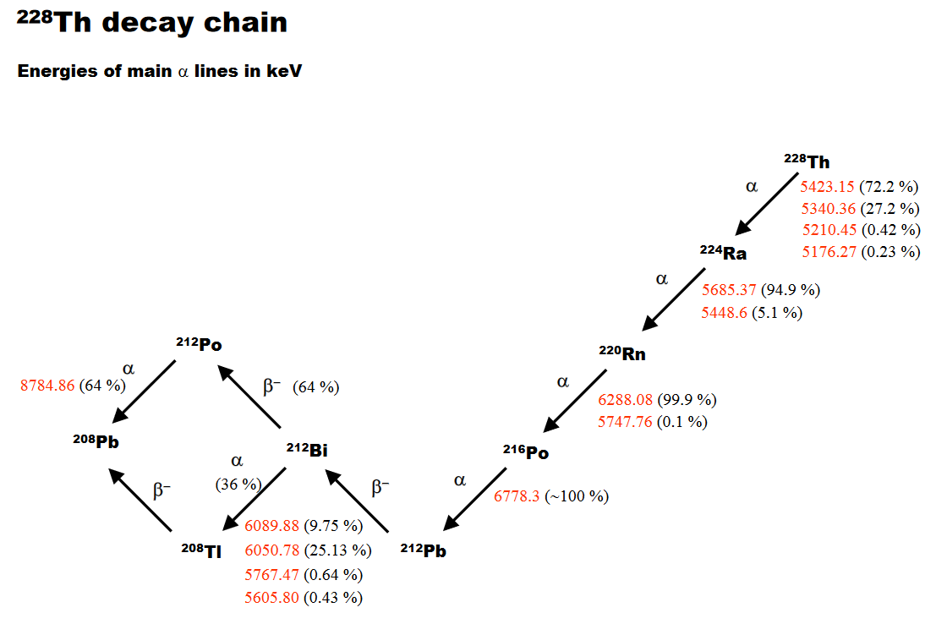
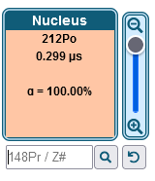
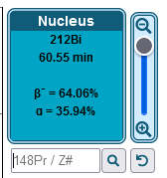
²²⁸Th Decay Chain

Slide 6
Gas Test run 0418 (run on 05/24/24, when gas had been flowing all day)

Slide 7
Gas Test run 0421 (run on 05/29/24 as one of the first runs after not flowing gas for 5 days)

Slide 8
Run 0003

Slide 9
Run 0004

Slide 10
Run 0005

Slide 11
Run 0006

Slide 12
Run 0007

Slide 13
Run 0008

Slide 14
Run 0010

Slide 15
Run 0011

Slide 16
Run 0012

Slide 17
Run 0013

Slide 18
Run 0014

Slide 19
Run 0015

Slide 20
Run 0016

Slide 21
Run 0017

Slide 22
Run 0018 (no ²²⁰Rn flow)

Slide 23
Run 0019 (no ²²⁰Rn flow)

Slide 24
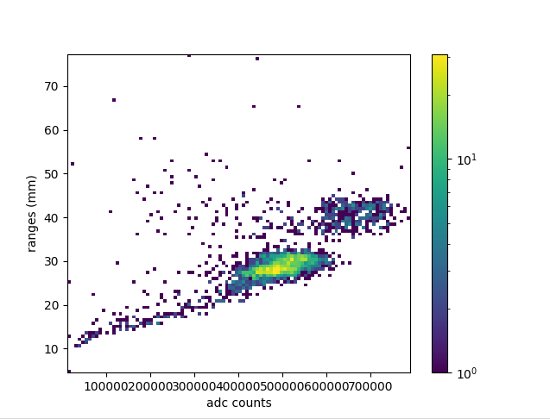
Run 0020 (no ²²⁰Rn flow)

Slide 25
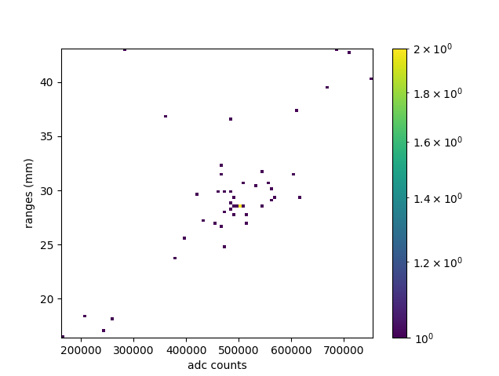
Run 0021 (no ²²⁰Rn flow)

Slide 26
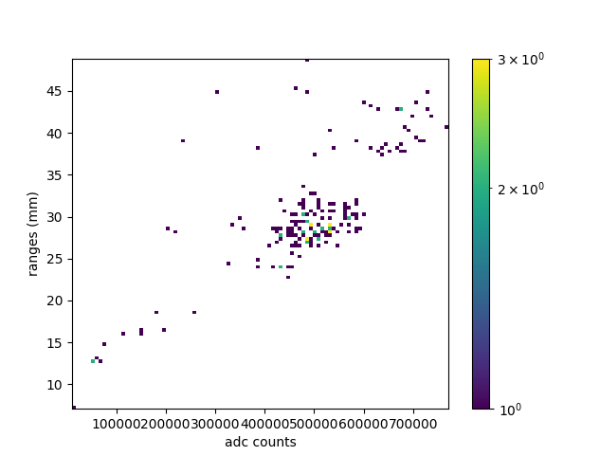
Run 0022 (no ²²⁰Rn flow)

Slide 27
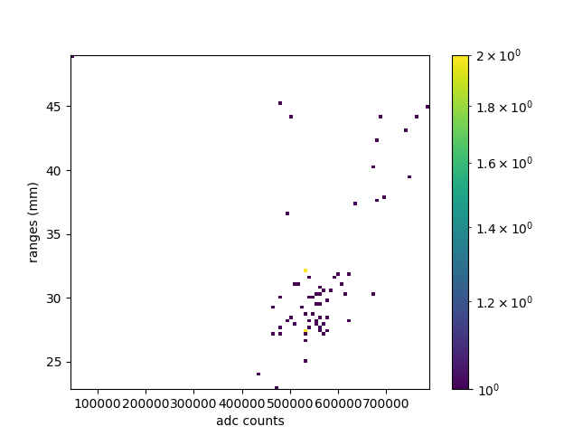
Run 0023 (evacuated upstream)

Slide 28
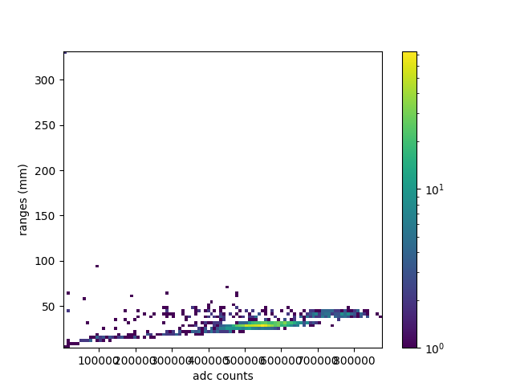
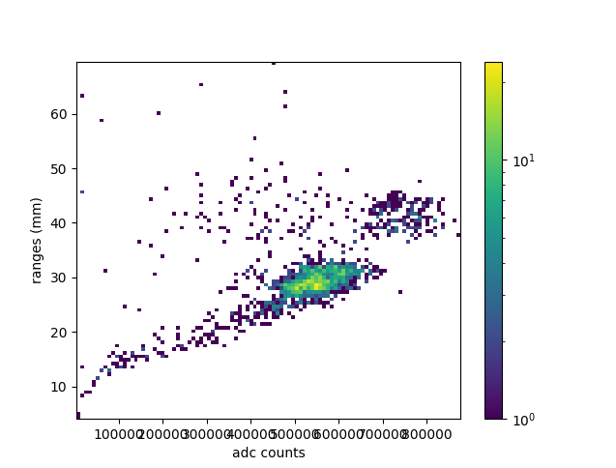
Run 0024 (evacuated upstream)
No range limits
Range limits: 0-80

Slide 29
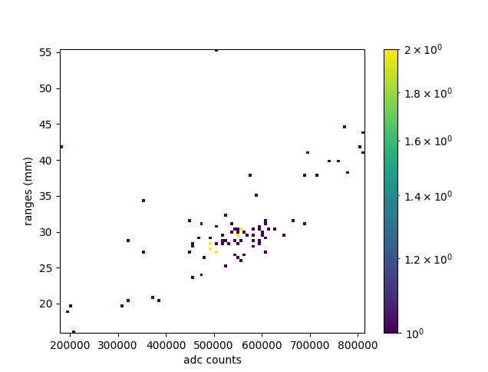
Run 0025 (evacuated upstream)

Slide 30
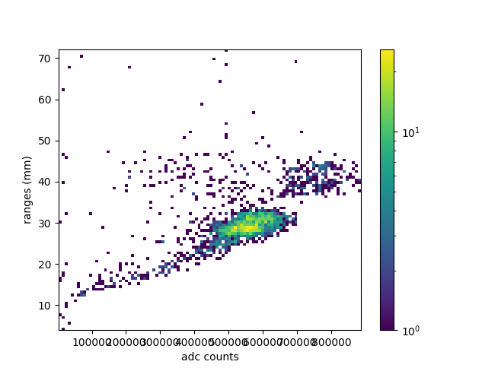
Run 0026 (evacuated upstream)

Slide 31
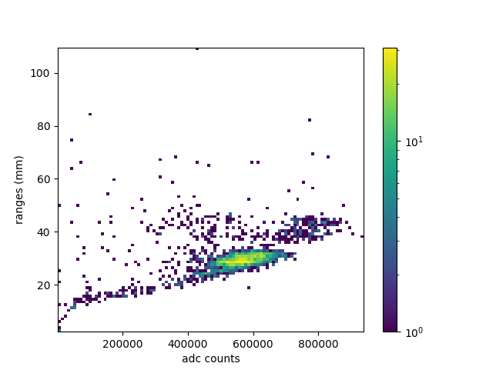
Run 0027 (evacuated upstream)
No range limits
Range limits: 0-80

Slide 32
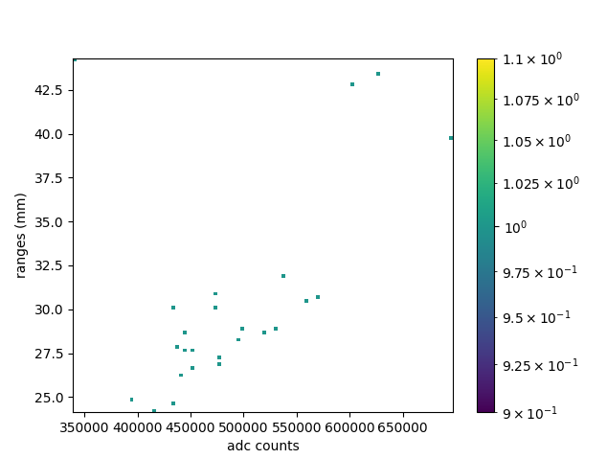
Run 0028 (Source Still Isolated, flow 24 sccm)
Flow 024 sccm: 0.3779 events/sec

Slide 33
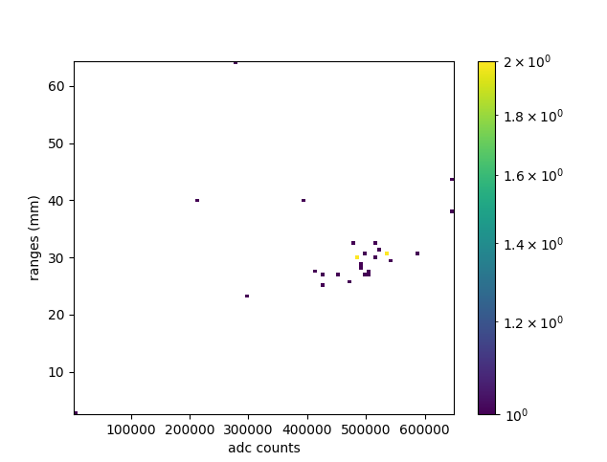
Run 0029 (Source Still Isolated, flow 175 sccm)
Flow 175 sccm: 0.3314 events/sec

Slide 34
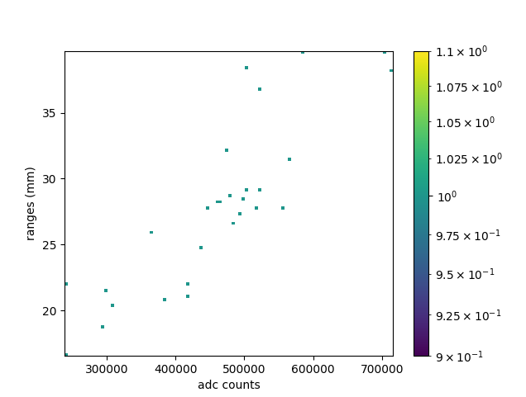
Run 0030 (Source Still Isolated, flow 521 sccm)
Flow 521 sccm: 0.3187 events/sec

Slide 35
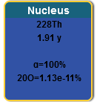
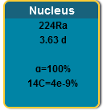
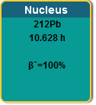
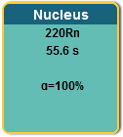
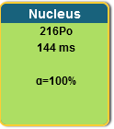
²²⁸Th Decay Chain

Slide 36
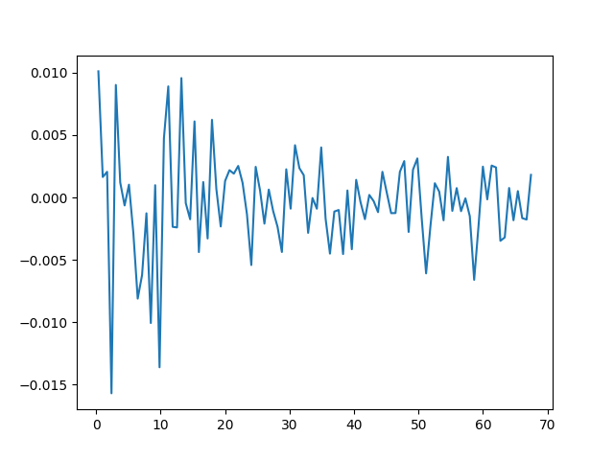
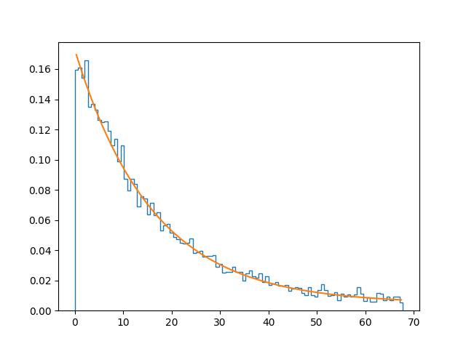
2024/06/10

Slide 37
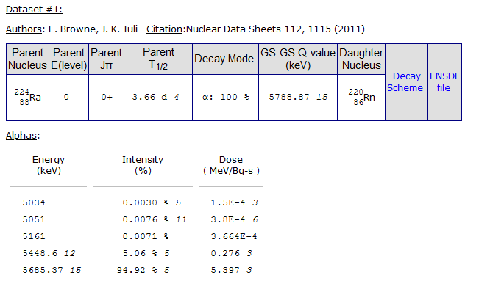
²⁴¹Am and ²²⁴Ra Decays
²⁴¹Am Decays to ²³⁷Np, which has a 2.1 million year half-life
²⁴¹Am has x-rays at 13.9 and 59.54 keV
²²⁴Ra has a 241 keV gamma with an intensity of 4% (which we do see in the Ge spectrum)
²²⁸Th has gamma 132 keV, 166 keV, 216 keV w/ intensity: 0.127%, 0.101%, and 0.25%

Slide 38
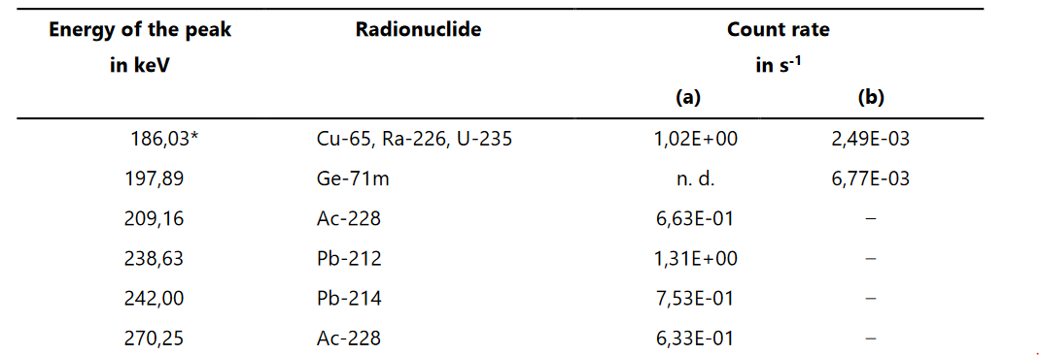
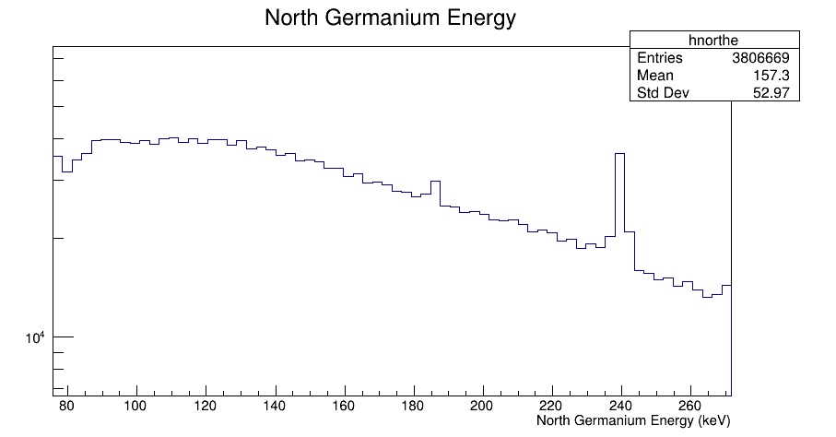
Evidence of ²²⁴Ra? (most likely Lead-212 or Lead-214)

Slide 39
Look at Mesh and Ge timing spectra (run 0017)

Slide 40
2D Hist with Mesh Spectrum and Gamma data (Run 0017)

Slide 41
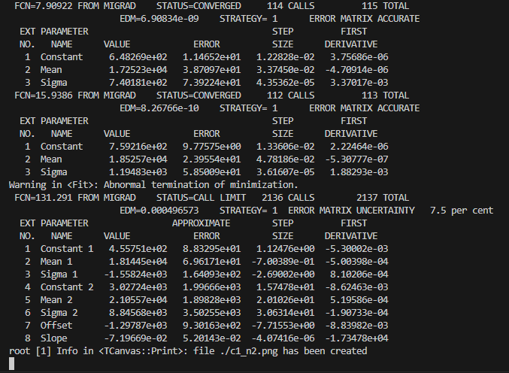
Mesh Energy Spectrum and fit (Run 0017) XIA

Slide 42
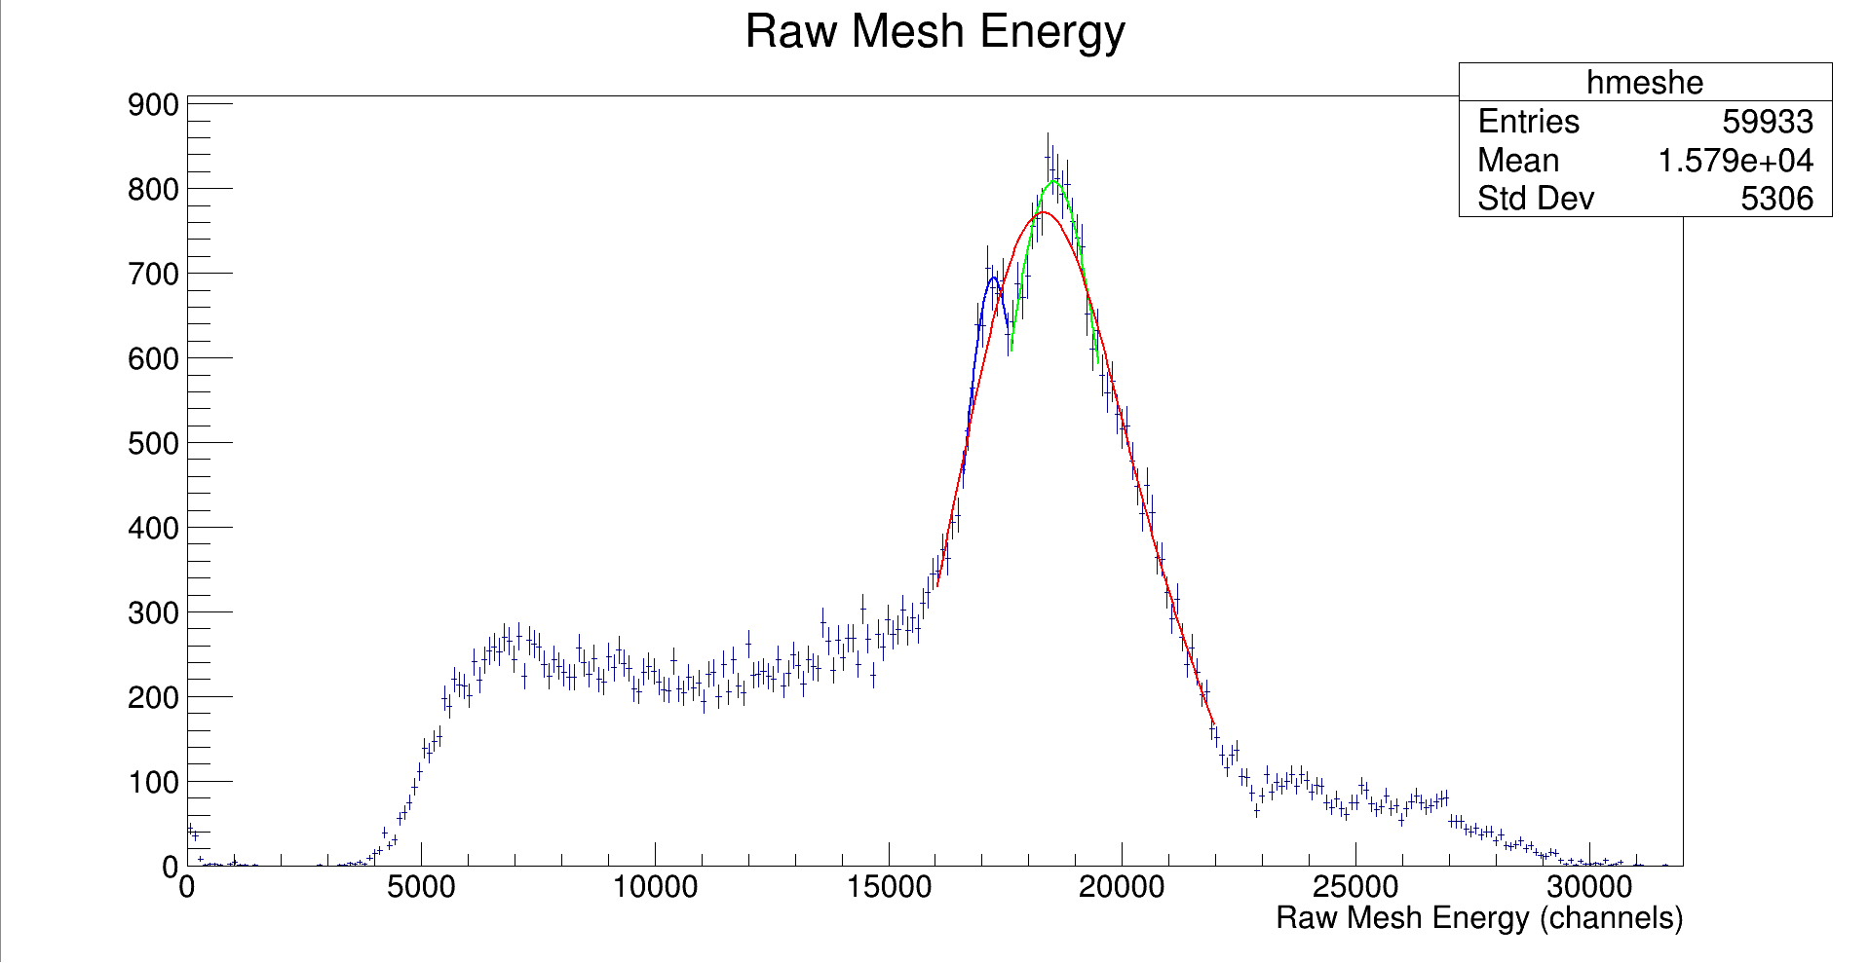
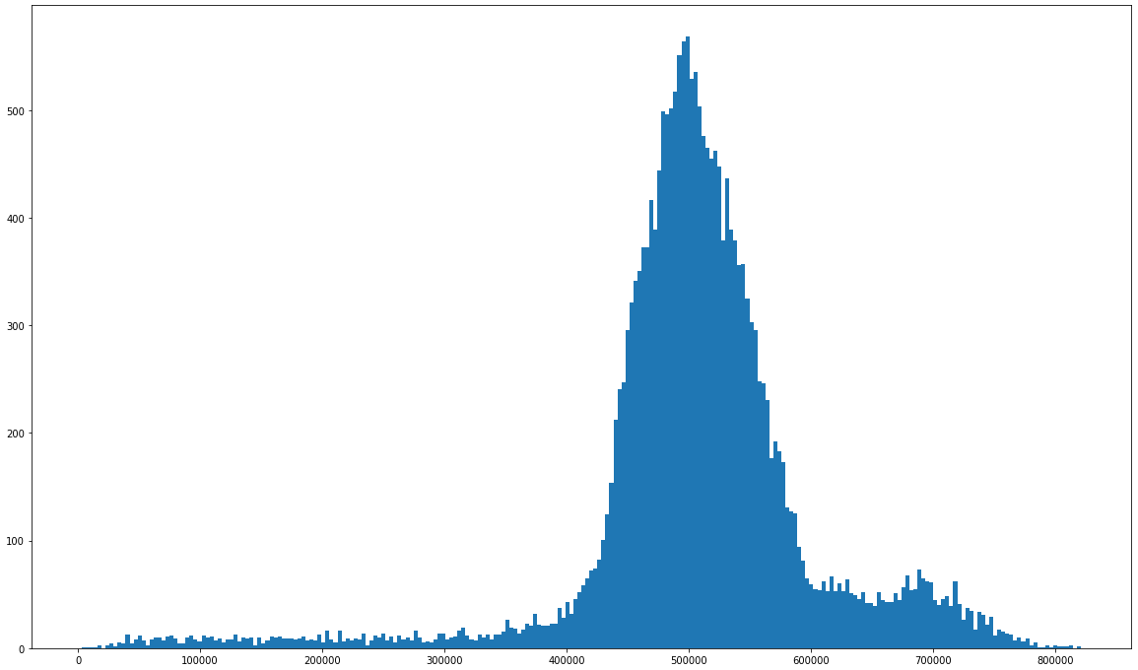
Mesh Energy Spectrum and fit (Run 0017) GET

Slide 43
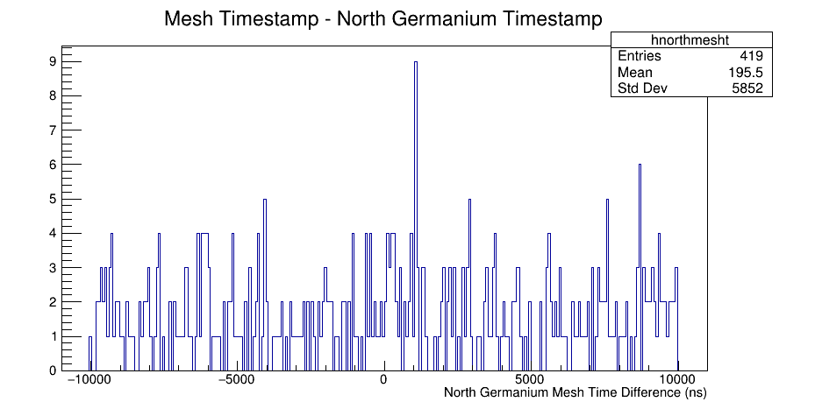
2024/06/13 THURSDAY
Sum from -10,000 ns to 15 ns: 197
Sum from 15 ns to 10,000 ns: 222

Slide 44
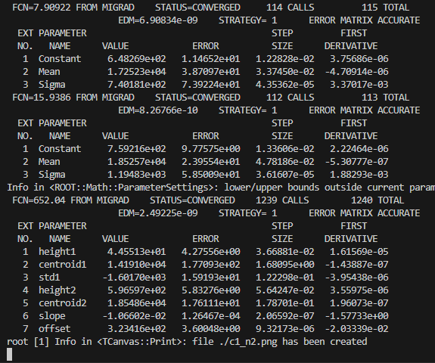
Fit Mesh with constrained FWHM

Slide 45
Increased Flow Rate Tests, source is still bypassed, we are just looking at ‘bg’ (runs 27-30)
Flow 000 sccm: 0.3794 events/sec
Flow 024 sccm: 0.3779 events/sec
Flow 175 sccm: 0.3314 events/sec
Flow 521 sccm: 0.3187 events/sec
Alex and I think that this could be explained by flowing gas in the opposite direction for a while. ²²⁸Th decays in that space after the cathode, and when the ²²⁰Rn is produced, the higher flow rate carries more of it away
Slightly inconsistent with wall effect changes from runs 16-19 on slides 20-23

Slide 46
Wall Effect Mystery
When we turn off flow, we see the top line disappear, which suggests to me that these lines are from different decays, not related to location in the chamber where the alpha was created
See runs 16-19 on slides 20-23

Slide 47
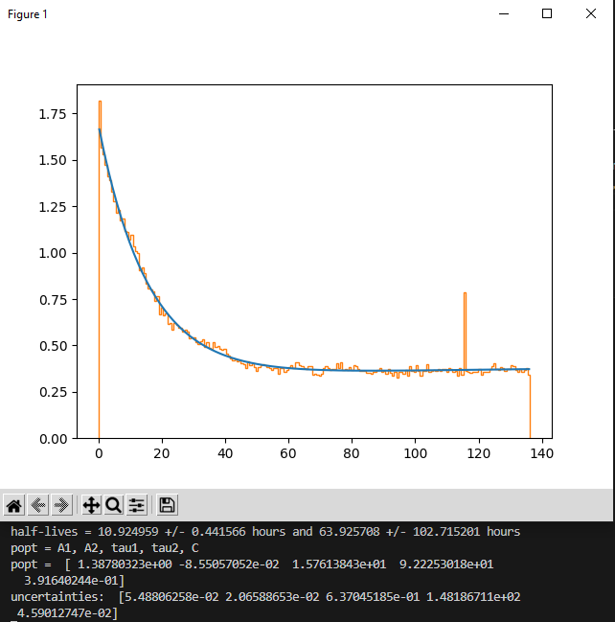
Decay Timestamp plot runs 0018-0030 (fitted with 2 decay curves 10 hours and 3.6 days)
²²⁸Th half-life: 1.8 years
²²⁴Ra half-life: 3.6 days
²²⁰Rn half-life: 55.6 seconds
²¹⁶Po half-life: 144 ms
²¹²Pb half-life: 10.6 hours
Suggests that we are possibly looking at ²²⁸Th

Slide 48
2024/06/17 MONDAY
Runs with no Ge data:

Slide 49
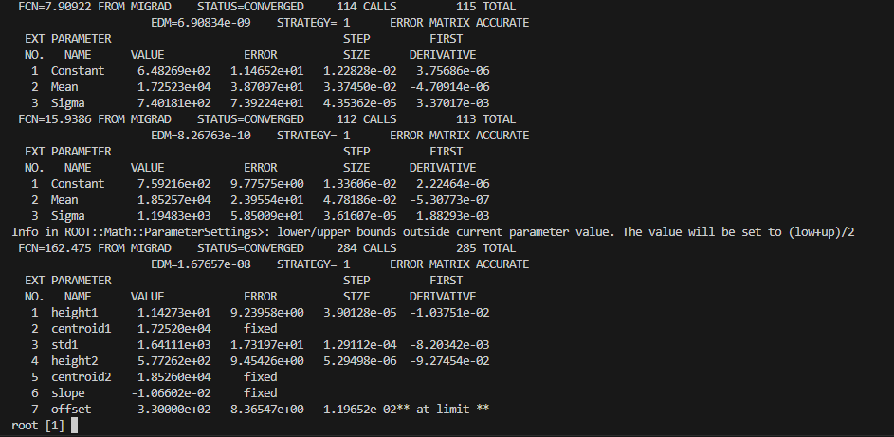
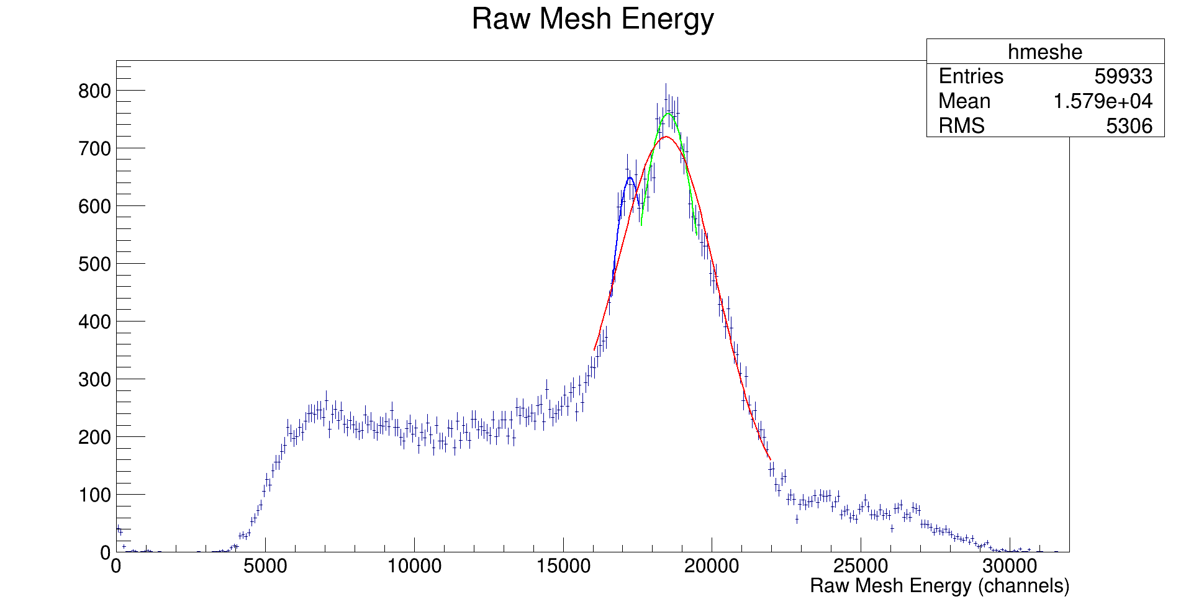
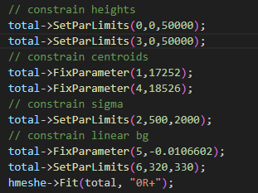
Fit Mesh Spectrum by hand

Slide 50
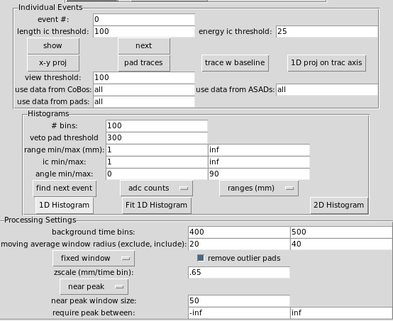
Reprocessed Earlier Runs so they are all using the following settings:
Using the config file: ‘p10_2000torr.gui_ini’
RUN 0006 IS GIVING US ERRORS, SEE SLIDE 11 (on fishtank)
Run 7 is able to be reprocessed on fishtank
Run 8

Slide 51
Some problems processing larger runs
The mac mini has what looks to be 32 GB of ram
Fishtank is a bit more complicated, maybe 12 GB available

Slide 52
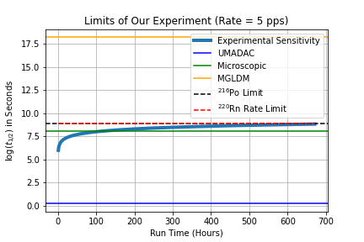
Event estimate
Total events from production runs 1-30: 3.57 million
Conservative estimate would say we have about 1 million alphas from ²²⁰Rn, assuming we get ~2.5 alphas per Radon decay

Slide 53
DNP Abstract
2000 characters long
Use information gathered in my guidance committee meeting as a start

Slide 54
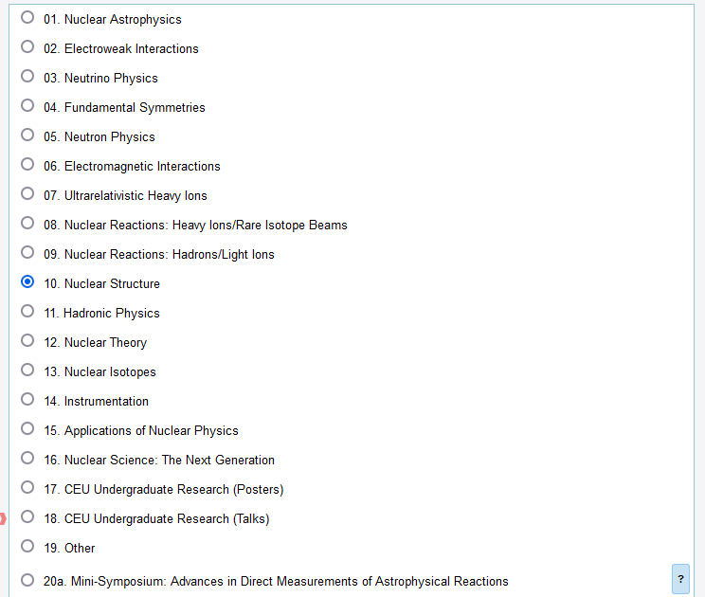
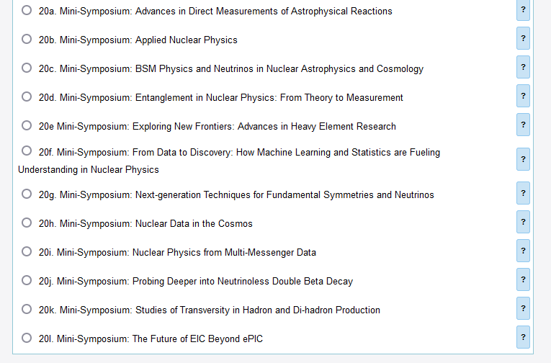
DNP Meeting Categories:

Slide 55
Data Estimate

Slide 56
Looking for ²³²U in the gamma data

Slide 57
Python GUI graphical cut

Slide 58
Testing attpc merger with evt and graw files

Slide 59
Convection/Diffusion Model for Radon distribution in the TPC active area

Slide 60
FYI Slides

Slide 61
CHANGING GAS PRESSURE running ATTPCROOT
For some reason, running the GADGET_II.root macro does not properly replace the two files in the geometry directory required to properly adjust the gas pressure, so I run the following commands to properly adjust the pressure
/mnt/simulations/pxct/joe/gadget/ATTPCROOTv2/macro/Simulation/GADGET$ root -q ../../../geometry/GADGET_II.C; cp GADGET_II.root ../../../geometry/; cp GADGET_II_geomanager.root ../../../geometry/; cd ../../../build/; make; cd ../macro/Simulation/GADGET/; root -q Mg20_test_sim_pag.C; root -q rundigi_sim_Ari.C;

Slide 62
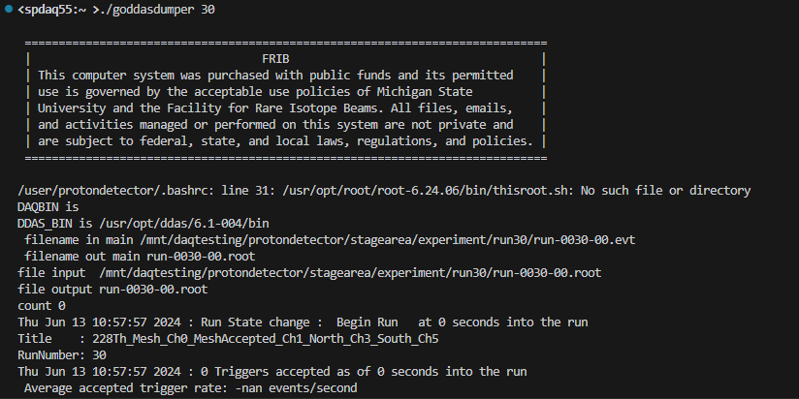
Evt to root files

Slide 63
Checking energy resolution at higher pressure with Michael Roosa’s code
Located in /mnt/simulations/proton_detector/michael

Slide 64
Argonne Cf source
²⁵²Cf -> α + ²⁴⁸Cm -> α + ²⁴⁴Pu -> α + ²⁴⁰U -> β + ²⁴⁰Np -> β + ²⁴⁰Pu -> α + ²³⁶U -> α + ²³²Th -> α + ²²⁸Ra -> β + ²²⁸Ac -> β + ²²⁸Th

