Slide 1
No embedded electrode
Gas ε_{r}=1
128 μm
PCB ε_{r}=4.5
150 μm

Slide 2
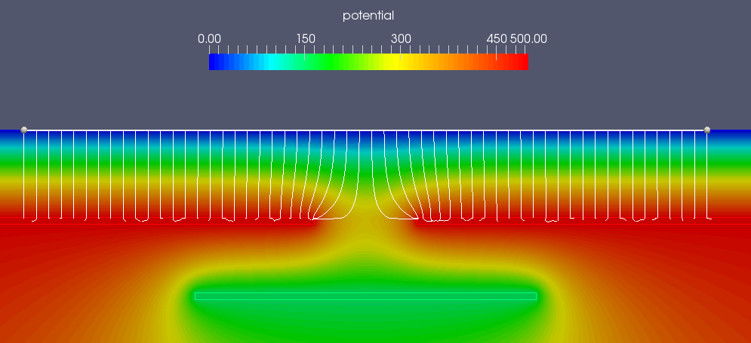
embedded electrode 150 V
128 μm
150 μm
100 μm
150 V

Slide 3
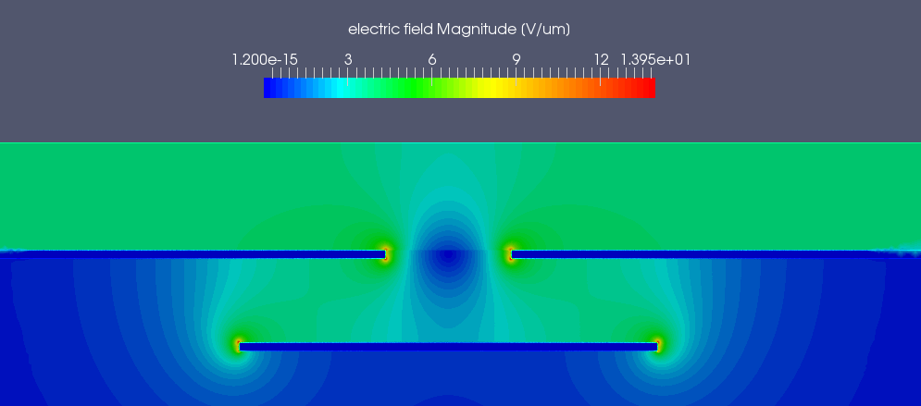
embedded electrode 150 V

Slide 4
embedded electrode 200 V
200 V

Slide 5
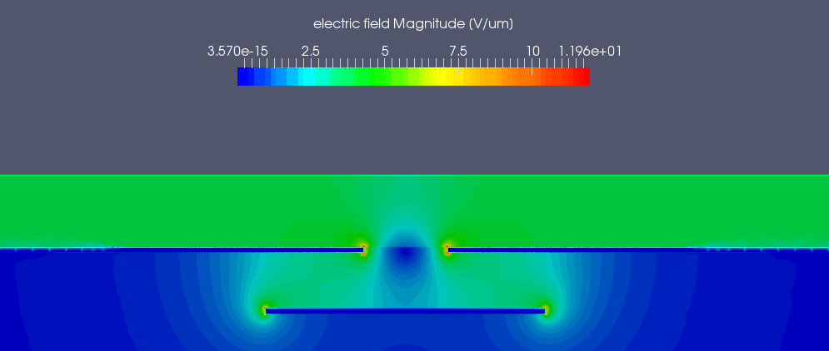
embedded electrode 200 V

Slide 6
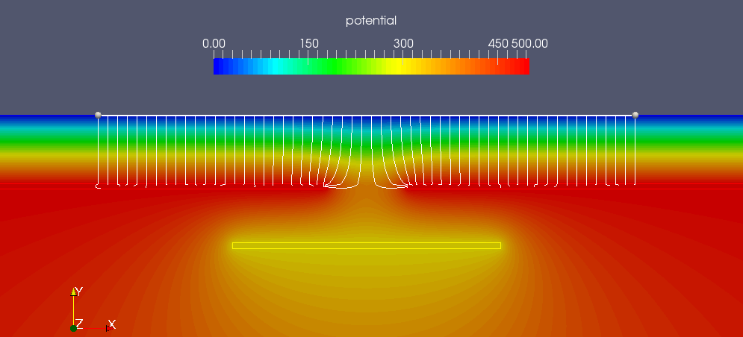
embedded electrode 300 V
300 V

Slide 7
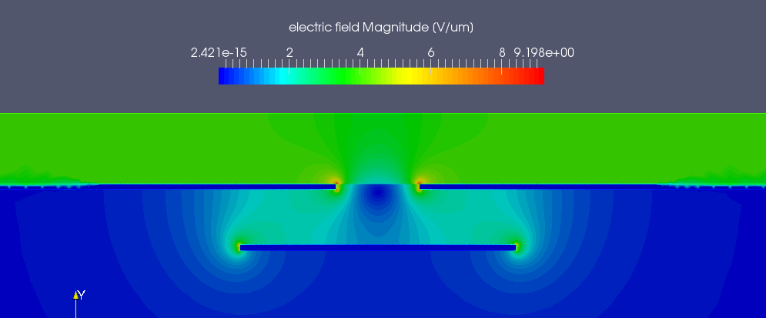
embedded electrode 300 V

Slide 8
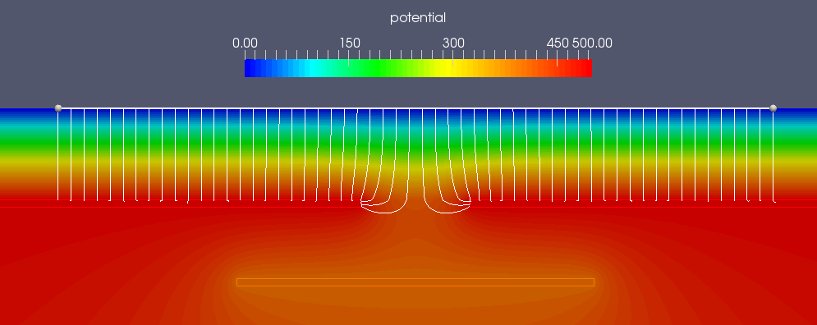
embedded electrode 400 V
400 V

Slide 9
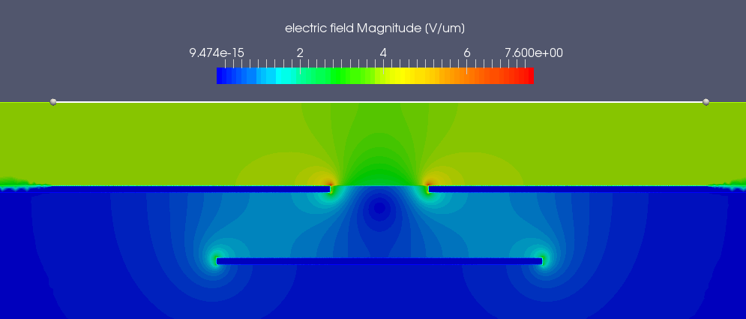
embedded electrode 400 V

Slide 10
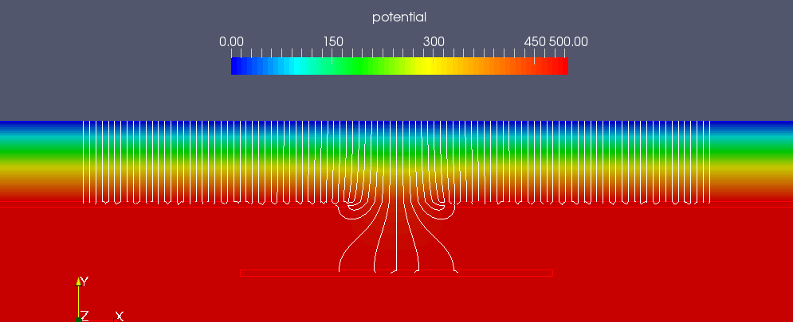
embedded electrode 500 V
500 V

Slide 11
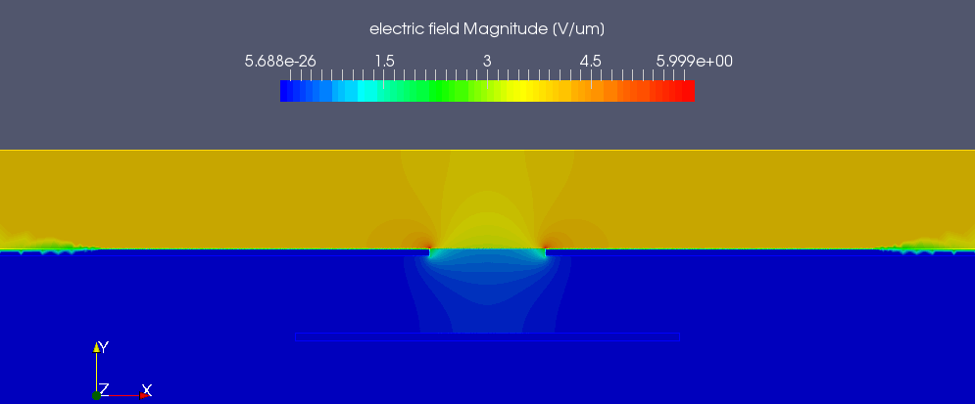
embedded electrode 500 V

