Slide 2
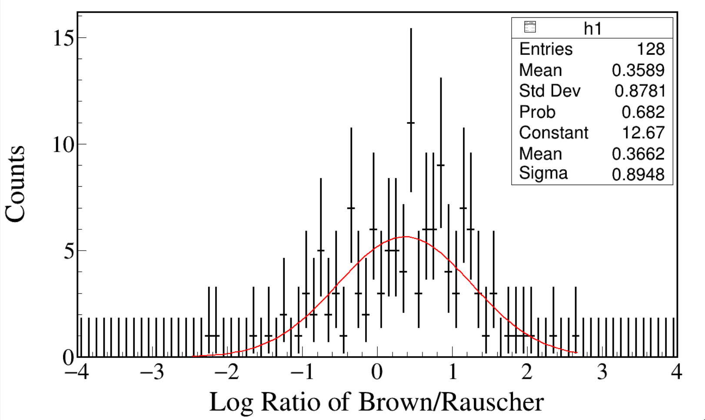
Γ_{p} Brown
Γ_{p} Rauscher
log₁₀
Notes:
#include <iostream>
#include <fstream>
#include <iomanip>
#include <math.h>
#include <time.h>
#include <map>
#include <TROOT.h>
#include <TSystem.h>
#include <TStyle.h>
#include <TCutG.h>
#include<TChain.h>
#include "TChain.h"
#include "TStyle.h"
#include "TCanvas.h"
#include "TEllipse.h"
#include "TString.h"
#include "TGraph.h"
#include "TSpectrum.h"
#include "TVirtualFitter.h"
#include "TRandom.h"
#include "TFile.h"
#include "TTree.h"
#include "TH1.h"
#include "TH2.h"
#include "TF1.h"
#include "TMath.h"
#include "TPaveText.h"
#include "TPad.h"
#include "string.h"
#include "stdlib.h"
#include "stdio.h"
#include "TLegend.h"
using namespace std;
void Fill_histogram_from_txt_byFill_p_width()//read bincontent from a txt file and create a histo and save it as a new root file.
{// input bin by bin, not event by event
int ii,jj;
float Channel[500];
float x,y,xe,ye;
long Count[500];
char outrootname[200], datname[200], tname[200];
int Entries=300;//modify
sprintf(tname, "%s", "D:/X/out/Alex_Brown_Proton_width");
sprintf(datname, "%s%s", tname, ".dat");
sprintf(outrootname, "%s%s", tname, ".root");
ifstream infile(datname,ios::in);
TFile *fout = new TFile(outrootname,"RECREATE");//It's better to define histograms and then define fout, in case of draw bugs.
TCanvas* canvaspeak = new TCanvas("canvaspeak", "canvaspeak", 1300, 800);//
canvaspeak->cd();//
canvaspeak->SetTopMargin(0.029);
canvaspeak->SetRightMargin(0.04);
canvaspeak->SetLeftMargin(0.11);
canvaspeak->SetBottomMargin(0.15);
canvaspeak->SetFrameLineWidth(3);
TH1F *h1 = new TH1F("h1","h1",80,-4,4);//create a histogram
string line;
while ( getline(infile, line) )
{
stringstream(line) >> x;
h1->Fill(log10(x));
//cout <<x<<endl;
}
h1->Draw("e");
h1->GetXaxis()->SetTitle("Log #Gamma_p Ratio of Brown/Rauscher");
h1->GetYaxis()->SetTitle("Counts");
h1->SetLineWidth(3);
h1->SetLineColor(1);
//h1->SetStats(0);
h1->SetBinErrorOption(TH1::kPoisson);
h1->SetTitle("");
h1->GetXaxis()->CenterTitle();
h1->GetYaxis()->CenterTitle();
h1->GetXaxis()->SetLabelFont(132);
h1->GetYaxis()->SetLabelFont(132);
h1->GetXaxis()->SetLabelSize(0.06);
h1->GetYaxis()->SetLabelSize(0.06);
h1->GetXaxis()->SetTitleFont(132);
h1->GetYaxis()->SetTitleFont(132);
h1->GetXaxis()->SetTitleOffset(1.0);
h1->GetYaxis()->SetTitleOffset(0.8);
h1->GetXaxis()->SetTitleSize(0.07);
h1->GetYaxis()->SetTitleSize(0.07);
//h1->GetXaxis()->SetRangeUser(100, 6000);
//h1->GetYaxis()->SetRangeUser(0, 30000);
h1->GetYaxis()->SetNdivisions(505);
h1->GetYaxis()->SetTickLength(0.015);
gPad->RedrawAxis();
cout<<"RMS= "<<setiosflags(ios::fixed)<<setprecision(9)<<h1->GetRMS();//you can also find the RMS in the rootfile
//fout->Write();
//fout->Close();
}

Slide 3
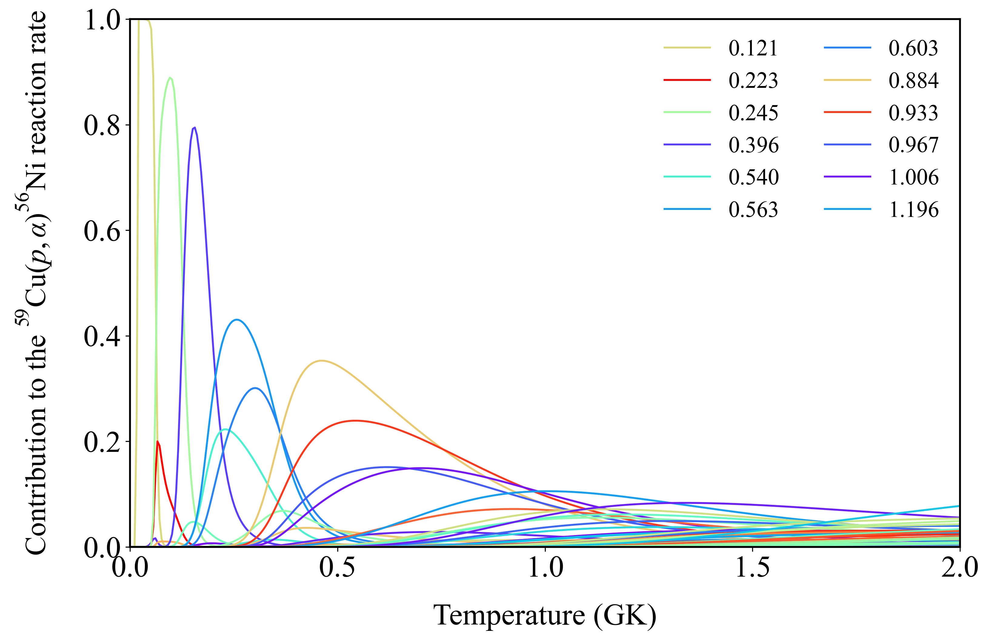
Brown Γ_{γ}
Brown Γ_{p}
Rauscher Γ_{α}
Γ_{tot} = Γ_{γ} + Γ_{γ} + Γ_{α}

Slide 4
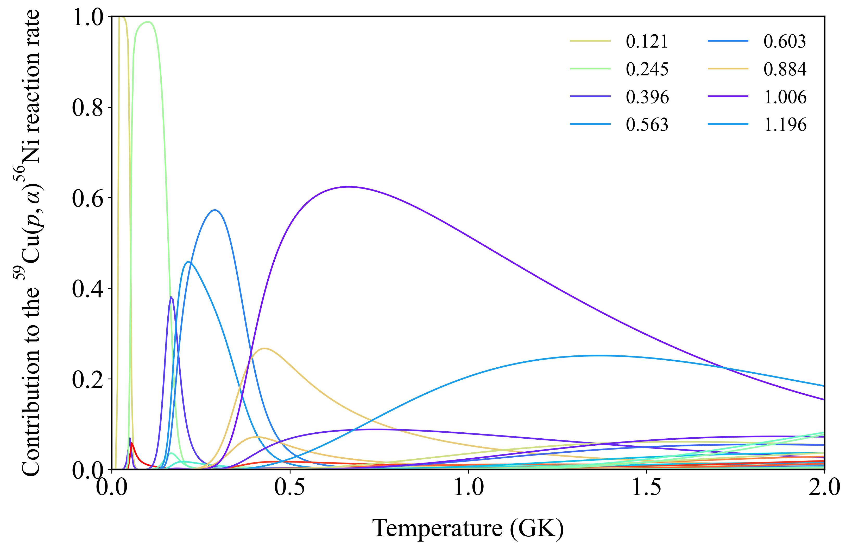
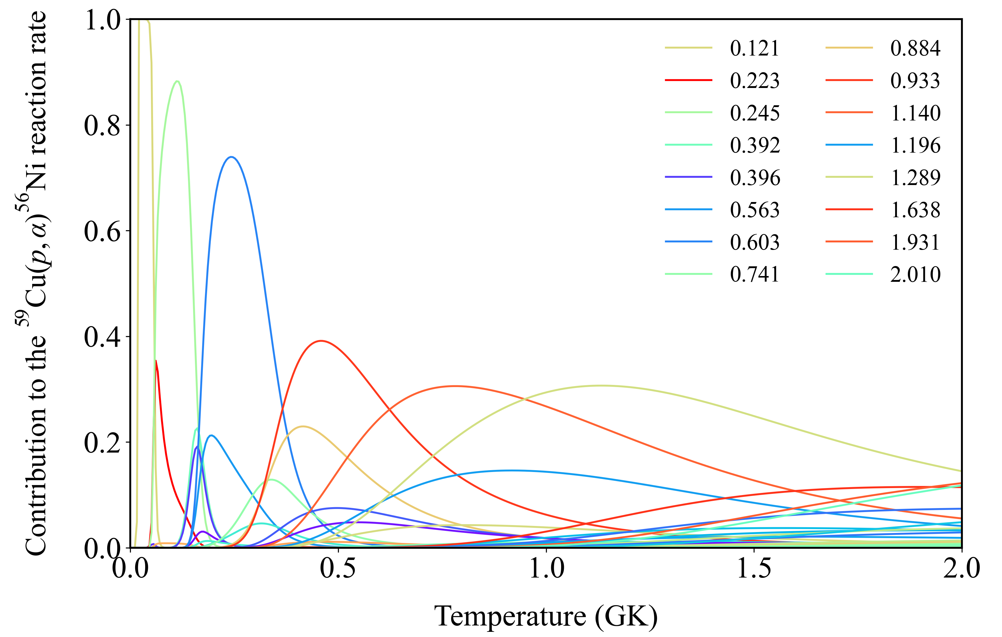
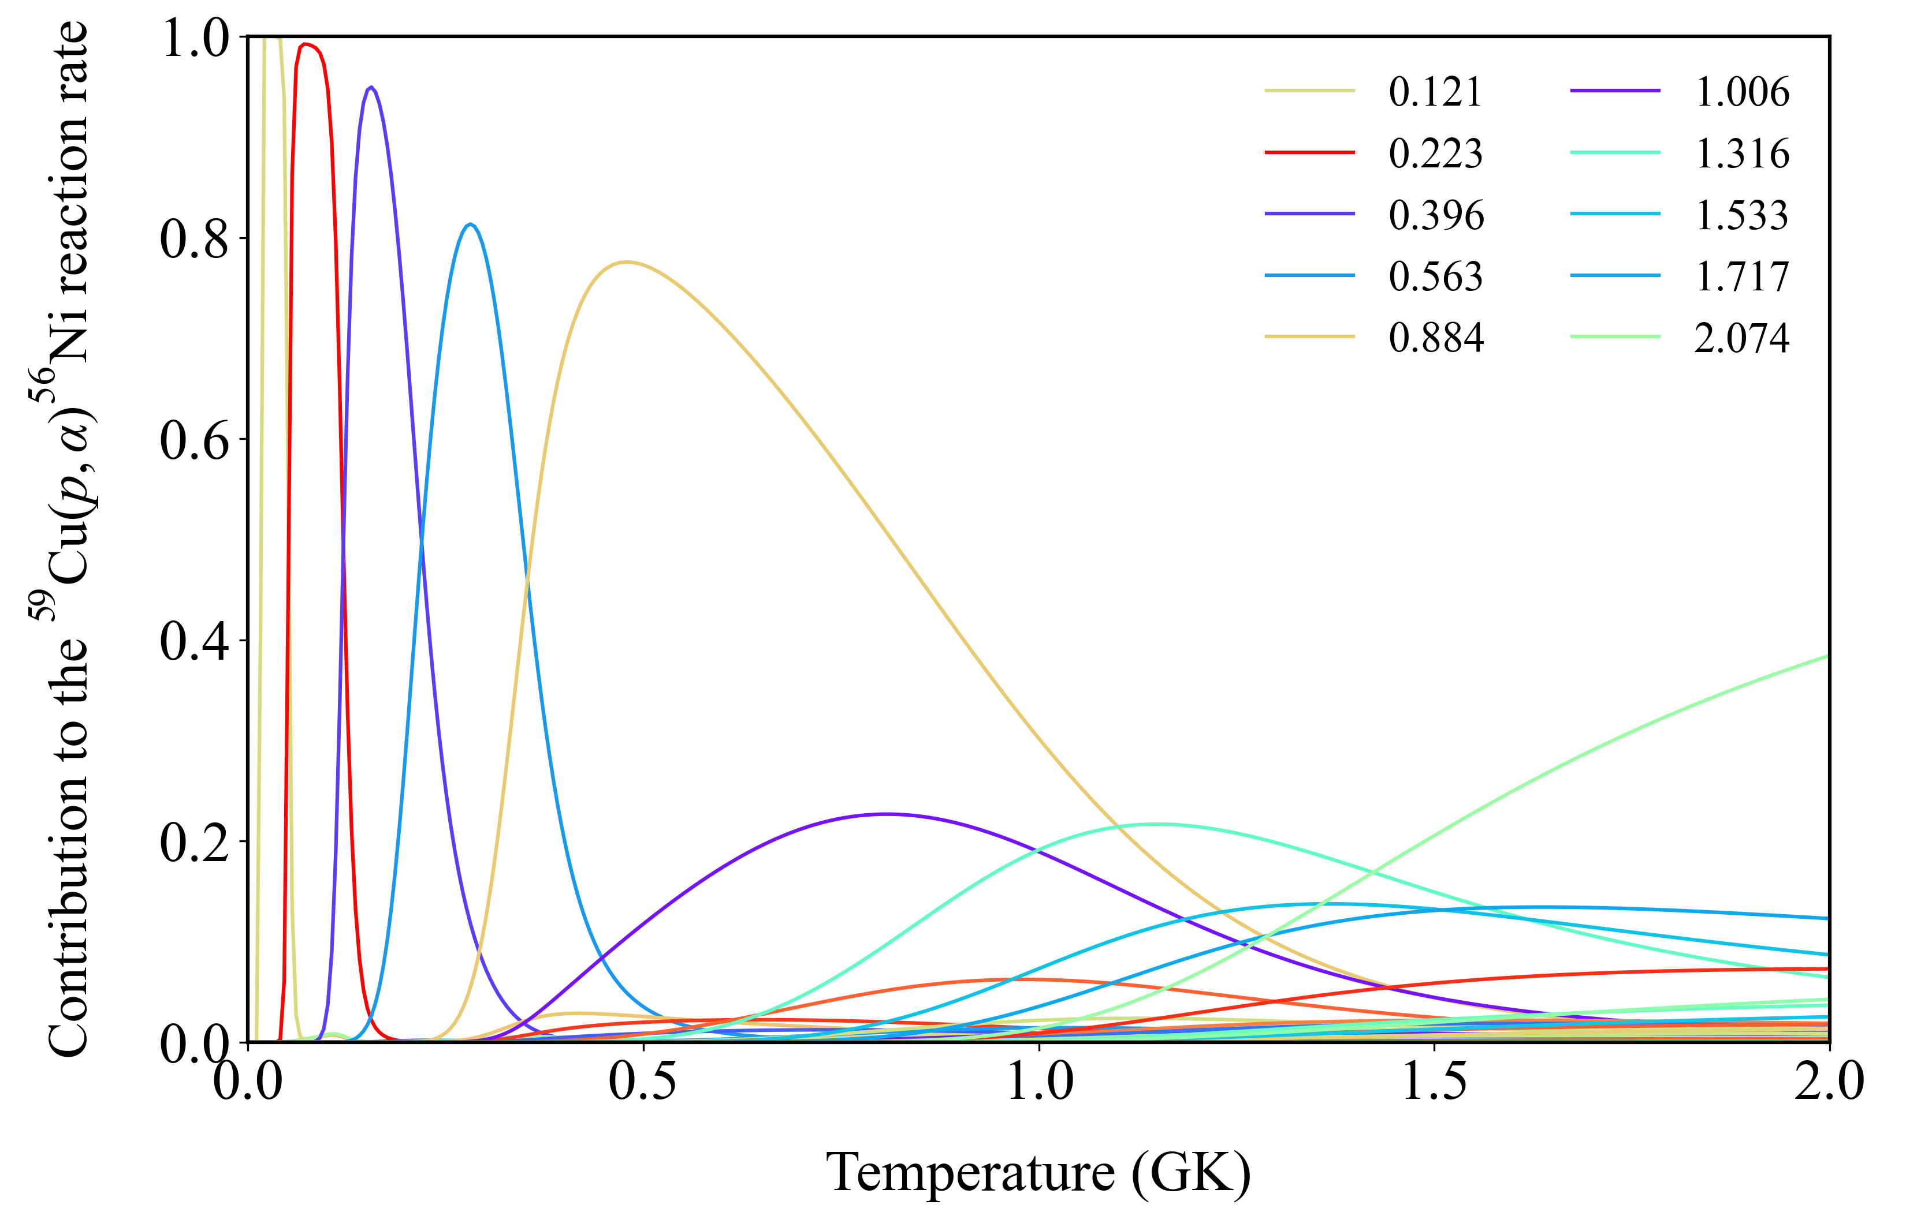
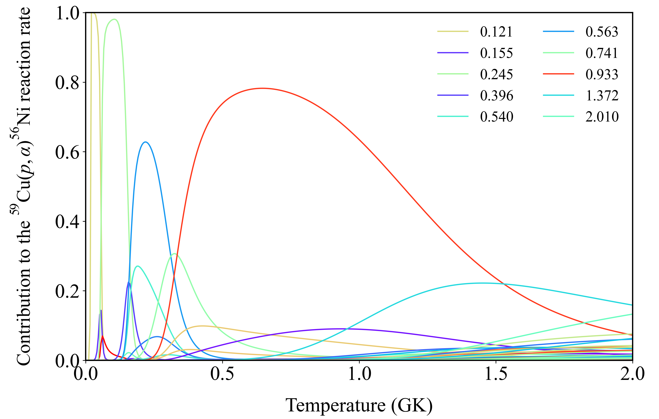
Brown Γ_{γ}
Brown Γ_{p}
Rauscher Γ_{α}*F
Γ_{tot} = Γ_{γ} + Γ_{γ} + Γ_{α}*F

Slide 5
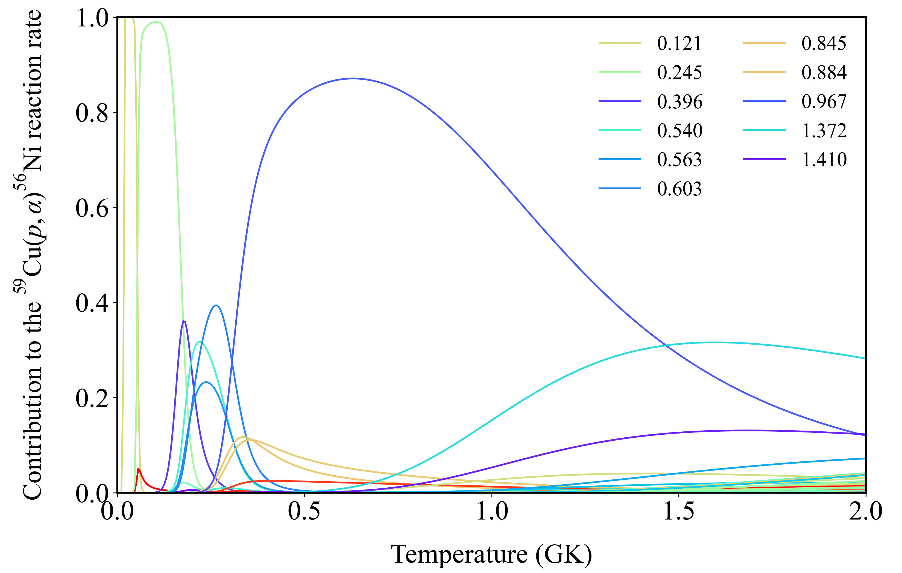
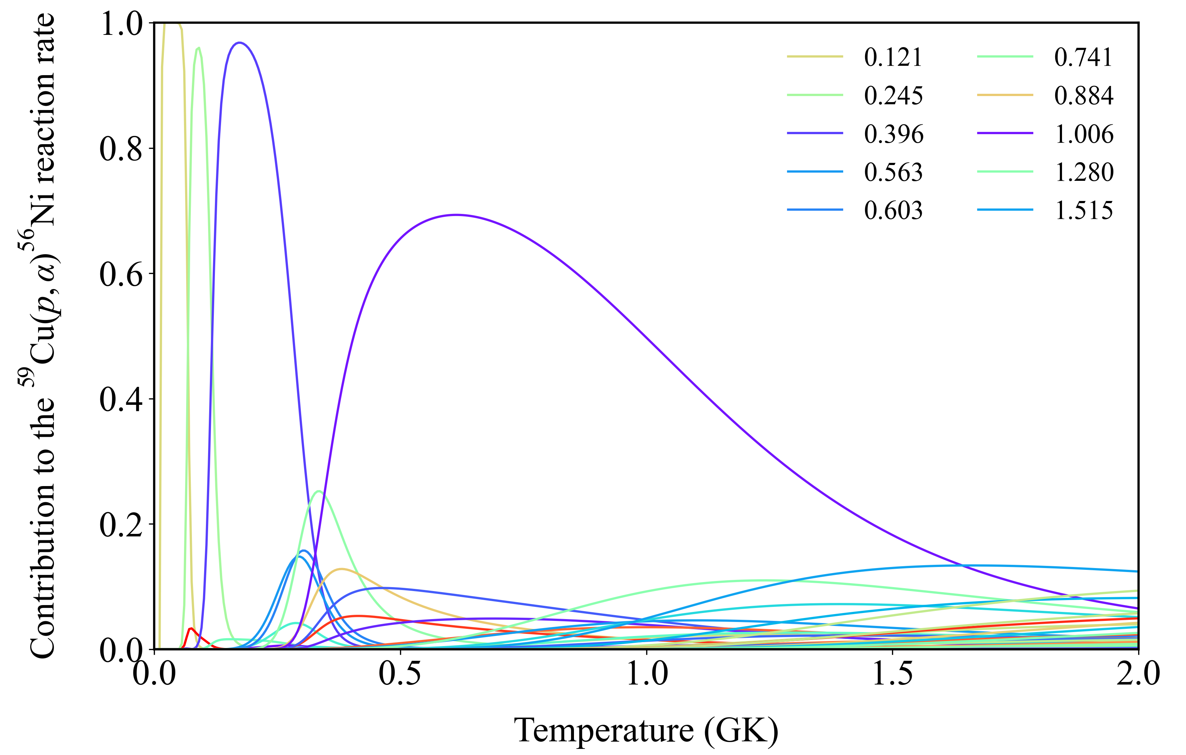
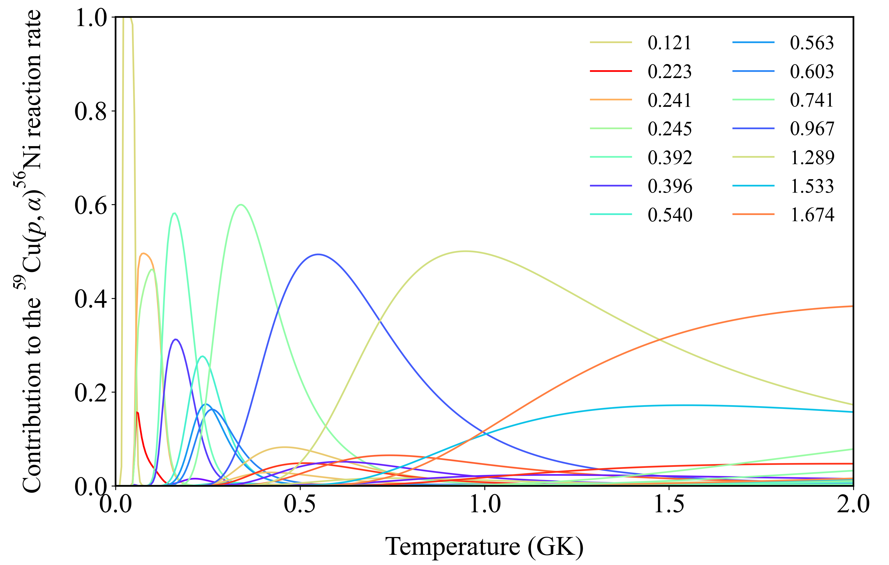
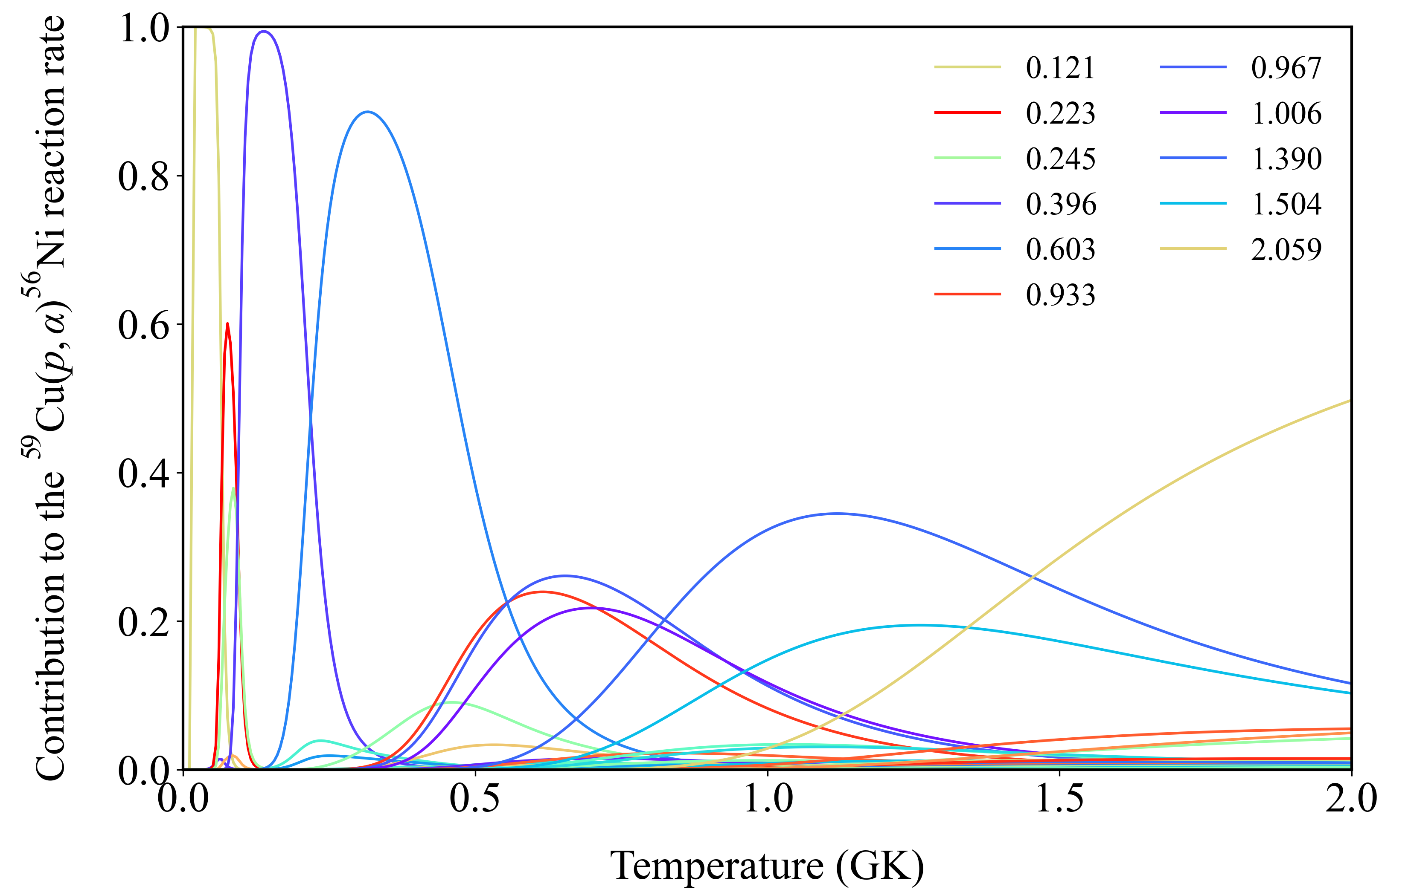
Brown Γ_{γ}
Brown Γ_{p}
Rauscher Γ_{α}*F
Γ_{tot} = Γ_{γ} + Γ_{γ} + Γ_{α}*F

Slide 6
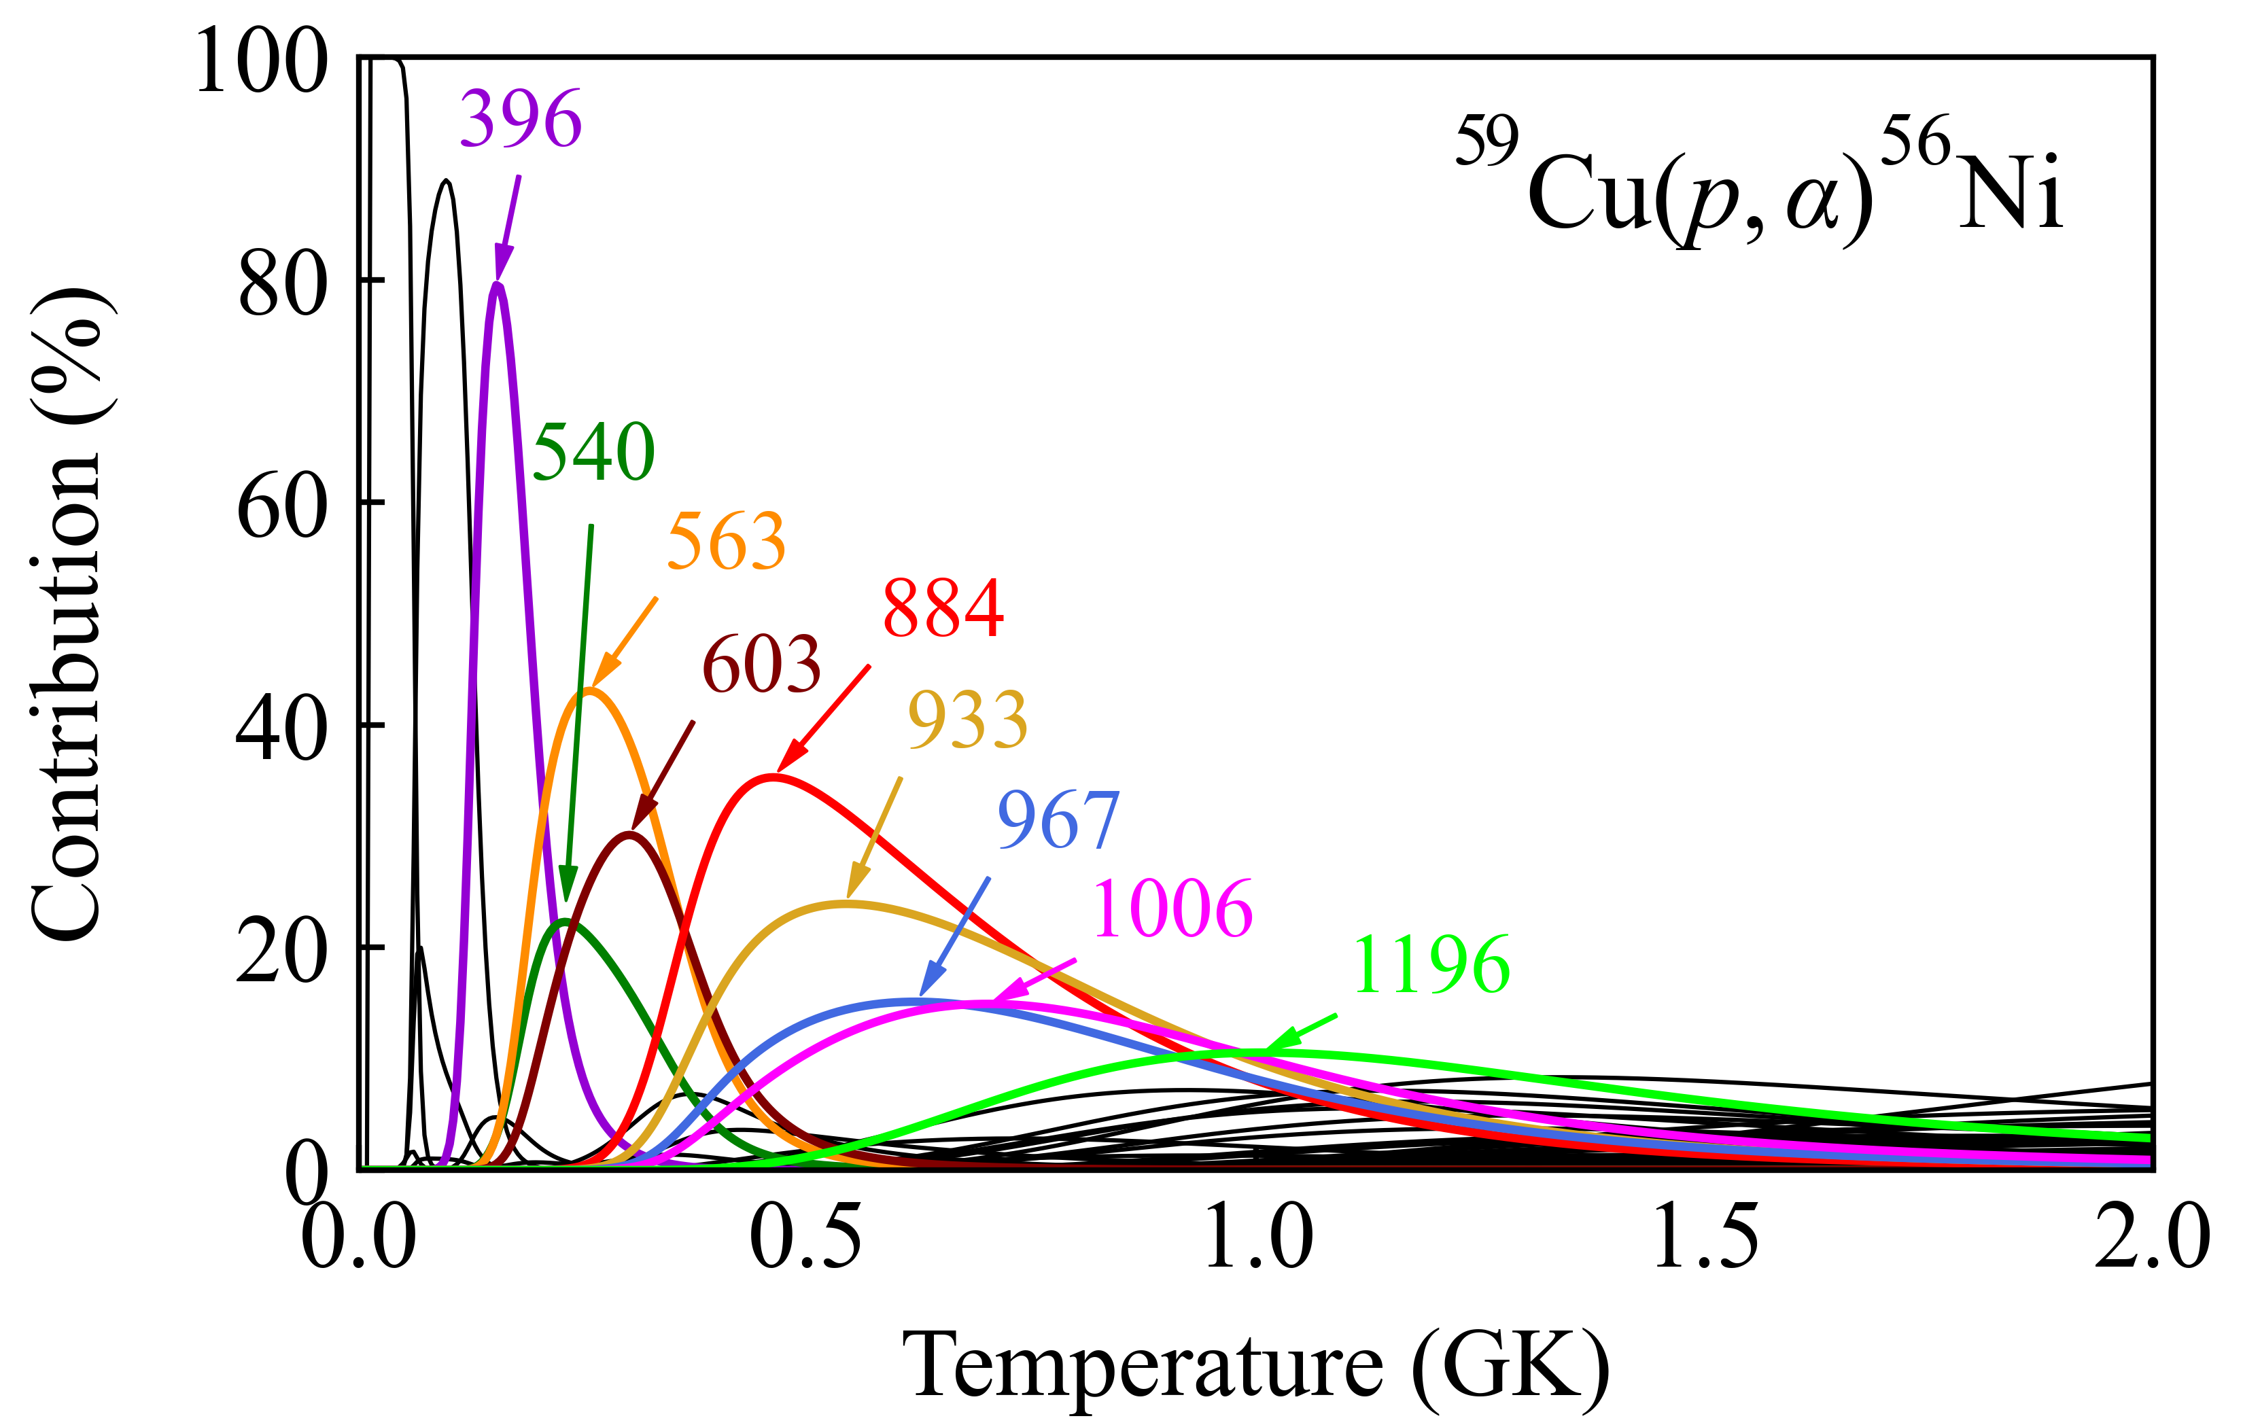
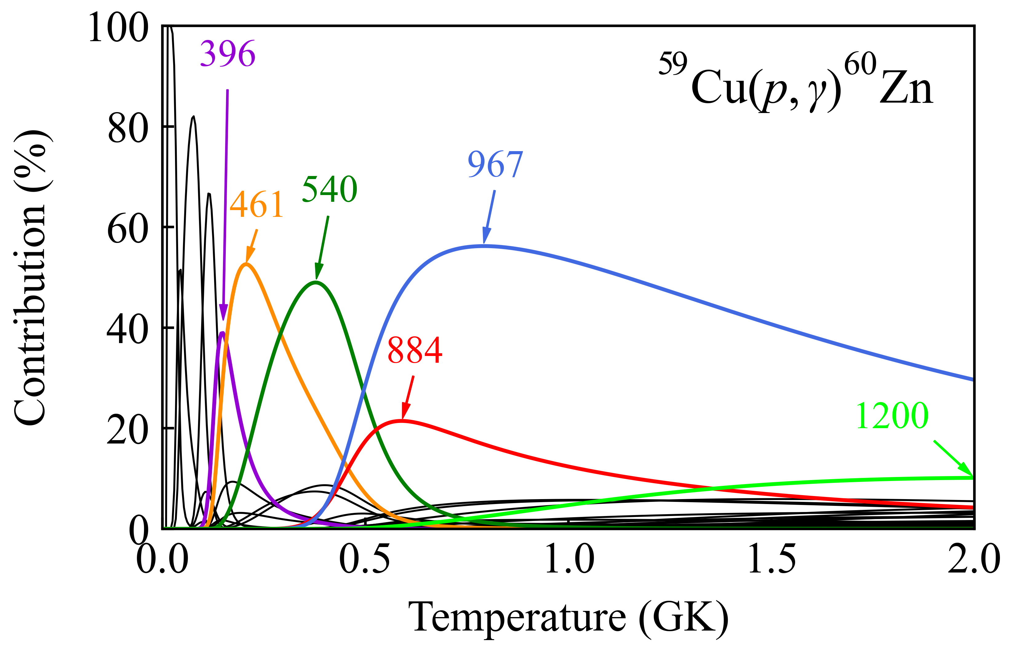
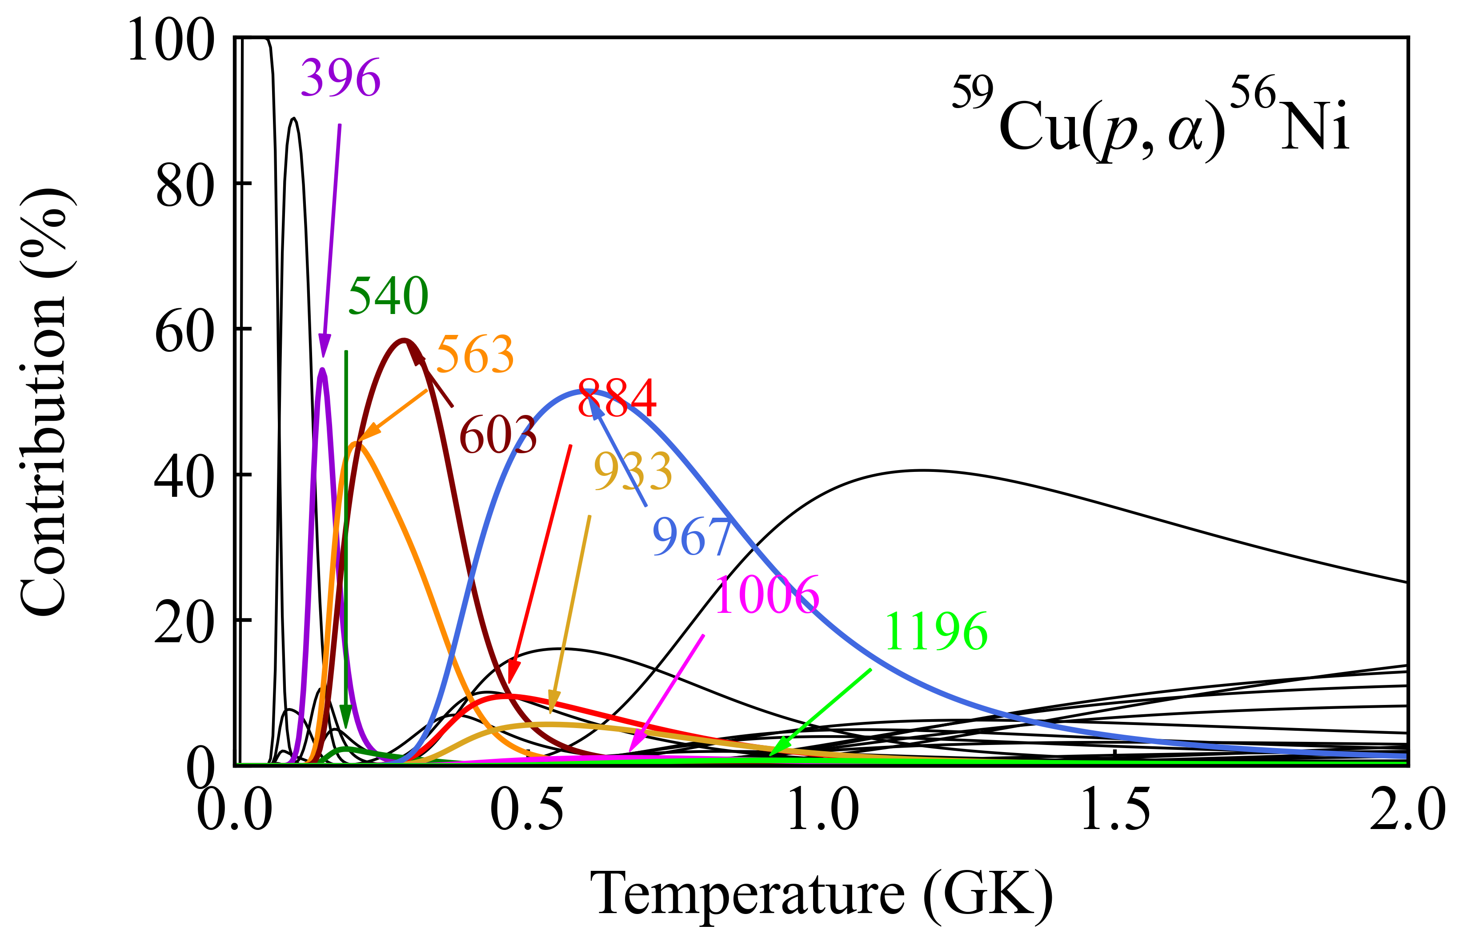

Slide 7
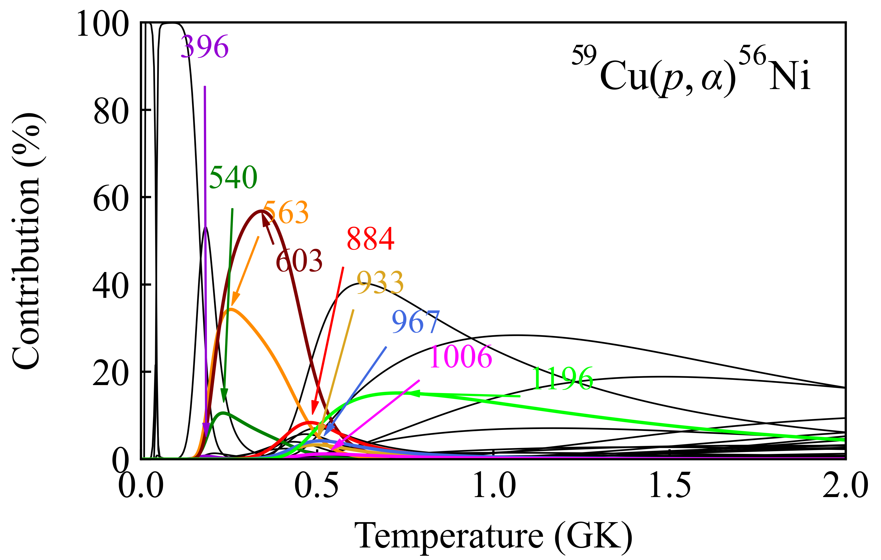
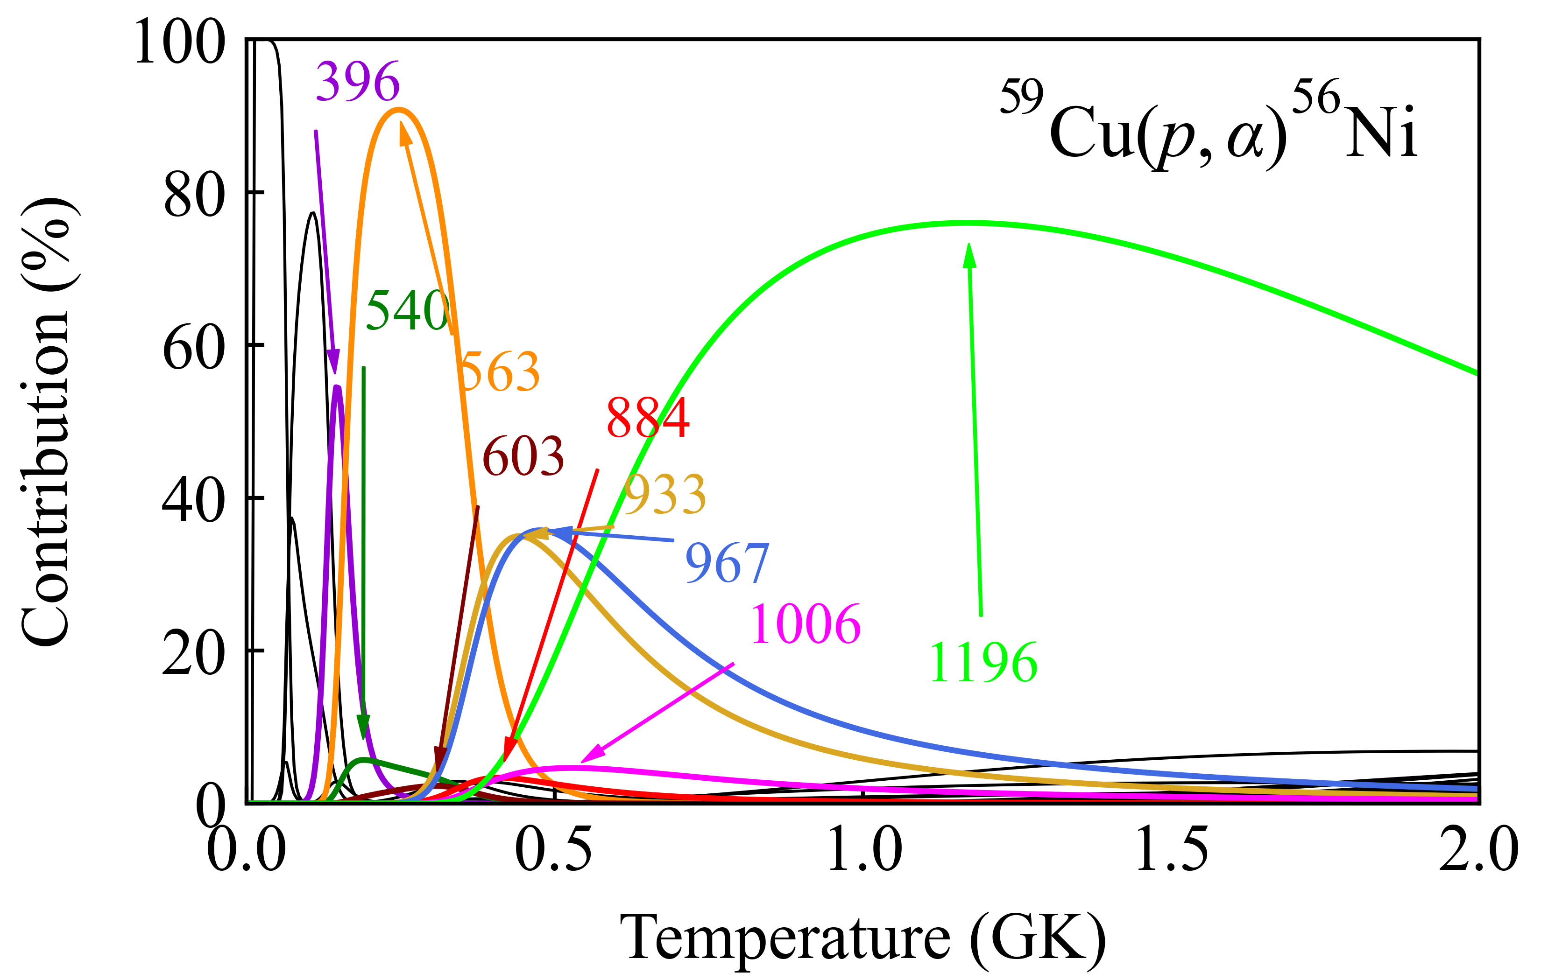

Slide 8
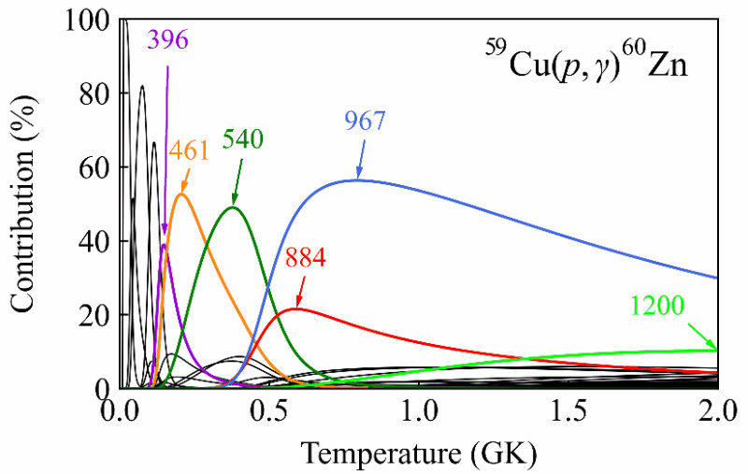

Slide 9
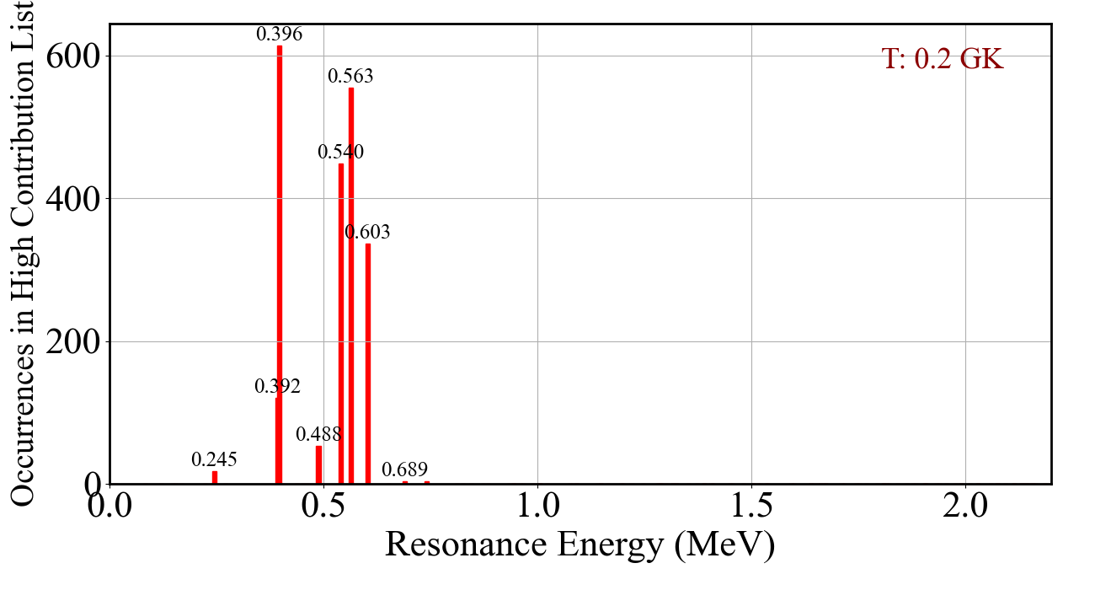
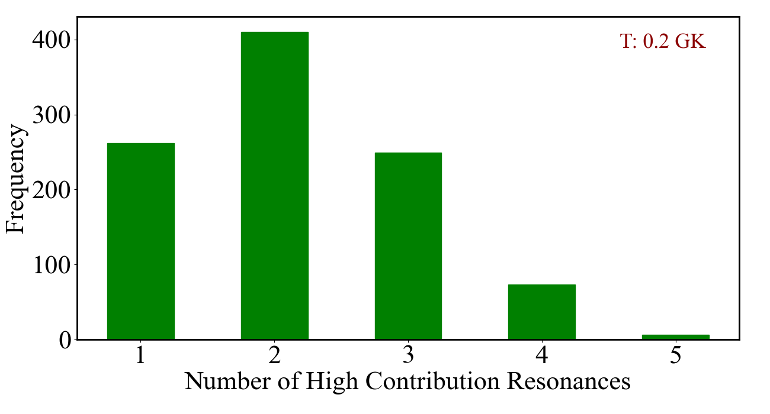

Slide 10
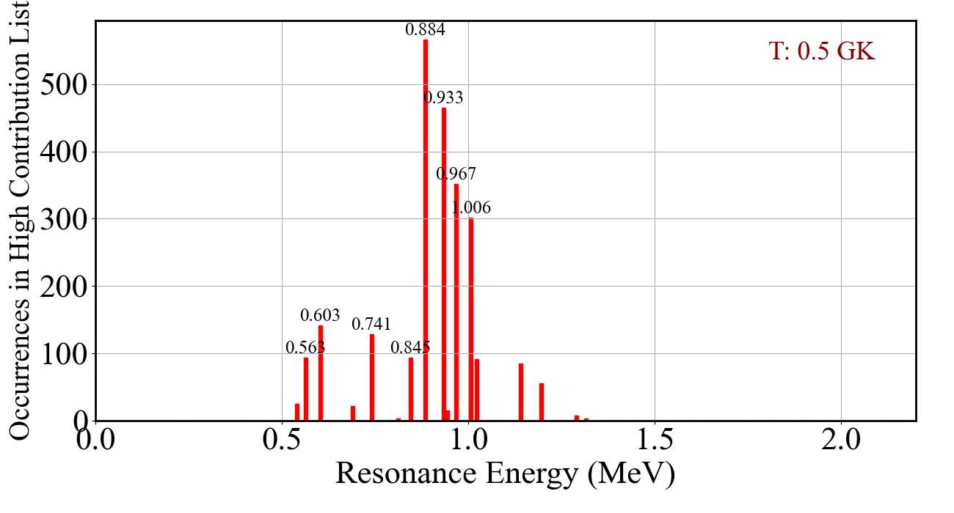
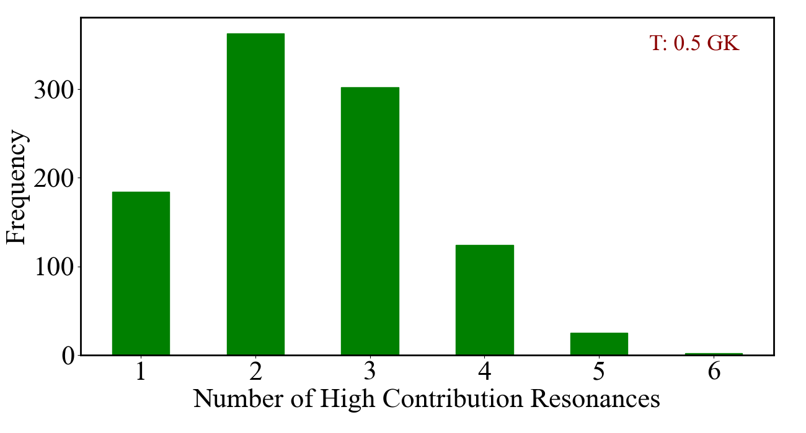

Slide 11
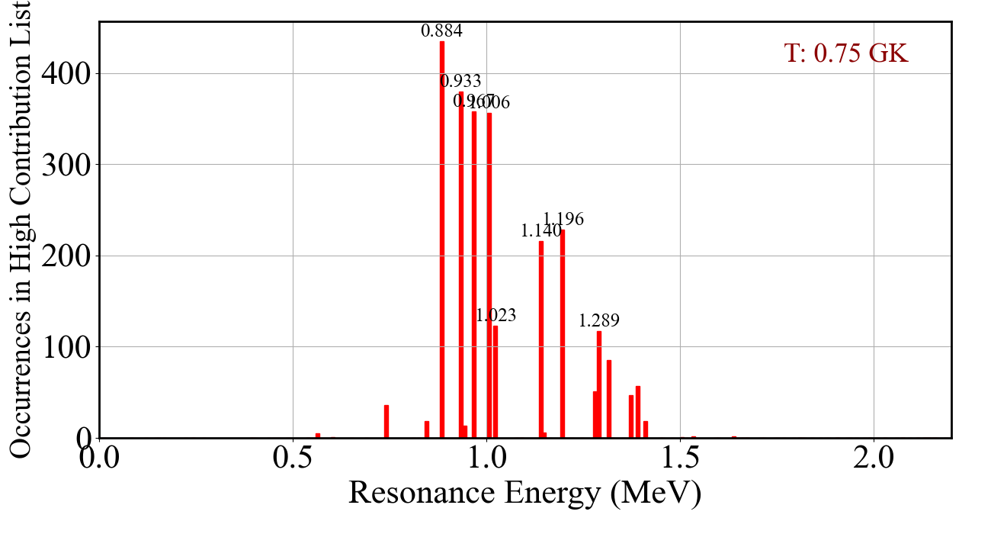
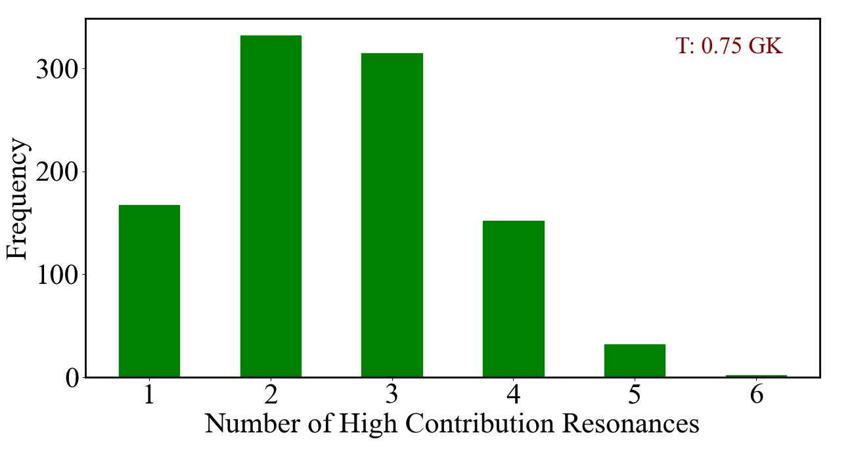

Slide 12
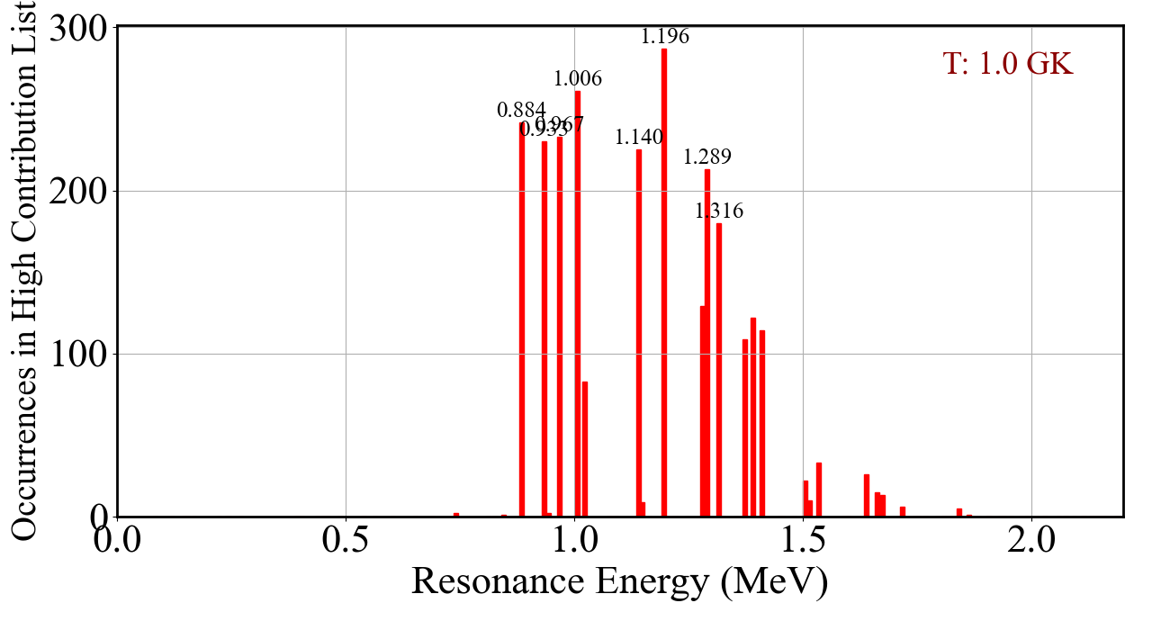
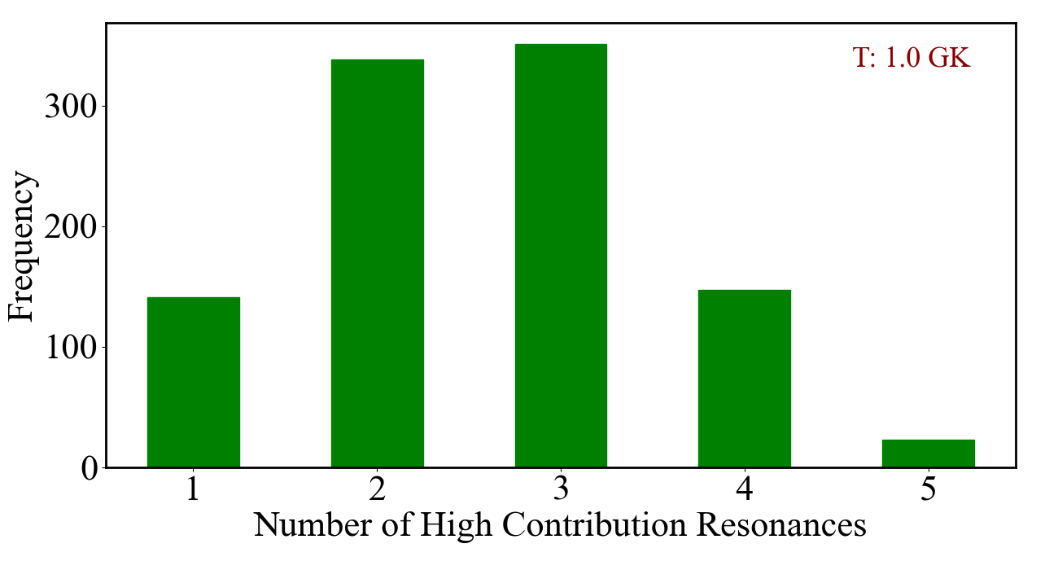

Slide 13
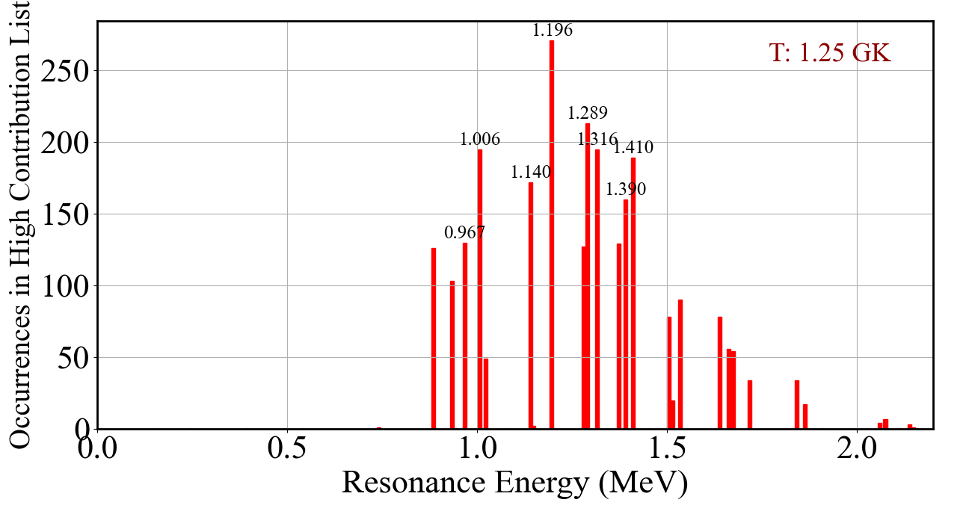
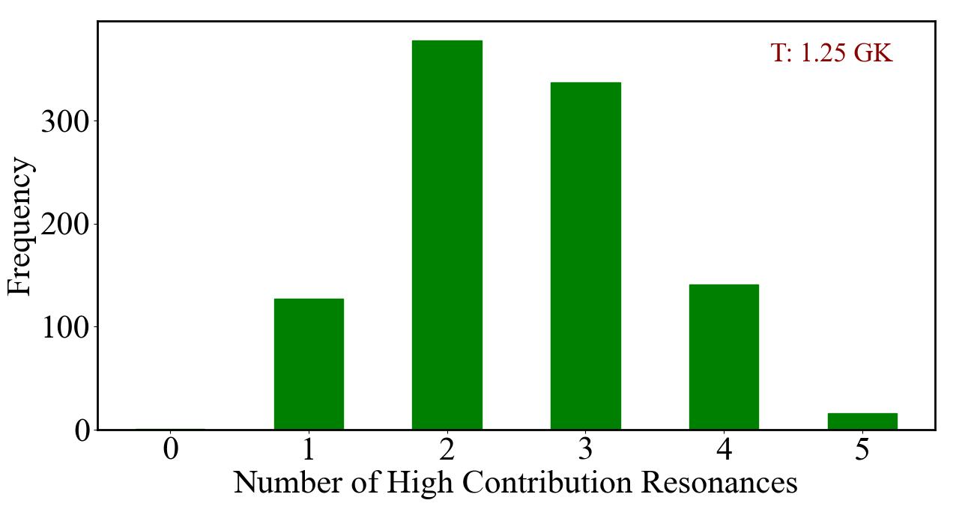

Slide 14
