Slide 1
PXCT Test
20230921

Slide 2
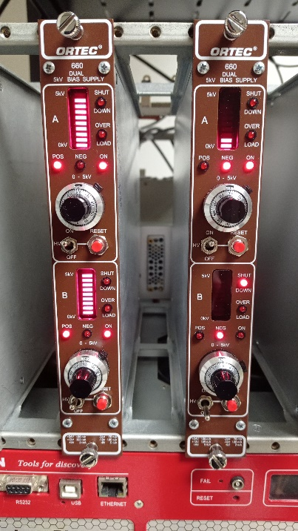
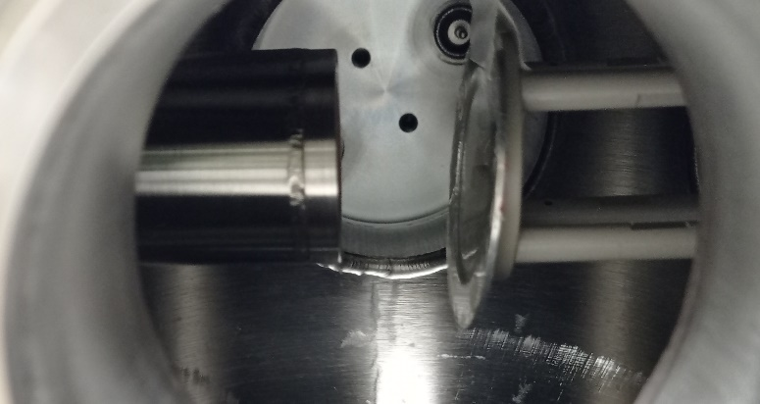
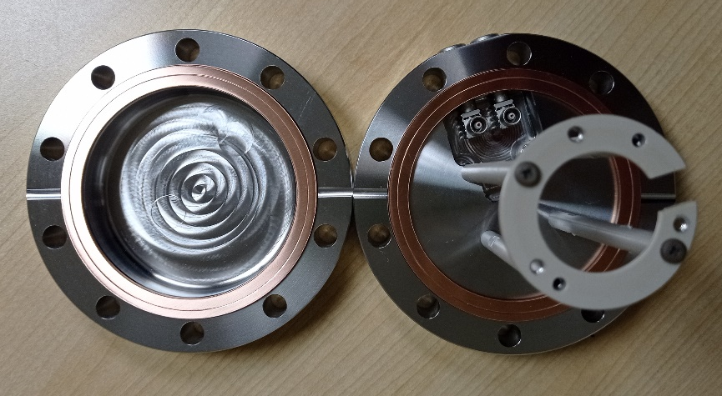
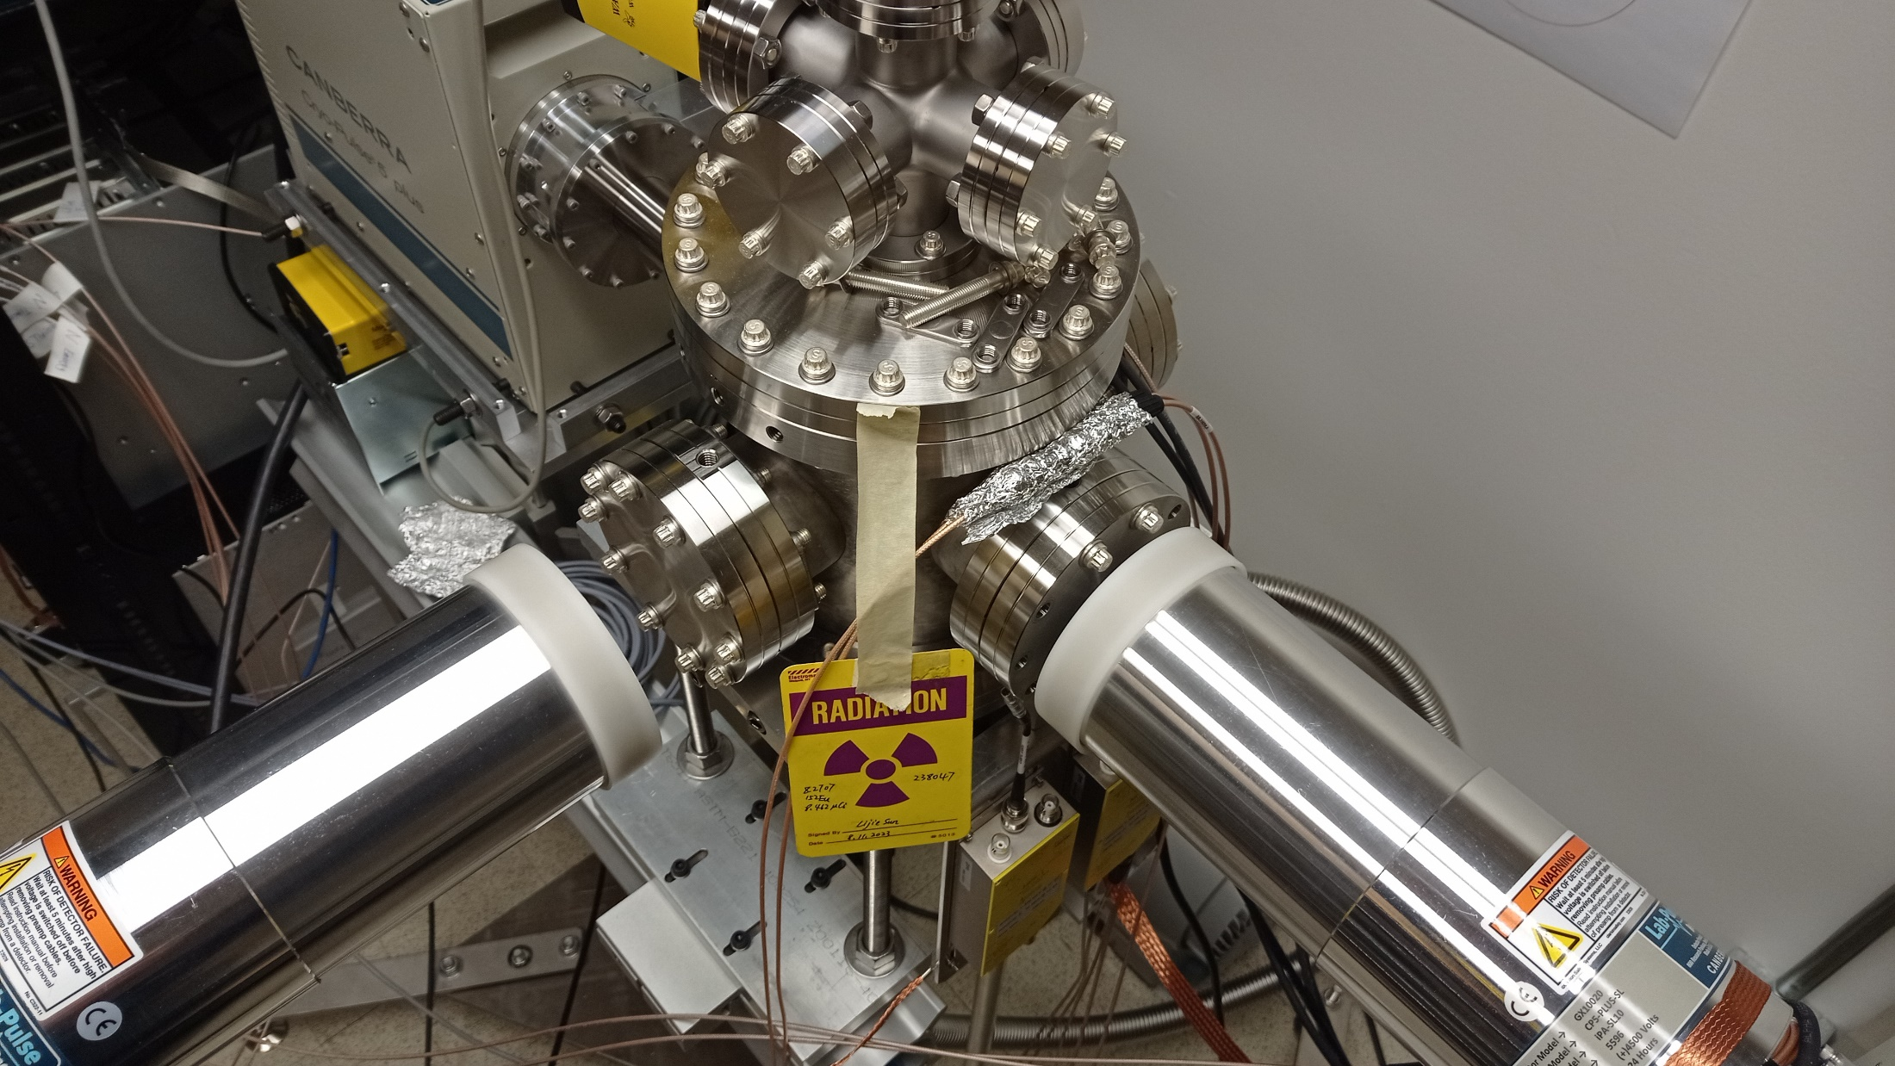
LEGe
¹⁵²Eu
5 cm of air
With cap on
1.5 cm of air
With cap on
XtRa North
XtRa South

Slide 3
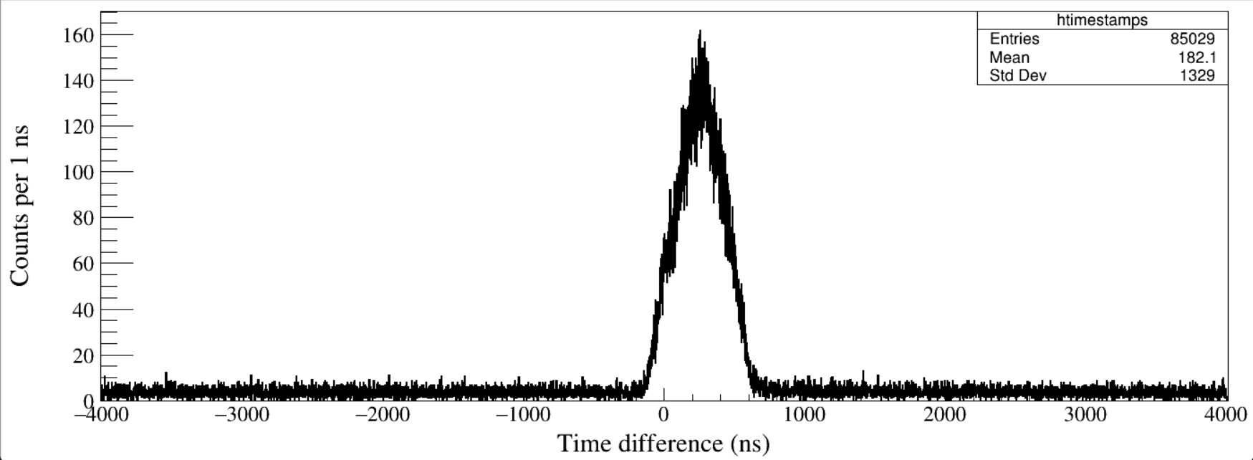
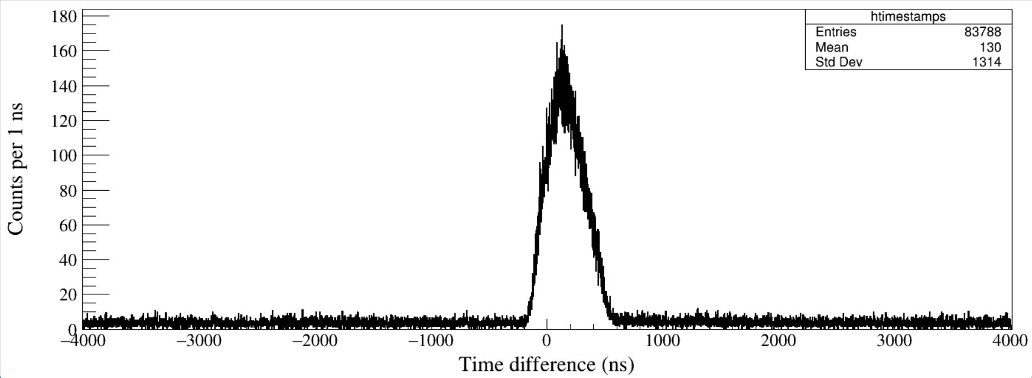
Run21
Coin. Window = 4 μs
North – LEGe
Run21
Coin. Window = 4 μs
South – LEGe
Notes:
TFile *_file0 = TFile::Open("F:/e21010/pxct/run0021-00_LEGe_XtRa_152Eu_50min_window4us_cal.root");
TCanvas* canvaspeak = new TCanvas("South", "South", 1400, 540);//建立画布
canvaspeak->cd();//进入画布
canvaspeak->SetTopMargin(0.025);
canvaspeak->SetRightMargin(0.02);
canvaspeak->SetLeftMargin(0.08);
canvaspeak->SetBottomMargin(0.13);
TH1D* htimestamps = new TH1D("htimestamps", "htimestamps", 8020,-4010,4010);
//tree->Draw("north_t-lege_t>>htimestamps","north_t>0&&lege_t>0");
tree->Draw("south_t-lege_t>>htimestamps","south_t>0&&lege_t>0");
//tree->Draw("north_t-south_t>>htimestamps","north_t>0&&south_t>0");
//tree->Draw("north_t_low-north_t>>htimestamps","north_t>0&&north_t_low>0");
//tree->Draw("south_t_low-south_t>>htimestamps","south_t>0&&south_t_low>0");
htimestamps->SetLineWidth(2);
htimestamps->Rebin(1);
htimestamps->SetLineColor(1);
//htimestamps->SetStats(0);
htimestamps->SetTitle("");
htimestamps->GetXaxis()->SetTitle("Time difference (ns)");//轴名
htimestamps->GetYaxis()->SetTitle("Counts per 1 ns");//轴名
htimestamps->GetXaxis()->CenterTitle();//居中
htimestamps->GetYaxis()->CenterTitle();//居中
htimestamps->GetXaxis()->SetLabelFont(132);//坐标字体
htimestamps->GetYaxis()->SetLabelFont(132);//坐标字体
htimestamps->GetXaxis()->SetLabelSize(0.05);
htimestamps->GetYaxis()->SetLabelSize(0.05);
htimestamps->GetXaxis()->SetTitleFont(132);//轴名字体
htimestamps->GetYaxis()->SetTitleFont(132);//轴名字体
htimestamps->GetXaxis()->SetTitleOffset(1.0);//轴名偏移
htimestamps->GetYaxis()->SetTitleOffset(0.66);//轴名偏移
htimestamps->GetXaxis()->SetTitleSize(0.06);
htimestamps->GetYaxis()->SetTitleSize(0.06);
//htimestamps->GetXaxis()->SetRangeUser(0,1600);
//htimestamps->GetYaxis()->SetRangeUser(1,5500);
htimestamps->Draw("hist");

Slide 4
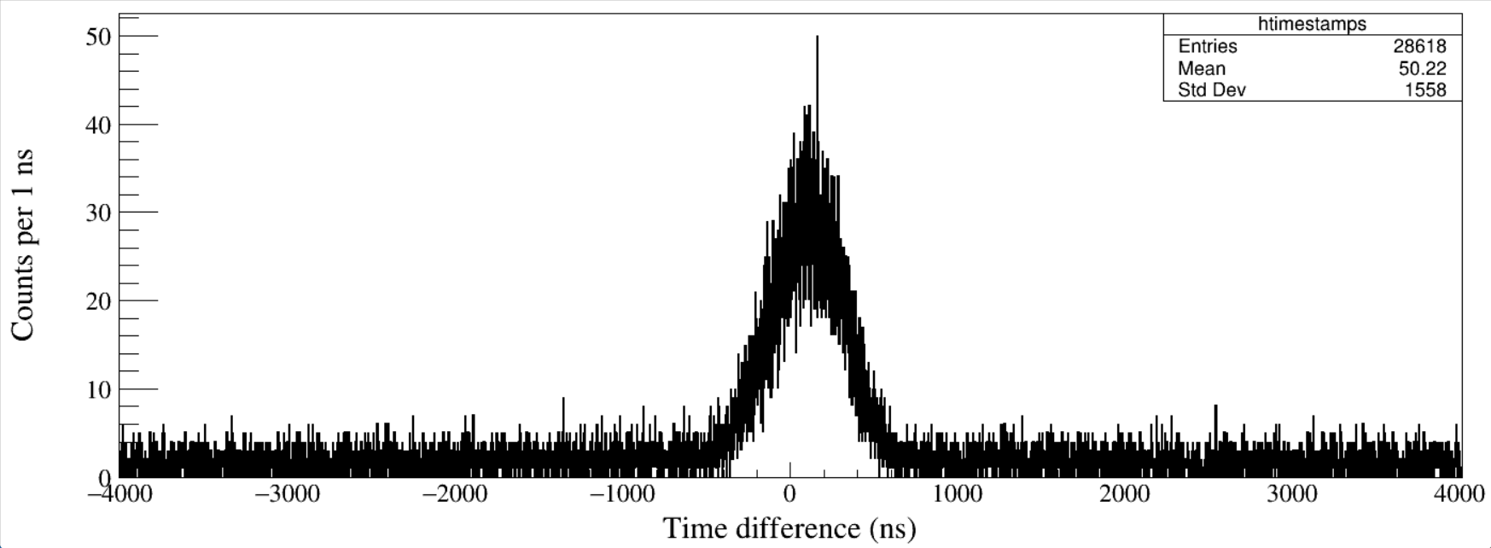
Run21
Coin. Window = 4 μs
North – South
Notes:
TFile *_file0 = TFile::Open("F:/e21010/pxct/run0021-00_LEGe_XtRa_152Eu_50min_window4us_cal.root");
TCanvas* canvaspeak = new TCanvas("South", "South", 1400, 540);//建立画布
canvaspeak->cd();//进入画布
canvaspeak->SetTopMargin(0.025);
canvaspeak->SetRightMargin(0.02);
canvaspeak->SetLeftMargin(0.08);
canvaspeak->SetBottomMargin(0.13);
TH1D* htimestamps = new TH1D("htimestamps", "htimestamps", 8020,-4010,4010);
tree->Draw("north_t-south_t>>htimestamps","north_t>0&&south_t>0");
//tree->Draw("north_t_low-north_t>>htimestamps","north_t>0&&north_t_low>0");
//tree->Draw("south_t_low-south_t>>htimestamps","south_t>0&&south_t_low>0");
htimestamps->SetLineWidth(2);
htimestamps->Rebin(1);
htimestamps->SetLineColor(1);
//htimestamps->SetStats(0);
htimestamps->SetTitle("");
htimestamps->GetXaxis()->SetTitle("Time difference (ns)");//轴名
htimestamps->GetYaxis()->SetTitle("Counts per 1 ns");//轴名
htimestamps->GetXaxis()->CenterTitle();//居中
htimestamps->GetYaxis()->CenterTitle();//居中
htimestamps->GetXaxis()->SetLabelFont(132);//坐标字体
htimestamps->GetYaxis()->SetLabelFont(132);//坐标字体
htimestamps->GetXaxis()->SetLabelSize(0.05);
htimestamps->GetYaxis()->SetLabelSize(0.05);
htimestamps->GetXaxis()->SetTitleFont(132);//轴名字体
htimestamps->GetYaxis()->SetTitleFont(132);//轴名字体
htimestamps->GetXaxis()->SetTitleOffset(1.0);//轴名偏移
htimestamps->GetYaxis()->SetTitleOffset(0.66);//轴名偏移
htimestamps->GetXaxis()->SetTitleSize(0.06);
htimestamps->GetYaxis()->SetTitleSize(0.06);
//htimestamps->GetXaxis()->SetRangeUser(0,1600);
//htimestamps->GetYaxis()->SetRangeUser(1,5500);
htimestamps->Draw("hist");

Slide 5
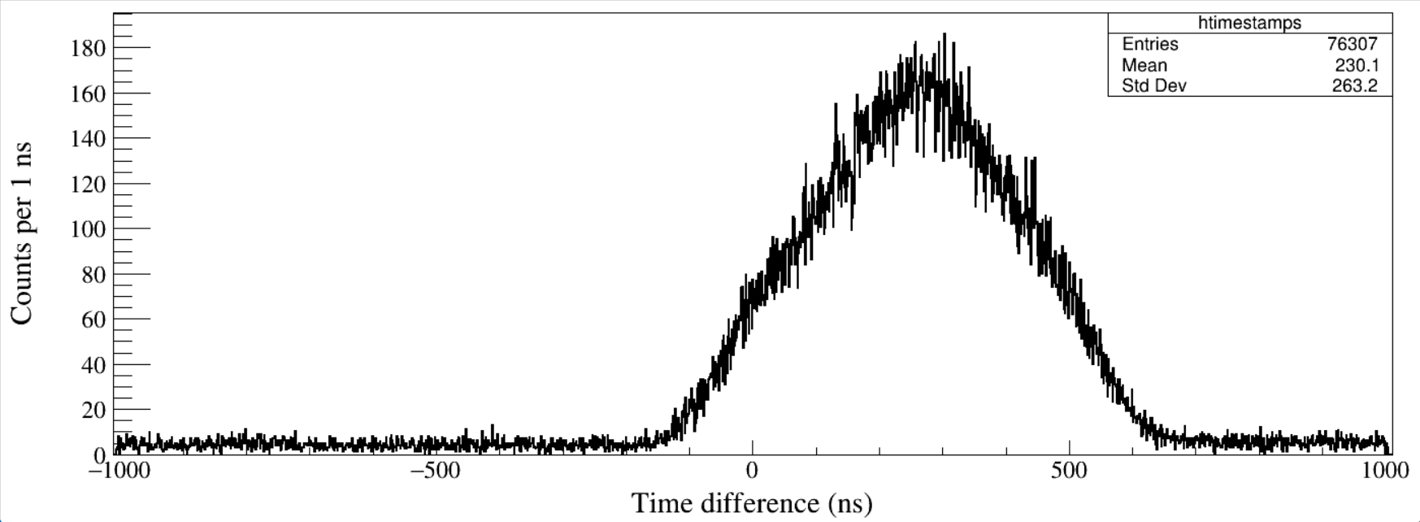
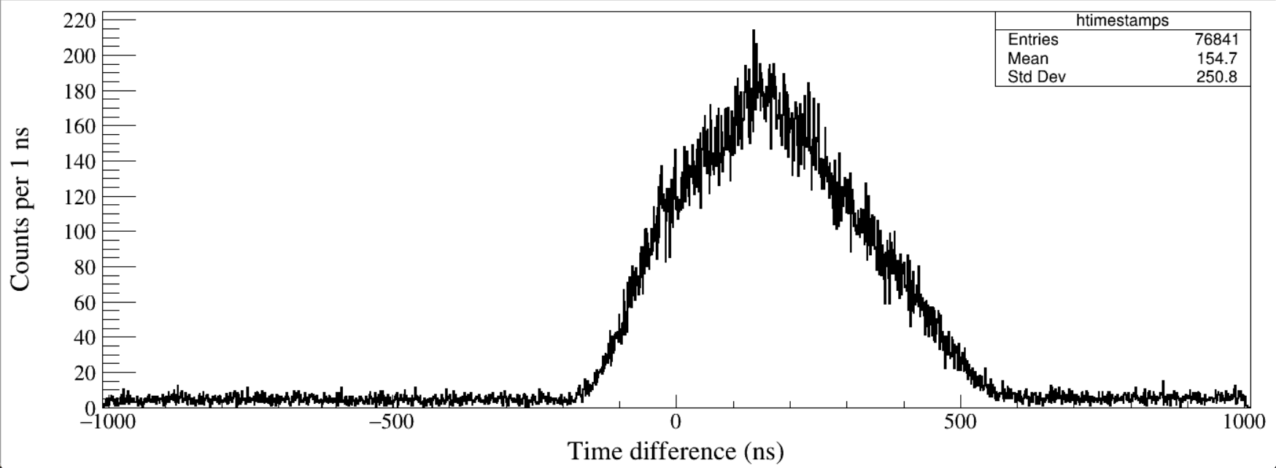
Run23
Coin. Window = 1 μs
North – LEGe
Run23
Coin. Window = 1 μs
South – LEGe
Notes:
TFile *_file0 = TFile::Open("F:/e21010/pxct/run0023-00_LEGe_XtRa_152Eu_60min_window1us_cal.root");
TCanvas* canvaspeak = new TCanvas("South", "South", 1400, 540);//建立画布
canvaspeak->cd();//进入画布
canvaspeak->SetTopMargin(0.025);
canvaspeak->SetRightMargin(0.02);
canvaspeak->SetLeftMargin(0.08);
canvaspeak->SetBottomMargin(0.13);
TH1D* htimestamps = new TH1D("htimestamps", "htimestamps", 2020,-1010,1010);
tree->Draw("north_t-lege_t>>htimestamps","north_t>0&&lege_t>0");
//tree->Draw("south_t-lege_t>>htimestamps","south_t>0&&lege_t>0");
//tree->Draw("north_t-south_t>>htimestamps","north_t>0&&south_t>0");
//tree->Draw("north_t_low-north_t>>htimestamps","north_t>0&&north_t_low>0");
//tree->Draw("south_t_low-south_t>>htimestamps","south_t>0&&south_t_low>0");
htimestamps->SetLineWidth(2);
htimestamps->Rebin(1);
htimestamps->SetLineColor(1);
//htimestamps->SetStats(0);
htimestamps->SetTitle("");
htimestamps->GetXaxis()->SetTitle("Time difference (ns)");//轴名
htimestamps->GetYaxis()->SetTitle("Counts per 1 ns");//轴名
htimestamps->GetXaxis()->CenterTitle();//居中
htimestamps->GetYaxis()->CenterTitle();//居中
htimestamps->GetXaxis()->SetLabelFont(132);//坐标字体
htimestamps->GetYaxis()->SetLabelFont(132);//坐标字体
htimestamps->GetXaxis()->SetLabelSize(0.05);
htimestamps->GetYaxis()->SetLabelSize(0.05);
htimestamps->GetXaxis()->SetTitleFont(132);//轴名字体
htimestamps->GetYaxis()->SetTitleFont(132);//轴名字体
htimestamps->GetXaxis()->SetTitleOffset(1.0);//轴名偏移
htimestamps->GetYaxis()->SetTitleOffset(0.66);//轴名偏移
htimestamps->GetXaxis()->SetTitleSize(0.06);
htimestamps->GetYaxis()->SetTitleSize(0.06);
//htimestamps->GetXaxis()->SetRangeUser(0,1600);
//htimestamps->GetYaxis()->SetRangeUser(1,5500);
htimestamps->Draw("hist");

Slide 6
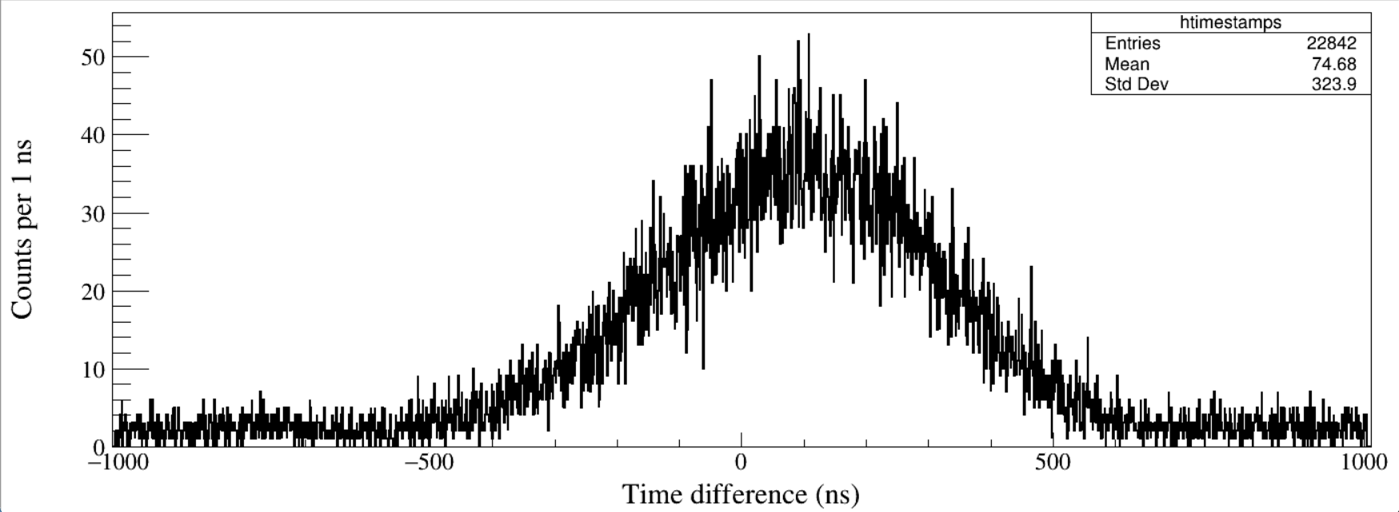
Run23
Coin. Window = 1 μs
North – South

Slide 7
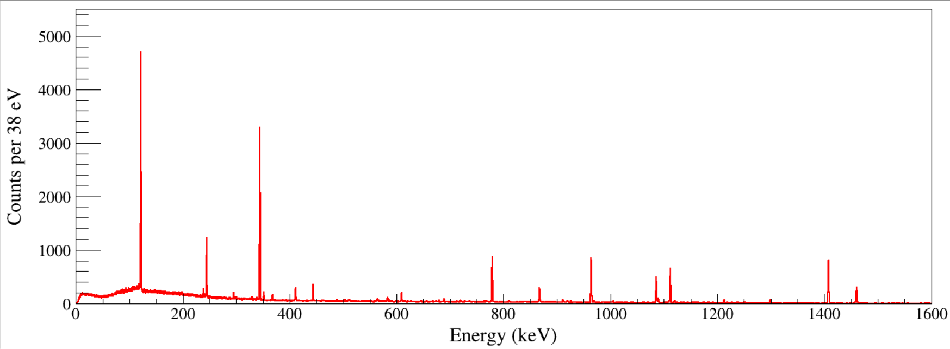
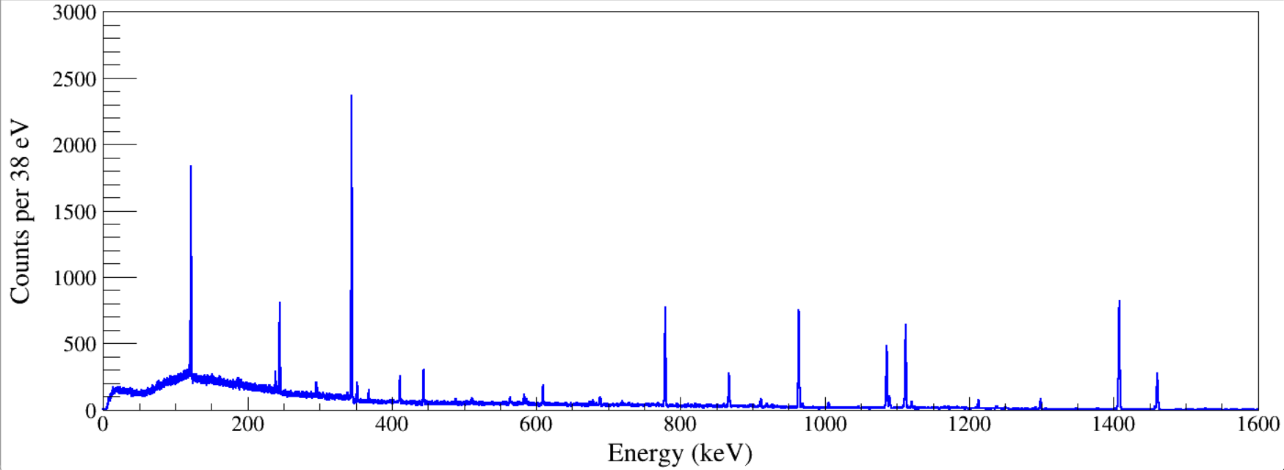
North
South
Notes:
TFile *_file0 = TFile::Open("F:/e21010/pxct/run0023-00_LEGe_XtRa_152Eu_60min_window1us_cal.root");
TCanvas* canvaspeak = new TCanvas("North", "North", 1400, 540);//建立画布
canvaspeak->cd();//进入画布
canvaspeak->SetTopMargin(0.025);
canvaspeak->SetRightMargin(0.02);
canvaspeak->SetLeftMargin(0.08);
canvaspeak->SetBottomMargin(0.13);
hnorth_e->SetLineWidth(2);
hnorth_e->Rebin(1);
hnorth_e->SetLineColor(1);
hnorth_e->SetStats(0);
hnorth_e->SetTitle("");
hnorth_e->GetXaxis()->SetTitle("Energy (keV)");//轴名
hnorth_e->GetYaxis()->SetTitle("Counts per 38 eV");//轴名
hnorth_e->GetXaxis()->CenterTitle();//居中
hnorth_e->GetYaxis()->CenterTitle();//居中
hnorth_e->GetXaxis()->SetLabelFont(132);//坐标字体
hnorth_e->GetYaxis()->SetLabelFont(132);//坐标字体
hnorth_e->GetXaxis()->SetLabelSize(0.05);
hnorth_e->GetYaxis()->SetLabelSize(0.05);
hnorth_e->GetXaxis()->SetTitleFont(132);//轴名字体
hnorth_e->GetYaxis()->SetTitleFont(132);//轴名字体
hnorth_e->GetXaxis()->SetTitleOffset(1.0);//轴名偏移
hnorth_e->GetYaxis()->SetTitleOffset(0.66);//轴名偏移
hnorth_e->GetXaxis()->SetTitleSize(0.06);
hnorth_e->GetYaxis()->SetTitleSize(0.06);
hnorth_e->GetXaxis()->SetRangeUser(0,1600);
hnorth_e->GetYaxis()->SetRangeUser(1,5500);
hnorth_e->Draw("hist");
TFile *_file0 = TFile::Open("F:/e21010/pxct/run0023-00_LEGe_XtRa_152Eu_60min_window1us_cal.root");
TCanvas* canvaspeak = new TCanvas("South", "South", 1400, 540);//建立画布
canvaspeak->cd();//进入画布
canvaspeak->SetTopMargin(0.025);
canvaspeak->SetRightMargin(0.02);
canvaspeak->SetLeftMargin(0.08);
canvaspeak->SetBottomMargin(0.13);
hsouth_e->SetLineWidth(2);
hsouth_e->Rebin(1);
hsouth_e->SetLineColor(1);
hsouth_e->SetStats(0);
hsouth_e->SetTitle("");
hsouth_e->GetXaxis()->SetTitle("Energy (keV)");//轴名
hsouth_e->GetYaxis()->SetTitle("Counts per 38 eV");//轴名
hsouth_e->GetXaxis()->CenterTitle();//居中
hsouth_e->GetYaxis()->CenterTitle();//居中
hsouth_e->GetXaxis()->SetLabelFont(132);//坐标字体
hsouth_e->GetYaxis()->SetLabelFont(132);//坐标字体
hsouth_e->GetXaxis()->SetLabelSize(0.05);
hsouth_e->GetYaxis()->SetLabelSize(0.05);
hsouth_e->GetXaxis()->SetTitleFont(132);//轴名字体
hsouth_e->GetYaxis()->SetTitleFont(132);//轴名字体
hsouth_e->GetXaxis()->SetTitleOffset(1.0);//轴名偏移
hsouth_e->GetYaxis()->SetTitleOffset(0.66);//轴名偏移
hsouth_e->GetXaxis()->SetTitleSize(0.06);
hsouth_e->GetYaxis()->SetTitleSize(0.06);
hsouth_e->GetXaxis()->SetRangeUser(0,1600);
hsouth_e->GetYaxis()->SetRangeUser(1,5500);
hsouth_e->Draw("hist");

Slide 8
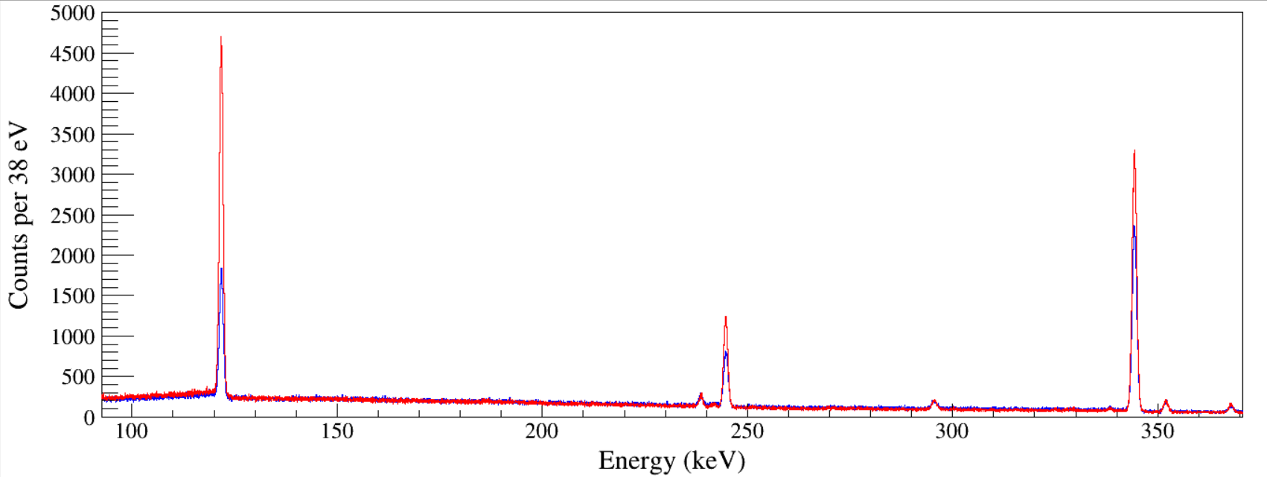
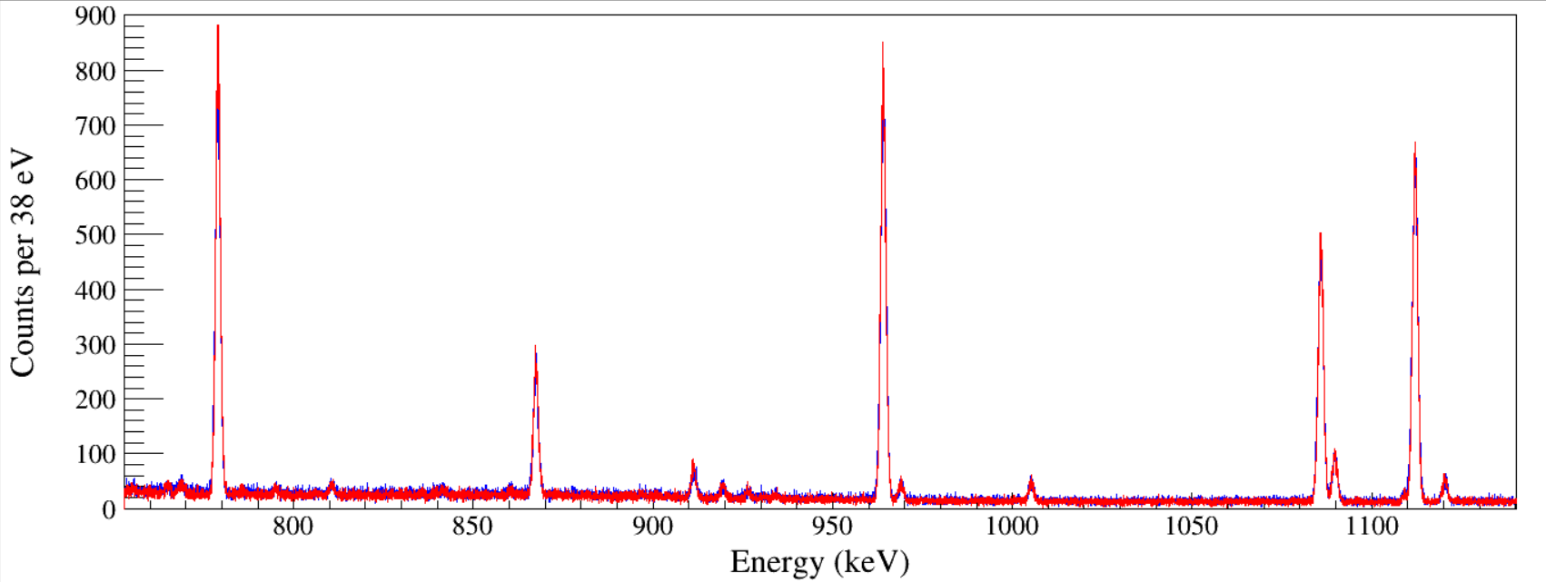
North
South

Slide 9
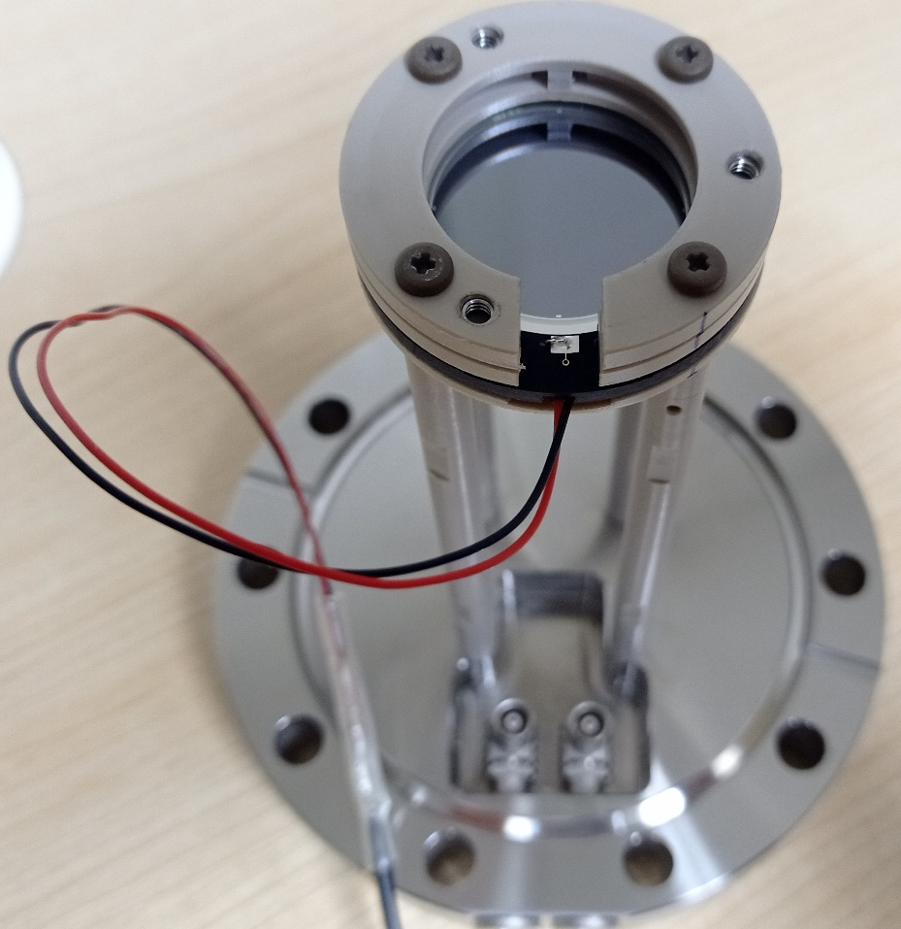
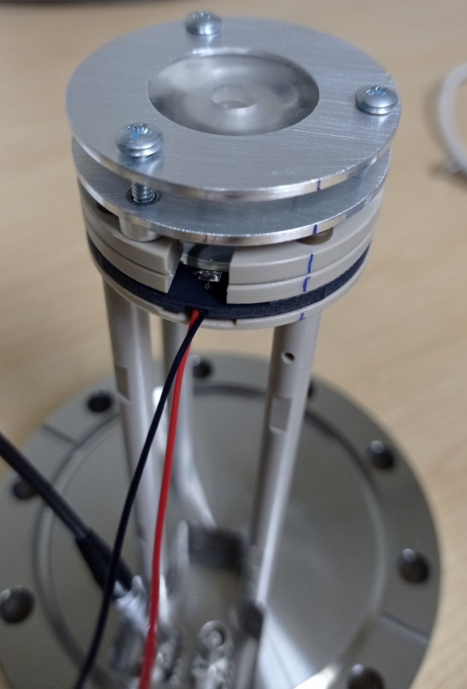
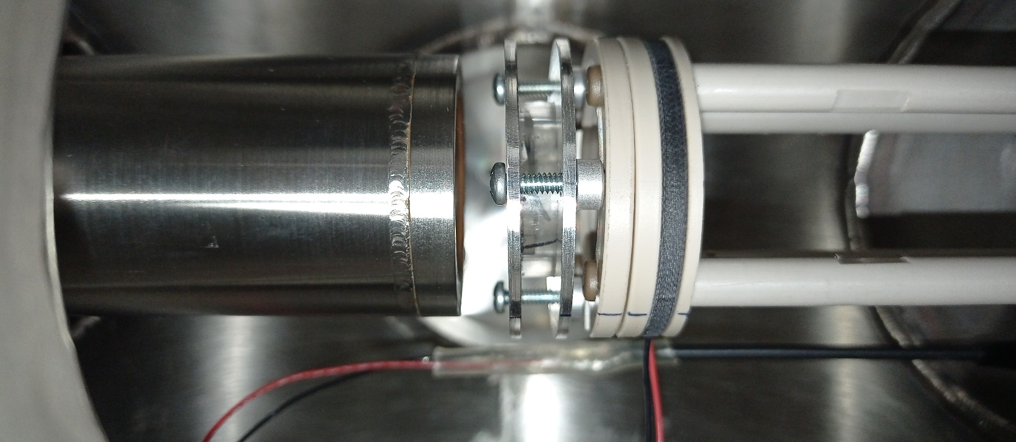

Slide 10
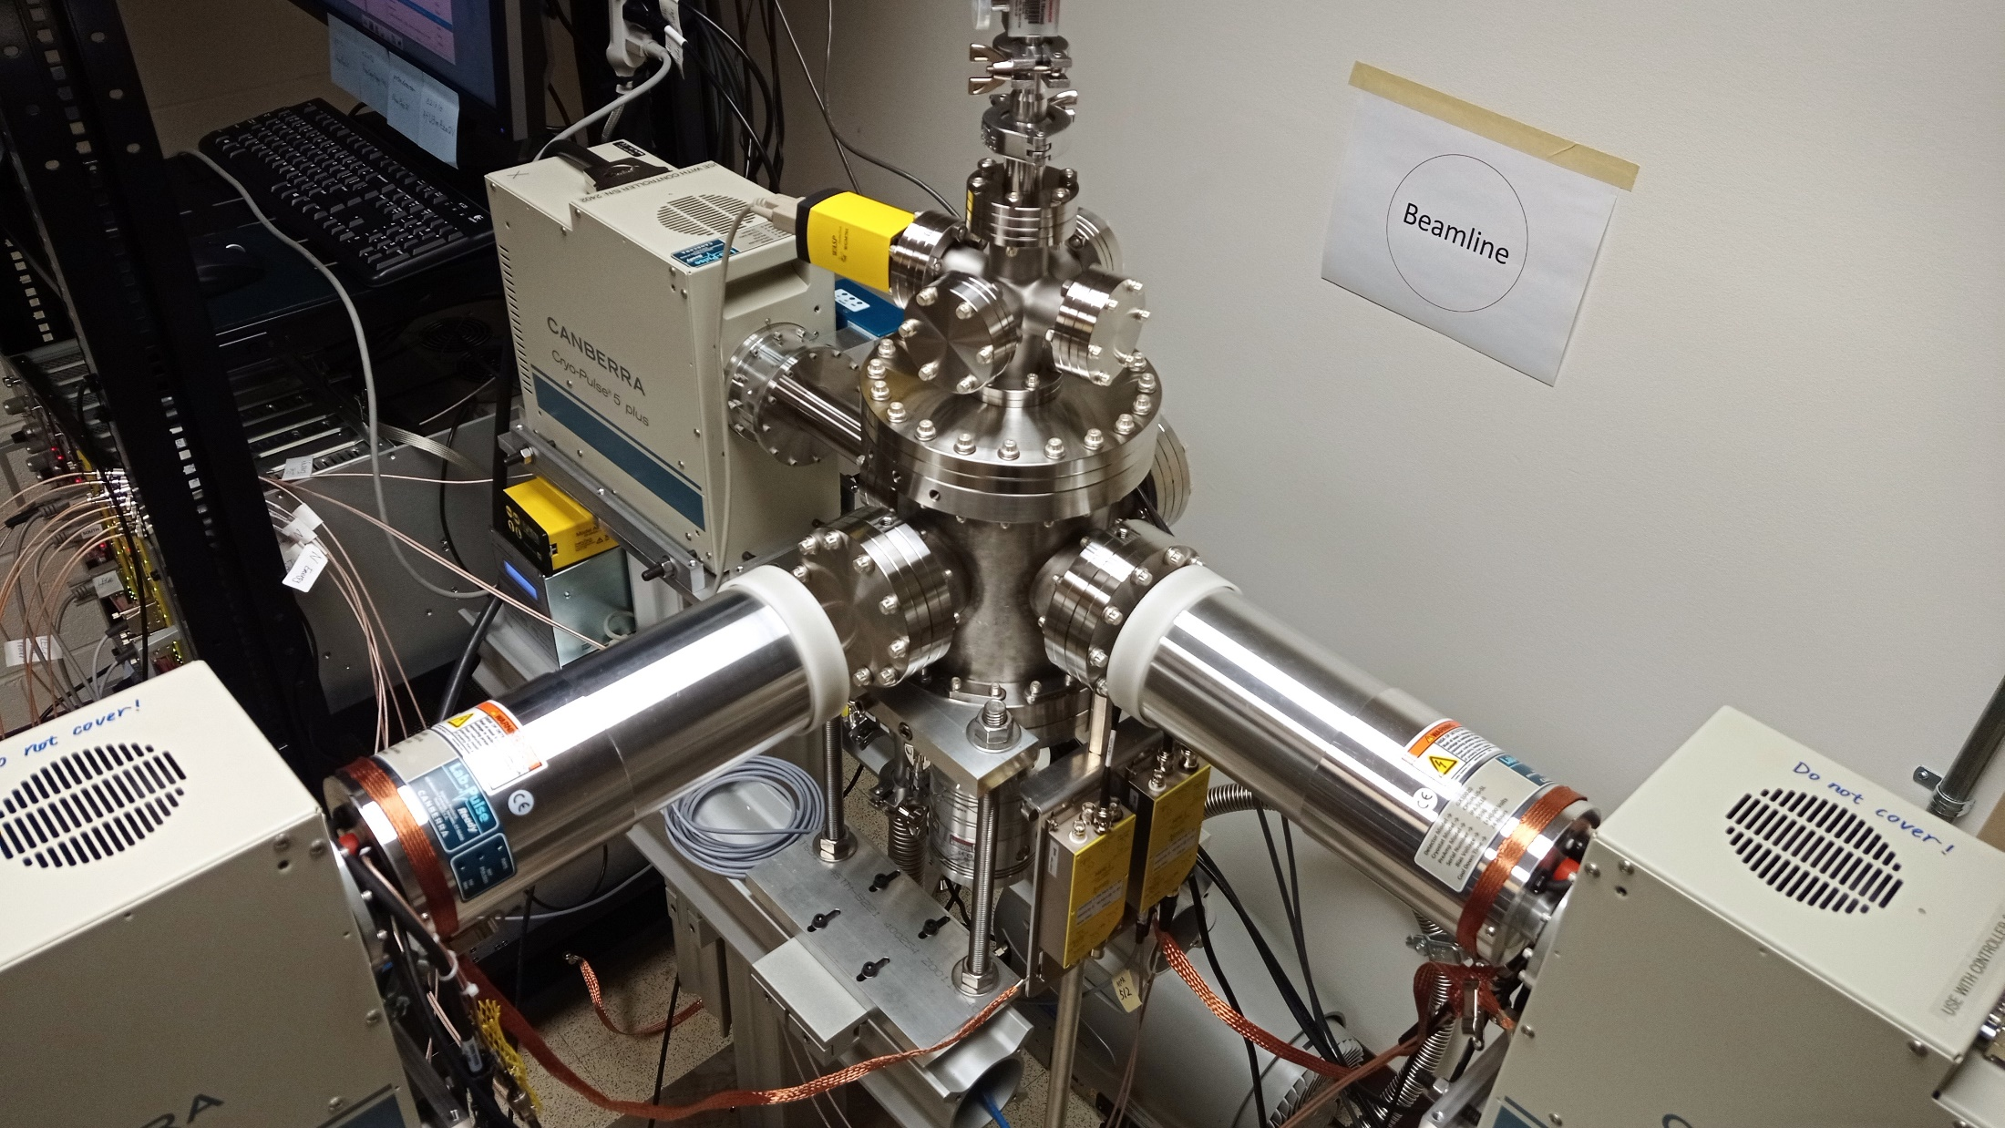

Slide 11
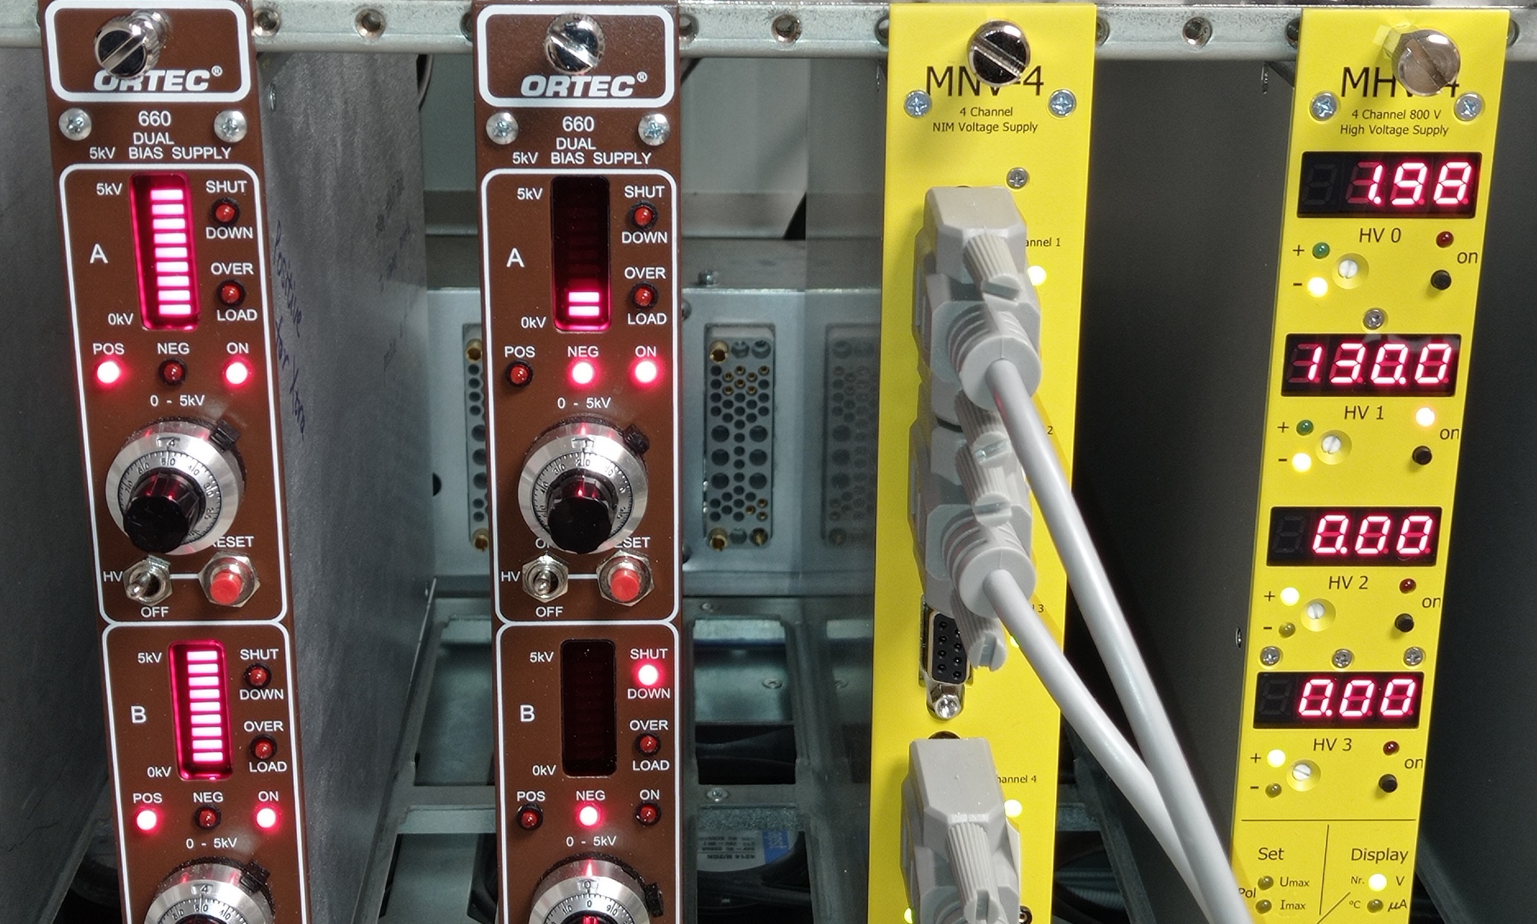

Slide 12
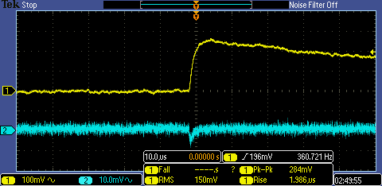
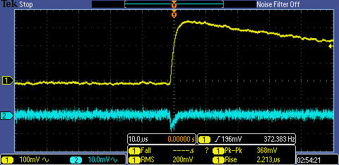
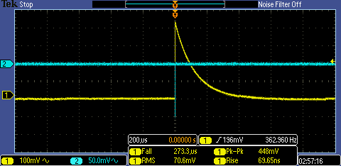
MSD26
MPR-1 512
Out1 Energy
Out2 Timing
Pressure: atmosphere
Bias: 0 V
Out1 Energy
Out2 Timing
Pressure: 1.8E-3 Torr
Bias: –130 V
Out2 Timing
Out1 Energy
Out1 Energy
Out2 Timing
Pressure: 1.8E-3 Torr
Bias: –130 V
Pressure: 7.7E-3 Torr
Bias: –130 V
Tests:
2022/07/15, V_{bias} = –130 V, I_{leak} = 62 nA, T = 65 ℉ (Manufacturer)
2023/09/10, V_{bias} = –130 V, I_{leak} = 110 nA, T = 101 ℉
2023/09/20, V_{bias} = –130 V, I_{leak} = 55 nA, T = 72 ℉

Slide 13
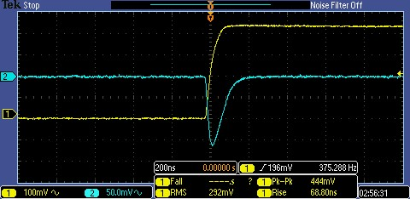
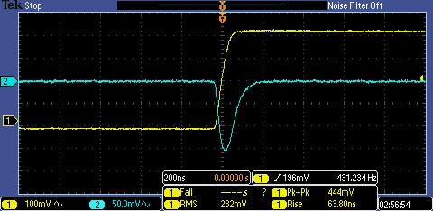
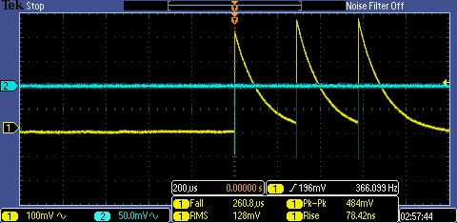
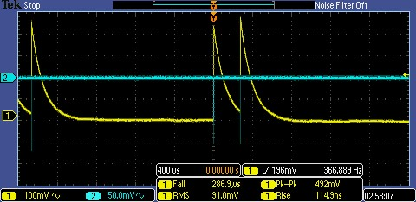
Out2 Timing
Out1 Energy
Pressure: 1.8E-3 Torr
Bias: –130 V

