Slide 1
PXCT hardware status

Slide 2
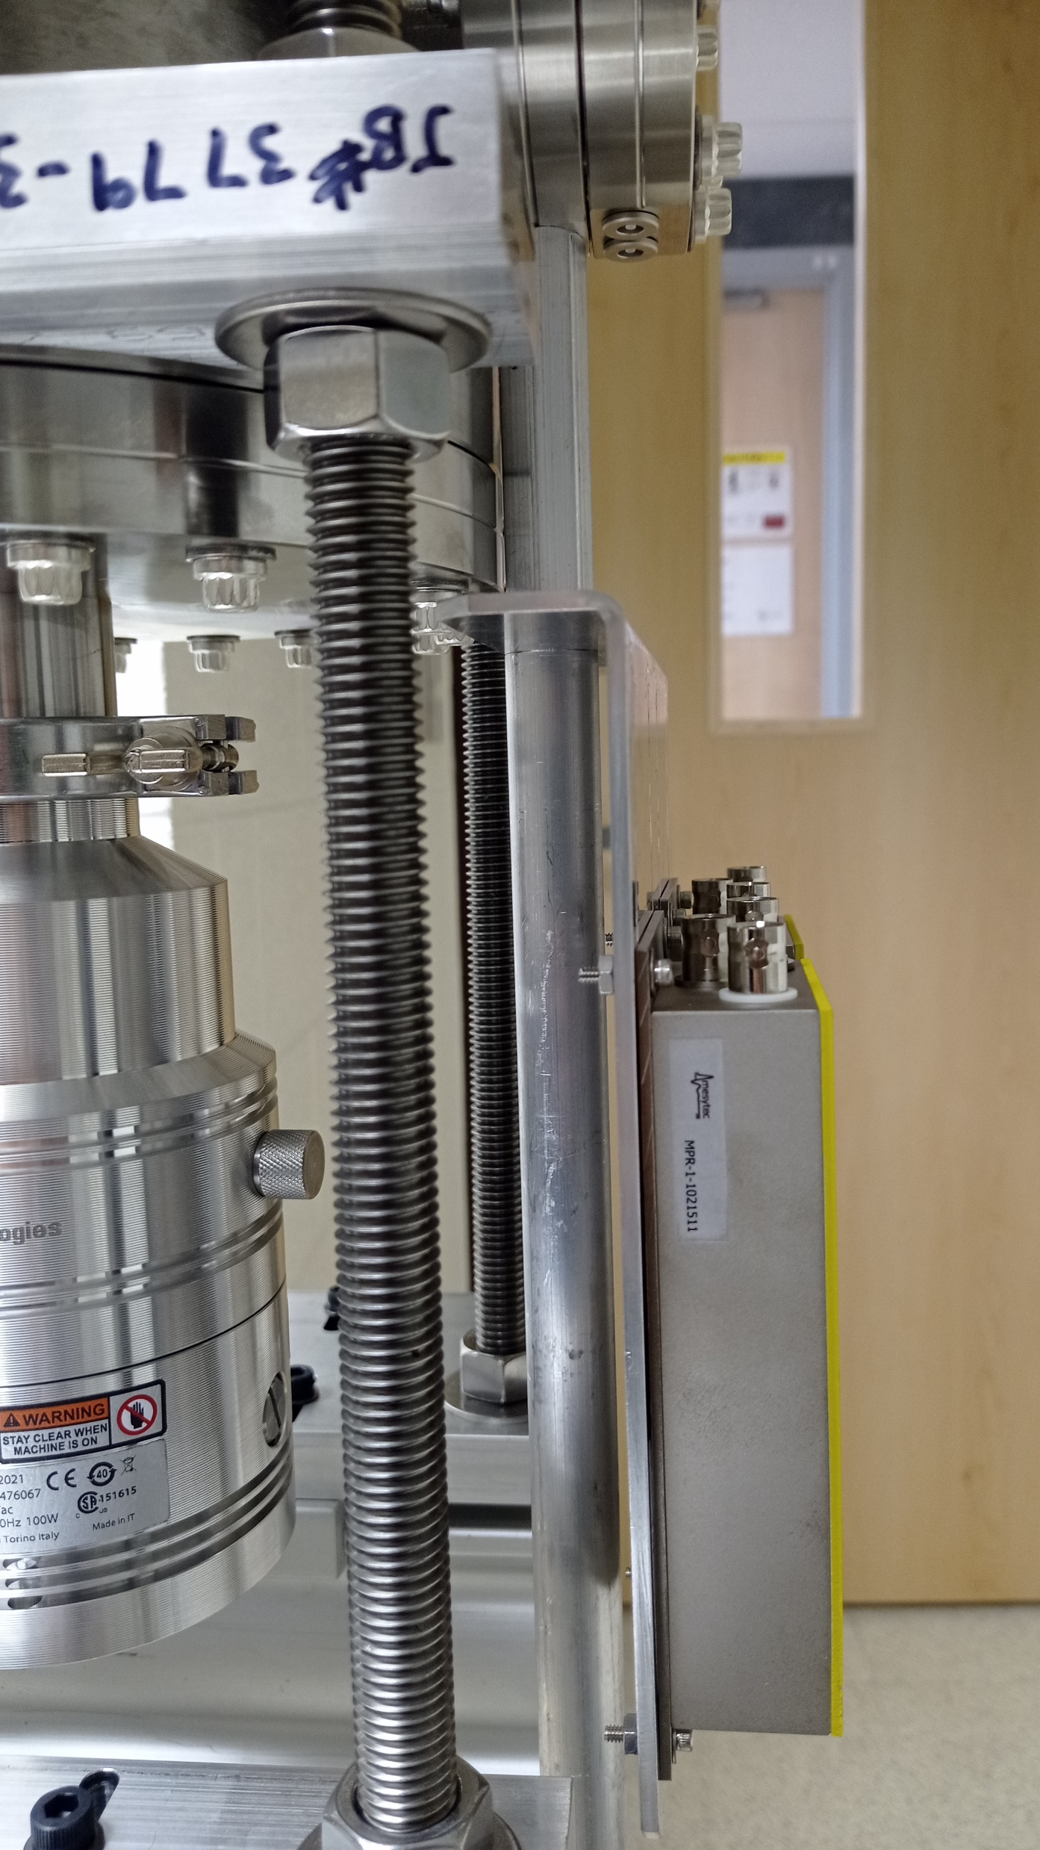
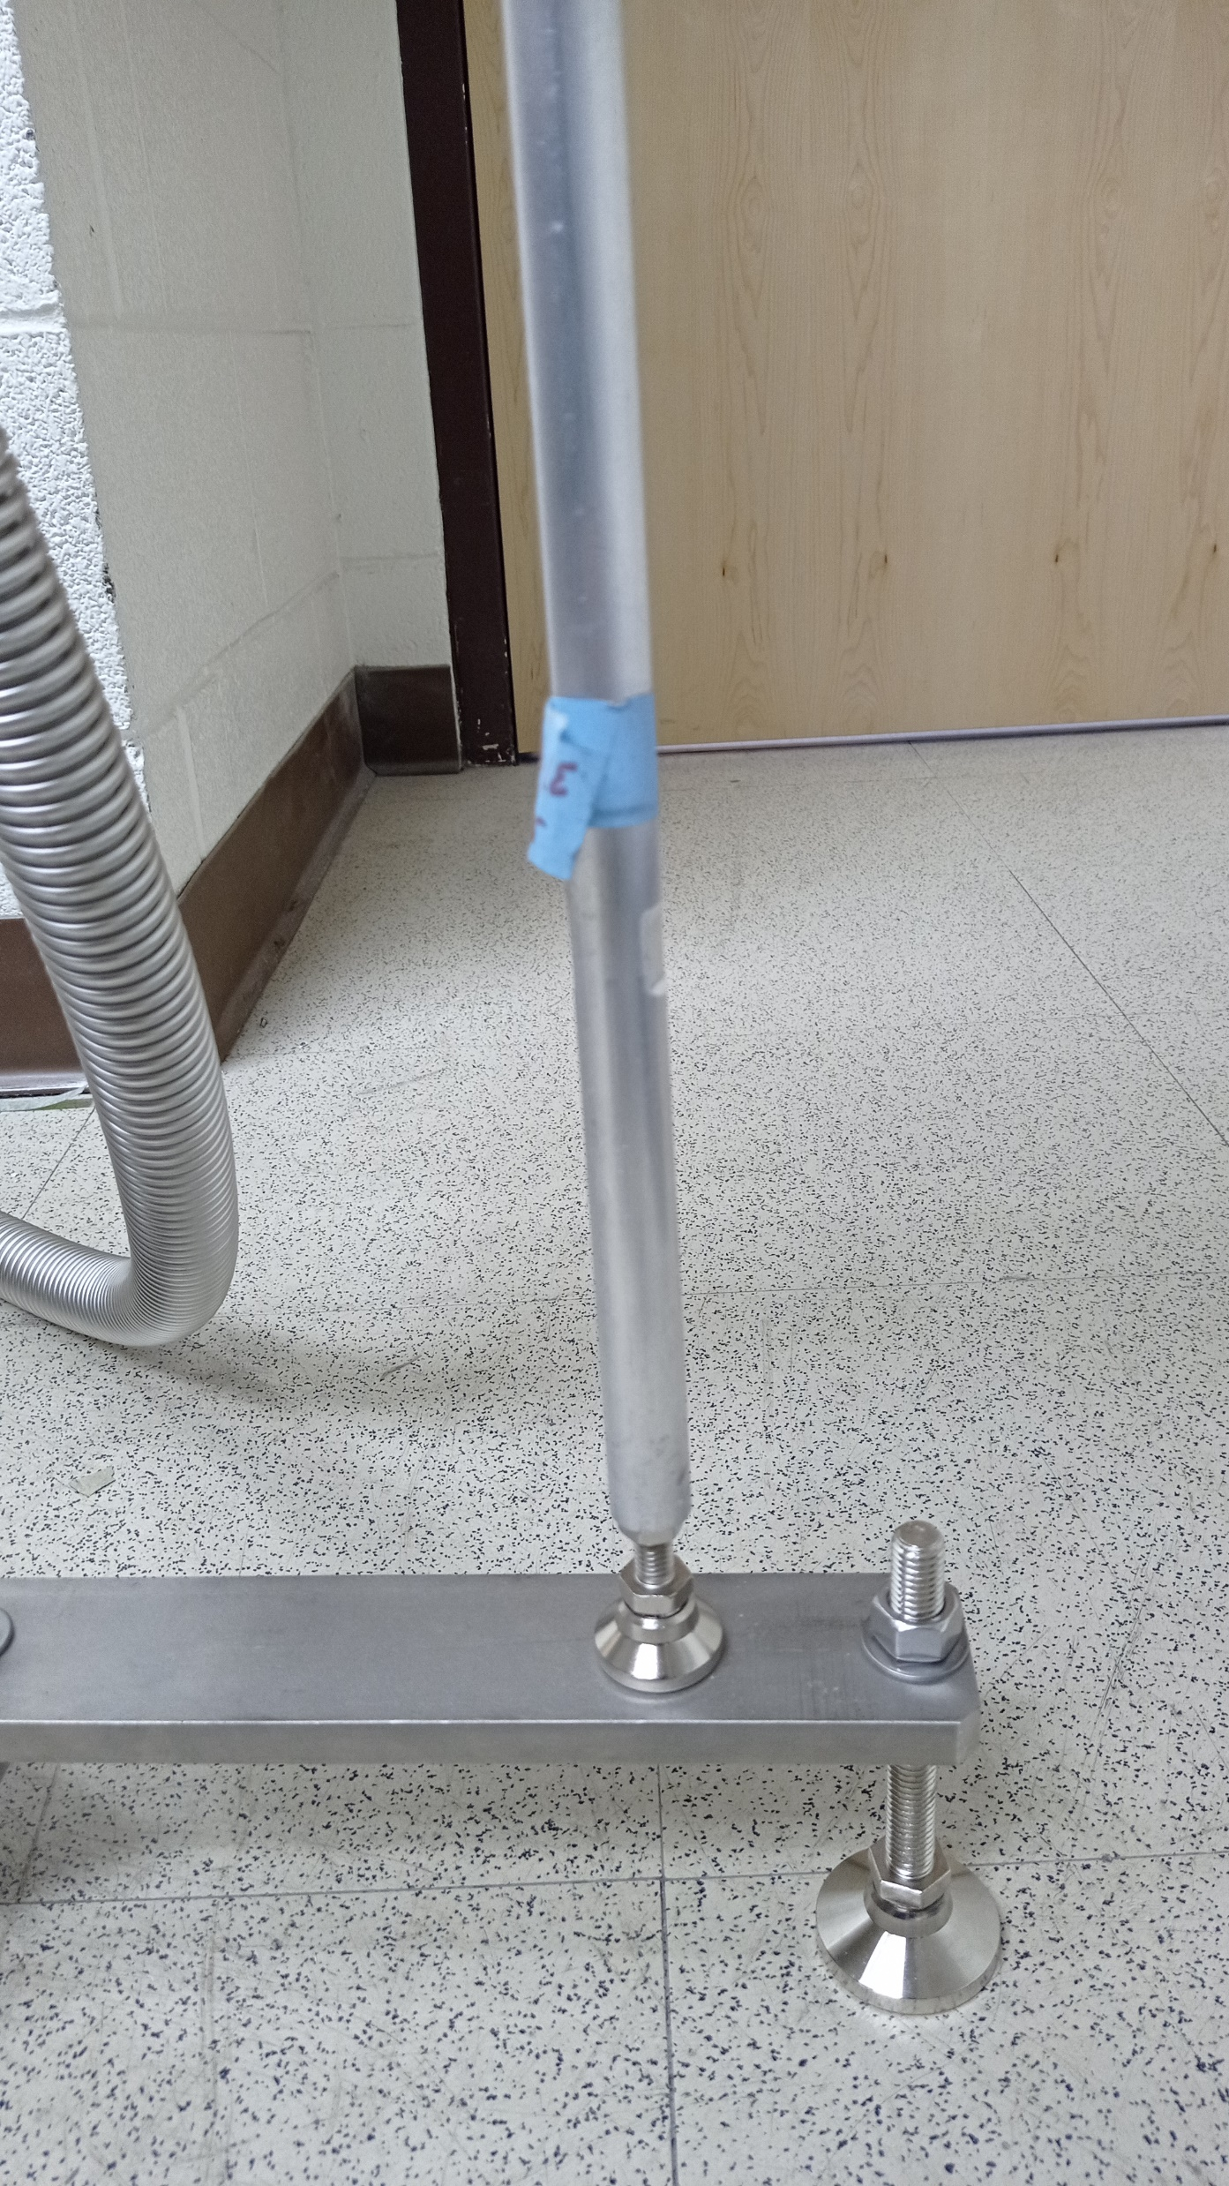
We had the rod modified at the machine shop.
Now we have much better support on the chamber side.

Slide 3
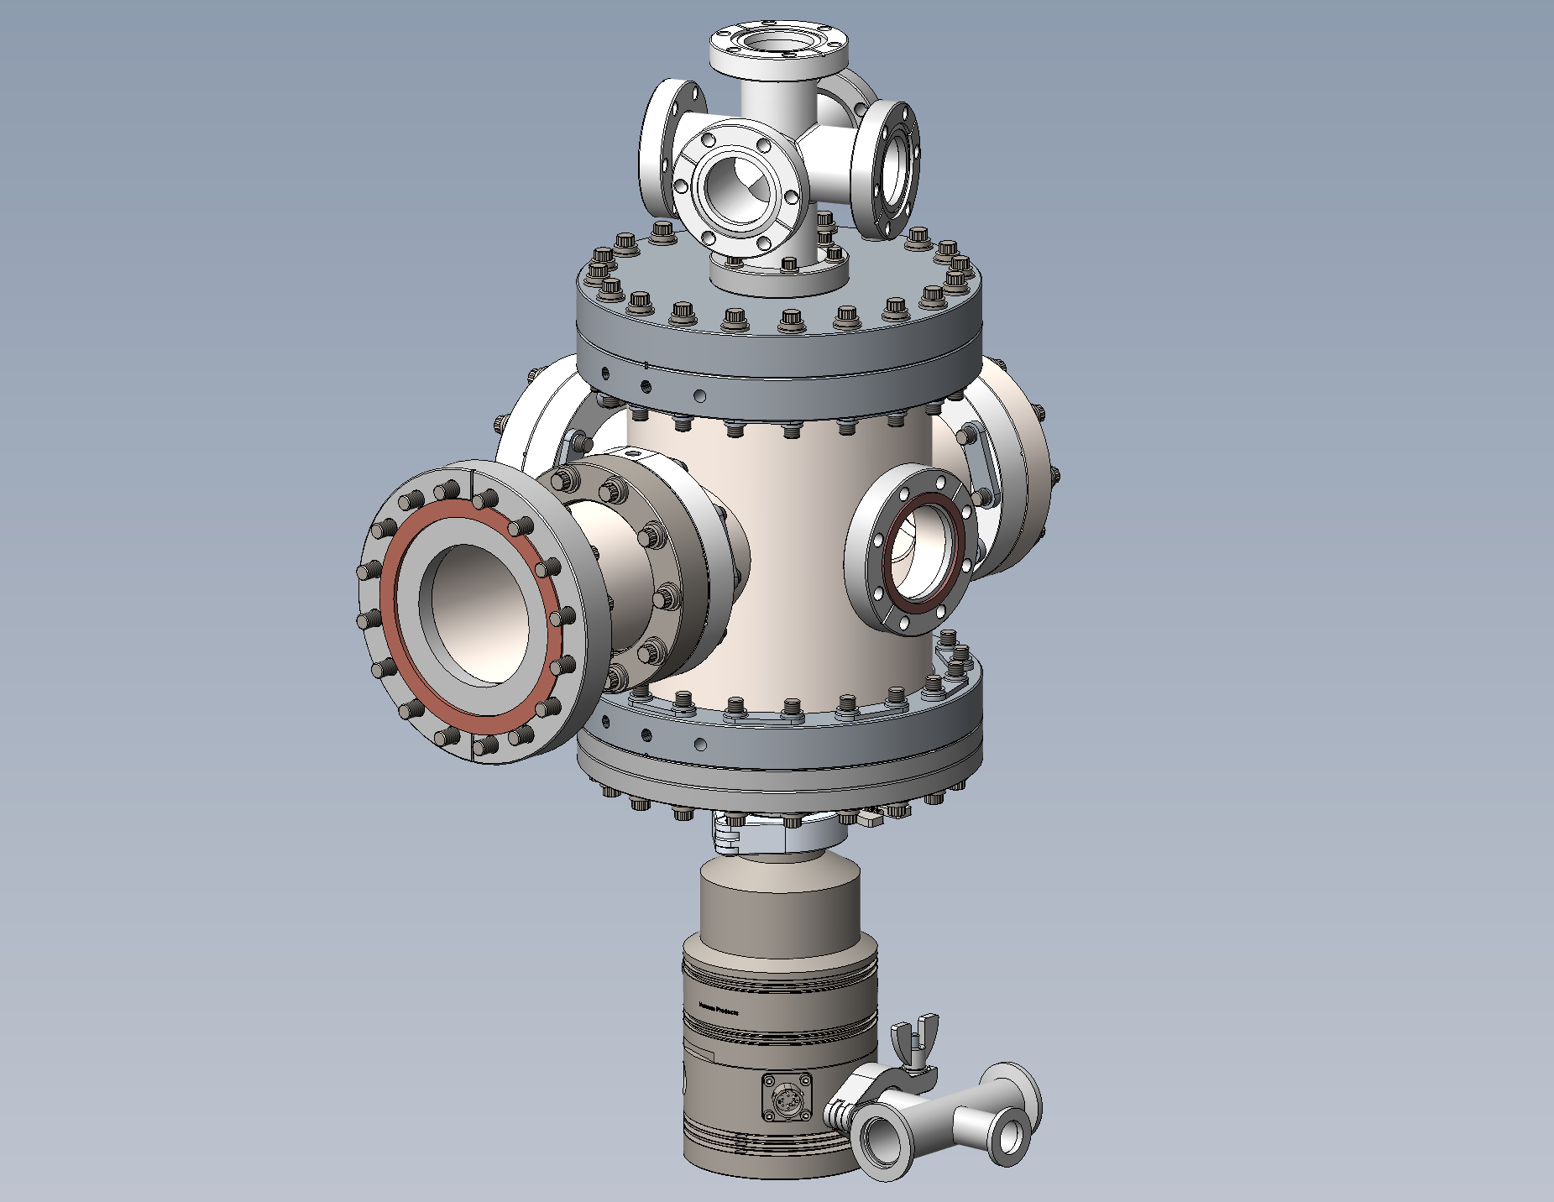
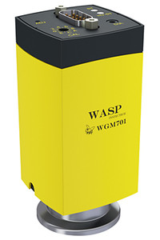
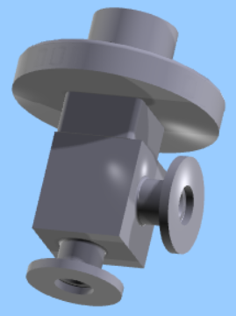
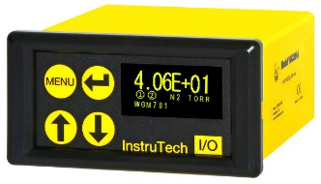
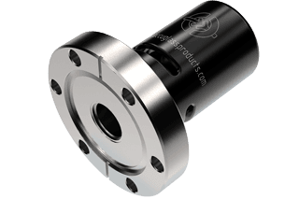
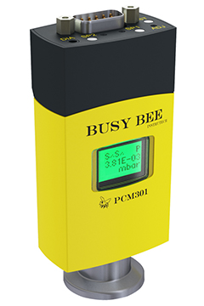
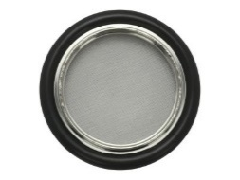
WGM701 Wasp
Cold Cathode Pirani Combination Vacuum Gauge
(2 3/4 in. CF)
AGC302 Single Channel Active Gauge Controller for PS301 Gauge Controller Power Supply
Needle valve
Pressure relief valve
C37102000 valve
(KF10) Unit Price: $548
Centering Ring Assembly KF-10 with Screen
PRV on a 2.75" CF Flange, Pressure Relief Valve - 2 PSI
PS401 Convection & Pirani Vacuum Gauge Power Supply
Inline check valve
Soft Start Valve Series 311 (KF16)
Centering Ring With Screen, NW40 Size ISO-KF Flange, Viton O-ring, 100318605
PCM301 Busy Bee Pirani Capacitance Combination Vacuum Gauge (NW16KF)
Roughing pump

Slide 4
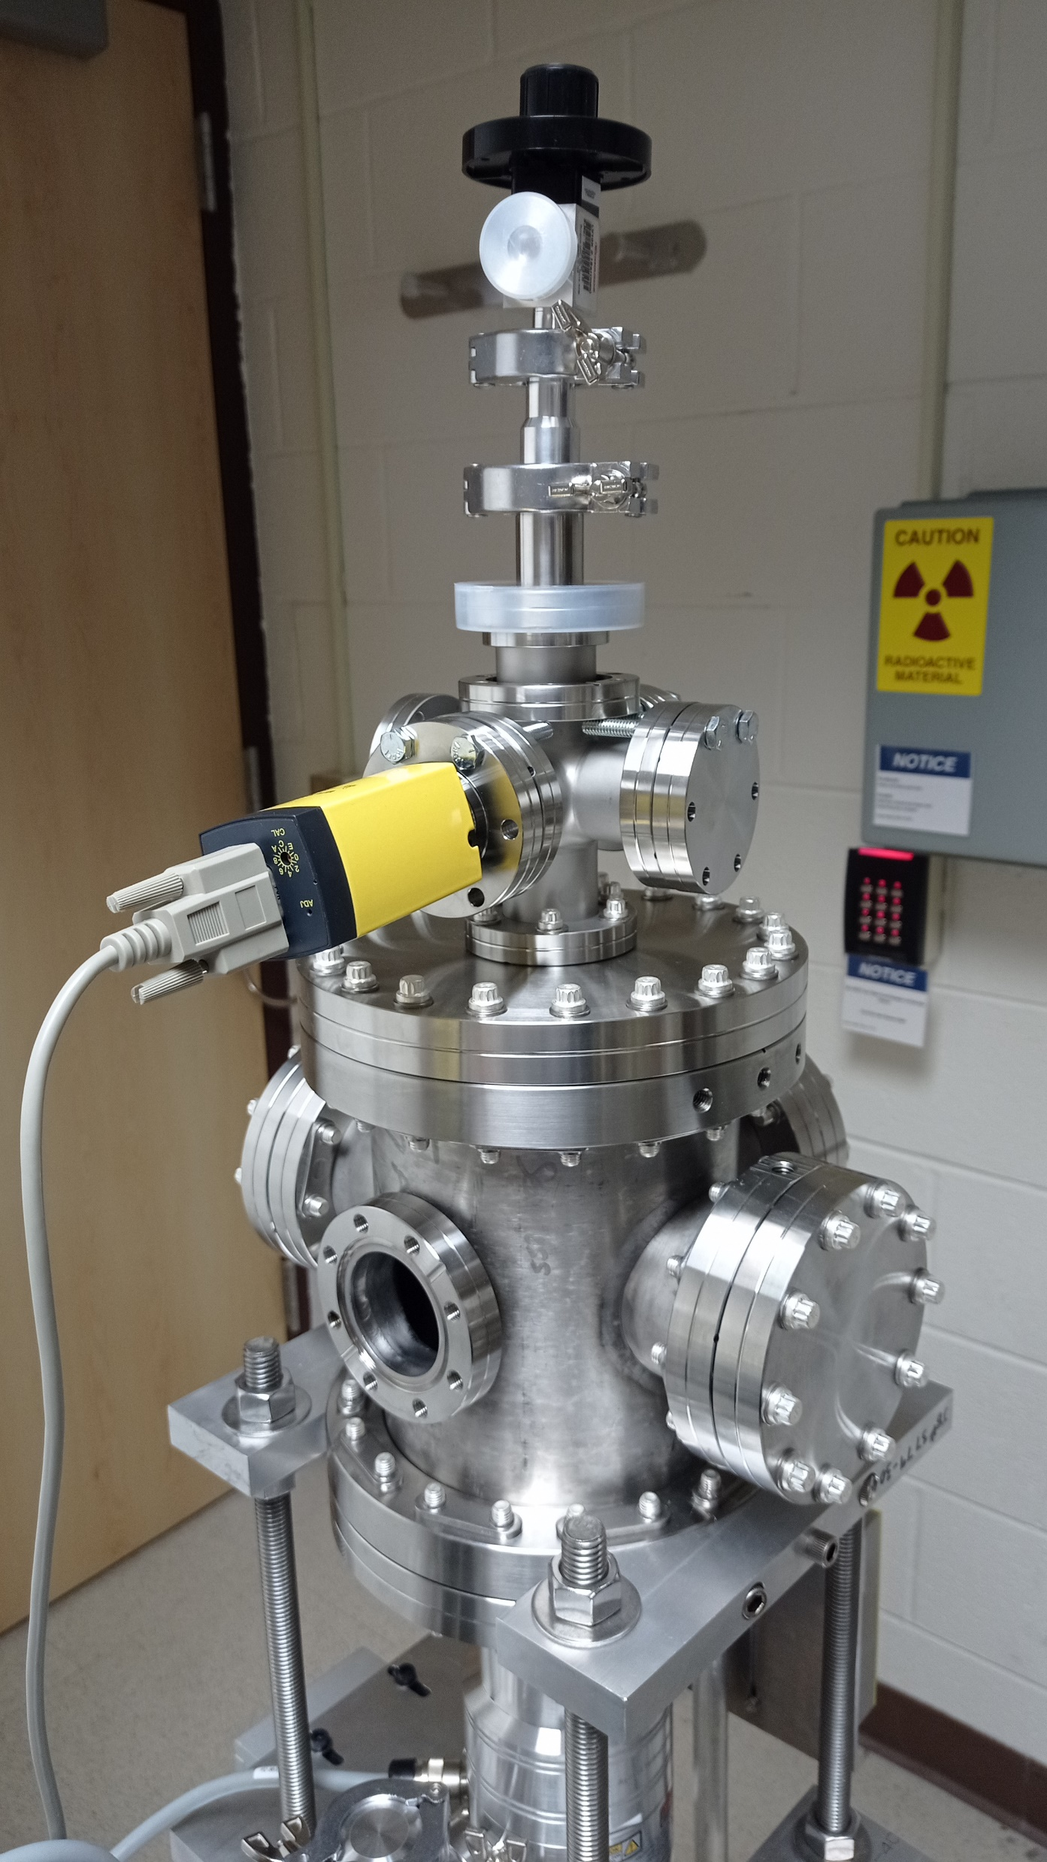
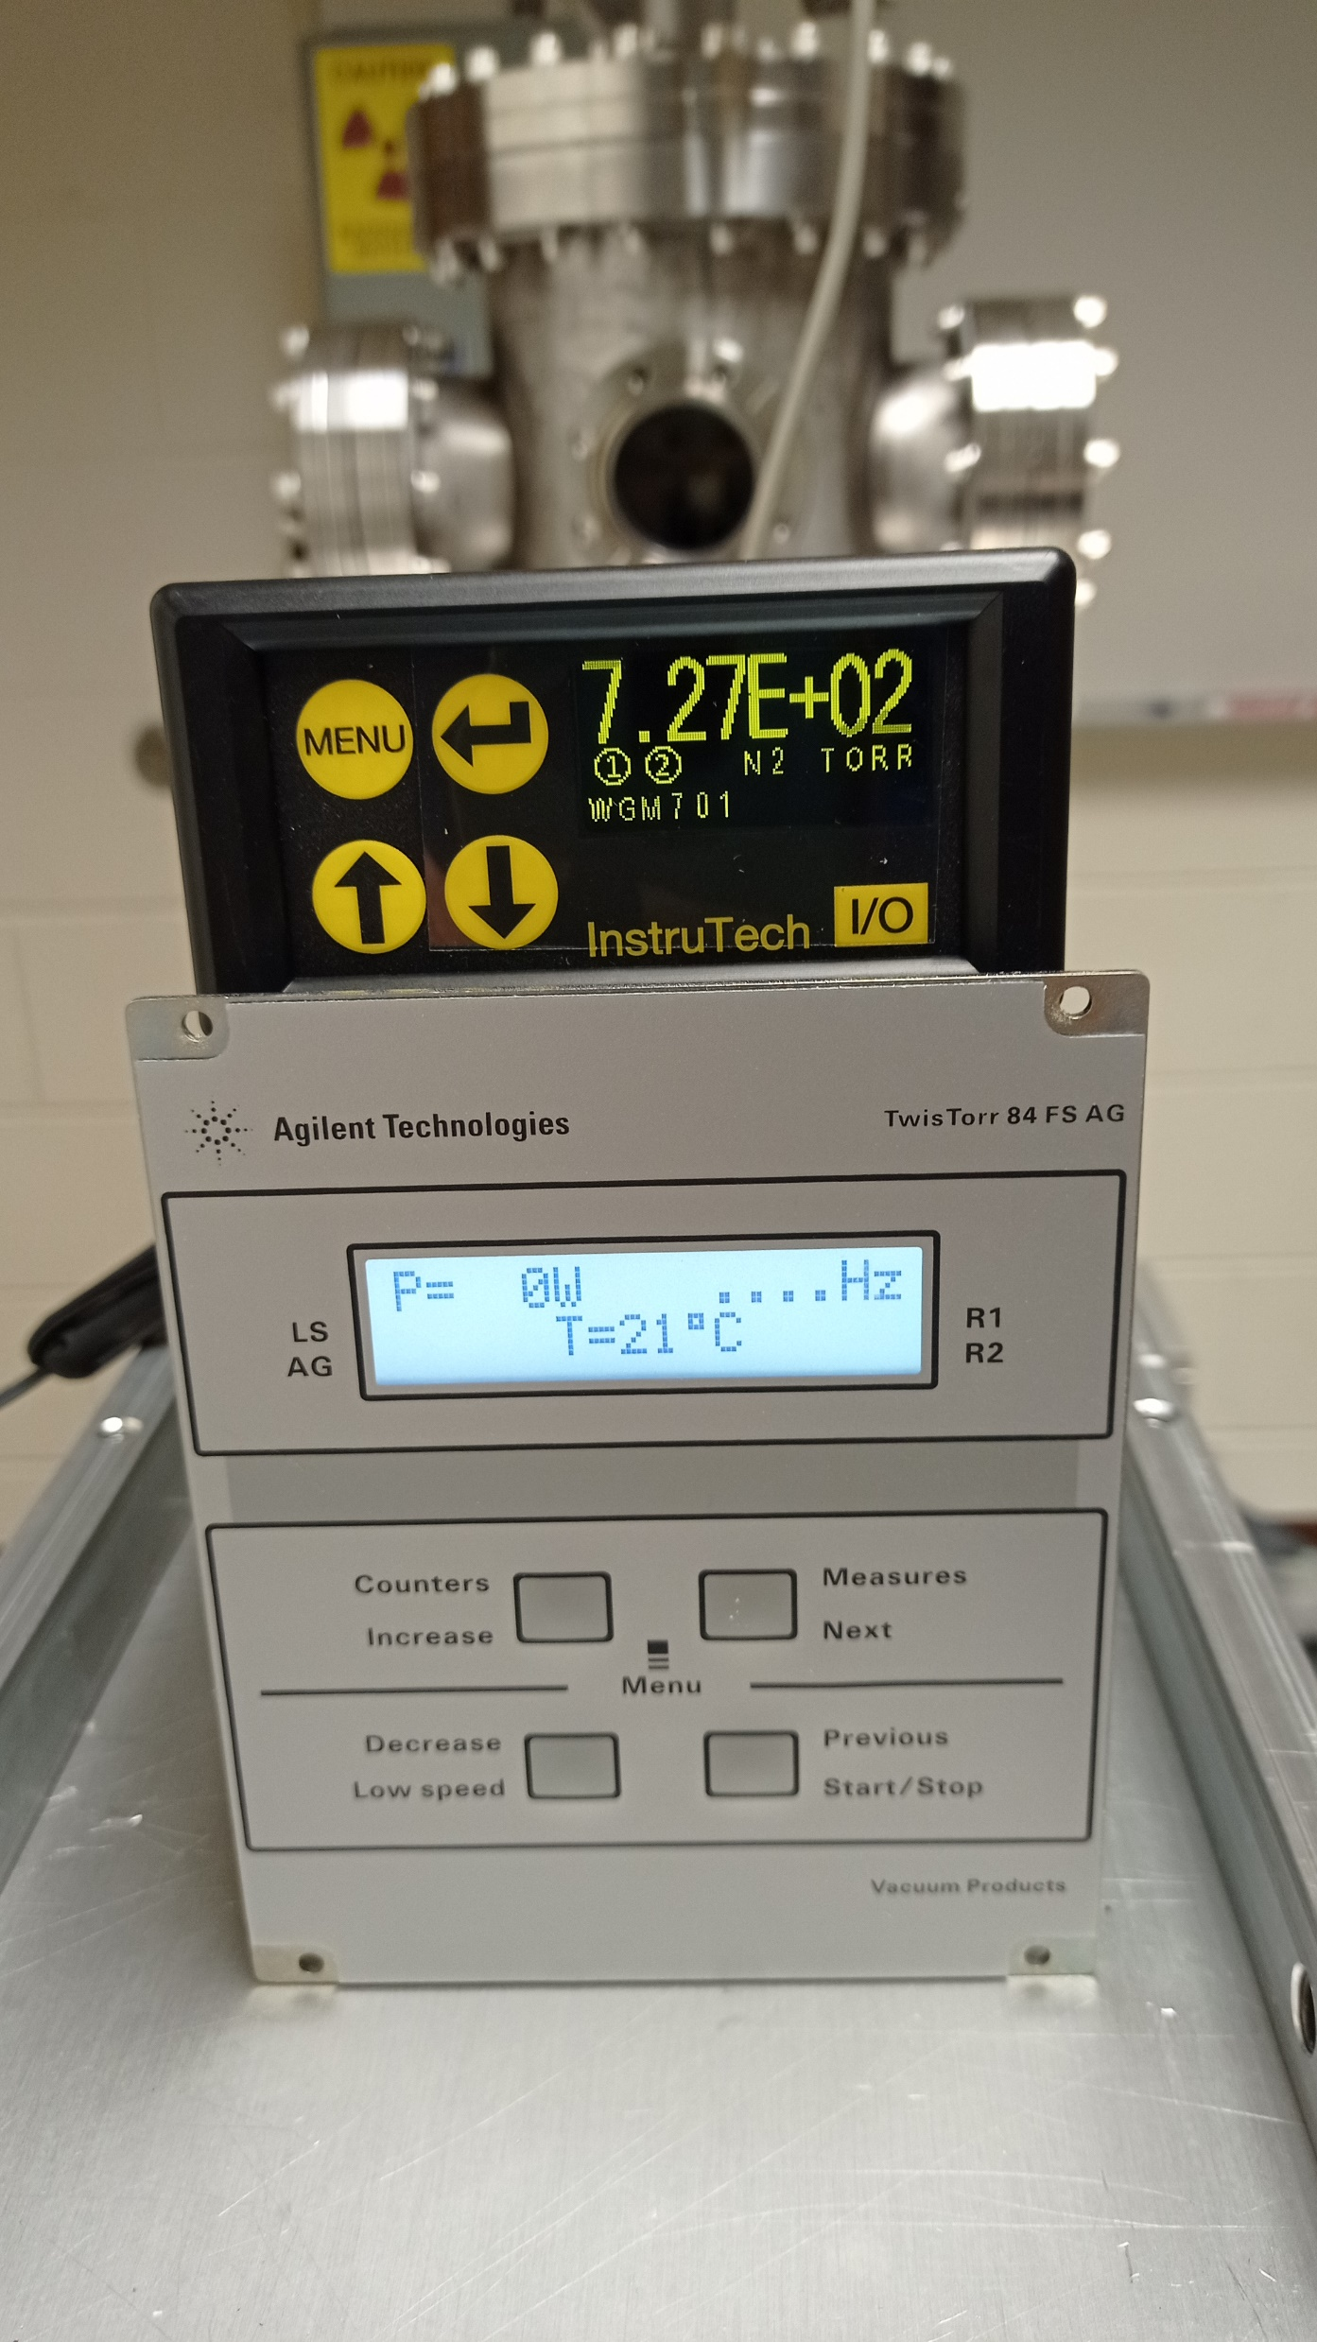
The chamber now is pretty tall like a Christmas tree.
We have ordered the PS401 Vacuum Gauge Power Supply, blank flanges, hinge clamps, bolts, nuts, and washers.
We will conduct a vacuum test as soon as they arrive.

