Slide 1
Class counts: {'Anomalous_Events': 1017, 'Individual_Events': 1065, 'Two_Particle_Events': 1116}
Target samples per class: 1017
Epoch 1/50
100%|██████████| 687/687 [00:44<00:00, 15.58it/s]
train Loss: 0.9507 Acc: 0.3463
100%|██████████| 77/77 [00:02<00:00, 29.26it/s]
val Loss: 0.9868 Acc: 0.5475
Validation loss decreased (0.986801 --> 0.986801). Saving model...
Epoch 2/50
100%|██████████| 687/687 [00:43<00:00, 15.63it/s]
train Loss: 0.9021 Acc: 0.3747
100%|██████████| 77/77 [00:02<00:00, 29.28it/s]
val Loss: 1.0163 Acc: 0.2918
Epoch 3/50
100%|██████████| 687/687 [00:43<00:00, 15.63it/s]
train Loss: 0.9021 Acc: 0.3769
100%|██████████| 77/77 [00:02<00:00, 29.44it/s]
val Loss: 0.9852 Acc: 0.2918
Validation loss decreased (0.985246 --> 0.985246). Saving model...
20240702
Notes:
/mnt/projects/e21072/OfflineAnalysis/Corrected_CNN_Images

Slide 2
Epoch 48/50
100%|██████████| 687/687 [00:43<00:00, 15.81it/s]
train Loss: 0.2646 Acc: 0.8696
100%|██████████| 77/77 [00:02<00:00, 29.64it/s]
val Loss: 0.3381 Acc: 0.8164
Validation loss decreased (0.338087 --> 0.338087). Saving model...
Epoch 49/50
100%|██████████| 687/687 [00:43<00:00, 15.83it/s]
train Loss: 0.2648 Acc: 0.8733
100%|██████████| 77/77 [00:02<00:00, 29.73it/s]
val Loss: 0.3213 Acc: 0.8066
Validation loss decreased (0.321265 --> 0.321265). Saving model...
Epoch 50/50
100%|██████████| 687/687 [00:43<00:00, 15.79it/s]
train Loss: 0.2692 Acc: 0.8704
100%|██████████| 77/77 [00:02<00:00, 30.09it/s]
val Loss: 0.3531 Acc: 0.8164
Test Acc: 0.8233
20240702

Slide 3
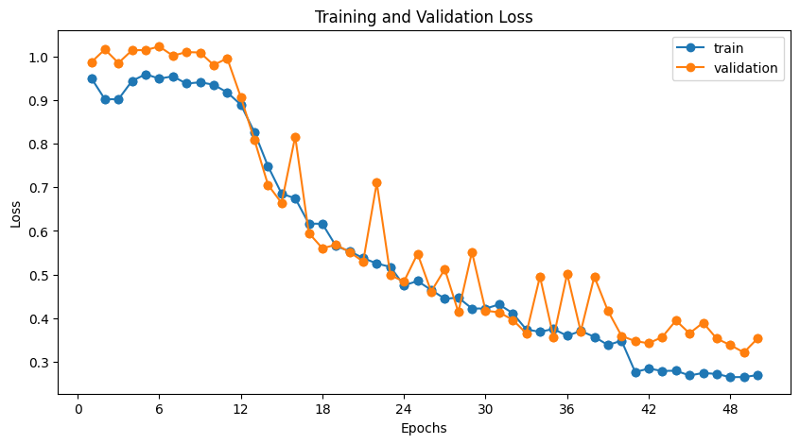
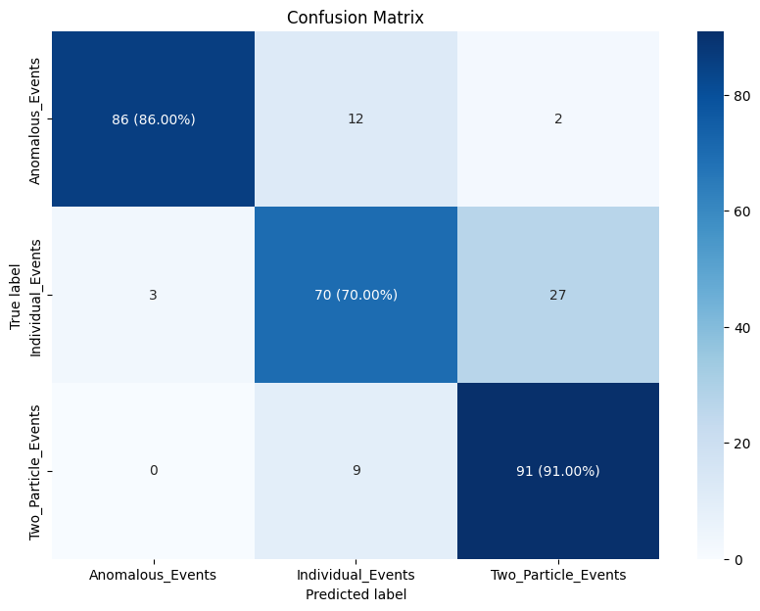
20240702

Slide 4
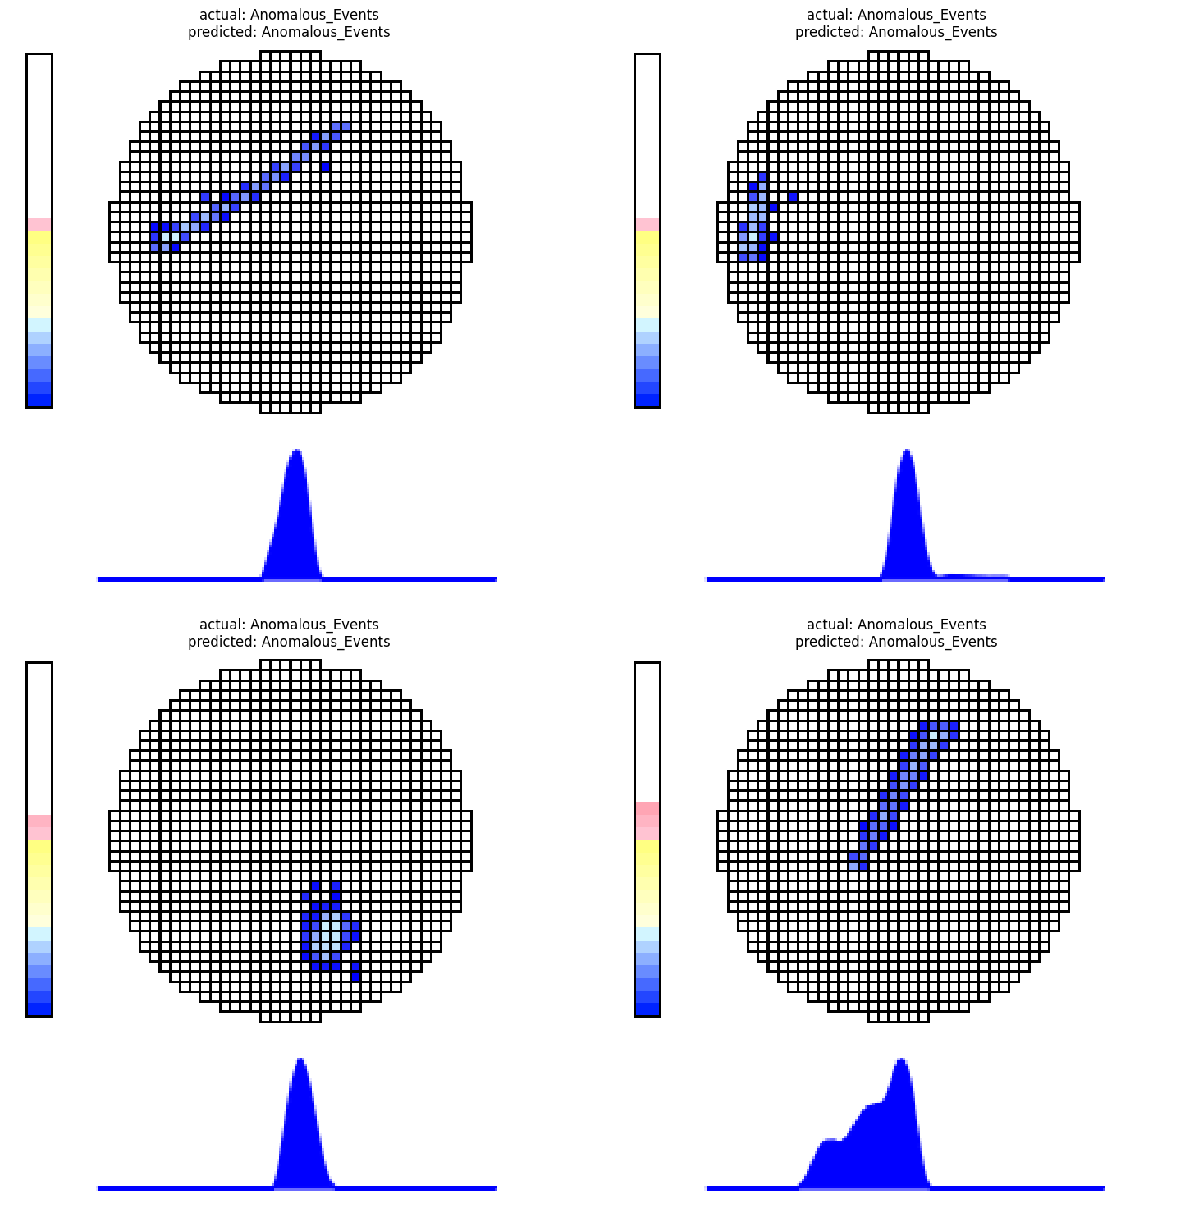
20240702

Slide 5
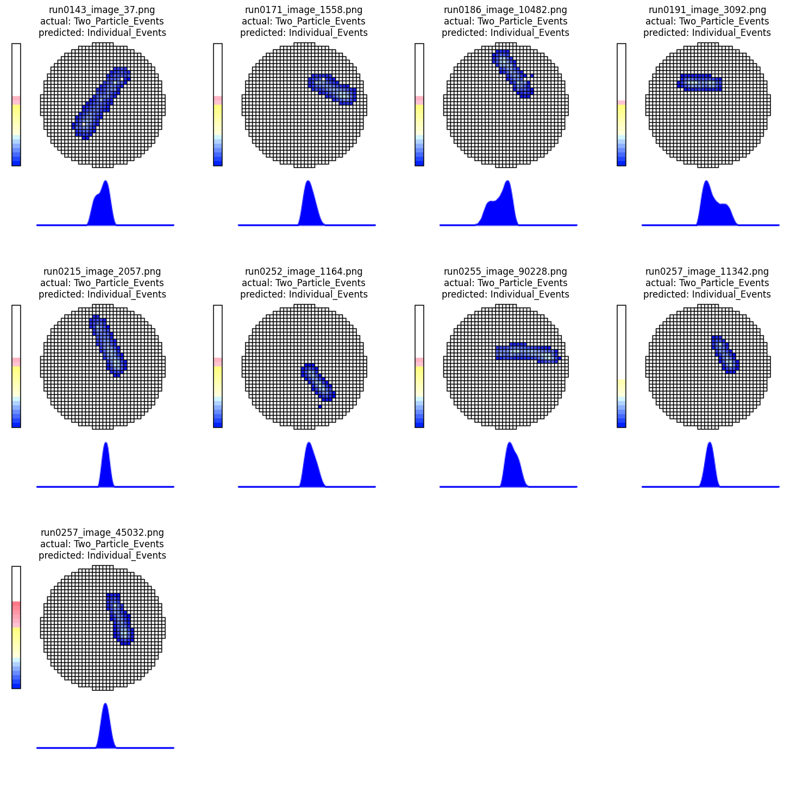
20240702

