Slide 1
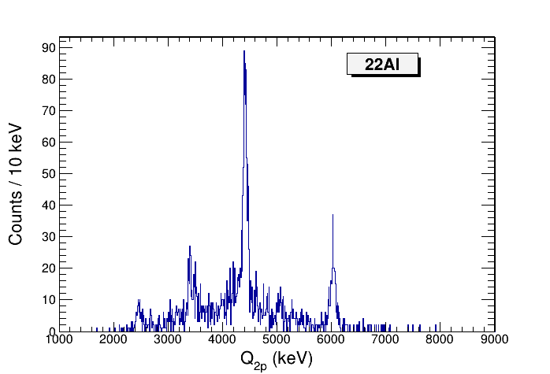
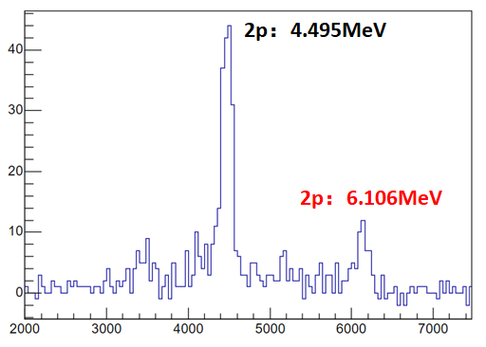
Jun 2023
@FRIB
IAS → ²⁰Ne 1st
IAS → ²⁰Ne gs
Nov 2017
@Lanzhou

Slide 2
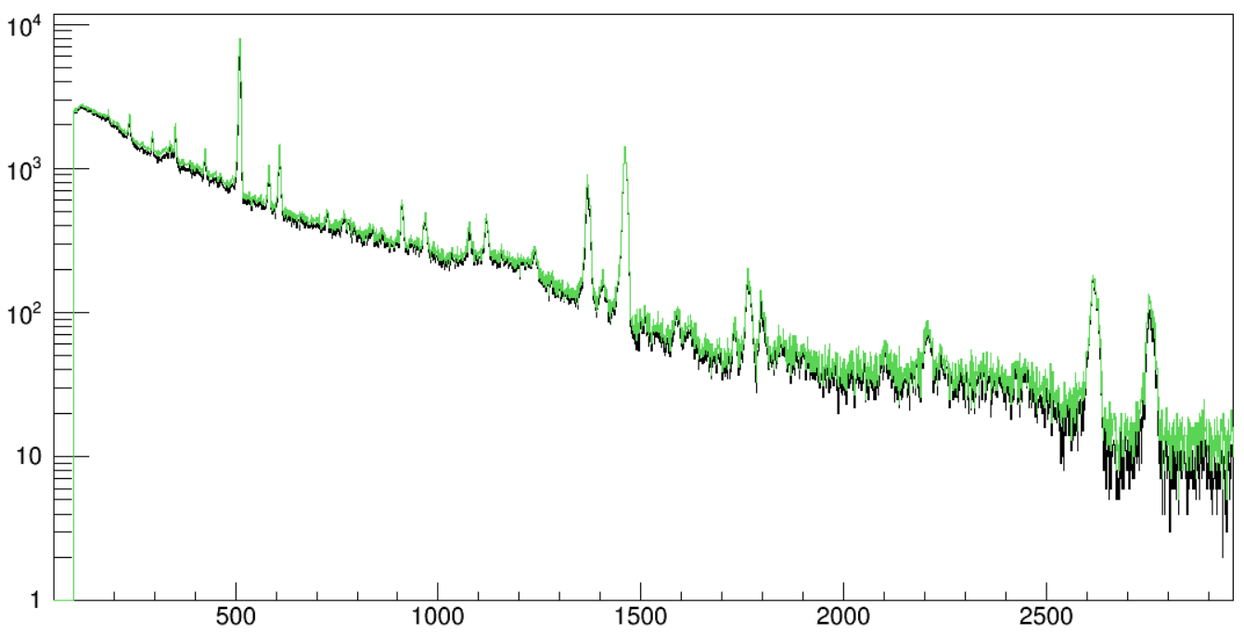
a101->Draw("FE>>(4000,1,4001)","FE>0")
a101->Draw("FE[0]","FE[0]>0","same")

Slide 3
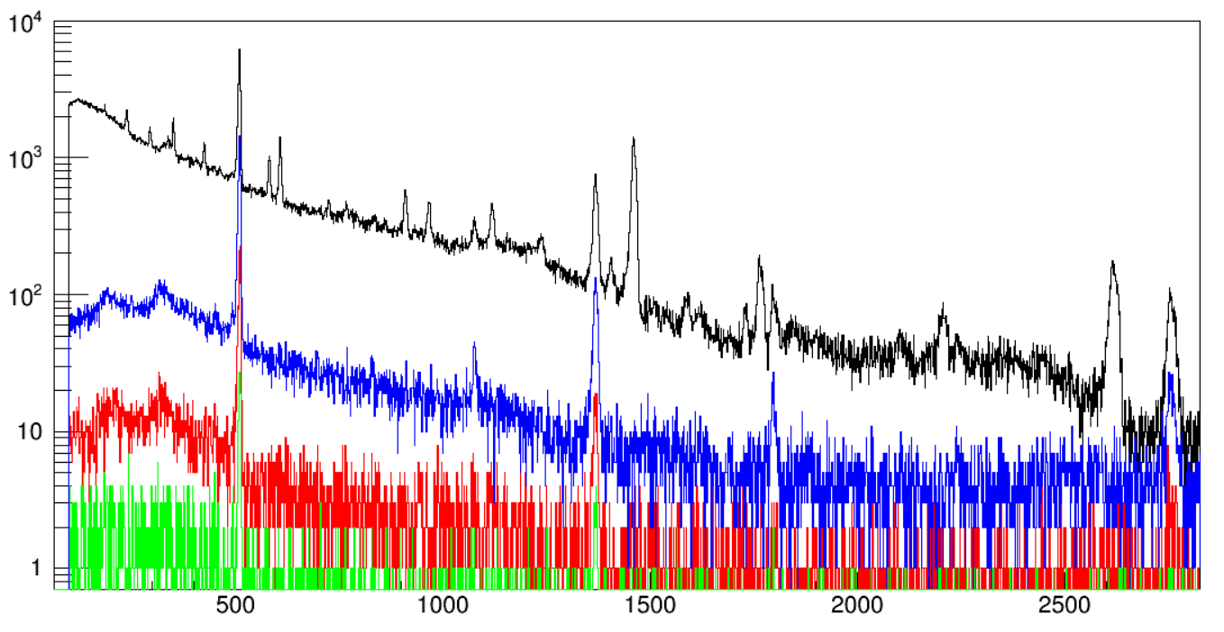
a101->Draw("FE[0]>>(4000,1,4001)","FE[0]>0")
a101->Draw("FE[1]","FE[1]>0","same")
a101->Draw("FE[2]","FE[2]>0","same")
a101->Draw("FE[3]","FE[3]>0","same")

Slide 4
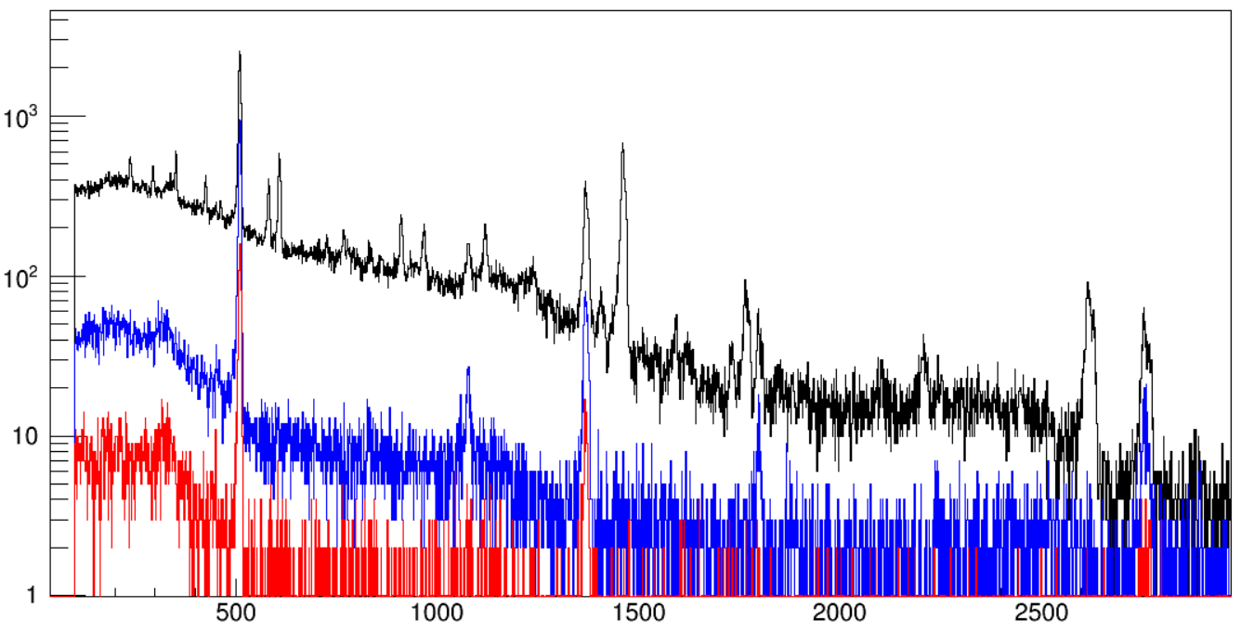
a101->Draw("FE[0]>>(4000,1,4001)","FE[0]>0&&id==12")
a101->Draw("FE[1]","FE[1]>0&&id==12","same")
a101->Draw("FE[2]","FE[2]>0&&id==12","same")

Slide 5
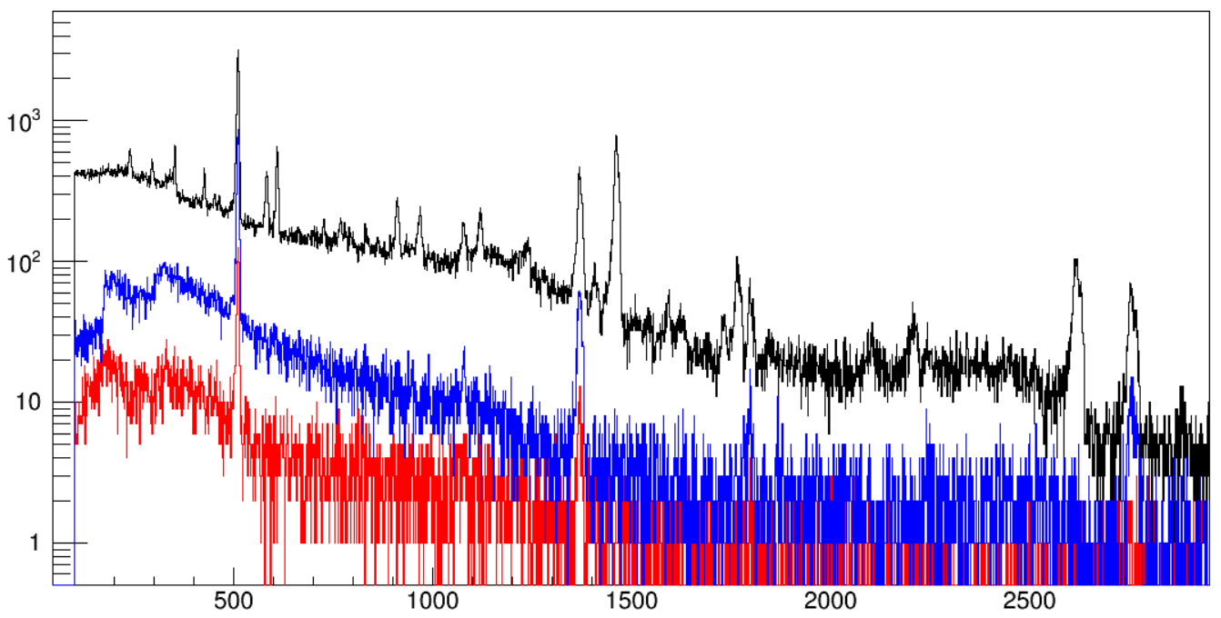
a101->Draw("FE>>(4000,1,4001)","FE>0&&id[0]==12")
a101->Draw("FE","FE>0&&id[1]==12","same")
a101->Draw("FE","FE>0&&id[2]==12","same")

Slide 6
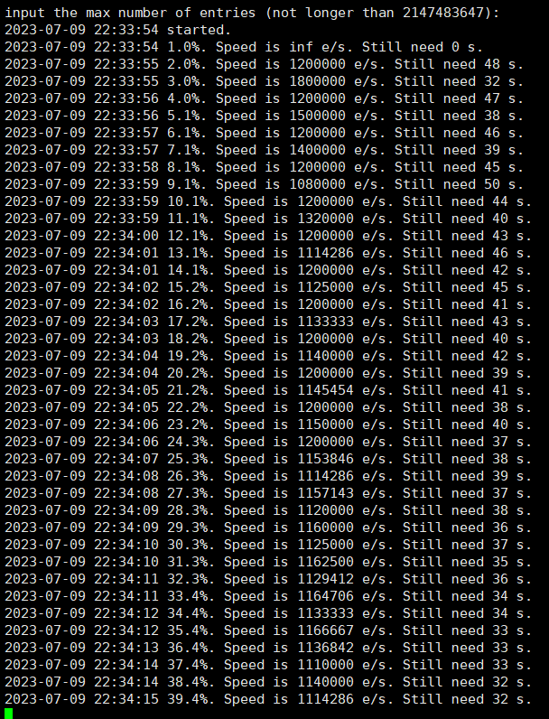

Slide 7
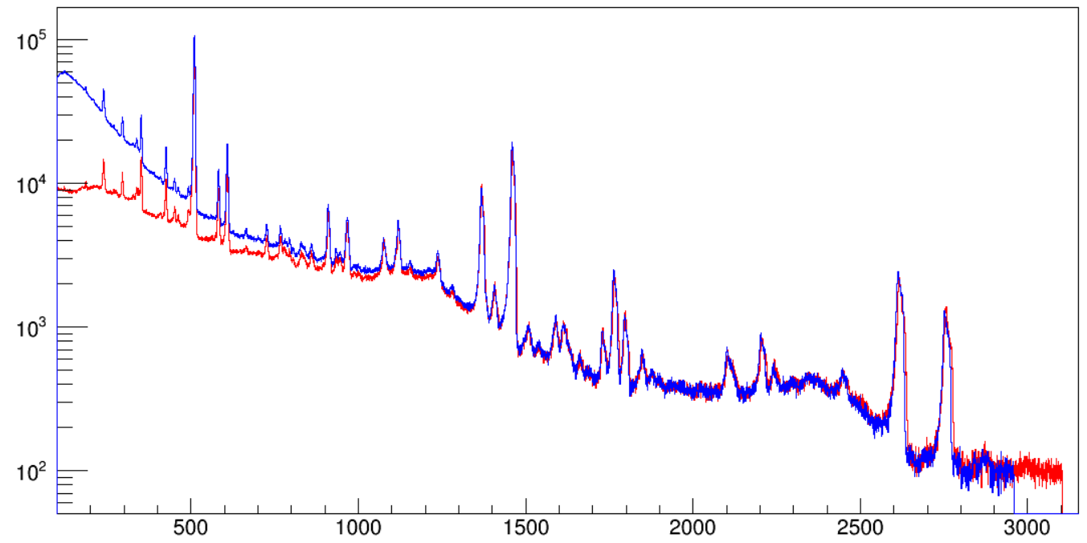
All 26P runs
Notes:
Run 85-117

Slide 8
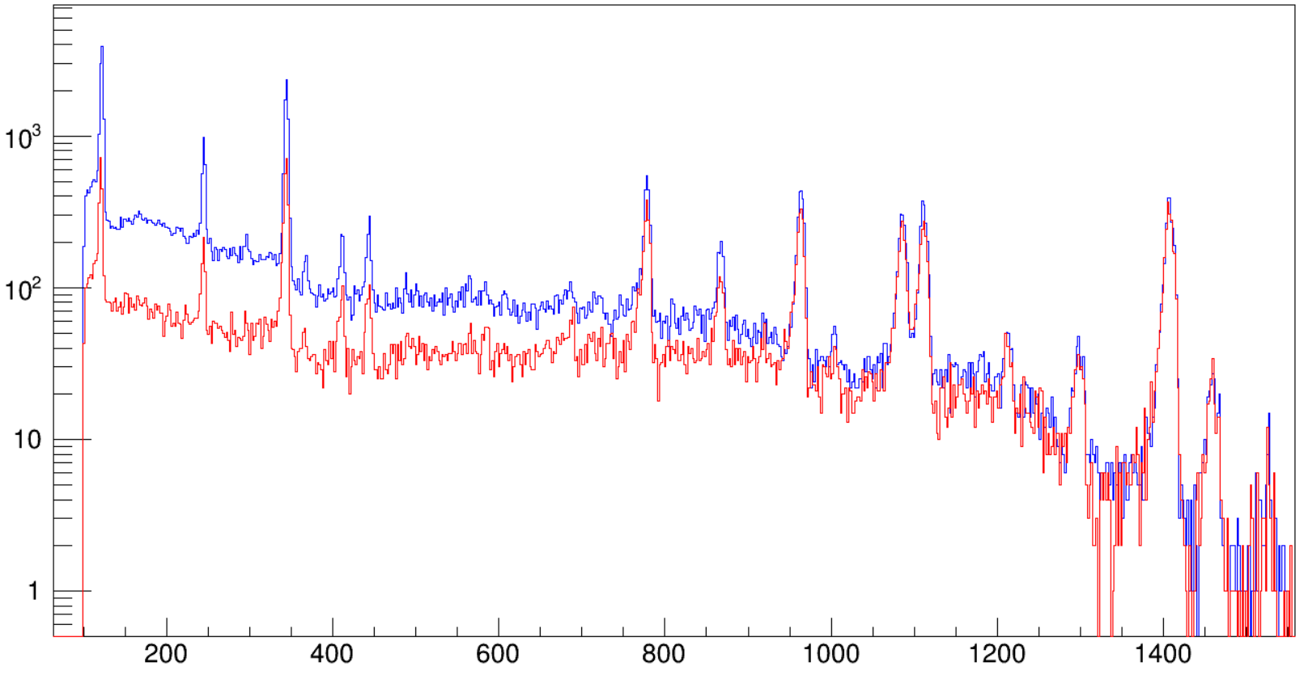
015_000m.root
152Eu outside of chamber
Notes:
a101->SetLineColor(4); a101->Draw("FE>>(2000,1,4001","FE>0&&id==13")
a101->SetLineColor(2); a101->Draw("FE","FE>0&&id==12","same")

Slide 9
Notes:
hGraw0->Draw()
hGraw1->Draw("same")

Slide 10
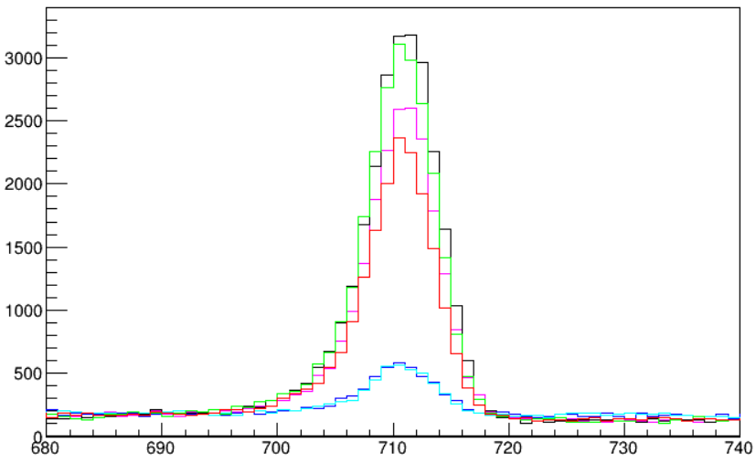
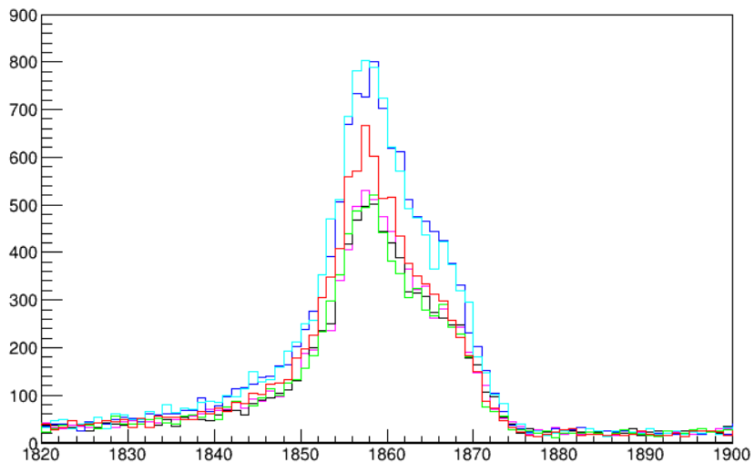
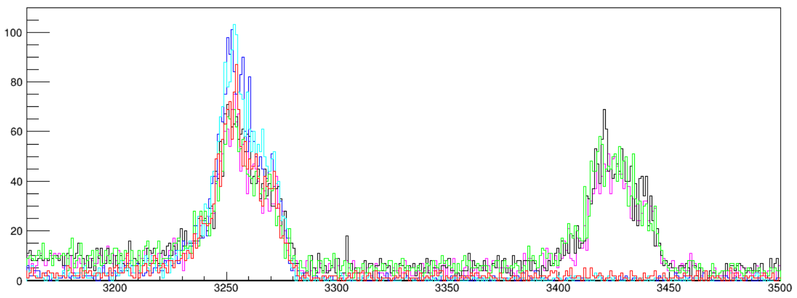
511
1461
No visible channel drift for G1
No need to do gain matching
2615
037_000.root
049_000.root
064_000.root
089_000.root
109_000.root
117_000.root
2754
Notes:
h101->Draw("G1E>>(4000,1,4001)","G1E>0")

Slide 11
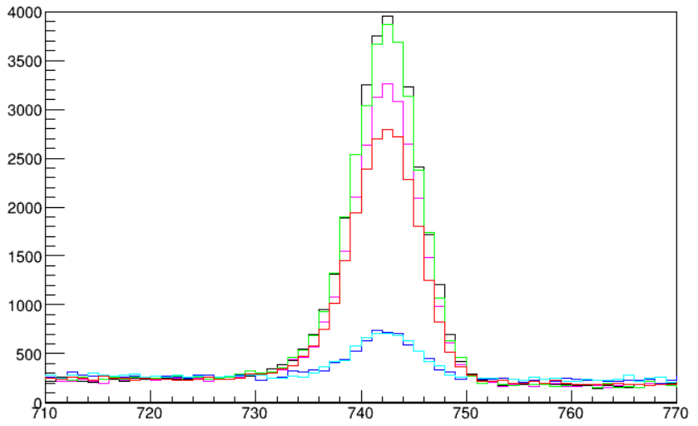
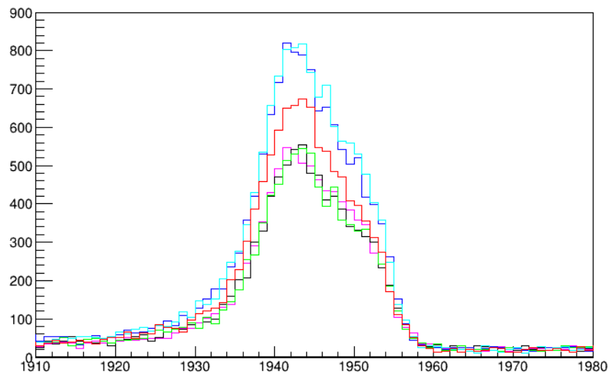
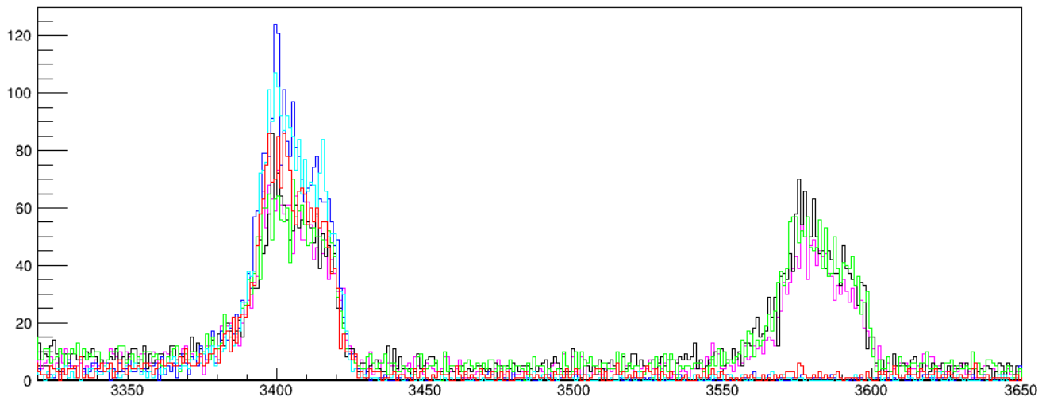
511
1461
No visible channel drift for G2
No need to do gain matching
2615
037_000.root
049_000.root
064_000.root
089_000.root
109_000.root
117_000.root
2754
Notes:
h101->Draw("G2E>>(4000,1,4001)","G2E>0")

Slide 12
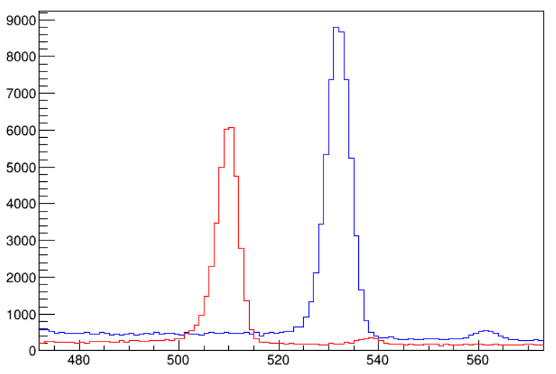
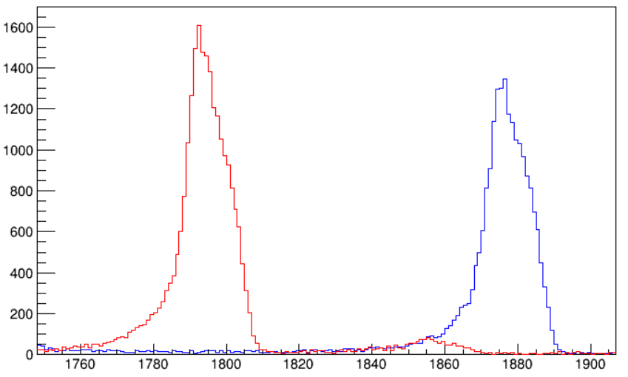
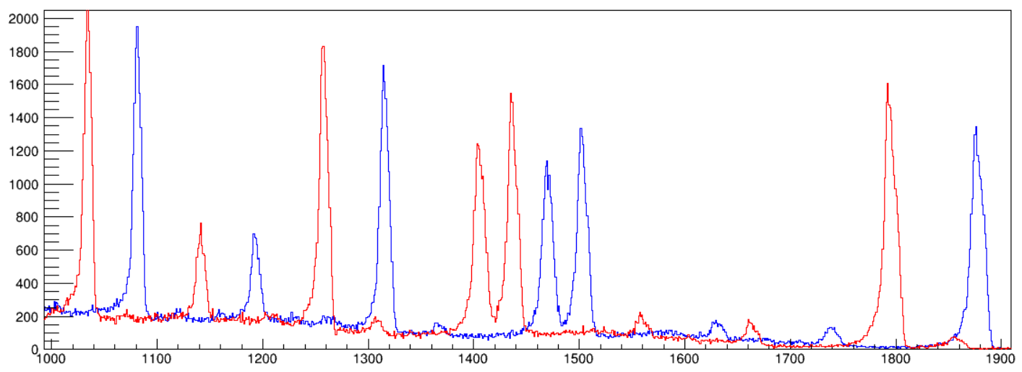
344 keV
1408 keV
121_000.root
152Eu at center
North vs South
Notes:
h101->SetLineColor(4); h101->Draw("G2E>>(4000,1,4001","G2E>0")
h101->SetLineColor(2); h101->Draw("G1E","G1E>0","same")

Slide 13
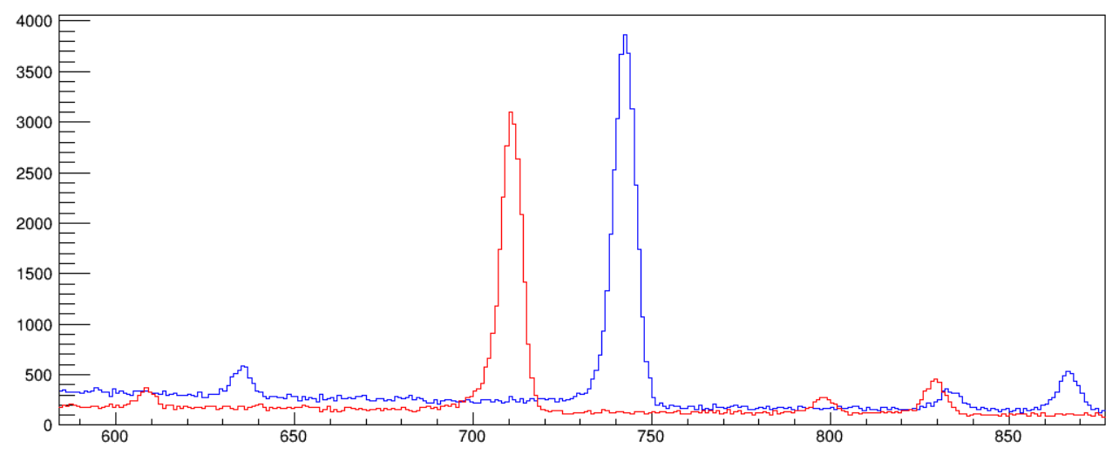
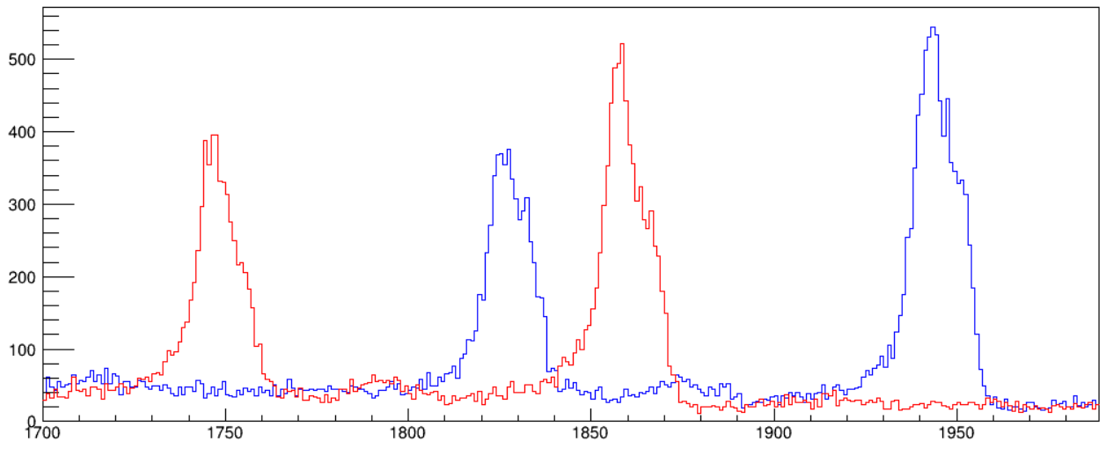
511 keV
117_000.root
26P
North vs South
1461 keV
1461 keV
1369 keV
1369 keV

Slide 14
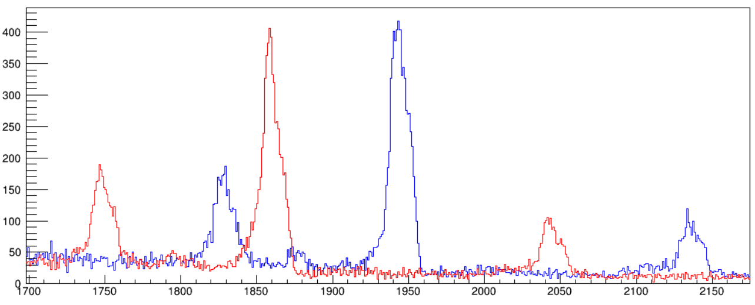
1461 keV
098_000.root
25Si
North vs South
1369 keV
1612 keV
Shaping time 0.25 μs
Trigger window 4 μs

Slide 15
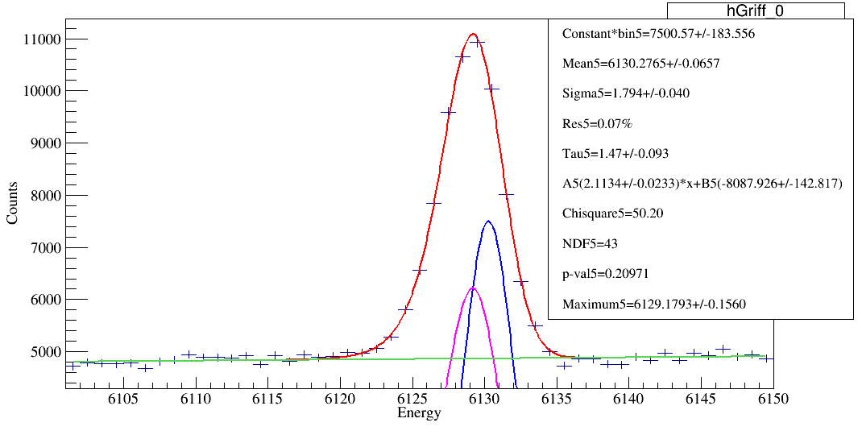
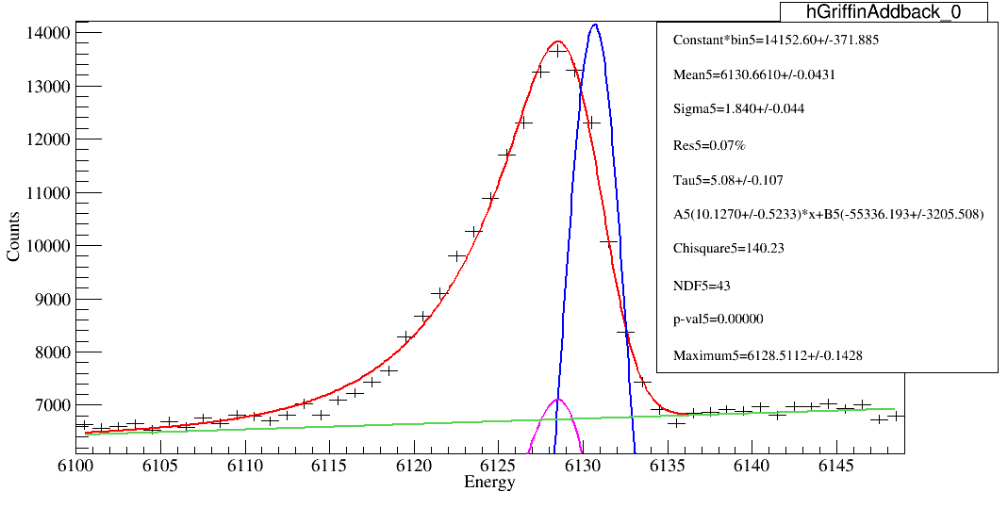
0 deg GRIFFIN
0 deg GRIFFIN with addback

