Slide 1
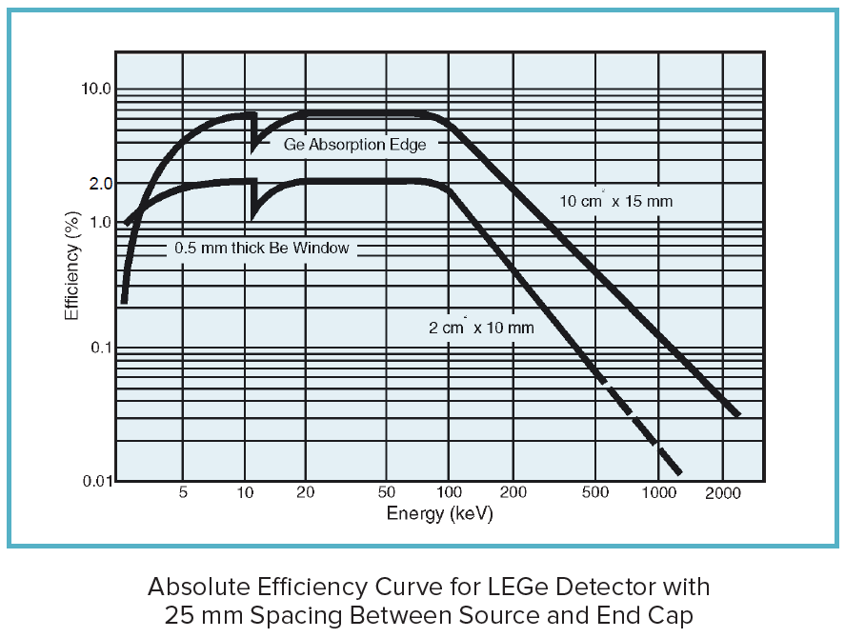
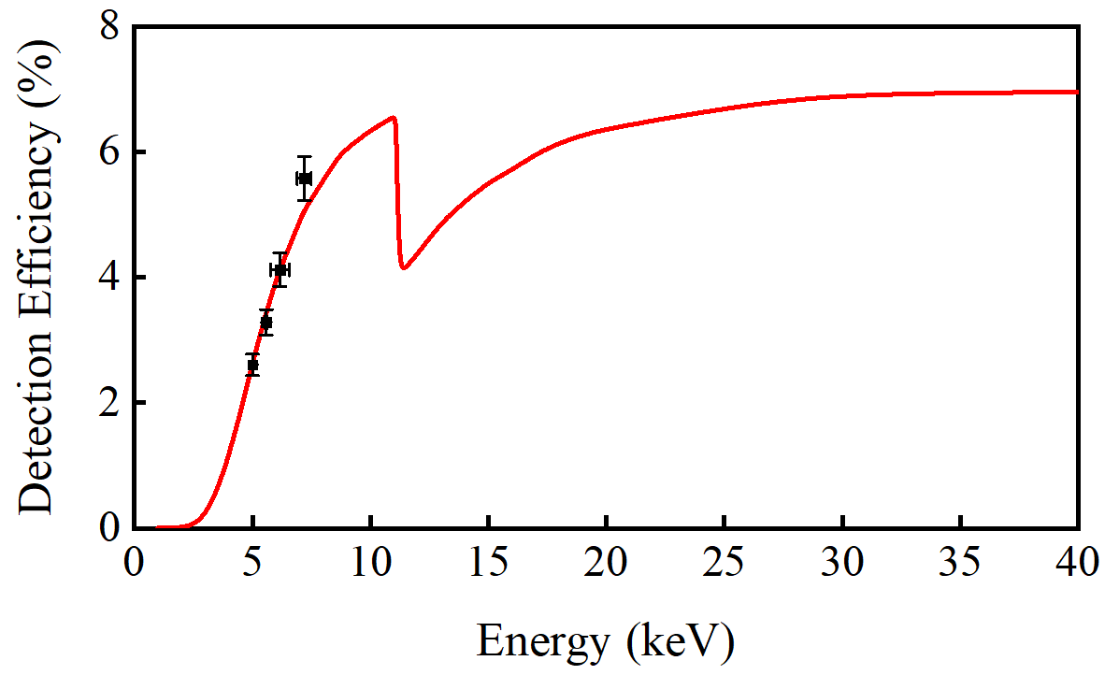
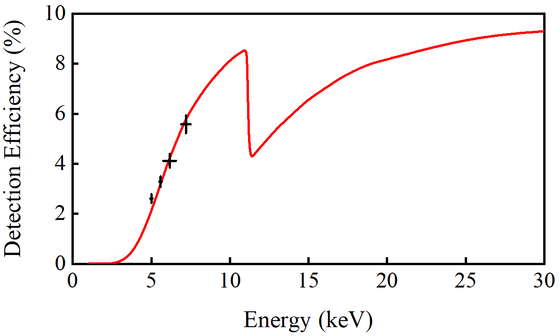
Ge K-absorption edge: 11.103(2) keV

Slide 2
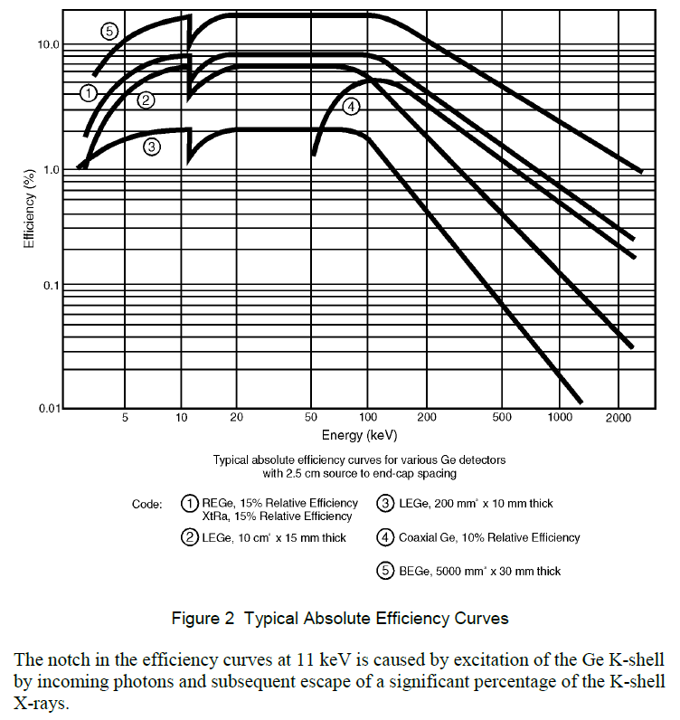
GL1015 1000 mm² * 15 mm
0.5 mm Be ~6.5%
GL0210 200 mm² * 10 mm
0.13(5) mm Be ~2%
Notes:
Mirion Germanium Detectors User Manual 9231358G

Slide 3
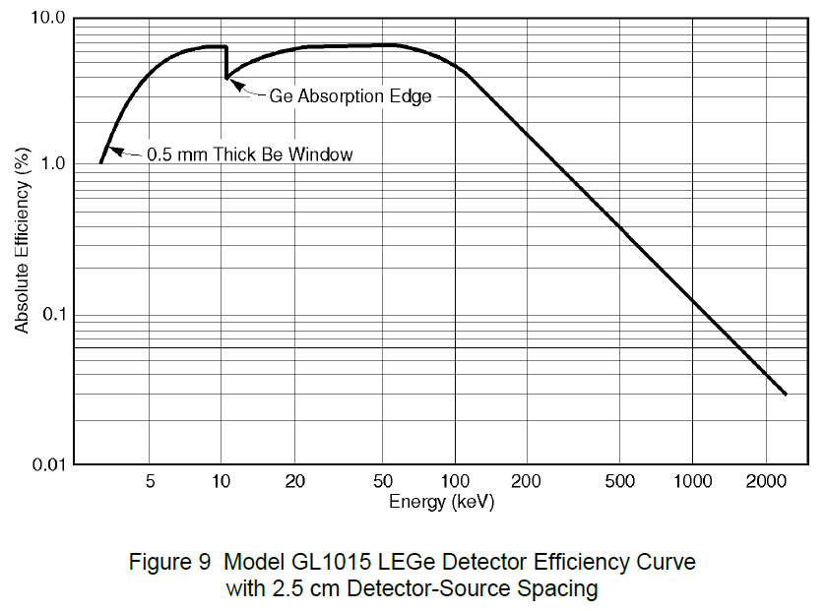

Slide 4
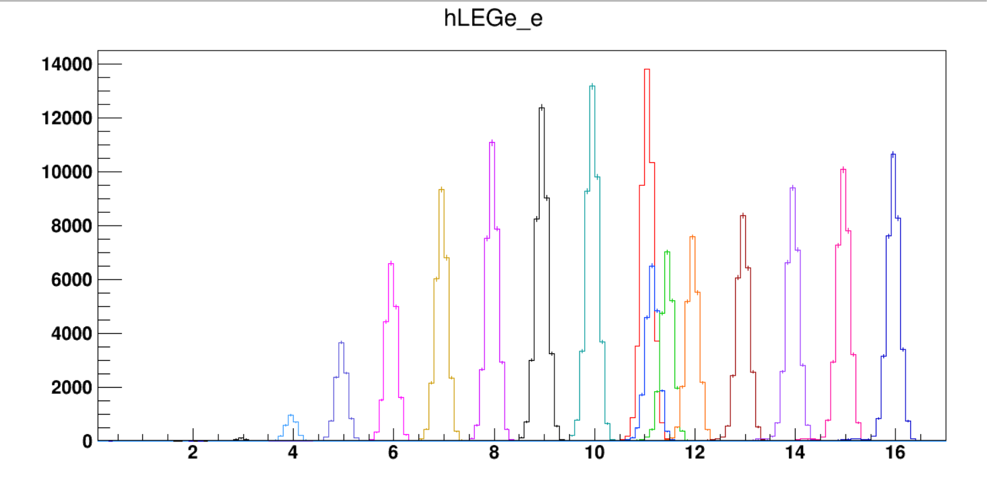
Notes:
152Eu
G4

Slide 5
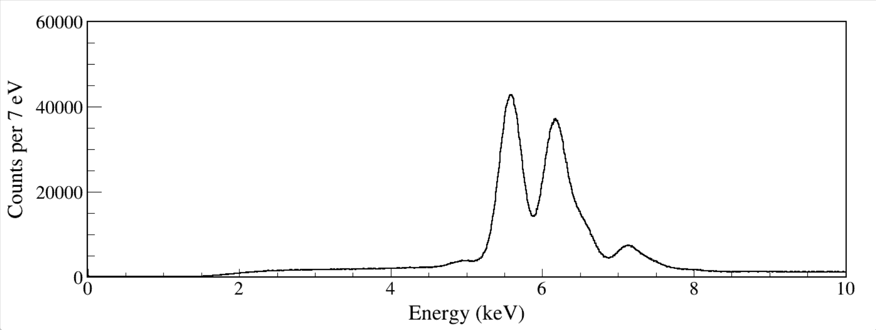
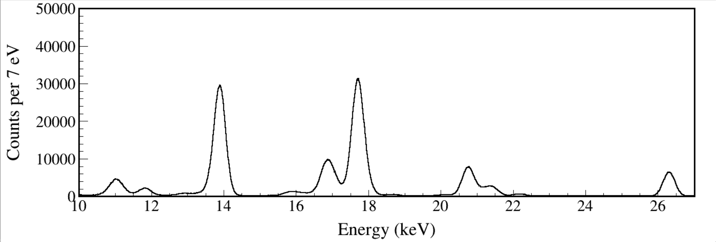
run0228-0230
run0334
Notes:
run0228_0229_0230_LEGe_XtRa_MSD26_152Eu_Z2707_inChamber_vacuum_XtRa_12mm_away_window1us_XtRaCFDdelay_0.2us_for_efficiency_cal.root
run0334_LEGe_241Am_Z7117_ChamberCenter_window1.5us_TrigRise0.064us_TrigGap0.952us_Th350_CFDDelay0.304us_Scale7_for_X_efficiency_cal.root

Slide 6
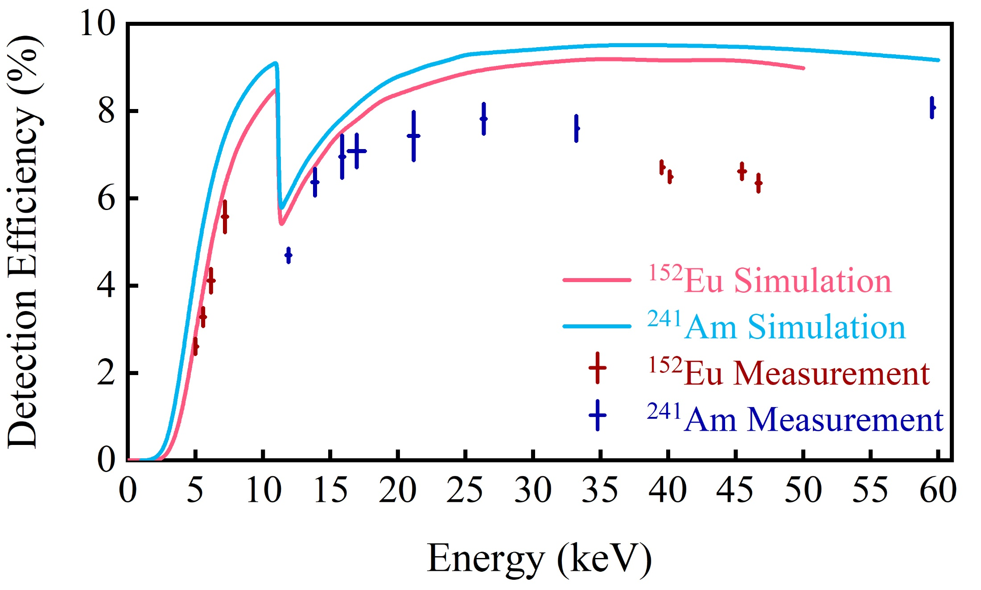
5-μm thick dead layer on LEGe.
Don't seem to match either source data points.

Slide 7
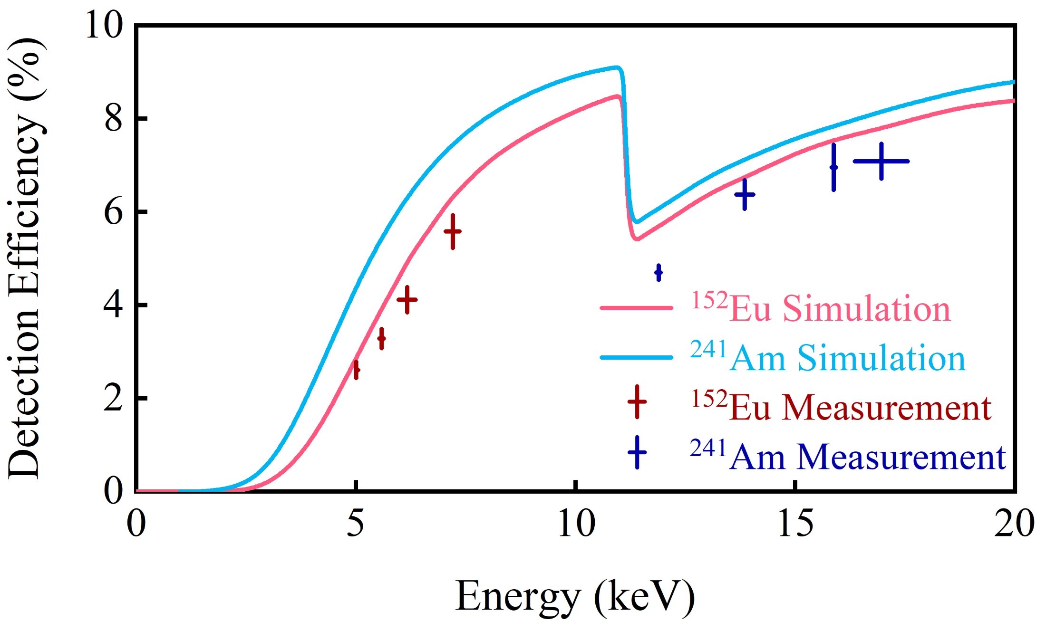
5-μm thick dead layer on LEGe. Zoom in.
Don't seem to match either source data points.

Slide 8
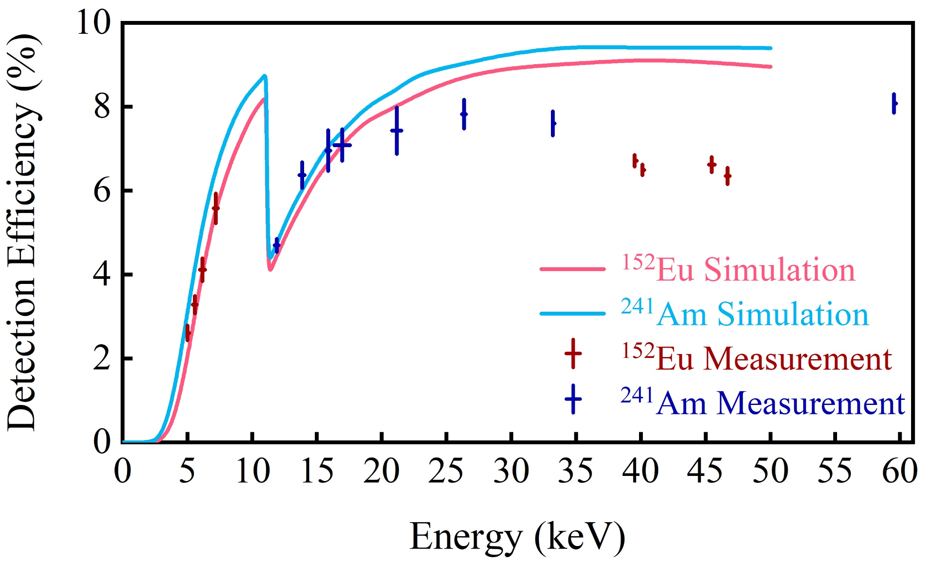
7.5-μm thick dead layer on LEGe.
Seem to match source data points at low energies.

Slide 9
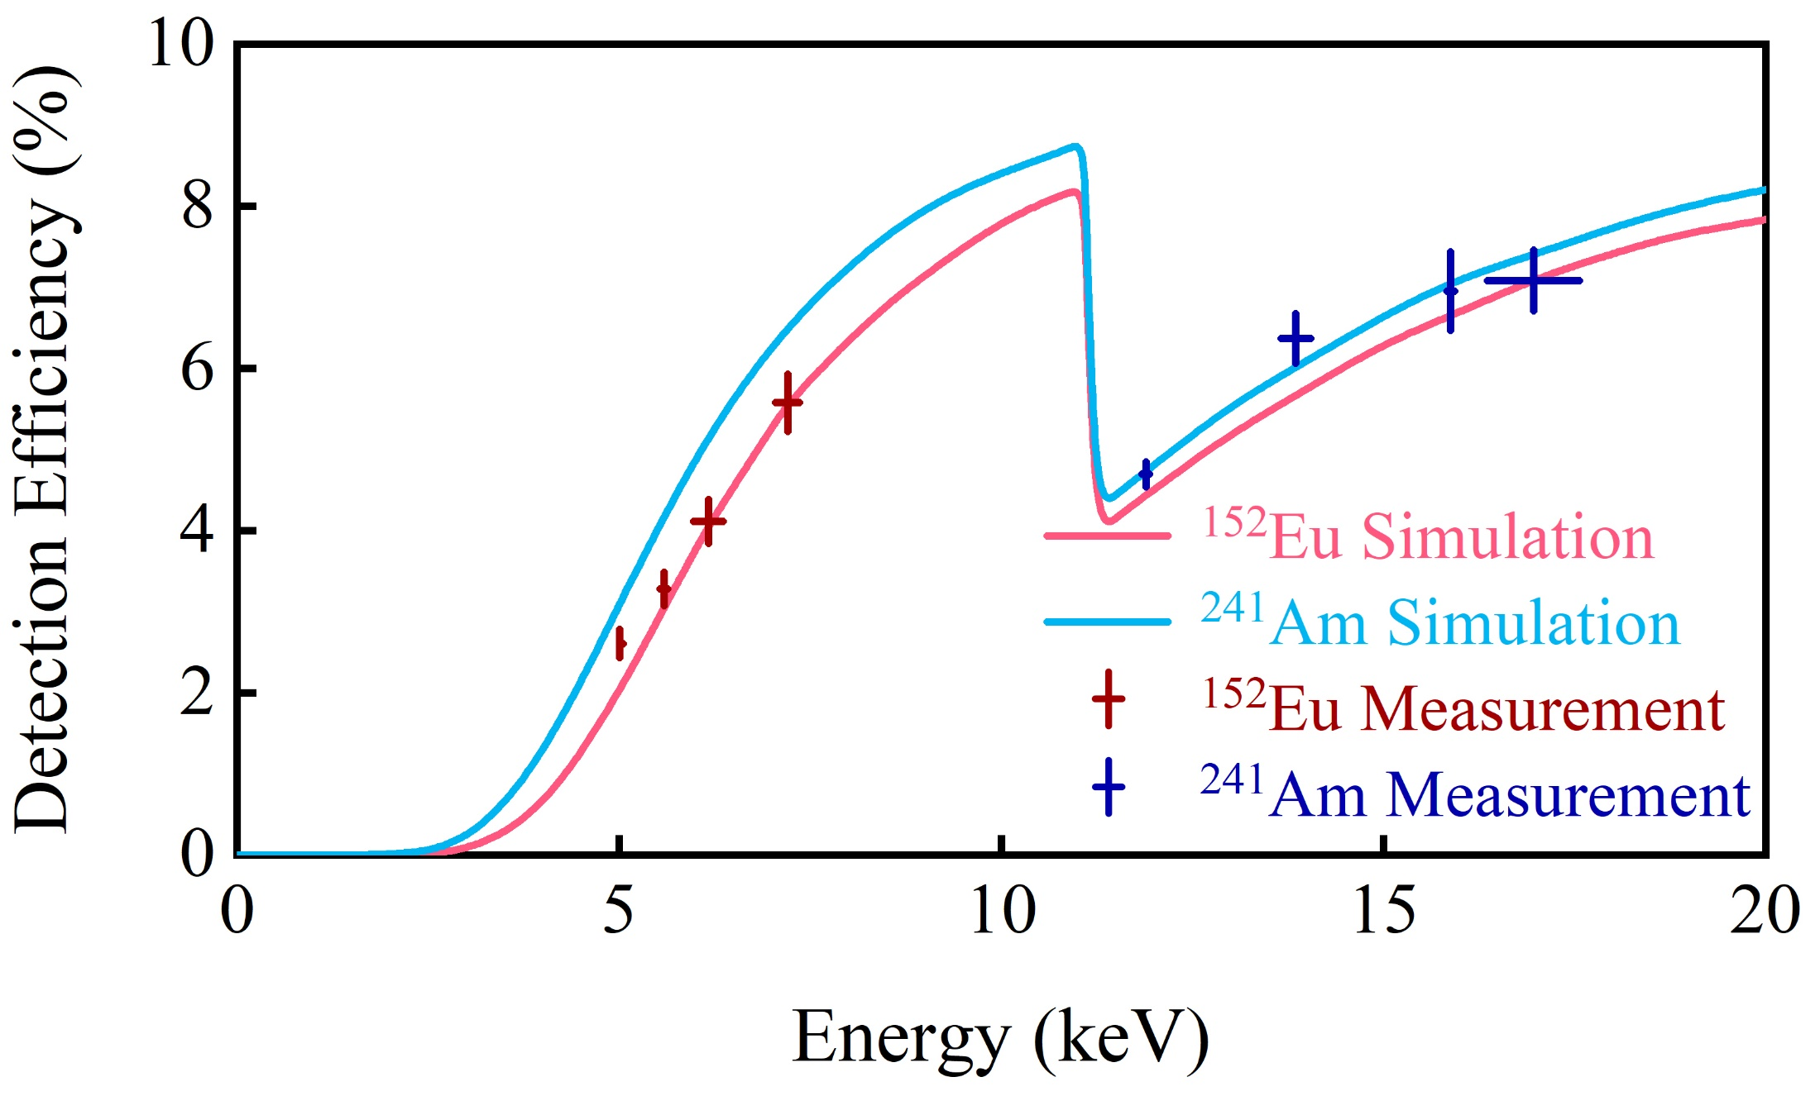
7.5-μm thick dead layer on LEGe. Zoom in.
Seem to match source data points at low energies.

Slide 10
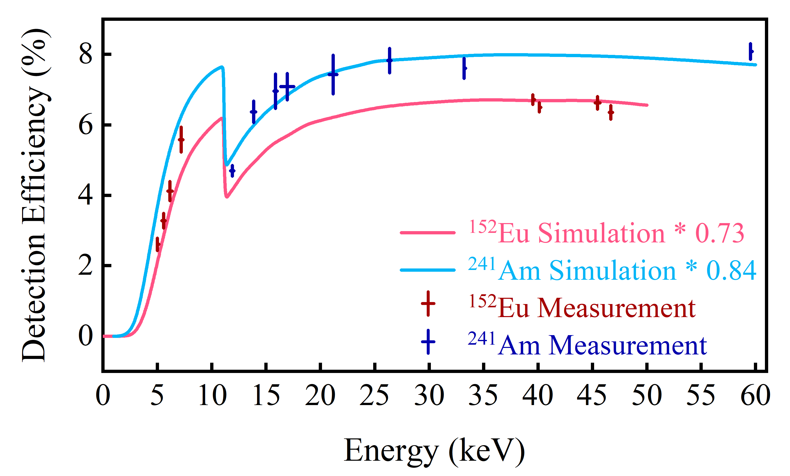
5-μm thick dead layer on LEGe. Scaling by a factor to match high-energy data points.

Slide 11
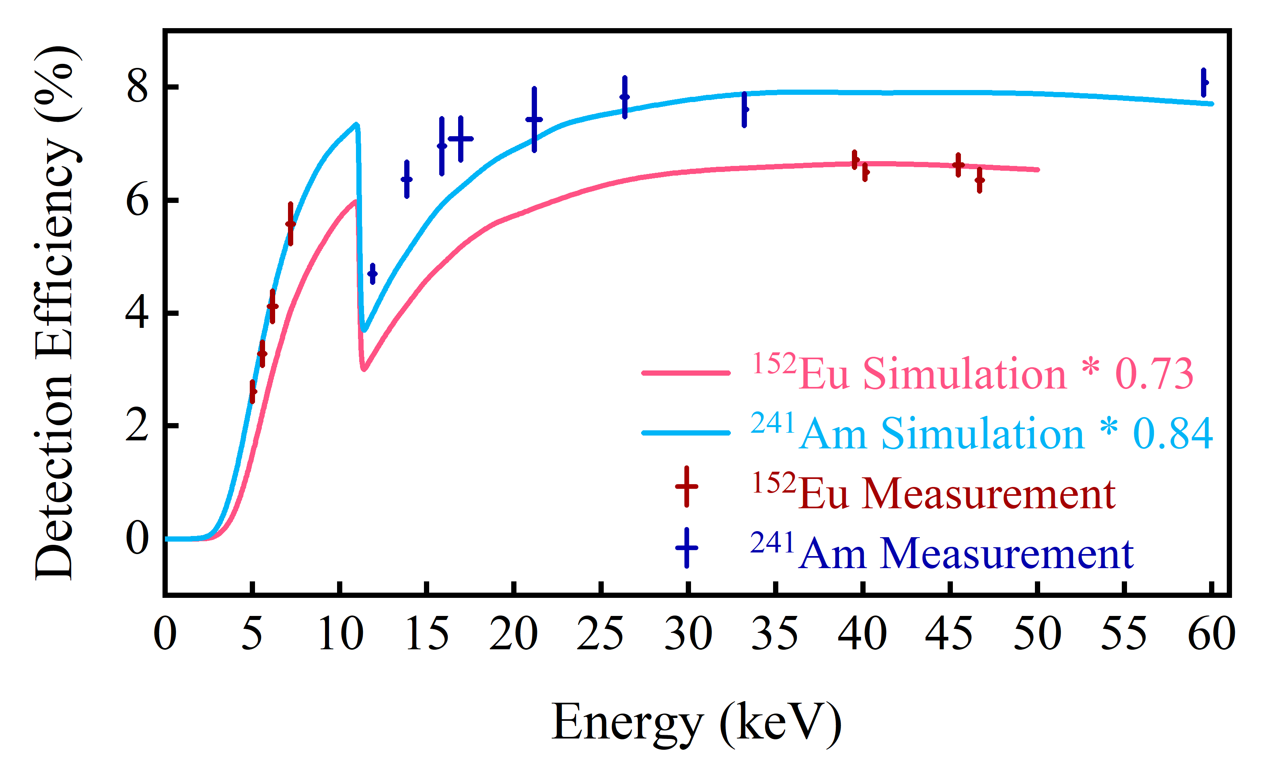
7.5-μm thick dead layer on LEGe. Scaling by a factor to match high-energy data points.

Slide 12
X-ray Detection Efficiency Uncertainties:
LEGe dead layer thickness ~5 μm
LEGe Be window thickness 0.13±0.05 mm
Source window: 152Eu 0.06 mm; 241Am open
X-ray intensities: http://www.lnhb.fr/home/nuclear-data/nuclear-data-table/
Geant4 photon-material interactions
Detector/source geometry: source-to-detector distance 12.5 mm
DAQ dead time: 152Eu 3000 pps 95.8%; 241Am 200 pps 99.7%
X-γ summing effect for 152Eu
Sm and Gd X rays from 152Eu; only Np X rays from 241Am
152Eu: thicker window; worse DAQ dead time; more summing effect.
241Am: no window; almost no DAQ dead time; less summing effect.
Our experimental condition should be something in between.

Slide 13
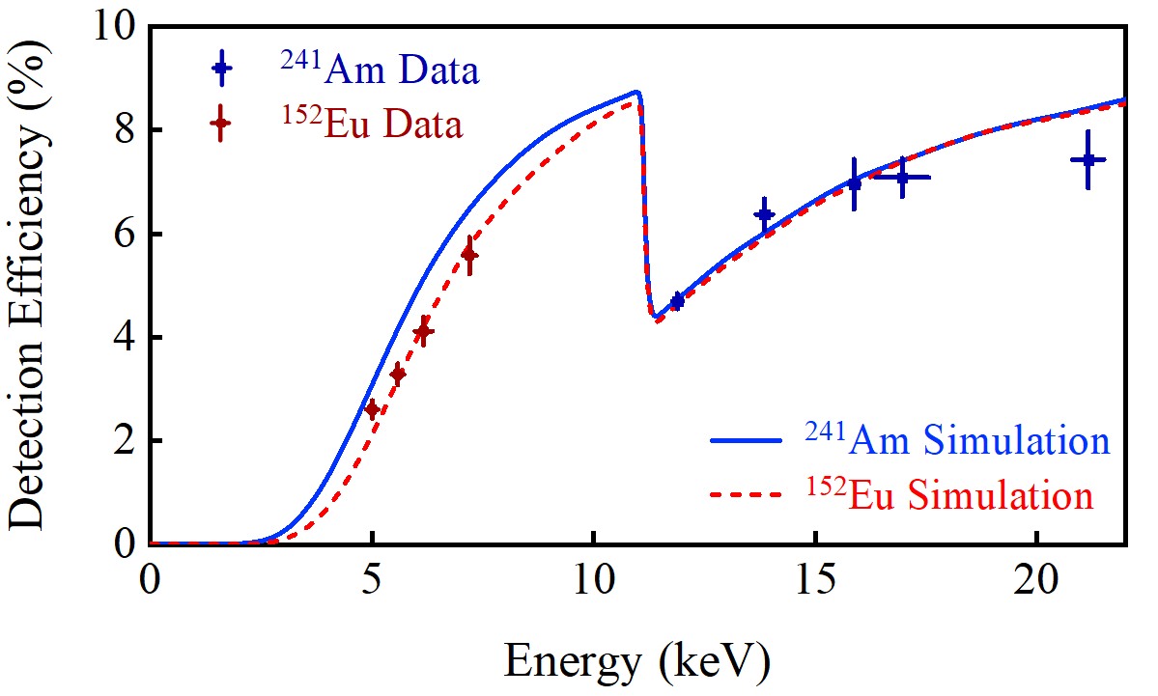
Pure ¹⁵²Eu Mylar Window effect
Affects X rays below 10 keV.

Slide 14
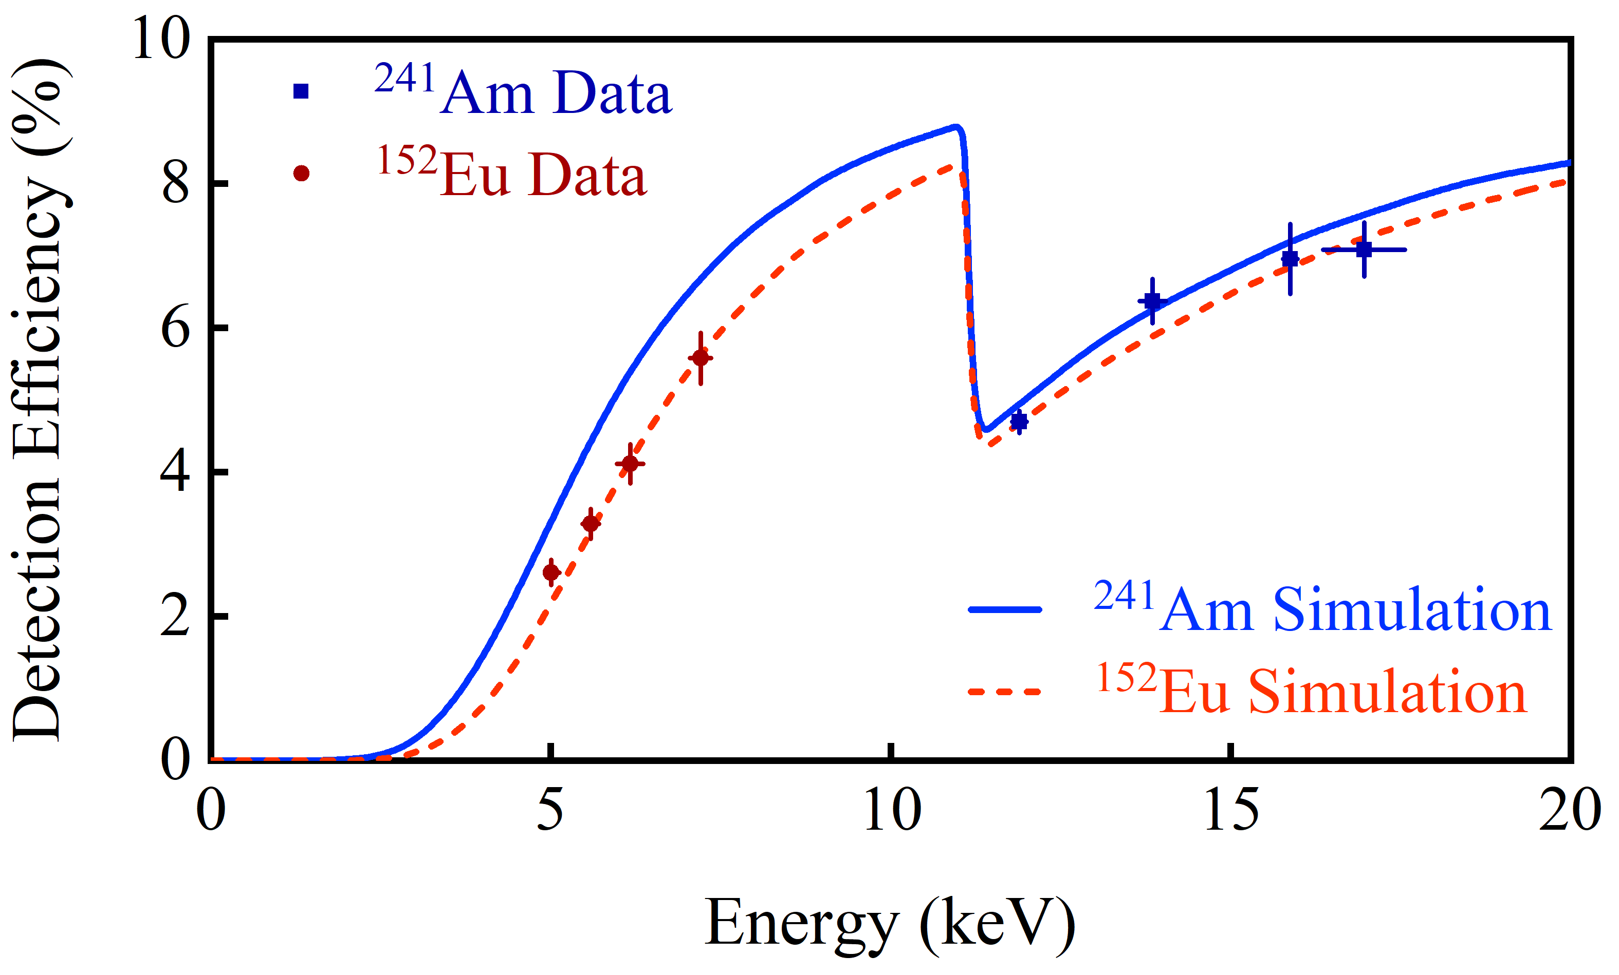
¹⁵²Eu Mylar Window + DAQ Dead Time effects
Affects X rays at all energies.
Notes:
Best figure X efficiency
D:\X\Geant4PKU\HPGe_PXCT
Run G4 simulation
C:\Si24\root_scripts\tree_GetEntries_from_G4_rootfiles_PXCT.C
Extract counts of each X-ray peak
TFile *_file0 = TFile::Open("F:/out/ExG4_LowEnergy_7.2keV_all.root") tree->Draw("LEGe_e","LEGe_e>6.8")

